Slide 1
Lecture 4
Exceptions
Interfaces

Slide 2
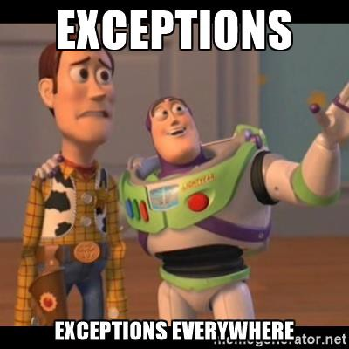
Exception? What is it?
Handling Exceptions
The Exception Class
Types of Exceptions
Throwing Exceptions
Best Practices

Slide 3
Exceptions? What is it?
The exceptions in .NET Framework are classic implementation of the OOP exception model
Deliver powerful mechanism for centralized handling of errors and unusual events
Substitute procedure-oriented approach, in which each function returns error code
Simplify code construction and maintenance
Allow the problematic situations to be processed at multiple levels

Slide 4
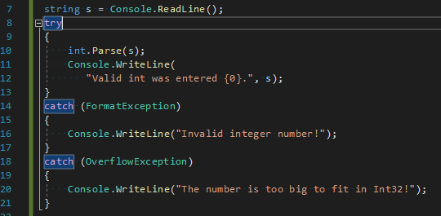
Handling Exceptions
In C# the exceptions can be handled by the try-catch-finally construction.
Catch blocks can be used multiple time to process different exception types
Don’t forget to log a meaningful information about caught exception.

Slide 5
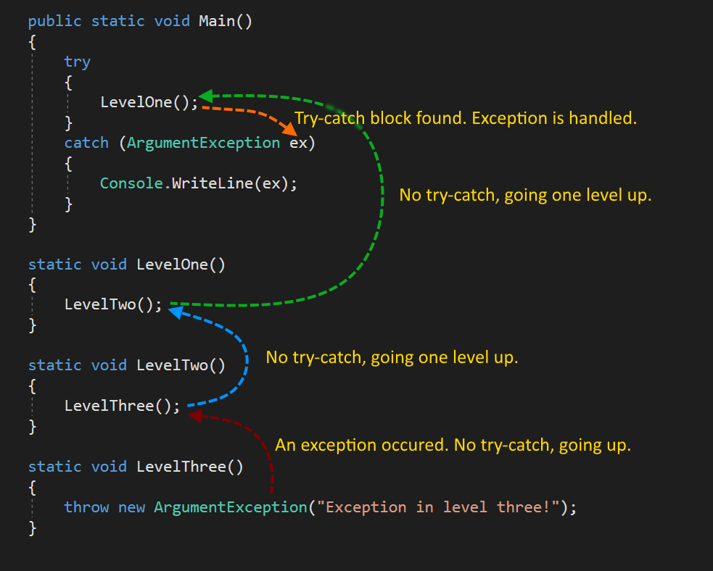
Handling exceptions - Example

Slide 6
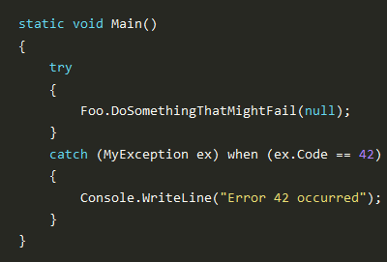
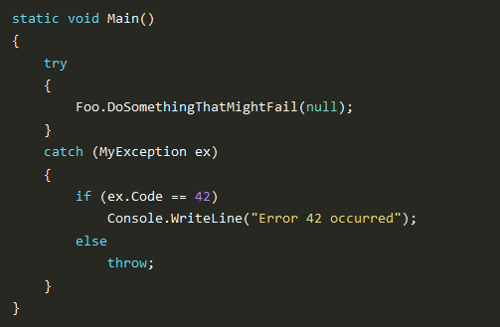
Handling Exceptions – Exception filters
Stack unwinding is not happening
Stack was unwound

Slide 7
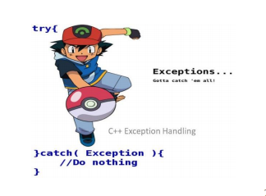
Forbidden exception handling technique – Ash style.

Slide 8
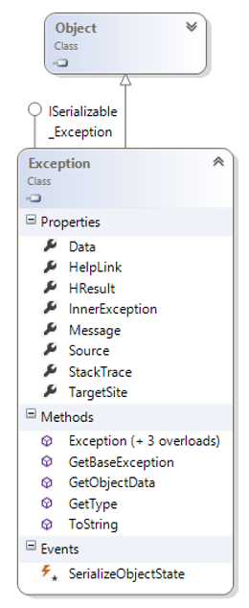
The Exception class
Exception is a base class for all exceptions.
Important properties:
Message – user-oriented message about error
Source – name of an error source (application or object)
InnerException – inner exception (if called from other)
StackTrace – call stack to the point of exception call
TargetSite – method name which raised an exception
HelpLink – URL-address to information about exception
Data – dictionary with additional information with exception (IDictionary)

Slide 9
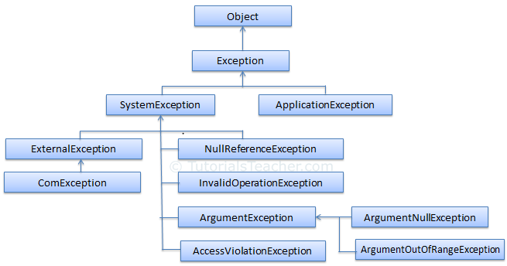
Types of Exception

Slide 10
Throwing Exceptions
Exceptions are thrown (raised) by throw keyword in C#
Used to notify the calling code in case of error or unusual situation
When an exception is thrown:
The program execution stops
The exception travels over the stack until a suitable catch block is reached to handle it
Unhandled exceptions display error message

Slide 11

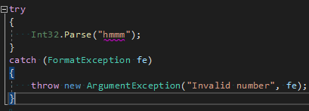
Using throw keyword
Throwing an exception with an error message:
Exceptions can accept message and cause:
Note: if the original exception is not passed the initial cause of the exception is lost

Slide 12
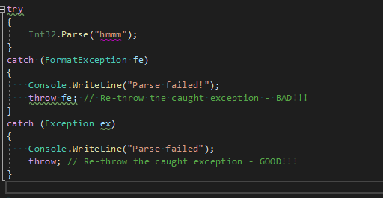
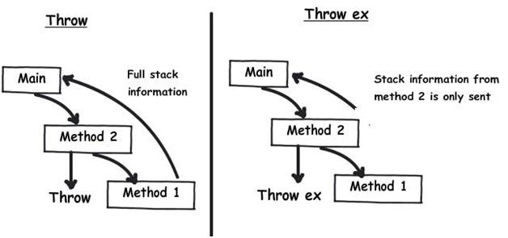
Re-throwing Exceptions

Slide 13
Choosing the exception type
When an invalid parameter is passed to a method:
ArgumentException, ArgumentNullException, ArgumentOutOfRangeException
When requested operation is not supported
NotSupportedException
When a method is still not implemented
NotImplementedException
If no suitable standard exception class is available
Create own exception class (inherit Exception)

Slide 14
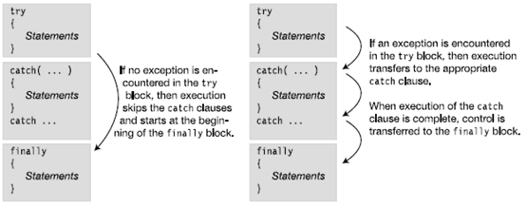
The finally statement

Slide 15
Exception Best Practices
catch blocks should begin with the exceptions lowest in the hierarchy
And continue with the more general exceptions
Otherwise, a compilation error will occur
Each catch block should handle only these exceptions which it expects
If a method is not competent to handle an exception, it should be left unhandled
Handling all exceptions disregarding their type is popular bad practice (anti-pattern)!

Slide 16
Exception Best Practices
When raising an exception always pass to the constructor good explanation message
When re-throwing an exception prefer throw; over throw ex;
When throwing an exception always pass a good description of the problem
Exception message should explain what causes the problem and how to solve it
Good: "Size should be integer in range [1…15]"
Good: "Invalid state. First call Initialize()"
Bad: "Unexpected error"
Bad: "Invalid argument"

Slide 17
Exception Best Practices
Exceptions can decrease the application performance
Throw exceptions only in situations which are really exceptional and should be handled
Do not throw exceptions in the normal program control flow (e.g. for invalid user input)
CLR could throw exceptions at any time with no way to predict them
E.g. System.OutOfMemoryException

Slide 18
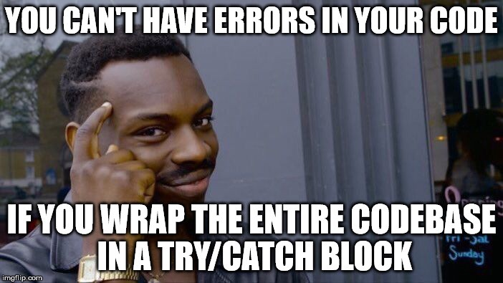

Slide 19
Live demo

Slide 20
Interfaces
Interfaces
Interfaces vs abstract classes
is keyword
IEnumerable interface
yield keyword

Slide 21
Interface? What is it?
An interface is a purely logical construct that describes functionality without specifying an implementation.
An interface contains definitions of related functionalities that a non-abstract class or a struct must implement
To implement an interface member, the corresponding member of the implementing class must be public, non-static, and have the same name and signature as the interface member.
By convention interface names begin with a capital I
An interface can’t be instantiated directly.
A class or struct can implement multiple interfaces.
Methods, properties, indexers – can be defined in an interface.

Slide 22
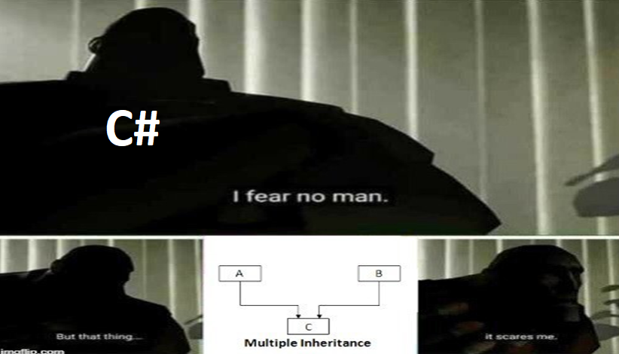
Interfaces. Main goal

Slide 23
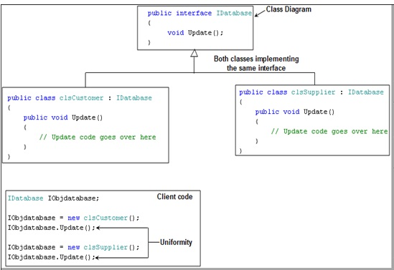
Interfaces. Example

Slide 24
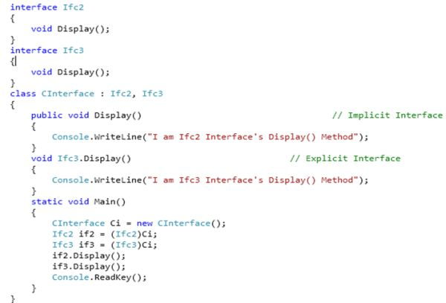
Explicit interface implementation.

Slide 25
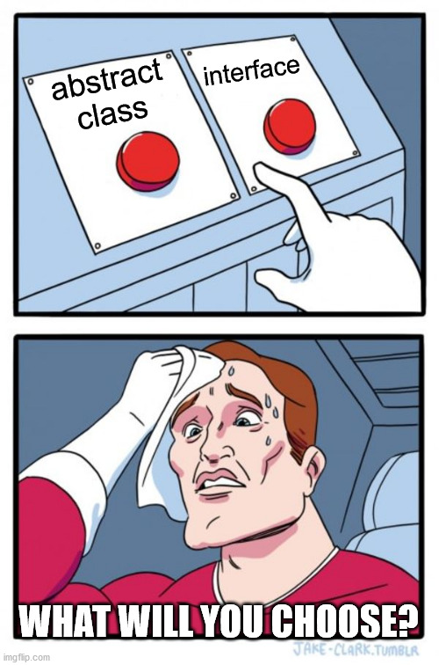
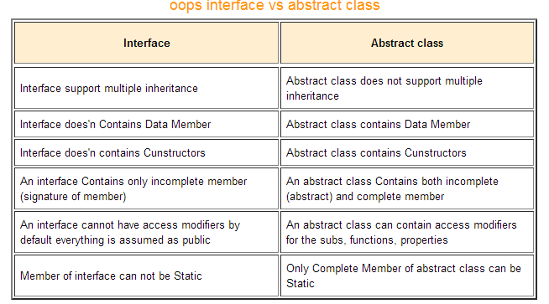
Interfaces vs abstract classes

Slide 26
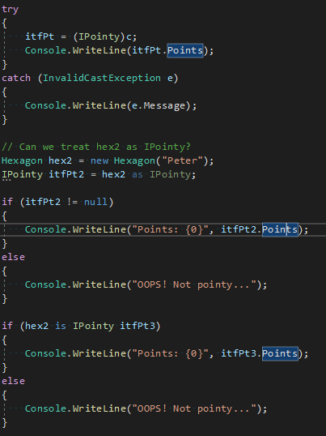
is / as keywords explained
Is operator is used to check if object can be cast to a given type and it returns the result as a Boolean.
As operator is used for casting of object to a given type and it returns the cast result or null if can’t be cast.

Slide 27
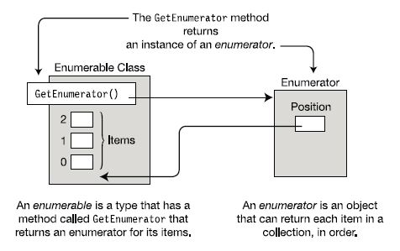
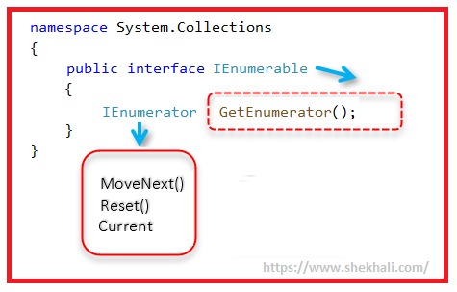
IEnumerable interface

Slide 28
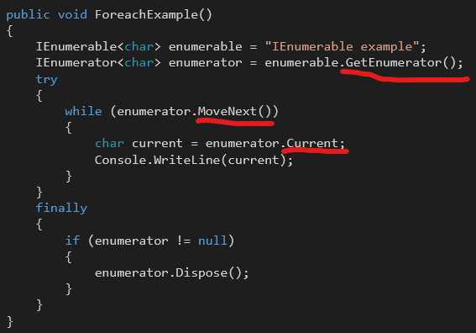
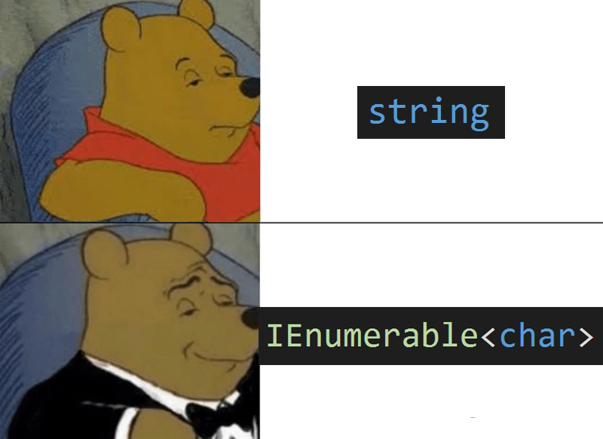
IEnumerable example

Slide 29
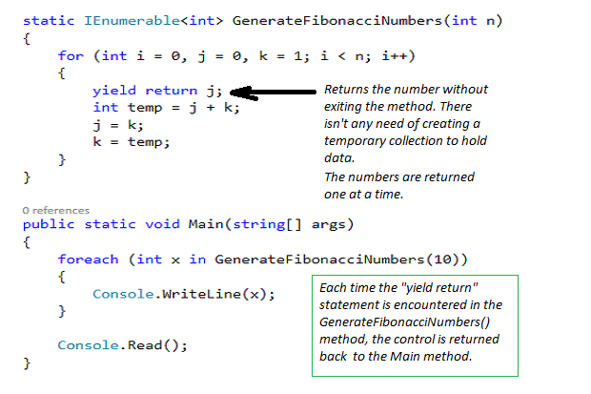
yield return keyword

Slide 30
Live demo

Slide 31
Questions?

