Slide 1
Lecture 5
Collections
Generics

Slide 2
Collections
Collection types
Non-generic collections
What’s wrong with non generic collections?
Generic collections
Collection initialization

Slide 3
Collection types
non-generic
located in System.Collection namespace
designed to operate with System.Object type
ex. ArrayList
generic
located in System.Collections.Generic namespace
type-safe
ex. List<T>
specialized
located in System.Collections.Specialized namespace
designed for certain problems

Slide 4
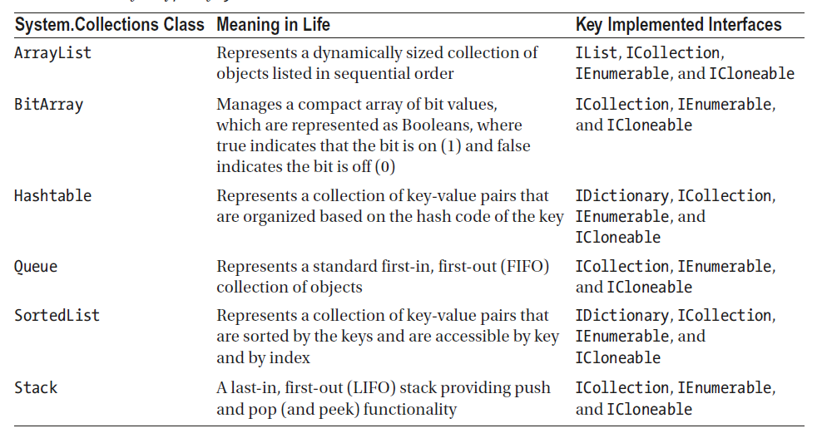
Non-generic collections
Notes:
Example of array list !!!

Slide 5
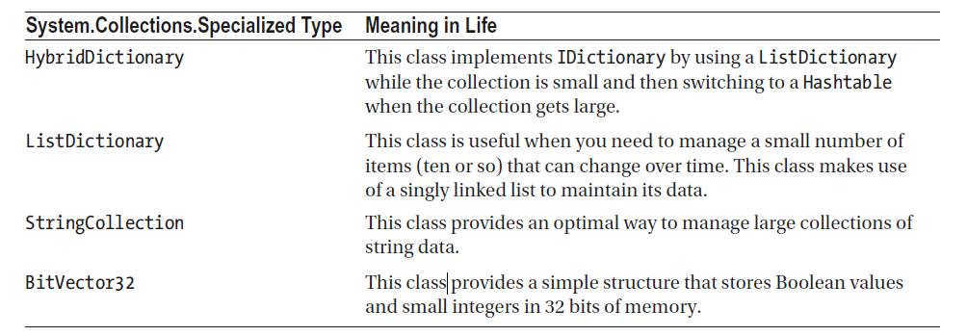
Specialized collections

Slide 6
What’s wrong with non-generic collection
poorly performing code (due to boxing)
not type-safe
code duplication for having type safety
Notes:
IssueWithNonGenericCollections !!!

Slide 7
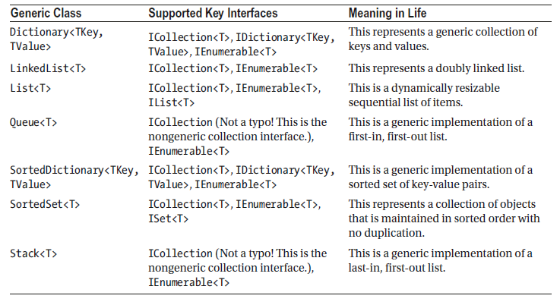
Generic collections

Slide 8
Live Demo
Notes:
Examples of different collections

Slide 9
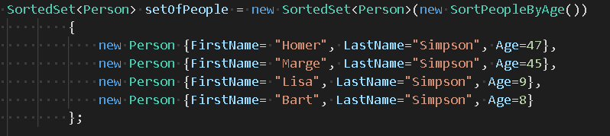
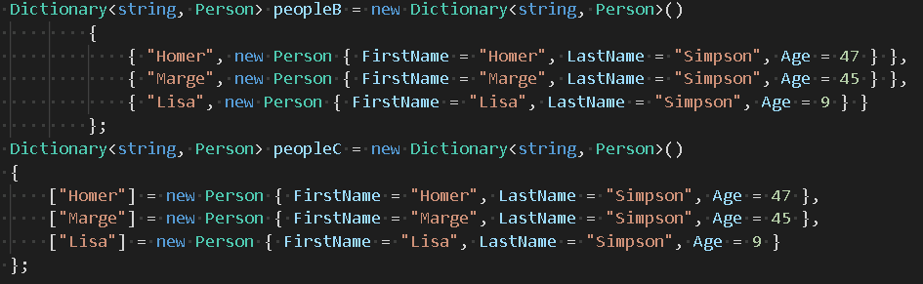
Collection initialization syntax
Notes:
Show call to Add();
Show list initialization without calling constructor;

Slide 10
Generics
Generics in C#
Benefits of generics
Generic classes
Generic methods
Constraints

Slide 11
Generics in C#
generics allow you to write a class or method that can work with any data type
generic can be classes, structs, interfaces, methods, events, delegates

Slide 12
Benefits of generics
Code reusability (no need to write code to handle different data types)
Type-safety (compile-time errors in case of usage different data type than one specified)
Performance faster (removes possibility of boxing and unboxing)

Slide 13
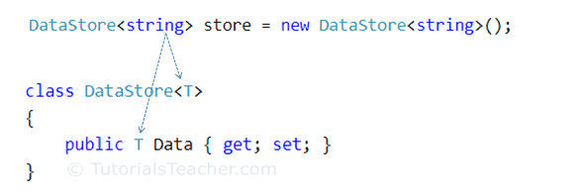
Generic classes
defined using a type parameter in an angle brackets after class name
class properties, fields can be of generic type

Slide 14
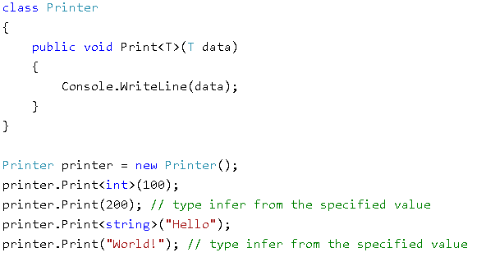
Generic methods
can be defined in generic and non-generic class
possible type inference
arguments and return type can be of generic type

Slide 15
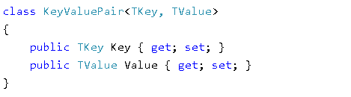
Generic with multiple type parameters
generic type can have any number of type parameters

Slide 16
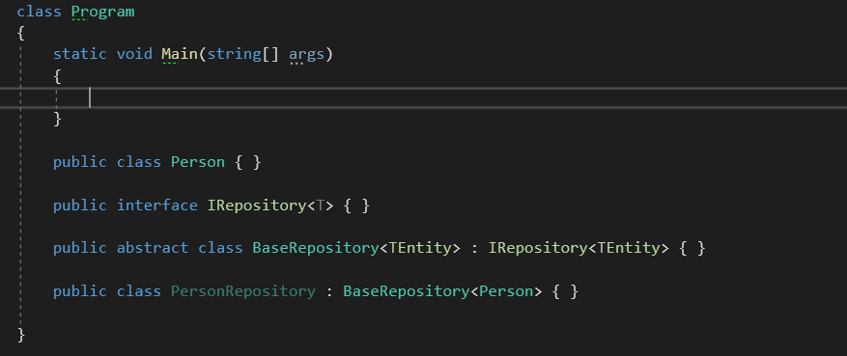
Inheritance of generic types

Slide 17
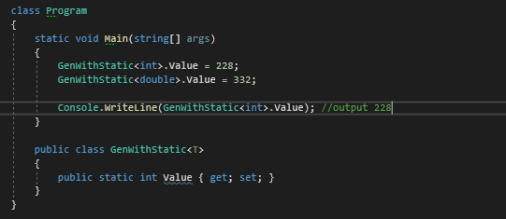
Static field in generic type
static variable is unique per closed generic type

Slide 18
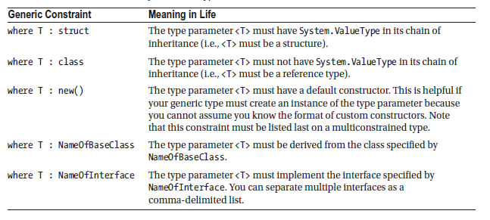
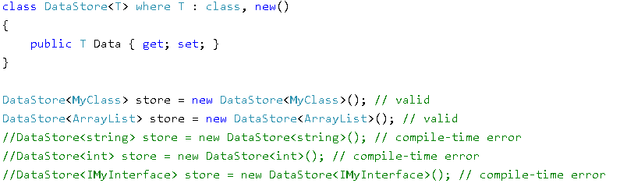
Constraining type parameters

