Slide 1
Lecture 7
LINQ

Slide 2
LINQ
What is LINQ?
Query vs Method syntax
LINQ operators
Deferred vs Eager execution
IEnumerable vs IQuerable

Slide 3
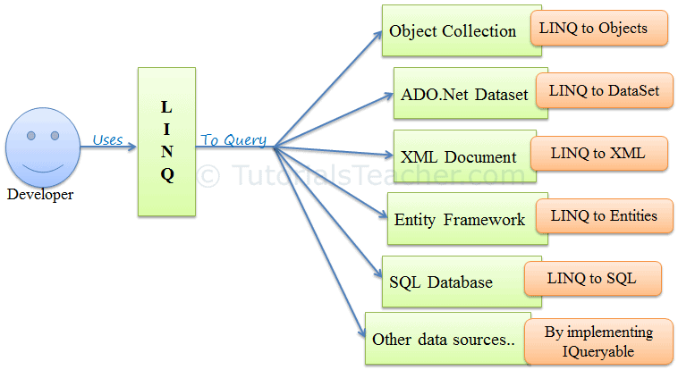

What is LINQ?
LINQ – Language Integrated Query, is a uniform query syntax in C# and VB.NET to retrieve data from different sources and formats.
LINQ queries return results as objects. It enables you to use object-oriented approach on the result set and not to worry about transforming different formats of results into objects.

Slide 4
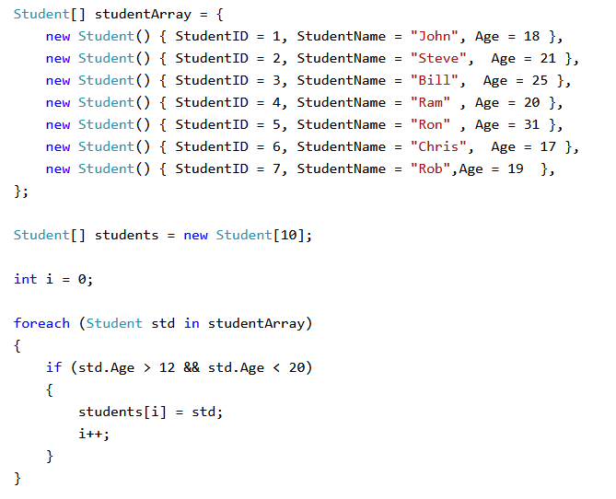
Example – Before LINQ

Slide 5
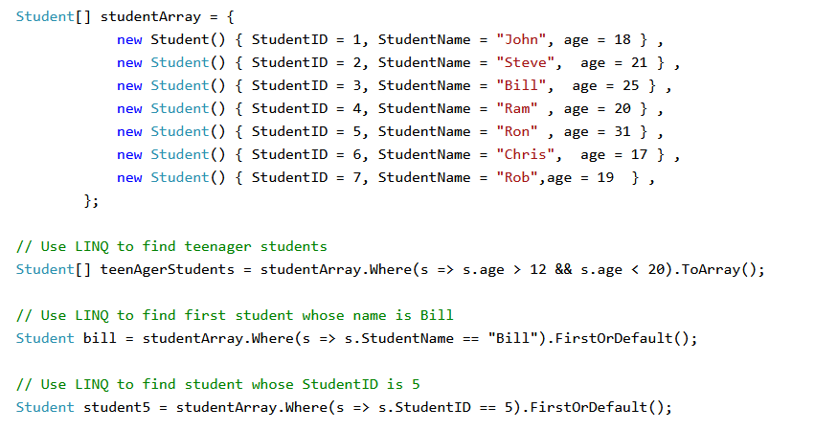
Example – Using LINQ

Slide 6
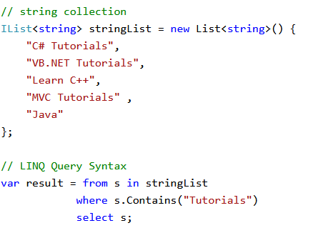
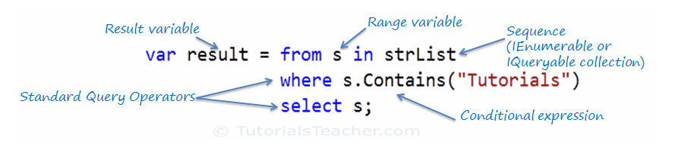
LINQ Query Syntax

Slide 7
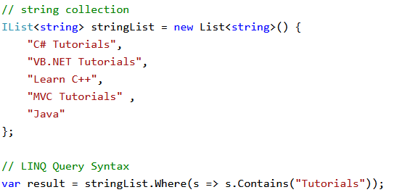
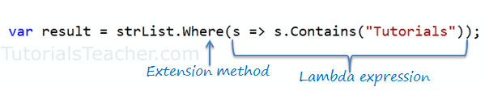
LINQ Method (Fluent) Syntax

Slide 8
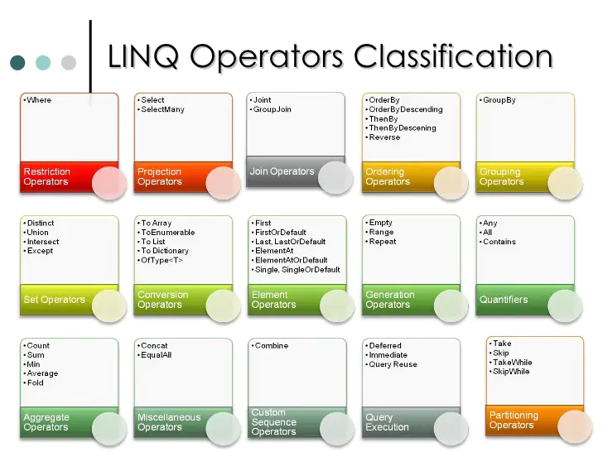
LINQ Operators
All operators are actually extension methods for the IEnumerable<T> and IQuerable<T> types.
There are over 50 standard query operators available in LINQ that provide different functionalities like filtering, sorting, grouping, aggregation etc.

Slide 9
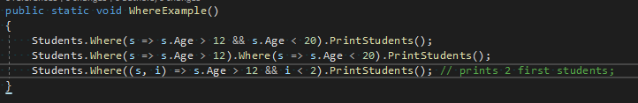
Where operator
Where is used for filtering the collection based on given criteria
Where has two overload methods. Use a second overload to know the index of current element in the collection
Multiple Where externsions are valid in a single LINQ query

Slide 10
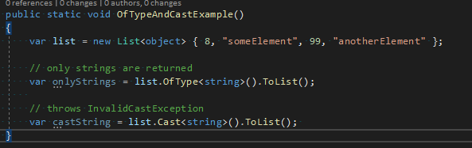
OfType vs Cast operator

Slide 11
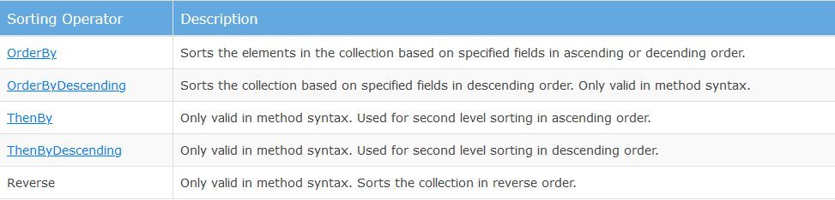
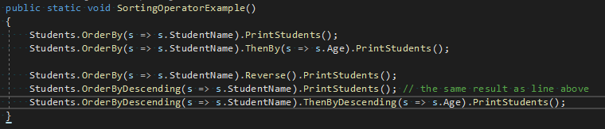
Sorting operators

Slide 12

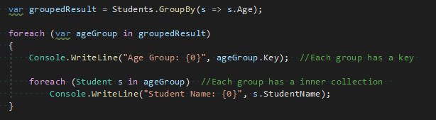
Grouping operators

Slide 13
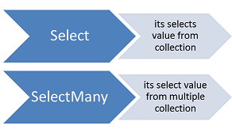
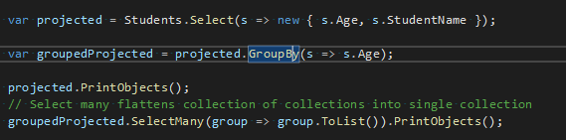
Projection operators

Slide 14
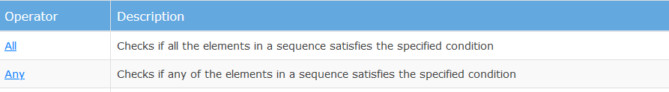
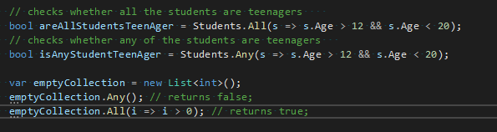
All & Any operators

Slide 15
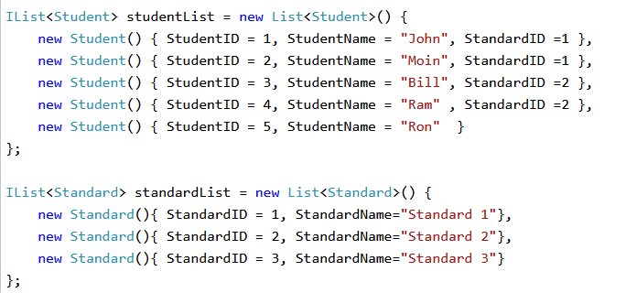
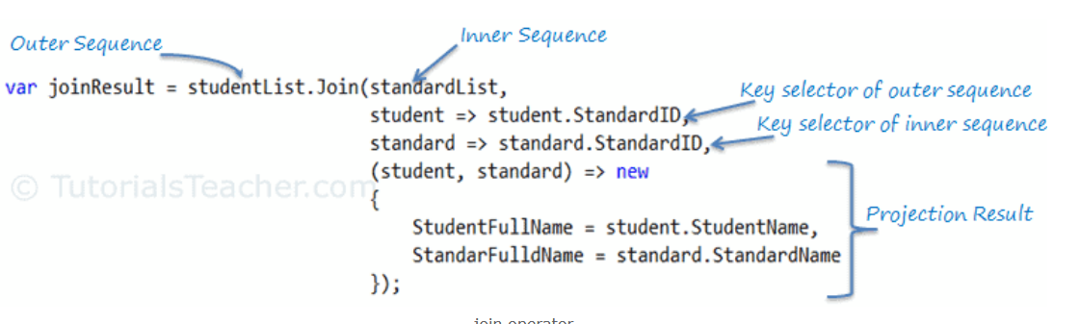

Join operator
Join is like inner join in SQL. It returns a new collection that contains common elements from two collections which keys matches.
Join operates on two sequences inner sequence and outer sequence and produces a result sequence
Join query syntax: from… in outerSequence join… in innerSequence on outerKey equals innerKey select…

Slide 16
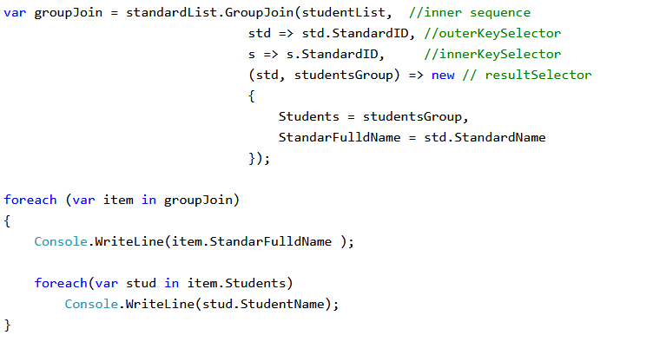
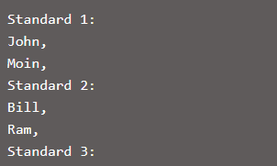
GroupJoin operator

Slide 17
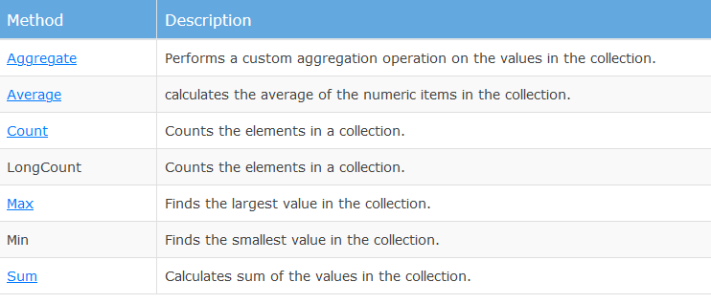
Aggregation operators

Slide 18
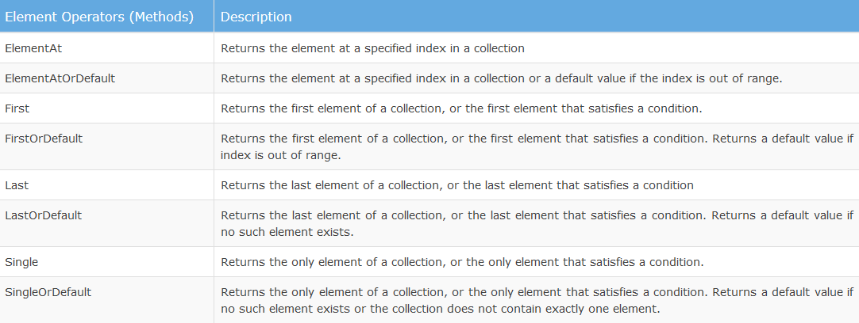
Element operators

Slide 19
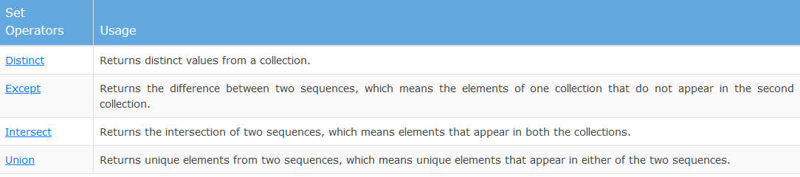
Set operators

Slide 20
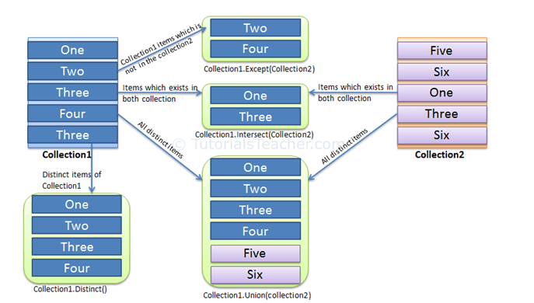
Set operators - Example

Slide 21
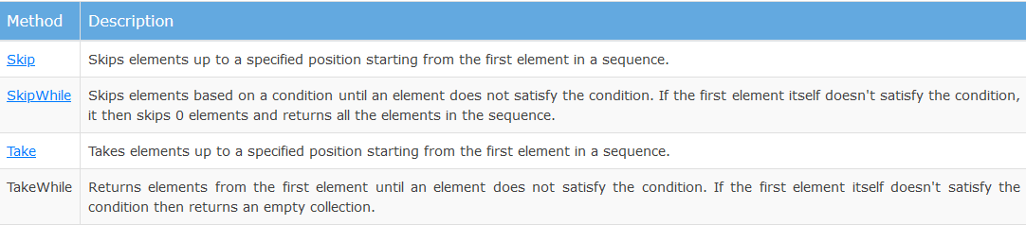
Partitioning operators

Slide 22
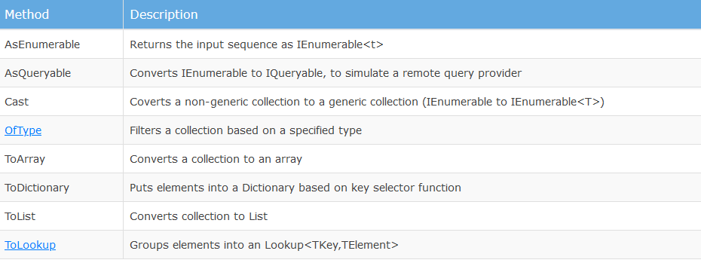
Conversion operators

Slide 23
Deferred execution of LINQ query
Deferred execution means that the evaluation of an expression is delayed until its realized value is actually required
It greatly improves performance by avoiding unnecessary execution
Deferred execution is applicable on any in-memory collection as well as remote LINQ providers like LINQ-to-SQL, LINQ-to-Entities, LINQ-to-XML, etc

Slide 24
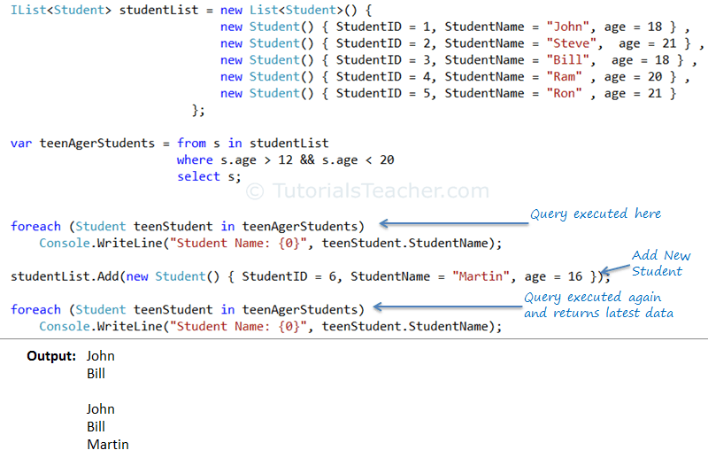
Understanding deferred execution

Slide 25
Immediate execution of LINQ query
Immediate execution is the reverse of deferred execution. It forces the LINQ query to execute and get the result immediately.
Methods which executes the giver query immediately:
All conversion operators, basically all ToXXX() methods
All element operators, First(), Last(), Single, ElementAt() etc.
All aggregation operators, Sum(), Count(), Aggregate(), etc
As a rule of thumb if returning type is not an IEnumerable<T> - means that the result is immediately executed.

Slide 26
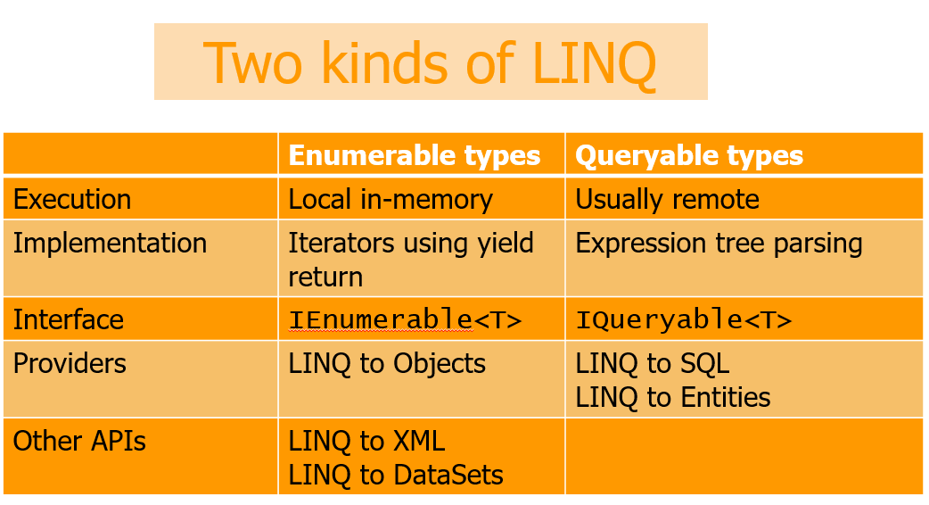
IEnumerable<T> vs IQueryable<T>

Slide 27
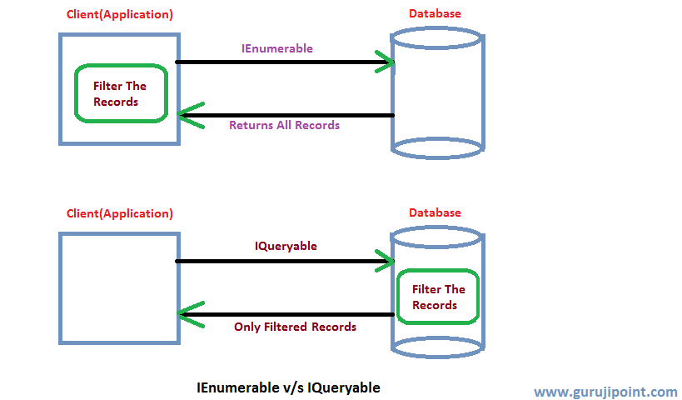
IEnumerable<T> vs IQueryable<T>

Slide 28
Advantages of LINQ
Familiar language: Developers don’t have to learn a new query language for each type of data source or data format.
Less coding: It reduces the amount of code to be written as compared with a more traditional approach.
Readable code: LINQ makes the code more readable so other developers can easily understand and maintain it.
Standardized way of querying multiple data sources: The same LINQ syntax can be used to query multiple data sources.
Compile time safety of queries: It provides type checking of objects at compile time.
IntelliSense Support: LINQ provides IntelliSense for generic collections.
Shaping data: You can retrieve data in different shapes.

Slide 29
Live demo

Slide 30
Questions?

