Slide 1
Lecture 1
First C# program
C# core programming constructs
Visual Studio overview

Slide 2
First C# Program
Solution
Project
References
Namespace

Slide 3
Introduction
C# can be used to develop two categories of programs:
Executable application programs
Component libraries
Executable programs are written to carryout certain tasks and require Main method in one of the classes
Component libraries do not require Main declaration because they are not standalone application programs. They are written for use by other applications

Slide 4
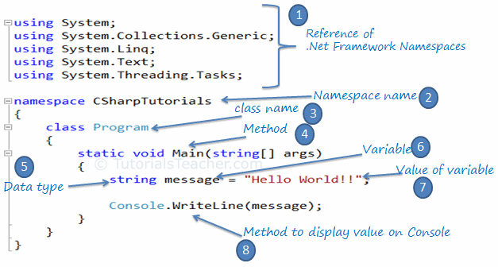
Simple C# Program

Slide 5
Live Demo

Slide 6
Namespaces
.NET uses namespaces to organize its many classes
Using directive is used to import namespace into the program

Slide 7
Command Line Arguments
Can be used to take an input from a user
Are parameters supplied to the Main method at the time of invoking it for execution
Can be set in Visual Studio for debug purpose
Notes:
Show BasicConsoleIOExample !!!

Slide 8
C# Core programming structures
Literals
Variables
Data types
Operators
Conditions
Loops
Strings
Comments

Slide 9
Literals
Literals are the value constants assigned to variables in a program
C# supports next types of literals:
Integer literals (8, 23)
Floating-point literals (47.4392)
Character literals (‘a’)
String literals (“Net Fundamentals”)
Null literals (null)
Boolean literals (true/false)

Slide 10
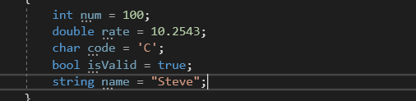
Variables
Is an identifier that denotes a storage location used to store data value
May take different values at different times during program execution
Must be assigned a value before using it
Notes:
EXAMPLES: LocalVarDeclarations in BasicDataTypesExample!!!

Slide 11
Variable naming convention
Variable names must be unique.
Variable names can contain letters, digits, and the underscore _ only.
Variable names must start with a letter or underscore.
Variable names are case-sensitive, num and Num are considered different names.
Variable names cannot contain reserved keywords. Must prefix @ before keyword if want reserve keywords as identifiers.
Notes:
Name should be meaningful !!!
Compiler will show errors if there are problems with naming.

Slide 12
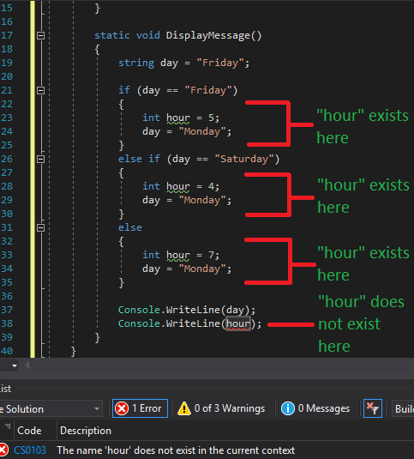
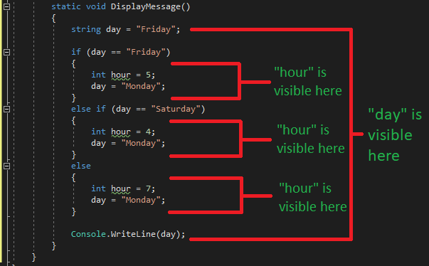
Scope of variables
It is region of code within which the variable can be accessed
Variable's scope is always the full extent of the code block it is declared within.
Notes:
Global scope variables for static.

Slide 13
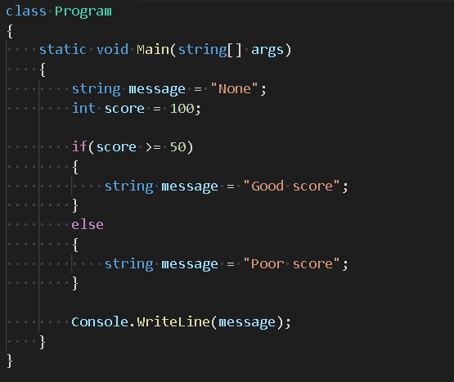
Variables Test
What’s wrong with this code?

Slide 14
Data types
C# is a strongly-typed language
Every variable in C# is associated with a data type
Specifies the size and type of values that can be stored
Types in C#
Value types(int, float, bool, enum, struct)
Reference types(class, interface, delegate, array)

Slide 15
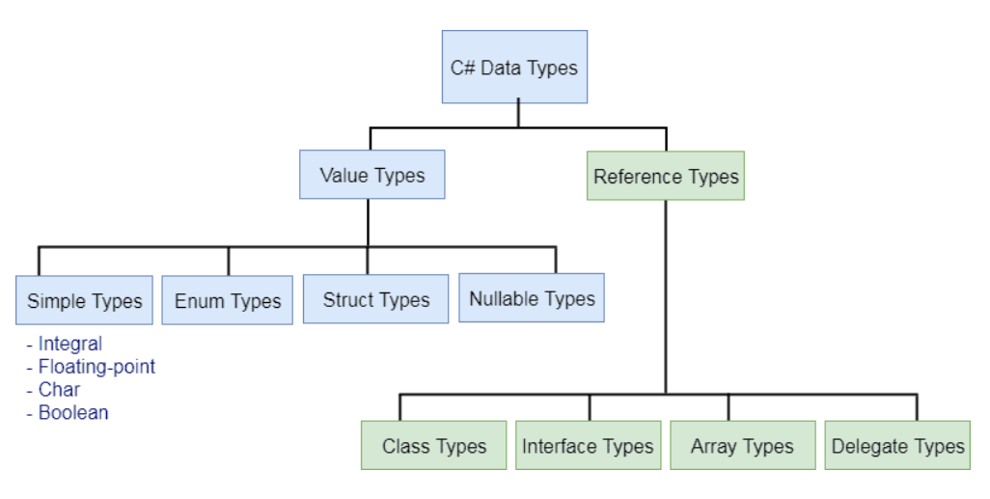
Taxonomy C# data types

Slide 16
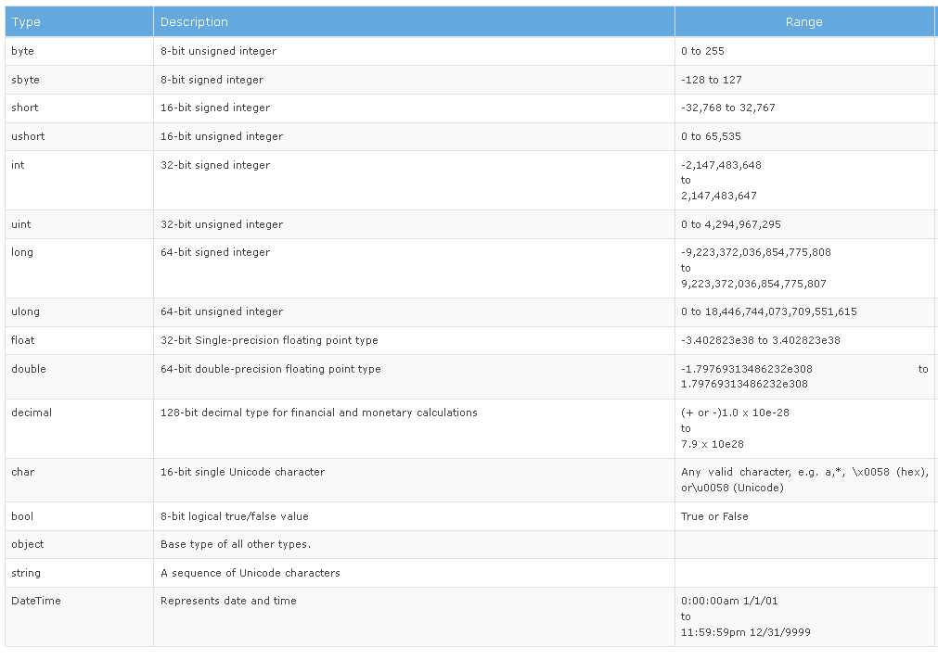
Predefined data types
Notes:
Default values !!!
BasicDataTypesExample!!!

Slide 17
Implicitly-typed variable
var keyword is used to declare method level variables without specifying a data type explicitly
must be initialized at the time of declaration
cannot be assigned by null
can be used to declare any built-in data type or a user-defined type or an anonymous type variable
cannot be used for function parameters.
Notes:
EXAMPLES!!! ImplicitlyTypesLocalVarExample !!!

Slide 18
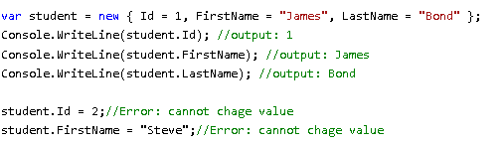
Anonymous Type
An anonymous type is a type (class) without any name
Properties of anonymous types are read-only and cannot be initialized with a null

Slide 19
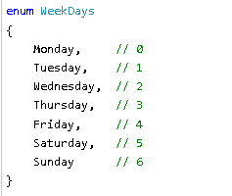
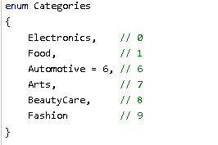
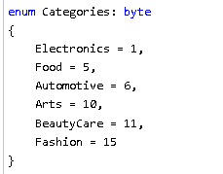
Enum
enum (or enumeration type) is used to assign constant names to a group of numeric integer values.
Notes:
EXAMPLES!!! EnumExamples!!!

Slide 20
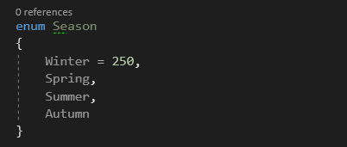
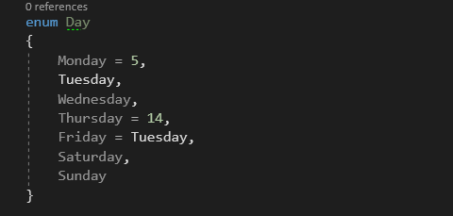
Enum Tests
What is the value of Season.Summer?
What is the value of Day.Sunday?

Slide 21



String
series of characters that is used to represent text
C# includes escaping character \ (backslash) before special characters to include in a string (\`, \”, \n, \t, \t)
string is immutable in C#

Slide 22
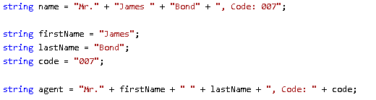
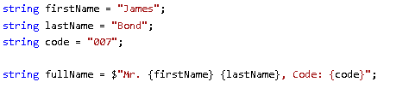
String concatenation and interpolation
strings can be concatenated with + operator
C# 6 includes a special character $ to identify an interpolated string
Notes:
Use StringBuilder for multiple concatenations !!!

Slide 23
String properties and methods
Length
ToUpper(), ToLower()
Contains()
StartsWith(), EndsWith()
Substring()
Replace()
IndexOf()
Equals()
Split()
string.IsNullOrEmpty(), string.IsNullOrWhiteSpace()
Notes:
EXAMPLES!!!! StringExample !!!

Slide 24
Covert from string
int.Parse(), int.TryParse()
double.Parse(), double.TryParse()

Slide 25
Test
What is difference between int.Parse() and Convert.ToInt32() methods?

Slide 26
Operators
special symbols that perform some action on operands
arithmetic operators(+, -, *, /, %, ++, --)
assignment operators(=, op=, ??=)
comparison operators(>, <, <=, >=)
equality operators(==, !=)
boolean logical operators(!, &&, ||)
more information there

Slide 27
Test
What is the difference between prefix and postfix ++ operator?

Slide 28
Conditional statements
Is a powerful decision-making statement
Used to control the flow of executions of statements
if, else if, else, switch

Slide 29
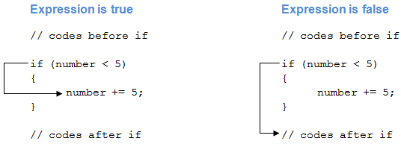
If statement

Slide 30
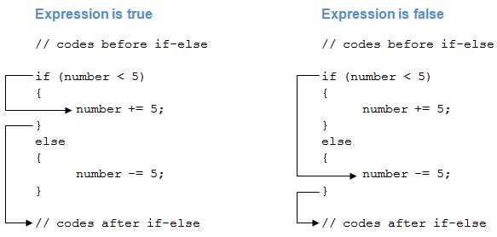
If-else statement

Slide 31
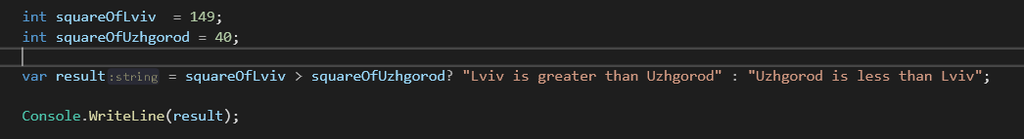
Ternary operator
Syntax: condition? statement 1 : statement 2
Can be rewritten using if-else statement
Example:

Slide 32
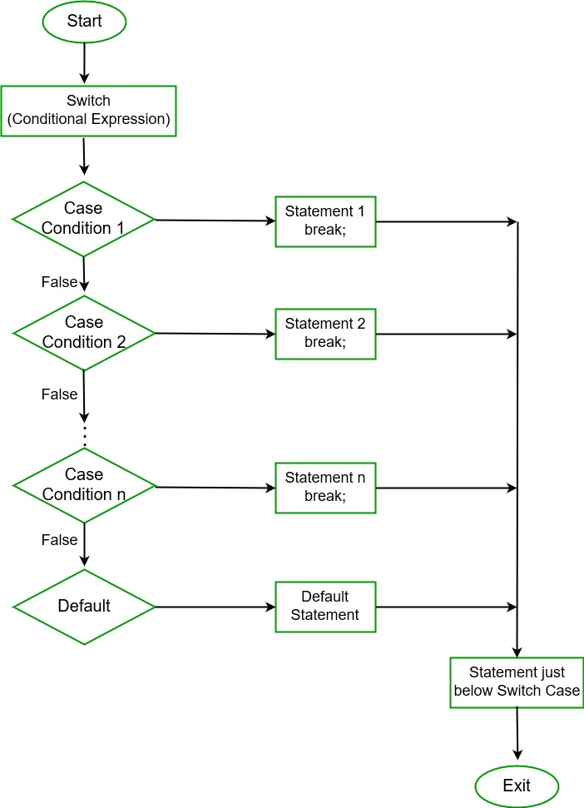
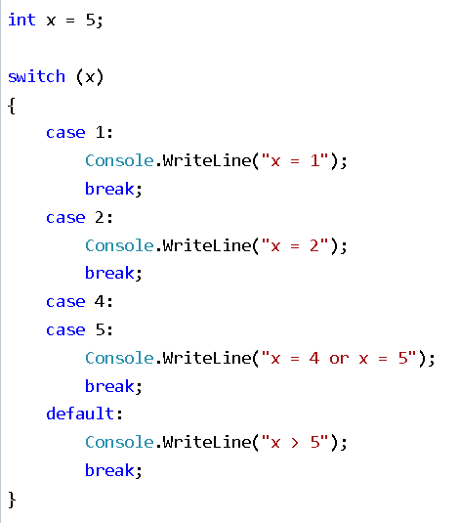
Switch statement
switch statement allows a variable to be tested for equality against a list of values.
Notes:
Switch expression !!!

Slide 33
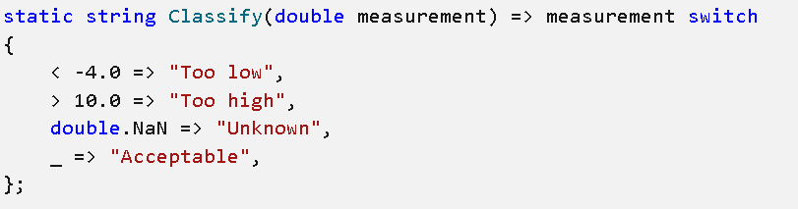
Pattern matching
technique where you test an expression to determine if it has certain characteristics

Slide 34
Loops
loop statement allows us to execute a statement or a group of statements multiple times
C# provides following types of loop:
for loop
while loop
do while

Slide 35
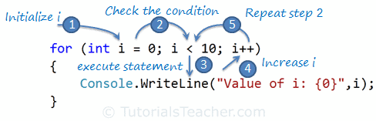
For loop
Executes a block of statements repeatedly until the specified condition returns false.

Slide 36
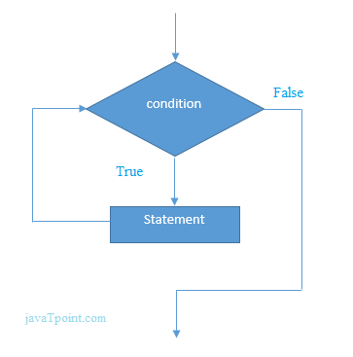
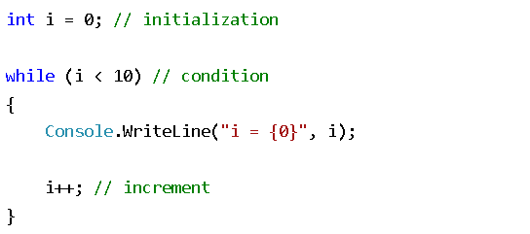
While loop
It repeats a statement or a group of statements while a given condition is true. It tests the condition before executing the loop body.

Slide 37
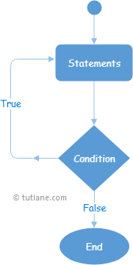
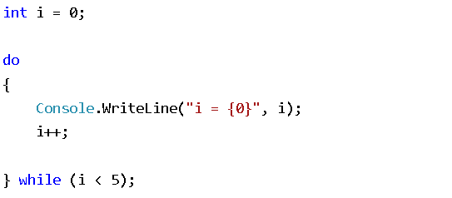
Do-while loop
Same as while loop, but executes at least once

Slide 38
Loop control statements
changes execution from its normal sequence
break statement (terminates the loop and transfers execution to the statement immediately following the loop)
continue statement (causes the loop to skip the remainder of its body and immediately retest its condition prior to reiterating)
Notes:
What loop control statements you know???

Slide 39
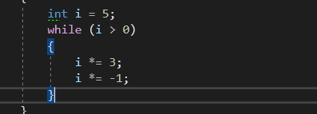
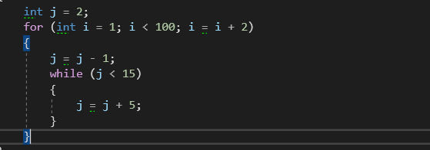
Loop Tests
How many times will loop execute?
How many times will j = j – 1 execute?

Slide 40
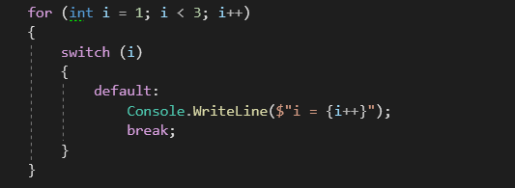
Loop Tests
What will be the output of the snippet?
How to do infinite loop?
Notes:
IterationAndDecisionExamples !!!

Slide 41

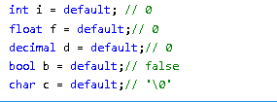
Other operators
nameof() - produces the name of a variable, type, or member as the string constant
default - produce the default value of a type

Slide 42
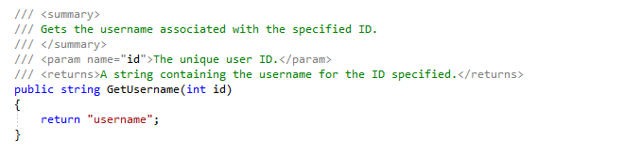
Comments
Enhanced readability and understanding of the code
Types of comments:
Single-line comments (//)
Multiline comments (/* ……. ….. */)
Summary is a special type of comment

Slide 43
Visual Studio overview
Solution explorer
Set us startup project
Error list
Bookmark window
Git Changes
Output
Call stack
Breakpoints
Watch windows
Immediate
Locals
C# Interactive

Slide 44
Live Demo

Slide 45
Questions?

