Slide 1
Billing system
Lucrezia Ruggeri, Fabiola Spinel, Dmytro Kashchuk

Slide 2
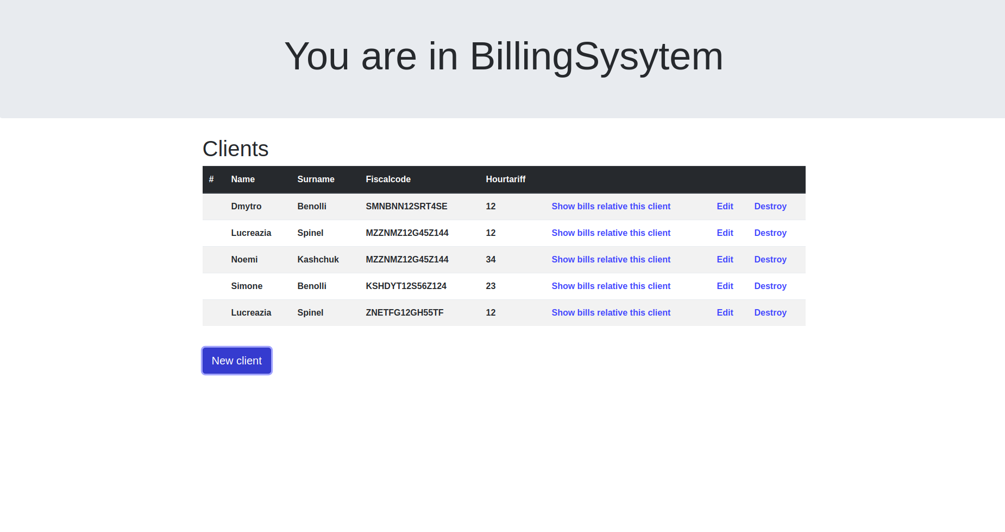
Start page
list of clients
Add new client
show bill for each client

Slide 3
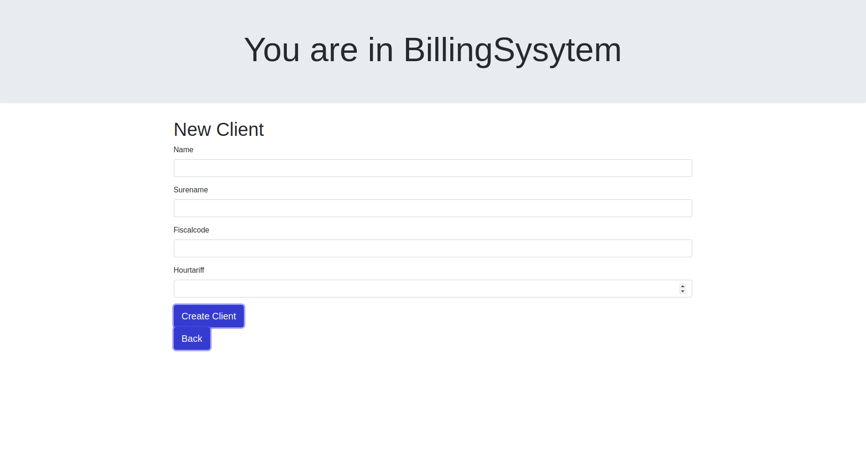
Creation of client

Slide 4
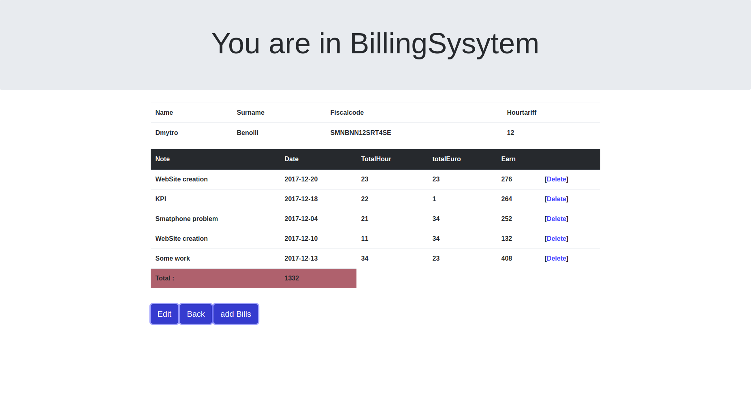
Bills of a specific client
total earned = sum of earns
add and edit bills

Slide 5
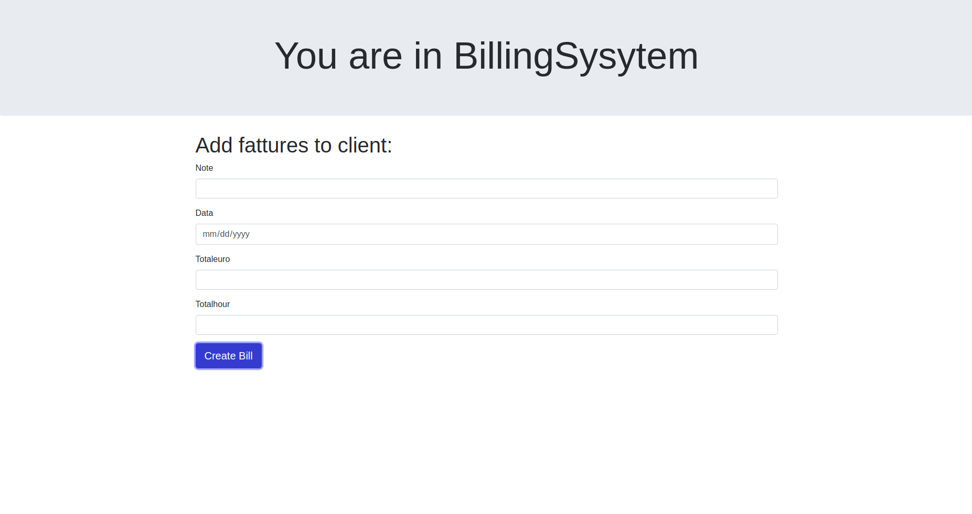
Creation of a bill for a client

