Slide 1
Unity Test Tools

Slide 2
Getting Started
Copy the zip on the USB stick across to your laptop’s hardrive.
Extract the installer and all copies of the project.
Install the Unity version supplied.
Open the project called GamingIQ-Conference-Workshop-Phase0
Wait quietly until you are told to do something.

Slide 3
Scene Setup
Make sure you have the correct project open and you are in an empty scene.
Save the empty scene to the “Scenes” folder and call it “Game”.

Slide 4

Moving Layers

Slide 5
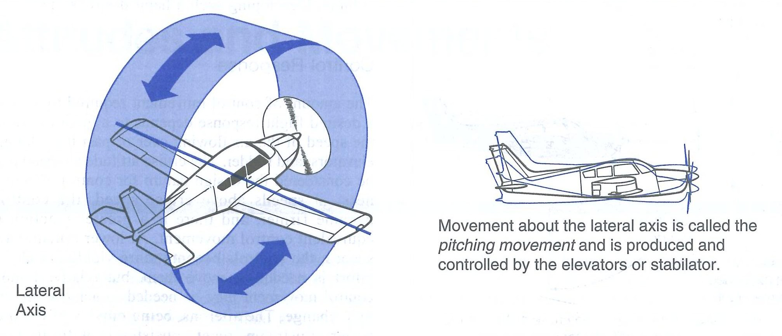
Moving Airplane

Slide 6

Adding Interactions

Slide 7

Writing Integration Tests

Slide 8

Wrapping UP

