Slide 1
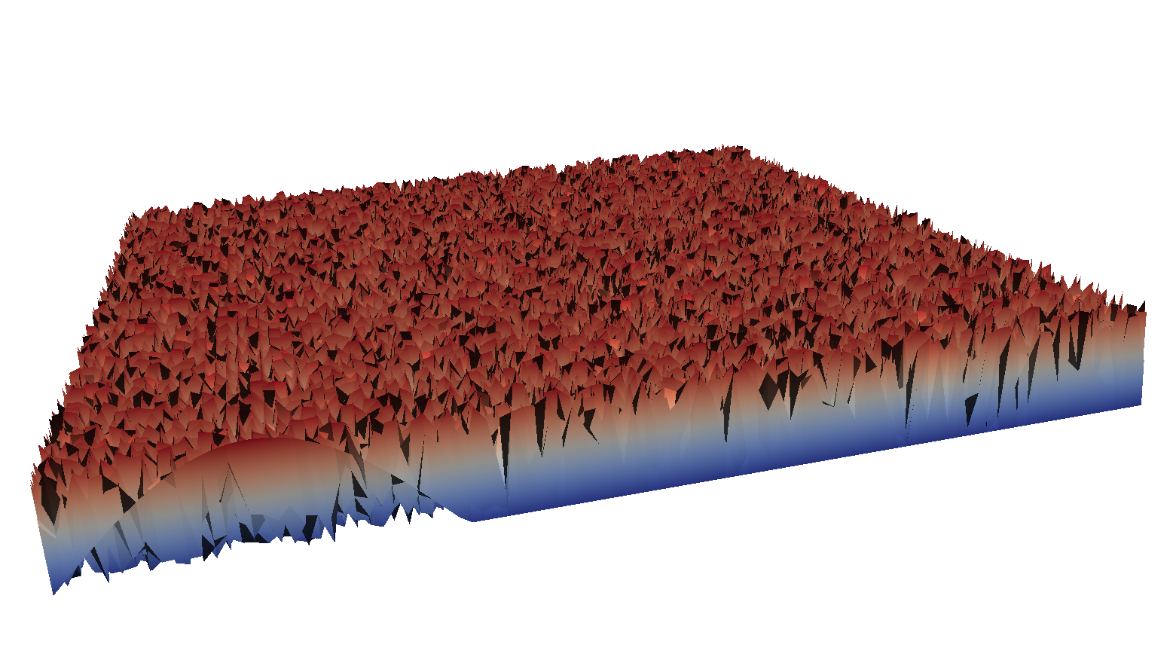
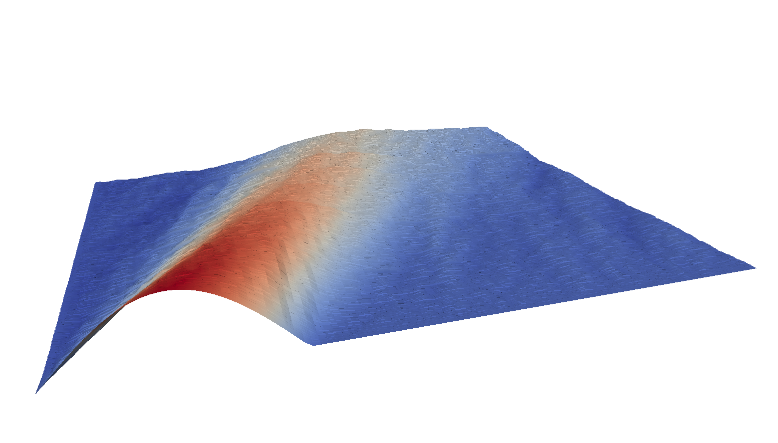
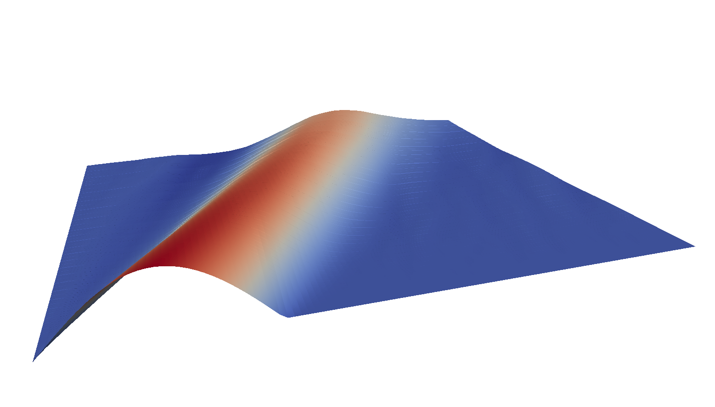
Space-Time Guess
Iterate
Finish
Time
Time
Time
Space
Space
Space
Warp
Parallel-in-Time Software

