Slide 1
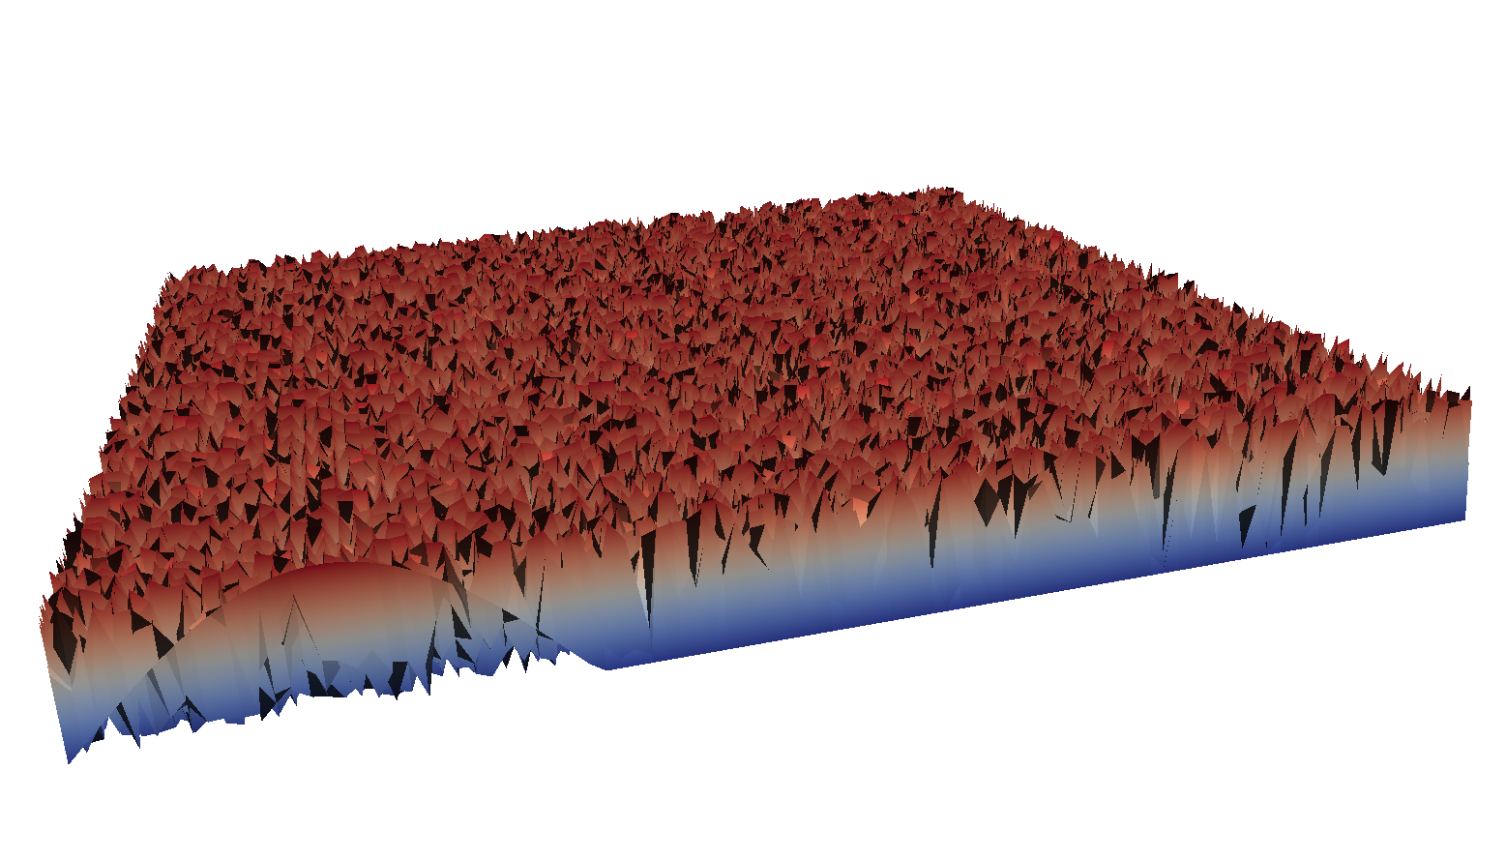
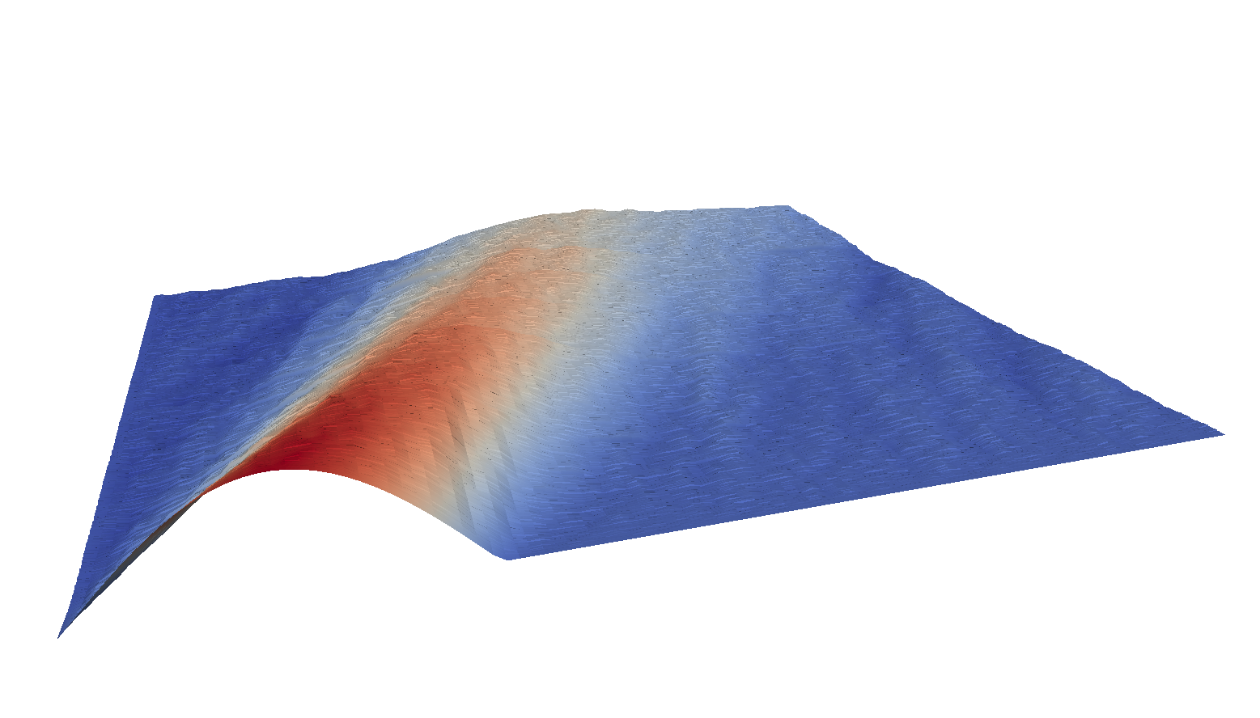
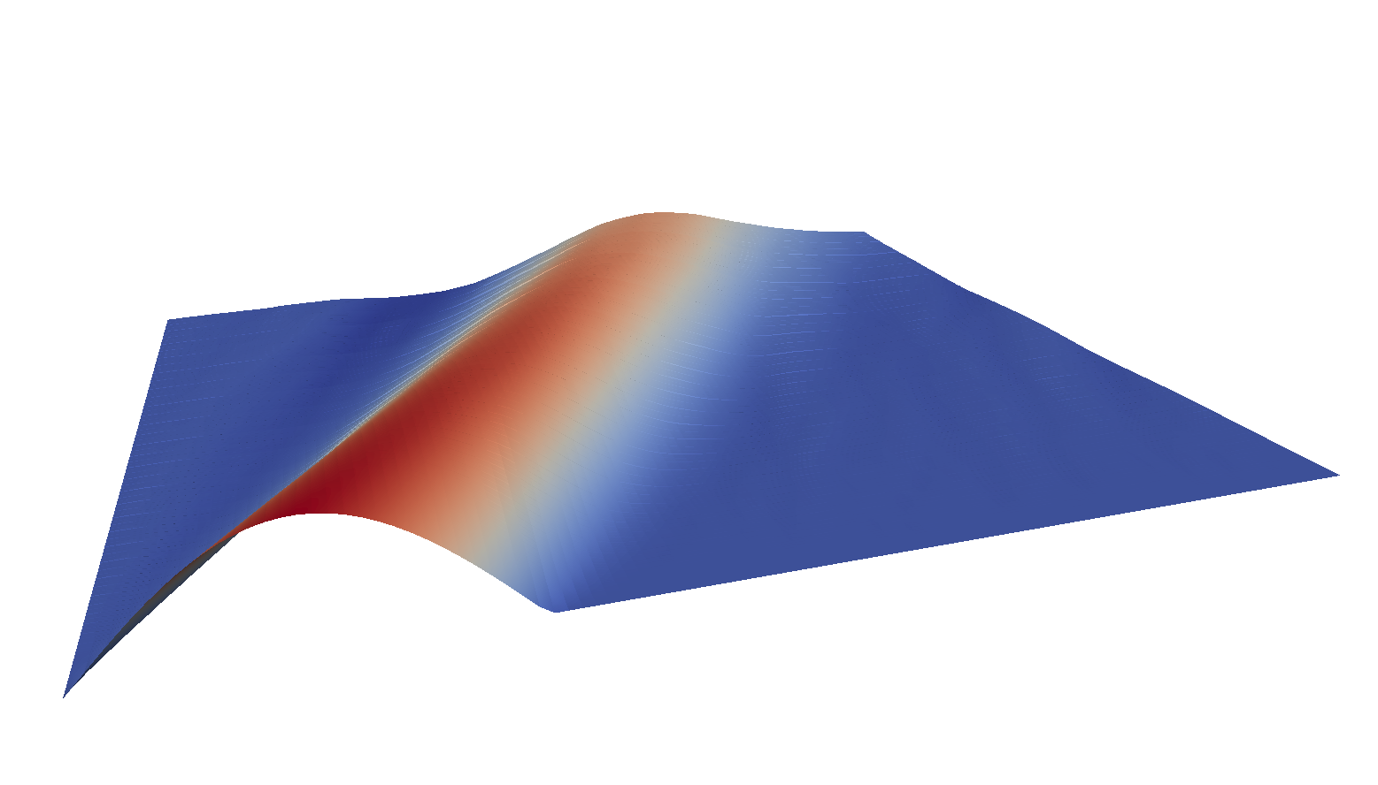
Initial Space-Time Guess
Iterate
Converge
Time
Time
Time
Space
Space
Space
Warp
Parallel-in-Time Software

