Slide 1
Sensorless motion estimation of ultrasound probe for 3D reconstruction
Dmytro Yesyp

Slide 2
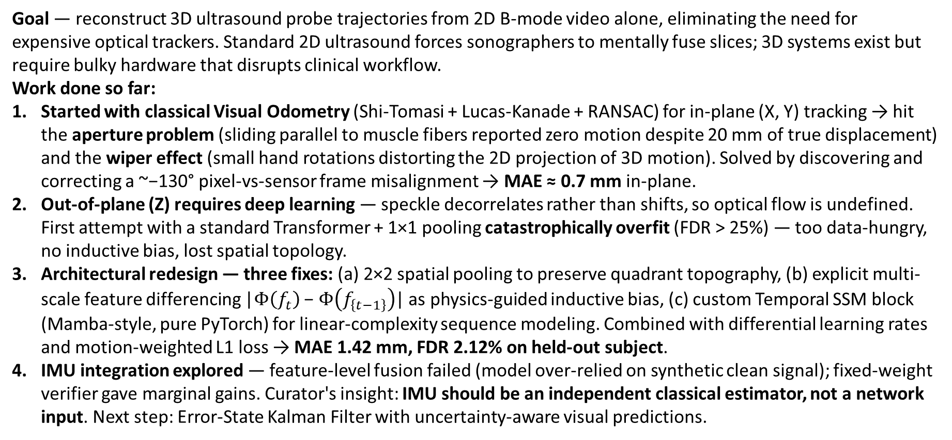
Project Overview
Goal — reconstruct 3D ultrasound probe trajectories from 2D B-mode video alone, eliminating the need for expensive optical trackers. Standard 2D ultrasound forces sonographers to mentally fuse slices; 3D systems exist but require bulky hardware that disrupts clinical workflow.
Work done so far:
Started with classical Visual Odometry (Shi-Tomasi + Lucas-Kanade + RANSAC) for in-plane (X, Y) tracking → hit the aperture problem (sliding parallel to muscle fibers reported zero motion despite 20 mm of true displacement) and the wiper effect (small hand rotations distorting the 2D projection of 3D motion). Solved by discovering and correcting a ~−130° pixel-vs-sensor frame misalignment → MAE ≈ 0.7 mm in-plane.
Out-of-plane (Z) requires deep learning — speckle decorrelates rather than shifts, so optical flow is undefined. First attempt with a standard Transformer + 1×1 pooling catastrophically overfit (FDR > 25%) — too data-hungry, no inductive bias, lost spatial topology.
Architectural redesign — three fixes: (a) 2×2 spatial pooling to preserve quadrant topography, (b) explicit multi-scale feature differencing |$Φ\left(f_{t}\right)$ − $Φ\left(f_{\left\{t−1\right\}}\right)$| as physics-guided inductive bias, (c) custom Temporal SSM block (Mamba-style, pure PyTorch) for linear-complexity sequence modeling. Combined with differential learning rates and motion-weighted L1 loss → MAE 1.42 mm, FDR 2.12% on held-out subject.
IMU integration explored — feature-level fusion failed (model over-relied on synthetic clean signal); fixed-weight verifier gave marginal gains. Curator's insight: IMU should be an independent classical estimator, not a network input. Next step: Error-State Kalman Filter with uncertainty-aware visual predictions.

Slide 3
Motivation & The Trackerless Challenge
Clinical need vs. why ultrasound breaks Visual SLAM assumptions
Clinical Bottleneck
• 2D US: cognitive load on sonographer
• 3D mechanical probes: bulky, narrow FoV
• External trackers: expensive, occlusion-prone
• Goal: 3D from a standard 2D probe
Why It's Hard
• Low SNR, acoustic artifacts
• Tissue deforms under probe pressure
• No persistent rigid landmarks
• Aperture problem on linear structures
The Z-Axis Wall
• Out-of-plane motion ≠ pixel translation
• Speckle DECORRELATES instead of shifting
• Optical flow undefined → no gradient
• Must be learned from data

Slide 4
Contributions of This Work
• Hybrid pipeline that decouples in-plane (classical) and out-of-plane (DL)
• Multi-scale explicit feature differencing — physics-guided inductive bias
• Custom Temporal SSM block — Mamba semantics in pure PyTorch (no nvcc)
• Differential learning-rate schedule with staged backbone unfreezing
• Motion-Weighted L1 loss — prevents collapse to slow-motion average
• Validated on TUS-REC 2024: best held-out subject MAE 1.42 mm (FDR 2.12%); 1197-scan global average MAE 11.56 mm (FDR 19.7%)

Slide 5
Background & Prior Work
Classical Speckle Decorrelation
• NCC patches between frames
• Gaussian beam profile model
• Pure dead-reckoning → drift
• Fails on multi-axis rotation
TUS-REC 2024 Benchmark
• MICCAI public dataset
• 50 subjects, ~140k sequences
• Optical-tracker GT (mm-level)
• Enabled fair architecture comparison
Prior DL Architectures
• Prevost '18 — 3D CNN, weak prior, drifts
• MoGLo-Net '25 — corr + LSTM, single-scale
• FiMA '24 — multi-scale + Transformer, O(S²)
• → This work blends MoGLo's diff + FiMA's scale

Slide 6
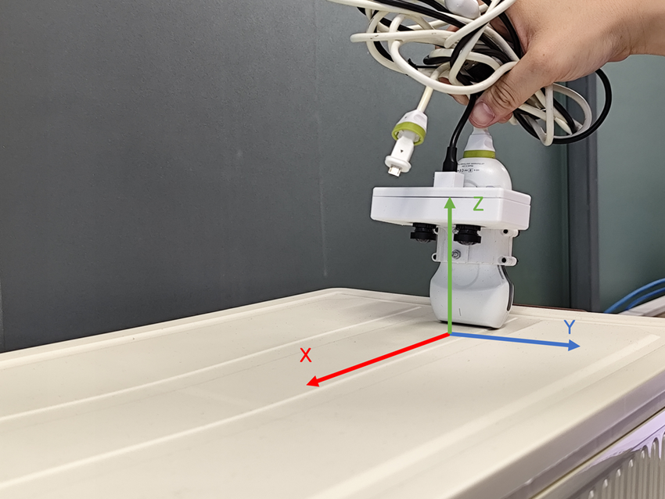
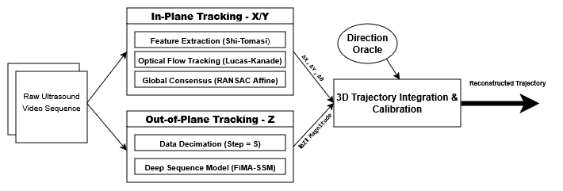
Proposed Hybrid Pipeline
• X / Y → visible motion → optical flow
• Z → speckle decorrelation → DL
• Best-of-both-worlds split
Decoupled X/Y (classical CV) and Z (deep learning).

Slide 7
Dataset, Preprocessing & Evaluation Protocol
• TUS-REC 2024 (Train Part 1) — 50 subjects
• HDF5 lazy loading — RAM-safe at scale
• Resize 480×640 → 256×256, normalize to [0,1]
• Sequence length S = 20 frames; subsampling step 4 → 2 (latest)
• Subject 050 strictly held out — never used for training or HP tuning
• Metrics: MAE (frame-stable error), FDR = final drift / trajectory length

Slide 8
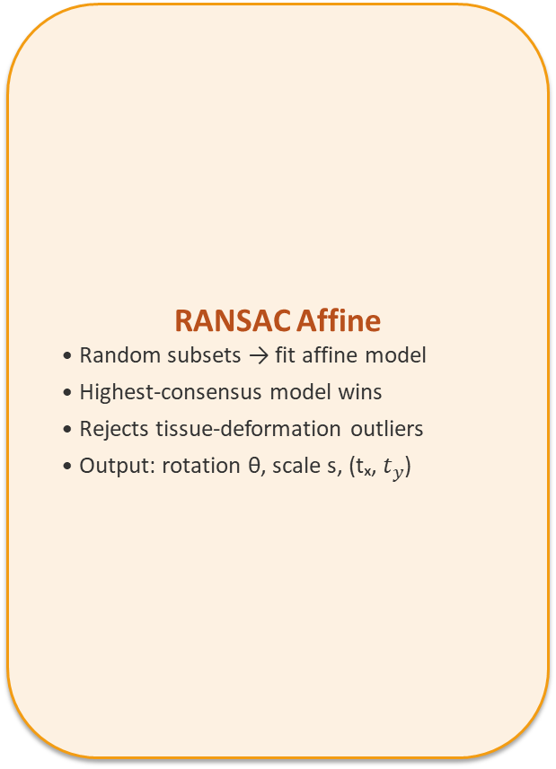
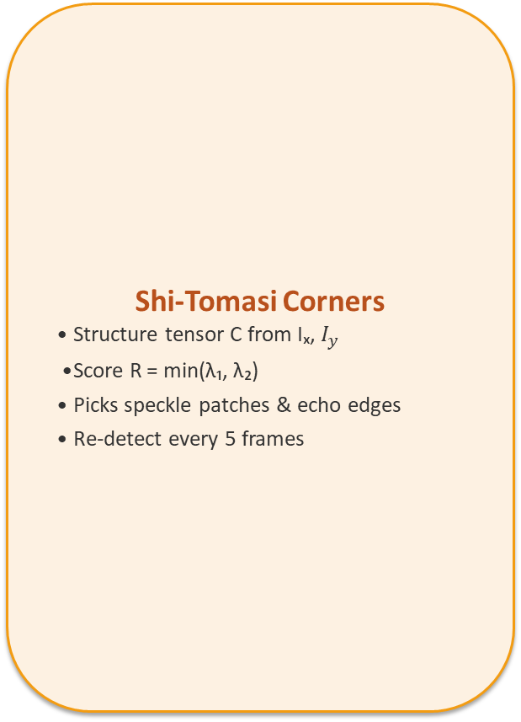
In-Plane Tracking — Visual Odometry Pipeline
Shi-Tomasi Corners
• Structure tensor C from Iₓ, $I_{y}$
• Score R = min(λ₁, λ₂)
• Picks speckle patches & echo edges
• Re-detect every 5 frames
Pyramidal Lucas-Kanade
• Brightness constancy + spatial coherence
• Multi-scale pyramid for large motion
• Per-feature velocity (u, v)
• Robust to small inter-frame shifts
RANSAC Affine
• Random subsets → fit affine model
• Highest-consensus model wins
• Rejects tissue-deformation outliers
• Output: rotation θ, scale s, (tₓ, $t_{y}$)

Slide 9
Pitfalls & Coordinate-Alignment Breakthrough
• Aperture problem: sliding parallel to fascia → visual reports ≈0 vs. 20 mm true
• Wiper effect: tiny hand rotation → arc at depth → distorted projection
• Hypothesis confirmed: pixel and sensor coordinate frames are misaligned
• Solver mapped pixel-traj → mm-traj: ≈ −130° offset + pixel-to-mm scale
• After alignment, visual & GT paths overlay cleanly
Sensor displacement
20 mm
Visual (raw)
≈ 0 mm
After alignment (MAE)
≈ 0.7 mm

Slide 10
Out-of-Plane (Z) — Why DL is Required
And why the obvious Transformer baseline failed
• Speckle decorrelates instead of shifting → optical flow undefined
• Need to learn the texture-change-rate ↔ physical mm mapping
• Baseline attempt: ResNet-18 + 1×1 pooling + Transformer encoder
– Train loss → 0, Validation FDR > 25% → catastrophic overfit
– Diagnosis: data-hungry attention, no inductive bias for motion
– 1×1 pooling destroyed spatial topography — model memorized anatomy, not physics
• → Redesign the architecture around physics-guided structure

Slide 11
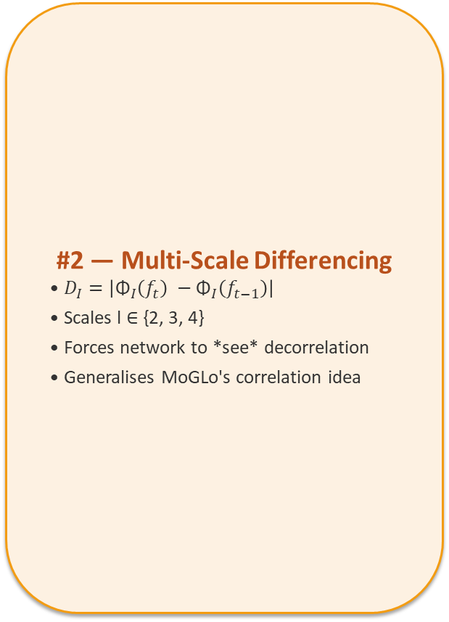
Three Architectural Fixes
#1 — 2×2 Spatial Pool
• Replaces 1×1 GAP
• 4 quadrants per feature map
• Localizes WHERE decorrelation occurs
• (128+256+512)×4 = 3584 features/frame
#2 — Multi-Scale Differencing
• $D_{I}=\left|{\text{Φ}}_{I}\left(f_{t}\right) −{\text{Φ}}_{I}\left(f_{t−1}\right)\right|$
• Scales l ∈ {2, 3, 4}
• Forces network to *see* decorrelation
• Generalises MoGLo's correlation idea
#3 — Temporal SSM Block
• Mamba-style, O(S) memory
• Causal Conv1d + SiLU gating
• Pure PyTorch — no nvcc required
• Beats Transformer at half the cost

Slide 12
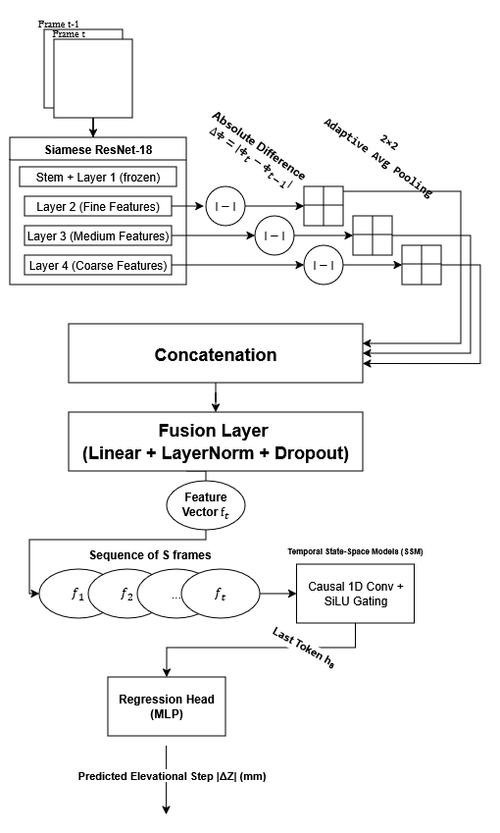
Final FiMA-SSM Architecture
Shared ResNet-18 → multi-scale diff → 2×2 pool → fusion → SSM → head.

Slide 13
Training Recipe & Engineering
Differential LR + Warmup
• stem & layer1: frozen (ImageNet edges)
• layer2/3/4: LR = 1e-5
• fusion + temporal + head: LR = 1e-4
• Warmup: backbone frozen 2 epochs
Motion-Weighted L1 Loss
• ℒ = mean( |ŷ−y| · (1 + α·y) ), α = 2
• Up-weights fast sweeps (~10% of frames)
• Prevents collapse to slow-motion mean
• Critical for tracking abrupt motion
System & Engineering
• AdamW + ReduceLROnPlateau (patience 3)
• AMP FP16, grad-clip max_norm 1.0
• HDF5 lazy load, batch 64, S = 20
• NVIDIA A10 24 GB; auto-versioned runs

Slide 14
Ablation Study — Architecture Variants
Variant | Pooling | Temporal | MAE (mm) | FDR (%)
ResNet-18 baseline | 1×1 | — | ≈ 15.9 | ≈ 25.7
MoGLo-Net replica | 1×1 | LSTM | ≈ 24.05 | ≈ 38.78
FiMA + Transformer | 4×4 | Transformer | overfit | > 25
Proposed FiMA-SSM | 2×2 | Conv1d SSM | ≈ 11.56 | ≈ 19.71
• Topographic pooling + explicit differencing each contribute substantially
• SSM matches Transformer accuracy at O(S) cost without overfit

Slide 15
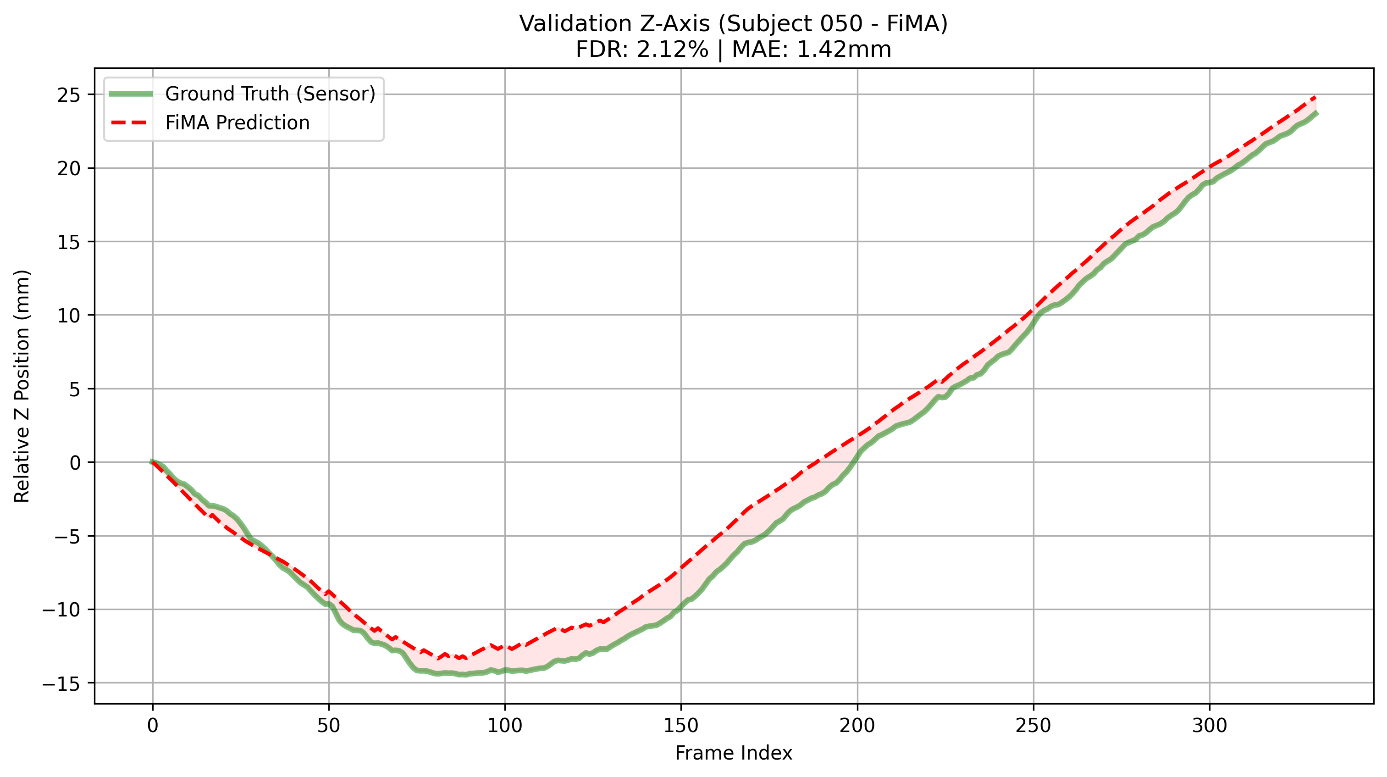
Validation on Held-Out Subject 050
MAE
1.42 mm
Final Drift Rate
2.12 %
Sequence length
300+ frames
Z-axis trajectory — predicted (red) vs. ground truth (green).

Slide 16
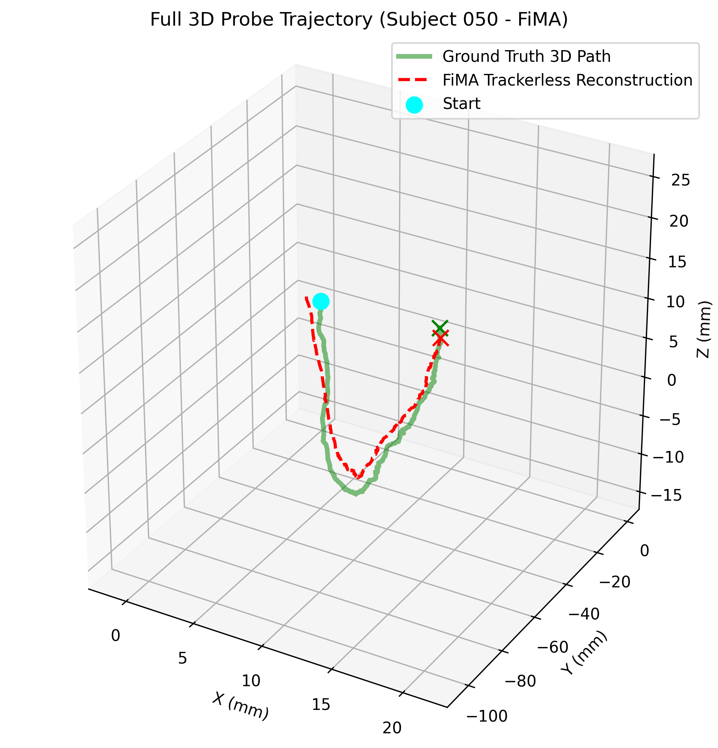
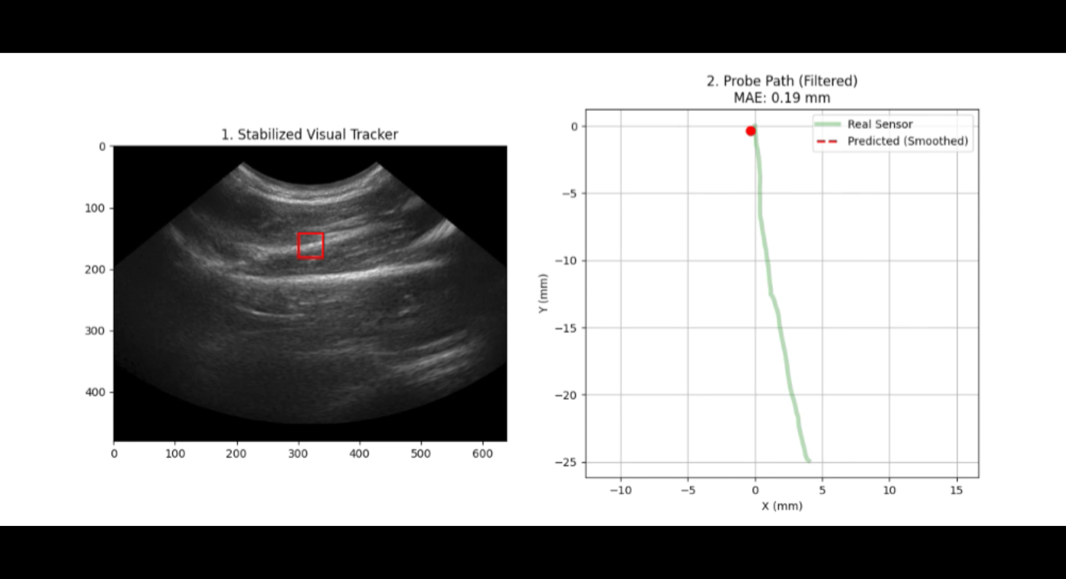
Full 3D Trajectory Reconstruction
2D animated visualization
Visual Odometry (X,Y) + DL Z prediction → full 6-DOF trajectory.

Slide 17
Recent Iterations — IMU Study & Training Hardening
IMU as In-Model Feature
• Synthetic IMU from tform derivatives
• Gated additive fusion in encoder
• → Degraded global metrics
• Model leaned on too-clean signal
IMU as External Verifier
• Independent |dz| via double integration
• Weighted fusion (α controls trust)
• Marginal at α=0.7; lowered to α=0.9
• Real hardware IMU is the proper next step
Latest Training-Loop Fixes
• Removed magnitude filter (|dz|<10mm)
• Frame step 4 → 2 (~2× more samples)
• Epochs 5 → 10
• Scheduler patience 1 → 3 (less LR thrash)
• Result: 11.56 mm global MAE, 19.71% FDR — best version to date

Slide 18
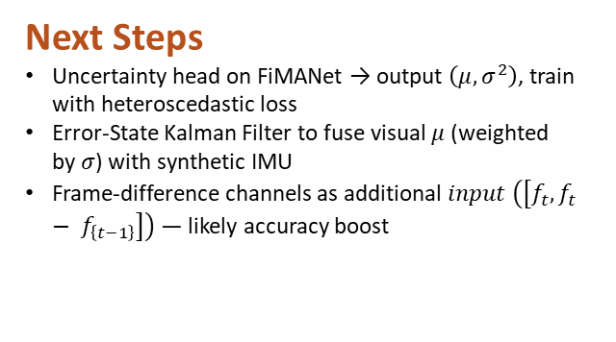
Conclusion & Future Work
Conclusion
Trackerless 3D US is feasible with a hybrid pipeline
Decoupling X/Y (classical) and Z (DL) plays to each method's strengths
Multi-scale 2×2 pool + explicit differencing + SSM beats Transformer
Motion-weighted loss + warmup-with-differential-LR are essential
Validation: MAE 1.42 mm, FDR 2.12% on unseen subject
Next Steps
Uncertainty head on FiMANet → output $\left(μ, σ^{2}\right)$, train with heteroscedastic loss
Error-State Kalman Filter to fuse visual $μ$ (weighted by $σ$) with synthetic IMU
Frame-difference channels as additional $input \left(\left[f_{t}, f_{t}− f_{\left\{t−1\right\}}\right]\right)$— likely accuracy boost
Future Work
Real hardware IMU mounted on the probe — eliminates the synthetic-data ceiling
Factor Graph Optimization (GTSAM) for global trajectory consistency, not just frame-by-frame
NeRF-US / 3D Gaussian Splatting for view-consistent volume rendering
Multi-center dataset collection beyond TUS-REC for cross-machine generalization
Real-time deployment — TensorRT export, custom Mamba CUDA kernels

