Slide 1
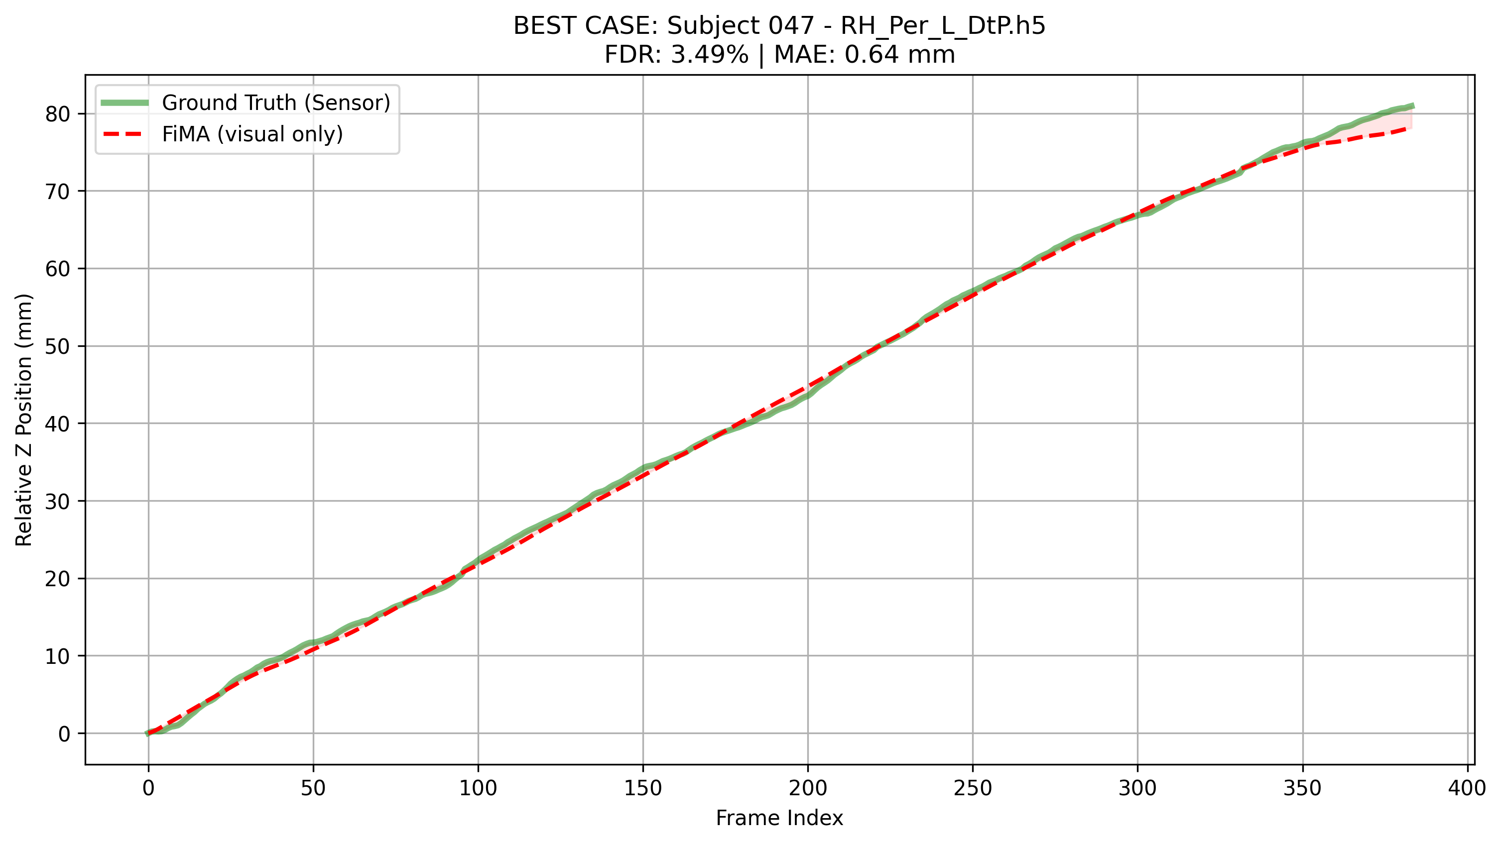
Trackerless 3D Ultrasound Reconstruction via Visual–Inertial Fusion
To reconstruct the 3D path of a freehand ultrasound probe without an external tracker, using only the B-mode video + a probe-mounted IMU.

Slide 2
What makes trackerless reconstruction hard
Tiny per-frame motion. At 30 fps the probe moves ≈ 0.1–0.5 mm between frames. The signal-to-noise ratio of speckle change is low.
Error accumulates. Reconstruction = cumulative sum of Δz. A 0.1 mm/frame bias becomes ≥ 4 cm of drift over a 400-frame scan.
Direction ambiguity. Two adjacent frames look almost identical for ±Δz of the same magnitude — the network has to learn which way it moved.
Notes:
This is essentially visual odometry on a noisy, low-baseline signal. Two consequences drive the whole design: (a) we need temporal context, not just frame pairs; (b) we need to predict a signed scalar carefully because sign errors are catastrophic.

Slide 3
TUS-REC2024 dataset & supervision signal
50 training subjects, 3 validation subjects × 24 scans each. 6 MHz curvilinear probe @ 30 fps. ~400–500 frames per scan.
For every scan: B-mode image stack [N, H, W] + 4×4 GT transforms [N, 4, 4] from optical tracker.
Supervision target = per-frame Δz: target[p] = z(p+1) − z(p) extracted from the translation column of tforms.
IMU is simulated from GT transforms (numerical 2nd derivative + bias/noise model) — swap-in real IMU later.
Notes:
I never give the model the absolute pose. It only ever sees images and predicts the increment. The trajectory is a cumulative sum at inference.

Slide 4
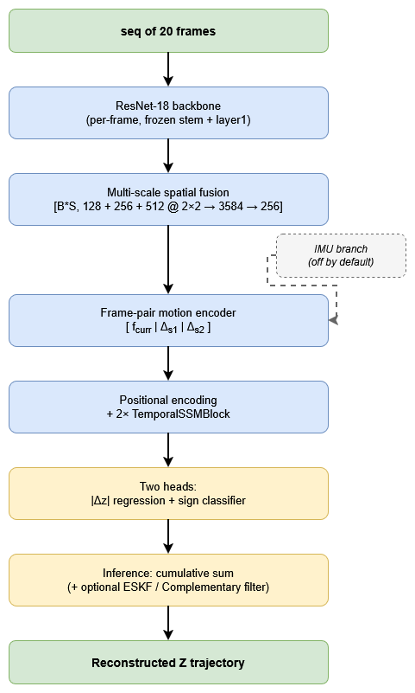
End-to-end pipeline

Slide 5
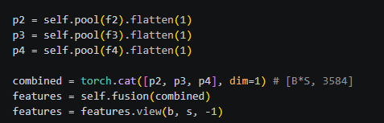
How the model sees each frame
Backbone: ResNet-18 pretrained on ImageNet, conv1 rewired to 1-channel input (grayscale US). Stem + layer1 frozen — they encode low-level texture which doesn't need adaptation.
Three feature maps tapped at different depths and pooled to 2×2 patches:
layer2 → 128×2×2 = 512
layer3 → 256×2×2 = 1024
layer4 → 512×2×2 = 2048
Concatenated → 3584-D → linear → 256-D per-frame embedding with LayerNorm + ReLU + Dropout(0.3).

Slide 6
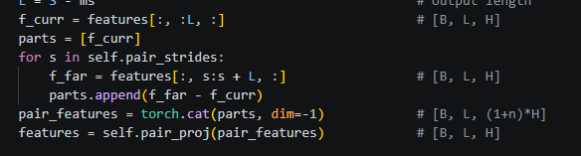
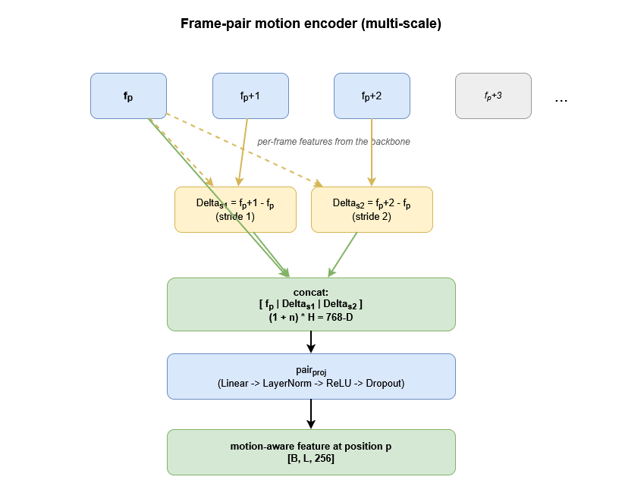

Making motion explicit, before the temporal block
Instead of feeding raw per-frame features into the sequence model, build a motion-aware feature at each position:
pair_p = $\left[ f_{p}\right|f_{\left\{p+s1\right\}} − f_{p}\left| f_{\left\{p+s2\right\}}− f_{p}\right]$
for strides $s ∈ \left\{1, 2\right\}$ (multi-scale).
Then pair_proj (Linear → LayerNorm → ReLU → Dropout) compresses it back to 256-D.
Output length shrinks from S to S − max(strides) (= 18 for SEQ_LEN=20, strides (1,2)). Targets are sliced accordingly.

Slide 7
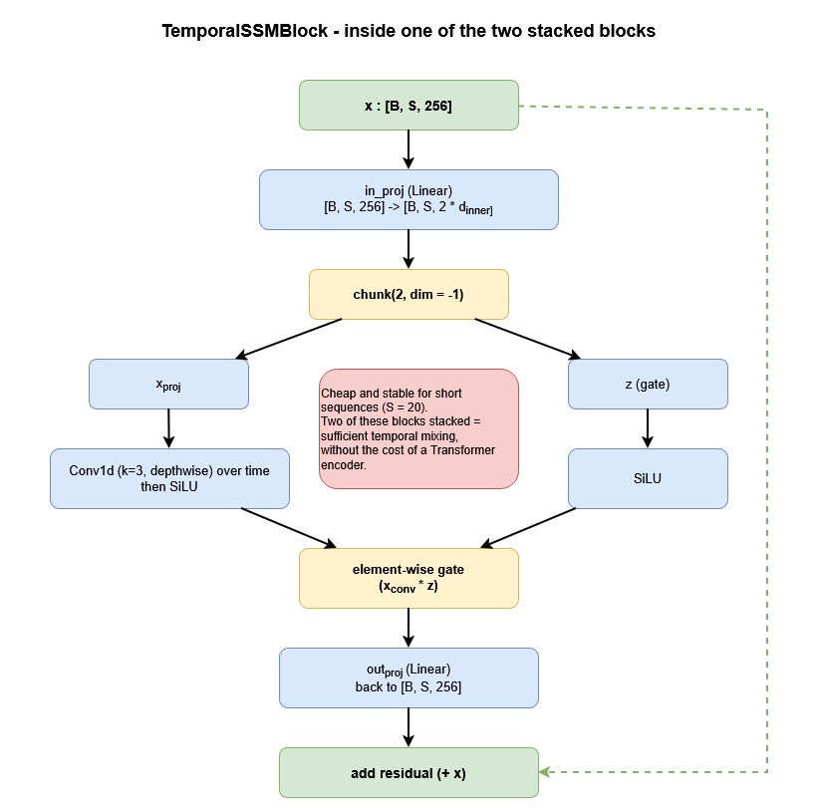
How temporal context is mixed
After positional encoding, the 256-D embeddings pass through 2 × TemporalSSMBlock — a Mamba-inspired structured state-space block.
Each block: input projection → depthwise Conv1d (k=3) over time → gated SiLU → output projection → residual.
Why not a Transformer here: sequence length is only 20, the cost is dominated by the backbone, and the conv-gated formulation is cheap and stable for this length.

Slide 8
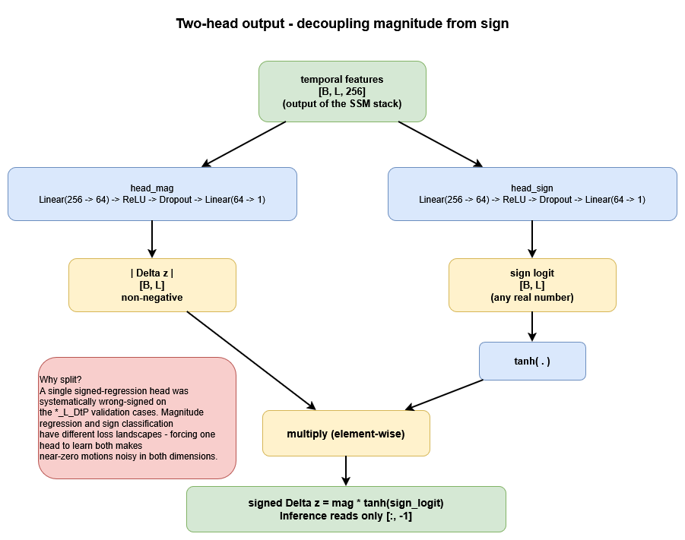

Decoupling magnitude and sign
A single regression head for signed Δz was systematically wrong-signed on the *_L_DtP validation cases (probe moved one way, predicted the other).
New design: two heads share the same temporal features:
$head_{mag}$ → predicts $|Δz|$ (always non-negative)
$head_{sign}$ → predicts a logit; sign at inference = tanh(logit)
At inference: $signed_{Δz}$ = mag · tanh($sign_{logit}$).
Heads emit one prediction per position; only the last position is used for trajectory cumulation.

Slide 9
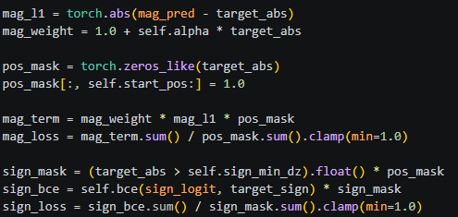
Motion-weighted L1 + masked sign BCE
Motion weighting. Most frames have small |Δz|; if we don't upweight, the model regresses to zero. Use w = 1 + α · |target| with α = 2.
Position masking. First 5 temporal positions are ignored — the temporal stack hasn't seen enough context yet. Loss only flows from positions ≥ 5.
Sign mask. BCE on the sign head is masked when |target| < 0.01 mm — near-stationary frames have undefined "true sign".
Final loss: L = motion_weighted_L1(mag, |target|) + 0.3 · masked_BCE(sign_logit, target > 0)

Slide 10
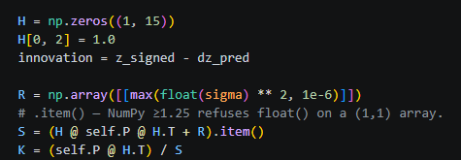
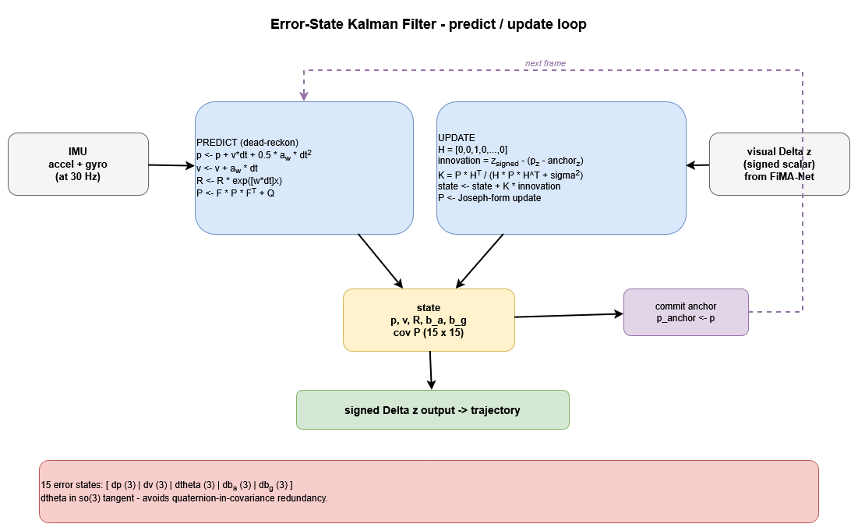

From accel/gyro to a corrected Δz
IMU Simulator — synthesises sensor readings from GT transforms:
Accel: $a_{sensor}$= $Rᵀ\left(a_{world}+ g\right)$where $a_{world}$ is the world-frame second derivative of position.
Gyro: $ω_{body}$ = $\log\left(Rᵢᵀ · Rᵢ^{+1}\right)$ / dt (body-frame, not world — earlier bug).
Adds white noise + random-walk bias + per-axis scale error each call (acts as augmentation).
Error-State Kalman Filter (Solà 2017) — 15-state error vector $\left[δp, δv, δθ, δb_{a}, δb_{g}\right]$:
Predict: IMU dead-reckon position/velocity/rotation, propagate covariance with the Jacobian F.
Update: measurement = signed Δz from the visual model with measurement noise σ.

Slide 11
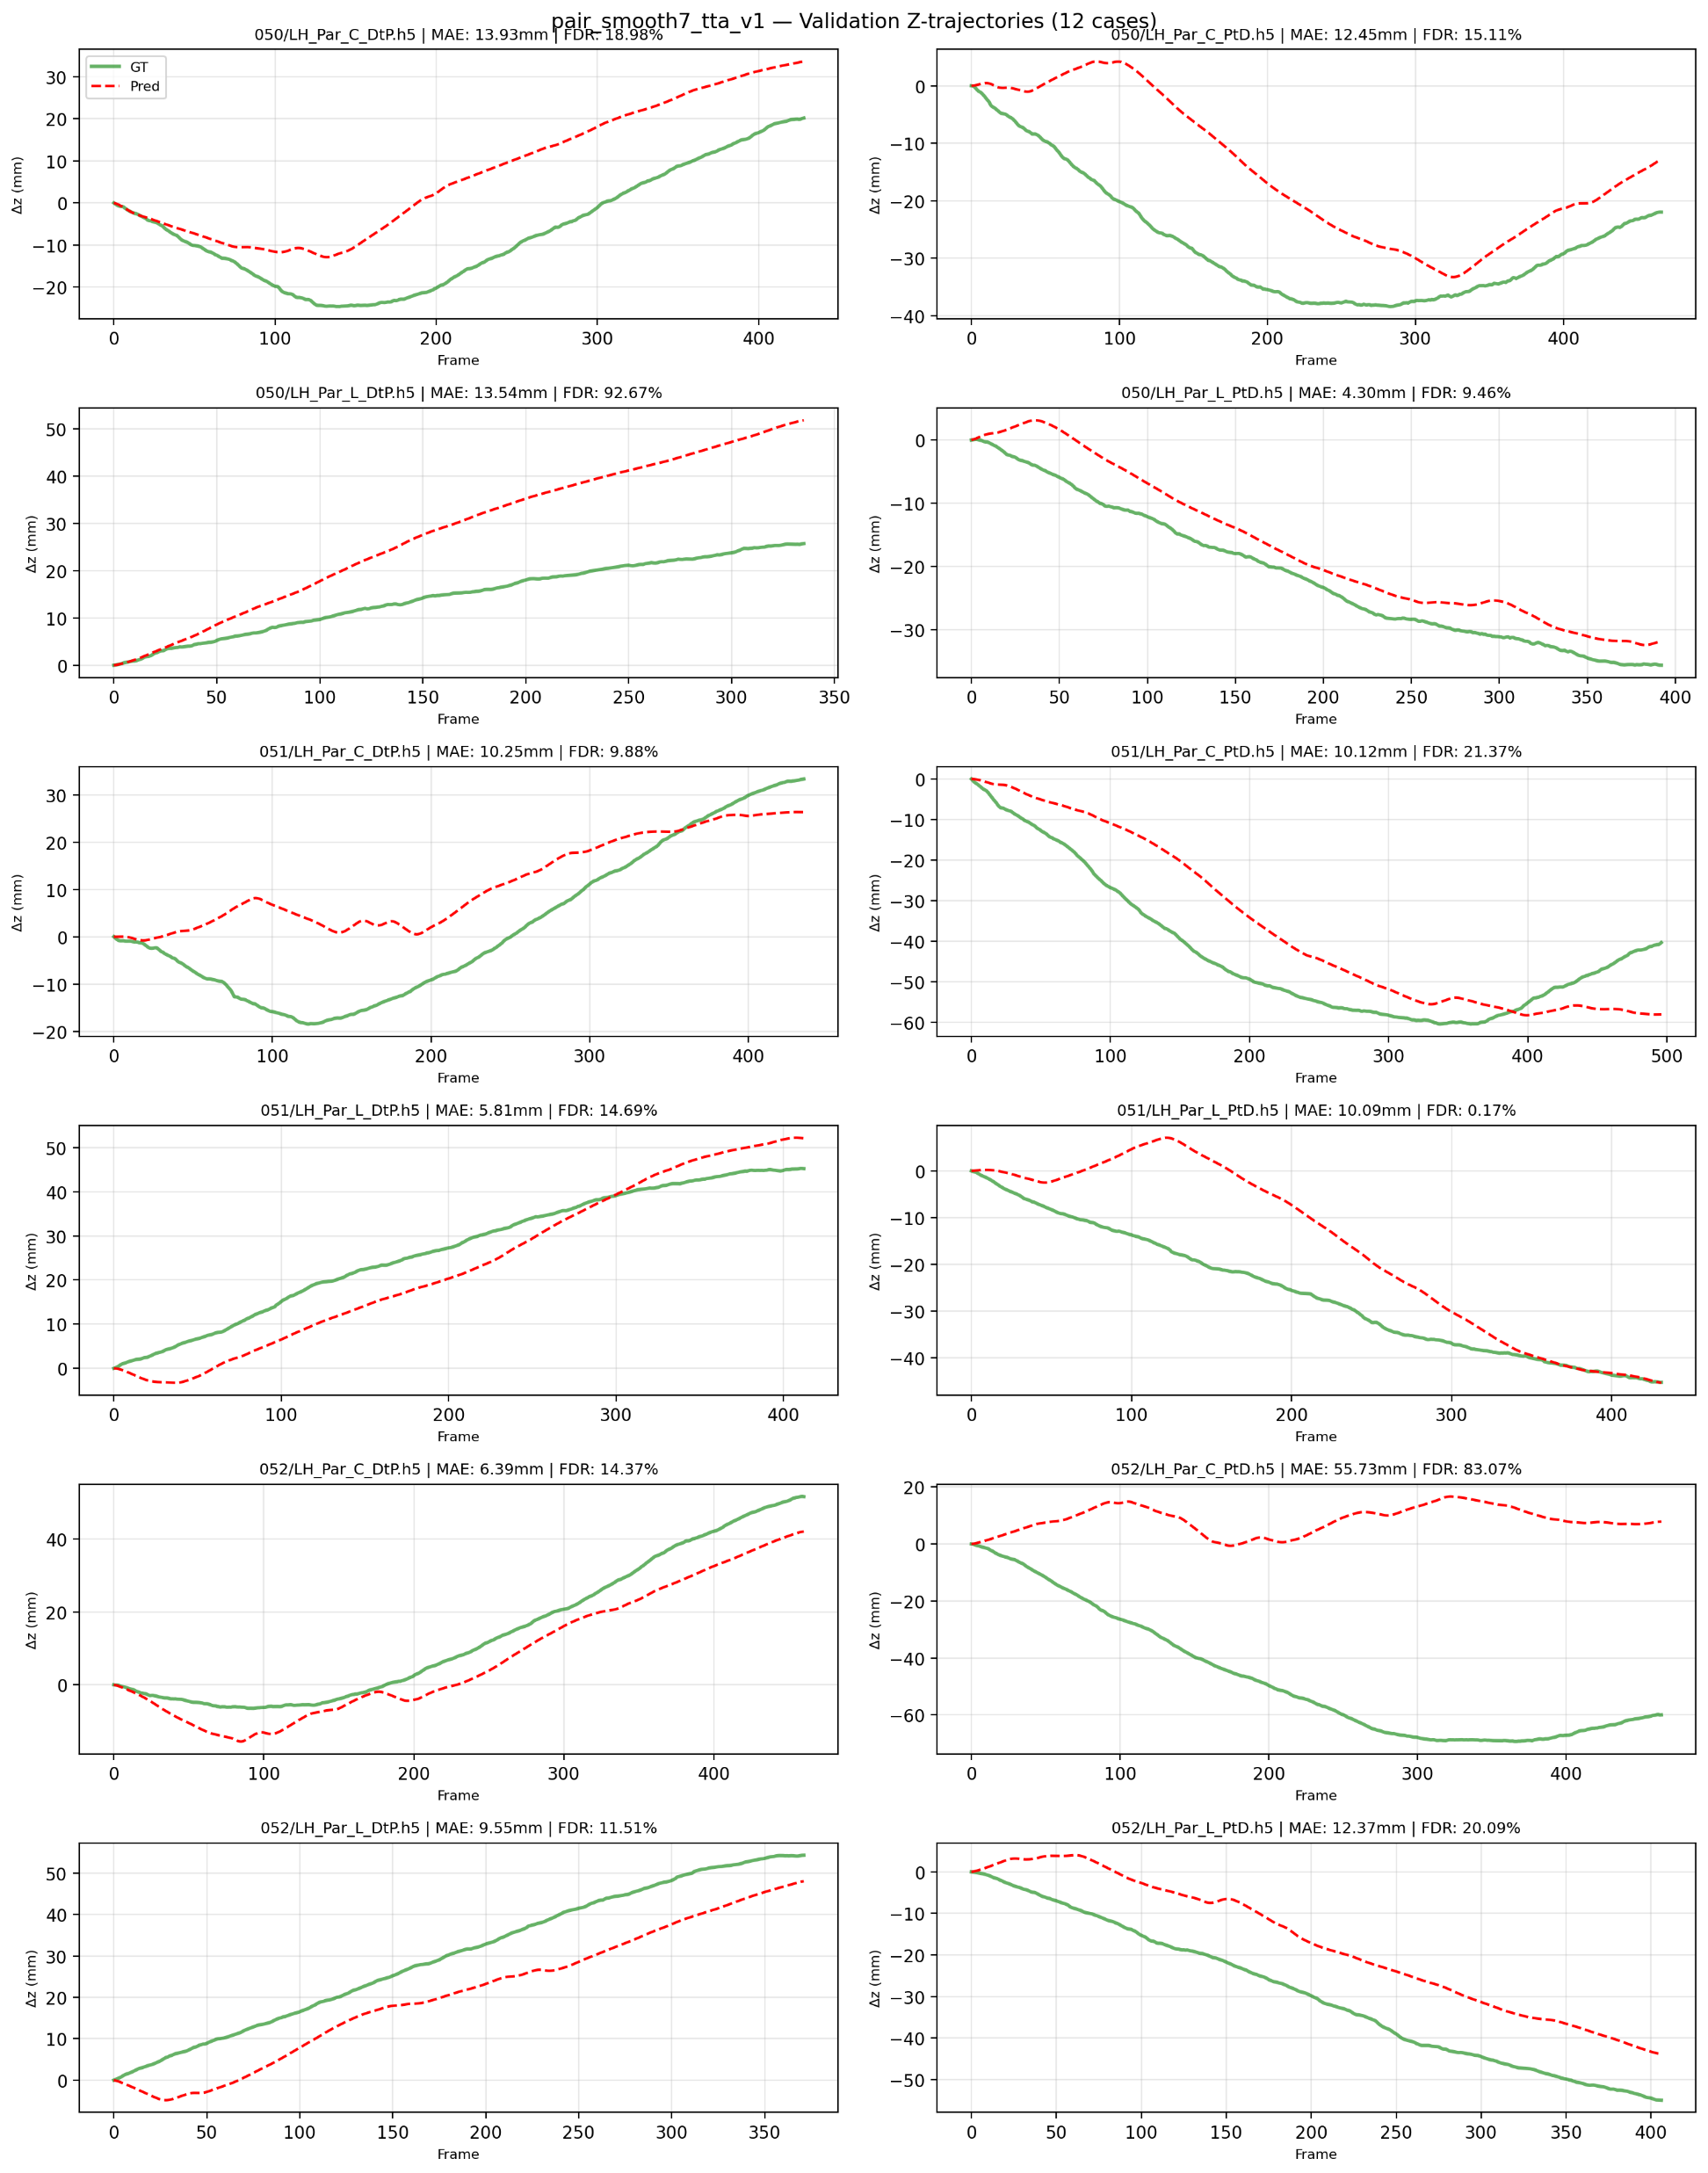

ESKF vs. Complementary vs. visual-only
Built a classical complementary filter as an apples-to-apples baseline: $v_{imu}= v + \left(a_{z}− g\right)·dt, v_{vis}=\frac{Δz}{dt}, v = α·v_{imu}+ \left(1−α\right)·v_{vis}$.
Ran an ablation across filter / σ / α / TTA. Showed:
Config | Val MAE | Global MAE | Valid scans
ESKF σ = 0.30 | 23.67 | 19.98 | 1043
ESKF σ = 0.10 | 16.69 | 13.48 | 1189
Complementary α = 0.3 | 13.00 | 10.59 | 1200
Visual only | 13.35 | 11.01 | 1200
Visual only + hflip TTA | 13.76 | 10.41 | 1200

Slide 12
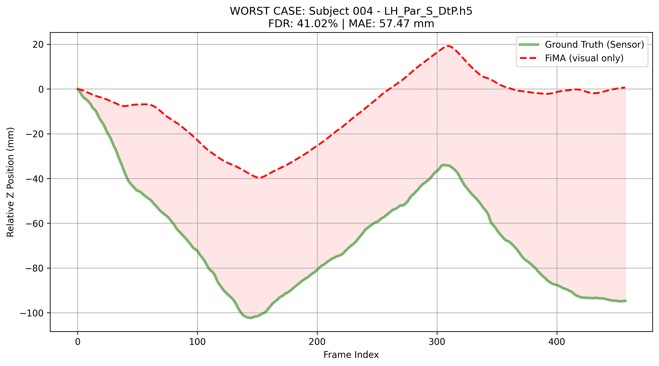
Headline result and takeaways
Final number: Visual-only + hflip TTA, pair encoder, two-head, augmentation, 4-epoch backbone warmup
Global MAE 10.41 mm across 1200 valid scans
Validation MAE 13.76 mm across 12 stratified cases (3 subjects × 4)
Per-frame MAE 0.124 mm
What made the difference (ranked):
Frame-pair motion encoder (−10 mm in global MAE vs. per-frame baseline)
Two-head sign decoupling (fixed direction failures on *_L_DtP)
Sequence augmentation + 4-epoch backbone warmup (closed train/val gap)
Best-by-val-MAE checkpoint selection
Negative results worth reporting:
Multi-step supervision (predict every position) — capacity drains away from the position we actually use.
15-state ESKF on simulated IMU — actively degrades trajectories at recommended σ.
Trajectory smoothing — null result; failure cases aren't spiky noise.
Next steps:
Real IMU stream (drop-in via IMUSimulator interface).
6-DOF prediction instead of monovariate Δz.
Investigate the systematic outlier 052/Par_C_PtD.

