Slide 1
S
FINAL REPORT
Auto-Analysis of Message Center Announcements
for Power Platform
Sunneteam · Politechnika Wrocławska × Volvo
Yehor Sakovtsev · Yauheniya Drozd · Yahor Andreichykau · Dmytro Zavhorodnii
WRO-BOOST Teams Projects 2026 · June 2026

Slide 2
01 / CONTENTS
What we'll cover
01
Team and timeline
06
The flow — 9 scoped stages
Roles, sprints, who delivered what
Trigger to update, with global error handling
02
The problem we set out to solve
07
Inside the brain
Why 86 000 announcements were unmanageable
AI classification: clean text in, JSON verdict out
03
Market alternatives
08
Verification and validation
Why we built rather than bought
Six scenarios, all green
04
Two AI approaches — and our choice
09
Python edition + handover docs
Prompt vs. Agent, scored and decided
The portable variant and the runbooks
05
Solution architecture
10
Conclusions and next steps
Event-driven pipeline on Power Platform
What landed, what's hard, what's next

Slide 3
02 / ORGANISATION
Team and responsibilities
ROLES
PROJECT TIMELINE
Yehor Sakovtsev
Planning, coordination, sprint delivery, workflow patches
1
Discovery & Use Case
12 Mar – 26 Mar
Project Manager / Team Lead
4 → 21 tasks; project description; Use Case diagram
Dmytro Zavhorodnii
Requirements, classification module (Gemma3), error handling
2
Core build
01 Apr – 07 May
Business Analyst
Classification module (Gemma3); DB ↔ workflow; Jira process refined
Yauheniya Drozd
Solution design, glossary, classification criteria
3
Integration prep
May 2026
IT Architect
End-to-end integration tests; Copilot Studio prep
Yahor Andreichykau
Integration tests, V&V, regression suite, client reports
4
Workflow + AI agent
29 May – 05 Jun
Test Manager / Tester
Power Automate logic finalised; Copilot Studio agent live
All four members
Flow build, AI prompt build, Copilot Studio agent configuration
5
Stabilisation + docs
05 Jun – 12 Jun
Developers
Full integration tests; technical doc, admin guide, glossary

Slide 4
03 / THE PROBLEM
Why this project exists
86,000
FUNCTIONAL
NON-FUNCTIONAL
SCOPE
Retrieve PP-related items
Classify category, priority, impact
Summarise via AI
Store full record
Notify on action needed
Skip duplicates
Reliable with error handling
Low cost (~$0.30/run)
Maintainable via ALM
No hard-coded secrets
Scales to large backlog
Native to Power Platform
IN: detection, classify, notify
IN: repository, alerts
IN: AI/GenAI on Power Platform
OUT: auto-remediation
OUT: non-Microsoft services
Message Center records to triage
A breaking change in Power Platform is buried in this noise.
Manual review is slow, inconsistent, error-prone.

Slide 5
04 / MARKET RESEARCH
We looked at three alternatives. None fit.
REJECTED
REJECTED
REJECTED
SELECTED
Native M365 Admin Portal
Third-party governance
Custom Graph scripts
PP + AI Builder
Read Message Center manually or via email digests.
CoreView · AdminDroid · ENow — broad tenant tooling.
Pull the Service Communications API with code.
MC → AI classify → repository → notify, in-platform.
WHY NOT / WHY
WHY NOT / WHY
WHY NOT / WHY
WHY NOT / WHY
No PP filter. No AI triage. Fully manual.
Expensive, generic, not PP-specific, no AI classification.
Code-first. Outside low-code governance. High build & maintenance.
PP-specific, low-code, low-cost, governed, extensible.
COST
COST
COST
COST
Tenant license only
$40k–$60k / year
Build + ongoing dev time
~$0.30 per run

Slide 6
05 / DECISION
Two AI approaches, scored side by side
SCORECARD
SELECTED — PRODUCTION
DOCUMENTED — UPGRADE PATH
Concept A — AI Builder Prompt
Concept B — Copilot Studio Agent
Cost
A
Determinism
A
A single Run-a-Prompt step inside Power Automate. GPT-5 reasoning returns a structured JSON verdict in one shot.
Multi-step autonomous reasoning. Richer output (executive + technical summaries). Higher cost, less deterministic.
Simplicity
A
Extensibility
B
— Deterministic, single-shot output
— Low cost — ~30 credits / ~6.7 s per run
— Simple to embed and version in ALM
— Predictable JSON for Parse JSON step
— Multi-step, autonomous reasoning
— Richer output (exec + technical summary)
— Extensible: knowledge sources & tools
— Higher cost; harder to keep deterministic
Rich output
B
Verdict: Prompt wins on cost & predictability for production; Agent kept for richer, multi-step analysis.

Slide 7
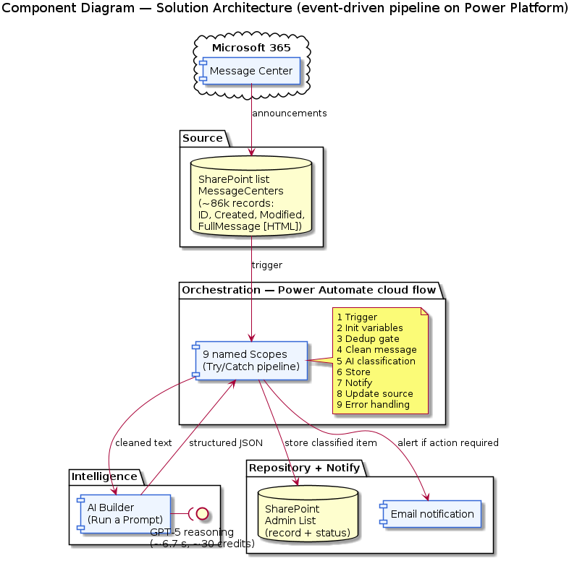
06 / ARCHITECTURE
Solution architecture — event-driven on Power Platform
1
SOURCE
SharePoint list MessageCenters
~86k MC records. ID · Created · Modified · FullMessage (HTML).
2
ORCHESTRATION
Power Automate cloud flow
Trigger: item created or modified. 9 scoped stages with a global Try/Catch.
3
INTELLIGENCE
AI Builder — Run a Prompt
GPT-5 reasoning. HTML → structured JSON verdict in ~6.7 seconds.
4
REPOSITORY + NOTIFY
SharePoint Admin List + email
Full record stored. Email alert only when action is required.

Slide 8
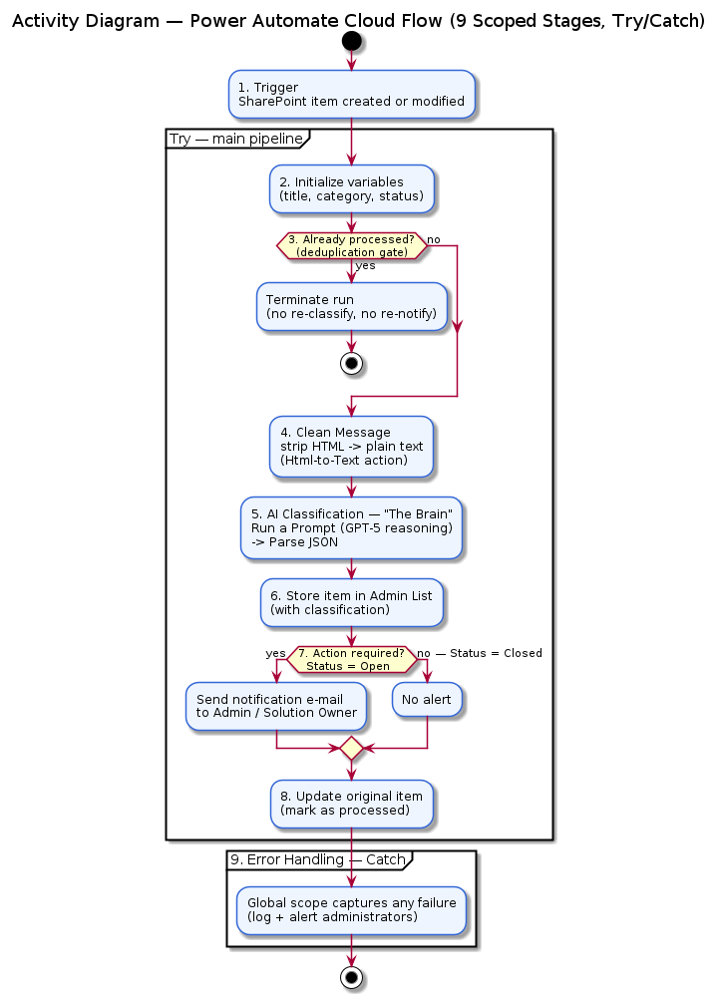
07 / IMPLEMENTATION
The flow — nine scoped stages, one Try/Catch
01
Trigger
SharePoint item created or modified
02
Initialize variables
title, category, status, clean message
03
Check If Needs Processing
Dedup gate → terminate on duplicate
04
Clean Message
HTML → text via Html-to-Text
05
AI Classification
Run a Prompt → Parse JSON
06
Store in Admin List
Create item with classification
07
Notify if Action Required
Send email when Status = Open
08
Update Original Item
Mark source as processed
09
Error Handling
Global scope: log + alert on failure

Slide 9
07 / IMPLEMENTATION
Inside the brain — AI classification
INPUT
CLASSIFICATION RULES
Cleaned MC text (HTML stripped)
Pattern | Category | Status | Action
Planned maintenance | Maintenance | Closed | Auto-close, no alert
New functionality | New Feature | Closed | Store, no alert
Deprecation / breaking | Breaking Change | Open | Email administrators
Unclear / ambiguous | Other | Open | Email + manual review
Not PP-related | Other | Open | Store, optional review
MODEL
GPT-5 reasoning · ~6.7 s · ~30 credits per run
OUTPUT
{
"category": "Maintenance",
"priority": "Low",
"impact": "Low",
"actionRequired": false,
"summary": "Minor service update
to Dataverse (SAM) → v9.2.24112…",
"actionsTaken": "No action;
monitor Service Health."
}
KEY INSIGHT
The prompt forbids Markdown fences and demands strict JSON. Any deviation triggers the global Error Handling scope — by design.

Slide 10
08 / VERIFICATION
Six test scenarios, every one green
TEST SCENARIOS
100%
1
Maintenance message
Classified Maintenance / Low, no alert
PASS
2
New feature message
Stored as New Feature, no alert
PASS
scenarios passed
3
Breaking change message
Alert email sent to administrators
PASS
6.7s
4
Unrelated / unclear
Flagged Other, marked for manual review
PASS
5
Duplicate item
Dedup gate terminated the run
PASS
average AI run time
6
Invalid AI JSON (negative)
Error Handling scope captured the failure
PASS
0
unhandled errors

Slide 11
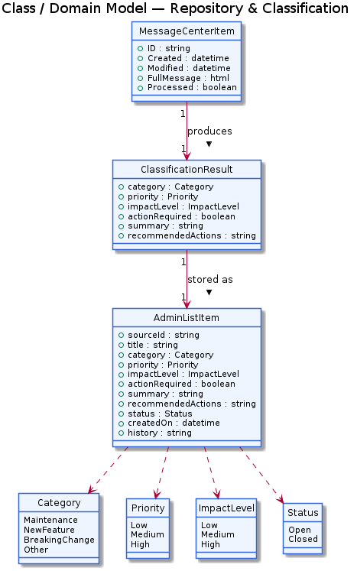
06 / ARCHITECTURE
Data model — two lists, one JSON contract
SOURCE — MessageCenters
Column | Type | Purpose
ID | Integer (PK) | Unique MC announcement ID — dedup key
Modified | DateTime | Last-modification timestamp
Created | DateTime | Creation timestamp
FullMessage | Multiline (HTML) | Raw MC content, Latin1-encoded
TARGET — Admin List (AI-enriched repository)
Column | Type | Purpose
SourceID | Integer (FK) | References ID on source list
Category | Choice | Maintenance | New Feature | Breaking Change | Other
Priority | Choice | High | Medium | Low
Status | Choice | Open (alert sent) | Closed (auto)
Summary | Multiline text | AI-generated 1–2 sentence summary

Slide 12
09 / HANDOVER
Beyond Power Platform — Python edition and runbooks
PORTABLE RUNTIME
ADMINISTRATOR
BUSINESS STAKEHOLDER
Python edition
Admin guide
Client overview
A 1:1 re-implementation of the cloud flow. Same 9 stages, same JSON contract, same dedup gate, same global error handler.
Deployment, day-2 operations, troubleshooting matrix, escalation paths. For Power Platform admins inheriting the solution.
The non-technical adoption brief. Outcomes, build-vs-buy, what decisions the customer still needs to make.
— Runs as Azure Function or scheduled container
— Test prompt changes without burning AI credits
— MSAL auth to SharePoint via Graph
— 22/22 pytest scenarios passing (all 6 V&V)
— Prerequisites & environment variables
— DEV → TEST → PROD with managed solution
— Health checks: flow runs, AI credit burn
— Replay misclassified items procedure
— Cost model: ~$0.30 per announcement
— Build vs buy comparison vs $40–60k tools
— Decisions: backfill, alert DL, escalation
— Next steps: Teams alerts, Power BI dashboard

Slide 13
10 / CONCLUSIONS
What landed, what was hard, what's next
ACHIEVEMENTS
CHALLENGES
LEARNINGS & NEXT
End-to-end automation live on Power Platform
AI classification, repository and notifications operational
Two AI concepts built and benchmarked
Full documentation: technical doc, admin guide, client overview
Python edition delivered alongside the Power Platform solution
86k records — deduplication at scale
Inconsistent FullMessage HTML across legacy items
Forcing strict JSON out of an LLM
Copilot Studio integration without HTTP connectors
Balancing AI capability vs. credit cost
Prompt = cost & determinism; Agent = reasoning
ALM and scoping discipline pay off
Next: Microsoft Teams alerts integration
Next: Power BI dashboard for leadership
Upgrade path: Copilot Studio agent for richer analysis
Thank you — questions welcome.

