Slide 1
What is Docker
Part #1

Slide 2
What is Docker
Docker is an open-source project that automates the deployment of applications inside software containers.¹
Docker containers wrap a piece of software in a complete filesystem that contains everything needed to run: code, runtime, system tools, system libraries – anything that can be installed on a server. This guarantees that the software will always run the same, regardless of its environment.²
1 - https://en.wikipedia.org/wiki/Docker_(software)
2 - https://www.docker.com/what-docker#/VM

Slide 3
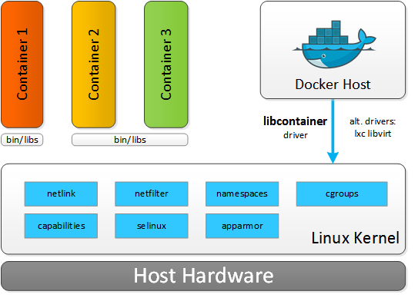
How does Docker work?
Linux containers (LXC) uses the resource isolation features of the Linux kernel to allow independent "containers" to run within a single Linux instance, avoiding the overhead of starting and maintaining virtual machines.
Docker is basically built on top of LXC and offers some high level LXC features with useful interface.

Slide 4
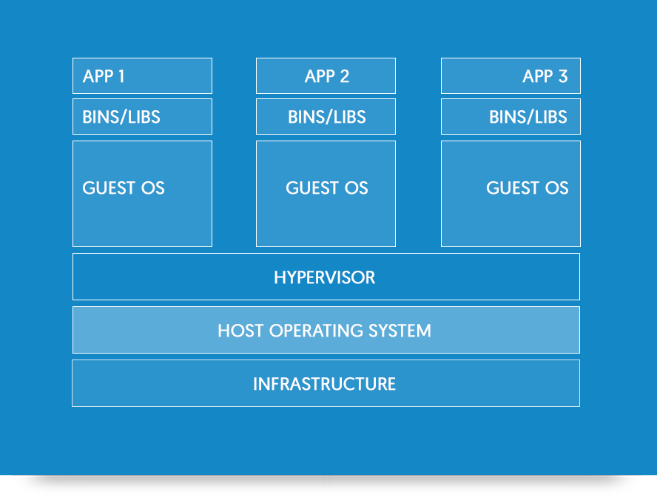
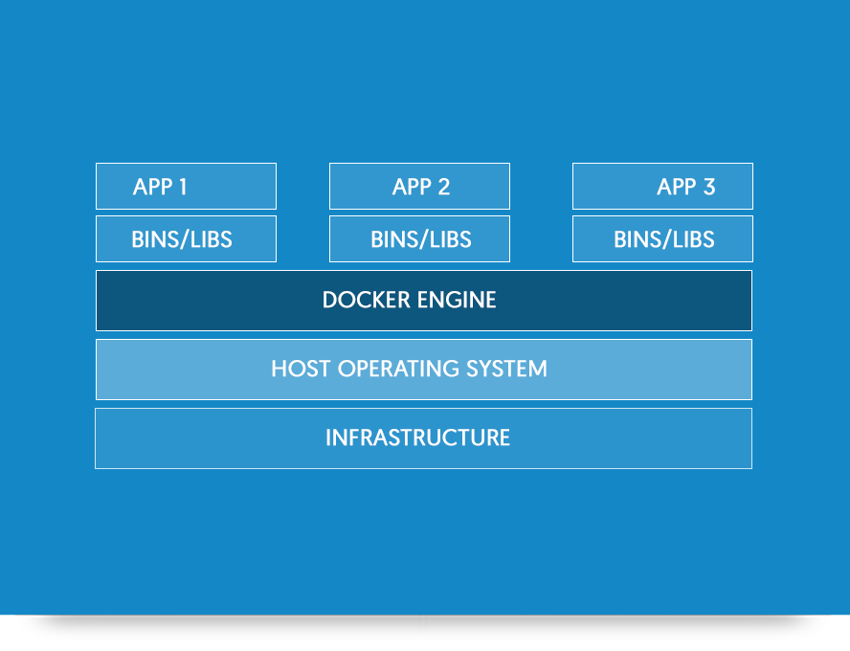
Docker vs Virtual machines
VM
Docker
https://www.docker.com/what-docker#/VM

Slide 5
The advantages of Docker
Rapid application deployment – containers include the minimal runtime requirements of the application, reducing their size and allowing them to be deployed quickly.
Portability across machines – an application and all its dependencies can be bundled into a single container that is independent from the host version of Linux kernel, platform distribution, or deployment model.
Increased productivity – Docker reduces time to develop and test applications because it works the same every time whenever it runs.
Lightweight footprint – Docker images are typically very small, which facilitates rapid delivery, reduces hardware costs and the time to deploy new application containers.
Advantages_of_Using_Docker.html

Slide 6
Images and containers
An image is a filesystem and parameters to use at runtime. It doesn’t have state and never changes.
A container is a running instance of an image.
https://docs.docker.com/engine/getstarted/step_two/

Slide 7
Public Docker register
https://hub.docker.com/explore/ - public Docker register
https://docs.docker.com/docker-hub - overview of Docker Hub
https://store.docker.com - register, specifically geared toward the needs of enterprises.
https://docs.docker.com/docker-store/ - overview of Docker store

Slide 8
Run image
docker images
show a list of Docker’s images on a computer
docker ps --all
show a list of Docker’s containers on a computer
docker search hello
give us a list of base images that contains hello in their names
docker pull hello-world
download hello-world image on our computer
docker run hello-world
run application stored within hello-world image

Slide 9
Run image with arguments
docker run docker/whalesay cowsay 'Hello dear student! :)'
run – load image, if absent, and run
docker/whalesay – a name of the image
cowsay – a command to run
'Hello dear student! :)' - argument to pass in the command

Slide 10
Get Docker
https://docs.docker.com/docker-for-windows/
https://docs.docker.com/docker-for-mac/
The installation provides
Docker Engine
Docker CLI client
Docker Compose
Docker Machine

Slide 11

Home work #1
Install Docker on your machine
Create Docker Hub account
Run hello-world and docker/whalesay images using learned commands

Slide 12
Have a nice day!

