Slide 1
Build your own image
Part #2

Slide 2
Dockerfile and base instructions
Dockerfile is a file with instructions how Docker should build an image
Base instructions :
The FROM instruction sets the Base Image for subsequent instructions. Must be the first non-comment instruction in the Dockerfile.
The RUN instruction will execute any commands in a new layer on top of the current image and commit the results. The resulting committed image will be used for the next step in the Dockerfile.
The CMD provides defaults for an executing container.
https://docs.docker.com/engine/reference/builder/#from
https://docs.docker.com/engine/reference/builder/#run
https://docs.docker.com/engine/reference/builder/#cmd

Slide 3
How to create an image
docker build -t <name:tag> .
Options:
--tag, -t - a name and, optionally, a tag in the ‘name:tag’ format. Possible to build with several tags at the same time.
. – tells the docker build command to look in the current directory for a file called Dockerfile.
--file, -f - a name of the Dockerfile (Default is ‘PATH/Dockerfile’)
--no-cache=true - do not use cache when building an image.
https://docs.docker.com/engine/reference/commandline/build/

Slide 4
Improve whalesay image
Create Dockerfile
Fill in Dockerfile with
FROM docker/whalesay:latest
RUN apt-get -y update && apt-get install -y fortunes
CMD /usr/games/fortune -a | cowsay
Run docker build -t docker-whale .
Run new image several times: docker run docker-whale
https://docs.docker.com/engine/getstarted/step_four/

Slide 5
Dockerfile instructions
The COPY instruction copies new files or directories from <src> and adds them to the filesystem of the container at the path <dest>.
COPY test /my-app
The ADD instruction copies new files, directories or remote file URLs from <src> and adds them to the filesystem of the image at the path <dest>.
ADD test /my-app
The ADD allows <src> to be an URL or if the <src> parameter of ADD is an archive in a recognized compression format, it will be unpacked.
https://docs.docker.com/engine/reference/builder/#copy
https://docs.docker.com/engine/reference/builder/#add

Slide 6
Dockerfile instructions
The ENV instruction sets the environment variable <key> to the value <value>.
ENV myCat fluffy
The ARG instruction defines a variable that users can pass at build-time to the builder with the docker build command using the --build-arg <varname>=<value> flag.
ARG type default-type
ARG type
https://docs.docker.com/engine/reference/builder/#env
https://docs.docker.com/engine/reference/builder/#arg

Slide 7
Dockerfile instructions
The USER instruction sets the user name or UID to use when running the image and for any RUN, CMD and ENTRYPOINT instructions that follow it in the Dockerfile.
USER daemon
The WORKDIR instruction sets the working directory for any RUN, CMD, ENTRYPOINT, COPY and ADD instructions that follow it in the Dockerfile. WORKDIR /path/to/workdir
https://docs.docker.com/engine/reference/builder/#user
https://docs.docker.com/engine/reference/builder/#workdir

Slide 8
Dockerfile instructions
The EXPOSE instruction informs Docker that the container listens on the specified network ports at runtime. EXPOSE does not make the ports of the container accessible to the host: Use –p option in docker run command.
The ENTRYPOINT allows you to configure a container that will run as an executable. The ENTRYPOINT can not be changed during image run (the CMD can be).
The VOLUME instruction creates a mount point with the specified name and marks it as holding externally mounted volumes from native host or other containers.
https://docs.docker.com/engine/reference/builder/#expose
https://docs.docker.com/engine/reference/builder/#entrypoint
https://docs.docker.com/engine/reference/builder/#volume

Slide 9
Dockerfile instructions
The ONBUILD instruction adds to the image a trigger instruction to be executed at a later time, when the image is used as the base for another build.
ONBUILD ADD . /app/src
ONBUILD RUN /usr/local/bin/python-build --dir /app/src
The LABEL instruction adds metadata to an image.
LABEL "com.example.vendor"="ACME Incorporated”
LABEL maintainer=”my@email.com"
https://docs.docker.com/engine/reference/builder/#onbuild
https://docs.docker.com/engine/reference/builder/#label

Slide 10
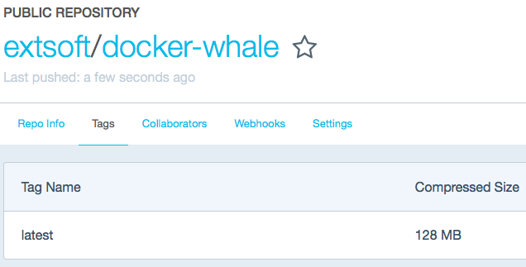
Push image
Create docker-whale repo on https://hub.docker.com
Log in to Docker registry:
docker login
Update image tag
docker tag docker-whale extsoft/docker-whale:latest
Push image
docker push extsoft/docker-whale:latest

Slide 11

Home work #2.1
Please improve whalesay image again. In previous example, we pass some message from fortune to cowsay. Now you goal is to pass message from a file. To do this you have to:
Create a file with some text
Copy this file to the Docker image
Pass a text from the file to cowsay

Slide 12
Home work #2.2
Unzip home-work-2.zip. Inside you will find instructions.txt file with instructions how to run an application. Based on them you have to:
Prepare Dockerfile
Build image and run it
Push your image to your repository called flask-example
Use ‘h2’ tag

Slide 13
Have a nice day!

