Slide 1
Docker
Mykhaylo Plesha, 13.01.2015

Slide 2
Agenda
What is a Docker?
Installing Docker
Basic Docker
Docker for DevOps

Slide 3
What is Docker?

Slide 4
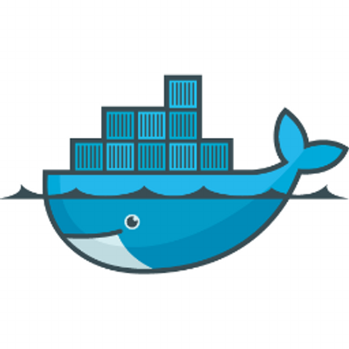
What is Docker?
Docker is an open platform for developers and sysadmins to build, ship, and run distributed applications
Build, Ship and Run Any App, Anywhere
https://www.docker.com/

Slide 5
What is Docker?
Dev
build once, run anywhere
Ops
conﬁgure once, run anything

Slide 6
What is Docker?
Origins of Docker
Original version written in Python, now written in Go
It’s a young project (~18 months), but with a huge community (http://en.wikipedia.org/wiki/Docker_%28software%29)

Slide 7
What is Docker?
Docker Timeline
January 2013 Docker started as an internal project inside of dotCloud
March 21, 2013 Solomon gives Docker lightning talk a PyCon US
March 27, 2013 Docker 0.1 released to Public
September 4, 2013 Docker merged into Openstack for the Havana release
September 19, 2013 Partnership with Red Hat around OpenShift
September 27, 2013 Docker 0.6.3 released

Slide 8
What is Docker?
Since it started in March 2013...
>200,000 pulls
>7,500 github stars
>200 significant contributors
>200 projects built on top of docker
UIs, mini-PaaS, Remote Desktop...
1000’s of Dockerized applications

Slide 9
What is Docker?
Since it started in March 2013...
Integration in Jenkins, Travis, Chef, Puppet, Vagrant and OpenStack
Meetups arranged around the world…
with organizations like Ebay, Cloudflare, Yandex, and Rackspace presenting on their use of Docker

Slide 10
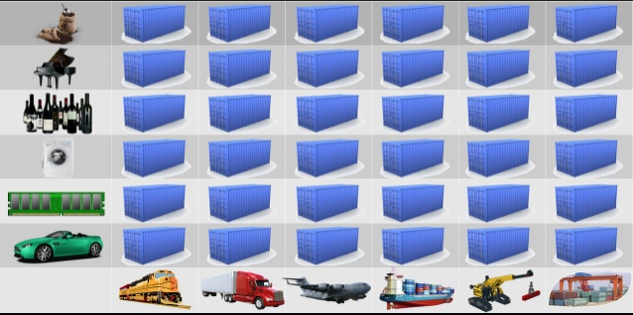
What is Docker?
Container in Docker

Slide 11
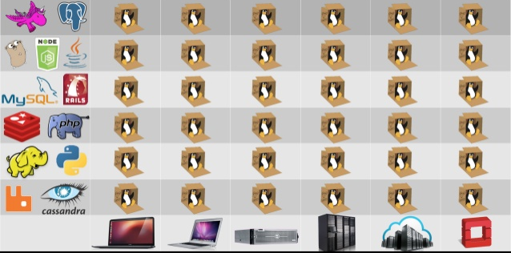
What is Docker?
Container in Docker

Slide 12
What is Docker?
Container in Docker
Kernel namespaces (ipc, uts, mount, pid, network and user)
Chroots (using pivot_root)
Apparmor and SELinux proﬁles
Kernel capabilities
Control groups (cgroups)
AUFS or replacement in 0.7 version and later

Slide 13
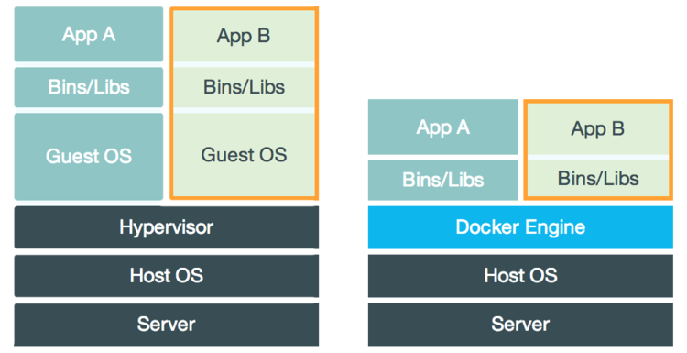
What is Docker?
Docker vs VMs

Slide 14
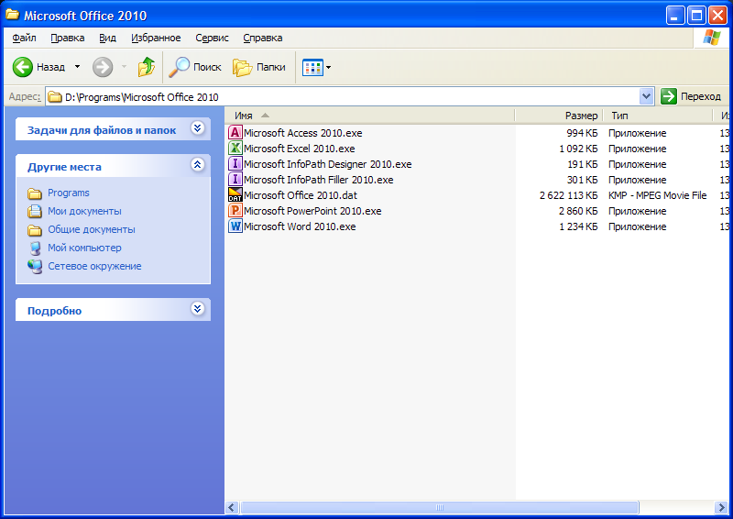
What is Docker?
Portable software for Windows are often containers:

Slide 15
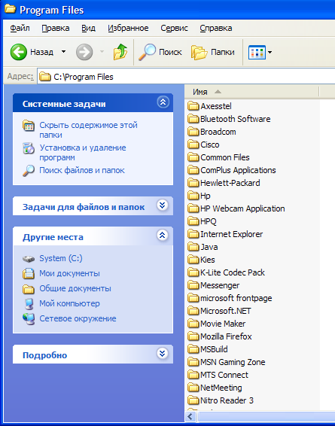
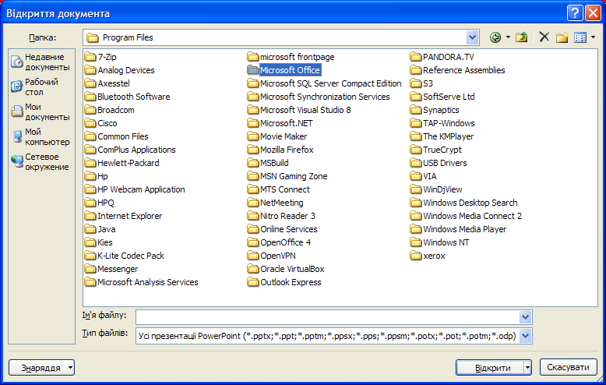
What is Docker?
Program Files under running portable program
Program Files

Slide 16
What is Docker?

Slide 17
Installing Docker

Slide 18
Installing Docker
Basic Requirements
Linux Kernel 3.8 or above
64-bit

Slide 19
Installing Docker
apt-get install docker.io # Ubuntu 14.04, Debian
apt-get install lxc-docker # Ubuntu 12.04
yum -y install docker-io #RHEL, CenOs
https://docs.docker.com/installation/
https://docs.docker.com/contributing/devenvironment/

Slide 20
Installing Docker
Binaries
Get the docker binary
wget –output-document=docker https://get.docker.io/builds/ Linux/x86_64/docker-latest
chmod +x docker
Run the docker daemon
sudo ./docker –d &

Slide 21
Docker Basics

Slide 22
Docker Basics
Find and download images
docker search ubuntu docker pull shykes/ubuntu
Notes:
https://github.com/docker/
https://hub.docker.com/
https://registry.hub.docker.com

Slide 23
Docker Basics
Docker repositories
https://github.com/docker/
https://hub.docker.com/
https://registry.hub.docker.com

Slide 24
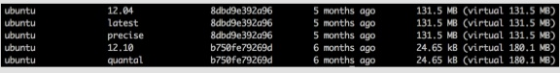
Docker Basics
List images
docker images

Slide 25
Docker Basics
Running
docker run ubuntu /bin/echo hi
docker run -i -t ubuntu /bin/bash

Slide 26
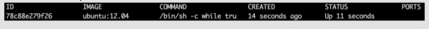
Docker Basics
Commit changes
docker ps -l
docker commit ID base/with_curl

Slide 27
Docker Basics
Push images
docker push abtris/curl

Slide 28
Docker Basics
Detached mode
docker run –d <container_id>
Stop/Start/Restart the container
docker stop <container_id>

Slide 29
Docker Basics
Other commands
docker cp
docker diff
docker top
docker rm/rmi

Slide 30
Docker Basics
Scripted way
Write a Dockerfile:
FROM ubuntu:12.04
RUN apt-get update
RUN apt-get install -y apache2
ENV APACHE_RUN_USER www-data
ENV APACHE_RUN_GROUP www-data
ENV APACHE_LOG_DIR /var/log/apache2
EXPOSE 80
ENTRYPOINT ["/usr/sbin/apache2"]
CMD ["-D", "FOREGROUND"]

Slide 31
Docker Basics
Scripted way
docker build –t=“label” .

Slide 32
Docker Basics
Save
docker save IMAGE
docker load IMAGE

Slide 33
Docker for DevOps

Slide 34
Docker for DevOps
Docker is both a runtime environment and a configuration management tool in one
Best of all Docker eliminates many common tasks in development cycle and creates a tighter feedback loop between development and operational tasks

Slide 35
Docker for DevOps
Docker:
Uses a layered approach to dependency management, making the configuration of environments easier to maintain
Provides various runtime options allowing the same image to be run in multiple ways without extra configuration

Slide 36
Docker for DevOps
Can use any or no DevOps tools to build up your Docker images reducing the learning curve across engineering
Lightweight runtime makes running multiple Docker images on a single machine more feasible than with VMs
Decoupled network and storage layers allows a single Docker image to be run on a single system or multiple systems easily

Slide 37
Docker for DevOps
These features allow makes maintaining a predictable production environment and a flexible development environment easy with one tool

