Slide 1
CHAPTER – 2
AWS CLOUD OVERVIEW

Slide 2
History of AWS
2003: In 2003, Chris Pinkham and Benjamin Black presented a paper on what Amazon's own internal infrastructure should look like. They suggested selling it as a service and preparing a business case for it. They prepared a six-page document and had a look over it to proceed with it or not. They decided to proceed with the documentation.
2004: SQS stands for “Simple Queue Service” and was officially launched in 2004. A team launched this service in Cape Town, South Africa.
2006: AWS (Amazon Web Services) was officially launched.
2007: In 2007, over 180,000 developers had signed up for AWS.
2010: In 2010, amazon.com retail web services were moved to AWS, i.e., amazon.com is now running on AWS.

Slide 3
History of AWS
2011: AWS suffered from some major problems. Some parts of the volume of EBS (Elastic Block Store) were stuck and were unable to read and write requests. It took two days for the problem to get resolved.
2012: AWS hosted a first customer event known as the re: Invent conference. First re: invent conference occurred in which new products were launched. In AWS, another major problem occurred that affects many popular sites such as Pinterest, Reddit, and Foursquare.
2013: In 2013, certifications were launched. AWS started a certifications program for software engineers who had expertise in cloud computing.
2014: AWS committed to achieving 100% renewable energy usage for its global footprint.

Slide 4
History of AWS
2015: AWS breaks its revenue and reaches USD 6 Billion per annum. The revenue was growing 90% every year.
2016: By 2016, revenue doubled and reached USD 13 Billion per annum.
2017: In 2017, AWS re: invent released a host of Artificial Intelligence Services due to which revenue of AWS doubled and reached USD 27 Billion per annum.
2018: In 2018, AWS launched Machine Learning Speciality Certs. It heavily focused on automating Artificial Intelligence and Machine learning.

Slide 5
Introduction to AWS
In 2021, AWS had $74 billion in annual revenue
AWS accounts for 47% of the market in 2021 (Microsoft is 2nd with 22%)
Pioneer and Leader of the AWS Cloud Market for the 10th consecutive year
Amazon Web Services has more than 1 million active users
AWS enables you to build sophisticated, scalable applications
Applicable to a diverse set of industries.
Use cases include: Enterprise IT, Backup & Storage, Big Data Analytics, Website hosting, Mobile & Social Apps, Gaming

Slide 6
Register For Aws Free Tier Account
Step 1. Open your web browser and navigate to AWS Free Tier Page
Step 2. Click on Create a Free Account
Step 3. Issue the details which you want to use for login your AWS account and click on Continue
Email address: Provide the mail id which hasn’t been registered yet with Amazon AWS.
Password: Type your password.
Confirm password: Authenticate the password.
AWS Account name: Choose a name for your account. You can change this name in your account settings after you sign up.

Slide 7
Register For Aws Free Tier Account
Step 4. Contact Information
Select your AWS type (Profesional/ Personal) Fill in the correct information to validate your account if you’re going to create personal use then click on “Personal Account” else use “Company Account”, Accepts the Terms and condition and then click on Create Account and Continue
Note: Make sure to provide proper contact details and mobile number to get the Verification code from AWS.
Step 5. Payment and PAN information: In this step, you must fill in your credit card /Debit Card info and billing address and click on Secure Submit.
Step 6. In this step, it will take you to the payment gateway to validate your payment information and for your credit card verification, Amazon will charge the minimum price based on Country. Here I have provided India, so Amazon charged 2 INR

Slide 8
Register For Aws Free Tier Account
Step 7. Phone verification: Here you will be taken to an identity verification page that will already have your phone number, so you just have to select either “Text message or Voice call” Provide a valid phone number, Solve the captcha and then click on Send SMS or Call Me Now(depending upon your selection).
Step 8. After clicking on Send SMS or Call me Now, you will immediately receive a call or SMS from Amazon, for verification code, Enter your code then click on Verify Code.
Step 9. Support plan: AWS support offers a selection of plans to meet your business needs.
Select your suitable plan then click continue.
Step 10. Registration Confirmation page.
Once you completed all the above steps and processes. You’ll get the confirmation page below. Now your account will be processed for activation. It may take somewhere between 30 minutes to 1 hour for you to receive an email confirmation that your Amazon Cloud Services account has been activated.

Slide 9
AWS Management Interfaces
There are three ways to access AWS resources:
The AWS Management Console.
The AWS Command Line Interface (AWS CLI).
The AWS Software Development Kits (SDKs).

Slide 10
AWS Management Console
AWS Console or AWS Management Console is a web console offered by AWS. It helps you manage different AWS Services. Here you have the option of choosing and accessing services that reside on the console. With AWS Management Console you can access metrics and billing details. You can launch different services like creating buckets or creating instances using AWS EC2.
Following are some of the features of the AWS Management Console:
Managing your AWS Account
Service Search in the AWS Management Console
Explore and Learn AWS more
Create shortcuts that can be pinned for easy access
Manage AWS Services and resources using Mobile

Slide 11
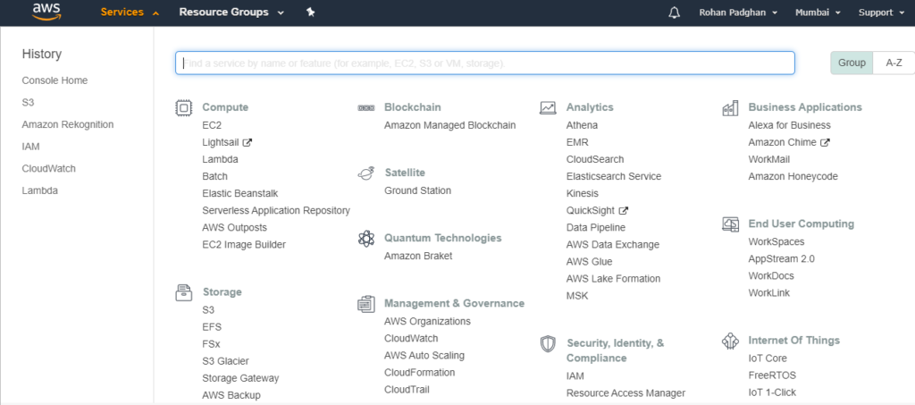
AWS Management Console

Slide 12
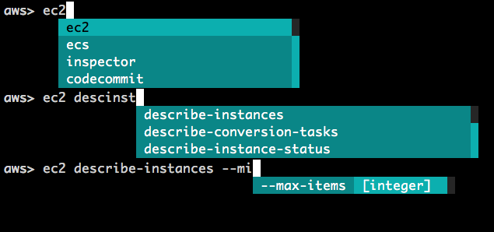
AWS Command Line Interface
The AWS Command Line Interface (AWS CLI) is a unified tool to manage your AWS services. With just one tool to download and configure, you can control multiple AWS services from the command line and automate them through scripts.

Slide 13
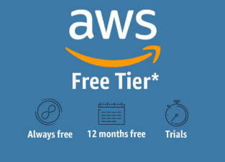
About AWS Free Tier
The free tier applies to certain participating AWS services up to a specific maximum amount of usage each month. The AWS Free Usage Tier is comprised of three different types of pricing models, a 12-month Free Tier, an Always Free offer, and short-term trials.
The AWS Free Usage Tier is available to everyone – students, entrepreneurs, small businesses, and Fortune 500 companies. More importantly, the AWS free usage tier is available to new AWS accounts created on or after October 21, 2010.

Slide 14
How to monitor your AWS Free Usage Tier?
You receive fairly generous credits of AWS resources as part of the Free Tier and you will not be billed unless your usage exceeds those credits. Additionally, AWS has brought in a new feature the Billing and Cost Management Dashboard to help you keep better track of your AWS usage, and see where you are at concerning the Free Tier credits for each service. It’s easy to view your actual usage (month to date) and your forecasted usage (up to the end of the month).
This feature should be used to estimate and plan your AWS costs, ensuring you stay within your free tier limits. You can even receive alerts if your costs exceed a threshold that you set, which could be $0. All of this information is available to you in the AWS Billing and Cost Management Dashboard.

Slide 15
AWS Free Tier Limits
750 hours of Amazon EC2 Linux or RHEL or SLES t2.micro instance usage (1 GiB of memory and 32-bit and 64-bit platform support) – enough hours to run continuously each month
750 hours of an Elastic Load Balancer plus 15 GB of data processing
750 hours of Amazon RDS Single-AZ Micro DB Instances, running MySQL, MariaDB, PostgreSQL, Oracle BYOL, or SQL Server Express Edition – enough hours to run a DB Instance continuously each month. You also get 20 GB of database storage and 20 GB of backup storage
50 hours of Amazon Elastic Cache Micro Cache Node usage – enough hours to run continuously each month.
30 GB of Amazon Elastic Block Storage in any combination of General Purpose (SSD) or Magnetic, plus 2 million I/Os (with EBS Magnetic) and 1 GB of snapshot storage
5 GB of Amazon S3 standard storage, 20,000 Get Requests, and 2,000 Put Requests

Slide 16
AWS Free Tier Limits
25 GB of Storage, 25 Units of reading Capacity, and 25 Units of Write Capacity, enough to handle up to 200M requests per month with Amazon DynamoDB
25 Amazon SimpleDB Machine Hours and 1GB of Storage
1,000 Amazon SWF workflow executions can be initiated for free. A total of 10,000 activity tasks, signals, timers, and markers, and 30,000 workflow days can also be used for free
100,000 Requests of Amazon Simple Queue Service
100,000 Requests, 100,000 HTTP notifications and 1,000 email notifications for Amazon Simple Notification Service
10 Amazon CloudWatch metrics, 10 alarms, and 1,000,000 API requests
50 GB Data Transfer Out, 2,000,000 HTTP and HTTPS Requests for Amazon CloudFront
15 GB of bandwidth out aggregated across all AWS services

Slide 17
Limits on the AWS Free Tier
The AWS free usage tier expires 12 months from the date you sign up. When your free usage expires, you simply pay standard, pay-as-you-go service rates.
The AWS free usage tier is available to new AWS accounts created on or after October 21, 2010.
Amazon Simple Workflow Service, Amazon DynamoDB, Amazon SimpleDB, Amazon Simple Notification Service(SNS), and Amazon Simple Queue Service(SQS) free tiers are some of the services that are available to both existing and new AWS customers indefinitely.

Slide 18
Services not available in the AWS Free Usage Tier
AWS Reserved Instances
AWS Support subscription
Route 53 is not included so you’ll still need to pay for hosted availability zones and domains
Any service that uses an instance size, like EC2, is generally limited to a rather small instance
Many of the amounts are high enough that you can get locked in — like 50GB Glacier storage or 1M calls/month to API Gateway
No transfers from existing solutions are included
You cannot use the free tier to mine for crypto. If you are caught, Amazon will charge you the normal rate and may suspend your account.

Slide 19
Services not available in the AWS Free Usage Tier
Not all AMIs (machine images) are available so, if you plan on using a larger instance in the future, you might not be able to start with the free tier, or you might need to move your image
The free 12 months are time-based, not usage-based so the clock is ticking after sign up
There is no rollover of quota from one month to the next
It does not include Amazon S3 RRS storage.
The free tier is not restricted. There are no guard rails. If you start using the services that aren’t free, Amazon will charge you the necessary expense.

Slide 20
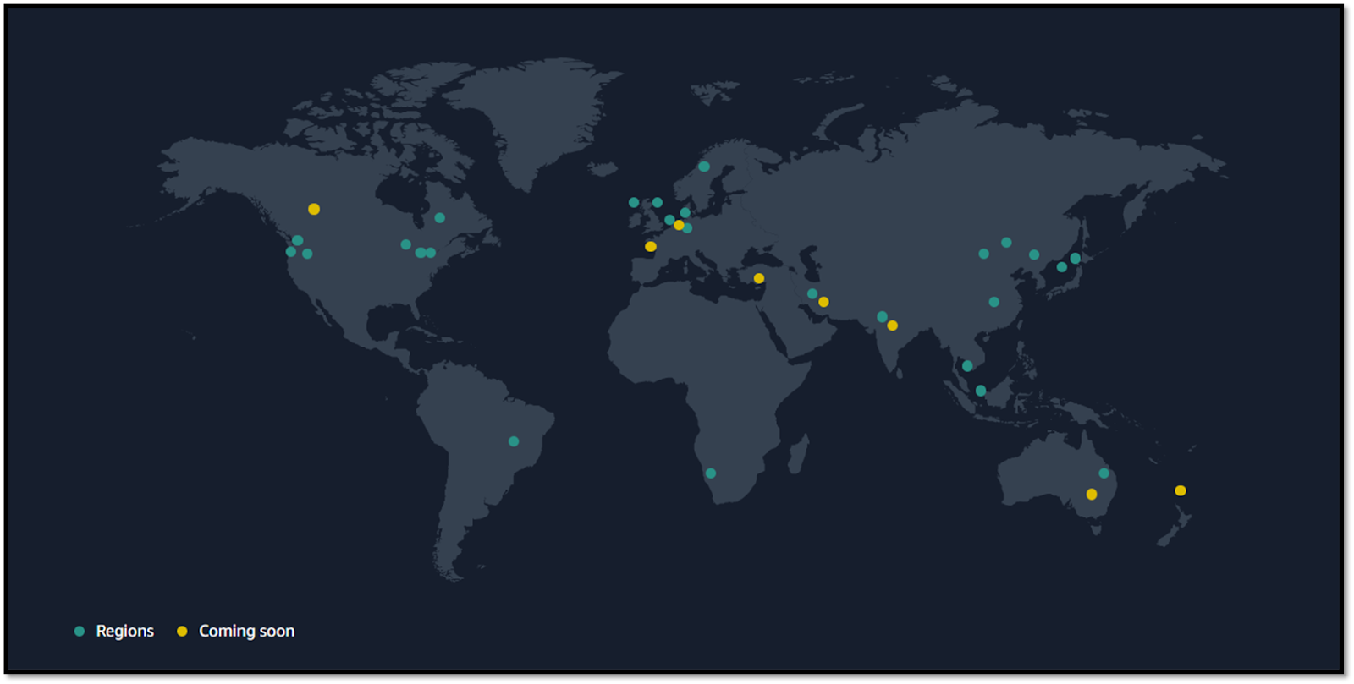
AWS Global Infrastructure Map
As on 15-08-2022

Slide 21
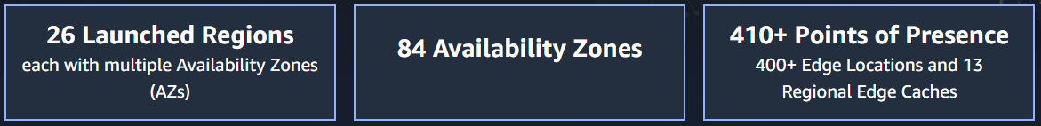
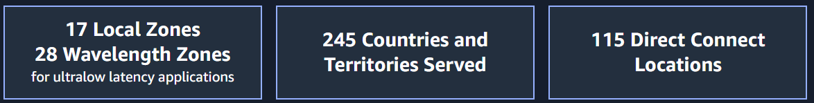
AWS Global Infrastructure
The AWS Global Cloud Infrastructure is the most secure, extensive, and reliable cloud platform, offering over 200 fully featured services from data centers globally.
The AWS Cloud spans 84 Availability Zones within 26 geographic regions around the world, with announced plans for 24 more Availability Zones and 8 more AWS Regions in Australia, India, Indonesia, Israel, New Zealand, Spain, Switzerland, and United Arab Emirates (UAE).
As on 15-08-2022

Slide 22
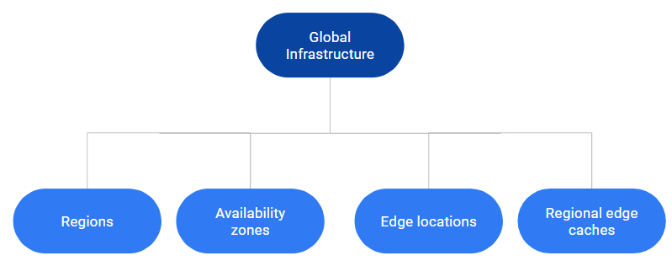
AWS Global Infrastructure
Components
AWS Regions
AWS Availability Zones
AWS Edge Locations
AWS Regional Edge caches

Slide 23
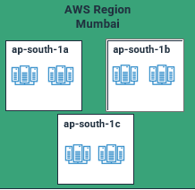
AWS Regions
An AWS region is a geographical area
Each region consists of 2 or more availability zones
Each Amazon Region is designed to be completely isolated from the other

Slide 24
AWS Availability Zones
Availability Zones (AZs) are locations into which you launch resources, such as Amazon EC2 instances
AZs physically separate and isolated from each other
AZs span one or more data centers and have direct, low-latency, high throughput, and redundant network connections between each other
Each AZ is designed as an independent failure zone
AZs are physically separated within a typical metropolitan region and use discrete power sources

Slide 25
AWS Edge Locations
Edge locations are the endpoints for AWS used for caching content.
Edge locations consist of CloudFront, Amazon's Content Delivery Network (CDN).
Edge locations are more than regions. Currently, there are over 150 edge locations.
Edge location is not a region but a small location that AWS has. It is used for caching the content.
Edge locations are mainly located in most of the major cities to distribute the content to end users with reduced latency.
For example, some user accesses your website from Singapore; then this request would be redirected to the edge location closest to Singapore where cached data can be read.

Slide 26
AWS Regional Edge Cache
AWS announced a new type of edge location in November 2016, known as a Regional Edge Cache.
Regional Edge cache lies between CloudFront Origin servers and the edge locations.
A regional edge cache has a large cache than an individual edge location.
Data is removed from the cache at the edge location while the data is retained at the Regional Edge Caches.
When the user requests the data, then data is no longer available at the edge location. Therefore, the edge location retrieves the cached data from the Regional edge cache instead of the Origin servers that have high latency.

Slide 27
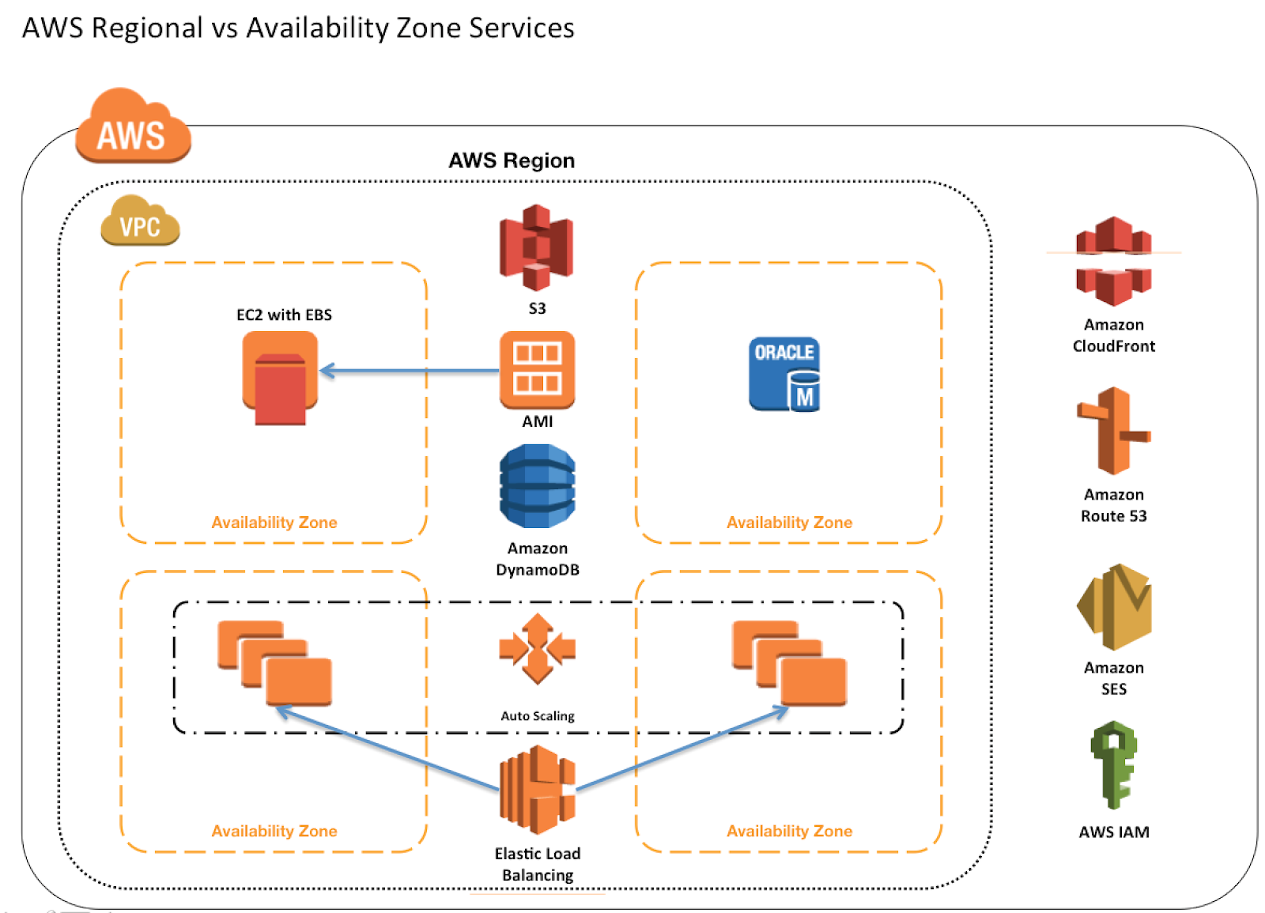
AWS Regional v/s Availability Services

Slide 28
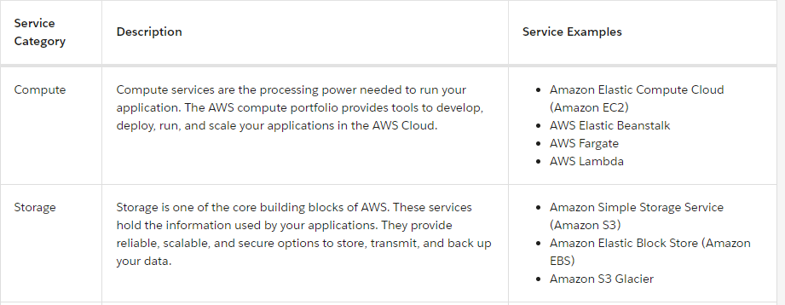
AWS Service Categories

Slide 29
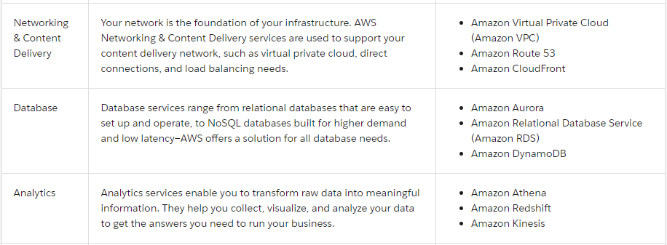
AWS Service Categories

Slide 30
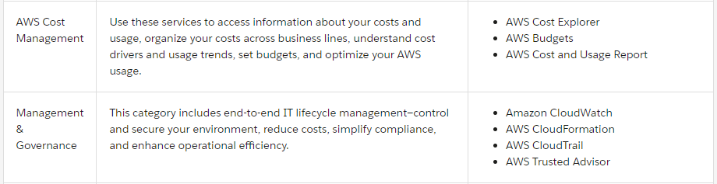
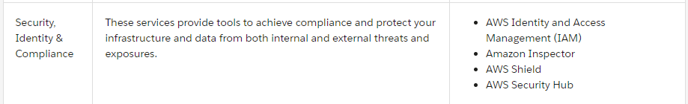
AWS Service Categories

Slide 31
AWS Acceptable Use Policy
This Acceptable Use Policy (“Policy”) governs your use of the services offered by Amazon Web Services, Inc. and its affiliates (“Services”) and our website(s) including http://aws.amazon.com (“AWS Site”). We may modify this Policy by posting a revised version on the AWS Site. By using the Services or accessing the AWS Site, you agree to the latest version of this Policy.
You may not use, or facilitate or allow others to use, the Services or the AWS Site:
for any illegal or fraudulent activity;
to violate the rights of others;
to threaten, incite, promote, or actively encourage violence, terrorism, or other serious harm;
for any content or activity that promotes child sexual exploitation or abuse;
to violate the security, integrity, or availability of any user, network, computer or communications system, software application, or network or computing device;
to distribute, publish, send, or facilitate the sending of unsolicited mass email or other messages, promotions, advertising, or solicitations (or “spam”).

Slide 32
AWS Acceptable Use Policy
Investigation and Enforcement
We may investigate any suspected violation of this Policy, and remove or disable access to any content or resource that violates this Policy. You agree to cooperate with us to remedy any violation
When determining whether there has been a violation of this Policy, we may consider your ability and willingness to comply with this Policy, including the policies and processes you have in place to prevent or identify and remove any prohibited content or activity.
Reporting of Violations
To report any violation of this Policy, please follow our abuse reporting process.

Slide 33
Thank You

