Slide 1
CHAPTER – 3
IDENTITY ACCESS MANAGEMENT (IAM)

Slide 2
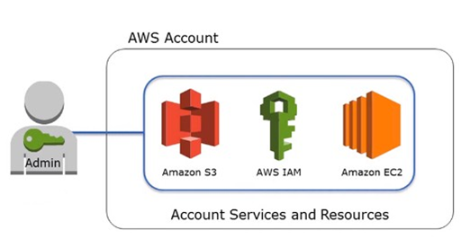
AWS IAM Overview
Amazon Web Services (AWS) cloud provides users with a secure virtual platform to deploy their applications. It offers high-level data protection when compared to an on-premises environment, at a lower cost. Among various AWS security services, Identity and Access Management (IAM) is the most widely used one. It enables secure control access to AWS resources and services for the users. Also, it helps to create and manage AWS users as well as groups and provides necessary permissions to allow or deny access to AWS resources

Slide 3
What is AWS IAM?
AWS Identity and Access Management (IAM) is a web service that helps you securely control access to AWS resources. With IAM, you can control who is authenticated and authorized to use resources.
When you first create an AWS account, you need a single sign-in identity to access all AWS services. This identity is called the AWS account root user. You can access it by signing in with the email ID and password that you used to create the account
It is used to set users, permissions, and roles. It allows you to grant access to the different parts of the AWS platform
Also, it enables Amazon Web Services customers to manage users and user permissions in AWS
IAM enables the organization to create multiple users, each with its security credentials, controlled and billed to a single AWS account
IAM allows the user to do only what they need to do as a part of the user’s job

Slide 4
Why is IAM important?
Identity and access management systems add an extra layer of security over your business’s network. Managers in the company can control which groups of employees have access to which applications.
Implementing IAM services is proactive if your team consists of numerous departments with unique roles. Only the users you choose can progress forward through a company portal, and they’ll be able to see only the information you want them to
Business leaders and IT departments are under increased regulatory and organizational pressure to protect access to corporate resources. As a result, they can no longer rely on manual and error-prone processes to assign and track user privileges. IAM automates these tasks and enables granular access control and auditing of all corporate assets on-premises and in the cloud.

Slide 5
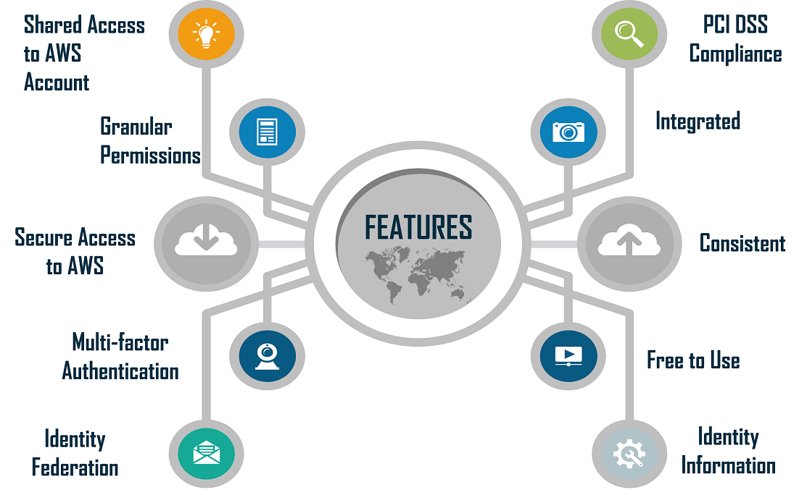
Features of IAM
1. Shared Access To Your AWS Account:
Without sharing your password you are eligible to access the other permission with respect to the administrator as well as the resources from your current AWS account.
2. Granular Permissions:
By using this granular permission you are able to grant the permissions for different according to their resources. By considering an example, you can give the whole access to Amazon EC2, S3 (Amazon simple storage services)

Slide 6
Features of IAM
3. Multi-Factor Authentication (MFA):
By using the MFA you can easily add the two-factor authentication not only for your account but also for the individual users for more security. Either you are your user can provide an access key or password to work with your account with the help of a code that is specifically configured by the device.
4. Identity Federation:
The identity federation at IAM will allow the users who already have their passwords. For example, let us consider an X corporate network or else an internet provider to get temporary access to your current AWS account.

Slide 7
Features of IAM
5. Identity Information For Assurance:
If are you using the Cloud Trail option for your AWS account, then you will get the log records that contain all the information that is made according to the resources in your account. All those information is generally named the IAM identities.
6. Secured Access To AWS Resources:
This IAM feature at AWS will be used to secure all the login credentials which can succeed on the EC2 instances. You can also offer them the permissions in order to access your application with respect to the AWS services.

Slide 8
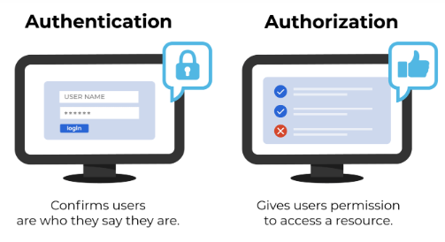
IAM: Authentication & Authorization
Identity and Access Management governs user access via authentication and authorization. Authentication verifies a user’s identity. Once authenticated, the verified user may use any of the resources their account is authorized to access.

Slide 9
IAM Authentication & Authorization
IAM Authentication
Authentication occurs whenever a user attempts to access your organization’s network and downstream resources. The user must verify their identity before being granted entry for security.
Entering credentials at a login prompt remains the most common authentication method. Verified credentials serve as the passport for your digital identity, authenticating users before they access various systems, applications, and data.
Organizations may include sophisticated or additional authentication methods to provide advanced information security. If the authentication process requires additional steps, it is referred to as “multi-factor authentication” (MFA)

Slide 10
IAM Authentication & Authorization
IAM Authorization
Authorization carries out the rest of an organization’s identity and access management processes once the user has been authenticated. Users are granted authorizations according to their role at an organization. This practice is referred to as “role-based access control” (RBAC).
Authorizations determine a role’s resources and level of access in the network. These items may include systems, applications, file shares, printers, and more. For example, an accounting department employee who regularly works with payroll software must be authorized to do such. If authentication resembles a passport, authorizations are the things your digital identity can access with it.
While authentication is fairly straightforward, authorizations and their management are far more challenging. Authorizations consist of complex sets of rules, rights, groups, and permissions explicitly configured per user account.

Slide 11
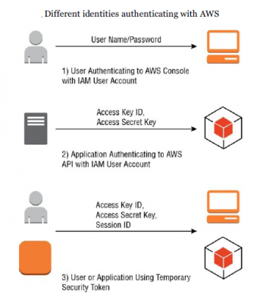
IAM Authentication Methods
User Name/Password – IAM allows to the creation of a password policy enforcing password complexity and expiration.
Access Key – a combination of access key ID (20 characters) and an access secret key (40 characters). Used by program manipulating AWS infrastructure via API.
Access Key/Session Token – when a process operates under an assumed role, a temporary security token provides an access key.

Slide 12
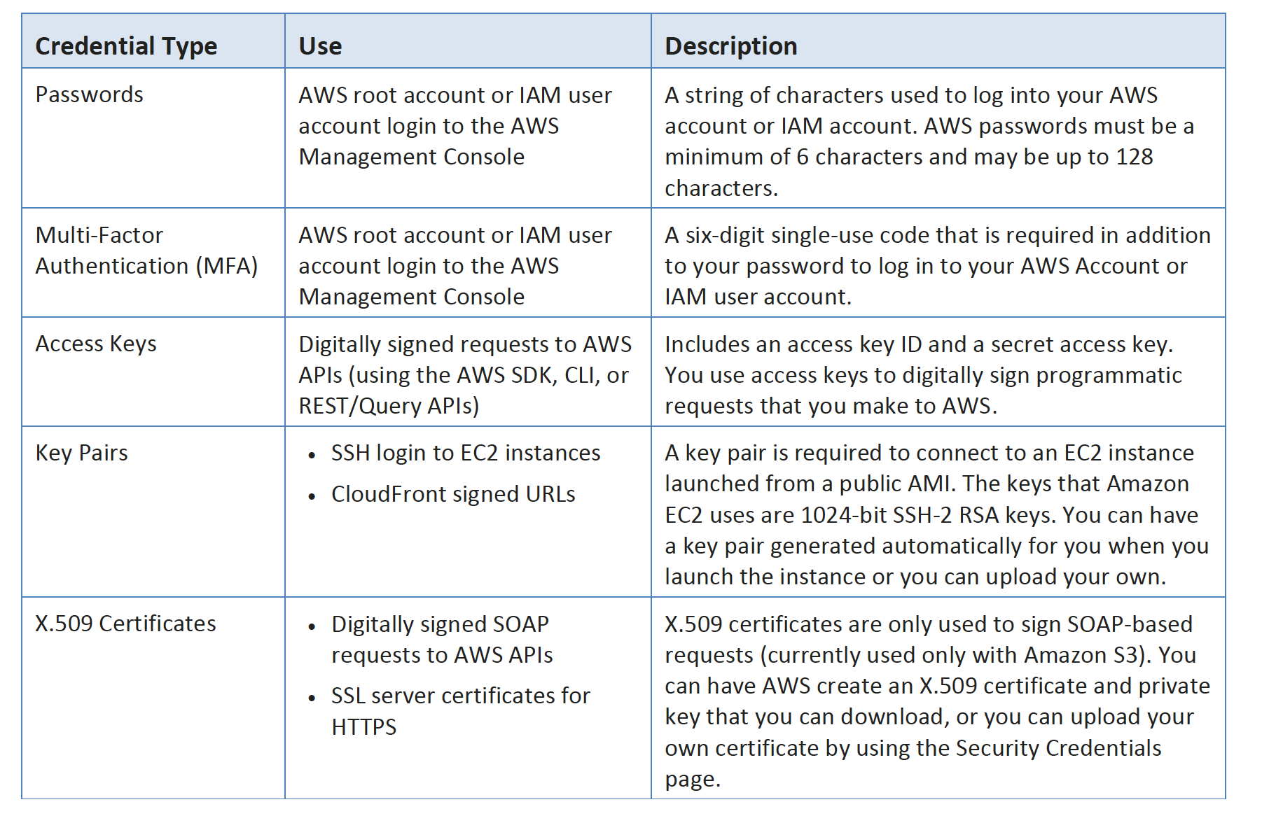

Slide 13
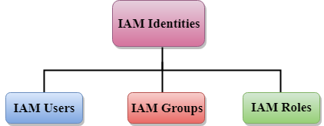
IAM Identities
IAM identities are created to provide authentication for people and processes in your AWS account
Account Root User
Root Account Credentials are the email address and password with which you sign in to the AWS account
Root Credentials has full unrestricted access to AWS account including the account security credentials which include sensitive information

Slide 14
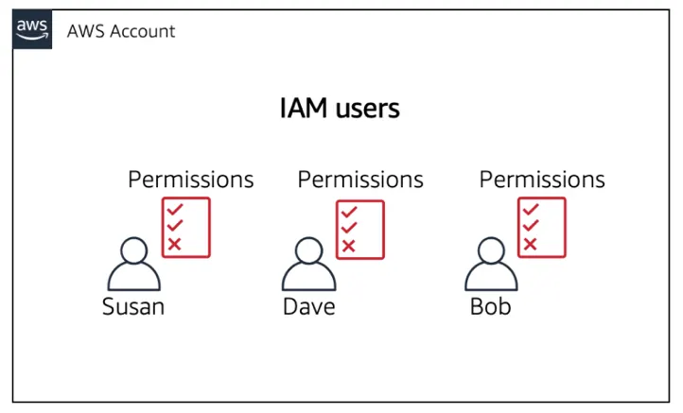
IAM Users
When you create an IAM user, you grant it permissions by making it a member of a user group that has appropriate permission policies attached (recommended), or by directly attaching policies to the user.
You can also clone the permissions of an existing IAM user, which automatically makes the new user a member of the same user groups and attaches all the same policies.

Slide 15
IAM Groups
Groups are collections of users and have policies attached to them
A group is not an identity and cannot be identified as a principal in an IAM policy
Use groups to assign permissions to users
Use the principle of least privilege when assigning permissions
You cannot nest groups (groups within groups)
A group is a collection of users, and a user can also belong to multiple groups.
Groups cannot be nested, i.e., a group cannot contain another group.

Slide 16
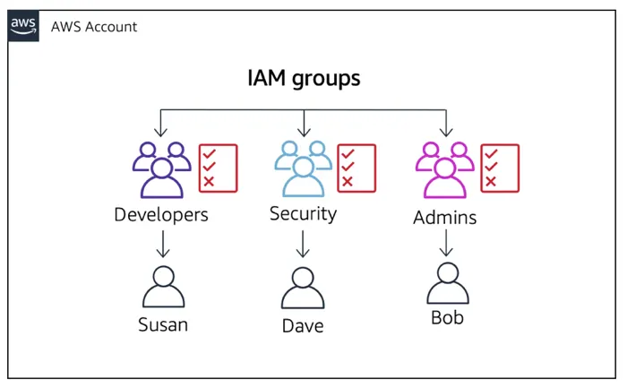
IAM Groups
No default group that automatically includes all the users in the AWS account. If you want a group like this, create a group and then add the users to a group.
There is a limit to the number of groups that you can have and also a limit to the number of groups that a user can belong to.

Slide 17
IAM Roles
An IAM role is very similar to a user, in that it is an identity with permission policies that determine what the identity can and cannot do in AWS. However, a role does not have any credentials (password or access keys) associated with it. Instead of being uniquely associated with one person, a role is intended to be assumable by anyone who needs it.
An IAM user can assume a role to temporarily take on different permissions for a specific task. A role can be assigned to a federated user who signs in by using an external identity provider instead of IAM. AWS uses details passed by the identity provider to determine which role is mapped to the federated user.

Slide 18
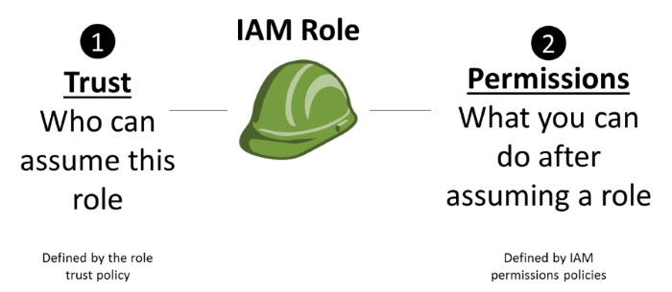
IAM Roles
Trust policy – This policy defines the entities that can assume a role. When you create a role by using the IAM console, the trust policy is created for you.
Permissions policies – These policies define which AWS resources a role can access and the actions it can perform on those resources

Slide 19
IAM Policies
Policies are documents that define permissions and can be applied to users, groups, and roles
Policy documents are written in JSON (key-value pair that consists of an attribute and a value)
All permissions are implicitly denied by default
The most restrictive policy is applied
The IAM policy simulator is a tool to help you understand, test, and validate the effects of access control policies
The Condition element can be used to apply further conditional logic

Slide 20


IAM Policies(Contd..)
Developer
Test Engineers
Operations
User
User
User
User
User
User
User
User
User
User
User
User
User

Slide 21


Securing the Users Account
To secure the user account you have two methods
IAM - Password Policy
Multi-Factor Authentication - MFA

Slide 22
IAM - Password Policy
Strong passwords = higher security for your account
In AWS, you can setup a password policy:
Set a minimum password length
Require specific character types:
including uppercase letters
lowercase letters
numbers
non-alphanumeric characters
Allow all IAM users to change their own passwords
Require users to change their password after some time (password expiration)
Prevent password reuse

Slide 23
Multi-Factor Authentication - MFA
Users have access to your account and can possibly change configurations or delete resources in your AWS account
You want to protect your Root Accounts and IAM users
MFA = password you know + security device you own
password
MFA
Successful login
+

Slide 24
AWS IAM Best Practices
AWS IAM Best Practices helps to perform certain relative audits and removes all the unused users and credentials. This is to secure the AWS resources for certain AWS identities and Access Management Service (IAM).
To Lock Away the AWS Account Root User Access Keys
Creation of Individual IAM Users
Use AWS Defined Policies for assigning the Permissions if required
Usage of certain groups to assign permissions to IAM users
Grant Least Privilege
Usage of Access Levels to Review IAM Permissions
The configuration of Strong Password Policy for Users

Slide 25
Thank You

