Slide 1
CHAPTER-6
AWS ROUTE-53, ELASTIC LOAD BALANCING,
AND AUTO SCALING

Slide 2
AWS Route 53
Route 53 is a highly available and scalable Domain Name System (DNS) web service.
Route 53 provides three main functions:
Domain Registration
Allows domain names registration
Domain Name System (DNS) service
It translates friendly domains names like www.example.com into IP addresses like 192.0.2.1
It responds to DNS queries using a global network of authoritative DNS servers, which reduces latency
It can route Internet traffic to CloudFront, Elastic Beanstalk, ELB, or S3. There’s no charge for DNS queries to these resources

Slide 3
AWS Route 53
Health Checking
Can monitor the health of resources such as web and email servers.
Sends automated requests over the Internet to the application to verify that it’s reachable, available, and functional.
CloudWatch alarms can be configured for the health checks to send notifications when a resource becomes unavailable.
Can be configured to route Internet traffic away from unavailable resources.

Slide 4
Supported DNS Resource Records
A (Address) Format
It is an IPv4 address in dotted decimal notation e.g. 192.0.2.1.
AAAA Format
It is an IPv6 address in colon-separated hexadecimal format.
CNAME Format
It is the same format as a domain name.
NS (Name Server) Format
An NS record identifies the name servers for the hosted zone. The value for an NS record is the domain name of a name server.

Slide 5
Supported DNS Resource Records
PTR Format
A PTR record Value element is the same format as a domain name.
SOA (Start of Authority) Format
SOA record provides information about a domain and the corresponding Amazon Route 53 hosted zone.
SPF (Sender Policy Framework) Format
SPF records were formerly used to verify the identity of the sender of email messages, however, is not recommended.
Instead of an SPF record, a TXT record that contains the applicable value is recommended.

Slide 6
Supported DNS Resource Records
SRV Format
An SRV record Value element consists of four space-separated values. The first three values are decimal numbers representing priority, weight, and port. The fourth value is a domain name e.g. 10 5 80 hostname.example.com
TXT (Text) Format
A TXT record contains a space-separated list of double-quoted strings. A single string includes a maximum of 255 characters. In addition to the characters that are permitted unescaped in domain names, space is allowed in TXT strings

Slide 7
Route 53 Hosted Zone
Hosted Zone is a container for records, which include information about how to route traffic for a domain (such as example.com) and all of its subdomains (such as www.example.com, retail.example.com, and seattle.accounting.example.com).
A hosted zone has the same name as the corresponding domain.
Routing Traffic to the Resources
Create a hosted zone with either a public hosted zone or a private hosted zone:
Public Hosted Zone – for routing internet traffic to the resources for a specific domain and its subdomains
Private hosted zone – for routing traffic within a VPC

Slide 8
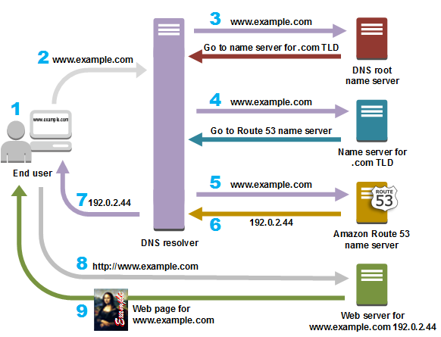
Route 53 Hosted Zone
Create records in the hosted zone
Records define where to route traffic for each domain name or subdomain name.
Name of each record in a hosted zone must end with the name of the hosted zone.

Slide 9
Choosing a Routing Policy
When you create a record, you choose a routing policy, which determines how Amazon Route 53 responds to queries:
Simple routing policy – Use for a single resource that performs a given function for your domain, for example, a web server that serves content for the example.com website. You can use simple routing to create records in a private hosted zone.
Failover routing policy – Use when you want to configure active-passive failover. You can use failover routing to create records in a private hosted zone.
Geolocation routing policy – Use when you want to route traffic based on the location of your users. You can use geolocation routing to create records in a private hosted zone.
Geo Proximity routing policy – Use when you want to route traffic based on the location of your resources and, optionally, shift traffic from resources in one location to resources in another.

Slide 10
Choosing a Routing Policy
Latency routing policy – Use when you have resources in multiple AWS Regions and you want to route traffic to the region that provides the best latency. You can use latency routing to create records in a private hosted zone.
IP-based routing policy – Use when you want to route traffic based on the location of your users, and have the IP addresses that the traffic originates from.
Multivalue answer routing policy – Use when you want Route 53 to respond to DNS queries with up to eight healthy records selected at random. You can use multi value answer routing to create records in a private hosted zone.
Weighted routing policy – Use to route traffic to multiple resources in proportions that you specify. You can use weighted routing to create records in a private hosted zone.

Slide 11
ELASTIC LOAD BALANCING

Slide 12
Elastic Load Balancing (ELB)
Elastic Load Balancing automatically distributes your incoming traffic across multiple targets, such as EC2 instances, containers, and IP addresses, in one or more Availability Zones. It monitors the health of its registered targets and routes traffic only to the healthy targets.
Elastic Load Balancing scales your load balancer capacity automatically in response to changes in incoming traffic. You can add and remove compute resources from your load balancer as your needs change, without disrupting the overall flow of requests to your applications.
Elastic Load Balancing supports the following load balancers: Application Load Balancers, Network Load Balancers, Gateway Load Balancers, and Classic Load Balancers. You can select the type of load balancer that best suits your needs.

Slide 13
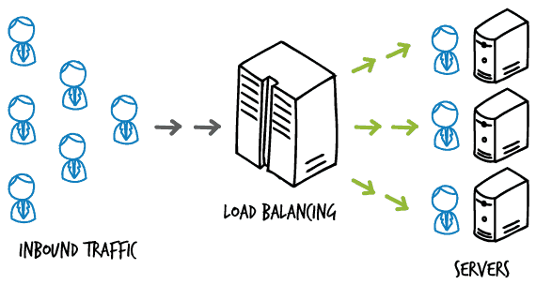
Load Balancer
A Load Balancer is a virtual machine or appliance that balances your web application load which could be HTTP or HTTPS traffic that you are getting in. It balances a load of multiple web servers so that no web server gets overwhelmed.

Slide 14
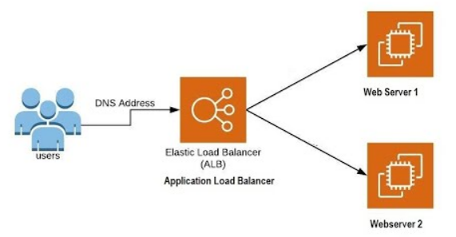
Types of Load Balancer
Application load balancer
Amazon Web Services (AWS) launched a new load balancer known as an application load balancer (ALB) on August 11, 2016.
It identifies the incoming traffic and forwards it to the right resources. For example, if a URL has /an API extension, then it is routed to the appropriate application resources.
Application load balancers are intelligent, sending specific requests to specific web servers. It is best suited for load balancing of HTTP and HTTPS traffic.

Slide 15
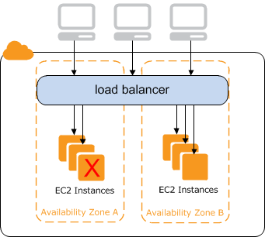
Classic load balancer
Classic Load balancers are legacy Elastic load balancers.
It routes the traffic between clients and backend servers based on IP address.

Slide 16
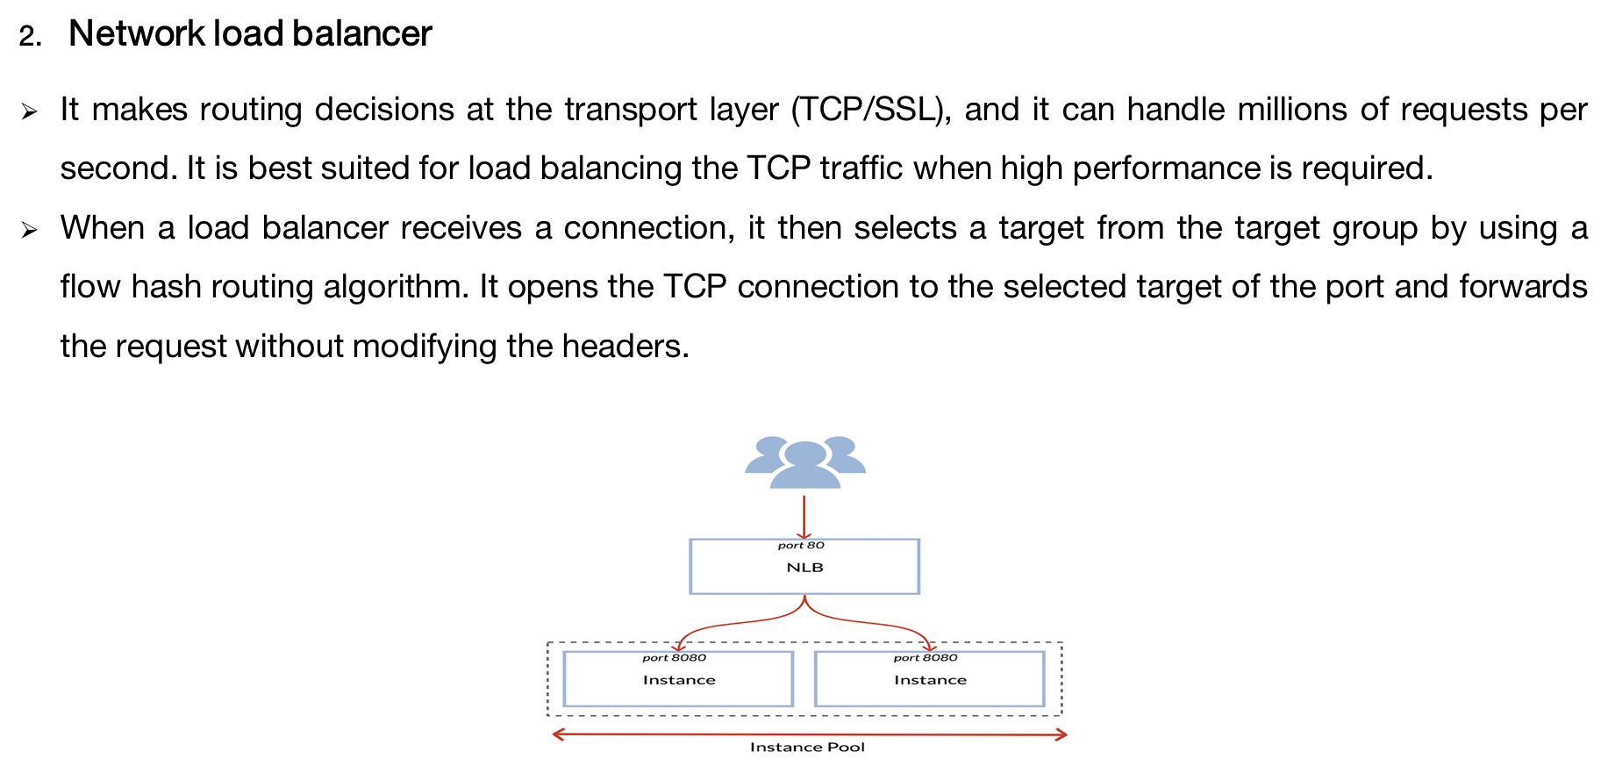

Slide 17
AUTOSCALING

Slide 18
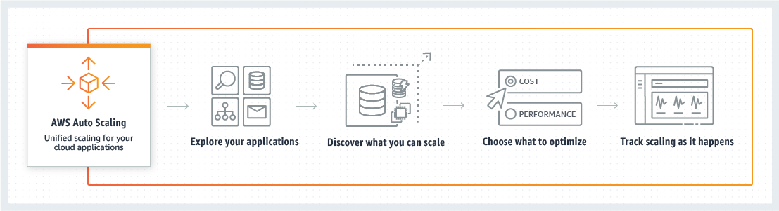
Autoscaling
AWS Autoscaling is a service that assists organizations in supervising AWS-based software and infrastructure. The service automatically adjusts capacity to maintain steady, predictable performance at the lowest possible cost.
AWS Auto Scaling can increase or decrease the capacity of AWS services to optimize costs. The service will monitor all scalable cloud services and resources related to a user’s applications.

Slide 19
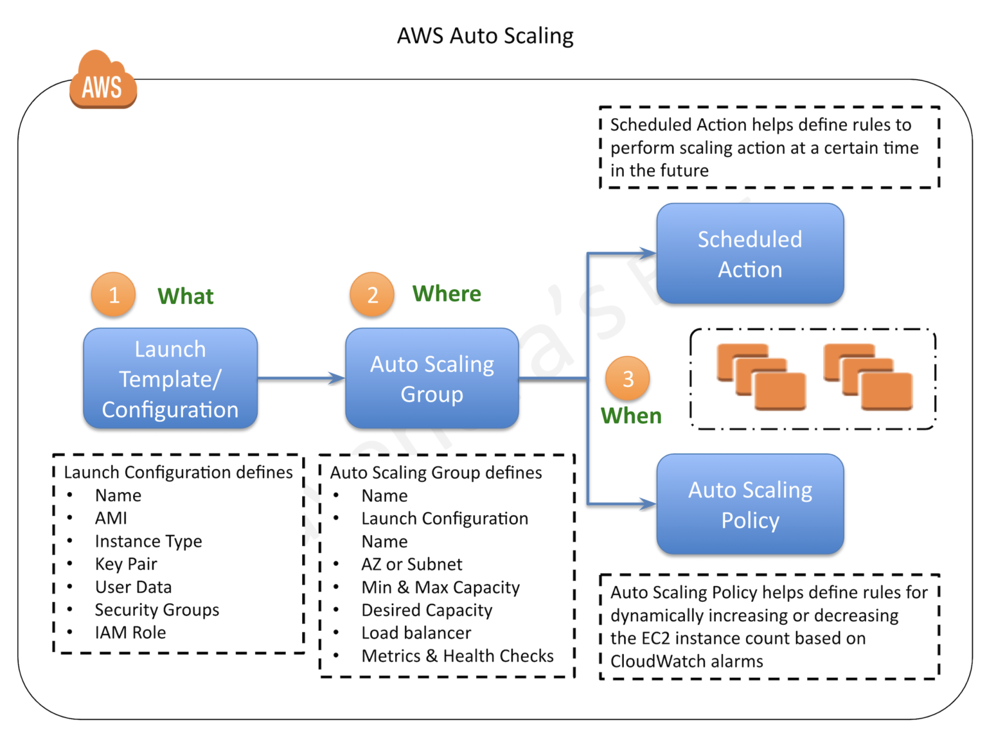
Auto Scaling Overview

Slide 20
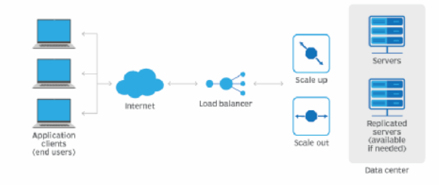
How Auto Scaling Works?
Elasticity is one of the cloud’s greatest attributes. Auto-scaling facilitates elasticity by automatically adding resources to meet new workload demands and reducing them when demand decreases.
AWS will elastically scale your EC2 instances by launching new ones and terminating old unhealthy ones. If an EC2 instance status-check fails, AWS Auto Scaling will replace the instance. This helps you develop more resilient applications.

Slide 21
How Auto Scaling Works? (Contd..)
Auto-scaling also utilizes performance-based metrics that are sent to CloudWatch, for instance, you might set performance metrics based on CPU thresholds. If CPU usage reaches a certain defined percentage, CloudWatch will notify AWS Auto Scaling. The auto-scaling service will respond by launching an extra instance to handle the pressure and add more capacity, this is how autoscaling works at the basic level.

Slide 22
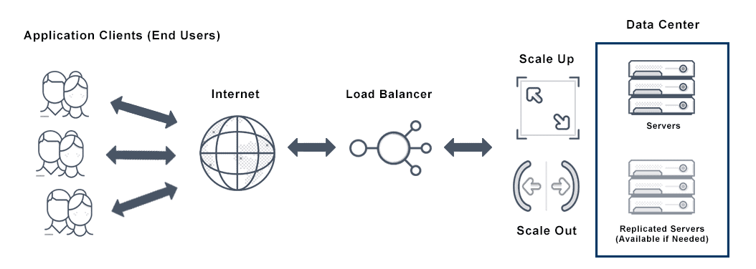
Autoscaling Groups (Asg)
Auto Scaling Groups(ASG) is a collection of EC2 instances. Thus, the size of the ASG is dependent on the capacity or the number of instances you’ve configured for the group. ASGs are free, no need to pay for them.
AWS Auto Scaling Groups are an integral part of the scaling process. In the case of EC2, they manage how instances are scaled using Launch Configurations or Launch templates. They scale out, scale in, and ensure that there are a minimum and a maximum number of instances running. They’re also responsible for automatically registering new instances to the load balancer.

Slide 23
Types Of Auto Scaling:
Vertical scaling:
In the same server, increasing resources is called a vertical scale-up
In the same server decreasing resources is called a vertical scale down.
Horizontal scaling:
When we are increasing the server is called a horizontal scale out.
When we are decreasing the server is called horizontal scale in.
A Drawback of Vertical scaling:
Single point failure.

Slide 24
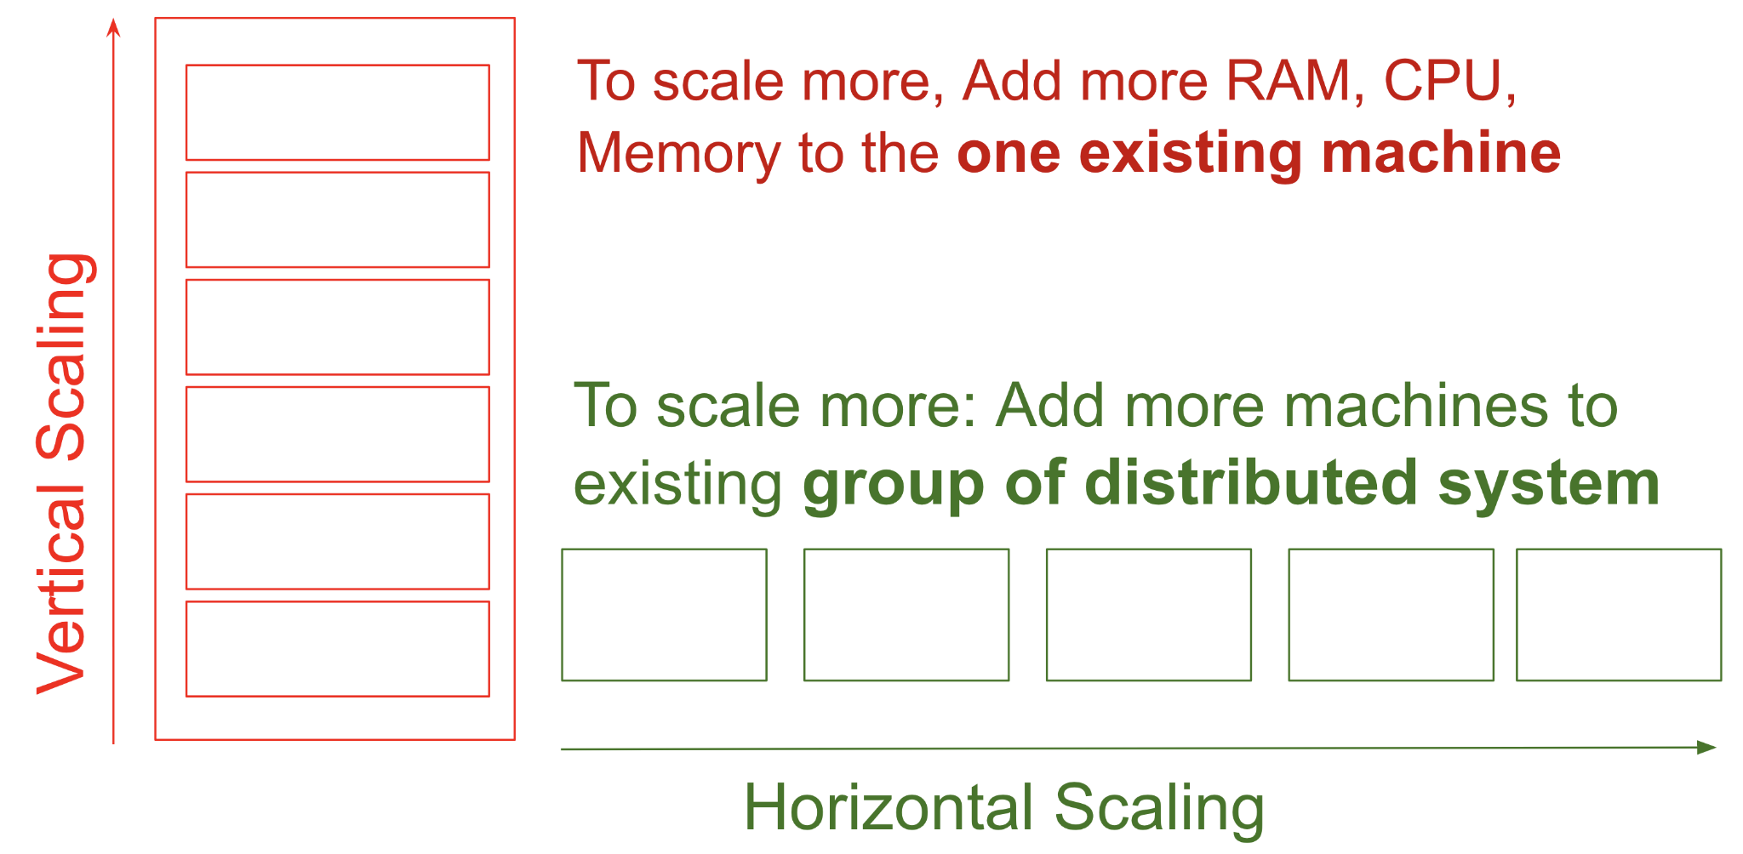
Difference Between Vertical Scaling and Horizontal Scaling

Slide 25
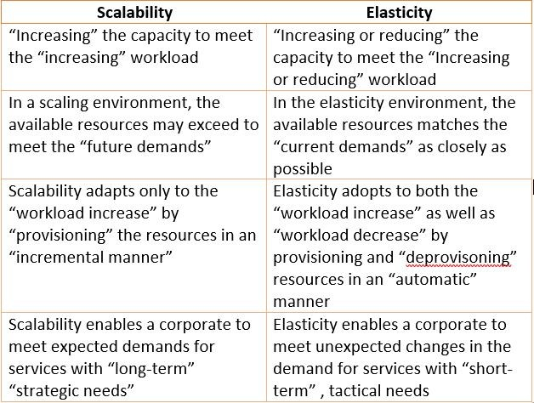
Elasticity and Scalability

Slide 26
Advantages of Auto Scaling Groups
Improved fault tolerance - AWS Auto Scaling allows you to monitor your applications. It can help you terminate any corrupted instances and automatically launch new ones.
Improved cost management - You can scale up or down depending on your organization’s requirements. This allows you to save money on personnel and equipment.
Reliability - Since scaling is done automatically, it’s incredibly efficient and reliable. whenever scaling is initiated, AWS will send notifications to phone or email addresses.

Slide 27
Thank You

