Slide 1
CHAPTERS – 4 and 5
AWS COMPUTE(EC2) and AWS STORAGE SERVICES

Slide 2
Virtualization
Virtualization is the process of running a virtual instance of a computer system in a layer abstracted from the actual hardware. Most commonly, it refers to running multiple operating systems on a computer system simultaneously. To the applications running on top of the virtualized machine, it can appear as if they are on their dedicated machine, where the operating system, libraries, and other programs are unique to the guest virtualized system and unconnected to the host operating system which sits below it.
Types of Virtualization
Desktop Virtualization
Application Virtualization
Server Virtualization
Storage Virtualization
Network Virtualization

Slide 3
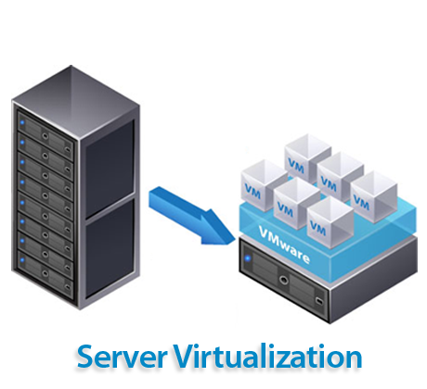
Server Virtualization
Server Virtualization is the process of dividing a physical server into several virtual servers, called virtual private servers. Each virtual private server can run independently.
The concept of Server Virtualization is widely used in the IT
infrastructure to minimize costs by increasing the utilization of existing resources.

Slide 4
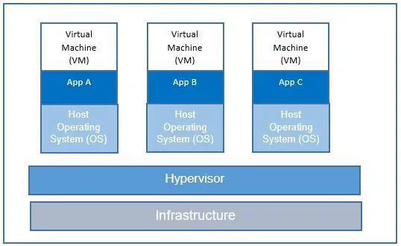
Virtual Machines Architecture
The architecture of a host VM includes the following components: the hardware layer or the host VM layer; the OS and hypervisor layer acting as the intermediary; and. the VM guest layer along with host utilities.

Slide 5

Amazon EC2
EC2 – Elastic Compute Cloud
An Amazon EC2 instance is a virtual server in Amazon's Elastic Compute Cloud (EC2) for running applications on the Amazon Web Services (AWS) infrastructure.
AWS is a comprehensive, evolving cloud computing platform; EC2 is a service that enables business subscribers to run application programs in the computing environment.
Instances are created from Amazon Machine Images (AMI). The machine images are like templates. They are configured with an operating system (OS) and other software, which determine the user's operating environment. Users can select an AMI provided by AWS, the user community, or through the AWS Marketplace.

Slide 6
Types of Instances
General purpose: General purpose instances provide a balance of computing, memory, and networking resources, and can be used for a variety of diverse .
Compute optimized: Compute Optimized instances are ideal for compute-bound applications that benefit from high-performance processors.
Memory optimized: Memory-optimized instances are designed to deliver fast performance for workloads that process large data sets in memory
Storage optimized: Storage optimized instances are designed for workloads that require high, sequential read and write access to very large data sets on local storage.
Accelerated computing: Accelerated computing instances use hardware accelerators, or co-processors, to perform functions, such as floating point number calculations, graphics processing, or data pattern matching

Slide 7
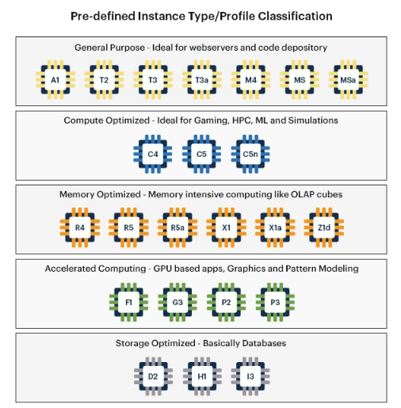

Slide 8
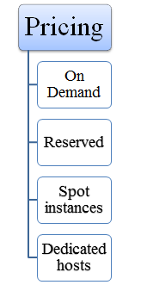
Classification Based on Pricing
When you sign up for AWS, you can get started with Amazon EC2 for free using the AWS Free Tier
1. On Demand: It allows you to pay a fixed rate by the hour or even by the second with no commitment.
It is useful for the applications that have been developed or tested on Amazon EC2 for the first time.
On Demand instance is recommended when you are not sure which instance type is required for your performance needs.

Slide 9
Classification Based on Pricing
2. Reserved: It is a way of making a reservation with Amazon or we can say that we make a contract with Amazon. The contract can be for 1 or 3 years in length.
In a Reserved instance, you are making a contract means you are paying some upfront, so it gives you a significant discount on the hourly charge for an instance
3.Spot Instances: It allows you to bid for a price whatever price that you want for instance capacity, and providing better savings if your applications have flexible start and end times.
Spot Instances are useful for those applications that have flexible start and end times.
4.Dedicated hosts: A dedicated host is a physical server with EC2 instance capacity which is fully dedicated to your use. It can be purchased as a Reservation for up to 70% off On-Demand price

Slide 10
AWS EC2 Use Cases
Host a variety of software from simple web sites to enterprise-grade web applications on a on-demand infrastructure. Easy to lift-and-shift from on-premises since you have full control of the operating system. Spot pricing can help save up to 80-90% on hosting costs.
Create fault tolerant architecture with auto-scaling and load balancing options.
If you need heavy computation and GPU power for deep learning/ machine learning, choose EC2 accelerated computing instances.

Slide 11
Instance User data & Metadata
User Data
User data is data that is supplied by the user at instance launch in the form of a script
User data is limited to 16KB
User data and metadata are not encrypted
Metadata
Instance metadata is data about your instance that you can use to configure or manage the running instance.
The Instance Metadata Query tool allows you to query the instance metadata without having to type out the full URI or category.

Slide 12
Launch EC2 Instance (Windows)
Go to the management console.
Click on launch instance.
Under choose AMI to search for windows.
Under choose an instance type, select general purpose of t2.micro type and this is the step where we select all the hardware configurations. There are multiple configurations to modify the instance and then click on review and launch.

Slide 13
Launch EC2 Instance (Windows)
Click the launch button and accept the defaults and create the windows machine.
A pop-up will be shown to select a key pair if not we can also create a new key pair and download the key pair.
Click on the launch instance button.
Now newly created instances will be shown up in the dashboard.
Click on the pencil icon of the newly created instance and give the name of the instance that we have created.
On the Instance page, right-click on the newly created instance and click “get windows password”.
Under the key pair path, provide the key pair we downloaded while launching the instance.
Click on the decrypt password button.

Slide 14
Launch EC2 Instance(Windows)
After decrypting the password in the next step we can see the username, password, and also public DNS name.
We can connect the windows machine using the remote desktop connection utility (go to start menu and search for remote desktop connection).
Type the DNS name that we identified while decrypting the key-pair file & click on show options.
A warning prompt will be shown, click on yes.
We can see that we have successfully connected to an AWS EC2 windows machine, we can perform all the activities in this instance.

Slide 15
Launch EC2 Instance (Linux)
Go to the management console.
Click on launch instance.
Under choose AMI, search for ubuntu and select ubuntu server 18.04 which is the free tier.
Under choose instance type select general-purpose t2.micro which is a free tier.
Under configure instance type, we can modify the number of instances.
Under add storage, we can modify the hard disk capacity and click on add tags button.
Under add tags, we can specify the tags for identification of machines.
We will be running applications that will run on ports, so these ports have to be opened so that our applications can be accessible to the outside world.

Slide 16
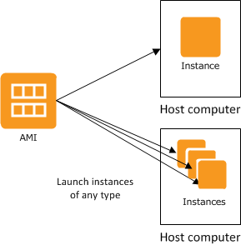
Amazon Machine Image (AMI)
An Amazon Machine Image (AMI) is a supported and maintained image provided by AWS that provides the information required to launch an instance.
You must specify an AMI when you launch an instance. You can launch multiple instances from a single AMI when you require multiple instances with the same configuration.

Slide 17
Amazon Machine Image (AMI)
AWS publishes many AMI that contains common software configurations for public use. In addition, members of the AWS developer community have published their own custom AMIs.
You can also create your own custom AMI or AMIs; doing so enables you to quickly and easily start new instances that have everything you need. For example, if your application is a website or a web service, your
AMI could include a web server, the associated static content, and the code for the dynamic pages. As a result, after you launch an instance from this AMI, your web server starts, and your application is ready to accept requests.

Slide 18
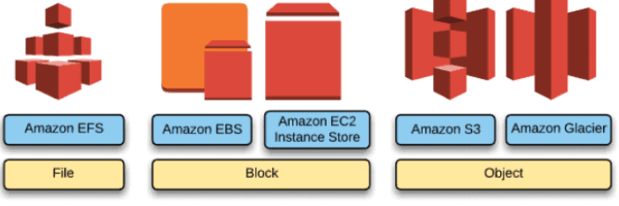
Aws Storage Services
Cloud Storage can be defined as a virtual memory unit that allows users to create, update, delete and perform all manipulative operations on the data with the use of the internet.
In this storage method, files and folders can be stored in the internet-based cloud memory offered by the cloud service providers. This enables the users with options to access the data and files from anywhere, from any device, at any given point in time, and also allows to share these data to anyone across the network.

Slide 19
Why do we need Cloud Storage?
In earlier days, it was a common sight of seeing people carrying flash drives and other storage devices that contain much crucial information related to them. But it was easy losing the drives and losing all the relevant information. The file backup is not easy as a backup also requires another device with the same storage level.
Storage capacity will also depend on each device but we were not able to store lots of data. And to transfer data from one person to another, we should find a system and it takes a long time to complete the file transfer if the files are big.
If any bug or virus enters the device, the chances of losing the data and files are pretty high. Also if the device stops working all of a sudden, all the hard work will be wasted. Here cloud storage came as a savior with less money and more power.
We can access data from anywhere in the world without carrying the storage device physically. Since the files are saved online, any computer can be used to store data. Backups are easily made for the data.

Slide 20
Why do we need Cloud Storage?
Data has been increasing a lot nowadays from all the places of business and it became necessary to store data in a safe place and without physical hassle. Also when the customer segment grew, their needs changed and they were ready to take risks considering the ease of storage. Risk comes from the safety of the files.
Now companies need not worry about the maintenance of the files as it is taken care of by cloud providers. The flexibility offered by cloud storage is appreciable as employees can log in from anywhere and check the information needed for them.

Slide 21
Advantages of Cloud Storage
Data is accessible from any part of the world with the help of the internet as it is stored online on servers.
Data can be shared easily between persons or devices with cloud storage.
Communication with the data can be done easily as the sharing is done automatically by providing a link like Google Drive.
Companies need not worry about the maintenance of the storage devices as it is managed by a service provider.
Data is protected easily with the cloud rather than with storage devices. As the user need not worry about hiding the device from intruders, data is stored safely.
Backup can be created easily with cloud storage as the data is stored in many servers and is available online.

Slide 22
Advantages of Cloud Storage
Money can be saved due to its maintenance, buying physical devices, the space to keep the devices, and supporting staff to do the work needed.
Once moving all the files to the cloud, the system will have lots of space. In short, the system is free of any large files and can work freely.
A copy of the data is stored locally near the user’s region and it helps in regulatory compliance of the data.
When data is stored in physical devices, one should be careful about the virus attacks. It relieves the users from such kind of burden.

Slide 23
Types of AWS Storage Services
Block storage
File storage
Object storage

Slide 24
Instance Store Volume
Instance store: instance store provides temporary block-level storage for your instance. This storage is located on disks that are physically attached to the host computer.
An instance store-backed instance is an EC2 instance using an Instance store as root device volume created from a template stored in S3.
An instance store is ephemeral storage that provides temporary block-level storage for your instance. The instance store is ideal for temporary storage like buffers, caches, and other temporary content.
Instance store volumes access storage from disks that are physically attached to the host computer.
When an Instance stored instance is launched, the image that is used to boot the instance is copied to the root volume (typically sda1).

Slide 25
Instance Store Volume (Contd..)
Instance store provides temporary block-level storage for instances.
Data on an instance store volume persists only during the life of the associated instance; if an instance is stopped or terminated, any data on instance store volumes is lost.

Slide 26
Elastic Block Storage (EBS)
Amazon Elastic Block Store (Amazon EBS) provides persistent block storage volumes for use with Amazon EC2 instances in the AWS Cloud.
Each Amazon EBS volume is automatically replicated within its Availability Zone to protect you from component failure, offering high availability and durability.
EBS volume data persists independently of the life of the instance.
EBS volumes do not need to be attached to an instance.
We can attach multiple EBS volumes to an instance.
We cannot attach an EBS volume to multiple instances.
EBS volumes must be in the same AZ as the instances they are attached to.

Slide 27
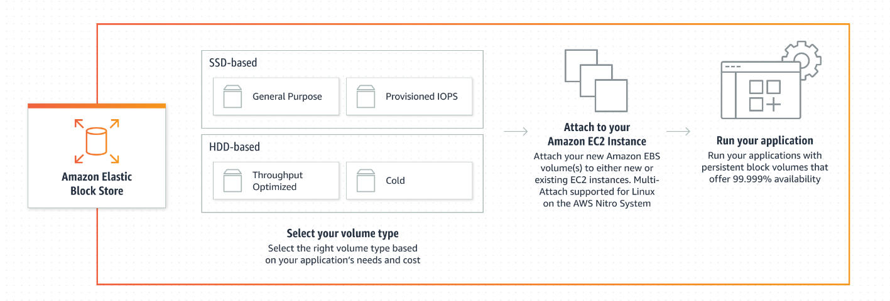
How EBS works?

Slide 28
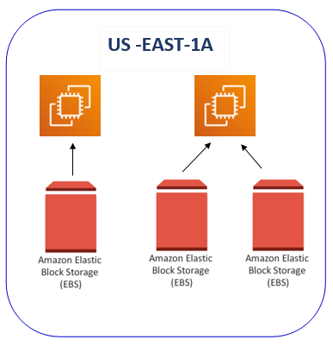
EBS volume
EBS volume is only attached to one instance at a time, but we can easily detach EBS volume and attach the same EBS volume to another EC2 instance in the same AZ (Availability Zone). But one instance can have multiple EBS volumes. And this is not a global or regional service; this storage belongs to one availability zone.

Slide 29
EBS Volume Types
Solid State Drives (SSD)
EBS Provisioned IOPS SSD (io1)
EBS General Purpose SSD (gp2)
Hard Disk Drives (HDD)
Throughput Optimized HDD (st1)
Cold HDD (sc1)

Slide 30
EBS Provisioned IOPS SSD (io1)
The highest performance SSD volume is designed for latency-sensitive transactional workloads.
Used for I/O-Intensive NoSQL and relational databases.
Volume Size 4GB – 16TB.
Max IOPS/Volume is 64,000.
Max Throughput/Volume is 1,000 MB/s.

Slide 31
EBS General Purpose SSD (gp2)
General Purpose SSD volume that balances price performance for a wide variety of transactional workloads
Used for Boot volumes, low-latency interactive apps, dev & test
Volume Size 1GB – 16TB.
Max IOPS/Volume is 16,000.
Max Throughput/Volume is 250 MB/s.

Slide 32
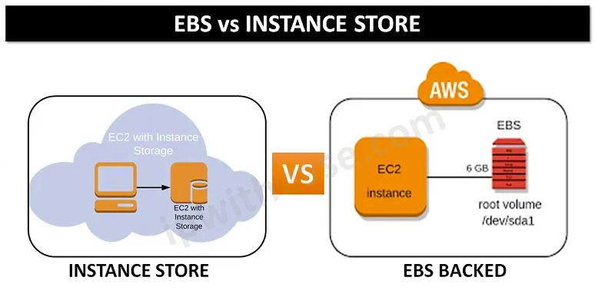
EBS v/s Instance Store

Slide 33
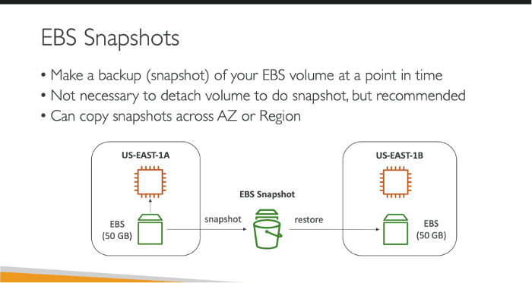
AWS EBS Snapshots

Slide 34
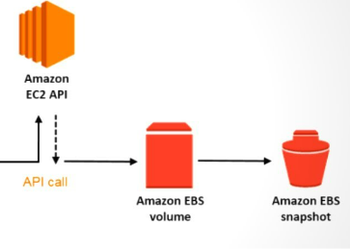
EBS Volumes v/s Snapshots
Snapshots go across regions where volumes stay in the same region as the snapshot. We can create a copy of a snapshot but we can't create a copy of a volume. To make a copy of a volume, we have to use a snapshot. Volumes, images, and instances all depend on the snapshot.

Slide 35
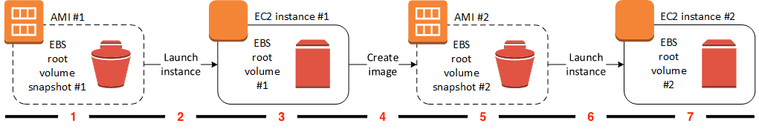
Overview of creating Amazon EBS-backed AMIs
Step 1 – AMI #1: Start with an existing AMI
Find an existing AMI that is similar to the AMI that you'd like to create.

Slide 36
Creating Amazon EBS-backed AMIs
Step 2 – Launch instance from existing AMI
The way to configure an AMI is to launch an instance from the AMI on which you'd like to base your new AMI, and then customize the instance (indicated at 3 in the diagram).
Step 3 – EC2 instance #1: Customize the instance
Connect to your instance and customize it for your needs. Your new AMI will include these customizations.
You can perform any of the following actions on your instance to customize it:
Install software and applications
Copy data
Reduce start time by deleting temporary files, defragmenting your hard drive, and zeroing out free space
Attach additional EBS volumes

Slide 37
Creating Amazon EBS-backed AMIs
Step 4 – Create Image
When you create an AMI from an instance, Amazon EC2 powers down the instance before creating the AMI to ensure that everything on the instance is stopped and in a consistent state during the creation process.
Step 5 – AMI #2: New AMI
After the process completes, you have a new AMI and snapshot (snapshot #2) created from the root volume of the instance.
Step 6 – Launch Instance from new AMI
You can use the new AMI to launch an instance.
Step 7 – EC2 Instance #2: New Instance
When you launch an instance using the new AMI, Amazon EC2 creates a new EBS volume for the instance's root volume using the snapshot

Slide 38
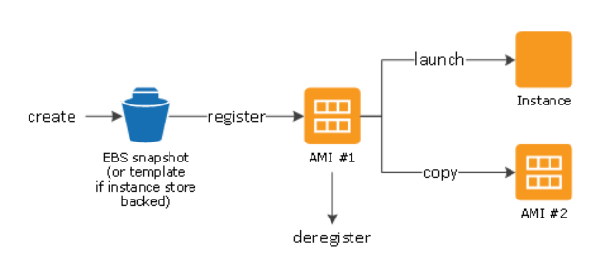
Lifecycle of AMI
After you create and register an AMI, you can use it to launch new instances. (You can also launch instances from an AMI if the AMI owner grants you launch permissions.) You can copy an AMI within the same AWS Region or to different AWS Regions. When you no longer require an AMI, you can deregister it.
You can search for an AMI that meets the criteria for your instance. You can search for AMIs provided by AWS or AMIs provided by the community. After you launch an instance from an AMI, you can connect to it. When you are connected to an instance, you can use it just like you use any other server.

Slide 39
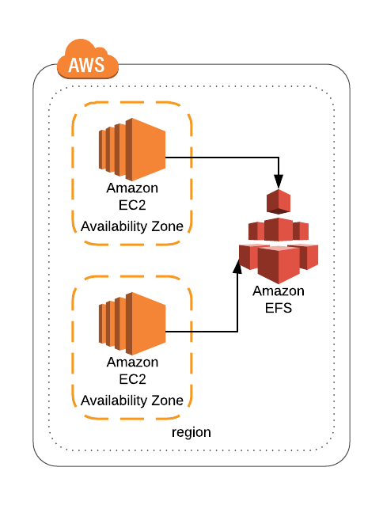
Elastic File Storage (EFS)
Amazon Elastic File System (Amazon EFS) is a simple, serverless, set-and-forget elastic file system that lets you share file data without provisioning or managing storage.
Data is stored across multiple AZs within a region

Slide 40
Elastic File Storage (EFS)
Good for big data and analytics, media processing workflows, content management, web serving, home directories, etc.
Pay for what you use (no pre-provisioning required).
EFS is elastic and grows and shrinks as you add and remove data. Can concurrently connect 1 to 1000s of EC2 instances, from multiple AZs. A file system can be accessed concurrently from all AZs in the region where it is located.
By default you can create up to 10 file systems per account.

Slide 41
Amazon Data Life Cycle Manager
You can use Amazon Data Lifecycle Manager to automate the creation, retention, and deletion of EBS snapshots and EBS-backed AMIs. When you automate snapshot and AMI management, it helps you to:
Protect valuable data by enforcing a regular backup schedule.
Create standardized AMIs that can be refreshed at regular intervals.
Retain backups as required by auditors or internal compliance.
Reduce storage costs by deleting outdated backups.
Create disaster recovery backup policies that back up data to isolated accounts.

Slide 42
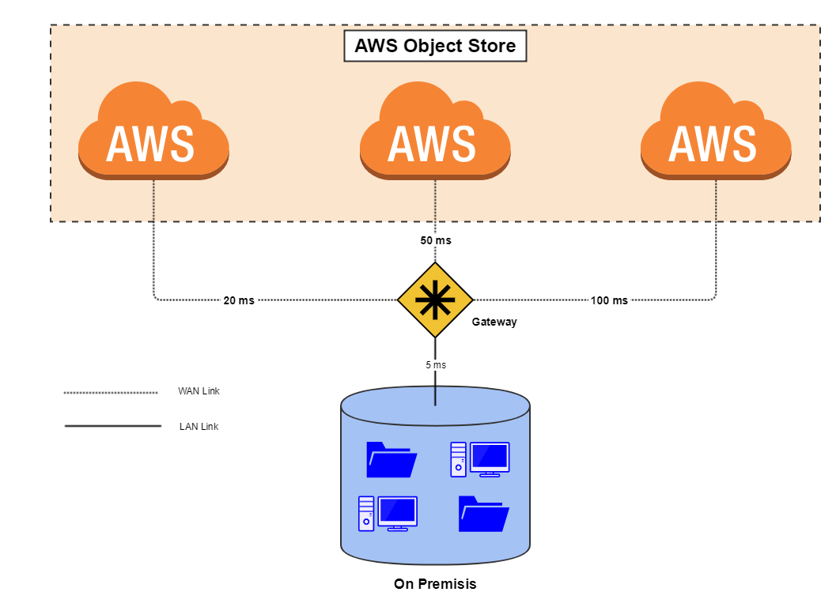
Object Storage(S3)
Object-based storage systems manage data as individual objects, rather than as blocks and sectors (block-based) or a file hierarchy (file-based).
Each object includes the data itself, metadata (data about the data), and a globally unique identifier.
Due to its flat file structure, object storage has virtually unlimited scalability and allows the retention of massive amounts of unstructured data.

Slide 43
Bucket Versioning
Versioning is a means of keeping the multiple forms of an object in the same S3 bucket. Versioning can be used to retrieve, preserve and restore every version of an object in an S3 bucket.
It serves two purposes:
If you delete an object, instead of deleting the object permanently, it creates a delete marker which becomes a current version of an object.
If you overwrite an object, it creates a new version of the object and also restores the previous version of the object.

Slide 44
Replication
Replication is the automatic, asynchronous copying of objects across buckets in the same or different AWS Regions.
Replication copies newly created objects and object updates from a source bucket to a destination bucket or buckets.
Replication rules define which source bucket objects to replicate and the destination bucket or buckets where the replicated objects are stored.
If you specify an object version ID to delete, Amazon S3 deletes that object version in the source bucket. But it doesn't replicate the deletion in the destination bucket.

Slide 45
Replication (Contd..)
You can create a rule to replicate all the objects in a bucket or a subset of objects with a specific key name prefix, one or more object tags, or both.
A destination bucket can be in the same AWS account as the source bucket, or it can be in a different account.

Slide 46
S3 SRR (SAME REGION REPLICATION)
Automatically replicates data between buckets within the same AWS Region.
Replication can be set up at a bucket level, a shared prefix level, or an object level using S3 object tags.
SRR can be used to make a second copy of data in the same AWS Region.

Slide 47
S3 CRR (CROSS REGION REPLICATION)
Automatically replicates data between buckets across different AWS Regions.
Provides the ability to replicate data at a bucket level, a shared prefix level, or an object level using S3 object tags.
CRR provides lower-latency data access in different geographic regions.
CRR can help with compliance requirements to store copies of data hundreds of miles apart

Slide 48
S3 Lifecycle Configuration
An S3 Lifecycle configuration is a set of rules that define actions that Amazon S3 applies to a group of objects.
S3 Lifecycle configuration rules for objects that have a well-defined lifecycle. For example:
If you upload periodic logs to a bucket, your application might need them for a week or a month. After that, you might want to delete them.
Some documents are frequently accessed for a limited period. After that, they are infrequently accessed. At some point, you might not need real-time access to them, but your organization or regulations might require you to archive them for a specific period. After that, you can delete them.
You might upload some types of data to Amazon S3 primarily for archival purposes.

Slide 49
S3 Storage Classes

Slide 50
S3 Standard
S3 Standard is the default storage class if none of the storage classes is specified during upload. It is ideal for frequently accessed data because it provides low latency and high availability. It is the most expensive storage class among all others.
Key Points:
High Availability and low latency
Data is stored in multiple locations. So it is resilient against events that affect an entire availability zone
The durability of 99.999999999% and availability of 99.99% availability over a given year
Most expensive storage class among all others.

Slide 51
S3 Standard-IA
S3 Standard-Infrequent Access is optimized for long-lived and less frequently accessed data but requires rapid access whenever required. Similar to S3 Standard, it also offers high durability, low latency, and high throughput but has a low per GB storage price and per GB retrieval fee. The S3 Standard-IA is ideal for backups, long-term storage, and as a data store for disaster recovery
Key Points:
High Availability and Low Latency (Same as S3 Standard)
Offers greater availability and resiliency than the OneZone-IA storage.
The durability of 99.999999999% and availability of 99.99% availability over a given year
Less expensive than S3 Standard storage but you will be charged a retrieval fee hence suitable for infrequently accessed data.

Slide 52
S3 Intelligent-Tiering
S3 Intelligent-Tiering
S3 Intelligent-Tiering optimizes costs by automatically moving data to the most cost-effective access tier, without performance impact or operational overhead. It moves objects that have not been accessed for 30 consecutive days to the infrequent access tier. If the object is accessed then it is automatically moved back to the frequent access tier. No retrieval fees or additional tiering fees are using the S3 Intelligent-Tiering storage class. It is ideal for storing long-lived data where the access patterns are unknown.
Key Points:
Low latency and high throughput performance
Automatically moves the data between two access tiers. (Infrequent Access and Frequent Access)
The durability of 99.999999999% and availability of 99.99% availability over a given year

Slide 53
S3 One Zone-IA
S3 One Zone- Infrequent Access is for the data that is accessed less frequently but available for millisecond access. Since the other S3 storage class stores data in a minimum of 3 Availability Zones (AZ), S3 One Zone-IA stores data in only one AZ which makes the costs 20% lesser than the S3 Standard-IA. It offers the same high durability, high throughput, and low latency. It can be considered a good choice for storing secondary backup copies or easily re-creatable data if an AZ fails.
Key Points:
Low Latency and High throughput performance
The durability of 99.999999999% and availability of 99.5% availability over a given year
Data will be lost if the Availability Zone where the data is stored is destroyed.
Suitable for larger objects greater than 128 KB kept for at least 30 days (charged minimum for 30 days)

Slide 54
S3 Glacier
S3 Glacier is a low-cost storage class for data archiving where data access is infrequent. It provides a configurable retrieval time for the data from minutes to hours. This storage class uses a very low-cost Glacier storage service but the objects are still managed through S3.
Key Points:
Low-cost design for long-term archiving
Data will be available in case of entire Availability Zone destruction
The durability of 99.999999999% and availability of 99.9% availability over a given year
It has a minimum storage duration period of 90 days.

Slide 55
S3 Glacier Deep Archive
The S3 Glacier Deep Archive provides the lowest-cost-storage class and supports long-term retention and digital preservation for data that may be accessed only once or twice in a year. It is ideal for those industries which store data for 5-10 years or longer like healthcare, finance, etc. It can also be used for backup and disaster recovery.
Key Points:
Lowest cost storage option in S3
The durability of 99.999999999% and availability of 99.9% availability over a given year
Retrieval costs can be reduced by using bulk retrieval
It has a minimum storage duration period of 180 days

Slide 56
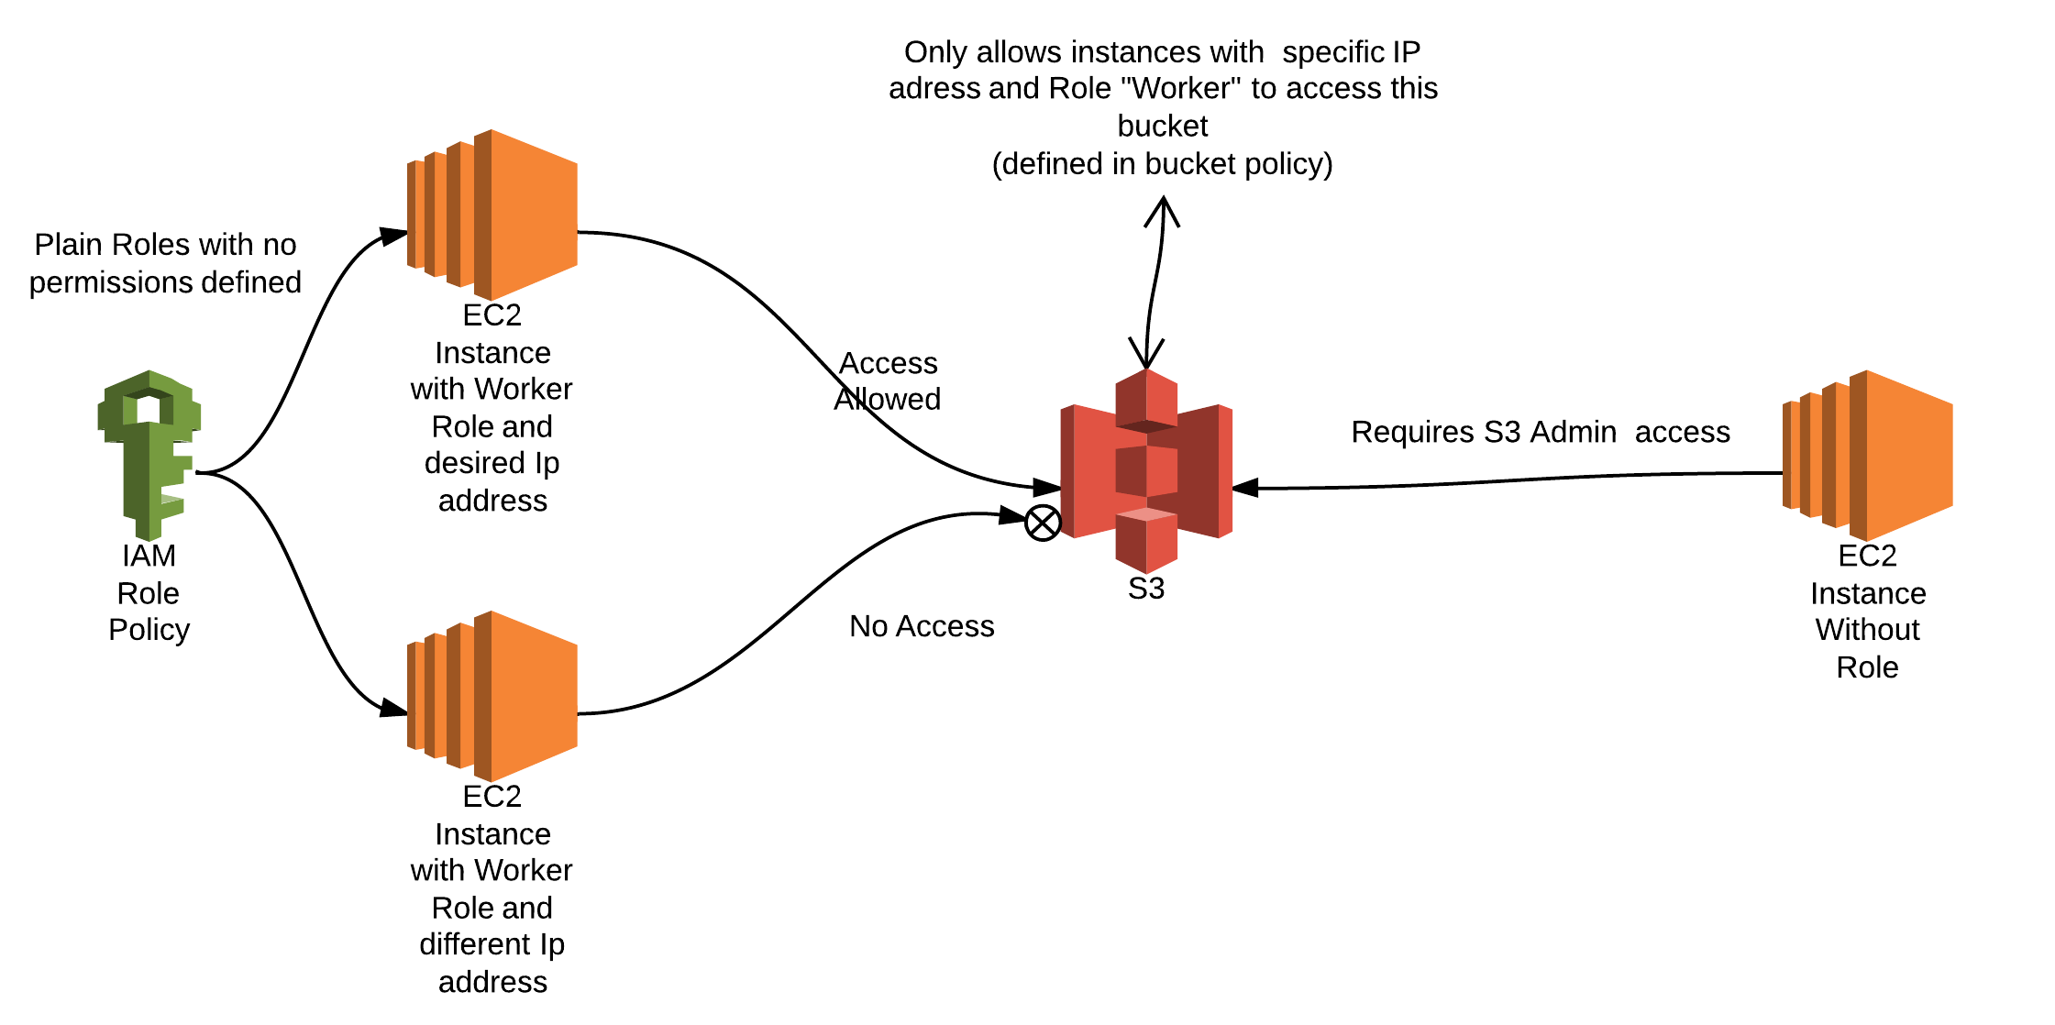
Access Amazon S3 Bucket from EC2 with IAM Role

Slide 57
Access Amazon S3 Bucket from EC2 with IAM Role
To connect to your S3 buckets from your EC2 instances, you must do the following:
1. Create an AWS Identity and Access Management (IAM) profile role that grants access to Amazon S3.
2. Attach the IAM instance profile to the instance.
3. Validate permissions on your S3 bucket.
4. Validate network connectivity from the EC2 instance to Amazon S3.
5. Validate access to S3 buckets.

Slide 58
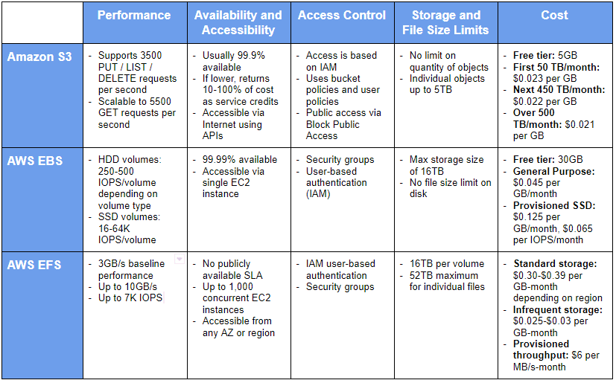
Difference Between EFS, EBS, and S3

Slide 59
Thank You

