Slide 1
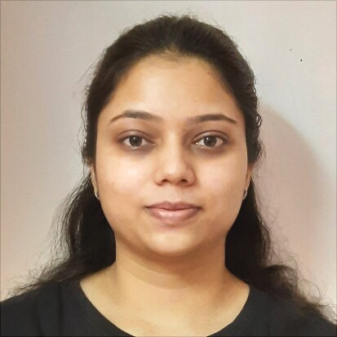
Dnyanada Dhore
Analyst
Bachelor In Computer Engineering : 2018-2022
I Transform L&D Left shift batch
Skills
C# | Basics, OOPS, Exception Handling ,Arrays ,Collection and Generics, Delegates and Events, File Io and Serialization.
.NET Framework | ADO.NET,ASP.NET with MVC and WEB API, Entity Framework
Angular | Components, Services, Modules, Routing, Forms & Validation
Database | SQL (SSMS)
Tools | GIT
UI Technology | HTML ,CSS & Angular
Add On Skills | Communication Skills
dnyanada.dhore@gmail.com
A4
+91 9767394742
Full Stack Developer
Understanding of RDMS concepts using SQL Server.
Practical understanding of C# and SQL concepts using Visual Studio and SQL Server
Hands on experience in developing applications using .NET Framework, ADO.NET Core
Understanding of HTML , CSS and Angular Cli
Practical understanding of Python .
Completed case study on Online Shopping Cart System using Angular, ASP.NET , Microsoft SQL server. This is the online website where user can buy different products from anywhere and this products will be home delivered. Payment can be possible through card or user can pay after the get the delivery.
Video Link:-Click Here
Git Hub :-Click Here
Linked In :-Click Here

