Slide 1

AJEENKYA D Y Patil School of Engineering & Technology,
Lohegaon, Pune
Department of Computer Engineering
SE SEM-II
A PBL Presentation On AnyChat Application
Presented by
Name: Avadhut Patil
Pallavi Tarate Dnyaneshwar Tupe
Lalit Wani
Roll No. : 72,75,76,78
Guided by:
Prof. Yashanjali Sisodia
7 March 2024
1

Slide 2
Contents
Introduction
Aim & Objective
Literature Survey
System Architecture
Techniques Used
Hardware & Software Requirements
Results
Conclusion & Future Scope
References

Slide 3
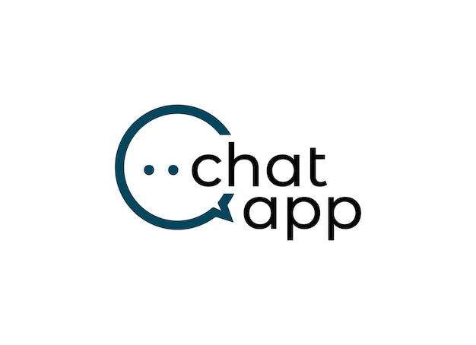
Introduction
The AnyChat, also known as a web chat or online chat, is a software application that allows users to communicate with each other in real-time through a web browser. Unlike traditional chat applications that require you to download and install software, web-based chat apps are accessible from any device with an internet connection.

Slide 4
Aim & Objective
Aim and Objectives of a Web-Based Chat Application
Aim:
The overall aim of a web-based chat application is to facilitate real-time communication between users over the internet through a web browser, without the need to download or install additional software.
Objectives:
Enable easy and convenient communication: The application should be user-friendly and accessible, allowing users to connect and chat with others effortlessly.
Provide real-time messaging: Messages should be sent and received instantly, creating a seamless and dynamic conversation experience.

Slide 5
Literature Survey
Sr. No | Title of the Paper and Author’s Name | Publication Details | Description | Challenges
1. | “Research paper on Group chatting Application” ~Ashutosh Kumar ~Atul Singh | Research Proposal May 2022 | The internet has transformed the way we communicate and access information. This project focuses on the development of a web-based chat application. The application allows users to chat with each other in real-time through a web browser. | System Maintenance: This refers to monitoring, evaluating, and modifying a system after it's been deployed and used by end-users.
2. | “Development of Chat Application” ~ Dr. Abhay Kasetwar ~ Ritik Gajbhiye ~ Gopal Papewar ~ Rohan Nikhare ~ Priya Warade | Paper Id: IJRASET42902 Publish Date: 2022-05-18 ISSN : 2321-9653 Publisher Name: IJRASET | This project builds a chat server using Javascript and network concepts. It offers private and public chat functionalities. Users can share files, photos, and videos. | Security: Protecting user data, including messages and personal information, is paramount. This requires implementing robust security measures to prevent unauthorized access, data breaches, and malicious activities.
7 March 2024
5

Slide 6
Sr. No | Title of the Paper and Author’s Name | Publication Details | Description | Challenges
3. | “Real-Time Chat Application” ~ Ms. Archana Nikose ~ Sakshi Dosani ~ Shreya Pardhi ~Deep Nikode | Research Proposal April 2023 | This thesis introduces a real-time chat application built using the MEAN stack (MongoDB, Express.js, Angular, and Node.js). | Real-time Communication: Delivering messages instantly and consistently across a large user base demands efficient server infrastructure and communication protocols.
4 | “Multi-User Chat Application” ~ R. Gayathri ~ C. Kalieswari | Research Proposal May 2020 | The application allows users to communicate through text messages, both publicly and privately. It even offers file sharing capabilities for additional functionality. | Sharing resources through other public applications are not much reliable & secure. There are several restrictions in public applications.
5. | “Group Chat Application” ~ Mr. Bhosale Chaitanya Vaibhav ~ Mr. Waghule Sourabh Rajesh | Research Proposal June 2022 | This paper shows the importance of chat application in day today life and its impact in technological world. This project is to develop a chat system based on Java multi threading and network concept. | Network Dependence: The application relies on internet connectivity. How will it function in areas with poor or unreliable internet?

Slide 7
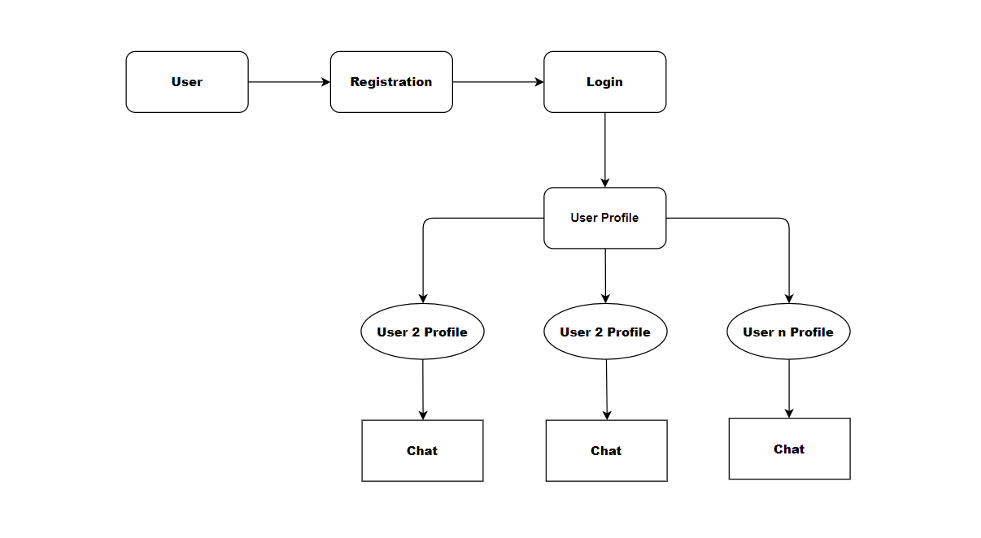
System Architecture

Slide 8
Techniques Used
1) Front-end
HTML, CSS, BOOTSTRAP
2) Back-end
JAVASCRIPT, PHP
3) Xampp Server
4) MySQL Database

Slide 9
Hardware & Software Requirements
1) Operating System :-
The project will be able to run on the various operating systems
like Windows, Linux and MacOS.
2) Text Editor or IDE :-
We will use the VS-Code Integrated Development Environment(IDE)
for writing and editing the code of the project.

Slide 10
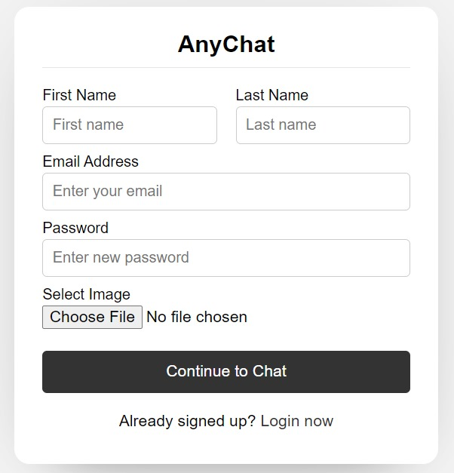
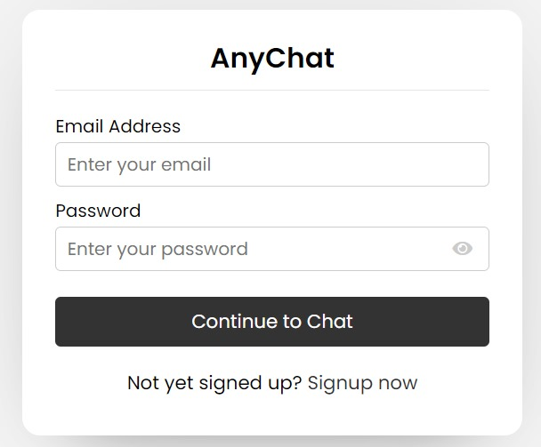
Results
Signed Up Page
Login Page

Slide 11
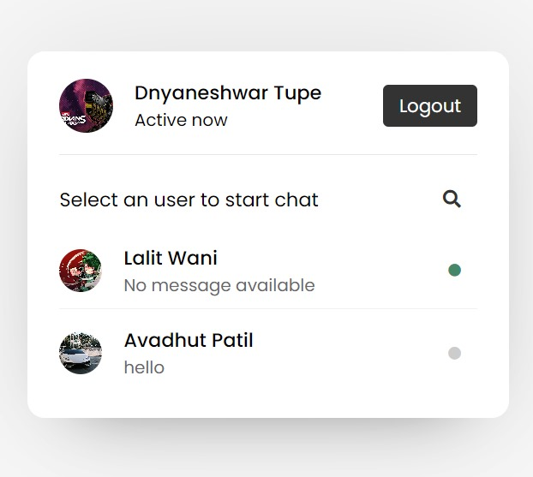
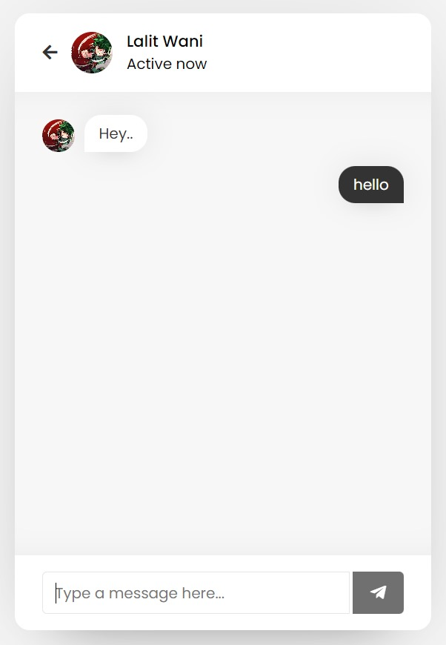
Profile Page
Chat Page

Slide 12
Conclusion & Future Scope
Conclusion:
This web-based Anychat application has successfully addressed the need for a user-friendly and accessible platform for real-time communication.
Future Scope:
Establish connection between multiple users.
User friendly interface.
Security.
Data encryption and decryption.

Slide 13
References
https://www.ijraset.com/best-journal/development-of-chat-application
https://ijarsct.co.in/Paper4958.pdf
https://www.ijeat.org/wp-content/uploads/papers/v9i5/E9578069520.pdf

Slide 14

7 March 2024
14

