Slide 1

WIPRO NGA Program – Linux Batch
Capstone Project Presentation – 31 July 2024
Project Title Here - online shopping system Using Client side server Presented by – dnyaniya Gurav
www . rpsconsulting .in

Slide 2
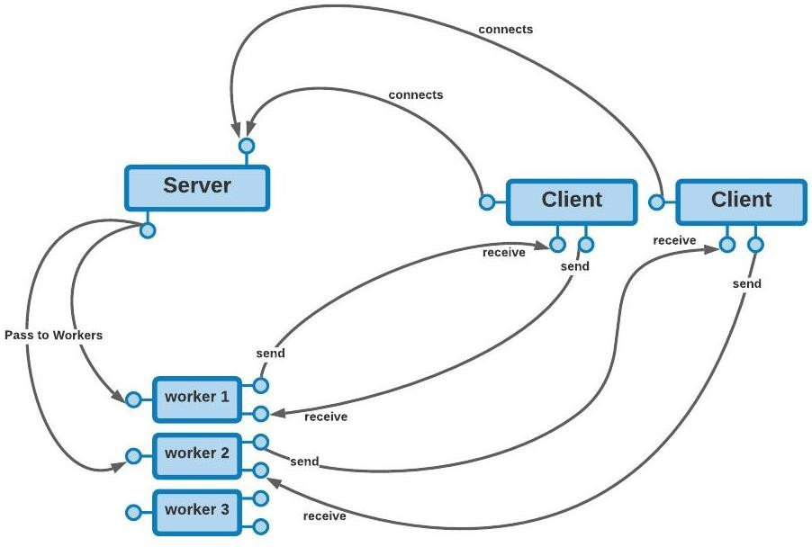

Slide 3
PROJECT OVERVIEW
This project aims to provide hands-on experience in developing a Linux device driver to print system metrics. In this project we will learn how to interact with
the Linux kernel, read system metrics, and output these metrics via a character device interface.
INTRODUCTION
This project involves developing a Linux character device driver to retrieve and output system metrics such as CPU usage, memory usage, and disk I/O metrics. The device driver can be loaded and unloaded from the kernel and provides a character device interface for user interaction.

Slide 4
MOTIVATION
The motivation behind this project is to develop a Linux character device driver that provides real-time monitoring of system performance metrics. This tool helps in proactive resource management by offering insights into CPU,
memory, and disk usage. Additionally, it serves as a valuable learning
experience in Linux kernel programming and practical system monitoring.
PROJECTSCOPE
Create a Linux character device driver to print system metrics.
Retrieve various system metrics such as CPU usage, memory usage, and disk I/O.
Output the retrieved metrics through a character device.

Slide 5
Various Application Tools That Are Used In This Project:-
Code blocks
Visual studio
terminal
By integrating these various tools and applications, the project ensures comprehensive development, testing, and debugging of the Linux character
device driver for system metrics. This combination facilitates efficient system monitoring and provides a reliable interface for accessing crucial system performance data.

Slide 6
The Modules That I Have Worked On This Project:-
admin
client
customer
employee
person

Slide 7
By working on these modules, the project ensures a comprehensive and
functional Linux character device driver that outputs system metrics, offering valuable insights into system performance and resource usage.
The List Of Functions That Used In This Project:-
“constructor” Client (ipAddr : const string&, port: const int &)
The constructor is used to initialize the IP address and port number of the remote server. The default values are “127.0.0.1” and “7777” respectively if the parameters are omitted.
“destructor” ~Client
The destructor is used to cleanup and close the winsock APIs.

Slide 8
​start() : bool
A public member function which initializes the winsock APIs. If an error occurs, it returns false; otherwise, it returns true and also connects with the server.
Connect() : void
A private member function which creates a socket and connects with the server at the specified address.
-
Send(…) : int
A public function which is used to send information across the connection. It consists of 3 overloads which are able to take int, double, and strings as their arguments. Note that although the inputs are more than one data types, the information is still converted to a char* and then sent over to the server. The function returns the number of bytes sent.

Slide 9
Future Amendments Addressing Common Challenges:-
Handling Increased Load:
Challenge: As systems become more complex, the device driver might need to handle larger volumes of data or more frequent metrics collection.
Amendment: Optimize the driver to efficiently handle high-frequency data collection and large datasets, possibly incorporating asynchronous processing or batch data
handling.
Extended Metrics:
Challenge: Users might require additional or more granular metrics beyond those initially implemented.

Slide 10
Amendment: Extend the metrics collection capabilities to include more detailed or diverse system data, such as network statistics or application-specific metrics.

