Slide 1
Pay on Arc
Subscriptions that collect themselves.
A USDC-native payment suite on Arc. Approve once — an autonomous billing agent pulls every payment when it falls due, with no wallet prompt and no human in the loop.
Arc Testnet
under $0.0001
105 in CI
LIVE ON
COST PER CHARGE
AUTOMATED TESTS
payonarc.com · github.com/Dnyelfy/pay-on-arc · @Dnyelfy
Notes:
Pay on Arc — Circle grant application deck. Solo builder, Kayseri, Türkiye. Live product on Arc Testnet.

Slide 2
THE PROBLEM
Crypto has no standing order.
Every on-chain payment needs a human signature at the exact moment it is due. That single constraint removes an entire category of money movement from crypto.
Why it stayed unsolved
The EVM cannot push. A contract cannot initiate a transfer from a user’s wallet on a schedule — no protocol can simply add recurring payments.
Pull works, but needs a keeper. Allowance-pull is the only viable model, and it only works if something reliable watches the clock and pays the gas. Most teams stop here.
Arc removes the economics. Sub-cent fees denominated in USDC and sub-second finality make a $5/month plan worth collecting for the first time.
Subscriptions
The backbone of Web2 commerce — and absent on-chain.
Rent and payroll
Recurring by nature, impossible to schedule from a wallet.
Small plans
Gas volatility made collecting $5 cost more than $5.
Notes:
Recurring payments are the missing primitive on a payments-native chain.

Slide 3
THE SOLUTION
Three pieces, one live product.
01
02
03
ArcSub
The billing agent
Payment rails
A non-custodial subscription contract on an allowance-pull model. Funds never leave the subscriber’s wallet. Each period is pulled only when due, the price is fixed at creation, and either side cancels in one transaction.
A keeper with its own wallet that watches ArcSub and collects every due payment by itself — no pop-up, no click, no human. It pays only transaction fees; subscription money moves subscriber → merchant directly.
One-time USDC payments with on-chain memos, shareable pay-links and subscribe-links, splits to 20 wallets, recallable payments, a Pyth-fed USDC/EURC treasury rebalancer, and CCIP messaging to Sepolia.
All three are deployed and verified on Arc Testnet today.
Notes:
ArcSub + autonomous keeper + payment rails. Sister dApp Arc Agent Forge extends the same agent into ERC-8004/8183.

Slide 4
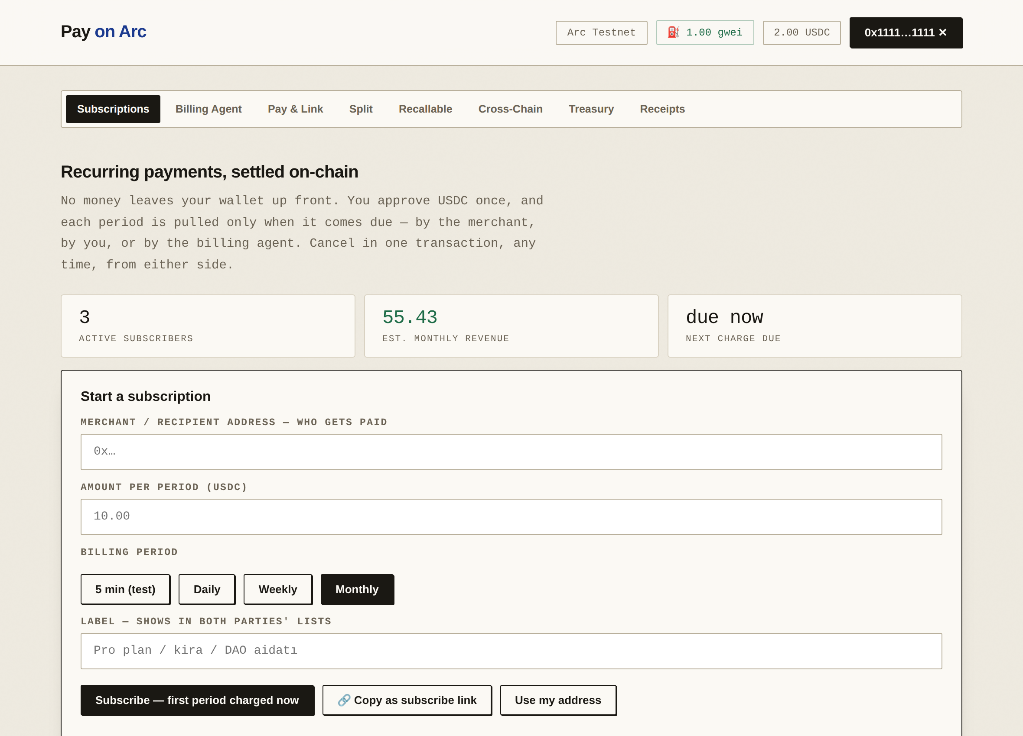
PRODUCT
Subscriptions, settled on-chain.
Approve once
One USDC approval. No money moves up front.
Pulled when due
The contract charges the period, never earlier.
Both sides listed
What you fund and who subscribes to you, live.
Cancel in one click
On-chain, either party, no notice period.
Notes:
Live UI. Merchants can also copy a plan as a subscribe-link and send it to a customer.

Slide 5
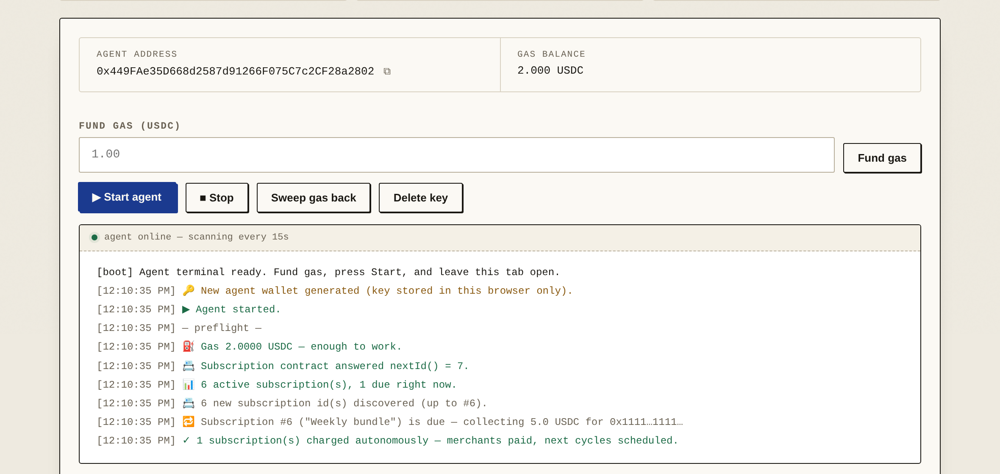
THE DIFFERENTIATOR
A worker that bills for you.
The agent holds its own wallet, watches the subscription table every 15 seconds, batches everything due into a single charge, and reports what it did. Nobody signs anything.
Autonomous, verifiably
Charges on ArcSub were executed by the agent with zero human signatures.
Money never touches it
USDC moves subscriber → merchant. The agent pays gas only.
Next: hosted 24/7
Milestone 1 moves the keeper off the browser onto Circle Developer-Controlled Wallets.
Notes:
This is the piece competitors do not have: the collection actually happens without a human.

Slide 6
PRODUCT
The rails around it.
The subscription contract sits inside a wider payment suite. Every one of these is deployed and exercised on Arc Testnet today.
→
Pay & link
≡
Split payments
↺
Recallable
One-time USDC with an on-chain memo, or a shareable link that fills itself in for the payer.
One transaction, up to 20 recipients — payroll, revenue shares, bounties.
A payment the sender can pull back inside a window, until the recipient claims it.
⚭
Cross-chain
◑
Treasury
✓
Receipts
Chainlink CCIP from Arc to Sepolia, verified end-to-end twice.
A Pyth-fed rebalancer holding a target USDC/EURC ratio.
Every payment, split and recall readable back from the chain.
Notes:
Every rail is deployed and exercised on Arc Testnet.

Slide 7
TRACTION
Everything here is on-chain today.
105
3
800+
10+
automated tests green in CI
contracts verified on Arc
Arc community points
dApps shipped 2025–2026
Verifiable on ArcScan
ArcSub — recurring charges executed by the agent, with no human signature on any of them.
ArcPay V2 — live payments, splits and recallable payments, plus two end-to-end CCIP messages to Sepolia.
Agent Forge — a self-registered ERC-8004 agent that priced, delivered and was paid for escrow jobs autonomously.
Engineering — 60 contract tests and 45 Playwright UI tests in CI, plus a published line-by-line security review of all three contracts.
Testnet-stage by design. This grant is what takes it to production.
Notes:
Contract addresses: ArcSub 0x015f...35eC, ArcPay V2 0x418E...979b, TreasuryAgent 0xC99f...eA53.

Slide 8
CIRCLE INTEGRATION
Built on Circle, deepening on Circle.
Integrated today
Planned
USDC on Arc
Developer-Controlled Wallets
Native gas and the settlement asset for every flow in the product.
Wallet layer for the hosted 24/7 keeper — weeks 1–6.
CCTP
EURC on Arc
Fund subscriptions with USDC from other chains — weeks 7–14.
Transfers and treasury rebalancing against USDC.
Paymaster
Gasless subscriber onboarding — weeks 10–14.
Developer-Controlled Wallets
The wallet layer inside Agent Forge.
Gateway
Evaluation in Q1 2027.
Notes:
Circle products are the wallet, settlement and cross-chain layer — not a bolt-on.

Slide 9
ROADMAP
Three milestones, 30,000 USDC.
MILESTONE 1
MILESTONE 2
MILESTONE 3
10,000 USDC
12,000 USDC
8,000 USDC
Q3 2026 · 6 weeks
Q4 2026 · 8 weeks
Q1 2027 · 8 weeks
Production-ready subscriptions
Mainnet and Circle depth
Adoption and agent marketplace
Allowance caps instead of unlimited approvals, charge-window guards, pause controls, and fixes for every finding in our published review. Keeper moves off the browser onto a hosted service.
Complete the audit and deploy to Arc mainnet. Integrate CCTP for cross-chain funding and Paymaster for gasless onboarding. Merchant dashboard v2 with analytics and webhooks.
Onboard 25 merchants and 250 active subscriptions. Ship ERC-8004-identified billing agents anyone can hire, earning a fee per collection.
Audit-ready contracts · hosted keeper at ≥ 99% on-time collection over two weeks
Verified mainnet contracts · live CCTP funding · 5 pilot merchants
Public Dune dashboard · 3 case studies · open-source keeper SDK
Every milestone is payable against a deliverable that can be verified on-chain.
Notes:
Total ask 30,000 USDC: 10,000 / 12,000 / 8,000.

Slide 10
THE ASK
From working prototype to production infrastructure.
Security audit
Hosted keeper
A professional audit of ArcSub and ArcPay before real funds touch them. Our published review and the 105-test suite are the preparation, not the substitute.
Billing that no longer depends on an open browser tab.
Full-time focus
Merchant onboarding
Two quarters of undivided work on the product.
Incentives for the first cohort.
Dönay Uzunhisarcıklı · Founder & Developer · Kayseri, Türkiye
payonarc.com · github.com/Dnyelfy/pay-on-arc · @Dnyelfy · youtu.be/83F9jdbbfYQ
Notes:
Ask: 30,000 USDC across three milestones.

