Slide 1
Slot 7, 8, 9 Recursion

Slide 2
Contents
1- Introduction to recursion.
2- Describing a recursive operation.
3- Implementing a recursive method.
4- Classifying recursive functions
5- How to manage running functions?
6- Anatomy of a Recursive Call
7- Evaluating performance of recursive methods.
8- Eliminating recursion
9- Backtracking (15 exercises)

Slide 3
Learning Outcomes
LO3.1 Describe the basic ideas of recursion and how to set up recursive systems that represent certain real-world phenomena.
LO3.2 Know how to develop recursive algorithms and programs
LO3.3 Write programs in Java using recursion to solve some problems, like creating the Fibonacci sequence.
LO3.4 Analyze a recursive function to find out its’ output without running.
LO3.5 Explain type of recursive functions, give examples and comparing them.
LO3.6 Compare recursion with iteration, analyze their pros and cons

Slide 4
1- Introduction to Recursion
Definition:
Recursion is a technique in which a concept/an operation is defined by itself ( đệ: đưa ra, quy: quay về).
Examples
Person = a child of other two persons
n! = n* (n-1)! ( factorial)
F(n) = F(n-1) + F(n-2) // Fibonacci sequence
a(n) = a(n-1)+ d: Arithmetic progression – CS cộng
b(n) = q*b(n-1) // geometric progression- CS nhân
public static int fibo (int n){
if (n<3) return 1;
return fibo(n-1) + fibo(n-2);
}
Notes:
Hàm gồm tên hàm, tham số, kiểu dữ liệu, body{}

Slide 5
1- Introduction to Recursion
How to understand Recursion?
We use a reverse deduction (suy diễn ngược) with an initial data.
Examples:
Person = a child of other two persons
Initial persons: Adam, Eve
1 3 5 7 9 …..
A(n) = 1, n=1
A(n) = A(n-1) + 2, n> 1
1, 1, 2, 3, 5, 8, 13, …
F(n) = 1, n<3
F(n) = F(n-1) + F(n-2)
public static int fibo ( int n){
if (n<3) return 1;
return fibo(n-1) + fibo(n-2);
}
A recursive method:

Slide 6
1- Introduction to Recursion
Where recursion are used?
The Fibonacci sequence:
1- Recursion is used to generate new elements of a group.
2- Recursion is used to test whether a value belonging a group or not.
3- Recursion is a another way to express a loop when number of executions is not known in advance.
n | 1 | 2 | 3 | 4
F(n) | 1 | 1 | 2 | 3
F(10) =?
Test whether 34 is an element of the Fibo sequence or not?
F(n) = 1, n<=2 = F(n-2)+F(n-1), n>2 | public int fiboRec( int n) { if (n<3) return 1; return fiboRec(n-2) + fiboRec(n-1); } | public int fiboLoop ( int n) { int result =1, t1 =1, t2=1; for (int i=3; i<=n; i++) { result = t1 + t2; t1 = t2; t2= result; } return result; }

Slide 7
2- Describing a recursive operation
A recursive definition consists of two parts:
The anchor or ground case or base case, the basic elements that are the building blocks of all other elements of the set
Rules that allow for the construction of new objects out of basic elements or objects that have already been constructed
Notes:
Anchor: tình huống neo – tình huống dc chấp nhận

Slide 8
2- Describing a recursive operation
Practice: Recursive expression of numeric sequences
Use the Divide and conquer principle– chia để trị
(1) Write numbers in a line: d1, d2, d3, d4, d5, ………, dn
(2) Some beginning values can be anchors.
(3) Find out relationship next values with previous values → Deduction
Example: Examine the Fibonacci sequence:
1 1 2 3 5 8 13 21 34
Anchors: 1, n<=2
Deductive rule: F(n) = F(n-2) + F(n-1), n>2

Slide 9
2- Describing a recursive operation
Practice: Recursive expression of operations :
- With recursive methods, there may be more difficulties.
Use the Divide and conquer principle
Write the operation in details
Right side may be anchor
Left side is the same operation with smaller input
Example: Calculate n!
n! = 1.2.3.4.5.6.…(n-1).n
= (n-1)! . n = n.(n-1)!
Anchors: 1, n<2
Deductive rule: n! = n.(n-1)!

Slide 10
2- Describing a recursive operation
Practice: Recursive operations on an array
Example: Sum of an array, named a, having n elements
Sum(a,n) = a[0] + a[1] + … + a[n-2] + a[n-1]
Sum(a, n-1)
Return 0,n=0
Return a[n-1] + Sum (a, n-1);

Slide 11
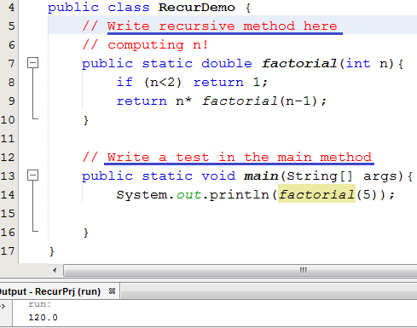
3- Implementing a recursive method
Pseudo-code
n! = 1, n<2
= n* (n-1)!, n>=2
2 lines
// Other recursive method
Demo 1
// Other test
Để dễ tiếp thu bài học, xin đừng thắc mắc “Hàm đệ quy chạy như thế nào?”. Câu hỏi này sẽ được trả lời ở phần sau của chương. Ở đây, chúng ta chú tâm vào cách suy nghĩ đệ quy, diễn đạt đệ quy và viết hàm đệ quy cho quen đã nhé.

Slide 12
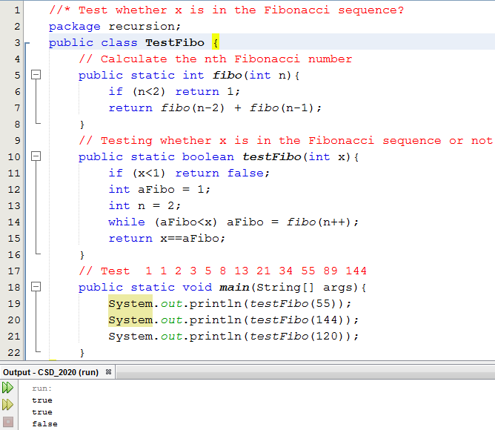
3- Implementing a recursive method
Demo 2
Recursive definitions serve two purposes:
Generating new elements
Testing whether an element belongs to a set
Demo: The Fibonacci sequence

Slide 13
3- Implementing a recursive method
Demo 3
1.5 3.5 5.5 7.5 9.5 11.5
Compute the n^{th} item of an arithmetic progression having the first item a and common difference d:
ap(n, a, d) = a, n=1
= ap(n-1, a, d) + d, n>1
public static double ap( int n, double a, double d) {
<Code yourself>
}
// Test 1.5 3.5 5.5 7.5 9.5 11.5
System.out.println( ap(6, 1.5, 2 )); // → 11.5

Slide 14
3- Implementing a recursive method
Demo 4
Compute the n^{th} item of a geometric progression having the first item a and common multiplier q:
gp (n, a, q) = a , n=1
= gp(n-1, a, q) * q, n>1
public static double gp( int n, double a, double q) {
<Code yourself>
}
// Test 1.5 3 6 12 24 48
System.out.println( gp(6, 1.5, 2)); // → 48

Slide 15
3- Implementing a recursive method
Demo 5
Calculate sum of integral array having n elements
Sum(a,n) = 0 + a[0] + a[1] + …….. + a[n-2] + a[n-1]
Sum(a, n) = 0, n=0;
= Sum(a, n-1) + a[n-1], n>1
public static double sum( double[] a, int n) {
<Code yourself>
}
// Test :
double a[] = { 1.5, 2, 4, 5, 2, 6.5 };
System.out.println( sum(a, 6)); // → 21

Slide 16
3- Implementing a recursive method
Demo 6
Calculate the maximum value in an integral array having n elements
1 5 9 7 2 10 19
max(a, n) := if (n==1) return a[0]
int m= max(a, n-1) // 10
return m>a[n-1]? m : a[n-1]
public static double max( double[] a, int n) {
<Code yourself>
}
// Test :
double b[] = { 1, 5, 9, 7, 2, 19,10 };
System.out.println( max(b, 7)); // → 19

Slide 17
3- Implementing a recursive method
Demo 7
Calculate the minimum value in an integral array having n elements
min (a,n) = (Do yourself)
public static double min( int[] a, int n) {
<Code yourself>
}
// Test : int b[] = { 1, 5, 9, 7, 2, 19,10 };
System.out.println( min(b, 7)); // → 1

Slide 18
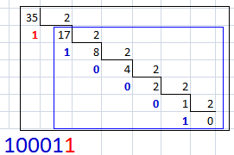

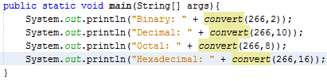
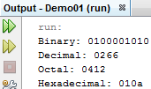
3- Implementing a recursive method
Demo 8
Convert a decimal integer to a b-based numeric string:
n= 35, base=2 ➔ 100011
“100011” = “10001” + “1”
convert(35,2) = convert(17,2) + digit of 35%2
convert(n,base) = convert(n/base,base) + digit of n%base
Anchor: If n==0 return “0”
Notes:
Parition table mảng 1 chiều
I-nodes
Root-….

Slide 19

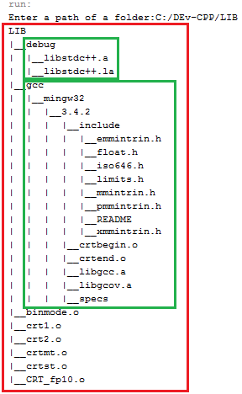
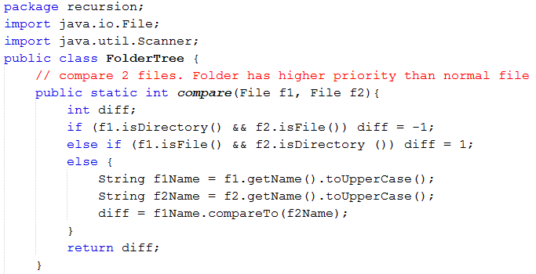
3- Implementing a recursive method
Demo 9:
Printing contents of a folder in a tree format:

Slide 20
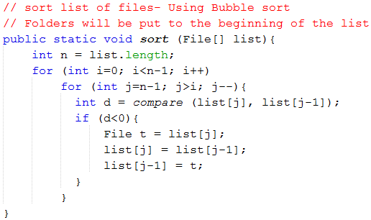
3- Implementing a recursive method
Demo 9:
Printing contents of a folder in a tree format:

Slide 21
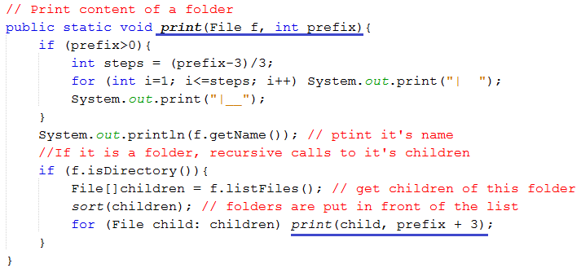
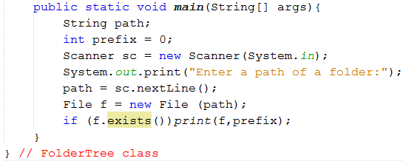
3- Implementing a recursive method
Demo 9:
Printing contents of a folder in a tree format:
Notes:
Gõ tập tin: => ra tên tập tin
Thư mục => list tập tin

Slide 22
4- Classifying Recursive Functions
Aspect | Types
Position where a recursive call is put | Tail/ non-tail | Head/ non-head recursion
Number of recursive calls | Linear/ non-linear recursion
Recursive call is easily detected | Direct/ indirect recursion

Slide 23
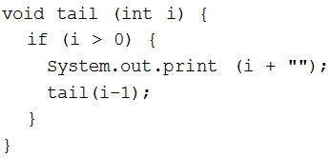
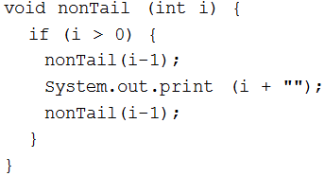

4- Classifying Recursive Functions
Tail recursion is characterized by the use of only one recursive call at the very end of a method implementation.
The last operation is a multiplication.
→ It is not a tail recursion

Slide 24
4- Classifying Recursive Functions
Based on number of recursive calls: Linear, non-linear recursion.
int factorial ( int n) {
if (n==1) return 1;
return n*factorial(n-1);
}
int fibo ( int n) {
if (n<3) return 1;
return fibo(n-2) + fibo(n-1);
}
Two recursive calls
→ Binary recursion

Slide 25
4- Classifying Recursive Functions
Based on number of functions included in recursive call: → Indirect recursion.
Direct recursion→ Recursive call is put in the body of itself
receive(buffer)
while buffer is not filled up
if information is still incoming
get a character and store it in buffer;
else exit();
decode(buffer);
decode(buffer)
decode information in buffer;
store(buffer);
store(buffer)
transfer information from buffer to file;
receive(buffer);

Slide 26
5- How to Manage Running Functions?
This data group is called as method’s Activation record
How to manage a thing? ➔ We need its data.
How to manage a running method? ➔ … ?
Data of a method:
- Its parameters (data type, value)
- Its return data type
- Its extra local variables
- Return address in its caller
- Dynamic link: Address of its caller activation record
The function F1() calls the function F2()
F1(): Caller
F2(): Callee
Data needed when the callee runs
Address of the next instruction in the caller after the callee terminates
Address of the caller’s activation record. It will be the current AR after the callee terminates
Notes:
Activation record: bản ghi hoạt động
F1 gọi F2
F1 hàm gọi
F2 hàm bị gọi
Modun bị chứa đựng

Slide 27
5- How to Manage Running Functions?
Activation record in details:
Activation records contain the following:
Values for all parameters to the method, location of the first cell if an array is passed or a variable is passed by reference, and copies of all other data items
Local (automatic) variables that can be stored elsewhere.
The return address to resume control by the caller, the address of the caller’s instruction immediately following the call.
A dynamic link, which is a pointer to the caller’s activation record
The returned value for a method not declared as void

Slide 28
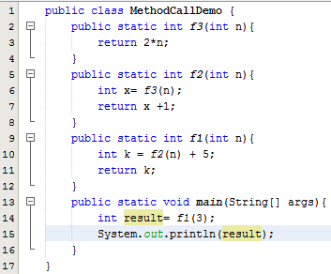

5- How to Manage Running Functions?
A demo.
Parameters and Local variables ( n )
Activation record of
f3(…)
Dynamic link (4000)
=
Return Address ( = )
5000
Return value ( int )
Parameters and Local variables ( n, x )
Activation record of
f2(…)
+
Dynamic link (3000)
Return Address ( + )
4000
Return value ( int )
Parameters and Local variables (n, k)
Activation record of
f1(…)
=
Dynamic link (2000)
Return Address ( = )
3000
Return value ( int )
Parameters and Local variables (args, result)
Activation record of
main(…)
Contents of the run-time stack when main() calls method f1(), f1() calls f2(), and f2() calls f3()
Dynamic link (1000)
Return Address ( null )
2000
Return value (void)
Constants
1000
All methods use Dynamic links to access constants.
Notes:
X = 6
K = 7 + 5
Hàm main static: cầu nối cái địa chỉ
System static.
Hàm sau cùng kết thúc trước, active record thu hồi trước

Slide 29
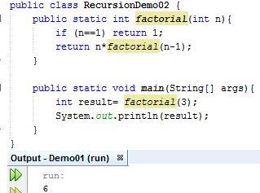
6- Anatomy of a Recursive Call
AR of factorial(1)
AR of factorial(2)
AR of factorial(2)
AR of factorial(2)
AR of factorial(3)
AR of factorial(3)
AR of factorial(3)
AR of factorial(3)
AR of factorial(3)
AR of main
AR of main
AR of main
AR of main
AR of main
AR of main
AR of main

Slide 30
7- Evaluating Performance of Rec. Methods
Advantage: Natural thinking
Disadvantages:
So many ARs need to be allocated.
→ High memory cost
So many method calls
→ High time cost
AR of factorial(1)
AR of factorial(2)
AR of factorial(2)
AR of factorial(2)
AR of factorial(3)
AR of factorial(3)
AR of factorial(3)
AR of factorial(3)
AR of factorial(3)
AR of main
AR of main
AR of main
AR of main
AR of main
AR of main
AR of main

Slide 31
7- Evaluating Performance of Rec. Methods
Disadvantages of Recursive Call:
So many ARs need to be allocated → High memory cost
So many method calls →High time cost
double fact1(int n) {
if (n<2) return 1;
return n*fact1(n-1);
}
double fact2 (int n) {
double result =1;
for (int i=2; i<=n; i++)
result *= i;
return result;
}
fact1(100); // ➔ 100 activation records
fact2(100); // ➔ 1 activation record

Slide 32
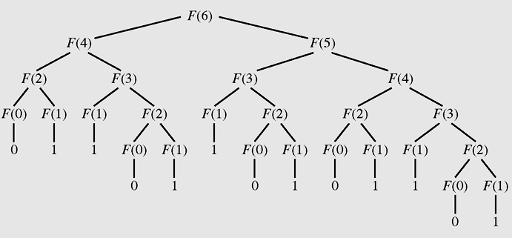
7- Evaluating Performance of Rec. Methods
Disadvantages of Recursive Call
- So many ARs need to be allocated → High memory cost
So many method calls → High time cost
One operation must be performed many times.
The tree of calls for Fib(6)

Slide 33
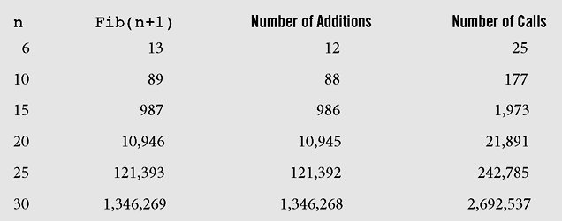
7- Evaluating Performance of Rec. Methods
Number of addition operations and number of recursive calls to calculate Fibonacci numbers

Slide 34
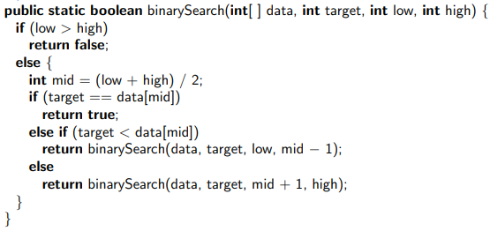
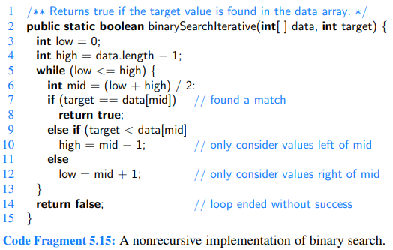
8- Eliminate Tail Recursion
If you can, you should eliminate recursive methods.
How? → Use loop statement + Stack for storing data.
An example: Binary Search the target in an sorted array.
Recursive version
Loop version, no additive memory is needed.

Slide 35
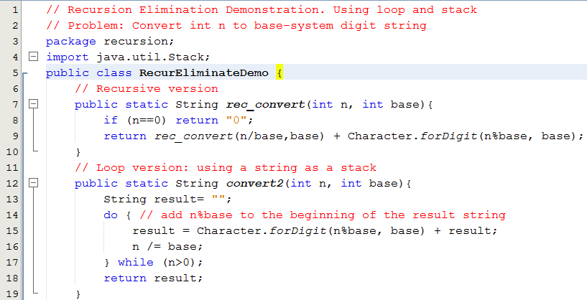
8- Eliminate Tail Recursion
Demo 10: Convert an integer to string numbers.

Slide 36
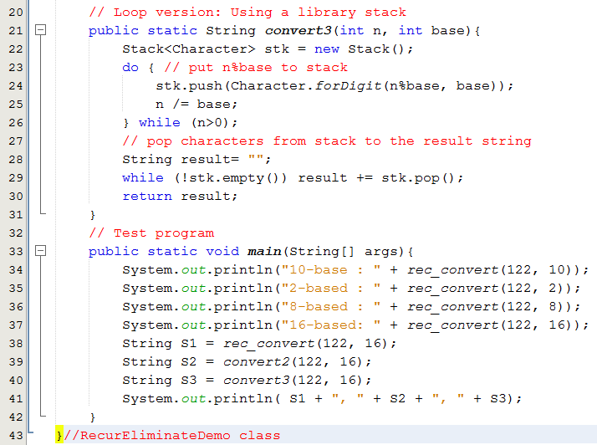
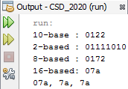
8- Eliminate Tail Recursion
Demo 10: Convert an integer to string numbers.

Slide 37
9- Backtracking- Hồi Quy
Backtracking is a technique for returning to a given position (e.g., entry point) after trying other avenues that are unsuccessful in solving a particular problem.
Backtracking is a technique for finding solutions of a multiple-variable problem.
- One-Step Backtracking: The simplest and common-use backtracking. If there is no suitable value which can be assigned to the i^{th} variable, backtrack to the (i-1)^{th} variable.
- K-step Backtracking: If there is no suitable value which can be assigned to the i^{th} variable, backtrack to the (i-k)^{th} variable.
→ Backtracking is an approach for finding all solutions of a problem (greedy algorithm ).
Recursion: Tính toán lùi về tình huống chặn rồi tiến tới sau
Backtracking: Đệ quy tính toán tới nếu bí thì lùi.
Notes:
Quy hoạch động

Slide 38
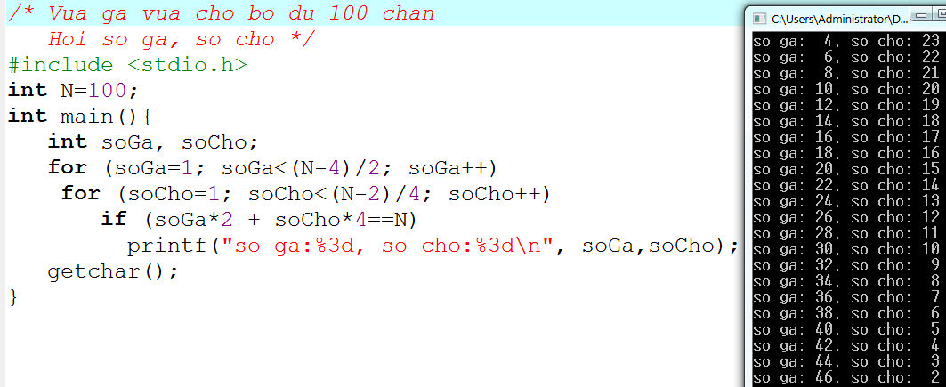
9- Backtracking- Hồi Quy
Example: One-step backtracking in C.
2 loại → 2 biến → 2 vòng lặp lồng nhau
Với n loại bất kỳ thì làm sao để giải?
➔ Đệ quy (vét cạn/hồi quy)

Slide 39
9- Backtracking- Hồi Quy
Definitions:
Problem: a set of variables (V), each variable has a distinct domain (D, set of domains).
Problem’s Constraints: Conditions (C) on values of variables.
A solution: set of specific values of variables (configuration) which satisfy the problem’s constraints.
Ex1: Vừa gà vừa chó bó đủ trăm chân. Hỏi số gà, số chó?
V: 2 variables, 2 domains:
sốGà: [1, (100-4)/2] , ít nhất có 1 con chó
sốChó: [ 1, (100-2)/4], ít nhất có 1 con gà
→ C: sốGà * 2 + sốChó *4 =100.

Slide 40
9- Backtracking- Hồi Quy
Ex2: Bài toán sinh chuỗi 4 bít
V: 4 biến: [0,1]
C: không có điều kiện cần kiểm tra
Ex3: Bài toán trâu
Trăm trâu trăm cỏ, con nhỏ ăn một, con lớn ăn hai, con già hai con một bó. Hỏi số trâu mỗi loại.
V: 3 variables, 3 domains.
small: [0, 100] / big: [0, 100] / old: [0, 100]
C: old là số chẵn AND
small + big + old = 100 AND
small* 1+ big* 2+ old/2 = 100

Slide 41
9- Backtracking- Hồi Quy
Ex 4: A customer likes to buy 3 TVs, 2 refrigerators, 2 fan with budget less than or equals 25,000,000$ (budget)
V: 7 variables, 3 domains.
v0: { TVs }, v1: { TVs }, v2: { TVs }
v3: { Refs }, v4: { Refs }, v5: { Fans }, v6: { Fans }
C: v0.price + v1.price + v2.price +
v3.price + v4.price + v5.price + v6.price <= budget
Backtracking implementations:
Using recursive approach
Using loop approach. A generator which will generate suggestions. Each suggestion will be test whether it matches the problem’s constraints or not.

Slide 42
9- Backtracking- Hồi Quy
Recursive Backtracking
Procedure backtrack (index, V, D, C, solutions)
Input: index, index of current variable
V: Set of variables
D: Set of domains of variables respectively
C: set of constraints
Output: solutions
For each value in D_{index} {
v_{index} = value;
if (index = n-1) { //the last variable was assigned
if (new configuration satisfied C) // new solution is detected
Add new configuration to solutions
}
else backtrack (index+1, V, D, C, solutions) // One-step backtracking
}
Procedure backtrack (V, D, C) {
solutions = empty set; backtrack (0, V, D, C, solutions);
return solutions:
}
At a time, a variable is examined to assign a value to it
V₀ | V₁ | … | V_{index} | V_{index+1} | … | V_{n-1}
Recursive implementation: Memory cost? Time cost?

Slide 43

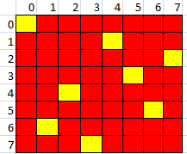
9- Backtracking- Hồi Quy
Demo 11: The Eight-Queen Problem
With size=8, → 64 cells
No. of queens = 8
Complexity: 64⁸
^{(64.63.62.61.60,59.58.57)}
We need a very very long time to find all solutions of the problem using greedy algorithm (our generator)
We should use recursive backtracking approach and stop immediately when a solution is detected.

Slide 44
9- Backtracking- Hồi Quy
Demonstrations: You can download from LMS:
QHD-ToHop-HoiQuy.docx

Slide 45
Summary

LO3.1 Describe the basic ideas of recursion and how to set up recursive systems that represent certain real-world phenomena.
LO3.2 Know how to develop recursive algorithms and programs
LO3.3 Write programs in Java using recursion to solve some problems, like creating the Fibonacci sequence.
LO3.4 Analyze a recursive function to find out its’ ouput without running.
LO3.5 Explain type of recursive functions, give examples and comparing them.
LO3.6 Compare recursion with iteration, analyzes their pros and cons






Slide 46
Ôn tập – Viết vào vở
1- Đệ quy là gì?
2- Con người có dùng kỹ thuật đệ quy hay không? Cho hai thí dụ.
3- Làm sao con người hiểu được đệ quy?
4- Tác vụ đệ quy được mô tả như thế nào? Cho thí dụ.
5- Làm sao có được kỹ năng diễn đạt đệ quy?
6- Đệ quy được dùng để làm gì?
7- Đệ quy đuôi là gì?
8- Đệ quy đầu là gì?
9- Đệ quy tuyến tính là gì?
10- Đệ quy phi tuyến là gì?
11- Đệ quy gián tiếp là gì?
12- Đệ quy hỗ tương là gì?
13- Làm sao hệ thống có thể quản lý các hàm đang thực thi?
14- Hãy cho biết activation record của một hàm gồm có những gì cùng với ý nghĩa của từng thành phần.
15- Tại sao hàm đệ quy khi thực thi lại tốn bộ nhớ?
16- Tại sao hàm đệ quy thực thi lại chậm?
17- Khử đệ quy là gì? Tại sao lại nên khử đệ quy?
18- Khử đệ quy bằng cách nào?
19- Hồi quy là gì?
20- Kỹ thuật hồi quy có thể được dùng trong những bài toán nào? Cho ví dụ.

