Slide 1

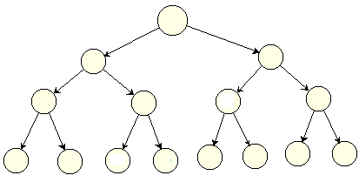
Trees-Part 2 Binary Search Trees

Slide 2
Learning outcomes of this part
LO4.1 Define general tree, Binary Tree and Binary Search Tree (BST).
LO4.2 Given a BST , draw resulted tree after an insert/ delete operations
LO4.3 Find the smallest and largest elements, number of nodes in a
tree and its’ height.
LO4.4 Write code to implement features of a binary search tree, such as insertion, deletion, searching, traversals, counting nodes, height calculation, rotation (part 3) ...
LO4.5 Derive the time complexities for the above operations on a BST.
LO4.6: Compare a BST over other data structures
LO4.7: Identify applications where a binary search tree will be useful.

Slide 3
Contents
What is binary search tree (BST)?
What are BST’s properties?
How to describe a node?
How to manager a tree?
When are BSTs used?
Demo.: BST of integers
Algorithms on BST:
Add new node
Getting minimum, maximum values
Getting tree’s height
Searching
Deleting
The given demonstration must be implemented by yourself and your works will be evaluated.

Slide 4
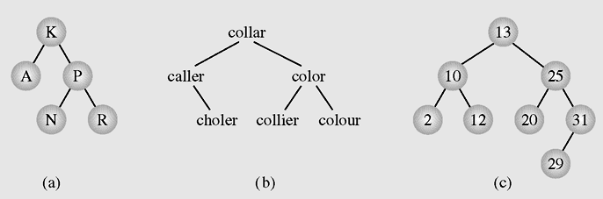
Binary Search Tree: Introduction
Binary Search tree is an orderly binary tree whose nodes are designated at exactly positions based on pre-defined comparisonal function.
Common used order:
Data in Left child node < data in father Node < data in Right child node
- LNR order in briefly.
Examples of binary search trees

Slide 5
BST: Introduction …
Natural orders:
On numbers: numerical comparison
On characters, strings: Dictionary order → ASCII comparison
Examples of binary search trees

Slide 6
BST: Introduction …
Order of User-defined Objects:
Programmer must define a comparison method. This method must return an integer.
In Java, the default comparison is declared in the interface java.lang.Comparable, method:
int compareTo(Object obj)
In Java, we can also use the interface Comparator, method:
int Compare (Object obj1, Object obj2)

Slide 7
BST’s Properties
5
Minimum value is put at the leftmost position of the tree.
Maximum values is put at the rightmost position of the tree.
2
8
1
3
6
9
4
7
10
Searching operation will not need to traverse all nodes but a path will be chosen ( searching x= 7)
Complexity of these operations are improved.
A BST is recommended to use when managing a collection of items in which search operations are frequently used→ Search operation must be improved → All elements are stored in pre-defined order.
Notes:
O(-3)

Slide 8
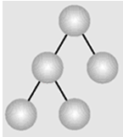
BST: Node and Tree Basic Structures
class BinTreeNode{
Object data;
BinTreeNode left;
BinTreeNode right;
}
class BST {
BinTreeNode root = null;
}
Notes:
Cấu trúc liên k

Slide 9
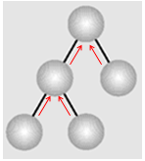
BST: Node and Tree Advanced Structures
class BinTreeNode{
Object data;
BinTreeNode left;
BinTreeNode right;
BinTreeNode father; // additive data
}
Implementation view: More memory accepted, higher performance gained in operations
class BST {
BinTreeNode root = null;
}

Slide 10
Algorithms on BSTs
Managing, Initializing
Add new node
Get minimum, maximum values
Calculate tree’s height
Traverse
Search
Delete

Slide 11
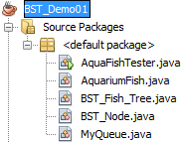
BST- Demo 01
Class | Purpose
AquariumFish | An aquarium fish
BST_Node | A node in a BST of aquarium fishes
BST_Fish_Tree | BST of aquarium fishes
MyQueue | A queue of BST nodes
AquaFishTester | Main program for testing
In this demonstration, write-to-file operations using the RandomAccessFile class are not implemented. If you want, you can do them by yourself.
The RandomAccessFile class is usually used in practical examinations.

Slide 12

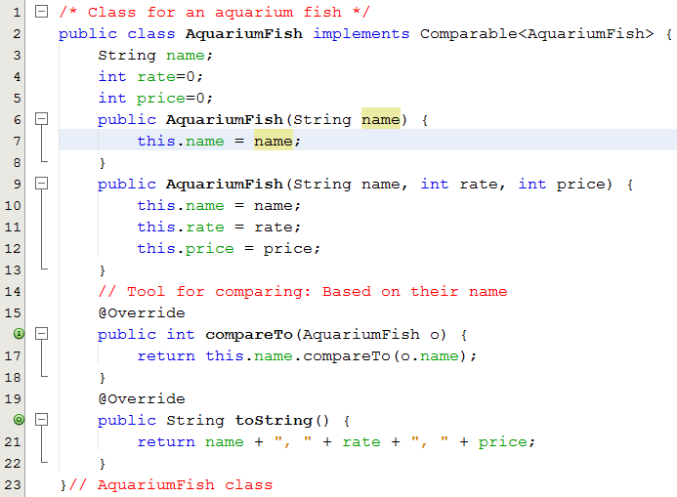
BST- Demo 01

Slide 13
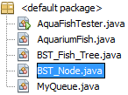
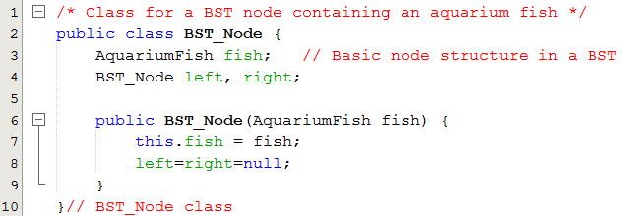
BST- Demo 01

Slide 14

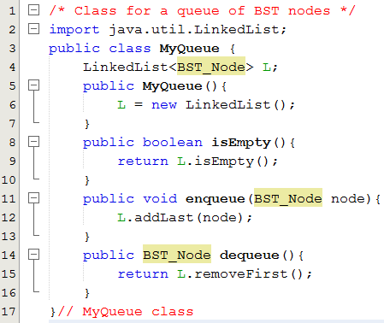
BST- Demo 01

Slide 15
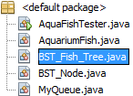
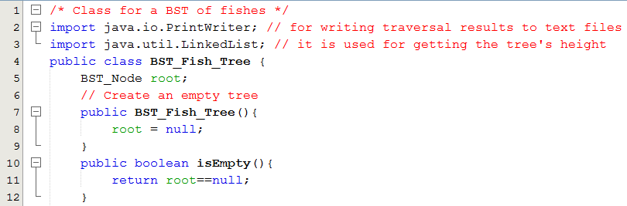
BST- Demo 01

Slide 16
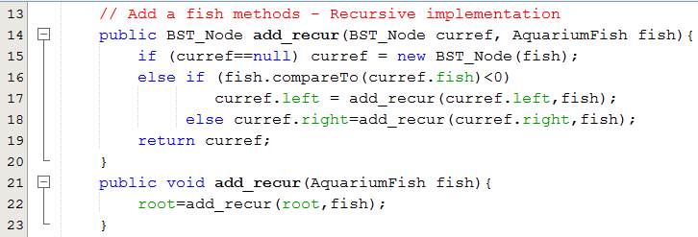
BST- Demo 01
Add a new node to BST – Recursive implementation
5
Add 6 to the root (node 5)
6>5 → Add 6 to the node root.right (node 8)
6 < 8 → Add 6 to (node 8 ).left
Java uses by- value parameters. So, the method add_recur(…) must return a value and in the caller, this return value must be assigned to a meaningful variable of the program (line 22) .
2
8
1
3
6
9

Slide 17
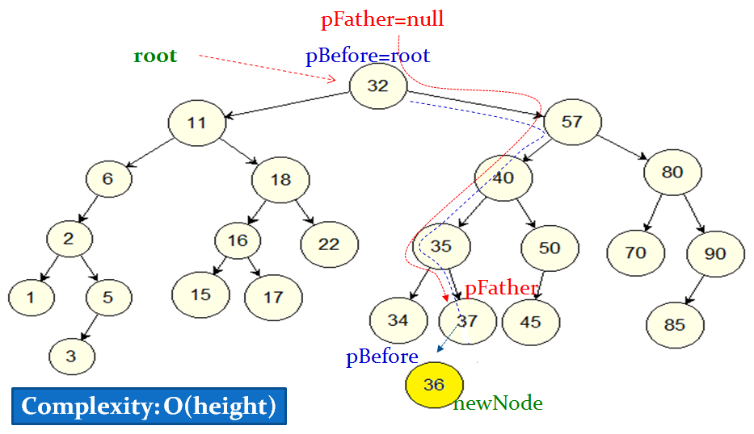
BST- Demo 01
Add a new node to BST – Non- Recursive impl.

Slide 18
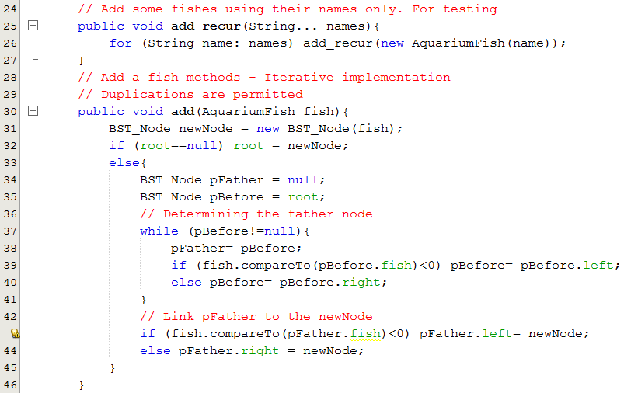
BST- Demo 01
Add a new node to BST – Non- Recursive implementation.
Notes:
25: hàm có đối số thay đổi.

Slide 19
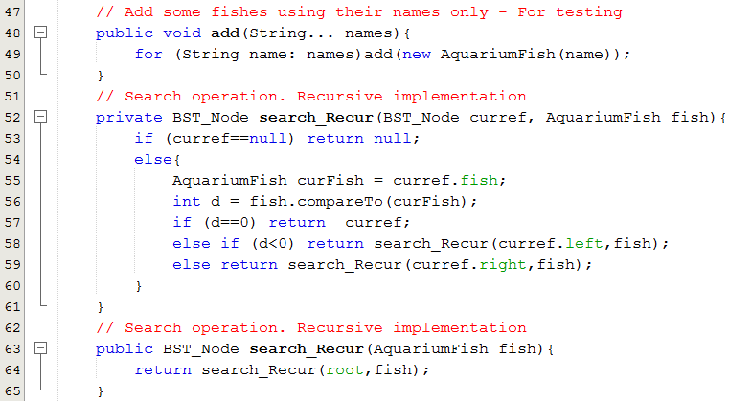
BST- Demo 01
Search operation: Recursive implementation.

Slide 20
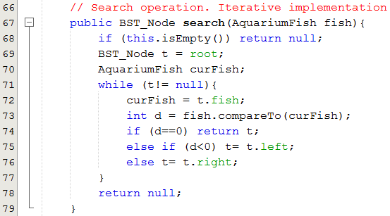
BST- Demo 01
Search operation: Iterative implementation.
Notes:
Dòng 78: return t chậm hơn return null
Null: hằng –> chạy thẳng câu lệnh
T: phải truy xuất

Slide 21
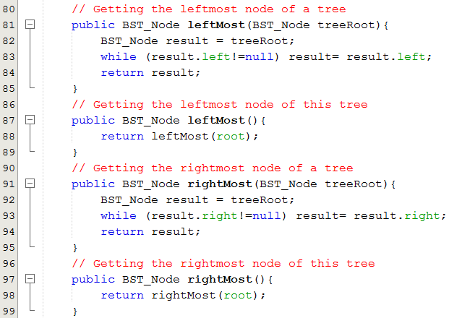
BST- Demo 01
Getting the leftmost and the rightmost nodes

Slide 22
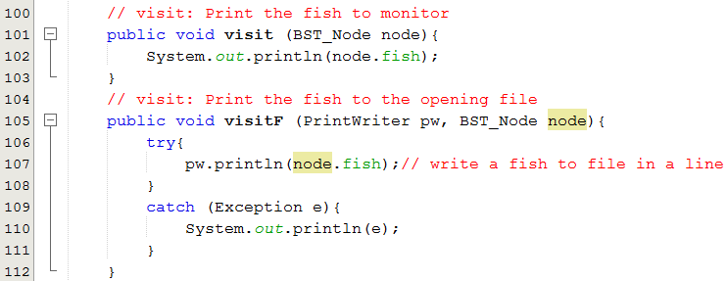
BST- Demo 01
Visiting a node. They are used in Traversals.

Slide 23
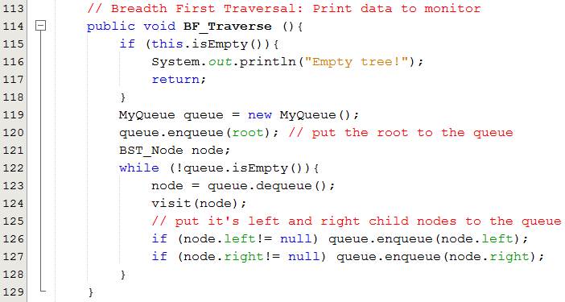
BST- Demo 01
Breadth-First Traversals. Using a queue.
Notes:
Xóa đi tạo mới
2. ghi đè, EOF = -1.
=> khác nhau
Tầm vực của biến, gom rác

Slide 24
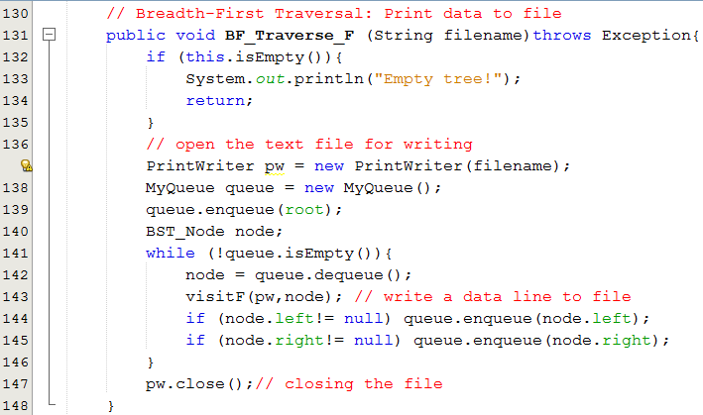
BST- Demo 01
Breadth-First Traversals. Using a queue.

Slide 25
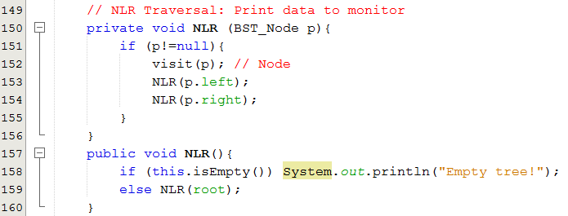
BST- Demo 01
DF Traversals. Using recursive implementations.

Slide 26
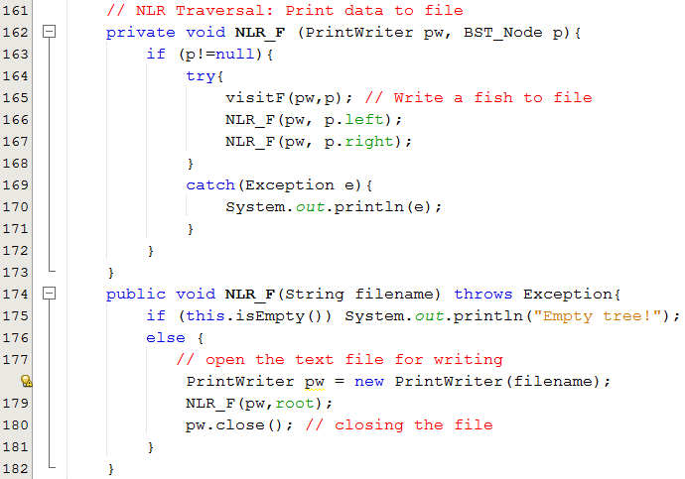
BST- Demo 01
DF Traversals. Using recursive implementations.
Notes:
178: ghi đè file nếu có file, còn ko mở mới file

Slide 27
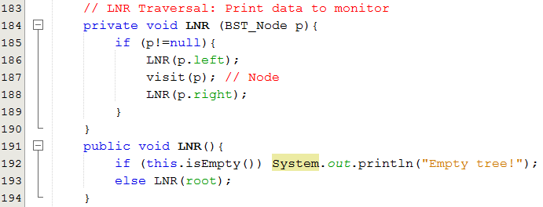
BST- Demo 01
DF Traversals. Using recursive implementations.

Slide 28
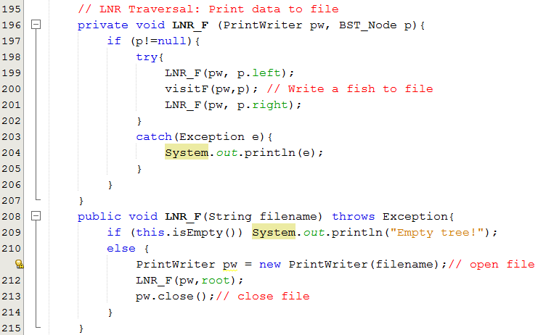
BST- Demo 01
DF Traversals. Using recursive implementations.

Slide 29
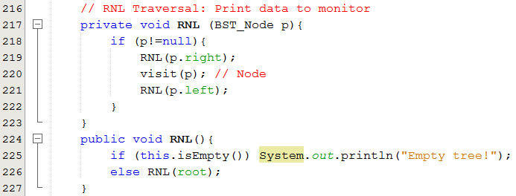
BST- Demo 01
DF Traversals. Using recursive implementations.

Slide 30
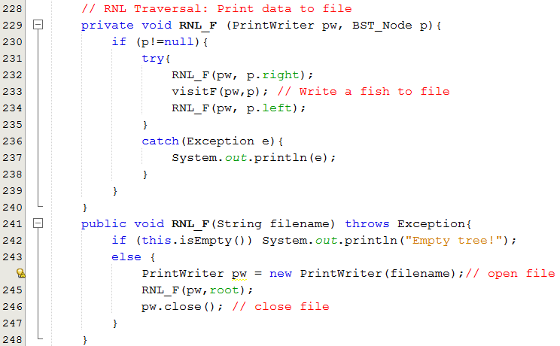
BST- Demo 01
DF Traversals. Using recursive implementations.

Slide 31
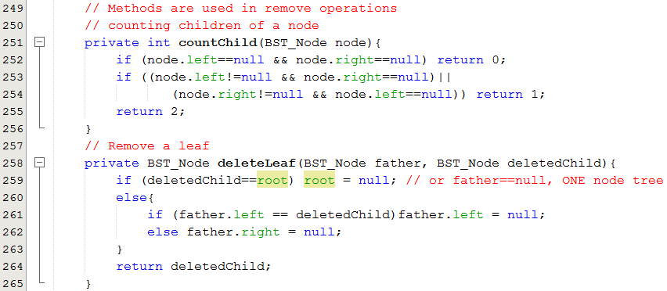
BST- Demo 01
Deletions in BST
root
x
f
x
Notes:
3 cách xóa
Lá
1 con
2 con

Slide 32
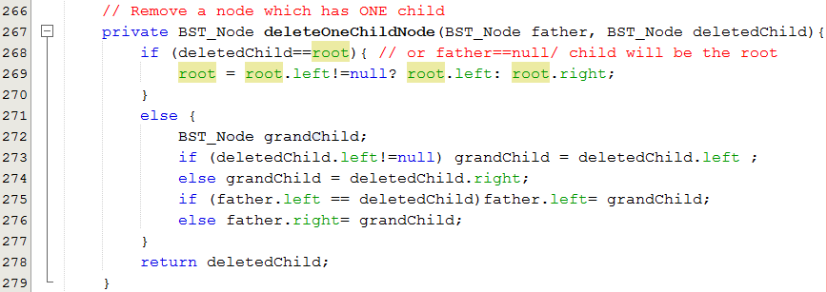
BST- Demo 01
Deletions in BST
GF
father
deletedNode = root
x
deletedNode
x
x
GC
grandChild

Slide 33
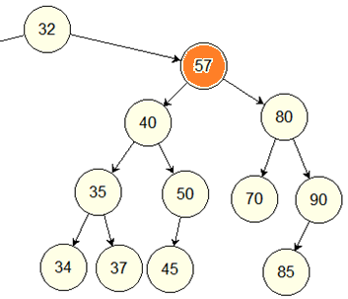
Alg.: Deleting
Removing a 2-child node by Merging
The IntBstTree class
delNode
grandFather
leftGrandChild
rightGrandChild
rightMost
The tree’s height may increase
(this example)
rightMost

Slide 34
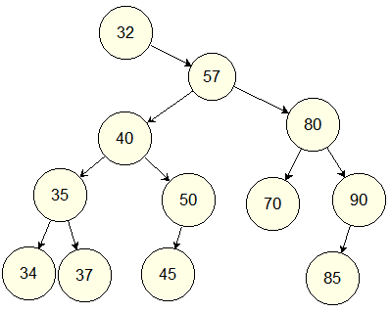
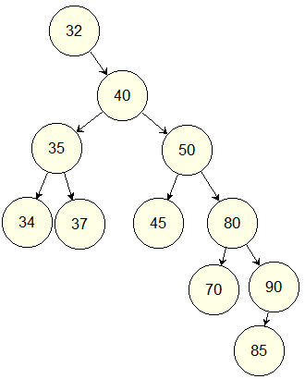
Alg.: Deleting
Removing a 2-child node by Merging
The IntBstTree class
Height= 5
Height= 6
It is NOT a GOOD method. The tree’s height may increase.

Slide 35
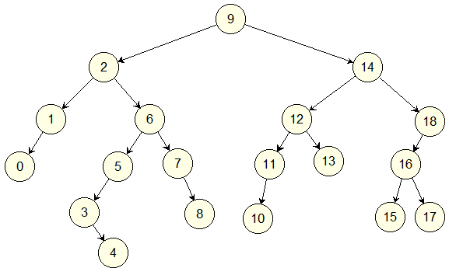
Alg. :Removing a node by Merging
Exercise:
Remove nodes by merging
After the node 1 was deleted, what is father of the node 0?
After the node 4 was deleted, what is child of the node 3?
After the node 5 was deleted what is father of the node 4?
After the node 14 was deleted, what is father of the node 18?
After the node 9 was deleted, what is the tree’s height?
Notes:
2
Null
3
13
8

Slide 36
Alg. :Removing a node by Merging
Exercise:
Remove nodes by merging
After the node 9 was deleted, what is father of the node 2?
After the node 9 was deleted, what is child of the node 14?
After the node 6 was deleted what is father of the node 5?
After the node 11 was deleted, what is father of the node 10?
After the node 9 was deleted, what is the tree’s height?

Slide 37
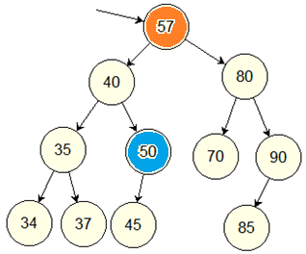
Alg.: Deleting
Removing a 2-child node by Copying
delNode
Steps
(1) Determine the rightmost node of the left sub tree of the deleted node.
(2) Copy data from the rightmost node to the deleted node.
(3) Remove the rightmost node.
Advantage
The tree’s height is preserved or may be reduced because a path reduces one in it’s length.
rightMost

Slide 38
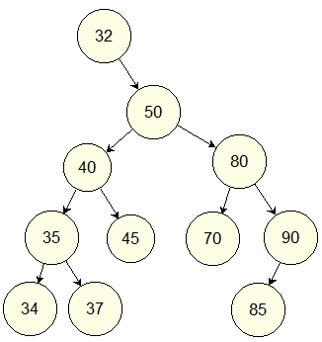
Alg.: Deleting
Removing a 2-child node by Copying
Height= 5
Height= 5
It is a GOOD method.
The tree’s height preserves or decreases.

Slide 39
Delete a node by copying
Exercise:
Remove nodes by copying
After the node 9 was deleted, what is father of the node 2?
After the node 9 was deleted, what is child of the node 14?
After the node 6 was deleted what is father of the node 5?
After the node 11 was deleted, what is father of the node 10?
After the node 11 was deleted, what is the tree’s height?

Slide 40
Delete a node by copying
Exercise:
Remove nodes by copying
After the node 1 was deleted, what is father of the node 0?
After the node 4 was deleted, what is child of the node 3?
After the node 5 was deleted what is father of the node 4?
After the node 14 was deleted, what is father of the node 18?

Slide 41
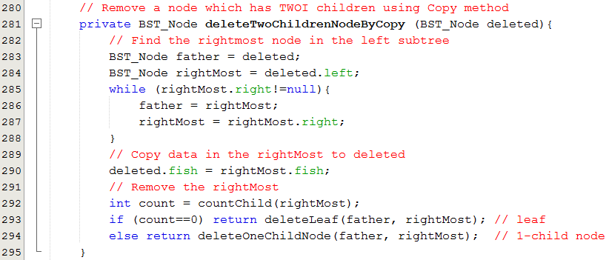
BST- Demo 01
Deletions in BST
Notes:
O(n) vòng while = chiều cao cây

Slide 42
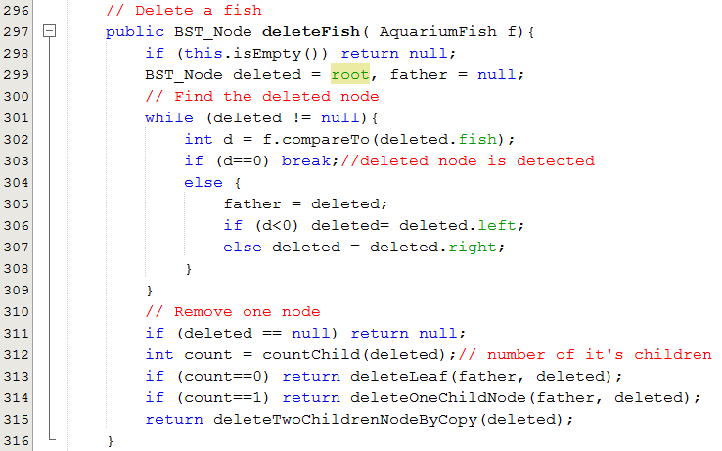
BST- Demo 01
Deletions in BST

Slide 43
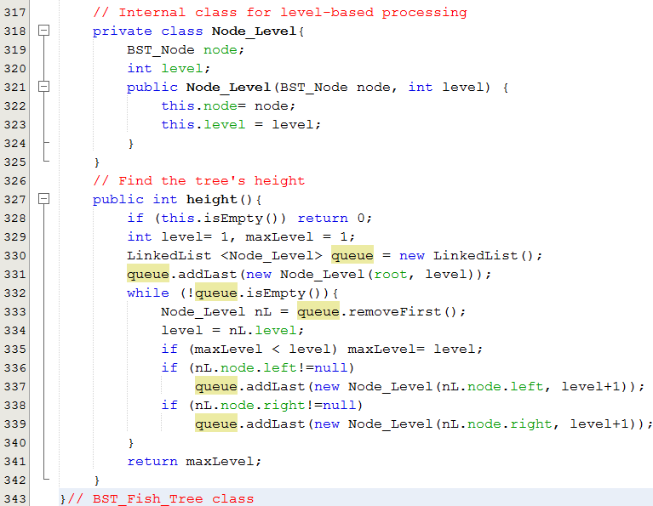
BST- Demo 01
Tree’s Height

Slide 44

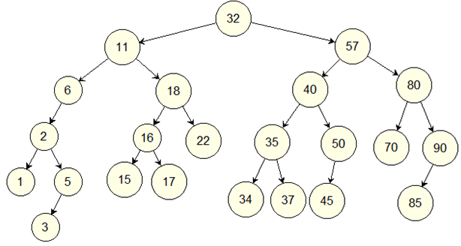
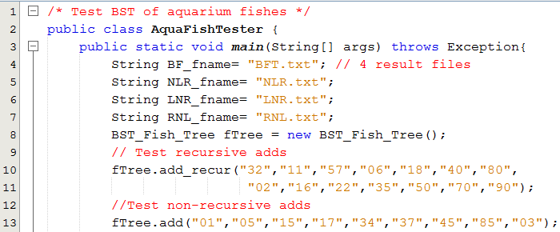
BST- Demo 01
Testing

Slide 45
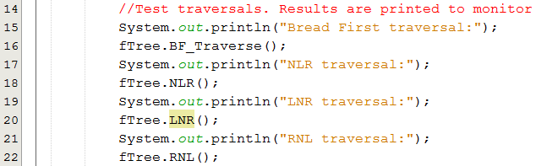
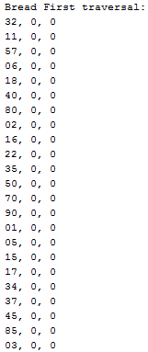
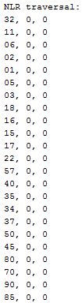
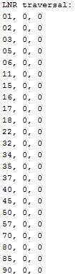
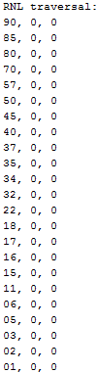
BST- Demo 01
Testing

Slide 46
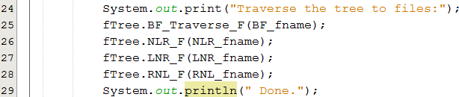
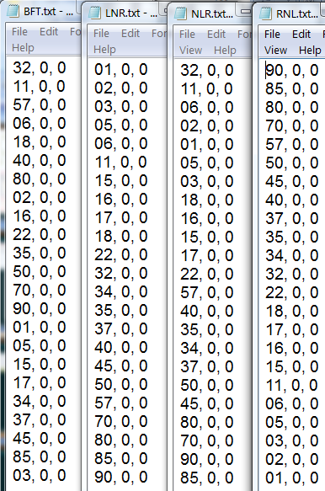
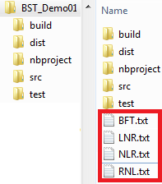
BST- Demo 01
Testing

Slide 47
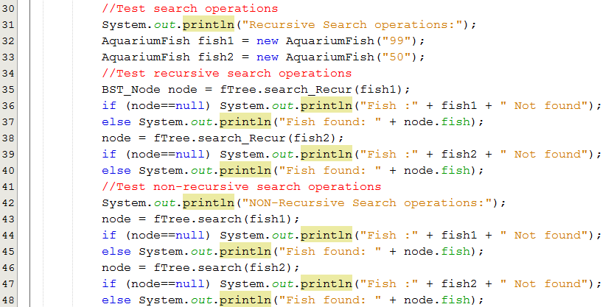

BST- Demo 01
Testing

Slide 48


BST- Demo 01
Testing

Slide 49
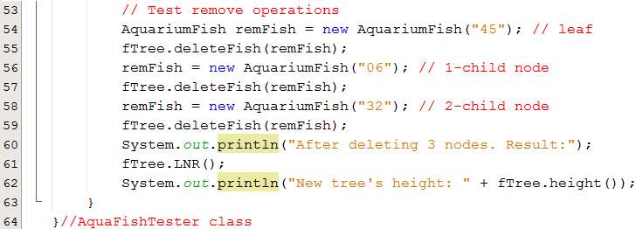
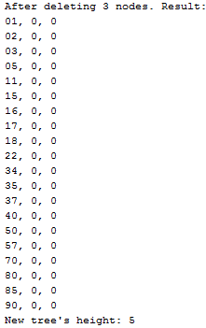
BST- Demo 01
Testing

Slide 50
Evaluating BSTs: Advantages
Operations including Adding, searching, removing are improved with complexity of O(tree’s height), less than O(number of items).
Sort operation is omitted because data in the tree are always sorted.
If the tree is a complete binary tree, the tree’s height will be minimum. In this case, operations on the tree are optimal.

Slide 51
Evaluating BSTs: Disadvantages
Tree’s height depends mainly on order of data added. This situation of complete BST is very hard to occur in normal problem.
In case of the BST is degraded, almost of data are at one direction, operations will have complexity of O(number of nodes) ← Hm Hm

Slide 52
Evaluating BSTs
Structure | Add | Search | Remove
Array | O(1), O(n) | O(n) | O(n)
Linked list | O(1), O(n) | O(n) | O(1)
BST | O(height) | O(height) | O(height)

Slide 53
Summary: All LOs are met.

LO4.1 Define general tree, Binary Tree and BST.
LO4.2 Given a BST , draw resulted tree after an insert/ delete operations
LO4.3 Find the smallest and largest elements, number of nodes in a tree and its’ height.
LO4.4 Write code to implement features of a binary search tree, such as insertion, deletion, searching, traversals, nodes and height calculation, rotation ...
LO4.5 Derive the time complexities for the above operations on a BST.
LO4.6: Compare a BST over other data structures
LO4.7: Identify applications where a binary search tree will be useful.







Slide 54
Ôn tập- Viết vào vở
Hãy vẽ một cây BST tuỳ ý sau đó cho kết quả của các phép duyệt: NLR, NRL, LNR, RNL, LRN, RLN.
Thứ tự tự nhiên là gì? Giải thích lý do.
Để một nút trong cây BST có thể chứa object, class của object này cần phải được khai báo thế nào? Slide 13 14 15
Hãy vẽ một cây BST tuỳ ý sau đó giải thích việc thêm một nút mới vào cây này.
Hãy viết vào vở 16 thao tác xoá trên 4 bài thí dụ trong slide này và cho kết quả.
Các trị sau được đưa vào cây BST trống theo thư tự: 3 5 7 9 2 4 6 8 1. Sau khi xoá nút 4, nút 3 là con của nút nào?
Các trị sau được đưa vào cây BST trống theo thư tự. Hỏi số phép so sánh phải tiến hành khi tìm trị 12. 3 5 7 9 2 4 6 8 1.
Giả sử nút gốc của cây nhị phân có mức 1. Hỏi số nút tối đa ở mức 10.
Các trị sau được đưa vào cây BST trống theo thư tự 3 5 7 9 2 4 6 8 1. Hãy cho biết kết quả của phép duyệt theo chiều rộng.

Slide 55
Next part: Balanced BST and Heap Structure

