Slide 1
Sorting

Slide 2
Objectives
Sorting: putting/arranging a number of objects in an order (Cambridge dictionary)
Sorting is a process that will swap elements in a group such they are in order based on some pre-defined criterion.
Natural orders: numerical order, dictionary order

Slide 3
Contents
1- Elementary Sorting Algorithms
2- Decision Trees
3- Efficient Sorting Algorithms (quick, merge, heap, radix, bucket sorts)
4- Sorting in the java.util package

Slide 4
Learning Outcomes
LO6.1 Explain the operation and performance of selection sort applying to arrays.
LO6.2 Explain the operation and performance of insertion sort applying to arrays.
LO6.3 Explain the operation and performance of bubble sort applying to arrays.
LO6.4 Explain the operation and performance of quick sort applying to arrays.
LO6.5 Explain the operation and performance of merge sort applying to arrays.
LO6.6 Explain the operation and performance of heap sort applying to arrays.
LO6.7 Demonstrate the operation and performance of radix sort.
LO6.8 Demonstrate the operation and performance of bucket sort.

Slide 5
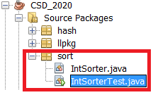
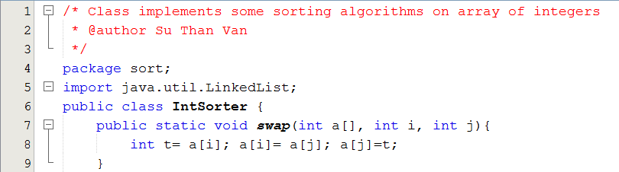
Your work
Implement sorting algorithms
Project structure:
IntSorter: class implements sort algorithms on an array of integers.
IntSorterTest: Class for testing sort algorithms

Slide 6
1- Elementary Sorting Algorithms
Why are they elementary?
What are they?
Selection Sort
Insertion Sort
Bubble Sort

Slide 7
1- Elementary Sorting Alg…
minIndex
Selection Sort
0 | 1 | 2 | 3 | 4 | 5 | 6 | 7 | 8
4 | 3 | 7 | 5 | 1 | 6 | 8 | 9 | 2
Swapping the element having minimum value in each group and the first element of the group.
0 | 1 | 2 | 3 | 4 | 5 | 6 | 7 | 8
1 | 3 | 7 | 5 | 4 | 6 | 8 | 9 | 2
0 | 1 | 2 | 3 | 4 | 5 | 6 | 7 | 8
1 | 2 | 7 | 5 | 4 | 6 | 8 | 9 | 3
0 | 1 | 2 | 3 | 4 | 5 | 6 | 7 | 8
1 | 2 | 3 | 5 | 4 | 6 | 8 | 9 | 7
0 | 1 | 2 | 3 | 4 | 5 | 6 | 7 | 8
1 | 2 | 3 | 4 | 5 | 6 | 8 | 9 | 7
Continue…

Slide 8
1- Elementary Sorting Alg…
Selection Sort
Selection sort is an attempt to localize the exchanges of array elements by finding a misplaced element first (ex: minimum value) and putting it in its final place.
Selectionsort(a[]){
L = a.length
for i = 0 to L-2 {
choose the smallest element among {a[i],a[L-1]}
swap it with a[i];
}
}

Slide 9
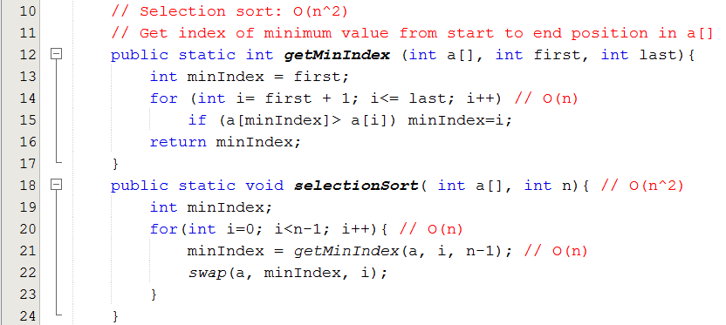
1- Elementary Sorting Alg…
Selection Sort
Go to the slide 47

Slide 10
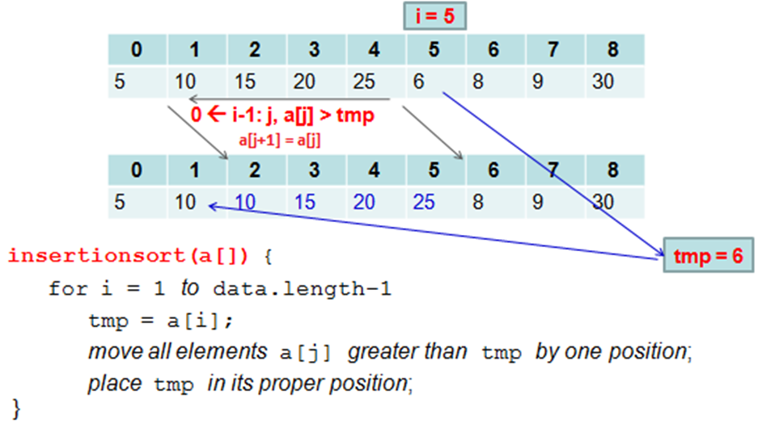
1- Elementary Sorting Alg…
Insertion Sort
O(n²)
O(n)
O(n)

Slide 11
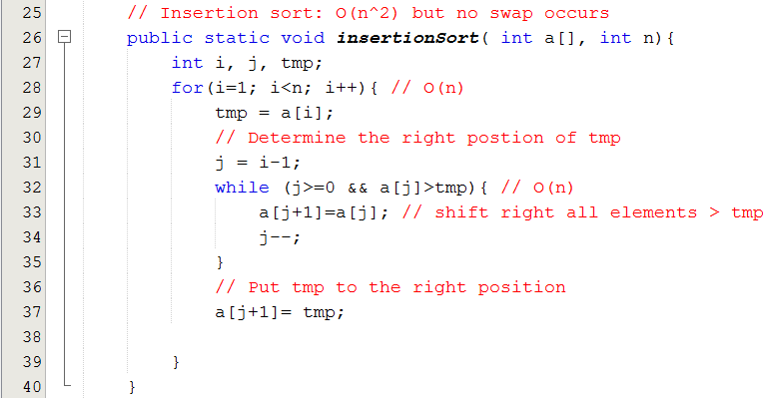
1- Elementary Sorting Alg…
Insertion Sort

Slide 12
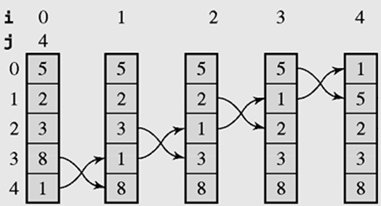
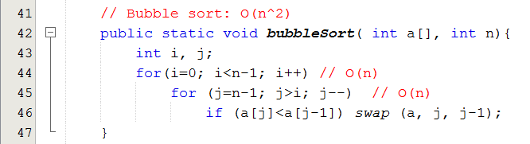
1- Elementary Sorting Alg…
Bubble Sort

Slide 13
2- Decision Trees
In three elementary sorts, which is the most efficient one? → Use decision tree.
Every sorting algorithm can be expressed in terms of a binary tree in which nodes are comparisons, and arcs carry the labels Y(Yes) or N(No)
A decision tree is when non-terminal nodes of the tree contain conditions or queries for labels, and the leaves have all possible orderings of the array to which the algorithm is applied.
It is a tool for comparing complexities of algorithms.

Slide 14
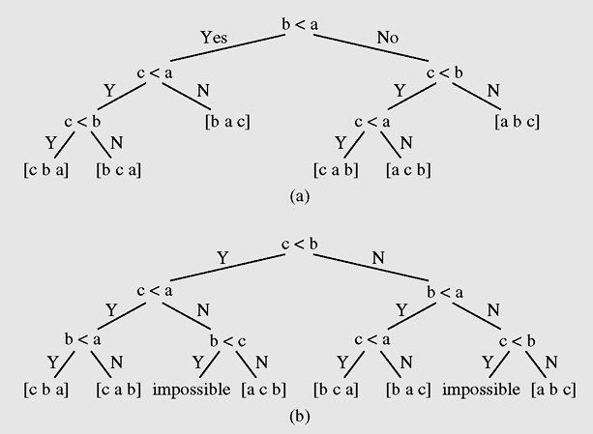
2- Decision Trees …
Decision trees for insertion sort as applied to the array [a b c]
Decision trees for bubble sort as applied to the array [a b c]
Examples of decision trees for an array of three elements

Slide 15
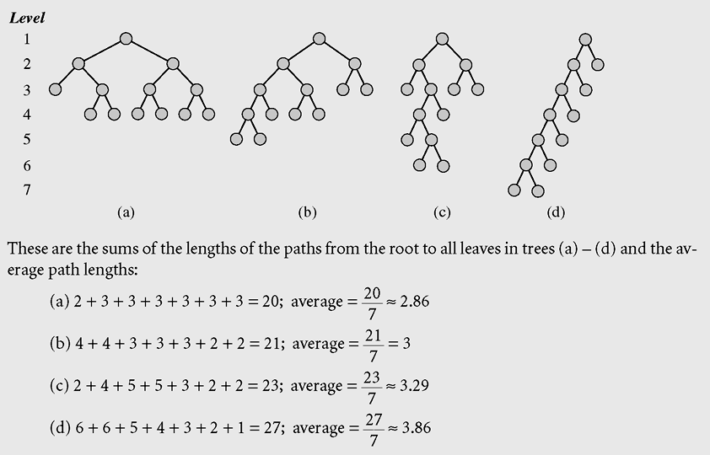
2- Decision Trees …
Examples for computing average paths of some binary trees

Slide 16
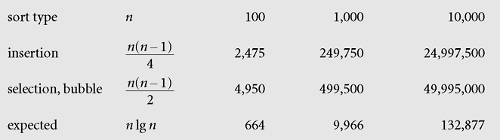
2- Decision Trees …
Evaluating elementary sorting algorithms
O(n²)
Complexity of elementary sorts and expectation
Notes:
THI

Slide 17
3- Efficient Sorting Algorithms
Common Principle: Divide and Conquer:
Divide: The initial large scale problem is divided into smaller scale similarly sub-problems. Solve these sub-problems.
- Conquer: Extra operations must be performed to connect sub-solutions.
There are about a dozen efficient sorting algorithms. Followings will be introduced:
Quick Sort
Merge Sort
Heap Sort
Radix sort
Bucket Sort
10²= 100 > 5² + 5² = 50
O(n²) > bO(n/b)²

Slide 18
The Master Theorem in the Discrete Mathematics
3- Efficient Sorting Algorithms
Let f be an increasing function that satisfies the recurrence relation f(n) = af(n/b) + cn^{d}
Whenever n= b^{k}, where k is a positive integer, a ≥ 1, b is an integer greater than 1, and c and d are real numbers with c positive and d nonnegative. Then
Notes:
The Master theorem is useful in analyzing the complexity of many important divide-and-conquer algorithms.
Theorem 1 is a special case of this theorem.

Slide 19
3- Efficient Sorting Algorithms…
Quick Sort
It is introduced by C. A. R. Hoare
Main idea:
Choose an element of array, called as bound/pivote (trị cầm canh) to divide(partition) the array to 2 subarrays. Left subarray contains values< pivote, right subarray contains values >= pivote.
Recursively performing on left subarray and right subarray.

Slide 20
3- Efficient Sorting Algorithms…
Quick Sort
lower→
← upper
9 | 6 | 2 | 1 | 5 | 3 | 4 | 8 | 7 | 0
pivote= an element in array.
pivote= 5
0 | 6 | 2 | 1 | 5 | 3 | 4 | 8 | 7 | 9
0 | 4 | 2 | 1 | 5 | 3 | 6 | 8 | 7 | 9
upper
lower
Best case: O(nlogn)
0 | 4 | 2 | 1 | 3 | 5 | 6 | 8 | 7 | 9
Recursively partitioning on this subarray
Recursively partitioning on this subarray

Slide 21
3- Efficient Sorting Algorithms…
Quick Sort
How to choose pivote(bound):
It can be first / last/ mid / random element
Median (phần tử trung vị, phần tử nằm giữa trong 3 phần tử được chọn)
Nhận xét:
Chọn pivote càng cầu kỳ càng tốn thêm xử lý. Nên chọn ngay phần tử đầu nhóm làm pivote là đơn giản nhất, ít xử lý nhất.
Pivote is the first element of the group
P
upper
lower
P
 |  |  |  |  | P
After a partition, the upper index the exact position for the pivote

Slide 22
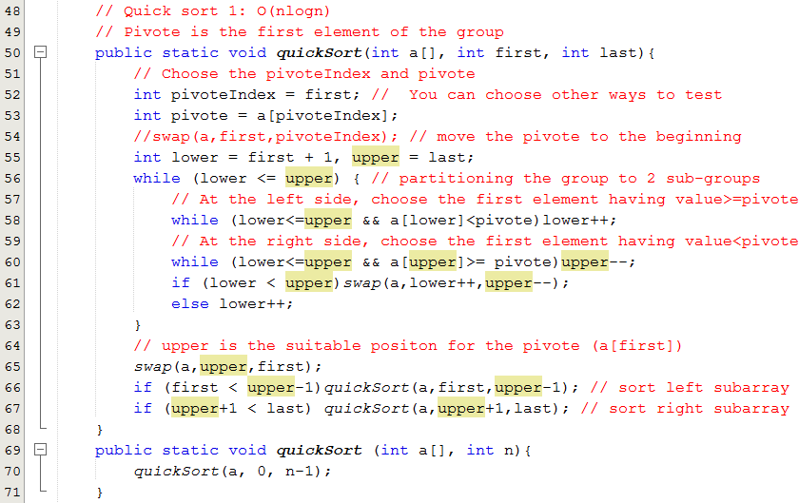
3- Efficient Sorting Algorithms…
Quick Sort

Slide 23
3- Efficient Sorting Algorithms…
Merge Sort
It was one of the first sorting algorithms used on a computer and was developed by John von Neumann.
Mergesort makes partitioning as simple as possible and concentrates on merging sorted halves of an array into one sorted array
mergesort(data)
if data have at least two elements
mergesort(left half of data); // recursion
mergesort(right half of data);
merge(both halves into a sorted list);

Slide 24
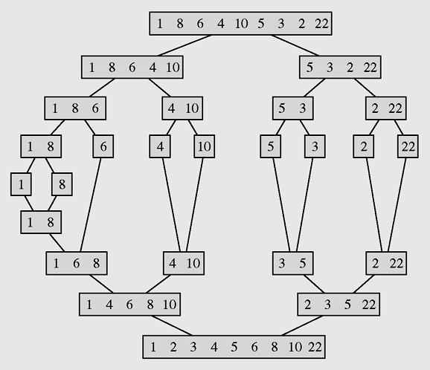
3- Efficient Sorting Algorithms…
Merge Sort
Partition until subarray contains 1 element
Merge
The array [1 8 6 4 10 5 3 2 22] sorted by mergesort
Notes:
Chia để trộn

Slide 25
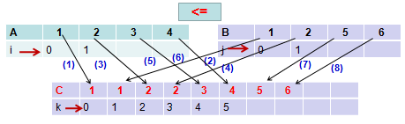
3- Efficient Sorting Algorithms…
Merge Sort
Merge 2 ordered arrays to one ordered array

Slide 26
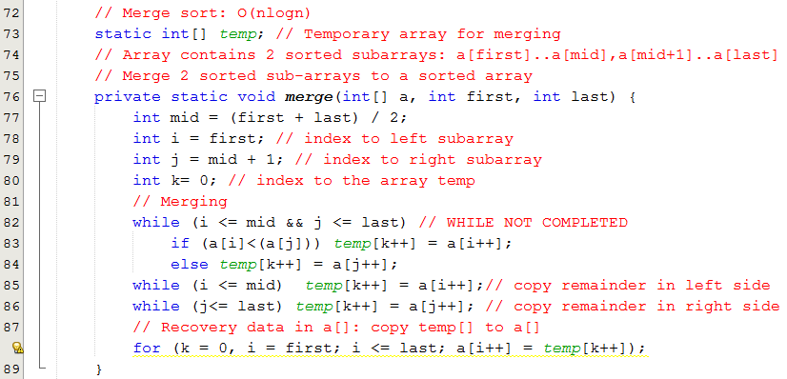
3- Efficient Sorting Algorithms…
Merge Sort

Slide 27
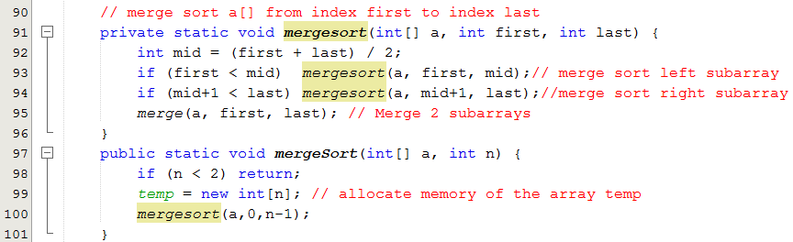
3- Efficient Sorting Algorithms…
Merge Sort

Slide 28
3- Efficient Sorting Algorithms…
Heap Sort
A heap is a binary tree, stored in an array, with the following two properties (it is introduced in the chapter Trees):
The value of each node is not less than the values stored in each of its children.
The tree is perfectly balanced and the leaves in the last level are all in the leftmost positions.
Elements in a heap are not perfectly ordered

Slide 29
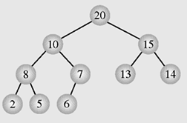
3- Efficient Sorting Algorithms…
Heap Sort
The largest element is in the root node and that, for each other node, all its descendants are not greater than the element in this node- Max heap
Index | 0 | 1 | 2 | 3 | 4 | 5 | 6 | 7 | 8 | 9
Value | 20 | 10 | 15 | 8 | 7 | 13 | 14 | 2 | 5 | 6

Slide 30
3- Efficient Sorting Algorithms…
Heap Sort
The largest element is in the root node and that, for each other node, all its descendants are not greater than the element in this node
Index | 0 | 1 | 2 | 3 | 4 | 5 | 6 | 7 | 8 | 9
Value | 20 | 10 | 15 | 8 | 7 | 13 | 14 | 2 | 5 | 6
Child index -1
Left = 2.Father +1
Right= 2.Father+2
Father index =
2

Slide 31
3- Efficient Sorting Algorithms…
Heap Sort
heapsort(data[])
transform data into a heap;
for i = data.length-1 downto 2 //reverse consideration
swap the root with the element in position i;
restore the heap property for the tree data[0], . . . , data[i-1];

Slide 32
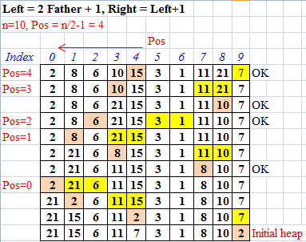
3- Efficient Sorting Algorithms…
Heap Sort
Transforming an array to the initial max heap

Slide 33
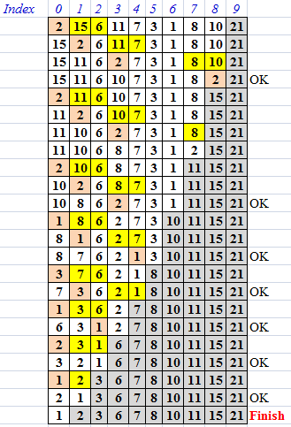
3- Efficient Sorting Algorithms…
Heap Sort
Restoring heap property

Slide 34
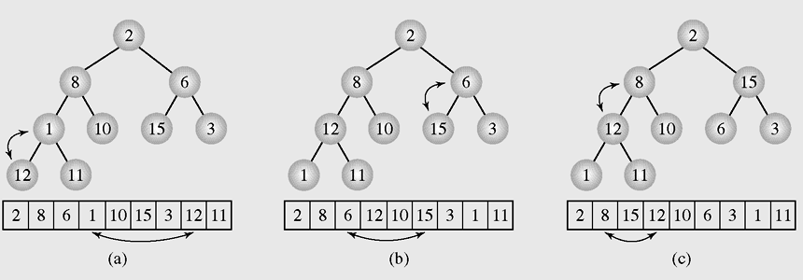
3- Efficient Sorting Algorithms…
Heap Sort
Figure 9-9 Transforming the array [2 8 6 1 10 15 3 12 11] into a heap

Slide 35
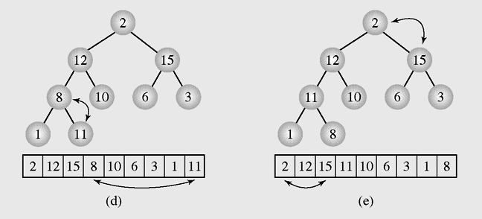
3- Efficient Sorting Algorithms…
Heap Sort
Figure 9-9 Transforming the array [2 8 6 1 10 15 3 12 11] into a heap (continued)

Slide 36
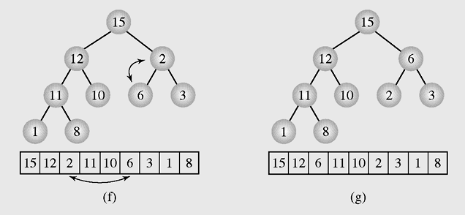
3- Efficient Sorting Algorithms…
Heap Sort
Figure 9-9 Transforming the array [2 8 6 1 10 15 3 12 11] into a heap (continued)

Slide 37
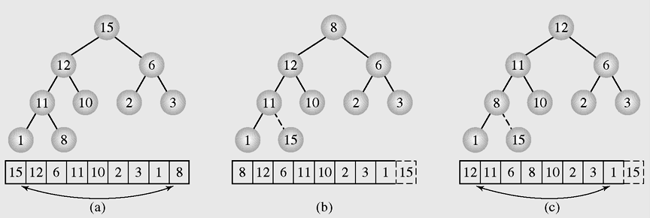
3- Efficient Sorting Algorithms…
Heap Sort
Figure 9-10 Execution of heap sort on the array [15 12 6 11 10 2 3 1 8], which is the heap constructed in Figure 9.9

Slide 38
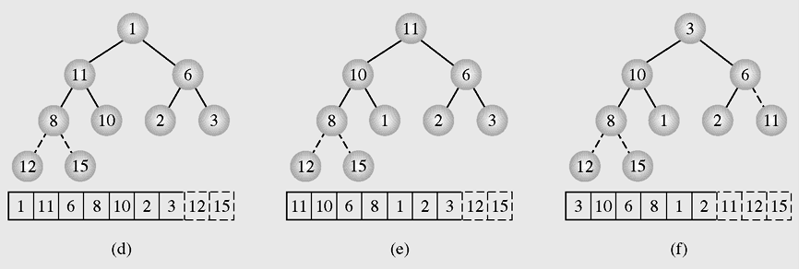
3- Efficient Sorting Algorithms…
Heap Sort
Figure 9-10 Execution of heap sort on the array [15 12 6 11 10 2 3 1 8], which is the heap constructed in Figure 9.9 (continued)

Slide 39
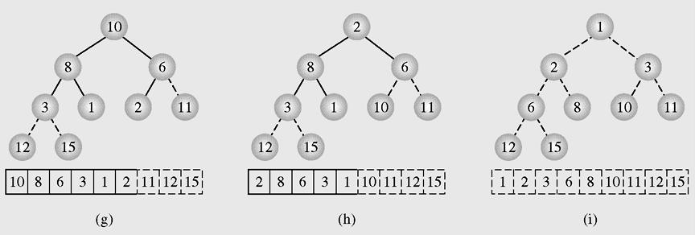
3- Efficient Sorting Algorithms…
Heap Sort
Figure 9-10 Execution of heap sort on the array [15 12 6 11 10 2 3 1 8], which is the heap constructed in Figure 9.9 (continued)

Slide 40
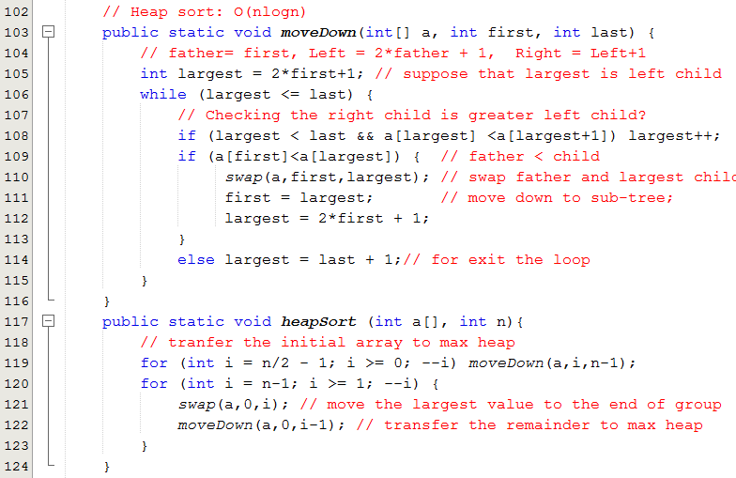
3- Efficient Sorting Algorithms…
Heap Sort

Slide 41
3- Efficient Sorting Algorithms…
Radix Sort
A technique to sort integers by proceeding right to left
A technique that looks at each number as a string of bits so that all integers are of equal length
radixsort()
for d = 1 to the position of the leftmost digit of longest number
distribute all numbers among piles 0 through 9 according to the dth digit;
put all integers on one list;

Slide 42
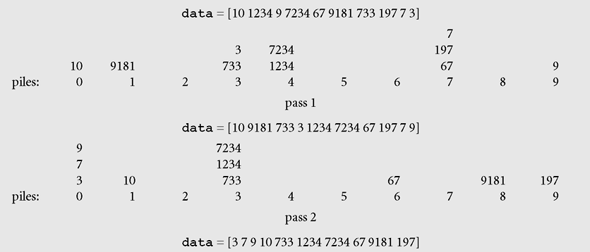
3- Efficient Sorting Algorithms…
Radix Sort → O(nlogn)
queues
The biggest of rightmost digit of longest numbers
O(n)
d= 1, units digits
O(n)
d= 2, tens digits
Sorting the list 10, 1234, 9, 7234, 67, 9181, 733, 197, 7, 3 with radix sort

Slide 43
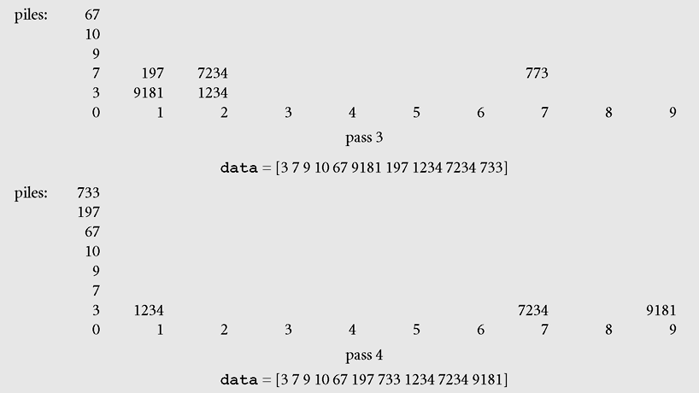
3- Efficient Sorting Algorithms…
Radix Sort
d= 3, hundreds digits
d= 4, thousands digits
Sorting the list 10, 1234, 9, 7234, 67, 9181, 733, 197, 7, 3 with radix sort

Slide 44
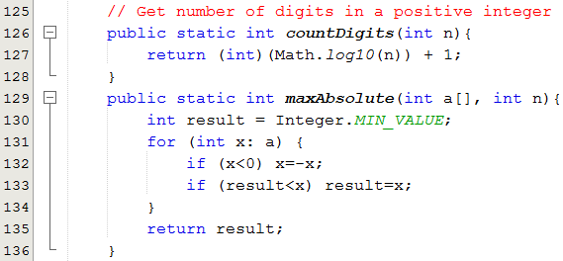
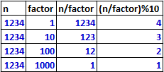
3- Efficient Sorting Algorithms…
Radix Sort
n | Digits
1..9 | 1
10..99 | 2
100..999 | 3
1000..9999 | 4
Digits = (int) log₁₀(n) +1
Getting a digit in an integer

Slide 45
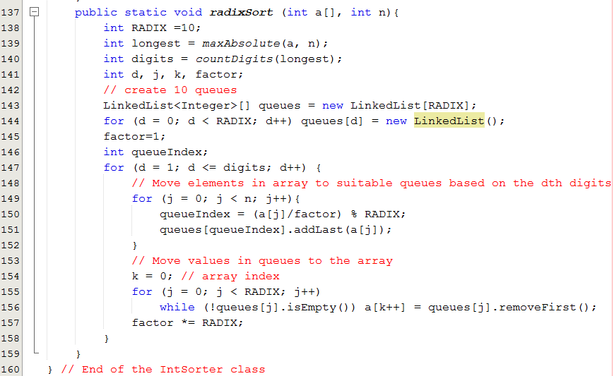
3- Efficient Sorting Algorithms…
Radix Sort

Slide 46
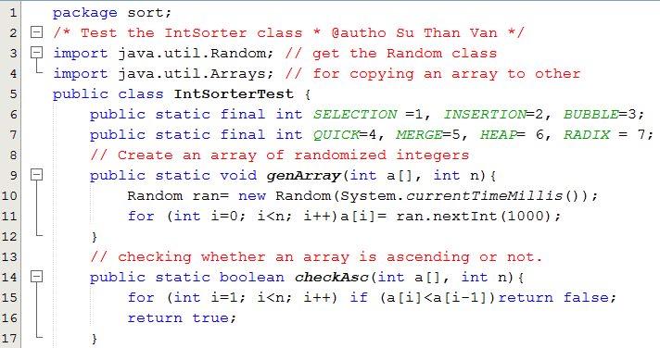
The IntSorterTest class

Slide 47
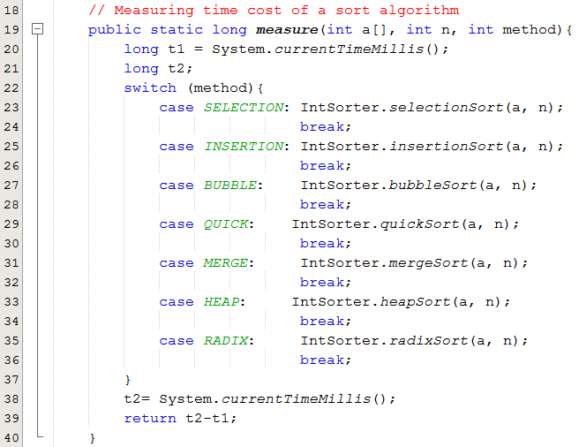
The IntSorterTest class

Slide 48
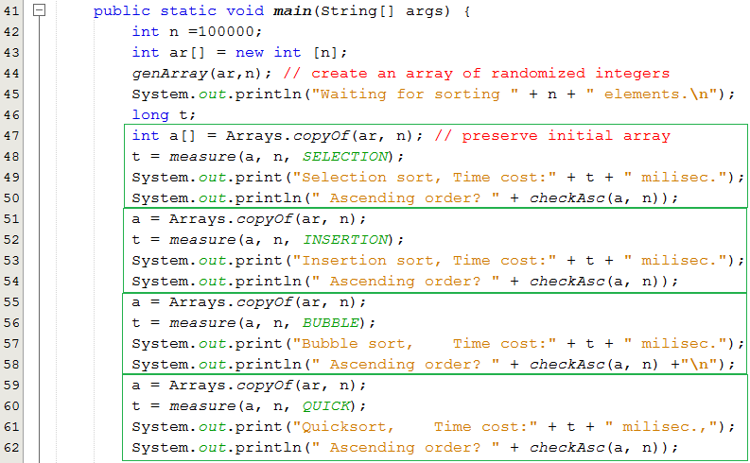
The IntSorterTest class

Slide 49
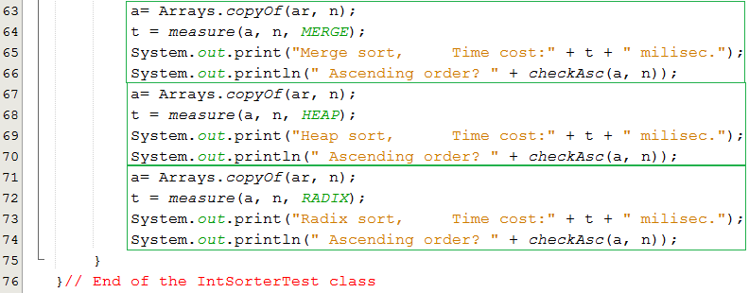
The IntSorterTest class

Slide 50
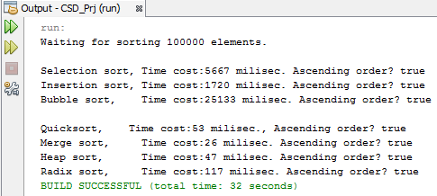
The IntSorterTest class
Results of a run:
Go to the slide 10

Slide 51
Efficient Sorting Algorithms…
Bucket Sort (sắp xếp theo khối)
A[] = {1,5,7,6,2,4,9,3,7,9,8,5,6,8,7,1} → [1,9]
Chọn b=3, [1,9] → [1,4], [4,7], [7,9]
Chia A thành 3 mảng con:
A1[] = {1,2,3,1} A2[] = {5,6,4,5,6} A3={7,9,7,9,8,8,7} Sắp xếp các mảng con:
A1[] = {1,1,2,3} A2[] = {4,5,5,6,6} A3={7,7,7,8,8,9,9}
Nối các mảng con:
A[] = {1,1,2,3,4,5,5,6,6,7,7,7,8,8,9,9}
Xong

Slide 52
Efficient Sorting Algorithms…
Bucket Sort:
A[] có khoảng trị [min, max]
Chọn số nguyên b, chia khoảng lớn thành b khoảng nhỏ
Phân chia A[] thành b mảng con phù hợp với các khoảng nhỏ
Sắp xếp các mảng con
Nối b mảng con thành mảng kết quả
Xong

Slide 53
Efficient Sorting Algorithms…
Bucket Sort: Đánh giá/ n = số phần tử của A[]
A[] có khoảng trị [min, max] → O(n)
Chọn số nguyên b, chia khoảng lớn thành b khoảng nhỏ → O(1)
Phân chia A[] thành b mảng con phù hợp với các khoảng nhỏ → O(n), m= n/b, số phần tử trung bình trong 1 mảng con
Sắp xếp các mảng con → bO(m²) hay bO(mlog(m))
Nối b mảng con thành mảng kết quả → O(n)
➔ Theo nguyên lý cộng, độ phức tạp chung: bO(m²) hay bO(mlog(m)) tùy thuộc thuật toán đã dùng để sắp xếp các mảng con.

Slide 54
4- Sorting in java.util
Java provides two sets of versions of sorting methods: one for arrays (Arrays) and one for lists (Collections)
The utility class Arrays includes a method for:
Searching arrays for elements with binary search
Filling arrays with a particular value
Converting an array into a list, and sorting methods
The sorting methods are provided for arrays with elements of all elementary types except Boolean

Slide 55
4- Sorting in java.util…
For each type of sorting method there are two versions:
One for sorting an entire array
One for sorting a subarray
public static void sort(int[] a);
public static void sort(int[] a, int first, int last);

Slide 56
4- Sorting in java.util…
How to use Java library to sort your array of objects?
The Comparator Interface
A comparison function, which imposes a total ordering on some collection of objects
The following demonstration will show you the way to sort a list based on different criteria: A list of employees will be sorted based on
(1) Ascending IDs
(2) Descending salaries then ascending IDs.

Slide 57
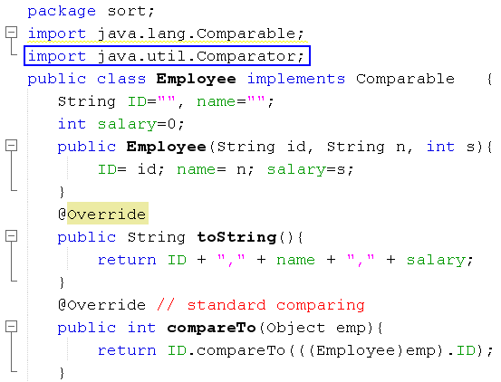
4- Sorting in java.util…
Java.lang is default package
Default Comparision based on IDs (Comparable interface)

Slide 58
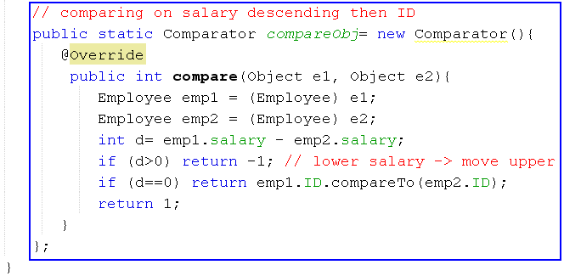
4- Sorting in java.util…
Comparing 2 employees based on descending salaries then ascending IDs → Use the Comparator interface.
Create an anonymous object for comparing 2 employees

Slide 59
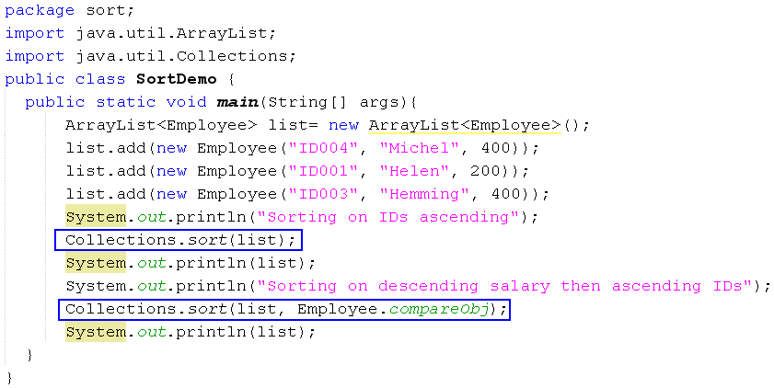

4- Sorting in java.util…

Slide 60
Summary
Sorting is a two step process: Choose the criteria that will be used to order data and determine how to put a set of data in order using that criterion
Elementary sorting algorithms: O(n²)
Selection sort is an attempt to localize the exchanges of array elements by finding a misplaced element first and putting it in its final place
An insertion sort starts by considering the two first elements of the array data, which are data[0] and data[1]
Bubble sort will swapping toe consecutive elements of the array

Slide 61
Summary (continued)
A decision tree is when non-terminal nodes of the tree contain conditions or queries for labels, and the leaves have all possible orderings of the array to which the algorithm is applied.
Based on the decision tree, the most efficient elementary sorting algorithm is insertion-sort.
Efficient Sorting Algorithms
They are introduced based on the “Divide and Conquer” principle.
Almost of them have complexity of O(nlogn)
Quick-sort will partition an array into two sub-arrays based on a pivote value.

Slide 62
Summary (continued)
Merge-sort makes partitioning as simple as possible and concentrates on merging sorted halves of an array into one sorted array.
Heap-sort uses characteristics of a heap to sort an array.
Radix sort is a technique to sort integers by proceeding right to left based on positions of digits.
Bucket sort will partition an original array into sub-arrays based on range of values. Sub-arrays are sorted then they are concatenated to create a total sorted array.
Java provides two sets of versions of sorting methods in the java.util package: one for arrays and one for lists.

Slide 63
Summary: Learning Outcomes

LO6.1 Explain the operation and performance of selection sort applying to arrays.
LO6.2 Explain the operation and performance of insertion sort applying to arrays.
LO6.3 Explain the operation and performance of bubble sort applying to arrays.
LO6.4 Explain the operation and performance of quick sort applying to arrays.
LO6.5 Explain the operation and performance of merge sort applying to arrays.
LO6.6 Explain the operation and performance of heap sort applying to arrays.
LO6.7 Demonstrate the operation and performance of radix sort.
LO6.8 Demonstrate the operation and performance of bucket sort.








