Slide 1
Text Processing

Slide 2
Introduction
Text = String = a sequence of characters = a sequence of bytes
Despite the wealth of multimedia information, text is still main data format in computers
Text is digitalized (ASCII, EBCDIC,… or a pre-defined code table)
WWW → HTML, XML, text documents, email,…
Many data sets are stored in text format (String)
Common Methods on text: trim(), charAt(index), subString(…), lower(), upper(), beginWith(…),…
indexOf(…)
Two basic problems on text data:
Matching a substring (search operation)
Compressing a document

Slide 3
Objectives: Learning Outcomes
3
LO8.1 Describe the Text Processing problem and its’ application.
LO8.2 Explain the Brute Force Text Pattern-Matching algorithm.
LO8.3 Describe the main idea of The Knuth-Morris-Pratt Algorithm.
LO8.4 Explain The Huffman Coding Algorithm.
LO8.5 Explain steps needed to use The Huffman Coding Algorithm for compressing a text file.
LO8.6 Explain the LZW encoding algorithm.
LO8.7 Explain the Run-length encoding algorithm.
Notes:
3

Slide 4
Contents
4
1- String Matching
Brute-Force algorithm
Knuth-Morris-Pratt Algorithm
2- Data Compression
Condition for Data Compression
Huffman Coding Algorithm
LZW Algorithm
Run-length Encoding
Your work: Re-implement demonstrations in this lecture.
Notes:
4

Slide 5
1- String Matching
Given a string S, the problem of string matching deals with finding whether a pattern p occurs in S and if p does occur then returning position in S where p occurs.
S= “ssdf egeg h5yh r5h45h j 6rhr”
P=“h5y”
➔ position = 10
2 algorithms are introduced:
The Brute Force Algorithm
The Knuth-Morris-Pratt (KMP) Algorithm

Slide 6
1- String Matching…
The Brute-Force Algorithm
Brute Force approach: A way for proving/programming in which a problem will be evaluated in all cases – vét cạn, exhausted searching.
S ( length n=10)
D | B | C | D | E | F | A | T | H | E
D | E | F | E
 | D | E | F | E
 |  | D | E | F | E
 |  |  | D | E | F | E
 |  |  |  | D | E | F | E
 |  |  |  |  | D | E | F | E
 |  |  |  |  |  | D | E | F | E
p (length m=4)
Loop (n-m+1) times
Loop matching m pairs of characters
O((n-m+1)(m)) ➔ O(nm)
Drawback: SLOW
Notes:
duyệt bị lặp
Chỉ đẩy dc 1 ô

Slide 7

1- String Matching…
The Bruth Force Algorithm
Project for demonstration

Slide 8
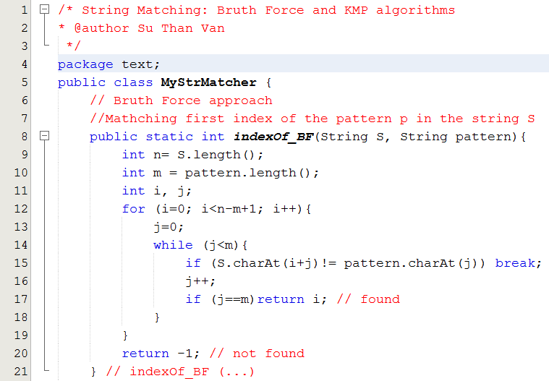
1- String Matching…
The Bruth Force Algorithm

Slide 9
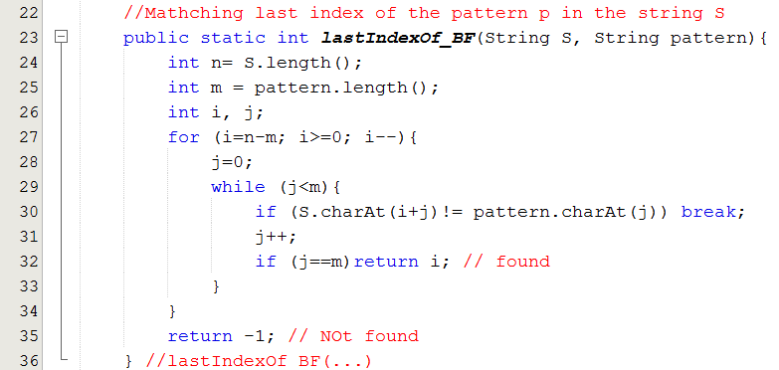
1- String Matching…
The Bruth Force Algorithm

Slide 10
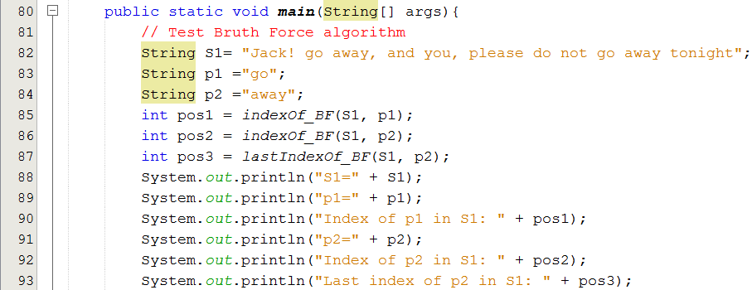
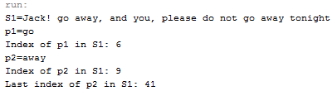
1- String Matching…
The Bruth Force Algorithm

Slide 11
1- String Matching…
The Knuth-Morris Pratt Algorithm
Knuth, Morris and Pratt proposed a linear time algorithm for the string matching problem.
A matching time of O(n+m) is achieved by avoiding comparisons with elements of S that have previously been involved in comparison with some element of the pattern p to be matched. i.e., backtracking on the string S never occurs.
Main idea: Pattern may be shifted MORE THAN ONE position in the source string.

Slide 12
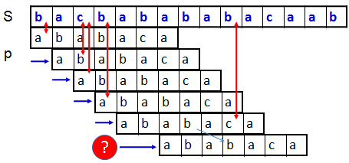
1- String Matching…
The Knuth-Morris Pratt Algorithm

Slide 13
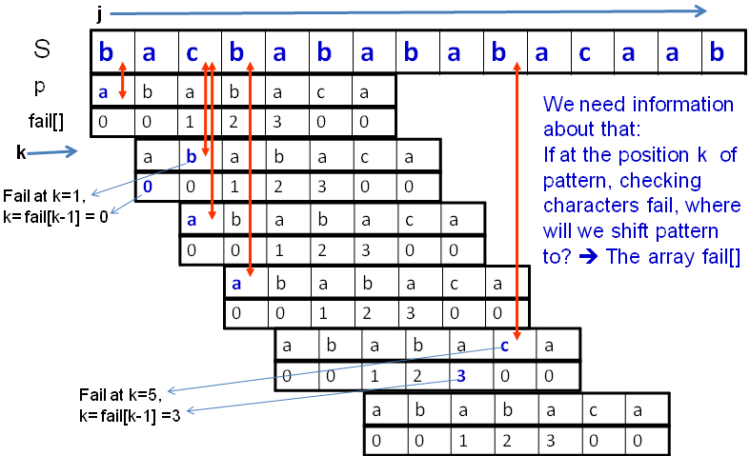
1- String Matching…
The Knuth-Morris Pratt Algorithm

Slide 14
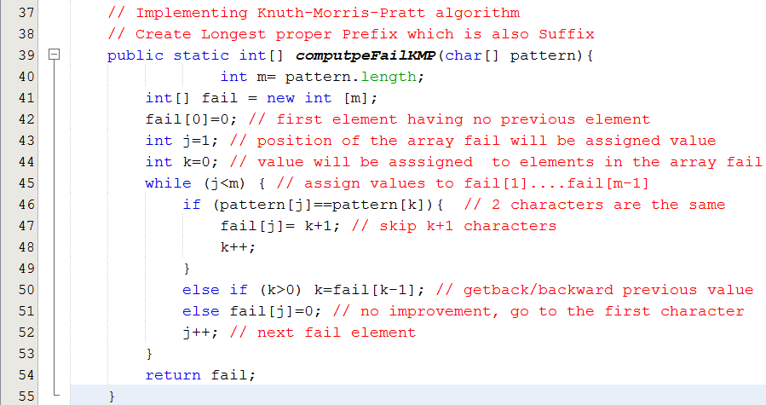
1- String Matching…
The Knuth-Morris Pratt Algorithm

Slide 15
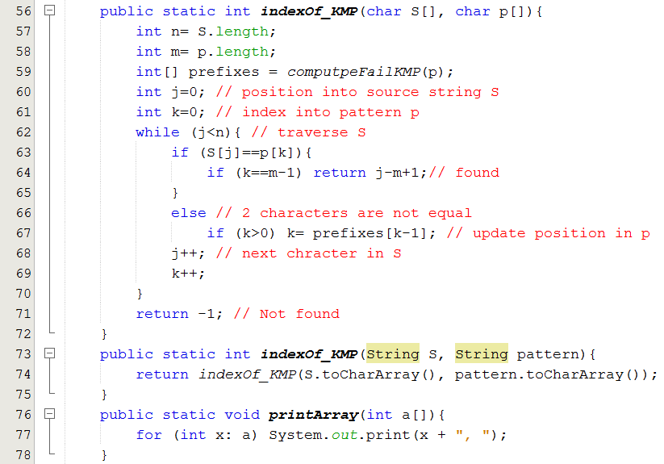
1- String Matching…
The Knuth-Morris Pratt Algorithm

Slide 16
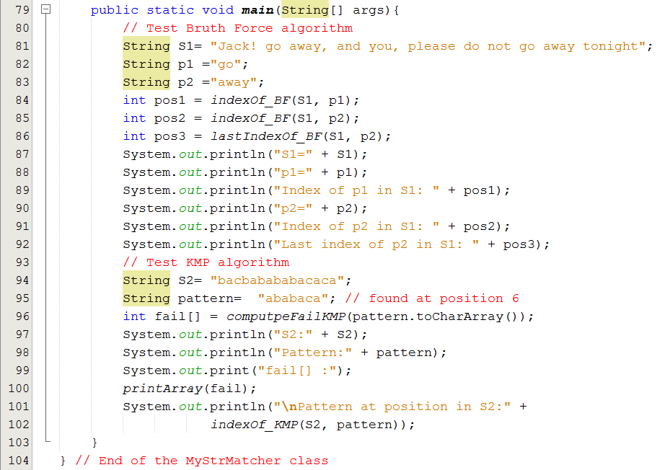

1- String Matching…
The Knuth-Morris Pratt Algorithm

Slide 17
2- Data Compression
Introduction to data compression
Some Compression Algorithms:
Huffman Encoding
Lempel-Ziv
RLE: Run Length Encoding

Slide 18
2- Data Compression…
Introduction
Raw data (10KB)
encoding
Compressed data (2KB)
decoding
Data compression or source coding is the process of encoding information using fewer bits (or other information-bearing units) than an un-encoded representation would use through use of specific encoding schemes.” (Wikipedia)
Advantages:
Reducing the consumption of storage.
Increasing transmission efficiency
Cost:
Time for compressing/decompressing.

Slide 19
2- Data Compression…
Introduction: Classification
Based on de-compressed data:
Lossy compression: MP3 ← → WAV, JPG ←→ BMP
Lossless compression: ZIP, RAR, GZ
Lossy compression: Nén bằng cách bỏ bớt. Âm thanh không nghe được thì bỏ đi (MP3), giảm độ phân giải của ảnh (BMP). → Khi giải nén, không thể phục hồi dữ liệu ban đầu
Lossless Compression Algorithms are introduced:
(1) Huffman Encoding
(2) Lempel-Ziv
(3) RLE: Run Length Encoding
→ Performance of a compression method depends on file type.

Slide 20
2- Data Compression…
Introduction: Prefix code compression
Basic of Lossless compression:
Main idea: Use smaller number of bits to store a data unit (8 bit-character- symbol).
Codeword: sequence of bits corresponding to a symbol. Codeword of a symbol is unique.
Average codeword length indicates efficiency of a compression .
Compression rate
length(input) – length (output) → dL
length(input) → L
Compression rate is used to compare the efficiency of different data compression methods when applied to the same data.

Slide 21
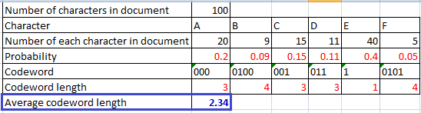
2- Data Compression…
Introduction: Prefix code compression
Computing the average codeword length:
→ Use the entropy formula – trung bình mức độ lộn xộn
L_{ave} = H = P(x₁)L(x₁) + · · · + P(x_{n})L(x_{n})
In which:
P(X_{i}): probability of the symbol X_{i}.
L(X_{i}): Codeword length of the symbol X_{i}.
Sum of products

Slide 22
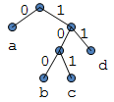
2- Data Compression…
Introduction: Prefix Code Compression
Properties of a set of codewords:
A variable length code assigns a bit string
(codeword) of variable length to every message value
Ex: a = 0, b = 100, c = 101, d = 11
A uniquely decodable code is a variable length code in which bit strings can always be uniquely decomposed into its codewords.
A prefix code is a variable length code in which no codeword is a prefix of another codeword. It can be viewed as a binary tree with message values at the leaves and 0 or 1s on the edges.

Slide 23
2- Data Compression…
Prefix Code: Exercises
Method 1: Draw the codeword tree.
Method 2: Checking duplication and scanning short codeword from the beginning of each longer one.
Given codeword sets. What set are invalid? And why they are not?
a = 0, b = 100, c = 101, d = 11 ← valid
A: 000, B: 0100, C: 001, D: 011, E: 1, F: 0101 ← valid
A: 00, B: 010, C: 001, D: 011, E: 1, F: 0101 ← invalid
A: 001, B: 010, C: 001, D: 011, E: 1, F: 0101 ← invalid
A: 01, B: 001, C: 011, D: 011, E: 10, F: 0101 ← invalid

Slide 24
2- Data Compression…
Prefix Code: Exercises
Given codeword set:
a = 0, b = 100, c = 101, d = 11
(1) String “bacadaba” will be encoded to 100010101101000 →compression rate = (64-15)/64 ?
(2) String “cadcaadacba” will be encoded to ____
(3) Encoded string “100,11,0,11100100” will be decoded to _____
(4) Encoded string “10111000100101” will be decoded to _______

Slide 25
2- Data Compression…
Introduction: The optimal Prefix Code
For a code C with associated probabilities p(c) the average length is defined as
We say that a prefix code C is optimal if for all prefix codes C, l_{a}(C) ≤ l’_{a}(C), l’_{a}(C) is average codeword length of other code set.
The Huffman code is known to be probably optimal under certain well-defined conditions for data compression.

Slide 26
Huffman Algorithm Mechanism
Data source (file)
Compressing
Main idea: Encoding higher probability symbols with fewer bits
Create frequency table
Freq. table
Construct Huffman Tree
Huffman Tree
Generate codewords
Codeword Table
Encode data
Bit String
Write file
Zipped File
Codeword Table
Binary data
Data source is read 2 times → Slow

Slide 27
2- Data Compression…
Huffman Encoding Algorithm: An Example
(Step 1)
Construct Frequency Table
Example:
A : 20% (.20)
B : 9% (.09)
C : 15% (.15)
D : 11% (.11)
E : 40% (.40)
F : 5% (.05)
Prob. = char. count/ number of chars. in document

Slide 28
2- Data Compression…
Huffman Encoding Algorithm: An Example
(Step 2) Constructing Codeword (Huffman) tree
Put symbols and their associated frequencies in descending order based on probabilities → We have a ordered forest in which each tree contains only one node.
Repeat grouping the two right tree into a tree until there is only one tree. It is the result codeword tree.
Notes:
28

Slide 29
2- Data Compression…
Huffman Encoding Algorithm: An Example
0.14
E
.40
A
.20
C
.15
D
.11
B
.09
F
.05
E
.40
A
.20
C
.15
BF
.14
D
.11
B
.09
F
.05
Notes:
29

Slide 30
2- Data Compression…
Huffman Encoding Algorithm: An Example
E
.40
BFD
.25
A
.20
C
.15
BF
.14
D
.11
B
.09
F
.05

Slide 31
2- Data Compression…
Huffman Encoding Algorithm: An Example
E
.40
AC
.35
BFD
.25
A
.20
C
.15
BF
.14
D
.11
B
.09
F
.05
Notes:
31

Slide 32
2- Data Compression:…
Huffman Encoding Algorithm: An Example
BFDAC
.60
E
.40
AC
.35
BFD
.25
A
.20
C
.15
BF
.14
D
.11
B
.09
F
.05
Notes:
32

Slide 33
2- Data Compression…
Huffman Encoding Algorithm: An Example
BFDACE
1.00
(Step 3) Generate Codewords (Codeword table)
A: 000
B: 0100
C: 001
D: 011
E: 1
F: 0101
0
1
BFDAC
.60
E
.40
0
1
AC
.35
BFD
.25
0
1
0
1
A
.20
C
.15
BF
.14
D
.11
0
1
B
.09
F
.05
Notes:
33

Slide 34
2- Data Compression…
Huffman Encoding Algorithm: Create Huffman Tree.
34
Make a leaf node for each code symbol
Add the generation probability or the frequency of each symbol to the leaf node (arrange them from left to right in descending order by probability)
Take the two leaf nodes with the smallest probability and connect them into a new node
Add 1 or 0 to each of the two branches
The probability of the new node is the sum of the probabilities of the two connecting nodes
If there is only one node left, the code construction is completed. If not, go back to (2)

Slide 35
2- Data Compression…
Huffman Encoding Algorithm: Create Huffman Tree
Notes:
There is no unique Huffman code
Assigning 0 and 1 to the branches is arbitrary
If there are more nodes with the same probability, it doesn’t matter how they are connected. However, if the probability in each node is unique and the left nodes probability is always larger than the rights one, then the code is unique.
When some sub-trees having the same probabilities, the position will add a sub-tree will affect to result.
Notes:
35

Slide 36
2- Data Compression…
Huffman Encoding Algorithm: An Example
(Step 4) Encode data →Bit String
“BEDEACEEA…..”
→
”01001011100000111000…..”
Codeword Table
A: 000
B: 0100
C: 001
D: 011
E: 1
F: 0101
(Step 5) Write File
”01001011100000111000…..”
Loop:
Convert each 8-bit string to 1-byte number
Write 1-byte number to file.
Notes:
36

Slide 37
Huffman Algorithm Mechanism
Zipped File
De-Compressing
Codeword Table
Binary data
Data source is read once → Fast
Read Codeword table
Codeword table
Construct Huffman Tree
Huffman Tree
Decompress data
Original data
Write file
Original file

Slide 38
2- Data Compression…
Lempel-Ziv Compression
38
This coding method is lossless coding and it is originated by Abraham Lempel and Jacob Ziv, improved by Tery Welch in 1984 (that is why it gets name LZW)
Files are commonly used: GIF, TIFF
Algorithms versions: LZ77, LZ78 and LZW

Slide 39
2- Data Compression…
Lempel-Ziv Compression
39
Using dictionaries for encoding and decoding based on initial character set.
LZW will encode sequences of symbols with location of sequence in a dictionary → dictionary coder
Encoding: a substring of characters → an integer
Decoding: an integer → a substring

Slide 40
2- Data Compression…
Lempel-Ziv Compression
Dictionaries are constructed from the set of characters which are used in the source string. For example. If the source is “AABAABBCCACC”, the character set to be used to initiated the dictionary can be { A, B, C }. In practice, they are ASCII characters because all bytes from 0 to 255 are used in the source.
When compression/de-compression performs, if a new substring is detected, it is added to dictionary.
40

Slide 41
2- Data Compression…
Lempel-Ziv Compression
41
An example:
Original dictionary: {A=0, B=1,C=2}
Source string: AABAABBCCACC
Compressed data: [0,0,1,3,1,1,2,2,0,9]
Steps for compressing and de-compressing are depicted in slides below.

Slide 42
LZW Compression: AABAABBCCACC → [0,0,1,3,1,1,2,2,0,9]
curSub | c | newSub = curSub +c | Compressing Dictionary | resultCode
“” | A | A | {A=0, B=1,C=2} ← Initial character set { A, B, C }
A | A | AA | {A=0, B=1,C=2}, add AA to dict, : A → 0 | 0
A | B | AB | {A=0, B=1, C=2, AA=3}, add AB to dict, : A → 0 | 0
B | A | BA | {A=0, B=1, C=2, , AA=3,AB=4} , add BA to dict, B → 1 | 1
A | A | AA(existed) | {A=0,B=1,C=2, AA=3,AB=4, BA=5 }, AA existed, read more
AA | B | AAB | {A=0,B=1,C=2, AA=3,AB=4, BA=5 }, add AAB to dict, AA → 3 | 3
B | B | BB | {A=0,B=1,C=2, AA=3,AB=4, BA=5 , AAB=6}, do similarly | 1
B | C | BC | {A=0,B=1,C=2, AA=3,AB=4, BA=5 , AAB=6,BB=7} | 1
C | C | CC | {A=0,B=1,C=2, AA=3,AB=4, BA=5 , AAB=6,BB=7, BC=8} | 2
C | A | CA | {A=0,B=1,C=2, AA=3,AB=4, BA=5 , AAB=6,BB=7, BC=8, CC=9} | 2
A | C | AC | {A=0,B=1,C=2, AA=3,AB=4, BA=5 , AAB=6,BB=7, BC=8, CC=9, CA=10} | 0
C | C | CC(existed) | {A=0,B=1,C=2, AA=3,AB=4, BA=5 , AAB=6,BB=7, BC=8, CC=9, CA=10,AC=11}
CC |  |  | {A=0,B=1,C=2, AA=3,AB=4, BA=5 , AAB=6,BB=7, BC=8, CC=9, CA=10,AC=11} | 9

Slide 43
2- Data Compression…
LZW De-Compression: [0, 0, 1, 3, 1, 1, 2, 2, 0, 9] → AABAABBCCACC
CurCode | Dict | Output | cur Trans | next Trans | newSub = curTrans + first char of nextTrans
[0, | {0=A,1=B,2=C} | 0→A | A
0, | {0=A,1=B,2=C} | 0→A | A | A | AA
1, | {0=A,1=B,2=C,3=AA} | 1→B | A | B | AB
3, | {0=A,1=B,2=C,3=AA,4=AB} | 3→AA | B | AA | BA
1, | {0=A,1=B,2=C,3=AA,4=AB,5=BA} | 1→B | AA | B | AAB
1, | {0=A,1=B,2=C,3=AA,4=AB,5=BA,6=AAB} | 1→B | B | B | BB
2, | {0=A,1=B,2=C,3=AA,4=AB,5=BA,6=AAB,7=BB} | 2→C | B | C | BC
2, | {0=A,1=B,2=C,3=AA,4=AB,5=BA,6=AAB,7=BB ,8=BC} | 2→C | C | C | CC
0, | {0=A,1=B,2=C,3=AA,4=AB,5=BA,6=AAB,7=BB ,8=BC,9=CC} | 0→A | C | A | CA
9] | {0=A,1=B,2=C,3=AA,4=AB,5=BA,6=AAB,7=BB ,8=BC,9=CC,10=CA} | 9→CC | A | CC | AC

Slide 44
Summary: LZW Data Compression/Decompression
2- Data Compression…
44
Compressing
Zipping Dictionary:
<subString, intCode>
{ A=0, B,=1 C =2}
List of integral codes
Characters
Add newSubStr
Extract subStr code
Data source
subStr
int code
Zipped result
AABAABBCCACC
Extract subStr
Add new subStr
[0,0,1,3,1,1,2,2,0,9]
Unzipping Dictionary:
<intCode, subString>
{ 0=A, 1=B, 2=C }
Read data-source and write result only one time → Fast
To decrease file size, codes are divided into some groups using different code-lengths
De-compressing

Slide 45

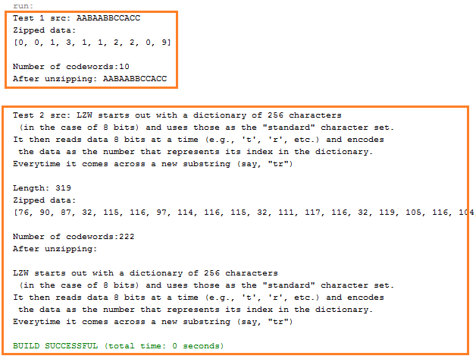
2- Data Compression…
LZW Encoding Algorithm: Demo
45
Notes:
GIF file
45

Slide 46

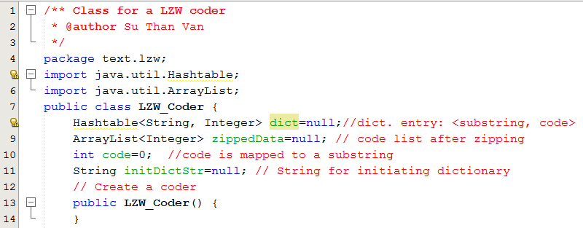
2- Data Compression…
LZW Encoding Algorithm: Implementation
46
Notes:
GIF file
46

Slide 47
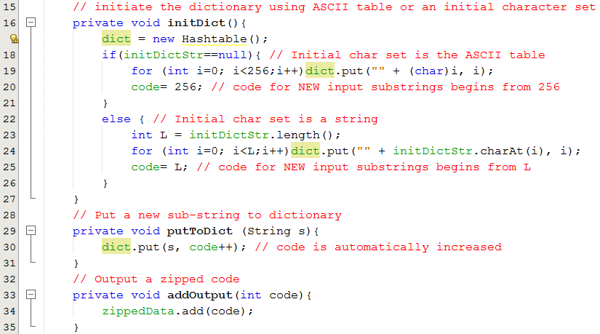
2- Data Compression…
LZW Encoding Algorithm: Implementation
47
Notes:
GIF file
47

Slide 48
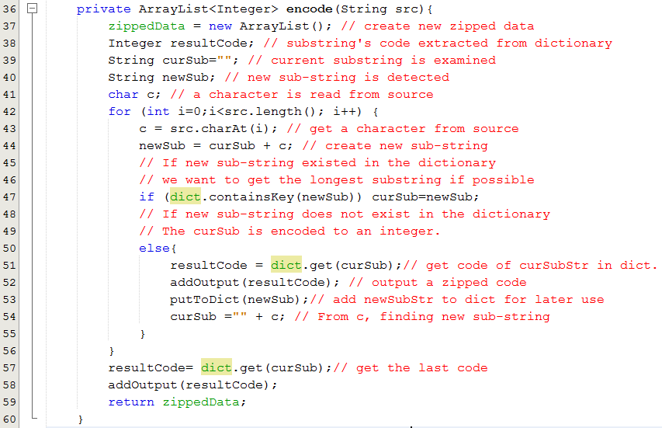
2- Data Compression…
LZW Encoding Algorithm: Implementation
48
Notes:
GIF file
48

Slide 49
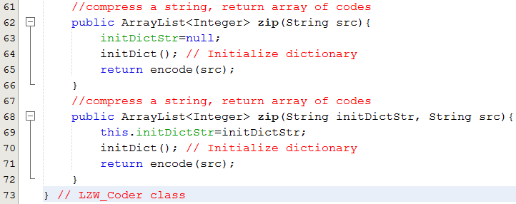
2- Data Compression…
LZW Encoding Algorithm: Implementation
49
Notes:
GIF file
49

Slide 50

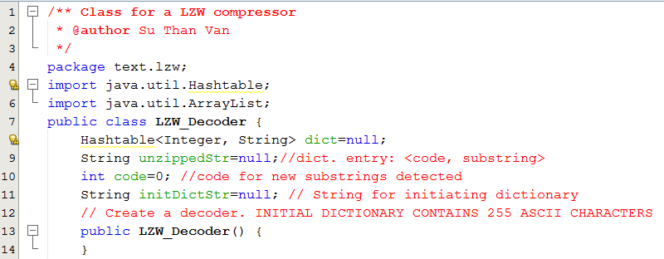
2- Data Compression…
LZW Decoding Algorithm: Implementation
50
Notes:
GIF file
50

Slide 51
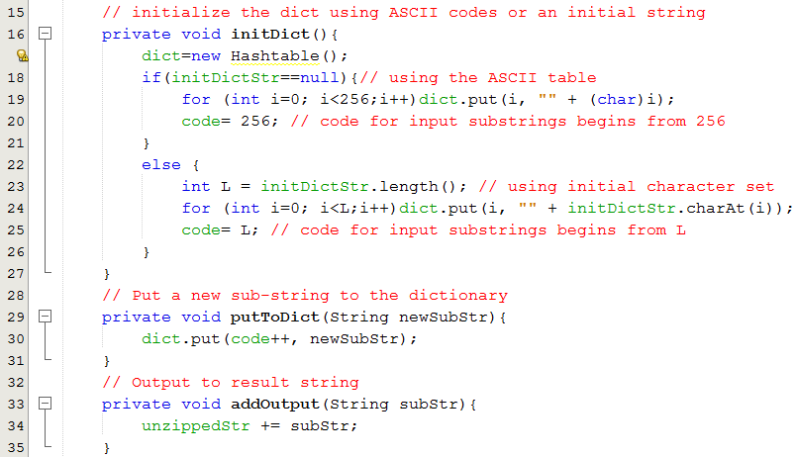
2- Data Compression…
LZW Decoding Algorithm: Implementation
51
Notes:
GIF file
51

Slide 52
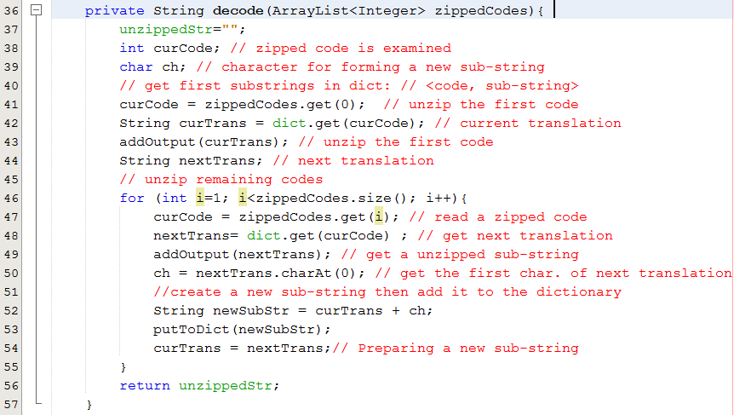
2- Data Compression…
LZW Decoding Algorithm: Implementation
52
Notes:
GIF file
52

Slide 53
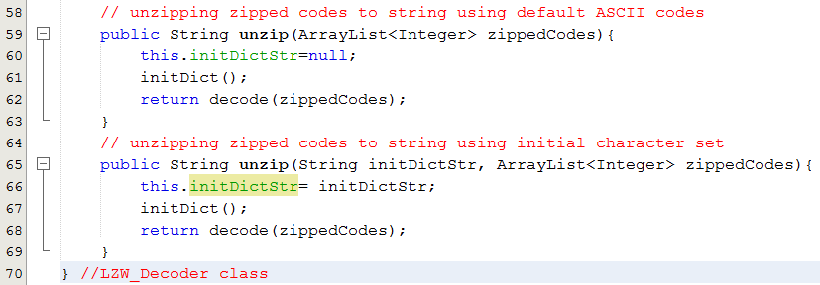
2- Data Compression…
LZW Decoding Algorithm: Implementation
53
Notes:
GIF file
53

Slide 54

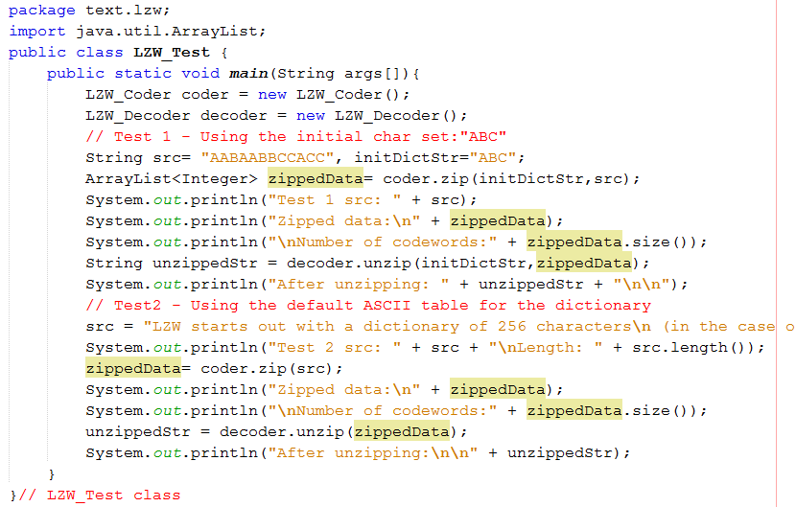
2- Data Compression…
LZW Encoding/Decoding Algorithms Test
54
"LZW starts out with a dictionary of 256 characters\n (in the case of 8 bits) and uses those as the \"standard\" character set.\nIt then reads data 8 bits at a time (e.g., 't', 'r', etc.) and encodes \n the data as the number that represents its index in the dictionary.\nEverytime it comes across a new substring (say, \"tr\")\n"
Notes:
GIF file
54

Slide 55
LZW Question
Suppose that initial dictionary is {A=1, B=2, C= 3, D=4}. What is the result data when the LZW compressing algorithm is applied on the source string “CDAAACABADAAA”

Slide 56
2- Data Compression…
Run-Length Encoding
Numeric run: Group of non-decreasing contiguous numbers.
1 2 8 5 5 6 7 9 8 3 4 6 → 4 runs
Character run: Group of the same contiguous characters.
AAABCDDDE : 5 runs

Slide 57
2- Data Compression…
Run-Length Encoding
FFFFOOOOFFFOOFFFFFOOOOOOOO
Raw :
4
4
3
2
5
7
Compressed:
4F4O3F2O5F7O
Compression Rate = (25-12)/25 = 52%
“ABCDEF” → “1A1B1C1D1E1F”

Slide 58
Summary
Digitalized text: Text in which each it’s character is coded as a bit string.
Abundance of Digitized Text: Text is still main data in computer programs
Brute-Force algorithm helps searching a short string in a long string using exhaustive approach and it’s complexity O(mxn). m is the length of long string and m is the length of short string.
Knuth-Morris-Pratt Algorithm helps matching a short string in a long string using improvement in shift steps and it has complexity of O(n+m).

Slide 59
Summary
Data Compression is a process to shorten initial data in order to reduce storage or bandwidth of communication.
Condition for Data Compression is codeword table of initial data unit.
Huffman Coding Algorithm is a lossless compression technique in which each initial source character will be expressed using number of bits less than 8. Codewords are generated based on character’s frequencies.
LZW Algorithm is a lossless compression technique based on a dictionary of input string.
Run-length Encoding is a lossless compression technique based on run of characters in input string.

Slide 60
Objectives: Learning Outcomes

LO8.1 Describe the Text Processing problems and its’ application.
LO8.2 Explain the Brute Force Text Pattern-Matching algorithm.
LO8.3 Describe the main idea of The Knuth-Morris-Pratt Algorithm.
LO8.4 Explain The Huffman Coding Algorithm.
LO8.5 Explain steps needed to use The Huffman Coding Algorithm for compressing a text file.
LO8.6 Explain the LZW encoding algorithm.
LO8.7 Explain the Run-length encoding algorithm.






Notes:
60

