Slide 1
Chapter 6
THE DATABASE LANGUAGE SQL

Slide 2
Objectives
Student can write a SQL script.
Student can compose SQL queries using set (and bag) operators, correlated subqueries, aggregation queries.
Student can manipulate proficiently on complex queries

Slide 3
Contents
Integrity constraints
Structure Query Language
DDL
DML
DCL (self studying)
Sub query

Slide 4
REVIEW
Getting
User
Requirement
High-Level
Design
Relational
Database
Schema
Design
Relational DBMS
ER diagram
Relational Database Schema
Figure 4.1: The database modeling and implementation process
Studied:
ER diagram
Relational model
Convert ERD 🡪 Relational model
Now: we learn how to set up a relational database on DBMS

Slide 5
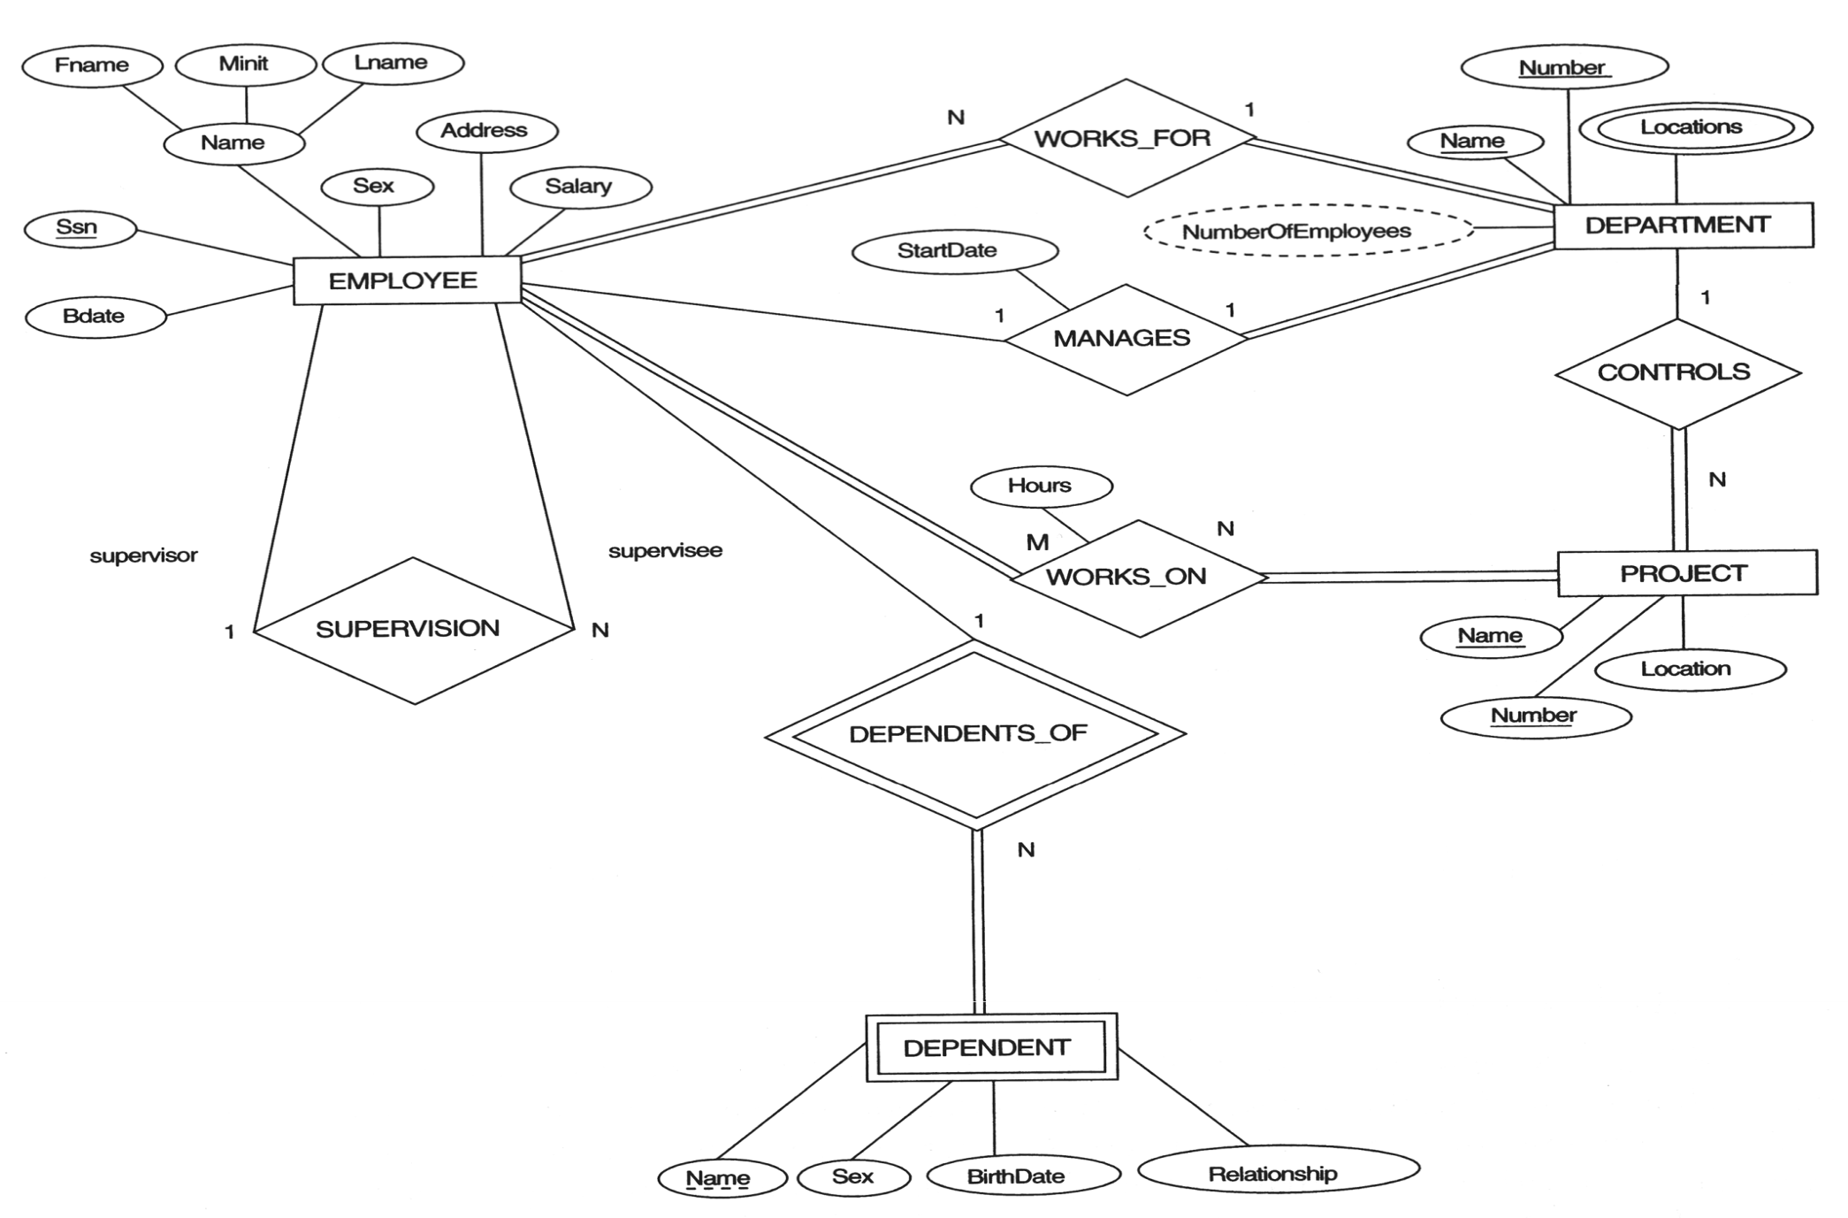
REVIEW – Entity Relationship Diagram
COMPANY Database
Notes:
EMPLOYEE(

Slide 6
Integrity constraints
Purpose: prevent semantic inconsistencies in data
Kinds of integrity constraints:
1. Key Constraints (1 table): Primary key, Candidate key (Unique)
2. Attribute Constraints (1 table): NULL/NOT NULL; CHECK
3. Referential Integrity Constraints (2 tables): FOREIGN KEY
4. Global Constraints (n tables): CHECK or CREATE ASSERTION (self studying)
We will implement these constraints by SQL

Slide 7
Comparison of Strings
Two strings are equal (=) if they are the same sequence of characters
Other comparisons: <, >, ≤, ≤, ≠
Suppose a=a₁a₂…a_{n} and b=b₁b₂…b_{m} are two strings, the first is less than the second if ∃ k≤min(n,m):
∀i, 1≤i≤k: a_{i} = b_{i}, and
a_{k+1}<b_{k+1}
Example
fodder < foo
bar < bargain

Slide 8
Pattern Matching in SQL
Like or Not Like
Two special characters
% means any sequence of 0 or more characters
_ means any one character
SELECT
FROM
WHERE s LIKE p;
SELECT
FROM
WHERE s NOT LIKE p;

Slide 9


Pattern Matching in SQL
Example 5.1:
Find all employees named as ‘Võ Việt Anh’
Example 5.2
Find all employees whose name is ended at ‘Anh’

Slide 10
Pattern Matching in SQL
USING ESCAPE keyword
SQL allows us to specify any one character we like as the escape character for a single pattern
Example
WHERE s LIKE ‘%20!%%’ ESCAPE !
Or WHERE s LIKE ‘%20@%%’ ESCAPE @
🡺 Matching any s string contains the 20% string
WHERE s LIKE ‘x%%x%’ ESCAPE x
🡺 Matching any s string that begins and ends with the character %

Slide 11
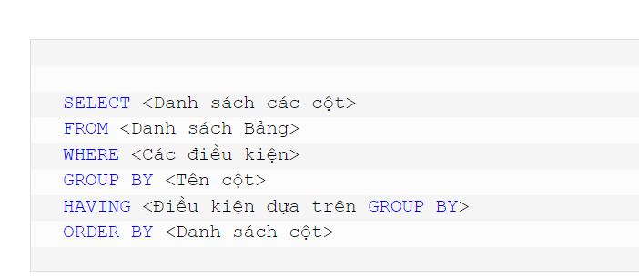
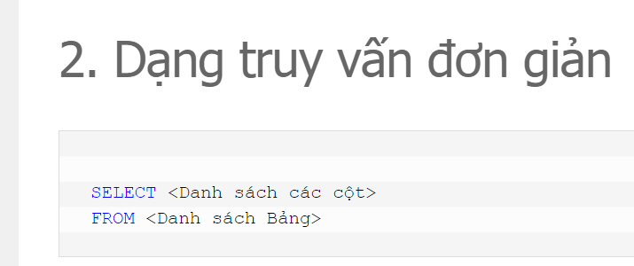

Slide 12
Dates and Times
Dates and times are special data types in SQL
A date constant’s presentation
DATE ‘1948-05-14’
A time constant’s presentation
TIME ‘15:00:02.5’
A combination of dates and times
TIMESTAMP ‘1948-05-14 12:00:00’
Operations on date and time
Arithmetic operations
Comparison operations

Slide 13
Null Values
Null value: special value in SQL
Some interpretations
Value unknown: there is, but I don’t know what it is
Value inapplicable: there is no value that makes sense here
Value withheld: we are not entitled to know the value that belongs here
Null is not a constant
Two rules for operating upon a NULL value in WHERE clause
Arithmetic operators on NULL values will return a NULL value
Comparisons with NULL values will return UNKNOWN

Slide 14
The Truth-Value UNKNOWN
Truth table for True, False, and Unknown
We can think of TRUE=1; FALSE=0; UNKNOWN=1/2, so
x AND y = MIN(x,y); x OR y = MAX(x, y); NOT x = 1-x
x | y | x AND y | x OR y | NOT x
TRUE | TRUE | TRUE | TRUE | FALSE
TRUE | UNKNOWN | UNKNOWN | TRUE | FALSE
TRUE | FALSE | FALSE | TRUE | FALSE
UNKNOWN | TRUE | UNKNOWN | TRUE | UNKNOWN
UNKNOWN | UNKNOWN | UNKNOWN | UNKNOWN | UNKNOWN
UNKNOWN | FALSE | FALSE | UNKNOWN | UNKNOWN
FALSE | TRUE | FALSE | TRUE | TRUE
FALSE | UNKNOWN | FALSE | UNKNOWN | TRUE
FALSE | FALSE | FALSE | FALSE | TRUE

Slide 15
The Truth-Value Unknown
SQL conditions in Where clause produce three truth values: True, False, and Unknown
Those tuples which condition has the value True become part of the answer
Those tuples which condition has the value False or Unknown are excluded from the answer

Slide 16
SQL Overview
SQL (sequel) is a database language designed for managing data in relational database management systems, and originally based upon relational algebra.
There are many different dialects of SQL
Ansi SQL (or SQL-86), SQL-92, SQL-99
SQL:2003, SQL:2006, SQL:2008, SQL:2009
Transact-SQL (T-SQL) is Microsoft's and Sybase's proprietary extension to SQL.
PL/SQL (Procedural Language/Structured Query Language) is Oracle Corporation's procedural extension for SQL and the Oracle relational database.
Today, SQL is accepted as the standard RDBMS language

Slide 17
Data Definition Language - CREATE
Database schema
Simple syntax: CREATE DATABASE dbname
Full syntax: https://docs.microsoft.com/en-us/sql/database
Relation schema ~ table
CREATE TABLE tableName
(
fieldname1 datatype [integrity_constraints],
fieldname2 datatype [integrity_constraints],
….
)
Full syntax: https://docs.microsoft.com/en-us/sql/table

Slide 18
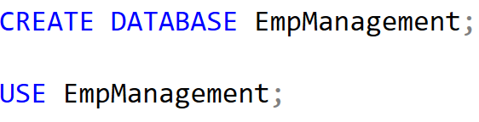
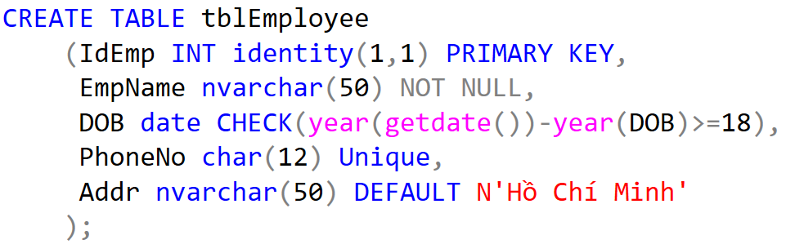
Data Definition Language - Demo

Slide 19
Data Definition Language – ALTER, DROP
Used to modify the structure of table, database
Add more columns
ALTER TABLE tableName
ADD columnName datatype [constraint]
Remove columns
ALTER TABLE tableName
DROP columnName datatype [constraint]
Modify data type
ALTER TABLE tableName
ALTER columnName datatype [constraint]

Slide 20
Data Definition Language– ALTER, DROP
Add/remove constraints
ALTER TABLE tablename
ADD CONSTRAINT constraintName PRIMARY KEY
(<attribute list>);
ALTER TABLE tablename
ADD CONSTRAINT constraintName FOREIGN KEY (<attribute list>)
REFERENCES parentTableName (<attribute list>);
ALTER TABLE tablename
ADD CONSTRAINT constraintName CHECK (expressionChecking)
ALTER TABLE tablename
DROP CONSTRAINT constraintName

Slide 21
1.Giới tính là Nam hoặc Nữ - Check
2.Giới tính mặc định Nam - default
3.Tên và địa chỉ cung cấp ko được trùng unique
1.Giới tính là Nam hoặc Nữ - Check
Quy tắc đặt tên: constraintName: Tên cột+Ràng buộc.
Ex: gender_check.
Sài char: cho user đa ngôn ngữ và chuyển vào database

Slide 22
2.Giới tính mặc định Nam - default
ALTER TABLE tblEmployee
ADD CONTRAINT
DEFAULT giá trị FOR Cột
Ex:
ALTER TABLE tblEmployee
ADD CONTRAINT.
DEFAULT 0 FOR gender
Default: chỉ chạy khi Insert không nhập giá trị.
Default ko ảnh hưởng Update

Slide 23
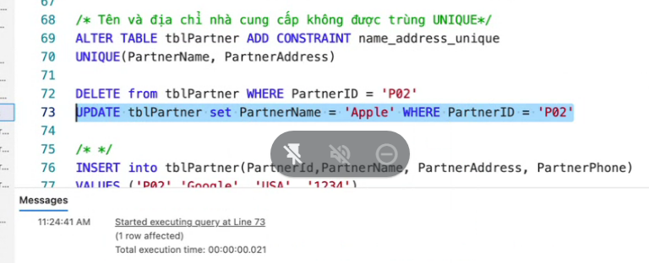
3.Tên và địa chỉ cung cấp ko được trùng: unique
ALTER TABLE tblPartner
ADD CONTRAINT name_address_unique
UNIQUE(PartnerName, PartnerAddress).

Slide 24
 | Insert | Update | Delete | Select
Check | x | x
Unique | X | X
Default | X
Foreign key | x | x | x

Slide 25
Sqlshack.com/delete-cascade-and-update-cascade-in-sql-server-foreign-key/

Slide 26
Data Definition Language– ALTER, DROP -Xóa
DROP TABLE tableName
DROP DATABASE dbName

Slide 27
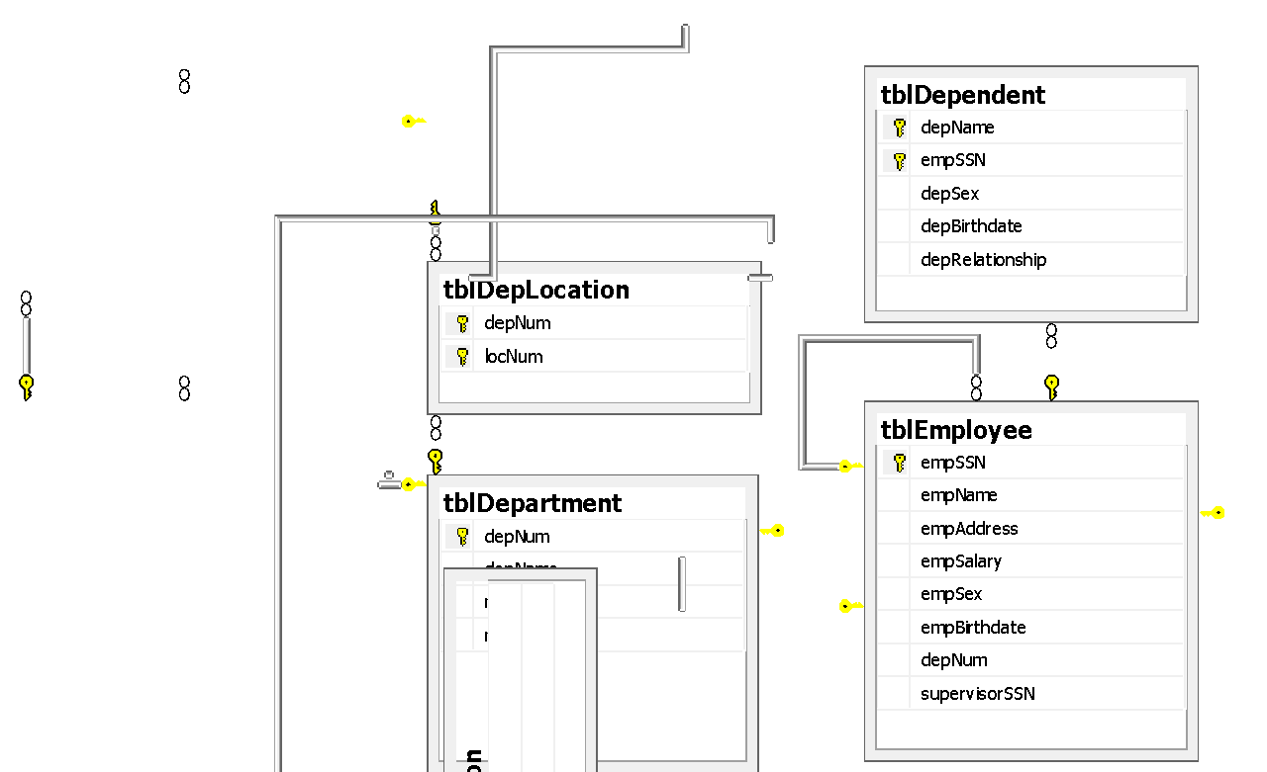
Physical Diagram - FUHCompany

Slide 28
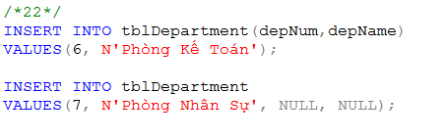
Data Manipulation Language (DML)
Key words: INSERT, UPDATE, DELETE, SELECT
INSERT INTO tableName
VALUES (<value 1>, ... <value n>)
INSERT INTO tableName(<listOfFields>)
VALUES (<value 1>, ... <value m>)
=> Ngăn ngừa lỗi phát sinh in the future.
INSERT INTO tableName
SELECT listOfFields FROM another_tableName

Slide 29
C1: phải đúng thứ tự
C2: có thể đảo trật tự bảng
chỉnh sửa số lượng cột cần thêm

Slide 30

Data Manipulation Language (DML)
UPDATE tableName
SET columnName = newValue
[WHERE condition]
Note: newValue could be a value/ an expression/ a SQL statement
Example: Update new salary and depNum for the employee named ‘Mai Duy An’

Slide 31
Update: Bảng
Set: Cột
Where: Dòng (Dùng Prime Key);

Slide 32
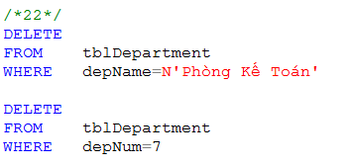
Data Manipulation Language (DML)
DELETE FROM tableName
[WHERE condition]
TRUNCATE TABLE tableName
What is difference between DELETE and TRUNCATE?
What should we do before implement DELETE or TRUNCATE? (referential integrity constraint)
Example:
remove a department named ‘Phòng Kế Toán’
remove a department which depNum is 7

Slide 33
Data Manipulation Language (DML)
SQL Queries and Relational Algebra
SELECT L
FROM R
WHERE C
π_{L}(σ_{C}(R))

Slide 34
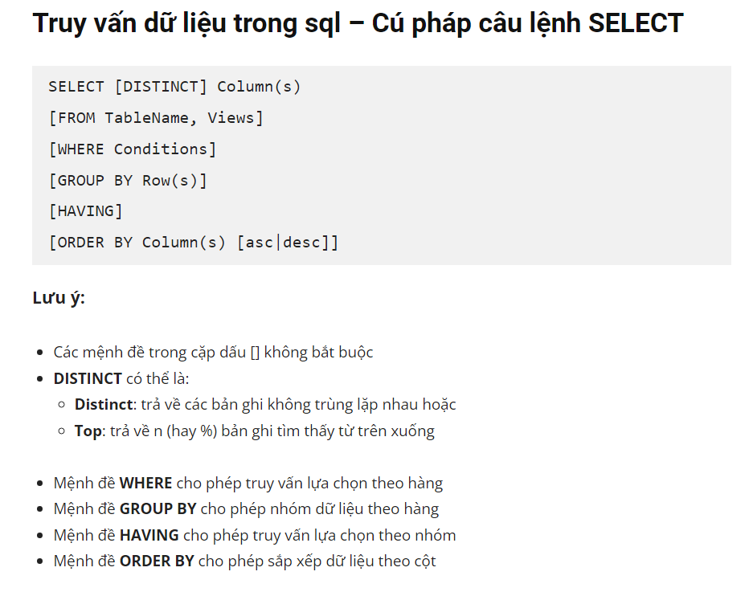
Chọn những cột muốn xem
1,n
Xác định bảng chứa dữ liệu
Xác định Điều kiện xem và lấy

Slide 35
T-SQL : Basic Syntax for a simple SELECT queries
SELECT [ ALL | DISTINCT ] [ TOP n [ PERCENT ] ]
* | {column_name | expression [alias],…}
[FROM table]
[WHERE conditions]
SELECT identifies what columns
ALL: Specifies that duplicate rows can appear in the result set. ALL is the default
DISTINCT: Specifies that only unique rows can appear in the result set. Null values are considered equal for the purposes of the DISTINCT keyword
TOP n [ PERCENT ]:Specifies that only the first n rows are to be output from the query result set. n is an integer between 0 and 4294967295. If PERCENT is also specified, only the first n percent of the rows are output from the result set. When specified with PERCENT, n must be an integer between 0 and 100
FROM identifies which table
The WHERE clause follows the FROM clause. Condition: is composed of column names, expressions, constants, and a comparison operator

Slide 36
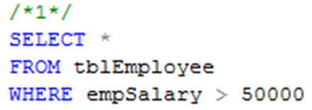
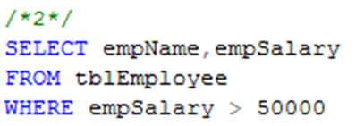
Common Query in SQL
Example 1: Listing all employees whose salary exceed at 50000
Example 2: Listing name and salary of all employees whose income exceed 50000

Slide 37
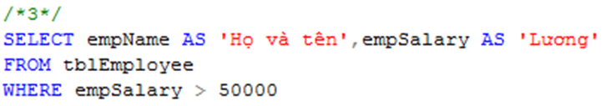
Projection in SQL
Using alias name in select clause
Example 3:
Listing full name and salary of all employees whose income exceed 50000

Slide 38
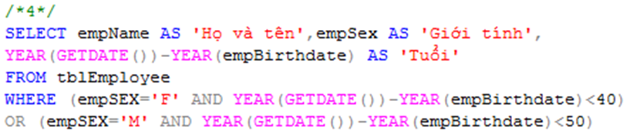
Selection in SQL
Example 4
List all under 40 year-old female or under 50 year-old male employees

Slide 39
Ordering the Output
Presenting the tuples produced by a query in sorted order
The order may be based on the value of any attribute
Syntax
Order by clause follows Where and any other clauses. The ordering is performed on the result of the From, Where, and other clauses, just before Select clause
Using keyword ASC for ascending order and DESC for descending order
SELECT <list of attributes>
FROM <list of tables>
WHERE <conditions>
ORDER BY <list of attributes>

Slide 40

Ordering the Output
Example 6:
Listing all employee by department number ascreasingly, then by salary descreasingly

Slide 41
6.2 QUERIES INVOLVING MORE THAN ONE RELATION

Slide 42
Queries Involving More Than One Relation
SQL allows we combine two or more relations through joins, products, unions, intersections, and differences

Slide 43
Products and Joins in SQL
When data from more than one table in the database is required, a join condition is used.
Simple way to couple relations: list each relation in the From clause
Other clauses in query can refer to the attributes of any of the relations in the From clause

Slide 44

Products and Joins in SQL
Example 7:
List all employees who work on ‘Phòng Phần mềm trong nước’ department

Slide 45
What we do if …
… a query involves several relations, and there are two or more attributes with the same name?

Slide 46
Tuple Variables
We may list a relation R as many times as we need
We use tuple variables to refer to each occurrence of R

Slide 47

Disambiguating Attributes
Example 8:
Find all cities in which our company is

Slide 48

What we do if …
… a query involves two or more tuples from the same relation?
Example 9:
Find all those project numbers which have more than two members

Slide 49
Union, Intersection, Difference of Queries
We combine relations using the set operations of relational algebra: union, intersection, and difference
SQL provides corresponding operators with UNION, INTERSECT, and EXCEPT for ∪, ∩, and -, respectively

Slide 50

Union, Intersection, Difference of Queries
Example 10.1
Find all those employees whose name is begun by ‘H’ or salary exceed 80000

Slide 51

Union, Intersection, Difference of Queries
Example 10.2
Find all those normal employees, that is who do not supervise any other employees

Slide 52
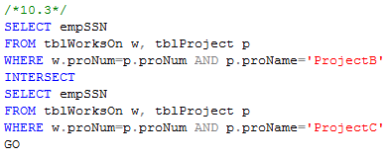
Union, Intersection, Difference of Queries
Example 10.3
Find all employees who work on projectB and projectC

Slide 53
6.3 SUB QUERIES

Slide 54
Sub-queries
One query can be used to help in the evaluation of another
A query that is part of another is called a sub-query
Sub-queries return a single constant, this constant can be compared with another value in a WHERE clause
Sub-queries return relations, that can be used in WHERE clause
Sub-queries can appear in FROM clauses, followed by a tuple variable

Slide 55
Sub-queries that Produce Scalar Values
An atomic value that can appear as one component of a tuple is referred to as a scalar
Let’s compare two queries for the same request

Slide 56
Sub-queries that Produce Scalar Values
Example 7: Find the employees of Phòng Phần mềm trong nước department

Slide 57
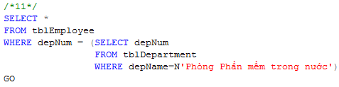
Sub-queries that Produce Scalar Values
Example 11:
Find the employees of Phòng Phần mềm trong nước department

Slide 58
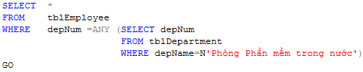
Sub-queries that Produce Scalar Values
Example 11:
Find the employees of Phòng Phần mềm trong nước department

Slide 59
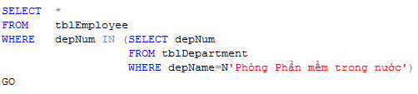
Sub-queries that Produce Scalar Values
Example 11:
Find the employees of Phòng Phần mềm trong nước department

Slide 60
Conditions Involving Relations
Some SQL operators can be applied to a relation R and produce a bool result
(EXISTS R = True) ⇔ R is not empty
(s IN R = True) ⇔ s is equal to one of the values of R
(s > ALL R = True) ⇔ s is greater than every values in unary R
(s > ANY R = True) ⇔ s is greater than at least one value in unary R

Slide 61
Conditions Involving Tuples
A tuple in SQL is represented by a list of scalar values between ()
If a tuple t has the same number of components as a relation R, then we may compare t and R with IN, ANY, ALL

Slide 62
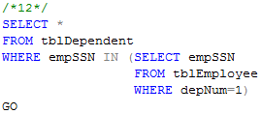
Sub-queries that Produce Scalar Values
Example 12:
Find the dependents of all employees of department number 1

Slide 63
Correlated Sub-queries
To now, sub-queries can be evaluated once and for all, the result used in a higher-level query
But, some sub-queries are required to be evaluated many times
That kind of sub-queries is called correlated sub-query
Note: Scoping rules for names

Slide 64
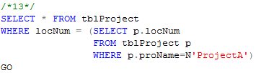
Correlated Sub-queries
Example 13:
Find all those projects have the same location with projectA

Slide 65
Correlated Sub-queries
Another example:
Find the titles that have been used for two or movies
SELECT title
FROM Movies Old
WHERE year < ANY
(SELECT year
FROM Movies
WHERE title =Old.title)

Slide 66
Sub-queries in FROM Clauses
In a FROM list we can use a parenthesized sub-query
We must give it a tuple-variable alias
Example: Find the employees of Phòng Phần mềm trong nước
SELECT *
FROM tblEmployee e, (SELECT depNum
FROM tblDepartment
WHERE depName=N'Phòng phần mềm trong nước') d
WHERE e.depNum=d.depNum

Slide 67
SQL Join Expressions
SQL Join Expressions can be stand as a query itself or can be used as sub-queries in FROM clauses
Cross Join in SQL= Cartesian Product
Syntax: R CROSS JOIN S;
Meaning: Each tuple of R connects to each tuple of S
Theta Join with ON keyword
Systax: R JOIN S ON R.A=S.A;
Meaning: Each tuple of R connects to those tuples of S, which satisfy the condition after ON keyword

Slide 68

SQL Join Expression
Example 15.1
Product two relations Department and Employee
Example 15.2
Find departments and employees who work in those departments, respectively

Slide 69
SQL Join Expression
More Example

Slide 70
Natural Joins
A natural join differs from a theta-join in that:
The join condition: all pairs of attributes from the two relations having a common name are equated, and there are no other condition
One of each pair of equated attributes is projected out
Syntax : Table1 NATURAL JOIN Table2
Microsoft SQL SERVER DONOT SUPPORT NATURAL JOINS AT ALL

Slide 71
Outer Joins
The outer join is a way to augment the result of join by the dangling tuples, padded with null values
When padding dangling tuples from both of its arguments, we use full outer join
When padding from left/right side, we use left outer join/right outer join

Slide 72

Outer joins
Example 17.1:
For each location, listing the projects that are processed in it

Slide 73

Outer joins
Example 17.2:
For each department, listing the projects that it controls

Slide 74
6.4 Full-Relation Operations
Study some operations that acts on relations as whole, rather than on tuples individually

Slide 75
Eliminating Duplicates
A relation, being a set, cannot have more than one copy of any given tuple
But, the SQL response to a query may list the same tuple several times, that is, SELECT preserves duplicates as a default
So, by DISTINCT we can eliminate a duplicates from SQL relations

Slide 76
Eliminating Duplicates
Example 17.3: List all location in which the projects are processed.
Location name is repeated many times
SELECT DISTINCT l.locNum, l.locName
FROM tblLocation l JOIN tblProject p ON l.locNum=p.locNum
SELECT DISTINCT l.locNum, l.locName
FROM tblLocation l JOIN tblProject p ON l.locNum=p.locNum

Slide 77
Duplicates in Unions, Intersections, and Differences
Set operations on relations will eliminate duplicates automatically
Use ALL keyword after Union, Intersect, and Except to prevent elimination of duplicates
Syntax:
R UNION ALL S;
R INTERSECT ALL S;
R EXCEPT ALL S;

Slide 78
Grouping and Aggregation in SQL
Grouping operator partitions the tuples of relation into groups, based on the values of tuples in one or more attributes
After grouping the tuples of relation, we are able to aggregate certain other columns of relation
We use GROUP BY clause in SELECT statement

Slide 79
Aggregation Operators
Five aggregation operators
SUM acts on single numeric column
AVG acts on single numeric column
MIN acts on single numeric column
MAX acts on single numeric column
COUNT act on one or more columns or all of columns
Eliminating duplicates from the column before applying the aggregation by DISTINCT keyword

Slide 80


Aggregation Operators
Example 18.1
Find average salary of all employees
Example 18.2
Find number of employees

Slide 81
Grouping
To partition the tuples of relation into groups
Syntax
SELECT <list of attributes>
FROM <list of tables>
WHERE <condition>
GROUP BY <list of attributes>

Slide 82

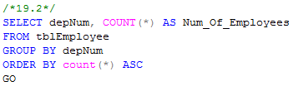
Grouping
Example 19.1:
Group employees by department number
Example 19.2
List number of employees for each department number

Slide 83
Grouping
There are two kinds of terms in SELECT clause
Aggregations, that applied to an attribute or expression involving attributes
Grouping Attributes, that appear in GROUP BY clause
A query with GROUP BY is interpreted as follow:
Evaluate the relation R expressed by the FROM and WHERE clauses
Group the tuples of R according to the attributes in GROUP BY clause
Produce as a result the attributes and aggregation of the SELECT clause

Slide 84

Grouping
Example 20
Compute the number of employees for each project

Slide 85
Grouping, Aggregation, and Nulls
When tuples have nulls, there are some rules:
The value NULL is ignored in any aggregation
Count(*): a number of tuples in a relation
Count(A): a number of tuples with non-NULL values for A attribute
NULL is treated as an ordinary value when forming groups
The count of empty bag is 0, other aggregation of empty bag is NULL

Slide 86
Grouping, Aggregation, and Nulls
Example: Suppose R(A,B) as followed
A | B
NULL | NULL
The result of query
SELECT A, count(B)
FROM R
GROUP BY A;
is one tuple (NULL,0)
The result of query
SELECT A, sum(B)
FROM R
GROUP BY A;
is one tuple (NULL,NULL)

Slide 87
Considerations …
If we want to apply conditions to tuples of relations, we put those conditions in WHERE clause
If we want to apply conditions to groups of tuples after grouping, those conditions are based on some aggregations, how can we do?
In that case, we follow the GROUP BY clause with a HAVING clause

Slide 88
HAVING clause
Syntax:
SELECT <list of attributes>
FROM <list of tables>
WHERE <conditions on tuples>
GROUP BY <list of attributes>
HAVING <conditions on groups>

Slide 89
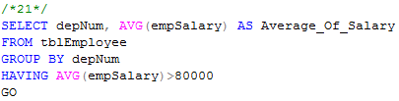
HAVING clause
Example 21:
Print the number of employees for each those department, whose average salary exceeds 80000

Slide 90
HAVING clause
Some rules about HAVING clause
An aggregation in a HAVING clause applies only to the tuples of the group being tested
Any attribute of relations in the FROM clause may be aggregated in the HAVING clause, but only those attributes that are in the GROUP BY list may appear un-aggregated in the HAVING clause (the same rule as for the SELECT clause)

Slide 91
HAVING clause
Example:
SELECT proNum, COUNT(empSSN) AS Number_Of_Employees,
FROM tblWorksOn
GROUP BY proNum
HAVING AVG(workHours)>20
SELECT proNum, COUNT(empSSN) AS Number_Of_Employees,
FROM tblWorksOn
GROUP BY proNum
HAVING proNum=4

