Slide 1
Inheritance

Slide 2
Objectives
Study concepts: superclass, subclass
Understand common relationships
Functions in inheritance
Using an “instanceof” operator
Casting

Slide 3
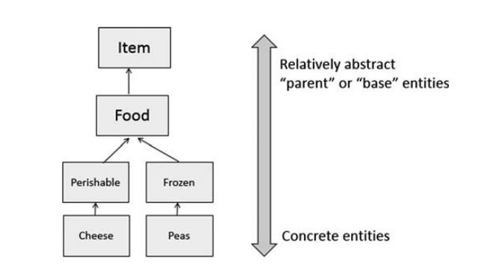
Derived and Super Classes
Object-oriented languages implement reusability of coding structure through inheritance
It refers to the relationship between classes where one class inherits the entire structure of another class
The root of our design is a relatively abstract entity, and we build upon that entity to produce progressively more concrete entities
the higher-level entities are “parent”, “base” or “super” classes
the lower-level ones built from them are “child”, "derived" or “sub” classes.

Slide 4
Object-Oriented Relationships
common relationships in classes:
“is-a/ a kind of”
“has-a”
Examples:
Student is a person
“A home is a house that has a family and a pet.”
An invoice contains some products and a product can be contained in some invoices

Slide 5
Object-Oriented Relationships…
The relation “is-a” is implemented as a sub-class
Person
String name, address String birthDate
+ String getName(); + void setName(String n);
…….
The relation “has-a” is implemented as reference
Classes Professor, Student are sub-classes of the class Person
Sub-classes inherit the structure of super class
is a
is a
Professor
String department
+ String getDepartment(); + void setDepartment(String d);
Student
String studentId, majorField String degreeSought
+ String getStudentId(); + void setStudentID(String id)
….
teach
The class Professor has the field Student[] students
The class Student has the field Professor pr

Slide 6
Inheritance…
How to construct a class hierarchy? → Intersection
Rectangle< length, width>
Box < length, width, height>
Rectangle
Dựa vào phần chung
Length width
Box
height

Slide 7
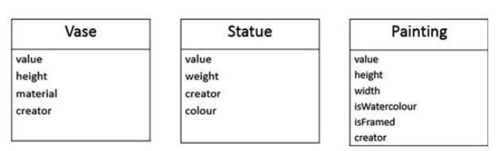
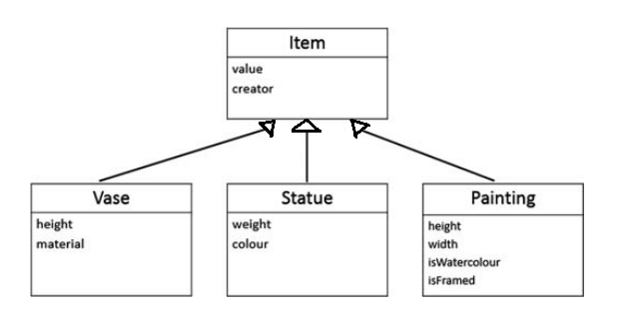
Inheritance…
How to construct a class hierarchy? → Intersection
Consider a shop that sells antiques items, namely vases, statues and paintings
Phần chung:
Value, creator

Slide 8
Inheritance
There are some sub-classes from one super class ➔ An inheritance is a relationship where objects share a common structure: the structure of one object is a sub-structure of another object.
The extends keyword is used to create sub-class.
A class can be directly derived from only one class ( Java is a single-inherited OOP language).
Java không hỗ trợ đa thừa kế
If a class does not have any superclass, then it is implicitly derived from Object class.
Kế thừa từ lớp Object.
Unlike other members, constructor cannot be inherited (constructor of super class can not initialize sub-class objects)

Slide 9
“super” Keyword
Constructors Are Not Inherited
super(...) for Constructor Reuse
super(arguments); //invoke a superclass constructor
Vd: public class extend Person().
Subclass constructor must invoke super class constructor, đặt trong CONSTRUCTION CON
The call must be the first statement in the subclass constructor, DÒNG ĐẦU TIÊN
Note: If a constructor does not explicitly invoke a superclass constructor, the Java compiler automatically inserts a call to the no-argument constructor of the superclass. If the super class does not have a no-argument constructor, you will get a compile-time error.
Nếu superclass ko có constructor, Java tự gọi (ko có tham số).

Slide 10
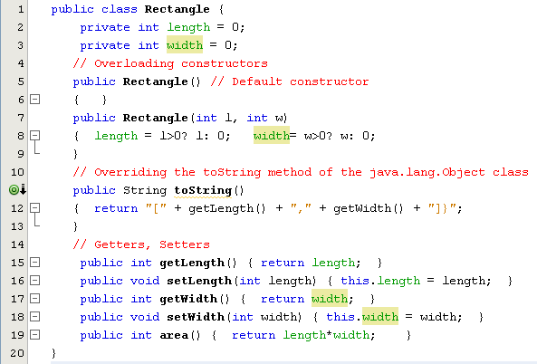
Inheritance…
Overloading: định nghĩa phương thức trùng tên nhưng khác nhau tham số.
toString: nối choỗi từng thuộc tính và trả về 1 choỗi

Slide 11
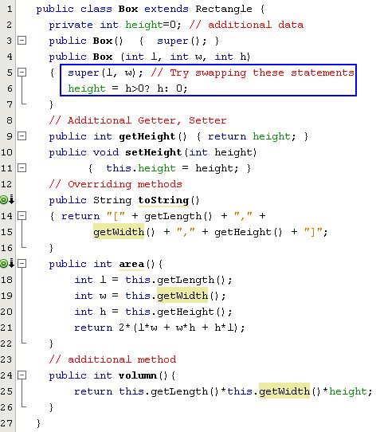
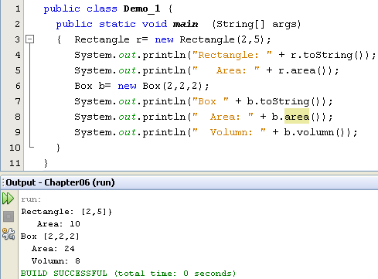
Inheritance…

Slide 12
Functions in inheritance
A derived class inherits from superclass is limited to the normal member functions of the superclass.
We use the Java keyword super as the qualifier for calling a superclass ’s method:
super.methodName(arguments);
To invoke the version of method methodName that was defined by our superclass.
Hiding a method: Re-implementing a static method implemented in super class

Slide 13
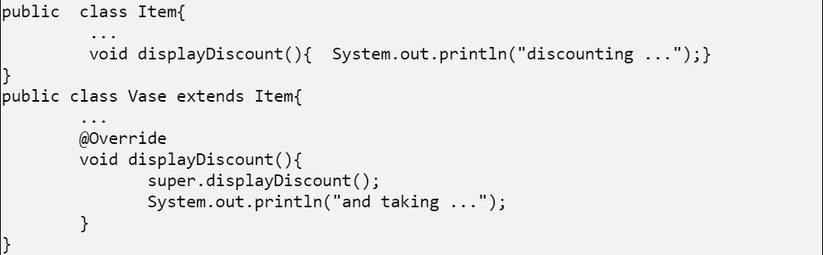
Functions in inheritance
Output:
discounting …
and taking …
The "displayDiscount" method has the same signature (name, plus the number and the type of its parameters) and return type as in the superclass. It is called overriding the superclass's method=> We will learn override method in the next topic
The "displayDiscount") that was defined by our superclass. We use the "super" keyword

Slide 14
Overriden
- Overriden: Tại lớp con khai báo trùng tên, tham số, kiểm trả về ( kế thừa).
Override chỉ xảy ra giữa các lớp có quan hệ kế thừa.
1 phương thức ở lớp cha được override ở lớp con thì phương thức override ở lớp con không được phép thu hẹp tầm vực của phương thức đó ở lớp cha.
Phương thức ở lớp cha được override ở lớp con thì phương thức override ở lớp con không được phép phát sinh những ngoại lệ kiểm tra (checked exception) khác loại hoặc không có quan hệ kế thừa với các ngoại lệ được ném ra từ phương thức đó ở lớp cha.
Sử dụng từ khóa super để gọi phương thức được override ở lớp cha tại phương thức override ở lớp con.
Ví dụ:

Slide 15
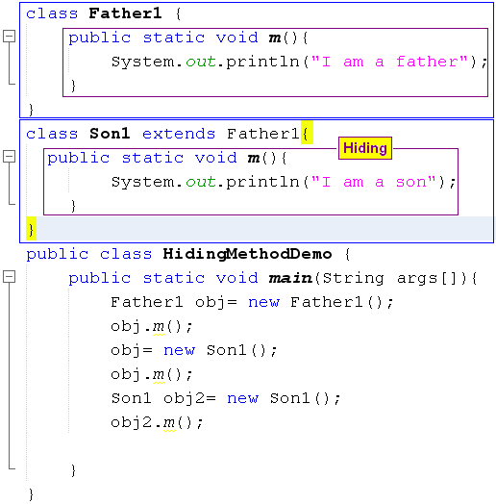

Functions in inheritance: Hiding Method
Static: lớp cha overridden ngược lại lớp con => vẫn sử dụng method cha.

Slide 16
Using an “instanceof” operator
Dynamic and Static type
dynamic type: A reference variable that has the type of the superclass can store the address of the object of sub class. It is called to be dynamic type, the type that is has at runtime. Rectangle obj1 = new Box();
Static type: The type that it has when first declared. Static type checking is enforced by the compiler. Box obj2 = new Box();
“Instanceof” operator: It checks whether the reference of an object belongs to the provided type or not, the instanceof operator will return true or false. If ( obj1 instanceof Box) System.out.println(“ obj1 is pointing to the Box object”);

Slide 17
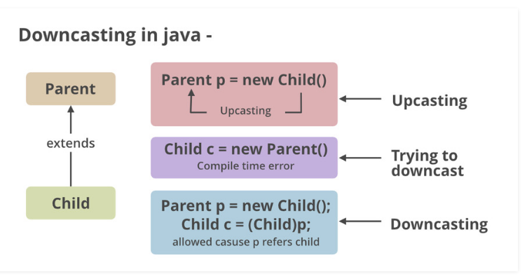
Casting có 2 cách
A variable that has the type of the superclass only calls methods of the superclass. To call methods of the subclass we must cast explicitly
for example,
Rectangle obj = new Box(); ((Box)obj).setHeight(300);

Slide 18
Summary
Object-oriented languages implement reusability of coding structure through inheritance
A derived class does not by default inherit the constructor of a super class
Constructors in an inheritance hierarchy execute in order from the super class to the derived class
Using the instanceof keyword if we need to check the type of the reference variable.
Check the type of the reference variable before casting it explicitly.

