Slide 1

GIT
Concepts and benefits

Slide 2
What is it?
It is a source control
Distributed source control
It allows parallel development without blocking each other
Works very well for Agile
Works very well for CI
It is extremely quick
Most operations can be done without server access
Cross-platform
Easy to switch tools
Easy to switch servers
It is free, but extremely well-tested
Notes:
But it is all just words for now. Let’s go through the basics and only THEN talk about real pros and cons.

Slide 3
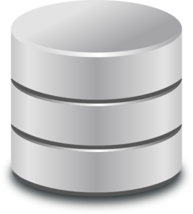

Centralized vs Distributed
Server
Server
PC_1
PC_2
PC_3
PC_1
PC_2
PC_3

Slide 4

What “distributed” means for us?
Everyone has the complete history // confidence
Every clone is a backup // safety
Almost everything can be done offline // stability and speed
Server migration with full history is trivial // e.g. BitBucket ↔ GitLab
You don’t need any server magic to start working with Git // let’s try
Price: some local memory

Slide 5

Branching model
TIME
FeatureA
State 1
State 2
master
+
+
Easy to get any state
Develop in parallel
Branch – chain of states, independent line of development
Notes:
Git allows you to consecutively memorize states of your project.
It gives the possibility to chain states, allowing for parallel lines of history.
Such chains of states are called branches. They have names and usually associated with continuous development tasks, such as implementing a feature or a bugfix.
Then the branches can be merged.

Slide 6




Developing in parallel
FeatureA
TIME
master
= TEST
= REVIEW
FeatureB
Notes:
With Git various features can be developed in parallel and their history saved without influence on other features.
History can be made accessible both locally and remotely. It allows you to separate your work into meaningful steps.
It is easy to configure triggering of automated acceptance tests anytime, but it is especially helpful when accepting a feature into main development stream.
Plus review can be conducted manually on the feature.
It is possible to view both all changes step by step and also their aggregation.
All this allows:
1) To develop in parallel without mixing features
2) To ensure that every state is accessible
3) Make sure that your development stream (master on the picture) is stable with pre-testing.

Slide 7

Best practices: Gitflow
…
v0.15
v0.16
…
FeatureA
…
…
development
+
FeatureB
Fit for CI and Agile
Notes:
It works very well for agile iteration-based development. There is a clean separation between features.
Plus you can add more acceptance tests which are started automatically when you try to create a label on release branch (which is just a state in a chain with stable states).
All this state creation and connection to tests is very easy and supported.
If you want you can have several level of acceptance.

Slide 8
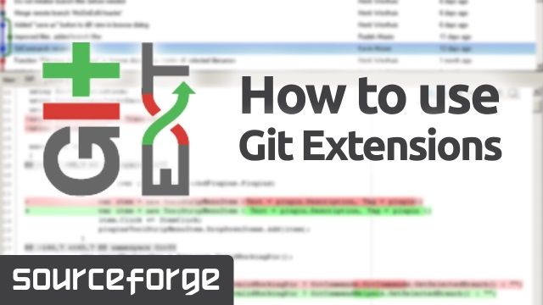




Tooling: local
+
Anyone can use what they like. Essence and data are the same!

Slide 9




Tooling: server
+
Trivial to move repo between servers

Slide 10
Pros and cons
Flexibility and stability
Perfect for CI and Agile
Scriptable
Safety in terms of back-ups
Used by huge amount of companies and community open-source
Trivial server migration
Trivial GUI change
Flexibility
Complex command line interface (countered with aliases)
GUIs are not perfect (but it doesn’t affect data safety )*
*where have you seen a perfect GUI?

Slide 11











If it is so nice, who uses it?
A lot of people both in open-source and companies

Slide 12
Appendix A
Useful links
https://git-scm.com/doc Documentation, explanations, tutorial etc. (Profound)
https://www.atlassian.com/git/ Explanations, tutorial, workflows etc. (Friendly)
https://www.git-tower.com/blog/git-cheat-sheet/ Git cheat sheet
https://git.wiki.kernel.org/index.php/Git_FAQ Some complex FAQ
https://www.kernel.org/pub/software/scm/git/docs/gitglossary.html Vocabulary
https://www.google.com
The last link is NOT a joke!
Git is used by many and easily googlable.
Plenty info on stackoverflow etc.

Slide 13
Appendix B
GUIs for Git
SourceTree
Tower
GitExtensions
TortoiseGit
SmartGit
+ VisualStudio2015 supports Git by default!
List of GUIs for Git:
https://git-scm.com/download/gui/win

Slide 14
Appendix C
Clouds for Git
GitHub
GitLab
BitBucket
Gogs
List of clouds for Git:
https://www.git-tower.com/blog/git-hosting-services-compared/

Slide 15

THANK YOU

