Slide 1

Dependency Injection in .NET
What we’ve learned since the first edition
Steven van Deursen
@dot_NET_Junkie dotnetjunkie

Slide 2
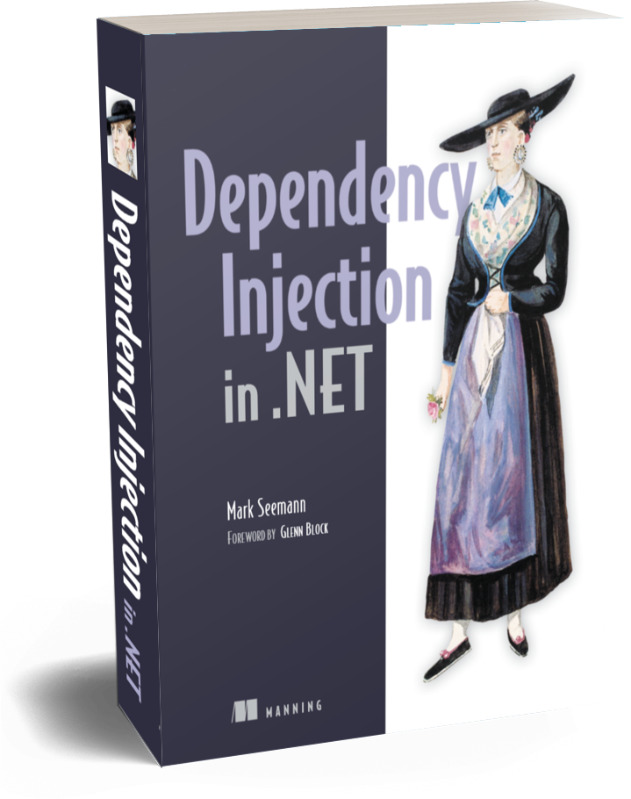
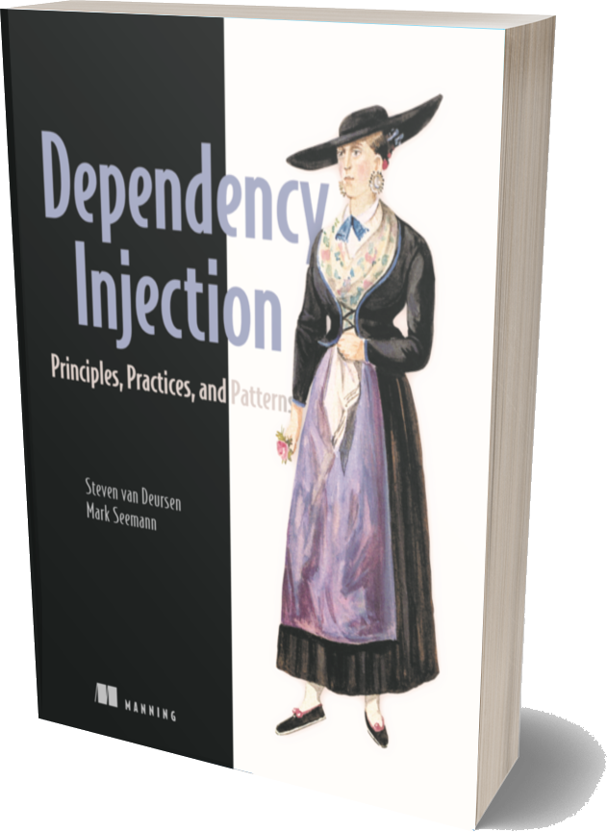
https://manning.com/seemann2

Slide 3
DI landscape
Constructor Injection
DI Container
Composition Root
Pure DI
Object Composition
DI Patterns
Method Injection
Transient
Property Injection
Singleton
Lifetime Management
DI
DI Anti-patterns
Control Freak
Captive Dependencies
Service Locator
Interception
Ambient Context
Decorators
Code smells
Constructor over-injection
Dynamic Interception
Abstract Factory
AOP
Cyclic Dependencies

Slide 4
What we’ve learned
Ambient Context
Compile-time weaving
Abstract Factories

Slide 5
Setting the Stage

Slide 6
Stable Dependencies vs. Volatile Dependencies
A Service
+ SomeMethod()
A Repository
An Entity
+ Update(Entity)
+ Id : Guid
System.Guid
+ NewGuid() : Guid

Slide 7
Volatile Dependencies
Out-of-process resource
Nondeterministic behavior
Needs replacing, mocking, decoration, interception

Slide 8
Volatile Dependencies Out-of-process resources
Databases
Web services
File systems
Message queues

Slide 9
Volatile Dependencies Nondeterministic Behaviour
System.Random
Guid.NewGuid
System.DateTime.Now

Slide 10
Volatile Dependencies Replace, Mock, Decorate, Intercept

Slide 11
A dependency is stable when it’s not volatile
https://manning.com/seemann2

Slide 12
Volatile Dependencies are the focal point of DI.
https://manning.com/seemann2

Slide 13
= Stable Dependency
Boolean.Parse("true");
?
☑ No Out-of-process
☑ Deterministic
☑ No replacing
interface IBooleanParser
{
bool Parse(string value);
}

Slide 14
Dal.SqlProductRepository.GetById(id);
= Volatile Dependency
?
☑ Out-of-process
☑ Nondeterministic
☑ Needs replacing
interface IProductRepository
{
Product GetById(Guid id);
}
√

Slide 15
Stable Dependencies vs. Volatile Dependencies

Slide 16
Ambient Context
Photo by Matheus Lira on Unsplash

Slide 17
Singleton
+ Instance: Singleton
- Singleton()

Slide 18
public class CarEngine
{
private CarEngine() { }
public static readonly CarEngine Instance = new CarEngine();
public void Start() { ... }
public void Switch(Gear gear) { ... }
}
CarEngine
= Volatile Dependency
public class Car
{
public void DriveTo(Location location)
{
CarEngine.Instance.Switch(Gear.Neutral);
CarEngine.Instance.Start();
...
}
}

Slide 19
public abstract class CarEngine
{
public static CarEngine Instance { get; set; } = new RealCarEngine();
public abstract void Start();
public abstract void Switch(Gear gear);
private class RealCarEngine : CarEngine { ... }
}
[Fact]
public void DriveTo_starts_the_car_engine()
{
var engine = new FakeCarEngine();
CarEngine.Instance = engine;
var car = new Car();
car.DriveTo(GetValidLocation());
Assert.True(engine.Started);
}

Slide 20
An Ambient Context supplies application code outside the [application’s entry point] with global access to a Volatile Dependency or its behavior by the use of static class members.
https://manning.com/seemann2

Slide 21
An Ambient Context supplies application code […] with global access to a Volatile Dependency or its behavior by the use of static class members.
public abstract class CarEngine
{
public static CarEngine Instance { get; set; } = new RealCarEngine();
public abstract void Start();
public abstract void Switch(Gear gear);
...
}

Slide 22
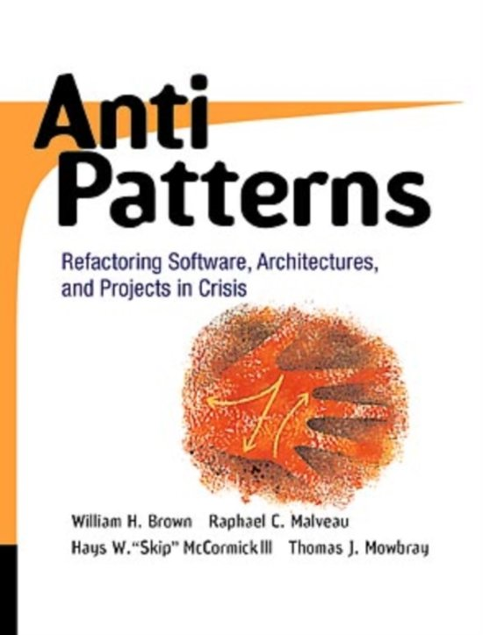
Anti-pattern
other documented solutions that prove to be more effective are [always] available

Slide 23
Controlling time
public class WelcomeMessageGenerator
{
public string GetWelcomeMessage()
{
DateTime now = DateTime.Now;
string partOfDay = now.Hour < 6 ? "night" : "day";
return $"Good {partOfDay}.";
}
}
DateTime.Now
= Volatile Dependency

Slide 24
Controlling time
public interface ITimeProvider
{
DateTime Now { get; }
}
public static class TimeProvider
{
public static ITimeProvider Current { get; set; }
}

Slide 25
Controlling time
public class WelcomeMessageGenerator
{
public string GetWelcomeMessage()
{
DateTime now = TimeProvider.Current.Now;
string partOfDay = now.Hour < 6 ? "night" : "day";
return $"Good {partOfDay}.";
}
}

Slide 26
Downsides

Slide 27
Downsides Dishonesty
public class WelcomeMessageGenerator
{
...
public string GetWelcomeMessage()
{
Some code here
...
More code here
...
All the way down here even more code
...
DateTime now = TimeProvider.Current.Now;
string partOfDay = now.Hour < 6 ? "night" : "day";
return $"Good {partOfDay}.";
}
}
Hidden dependency

Slide 28
Downsides Increased Complexity

Slide 29
ITimeProvider
+ Now: DateTime
Frozen Provider
Default Provider
- value: DateTime
+ Now: DateTime
+ Now: DateTime
SomeController
MessageGenerator
+ GetWelcomeMessage()

Slide 30
Downsides Increased Complexity
public class WelcomeMessageGenerator
{
private readonly ITimeProvider timeProvider =
TimeProvider.GetCurrent(
typeof(WelcomeMessageGenerator));
public string GetWelcomeMessage()
{
DateTime now = timeProvider.Now;
string partOfDay = now.Hour < 6 ? "night" : "day";
return $"Good {partOfDay}.";
}
}

Slide 31
Downsides Test Interdependency
Global state
[Fact]
public void Says_good_day_during_day_time()
{
// Arrange
DateTime dayTime = DateTime.Parse("2019-01-01 6:00");
TimeProvider.Current = new FakeTimeProvider { Now = dayTime };
var generator = new WelcomeMessageGenerator();
// Act
string actualMessage = generator.GetWelcomeMessage();
// Assert
Assert.Equal("Good day.", actual: actualMessage);
}
No Teardown

Slide 32
Fixing Ambient Context

Slide 33
Fixing Ambient Context Constructor Injection
public class WelcomeMessageGenerator
{
private readonly ITimeProvider timeProvider;
public WelcomeMessageGenerator(ITimeProvider provider)
{
this.timeProvider = provider ?? throw new Exception();
}
public string GetWelcomeMessage()
{
DateTime now = this.timeProvider.Now;
string partOfDay = now.Hour < 6 ? "night" : "day";
return $"Good {partOfDay}.";
}
}

Slide 34
Ambient Context
She might seem easy to use, that doesn’t make her healthy for you

Slide 35
Compile-Time Weaving

Slide 36
Aspect-Oriented Programming aims to reduce boilerplate code required for implementing Cross-Cutting Concerns.
https://manning.com/seemann2

Slide 37
Compile-Time Weaving

Slide 38
Notify property changed
public class Person
{
public string GivenNames { get; set; }
public string FamilyName { get; set; }
public string FullName => $"{GivenNames} {FamilyName}";
}

Slide 39
Notify property changed by hand
public class Person : INotifyPropertyChanged
{
private string givenNames;
private string familyName;
public event PropertyChangedEventHandler PropertyChanged;
public string GivenNames
{
get => this.givenNames;
set
{
if (value != this.givenNames)
{
this.givenNames = value;
this.OnPropertyChanged(nameof(GivenNames));
this.OnPropertyChanged(nameof(FullName));
}
}
}
public string FamilyName
{
get => this.familyName;
set
{
if (value != this.familyName)
{
this.familyName = value;
this.OnPropertyChanged(nameof(FamilyName));
this.OnPropertyChanged(nameof(FullName));
}
}
}
public string FullName => $"{this.GivenNames} {this.FamilyName}";
private void OnPropertyChanged(string name)
{
PropertyChanged?.Invoke(this, new PropertyChangedEventArgs(name));
}
}

Slide 40
Notify property changed with tooling
public class Person : INotifyPropertyChanged
{
public event PropertyChangedEventHandler PropertyChanged;
public string GivenNames { get; set; }
public string FamilyName { get; set; }
public string FullName => $"{GivenNames} {FamilyName}";
}

Slide 41
Authorization
public class SqlProductRepository : IProductRepository
{
private readonly CommerceContext context;
public SqlProductRepository(CommerceContext context)
{
this.context = context;
}
[Authorize("Admin")]
public void Insert(Product product)
{
this.context.Products.Add(product);
}
[Authorize("Admin")]
public void Delete(Product product)
{
this.context.Products.Remove(product);
}
public Product[] GetProducts() ...
}

Slide 42
Authorization
[AttributeUsage(...)]
[PSerializable]
[MulticastAttributeUsage(...)]
public class AuthorizeAttribute : OnMethodBoundaryAspect
{
private readonly string role;
public AuthorizeAttribute(string role)
{
this.role = role;
}
public override void OnEntry(MethodExecutionArgs args)
{
var userContext = new WcfUserContext();
if (!userContext.IsInRole(this.role))
throw new SecurityException();
} public override void OnSuccess(...)
public override void OnExit(...)
public override void OnError(...)
}

Slide 43
Authorization
public class SqlProductRepository : IProductRepository
{
...
public void Insert(Product product)
{
var userContext = new WcfUserContext();
if (!userContext.IsInRole("Admin"))
throw new SecurityException();
this.context.Products.Add(product);
}
public void Delete(Product product)
{
var userContext = new WcfUserContext();
if (!userContext.IsInRole("Admin"))
throw new SecurityException();
this.context.Products.Remove(product);
}
public Product[] GetProducts() ...
}

Slide 44
Compile-time weaving causes tight coupling
https://manning.com/seemann2

Slide 45
Authorization
public class SqlProductRepository : IProductRepository
{
...
public void Insert(Product product)
{
var userContext = new WcfUserContext();
if (!userContext.IsInRole("Admin"))
throw new SecurityException();
this.context.Products.Add(product);
}
public void Delete(Product product)
{
var userContext = new WcfUserContext();
if (!userContext.IsInRole("Admin"))
throw new SecurityException();
this.context.Products.Remove(product);
}
...
}

Slide 46
Stable vs. Volatile

Slide 47
Compile-time weaving is the opposite of DI; it's a DI anti-pattern.
https://manning.com/seemann2

Slide 48
Alternatives
Dynamic Interception
SOLID

Slide 49
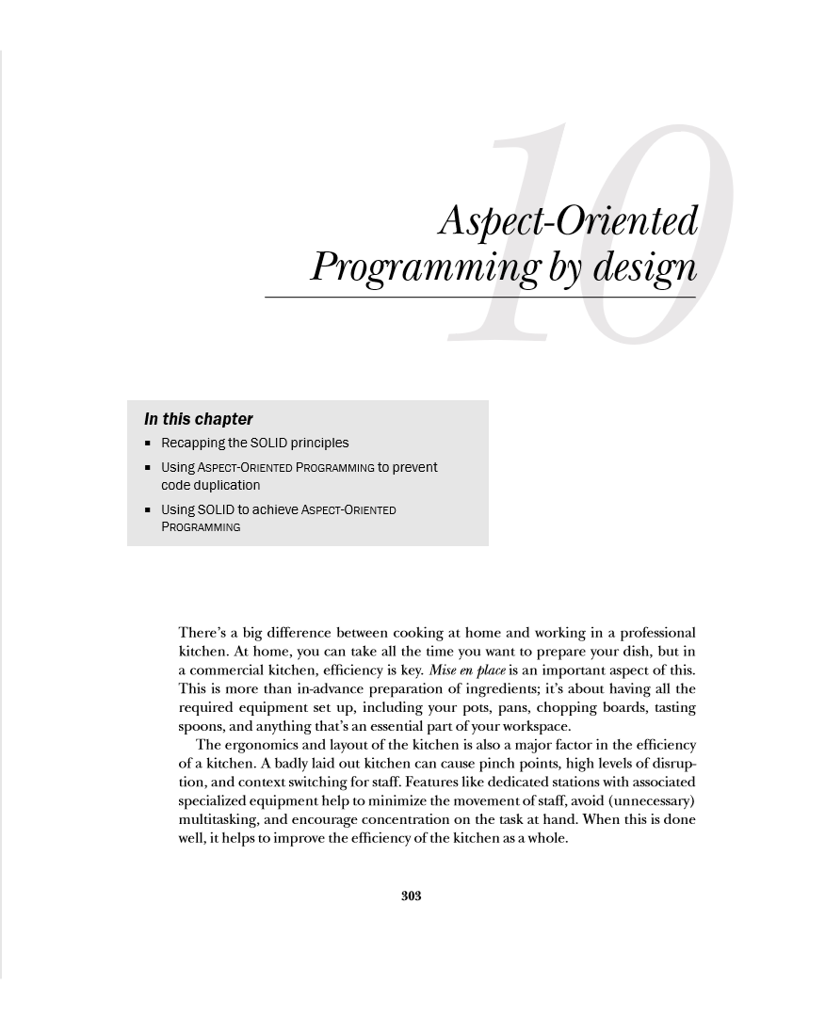
Alternatives SOLID

Slide 50
Alternatives SOLID
public interface ICommandHandler<TCommand>
{
void Handle(TCommand command);
}
CQRS

Slide 51
public class LoggingDecorator<TCommand> : ICommandHandler<TCommand>
{
private readonly ILog logger;
private readonly ICommandHandler<TCommand> decoratee;
public LoggingDecorator(ILog logger, ICommandHandler<TCommand> decoratee)
{
this.logger = logger;
this.decoratee = decoratee;
}
public void Handle(TCommand command)
{
this.logger.Info( "Handling '{0}' width data: '{1}'.", typeof(TCommand).Name, JsonConvert.SerializeObject(command));
this.decoratee.Handle(command);
}
}

Slide 52
Abstract Factories

Slide 53
public class HomeController : Controller
{
private readonly IProductRepositoryFactory factory;
public HomeController(IProductRepositoryFactory factory)
{
this.factory = factory;
}
public ViewResult Index()
{
IProductRepository repository = this.factory.Create();
try
{
var products = repository.GetProducts();
return this.View(products);
}
finally {
repository.Dispose(); }
}
}

Slide 54
public interface IProductRepository : IDisposable
{
Product[] GetProducts();
}
public interface IProductRepositoryFactory
{
IProductRepository Create();
}

Slide 55
High-level modules should not depend on low-level modules. Both should depend on abstractions.
Loose Coupling
Agile Principles, Patterns, and Practices, Robert C. Martin

Slide 56
Abstractions should be owned by the module using the abstraction
Ownership Inversion
Agile Principles, Patterns, and Practices, Robert C. Martin

Slide 57
public class HomeController : Controller
{
private readonly IProductRepositoryFactory factory;
public HomeController(IProductRepositoryFactory factory)
{
this.factory = factory;
}
public ViewResult Index()
{
IProductRepository repository = this.factory.Create();
try
{
var products = repository.GetProducts();
return this.View(products);
}
finally {
repository.Dispose(); }
}
}

Slide 58
HomeController
ProductRepository- Factory
Create()
new(…)
Sql- ProductRepository
a repository
GetProducts()
some products
Dispose()

Slide 59
public class HomeController : Controller
{
private readonly IProductRepository repository;
public HomeController(IProductRepository repository)
{
this.repository = repository;
}
public ViewResult Index()
{
var products = this.repository.GetProducts();
return this.View(products);
}
}

Slide 60
public interface IProductRepository : IDisposable
{
Product[] GetProducts();
}
public interface IProductRepositoryFactory
{
IProductRepository Create();
}

Slide 61
HomeController
IProductRepository
GetProducts()
some products

Slide 62
public class SqlProductRepositoryProxy : IProductRepository
{
private readonly string connStr;
public SqlProductRepositoryProxy(string connStr)
{
this.connStr = connStr;
}
public Product[] GetProducts()
{
using (var repository = this.Create())
{
return repository.GetProducts();
}
}
private SqlProductRepository Create()
{
return new SqlProductRepository(this.connStr);
}
}

Slide 63
Service abstractions shouldn't expose other service abstractions in their definition.
public interface IProductRepositoryFactory
{
IProductRepository Create();
}
https://manning.com/seemann2

Slide 64
Abstract Factories
Produce more smoke than is good for their consumers

Slide 65
Constructor Injection
Ambient Context
Compile-Time Weaving
SOLID
Proxy / Adapter
Abstract Factories

Slide 66
Steven van Deursen @dot_NET_Junkie dotnetjunkie
https://blogs.cuttingedge.it/steven
https://manning.com/seemann2

Slide 67
Resources
Steven van Deursen @dot_NET_Junkie dotnetjunkie
Second edition https://manning.com/seemann2
Free chapter 1 of second edition https://livebook.manning.com/#!/book/dependency-injection-principles-practices-patterns/chapter-1
The Service Locator anti-pattern (excerpt from 2nd edition) https://mng.bz/WaQw
The Ambient Context anti-pattern (excerpt from 2nd edition) https://mng.bz/8JqB
About CQRS and command handlers (Steven v. Deursen) https://blogs.cuttingedge.it/steven/p/commands
Abuse of Abstract Factories (excerpt from 2nd edition) https://mng.bz/zMlX

