Slide 1

Wearables & Bio-Materials
Making stuff & growing stuff in @DoESLiverpool

Slide 2
Ideas
People turn up at @DoESLiverpool Wearable Technology Evenings (7pm every 2nd & 4th Monday of the month) with ideas
Image courtesy @DoESLiverpool

Slide 3
Making
Everyone gets excited, adds more ideas and opinions and tools
Image courtesy @DoESLiverpool

Slide 4
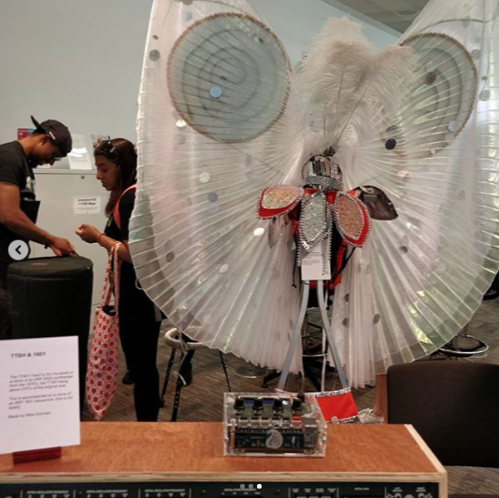
Making
Everyone gets excited, adds more ideas and opinions and tools and eventually start making stuff together
Image courtesy @DoESLiverpool

Slide 5
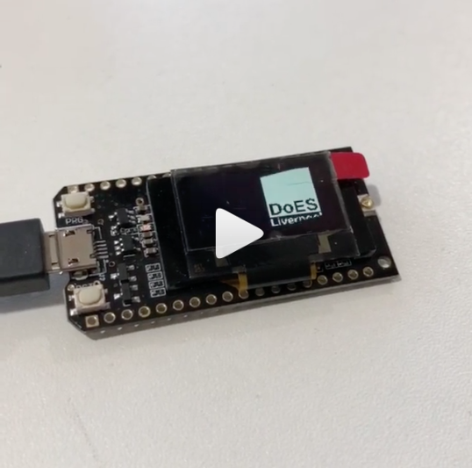
Tiny Computers
Many wearables at DoES take advantage of tiny cheap computers and people who share how they work.
Image courtesy @DoESLiverpool

Slide 6
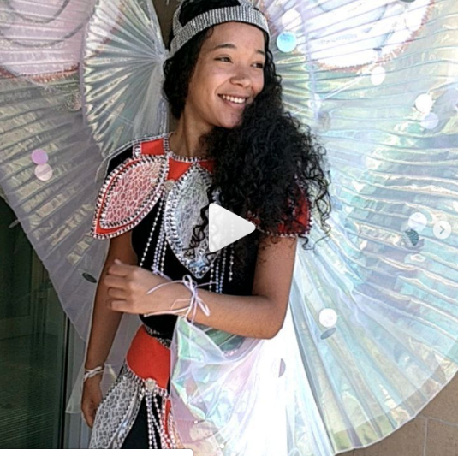
Wear It!
Eventually you get to wear something and use it. The tiny computers are in there somewhere making it work...
Image courtesy @DoESLiverpool

Slide 7
LEDs
Inevitably LEDs get involved; who doesn’t want to wear stuff that lights up?
Image courtesy @DoESLiverpool

Slide 8
LEDs
Visualise data, make beautiful imagery or temporarily dis-orientate an attacker (these are not necessarily mutually exclusive things)
Image courtesy @DoESLiverpool

Slide 9
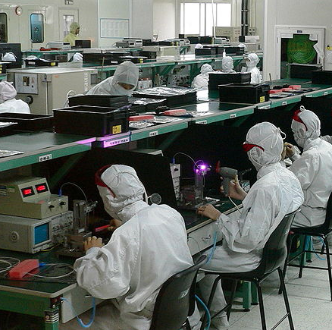
LEDs & computers & hi-tech fabric are great but they take alot of resources to make: what if we could grow our own in the same way we cook our own circuit boards or our own software systems?
Image courtesy Wikimedia Commons under CC2.0
https://commons.wikimedia.org/wiki/File:Electronics_factory_in_Shenzhen.jpg

Slide 10
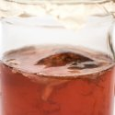
Kombucha
Kombucha is a kind of fermenting tea using a symbiotic mixed culture of bacteria and yeast which grows aerobically & anerobically into a
Cellular mass; a ‘Scoby’
Image courtesy materiom.com

Slide 11
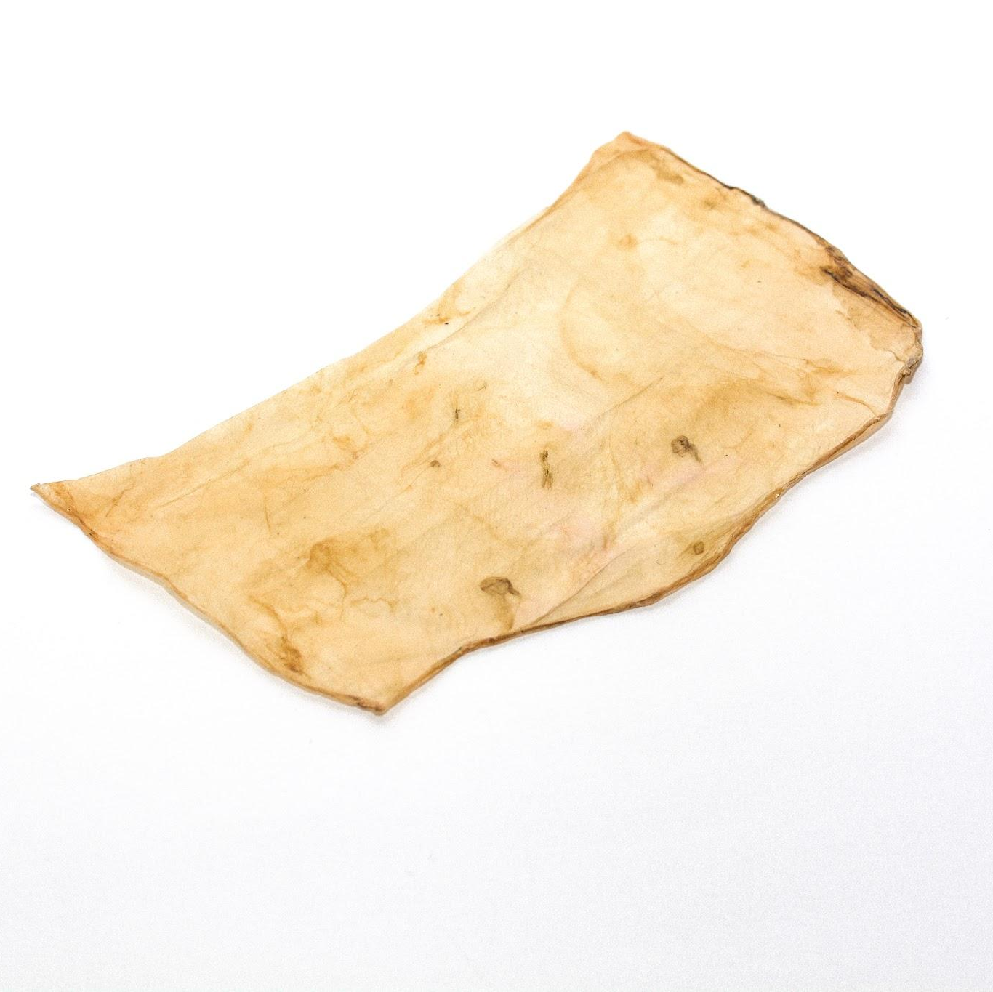
Kombucha
As it ferments it grows into a ‘scobie’ a partly living material that can be dried out, cured or tanned ready for sewing or laser cutting
Image courtesy materiom.com

Slide 12
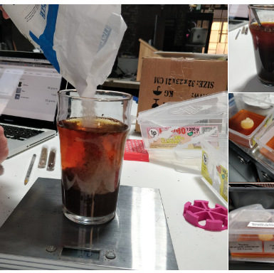
Image courtesy @DoESLiverpool
Notes:
Like all technology it takes alot of care, maintenance, time and people

Slide 13
Image courtesy @DoESLiverpool
Notes:
Like all technology it takes alot of care, maintenance, time and people

Slide 14
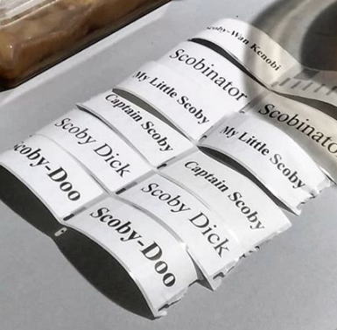
Image courtesy @DoESLiverpool
Notes:
Clearly puns are necessary

Slide 15
Image courtesy @DoESLiverpool

Slide 16
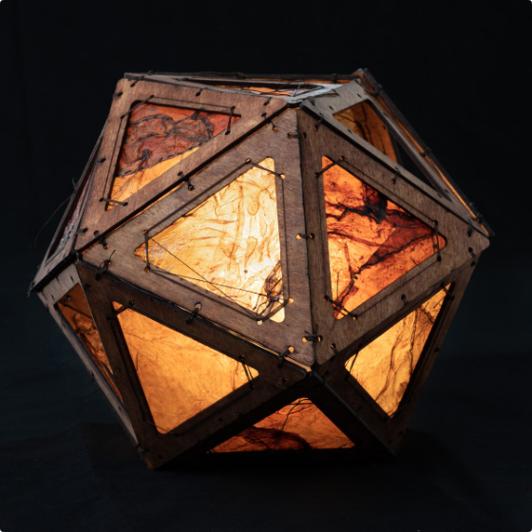
Image courtesy @DoESLiverpool & @thingomy

Slide 17
Growing your own material is always harder and takes more care and maintenance but the best thing is that you will have to do it with others; growing, like making, is all about other people
& other things
Image courtesy @littlepinkmaker

Slide 18
Scouse scientist @littlepinkmaker ran one of her excellent workshops @DoESLiverpool which helped kick-start our bio-material journey
Image courtesy @littlepinkmaker

Slide 19
Now we know there’s loadsa bio-materials in Merseyside!
Image courtesy @thehealthygutcompany

Slide 20
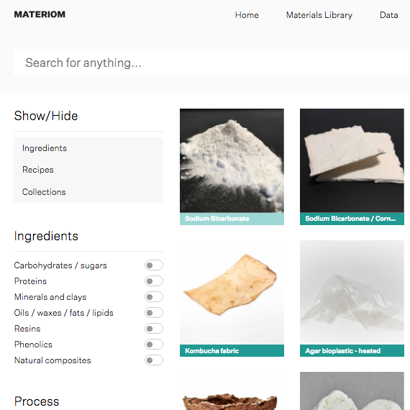
You don’t need a blockchain or a computing substrate; although a database can help :)
materiom.com
Image courtesy materiom.com

Slide 21
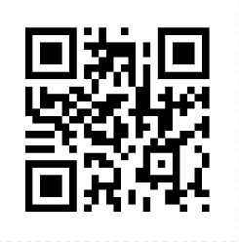
Join Us!
Wearables & Bio-Materials
Make stuff, grow stuff, wear stuff @DoESLiverpool
2nd & 4th Monday of the month
doesliverpool.com/calendar

