Slide 1
SCTP: Stream Control Transmission Protocol
Do Hai Son
Advanced Institute of Eng. and Tech. (AVITECH)
VNU - University of Eng. and Tech.

Slide 2
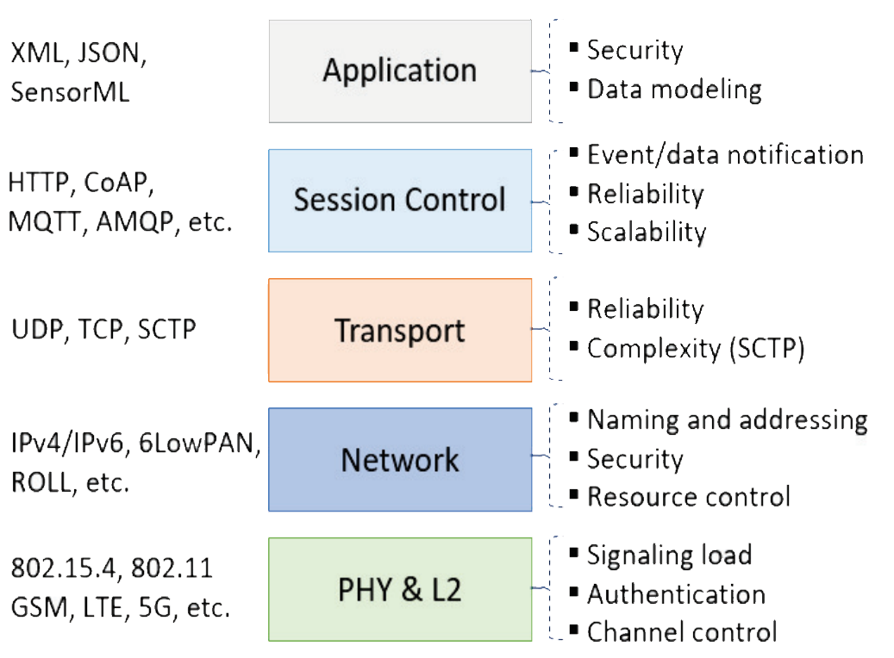
What is SCTP?
RFC 4960: Stream Control Transmission Protocol is a new reliable, message-oriented transport layer protocol
SCTP combine the best features of UDP and TCP
Designed for Internet applications that have recently been introduced, which need a more sophisticated service than TCP

Slide 3
Basic SCTP terminology
Chunk: A unit of data within an SCTP packet, similar to UDP Datagram
Path: A connection between two IPs
Association: The set of paths between two endpoints on a network
Transmission Sequence Number (TSN): A number assigned to each data chunk to keep track of it

Slide 4
SCTP Services?
Process-to-Process Communication
Multiple Streams
Multihoming
Full-Duplex Communication
SCTP offers full-duplex service, in which data can flow in both directions at the same time. Each SCTP then has a sending and receiving buffer.
Connection-Oriented Service
A connection is called an association. Connection steps:
The two SCTPs establish an association between each other.
Data are exchanged in both directions.
The association is terminated.
Reliable Service
SCTP, like TCP, is a reliable transport protocol. It uses an acknowledgment mechanism to check the safe and sound arrival of data.

Slide 5
SCTP Services: Process-to-Process Communication
SCTP uses all well-known ports in the TCP space.

Slide 6
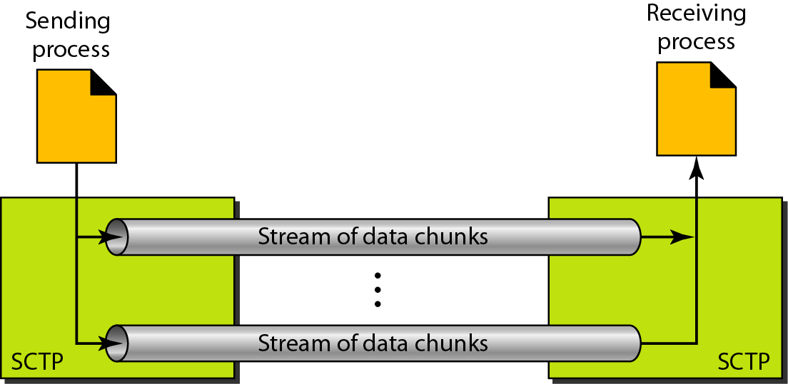
SCTP Services: Multiple Streams
SCTP allows multistream service in each connection, which is called association in SCTP terminology.
SCTP is mainly used to transfer real-time data (multimedia).
If one of the streams is blocked, the other streams can still deliver their data (fault tolerance).

Slide 7
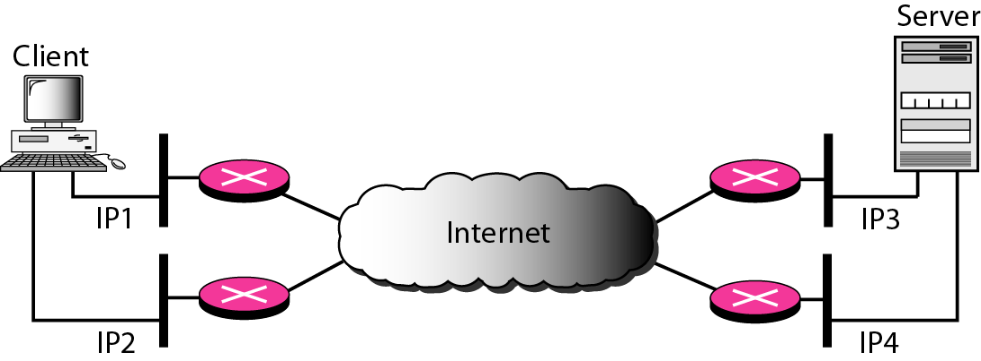
SCTP Services: Multihoming
The sending and receiving host can define multiple IP addresses in each end for an association.
This is a fault-tolerant approach:
when one path fails, another interface can be used for data delivery without interruption.
An association in SCTP can involve multiple streams.

Slide 8
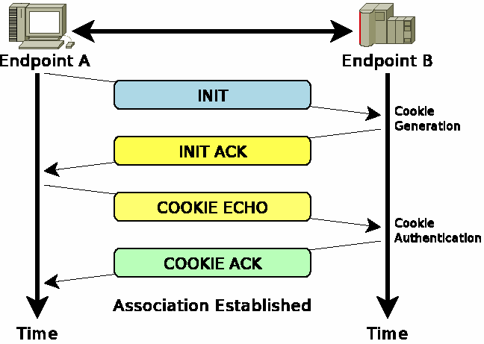
Creating an SCTP Association
SCTP requires a four-way step process also called a handshake:
INIT: Request sent by client to server
INIT ACK: Response to INIT, provides a Verification Tag and a Cookie which defines the current server state
COOKIE ECHO – Client echoes the Cookie
COOKIE ACK – Final acknowledgement of the connection

Slide 9
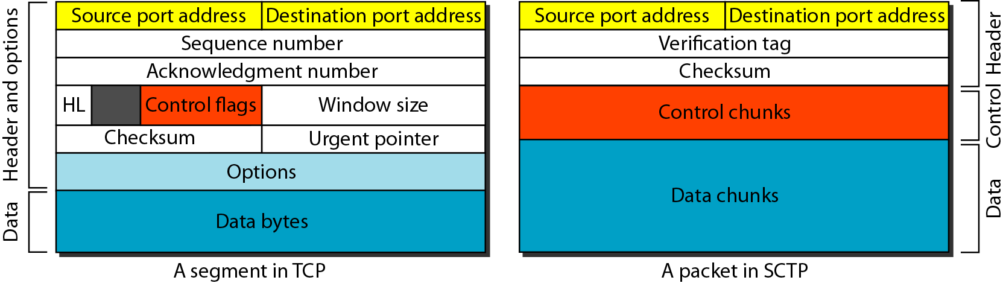
SCTP Features
Comparison between a TCP segment and an SCTP packet
Multiple chunks can be held together in the same packet
Control information is carried in chunks
Verification Tag – Unique identifier for the current Association

Slide 10
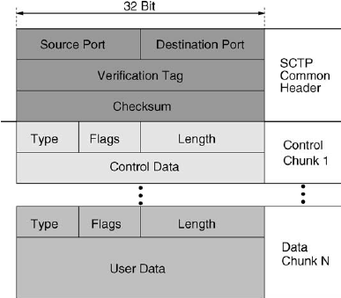
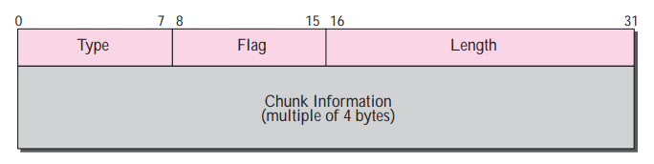
SCTP Chunk Structure
Type field: Data, Association requests, Acknowledgements, etc.
Flag field: Defines what flags a chunk may need
Length:Total size of the chunk in bytes

Slide 11
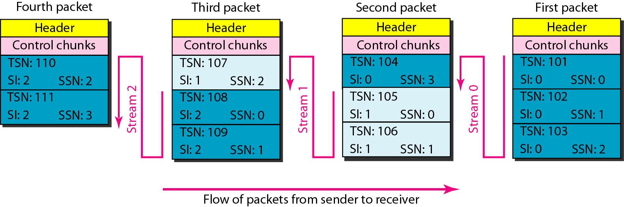
SCTP Features

Slide 12
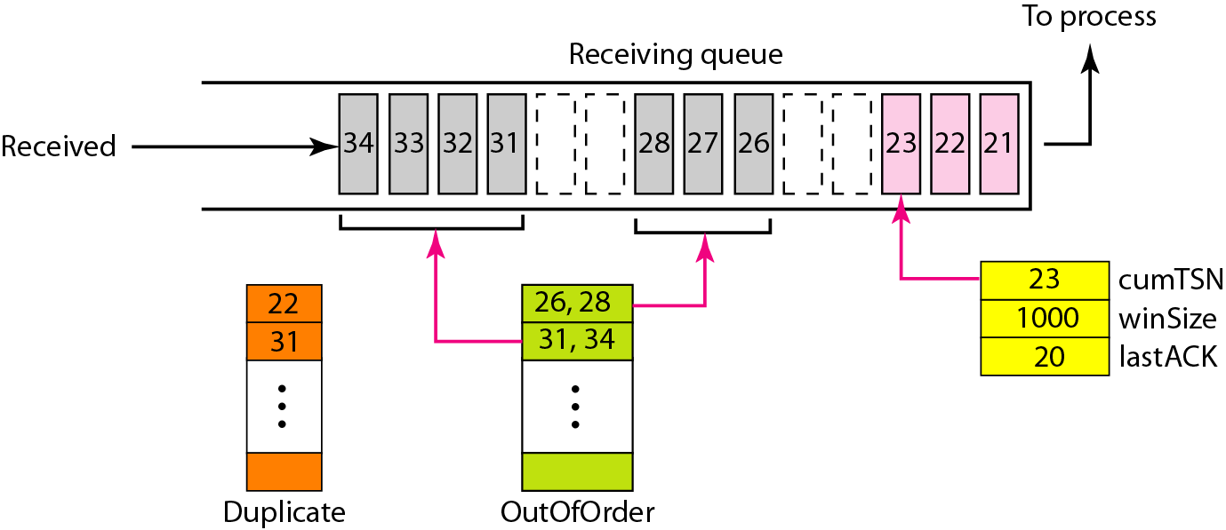
SCTP Features: Error control
Whenever a data chunk is received, an acknowledgement is returned to the transmitter.
If the transmitter does not receive an acknowledgement within a certain time frame (RTO), the chunk is re-transmitted.
If a receiver notices missing data chunks, it sends a selective acknowledgement to the transmitter.

Slide 13
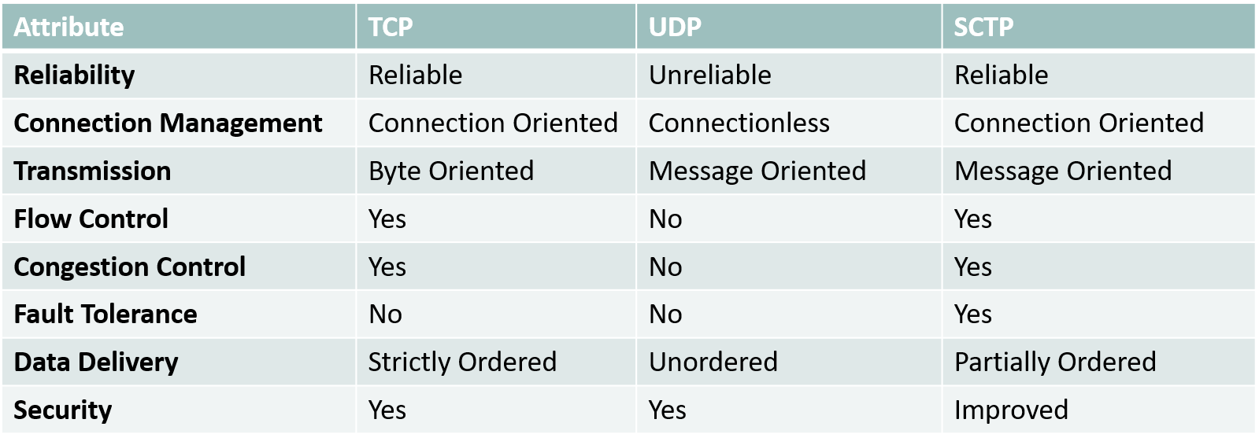
TCP and UDP compared to SCTP
Popularity Issues
TCP/IP is very widespread and integrated.
Lacks native support with Windows and Mac OS.
Does not cross NAT very well. Less than 1% of home or enterprise routers do NAT on SCTP.
SCTP fills peculiar needs that are not needed by many applications like multistream and ordered reliable datagrams.

Slide 14
I. Introduction
II. Đặt vấn đề
III. Thu thập dữ liệu & …
IV. Phát triển MHMP
V. Xác thực & kiểm chứng
VI. Kết luận
I.

Slide 15
I. Giới thiệu
II. Đặt vấn đề
III. Thu thập dữ liệu & …
IV. Phát triển MHMP
V. Xác thực & kiểm chứng
VI. Kết luận
II. Đặt vấn đề

Slide 16
I. Giới thiệu
II. Đặt vấn đề
III. Thu thập dữ liệu & …
IV. Phát triển MHMP
V. Xác thực & kiểm chứng
VI. Kết luận
III. Thu thập dữ liệu và phân tích

Slide 17
I. Giới thiệu
II. Đặt vấn đề
III. Thu thập dữ liệu & …
IV. Phát triển MHMP
V. Xác thực & kiểm chứng
VI. Kết luận
IV. Phát triển mô hình mô phỏng

Slide 18
I. Giới thiệu
II. Đặt vấn đề
III. Thu thập dữ liệu & …
IV. Phát triển MHMP
V. Xác thực & kiểm chứng
VI. Kết luận
V. Xác thực và kiểm chứng

Slide 19
I. Giới thiệu
II. Đặt vấn đề
III. Thu thập dữ liệu & …
IV. Phát triển MHMP
V. Xác thực & kiểm chứng
VI. Kết luận
VI. Kết luận

Slide 20
THANKS!
Any questions?
You can find me at
dohaison1998@vnu.edu.vn
More information:
https://dohaison.github.io

