Slide 1
Channel Multiplexing Techniques: OFDM
Tran Huu Ha and Do Hai Son
Advanced Institute of Eng. and Tech. (AVITECH)
VNU - University of Eng. and Tech.

Slide 2
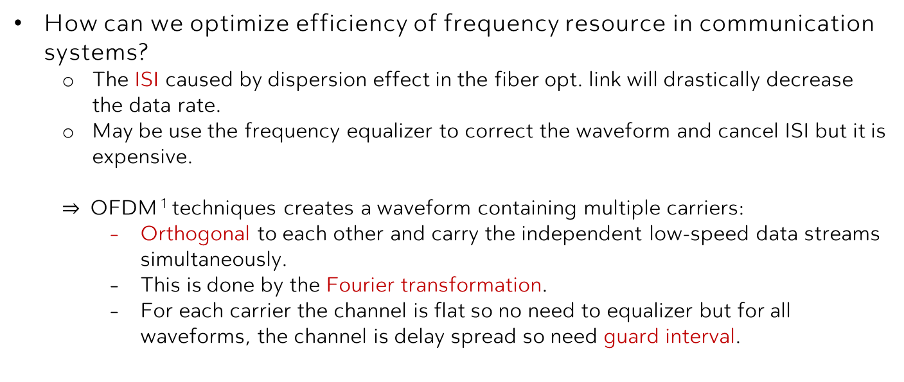
Questions
How can we optimize efficiency of frequency resource in communication systems?
The ISI caused by dispersion effect in the fiber opt. link will drastically decrease the data rate.
May be use the frequency equalizer to correct the waveform and cancel ISI but it is expensive.
$⇒$ OFDM ¹ techniques creates a waveform containing multiple carriers:
Orthogonal to each other and carry the independent low-speed data streams simultaneously.
This is done by the Fourier transformation.
For each carrier the channel is flat so no need to equalizer but for all waveforms, the channel is delay spread so need guard interval.
¹ : R. W. Chang, "Synthesis of band-limited orthogonal signals for multichannel data transmission," in The Bell System Technical Journal, vol. 45, no. 10, pp. 1775-1796, 1966.

Slide 3
Menu
OFDM Principle
Optical OFDM Transmitter
Optical OFDM Receiver
Optical OFDM Experiments
Conclusion

Slide 4
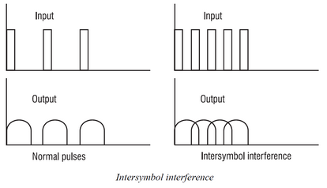
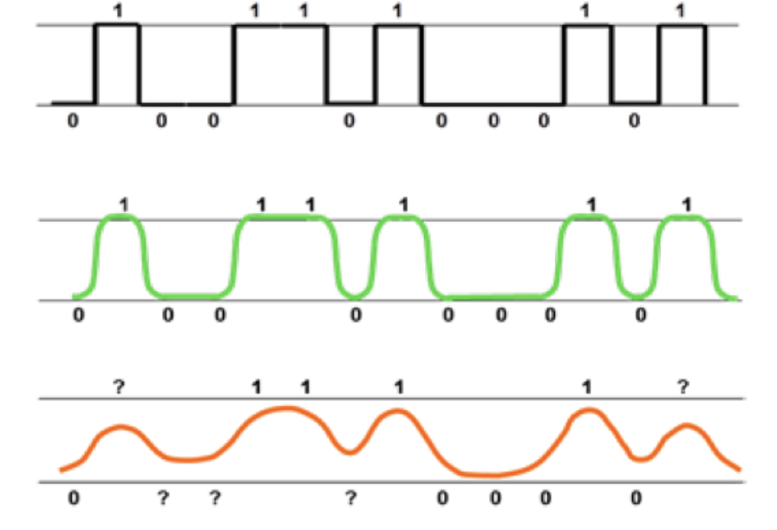


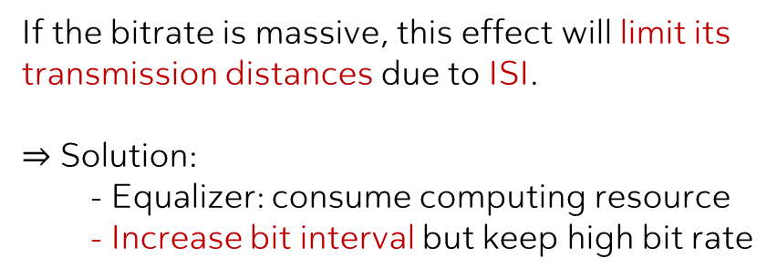
I. Principle
II. Opt. OFDM TX
III. Opt. OFDM RX
IV. Experiments
V. Conclusion
The dispersion effect in a single-mode opt. fiber (SMF) will be spread the pulse (ns/km).
A low bitrate $B_{T}$=120 Mbps:
101010, $D_{t}$=5 ns/km
A high bitrate $B_{T}$=200 Mbps:
1010101010, $D_{t}$=5 ns/km
(carrier wave not shown)
(carrier wave not shown)
If the bitrate is massive, this effect will limit its transmission distances due to ISI.
$⇒$ Solution:
- Equalizer: consume computing resource
- Increase bit interval but keep high bit rate

Slide 5
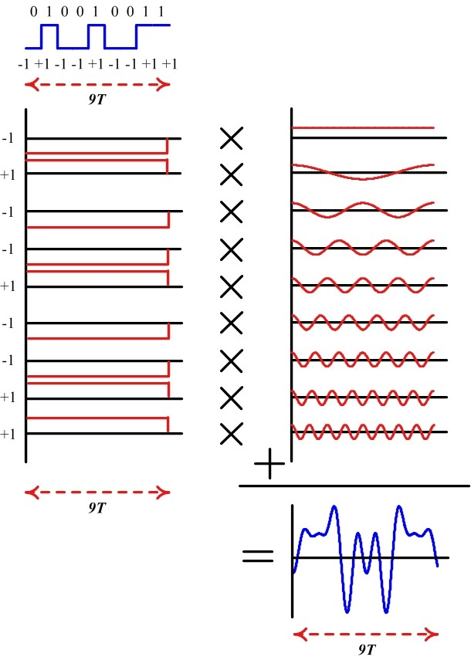
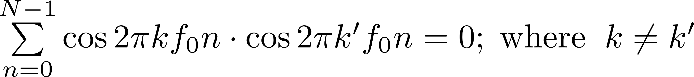


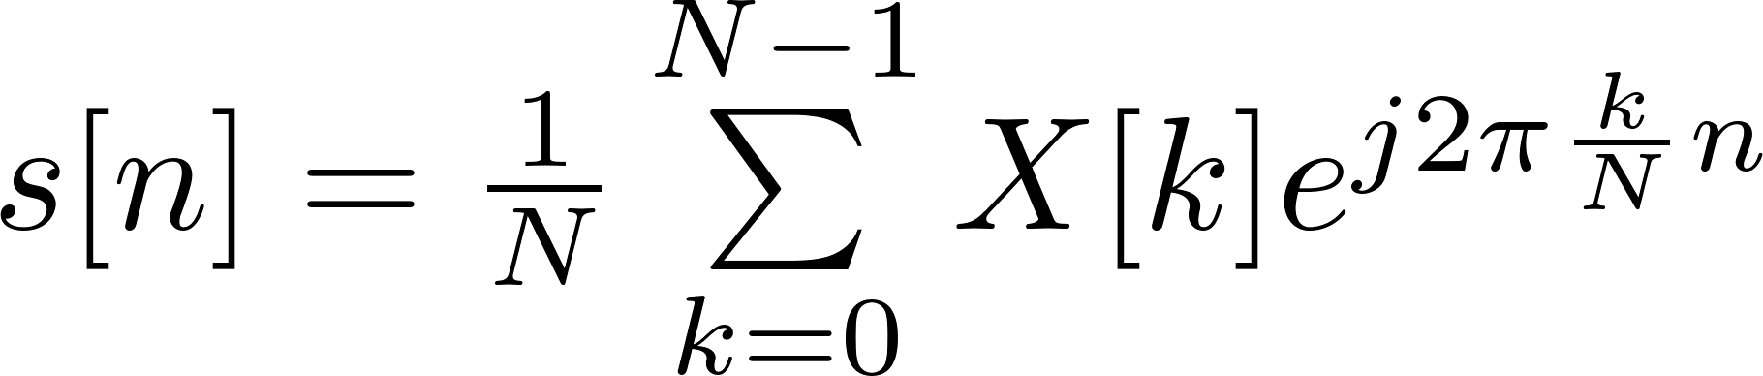
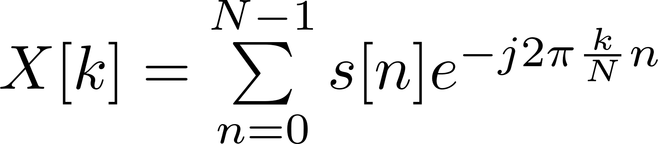
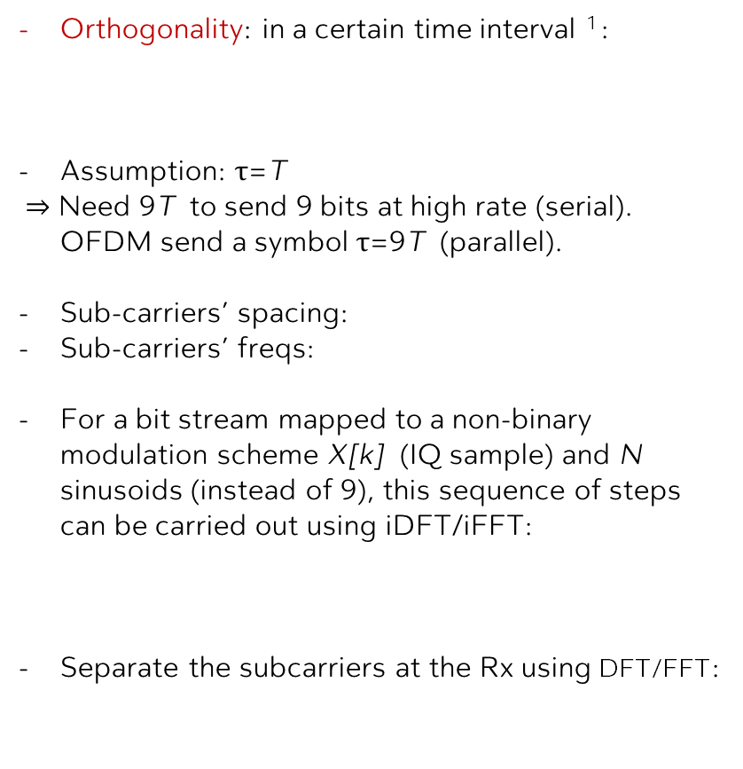
I. Principle
II. Opt. OFDM TX
III. Opt. OFDM RX
IV. Experiments
V. Conclusion
OFDM in Time-Domain: breaks one serial fast bit stream into many parallel slow bit streams
Orthogonality: in a certain time interval ¹ :
Assumption: $τ$=T
$⇒$ Need 9T to send 9 bits at high rate (serial).
OFDM send a symbol $τ$=9T (parallel).
Sub-carriers’ spacing:
Sub-carriers’ freqs:
For a bit stream mapped to a non-binary modulation scheme X[k] (IQ sample) and N sinusoids (instead of 9), this sequence of steps can be carried out using iDFT/iFFT:
Separate the subcarriers at the Rx using DFT/FFT:
¹ : Qasim Chaudhari, "A Beginner's Guide to OFDM," DSPrelated, 2017.

Slide 6
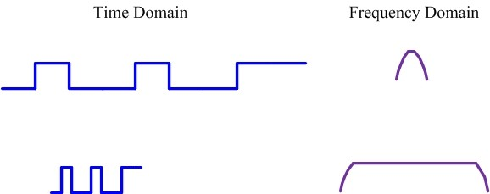
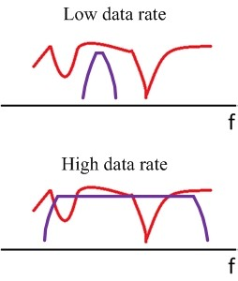
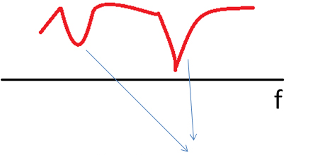
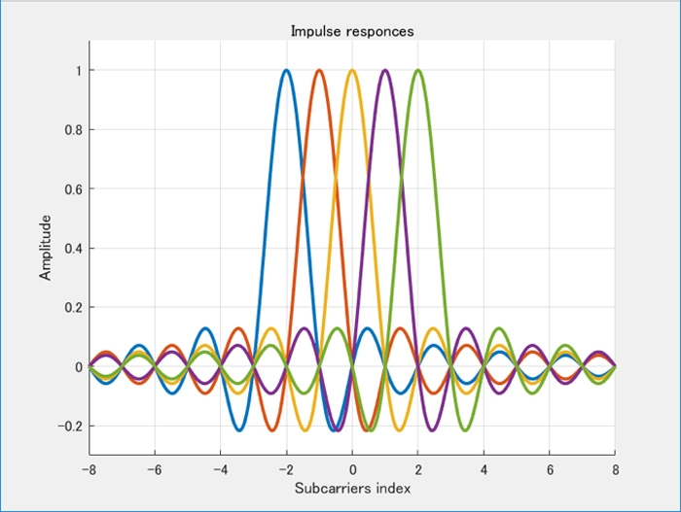
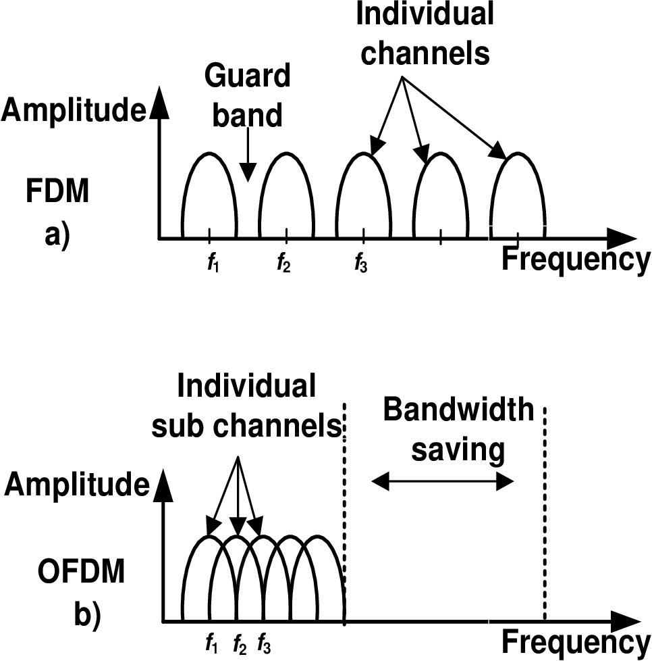
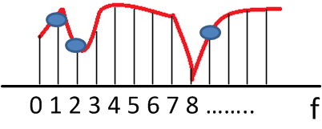
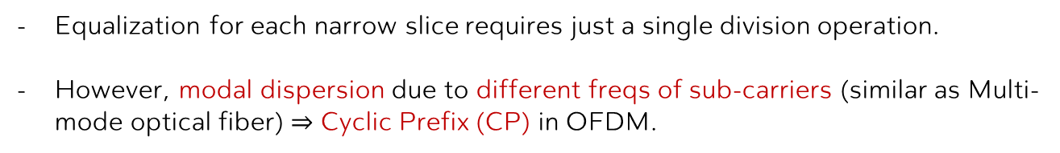
I. Principle
II. Opt. OFDM TX
III. Opt. OFDM RX
IV. Experiments
V. Conclusion
OFDM in Frequency-Domain
Fiber Opt. Link Freq response
deep fade
OFDM Slices
Truly OFDM spectrum
Bandwidth saving
Equalization for each narrow slice requires just a single division operation.
However, modal dispersion due to different freqs of sub-carriers (similar as Multi-mode optical fiber) $⇒$ Cyclic Prefix (CP) in OFDM.
¹ : Qasim Chaudhari, "A Beginner's Guide to OFDM," DSPrelated, 2017.

Slide 7

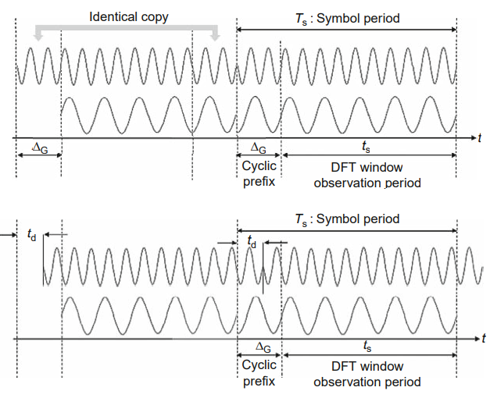
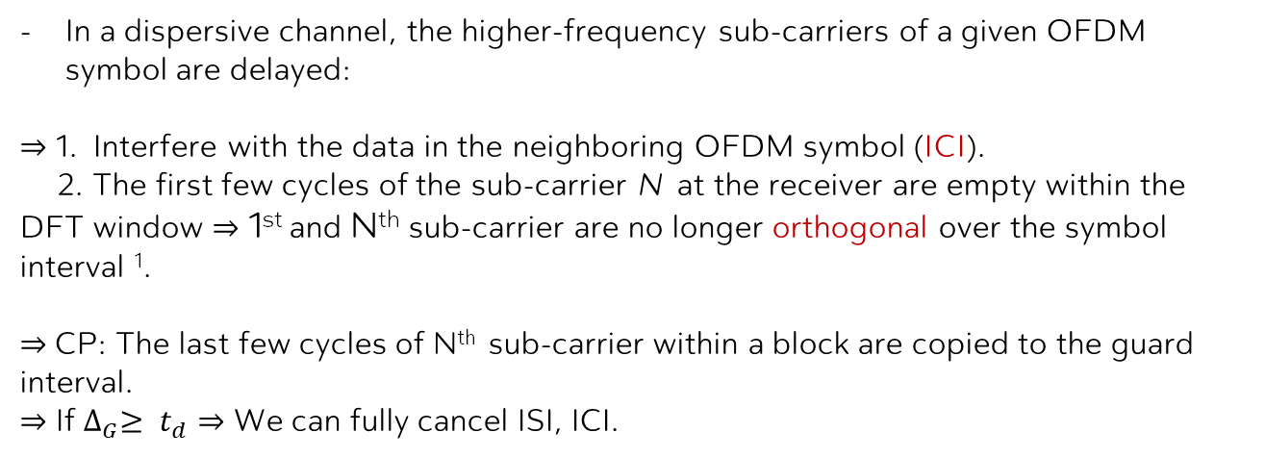


I. Principle
II. Opt. OFDM TX
III. Opt. OFDM RX
IV. Experiments
V. Conclusion
Cyclic Prefix (CP) in OFDM
In a dispersive channel, the higher-frequency sub-carriers of a given OFDM symbol are delayed:
$⇒$ 1. Interfere with the data in the neighboring OFDM symbol (ICI).
2. The first few cycles of the sub-carrier N at the receiver are empty within the DFT window $⇒$ 1st and N^{th} sub-carrier are no longer orthogonal over the symbol interval ¹.
$⇒$CP: The last few cycles of N^{th} sub-carrier within a block are copied to the guard interval.
$⇒$ If ${∆_{G}≥ t}_{d}⇒$ We can fully cancel ISI, ICI.
¹ : Shiva Kumar and M. Jamal Deen, Fiber Optic Communications: Fundamentals and Applications. Wiley & Sons, 2014.

Slide 8
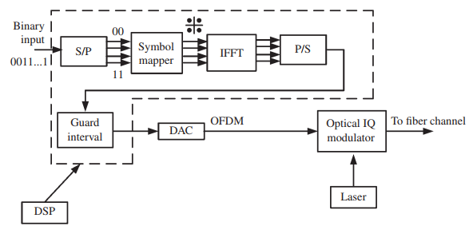


I. Principle
II. Opt. OFDM TX
III. Opt. OFDM RX
IV. Experiments
V. Conclusion
First, the binary serial input is converted to parallel (S/P). For example, a bit sequence {0011011} is broken into {00}, {10} , {01} and {11}. (QPSK)
The output of the symbol mapper is complex data which passes is converted to analog using (DAC).
The output of the DACs are used to modulate an optical IQ modulator. (MZM)

Slide 9
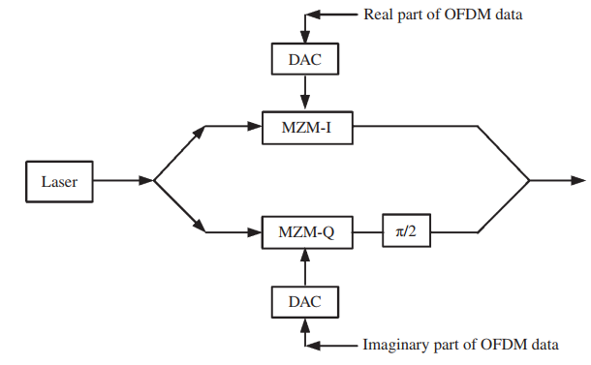
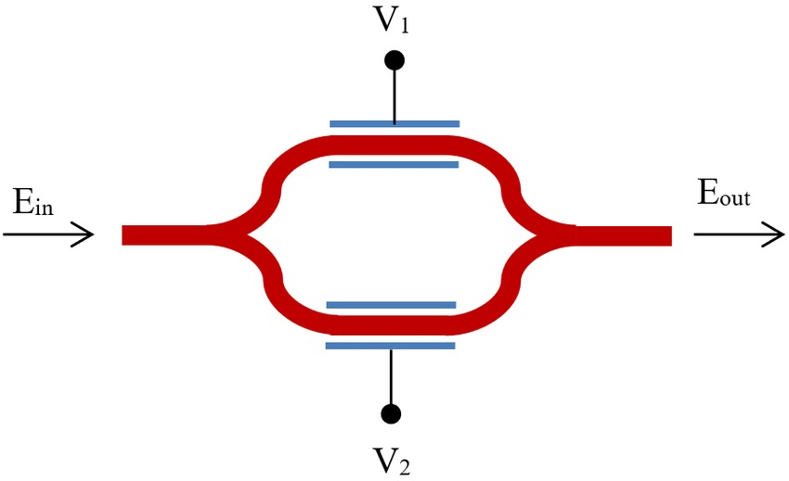
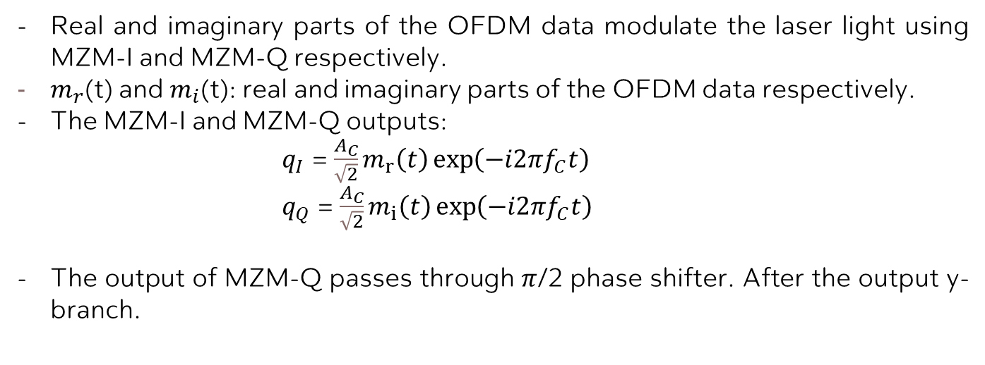
I. Principle
II. Opt. OFDM TX
III. Opt. OFDM RX
IV. Experiments
V. Conclusion
Real and imaginary parts of the OFDM data modulate the laser light using MZM-I and MZM-Q respectively.
$m_{r}$(t) and $m_{i}$(t): real and imaginary parts of the OFDM data respectively.
The MZM-I and MZM-Q outputs:
$q_{I}$ = $\frac{A_{C}}{\sqrt{2}}m_{r}\left(t\right)\exp\left(−i2πf_{C}t\right)$
$q_{Q}$ = $\frac{A_{C}}{\sqrt{2}}m_{i}\left(t\right)\exp\left(−i2πf_{C}t\right)$
The output of MZM-Q passes through $π$/2 phase shifter. After the output y-branch.

Slide 10
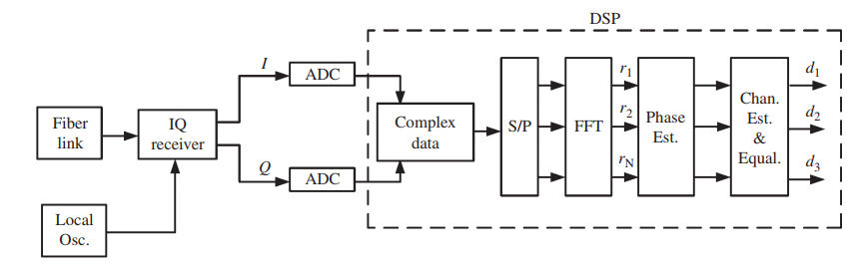
I. Principle
II. Opt. OFDM TX
III. Opt. OFDM RX
IV. Experiments
V. Conclusion
The output of the fiber-optic link passes through an optical IQ receiver consisting of 90 phase-shift and an array of photo-dectectors.
The I and Q branches of the IQ receiver output correspond to the real and imaginary parts of the OFDM data respectively.
Combining the real and imaginary parts, complex OFDM data is formed and the DFT of this data is computed using FFT, after serial-to-parallel conversion on each OFDM symbol.

Slide 11
I. Principle
II. Opt. OFDM TX
III. Opt. OFDM RX
IV. Experiments
V. Conclusion
Subcarrier Recovery: Channel dispersion, sampling timing offset, phase noises.
Laser phase noise with linewidth ranging from 100 KHz to several megahertz, which needs to be tracked on a per-symbol basis.

Slide 12
I. Principle
II. Opt. OFDM TX
III. Opt. OFDM RX
IV. Experiments
V. Conclusion
Transmission of a 1-Tb/s OFDM super channel over 8000 km of SSMF link at a spectral efficiency of 3.1 bit/s/Hz has been demonstrated experimentally.
The experimental demonstration of an 8-channel dense WDM transmission with a spectral efficiency of 7 bit/s/Hz using a 65.1-Gb/s coherent PDM-OFDM signal in each channel with 8-GHz channel spacing utilizing 32-QAM data on each subcarrier of an OFDM over a 240-km SSMF link has been carried out

Slide 13
I. Principle
II. Opt. OFDM TX
III. Opt. OFDM RX
IV. Experiments
V. Conclusion
Tán sắc sợi lại có thể làm nhiễu phi tuyến của từng hiệu ứng phi tuyến Kerr tác động khác nhau đến tín hiệu OFDM quang.
=> Ảnh hưởng của tin sắc về cần được xem xét

Slide 14
THANKS!
Any questions?
You can find me at
dohaison1998@vnu.edu.vn

