Slide 1
Chapter 1
Digital Design and Computer Architecture: ARM® Edition
Sarah L. Harris and David Money Harris

Slide 2
Chapter 1 :: Topics
Background
The Game Plan
The Art of Managing Complexity
The Digital Abstraction
Number Systems
Logic Gates
Logic Levels
CMOS Transistors
Power Consumption

Slide 3
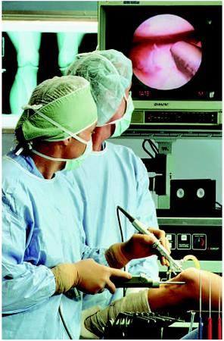

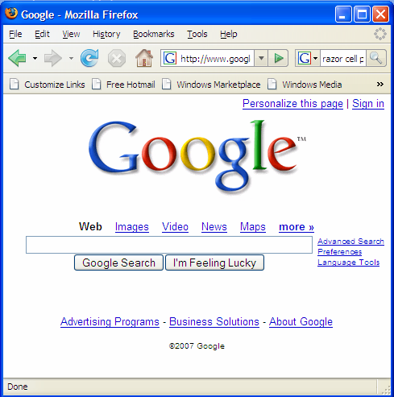
Background
Microprocessors have revolutionized our world
Cell phones, Internet, rapid advances in medicine, etc.
The semiconductor industry has grown from $21 billion in 1985 to $306 billion in 2013

Slide 4
The Game Plan
Purpose of course:
Understand what’s under the hood of a computer
Learn the principles of digital design
Learn to systematically debug increasingly complex designs
Design and build a microprocessor

Slide 5
The Art of Managing Complexity
Abstraction
Discipline
The Three –y’s
Hierarchy
Modularity
Regularity

Slide 6
Abstraction
Hiding details when they aren’t important

Slide 7
The Three -y’s
Hierarchy
A system divided into modules and submodules
Modularity
Having well-defined functions and interfaces
Regularity
Encouraging uniformity, so modules can be easily reused

Slide 8
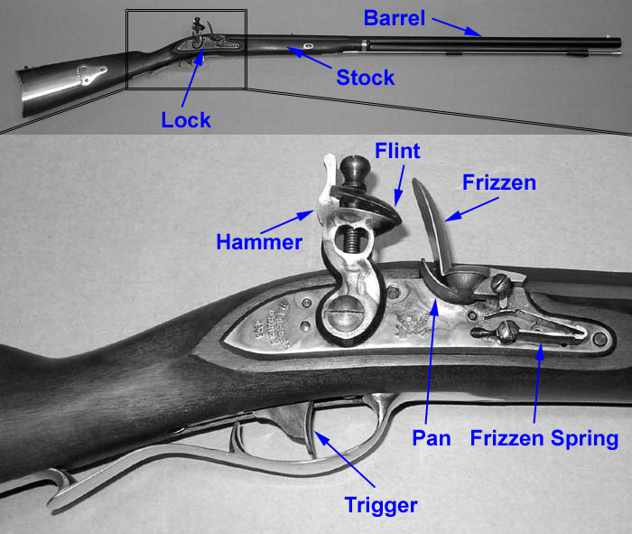
Example: The Flintlock Rifle
Hierarchy
Three main modules: lock, stock, and barrel
Submodules of lock: hammer, flint, frizzen, etc.

Slide 9
Example: The Flintlock Rifle
Modularity
Function of stock: mount barrel and lock
Interface of stock: length and location of mounting pins
Regularity
Interchangeable parts

Slide 10
Discipline
Intentionally restrict design choices
Example: Digital discipline
Discrete voltages instead of continuous
Simpler to design than analog circuits – can build more sophisticated systems
Digital systems replacing analog predecessors: i.e., digital cameras, digital television, cell phones, CDs

Slide 11
The Digital Abstraction
Most physical variables are continuous
Voltage on a wire
Frequency of an oscillation
Position of a mass
Digital abstraction considers discrete subset of values

Slide 12
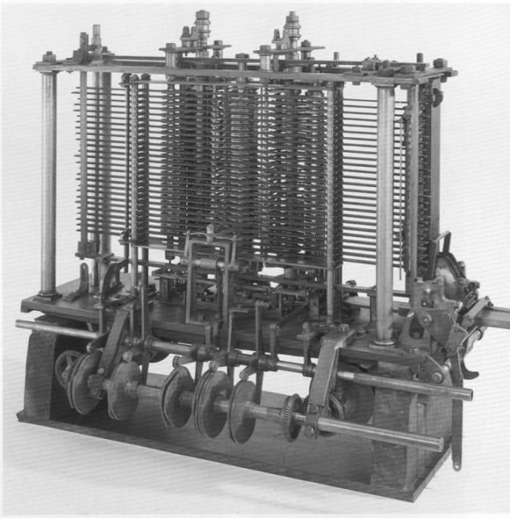
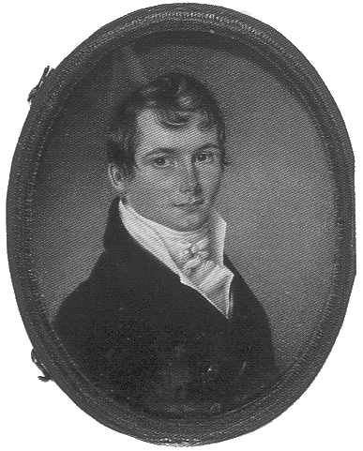
The Analytical Engine
Designed by Charles Babbage from 1834 – 1871
Considered to be the first digital computer
Built from mechanical gears, where each gear represented a discrete value (0-9)
Babbage died before it was finished

Slide 13
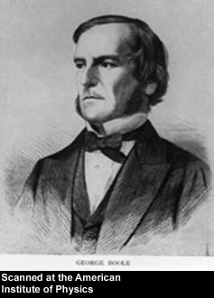
George Boole, 1815-1864
Born to working class parents
Taught himself mathematics and joined the faculty of Queen’s College in Ireland
Wrote An Investigation of the Laws of Thought (1854)
Introduced binary variables
Introduced the three fundamental logic operations: AND, OR, and NOT

Slide 14
Digital Discipline: Binary Values
Two discrete values:
1’s and 0’s
1, TRUE, HIGH
0, FALSE, LOW
1 and 0: voltage levels, rotating gears, fluid levels, etc.
Digital circuits use voltage levels to represent 1 and 0
Bit: Binary digit

Slide 15
Binary Values and Range
N-digit decimal number
How many values? 10^{N}
Range? [0, 10^{N} - 1]
Example: 3-digit decimal number:
10³ = 1000 possible values
Range: [0, 999]
N-bit binary number
How many values? 2^{N}
Range: [0, 2^{N} - 1]
Example: 3-digit binary number:
2³ = 8 possible values
Range: [0, 7] = [000₂ to 111₂]

Slide 16
Number Systems
Decimal numbers
Binary numbers

Slide 17
Powers of Two
2⁰ = 1
2¹ = 2
2² = 4
2³ = 8
2⁴ = 16
2⁵ = 32
2⁶ = 64
2⁷ = 128
2⁸ = 256
2⁹ = 512
2¹⁰ = 1024
2¹¹ = 2048
2¹² = 4096
2¹³ = 8192
2¹⁴ = 16384
2¹⁵ = 32768
Handy to memorize

Slide 18
Number Conversion
Binary to decimal conversion:
Convert 10011₂ to decimal
16×1 + 8×0 + 4×0 + 2×1 + 1×1 = 19₁₀
Decimal to binary conversion:
Convert 47₁₀ to binary
32×1 + 16×0 + 8×1 + 4×1 + 2×1 + 1×1 = 101111₂

Slide 19
Decimal to Binary Conversion
Two methods:
Method 1: Find the largest power of 2 that fits, subtract and repeat
Method 2: Repeatedly divide by 2, remainder goes in next most significant bit

Slide 20
Decimal to Binary Conversion
53₁₀
Method 1: Find the largest power of 2 that fits, subtract and repeat
53₁₀ 32×1
53-32 = 21 16×1
21-16 = 5 4×1
5-4 = 1 1×1 = 110101₂
Method 2: Repeatedly divide by 2, remainder goes in next most significant bit
53₁₀ = 53/2 = 26 R1
26/2 = 13 R0
13/2 = 6 R1
6/2 = 3 R0
3/2 = 1 R1
1/2 = 0 R1 = 110101₂

Slide 21
Decimal to Binary Conversion
Another example: Convert 75₁₀ to binary.
75₁₀= 64 + 8 + 2 + 1 = 1001011₂
or
75/2 = 37 R1
37/2 = 18 R1
18/2 = 9 R0
9/2 = 4 R1
4/2 = 2 R0
2/2 = 1 R0
1/2 = 0 R1

Slide 22
Hexadecimal Numbers
Base 16
Shorthand for binary

Slide 23
Hexadecimal Numbers
Hex Digit | Decimal Equivalent | Binary Equivalent
0 | 0 | 0000
1 | 1 | 0001
2 | 2 | 0010
3 | 3 | 0011
4 | 4 | 0100
5 | 5 | 0101
6 | 6 | 0110
7 | 7 | 0111
8 | 8 | 1000
9 | 9 | 1001
A | 10 | 1010
B | 11 | 1011
C | 12 | 1100
D | 13 | 1101
E | 14 | 1110
F | 15 | 1111

Slide 24
Hexadecimal to Binary Conversion
Hexadecimal to binary conversion:
Convert 4AF₁₆ (also written 0x4AF) to binary
0100 1010 1111₂
Hexadecimal to decimal conversion:
Convert 4AF₁₆ to decimal
16²×4 + 16¹×10 + 16⁰×15 = 1199₁₀

Slide 25
Bits, Bytes, Nibbles…
Bits
Bytes & Nibbles
Bytes

Slide 26
Large Powers of Two
2¹⁰ = 1 kilo ≈ 1000 (1024)
2²⁰ = 1 mega ≈ 1 million (1,048,576)
2³⁰ = 1 giga ≈ 1 billion (1,073,741,824)

Slide 27
Estimating Powers of Two
What is the value of 2²⁴?
2⁴ × 2²⁰ ≈ 16 million
How many values can a 32-bit variable represent?
2² × 2³⁰ ≈ 4 billion

Slide 28
Addition
Decimal
Binary

Slide 29
Binary Addition Examples
Add the following 4-bit binary numbers
Add the following 4-bit binary numbers

Slide 30
Overflow
Digital systems operate on a fixed number of bits
Overflow: when result is too big to fit in the available number of bits
See previous example of 11 + 6

Slide 31
Signed Binary Numbers
Sign/Magnitude Numbers
Two’s Complement Numbers

Slide 32
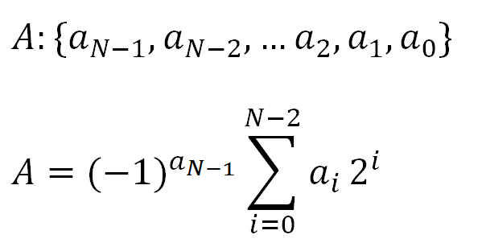
Sign/Magnitude Numbers
1 sign bit, N-1 magnitude bits
Sign bit is the most significant (left-most) bit
Positive number: sign bit = 0
Negative number: sign bit = 1
Example, 4-bit sign/mag representations of ± 6:
+6 = 0110
- 6 = 1110
Range of an N-bit sign/magnitude number:
[-(2^{N-1}-1), 2^{N-1}-1]

Slide 33
Sign/Magnitude Numbers
Problems:
Addition doesn’t work, for example -6 + 6:
1110
+ 0110
10100 (wrong!)
Two representations of 0 (± 0):
1000
0000

Slide 34
Two’s Complement Numbers
Don’t have same problems as sign/magnitude numbers:
Addition works
Single representation for 0

Slide 35
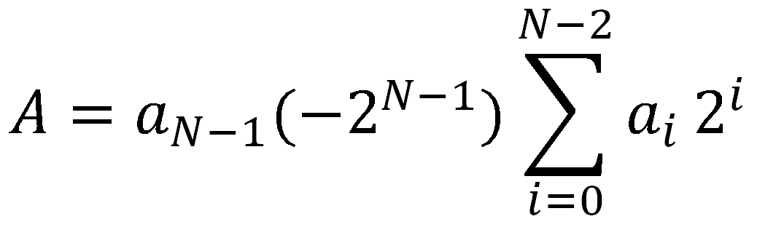
Two’s Complement Numbers
msb has value of -2^{N-1}
Most positive 4-bit number: 0111
Most negative 4-bit number: 1000
The most significant bit still indicates the sign (1 = negative, 0 = positive)
Range of an N-bit two’s complement number:
[-(2^{N-1}), 2^{N-1}-1]
+

Slide 36
“Taking the Two’s Complement”
“Taking the Two’s complement” flips the sign of a two’s complement number
Method:
Invert the bits
Add 1
Example: Flip the sign of 3₁₀ = 0011₂
1100
+ 1
1101 = -3₁₀

Slide 37
Two’s Complement Examples
Take the two’s complement of 6₁₀ = 0110₂
1001
+ 1
1010₂ = -6₁₀
What is the decimal value of the two’s complement number 1001₂?
0110
+ 1
0111₂ = 7₁₀, so 1001₂ = -7₁₀

Slide 38
Two’s Complement Addition
Add 6 + (-6) using two’s complement numbers
Add -2 + 3 using two’s complement numbers

Slide 39
Two’s Complement Addition
Add 6 + (-6) using two’s complement numbers
Add -2 + 3 using two’s complement numbers

Slide 40
Increasing Bit Width
Extend number from N to M bits (M > N) :
Sign-extension
Zero-extension

Slide 41
Sign-Extension
Sign bit copied to msb’s
Number value is same
Example 1:
4-bit representation of 3 = 0011
8-bit sign-extended value: 00000011
Example 2:
4-bit representation of -5 = 1011
8-bit sign-extended value: 11111011

Slide 42
Zero-Extension
Zeros copied to msb’s
Value changes for negative numbers
Example 1:
4-bit value = 0011 = 3₁₀
8-bit zero-extended value: 00000011 = 3₁₀
Example 2:
4-bit value = 1011 = -5₁₀
8-bit zero-extended value: 00001011 = 11₁₀

Slide 43
Number System Comparison
Number System | Range
Unsigned | [0, 2^{N}-1]
Sign/Magnitude | [-(2^{N-1}-1), 2^{N-1}-1]
Two’s Complement | [-2^{N-1}, 2^{N-1}-1]
For example, 4-bit representation:

Slide 44
Logic Gates
Perform logic functions:
inversion (NOT), AND, OR, NAND, NOR, etc.
Single-input:
NOT gate, buffer
Two-input:
AND, OR, XOR, NAND, NOR, XNOR
Multiple-input

Slide 45
Single-Input Logic Gates

Slide 46
Two-Input Logic Gates

Slide 47
More Two-Input Logic Gates

Slide 48
Multiple-Input Logic Gates
Multi-input XOR: Odd parity

Slide 49
SystemVerilog Description
module gates(input logic a, b, c,
output logic y1, y2, y3, y4, y5);
not g1(y1, a);
and g2(y2, a, b);
or g3(y3, a, b, c);
nand g4(y4, b, c);
xor g5(y5, a, c);
endmodule
Multi-input XOR: Odd parity

Slide 50
Logic Levels
Discrete voltages represent 1 and 0
For example:
0 = ground (GND) or 0 volts
1 = V_{DD} or 5 volts
What about 4.99 volts? Is that a 0 or a 1?
What about 3.2 volts?

Slide 51
Logic Levels
Range of voltages for 1 and 0
Different ranges for inputs and outputs to allow for noise

Slide 52
What is Noise?
Anything that degrades the signal
E.g., resistance, power supply noise, coupling to neighboring wires, etc.
Example: a gate (driver) outputs 5 V but, because of resistance in a long wire, receiver gets 4.5 V

Slide 53
The Static Discipline
With logically valid inputs, every circuit element must produce logically valid outputs
Use limited ranges of voltages to represent discrete values

Slide 54
Noise Margins

Slide 55
Noise Margins
High Noise Margin: NM_{H} = V_{OH} – V_{IH}
Low Noise Margin: NM_{L} = V_{IL} – V_{OL}

Slide 56
DC Transfer Characteristics
Ideal Buffer: Real Buffer:
NM_{H} = NM_{L} = V_{DD}/2
NM_{H}, NM_{L} < V_{DD}/2

Slide 57
DC Transfer Characteristics

Slide 58
V_{DD} Scaling
In 1970’s and 1980’s, V_{DD} = 5 V
V_{DD} has dropped
Avoid frying tiny transistors
Save power
3.3 V, 2.5 V, 1.8 V, 1.5 V, 1.2 V, 1.0 V, …
Be careful connecting chips with different supply voltages

Slide 59
V_{DD} Scaling
In 1970’s and 1980’s, V_{DD} = 5 V
V_{DD} has dropped
Avoid frying tiny transistors
Save power
3.3 V, 2.5 V, 1.8 V, 1.5 V, 1.2 V, 1.0 V, …
Be careful connecting chips with different supply voltages
Chips operate because they contain magic smoke
Proof: if the magic smoke is let out, the chip stops working

Slide 60
Logic Family Examples
Logic Family | V_{DD} | V_{IL} | V_{IH} | V_{OL} | V_{OH}
TTL | 5 (4.75 - 5.25) | 0.8 | 2.0 | 0.4 | 2.4
CMOS | 5 (4.5 - 6) | 1.35 | 3.15 | 0.33 | 3.84
LVTTL | 3.3 (3 - 3.6) | 0.8 | 2.0 | 0.4 | 2.4
LVCMOS | 3.3 (3 - 3.6) | 0.9 | 1.8 | 0.36 | 2.7

Slide 61
Transistors
Logic gates built from transistors
3-ported voltage-controlled switch
2 ports connected depending on voltage of 3rd
d and s are connected (ON) when g is 1

Slide 62
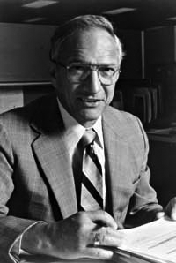
Robert Noyce, 1927-1990
Nicknamed “Mayor of Silicon Valley”
Cofounded Fairchild Semiconductor in 1957
Cofounded Intel in 1968
Co-invented the integrated circuit

Slide 63
Silicon
Transistors built from silicon, a semiconductor
Pure silicon is a poor conductor (no free charges)
Doped silicon is a good conductor (free charges)
n-type (free negative charges, electrons)
p-type (free positive charges, holes)

Slide 64
MOS Transistors
Metal oxide silicon (MOS) transistors:
Polysilicon (used to be metal) gate
Oxide (silicon dioxide) insulator
Doped silicon

Slide 65
Transistors: nMOS
Gate = 0
OFF (no connection between source and drain)
Gate = 1
ON (channel between source and drain)

Slide 66
Transistors: pMOS
pMOS transistor is opposite
ON when Gate = 0
OFF when Gate = 1

Slide 67
Transistor Function

Slide 68
Transistor Function
nMOS: pass good 0’s, so connect source to GND
pMOS: pass good 1’s, so connect source to V_{DD}

Slide 69
CMOS Gates: NOT Gate
A | P1 | N1 | Y
0 | ON | OFF | 1
1 | OFF | ON | 0

Slide 70
CMOS Gates: NAND Gate
A | B | P1 | P2 | N1 | N2 | Y
0 | 0 | ON | ON | OFF | OFF | 1
0 | 1 | ON | OFF | OFF | ON | 1
1 | 0 | OFF | ON | ON | OFF | 1
1 | 1 | OFF | OFF | ON | ON | 0

Slide 71
CMOS Gate Structure

Slide 72
NOR3 Gate
How do you build a three-input NOR3 gate?

Slide 73
AND2 Gate
How do you build a two-input AND gate?

Slide 74
Transmission Gates
nMOS pass 1’s poorly
pMOS pass 0’s poorly
Transmission gate is a better switch
passes both 0 and 1 well
When EN = 1, the switch is ON:
EN = 0 and A is connected to B
When EN = 0, the switch is OFF:
A is not connected to B

Slide 75
Pseudo-nMOS Gates
Replace pull-up network with weak pMOS transistor that is always on
pMOS transistor: pulls output HIGH only when nMOS network not pulling it LOW

Slide 76
Pseudo-nMOS Example
Pseudo-nMOS NOR4

Slide 77
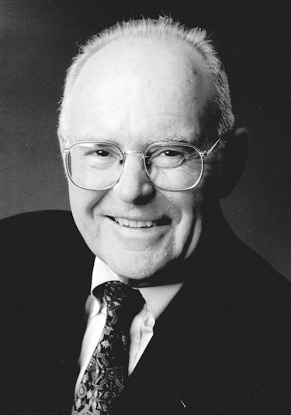
Gordon Moore, 1929-
Cofounded Intel in 1968 with Robert Noyce.
Moore’s Law: number of transistors on a computer chip doubles every year (observed in 1965)
Since 1975, transistor counts have doubled every two years.

Slide 78
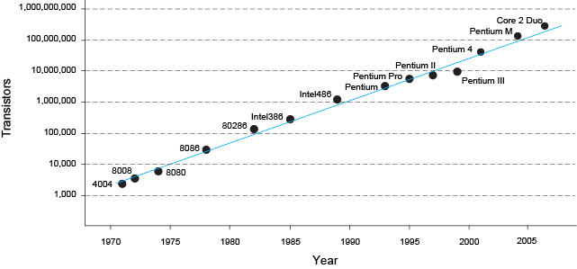
Moore’s Law
“If the automobile had followed the same development cycle as the computer, a Rolls-Royce would today cost $100, get one million miles to the gallon, and explode once a year . . .” (Robert Cringely, Infoworld)
– Robert Cringley

Slide 79
Power Consumption
Power = Energy consumed per unit time
Dynamic power consumption
Static power consumption

Slide 80
Dynamic Power Consumption
Power to charge transistor gate capacitances
Energy required to charge a capacitance, C, to V_{DD} is CV_{DD}²
Circuit running at frequency f: transistors switch (from 1 to 0 or vice versa) at that frequency
Capacitor is charged f/2 times per second (discharging from 1 to 0 is free)
Dynamic power consumption:
P_{dynamic} = ½CV_{DD}²f

Slide 81
Static Power Consumption
Power consumed when no gates are switching
Caused by the quiescent supply current, I_{DD} (also called the leakage current)
Static power consumption:
P_{static} = I_{DD}V_{DD}

Slide 82
Power Consumption Example
Estimate the power consumption of a mobile phone running Angry Birds
V_{DD} = 0.8 V
C = 5 nF
f = 2 GHz
I_{DD} = 10 mA
P = ½CV_{DD}²f + I_{DD}V_{DD}
= ½(5 nF)(0.8 V)²(2 GHz) + (10 mA)(0.8 V)
= (3.2 + 0.008) W ≈ 3.2 W

