Slide 1
Chapter 5
Digital Design and Computer Architecture: ARM® Edition
Sarah L. Harris and David Money Harris

Slide 2
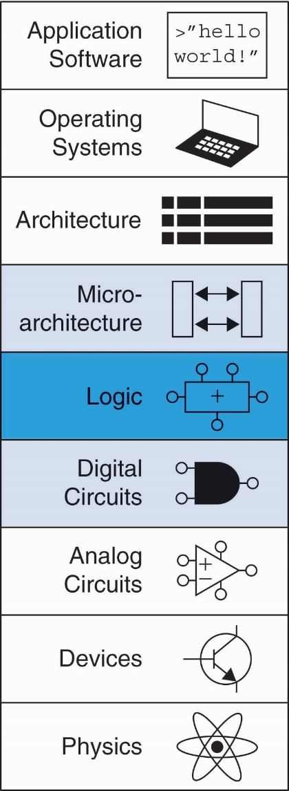
Chapter 5 :: Topics
Introduction
Arithmetic Circuits
Number Systems
Sequential Building Blocks
Memory Arrays
Logic Arrays

Slide 3
Introduction
Digital building blocks:
Gates, multiplexers, decoders, registers, arithmetic circuits, counters, memory arrays, logic arrays
Building blocks demonstrate hierarchy, modularity, and regularity:
Hierarchy of simpler components
Well-defined interfaces and functions
Regular structure easily extends to different sizes
Will use these building blocks in Chapter 7 to build microprocessor

Slide 4
1-Bit Adders

Slide 5
Multibit Adders (CPAs)
Types of carry propagate adders (CPAs):
Ripple-carry (slow)
Carry-lookahead (fast)
Prefix (faster)
Carry-lookahead and prefix adders faster for large adders but require more hardware
Symbol

Slide 6
Ripple-Carry Adder
Chain 1-bit adders together
Carry ripples through entire chain
Disadvantage: slow

Slide 7
Ripple-Carry Adder Delay
t_{ripple} = Nt_{FA}
where t_{FA} is the delay of a 1-bit full adder

Slide 8
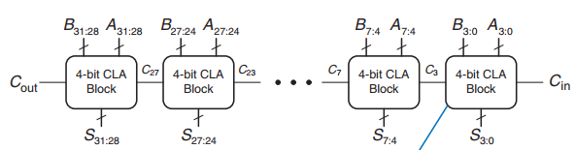
Can we calculate faster?

Slide 9
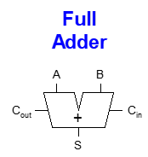
Carry-Lookahead Adder
Compute C_{out} for k-bit blocks using generate and propagate signals
Some definitions:
Column i produces a carry out by either generating a carry out or propagating a carry in to the carry out
Generate (G_{i}) and propagate (P_{i}) signals for each column:
Generate: Column i will generate a carry out if A_{i} and B_{i} are both 1.
G_{i} = A_{i} B_{i}
Propagate: Column i will propagate a carry in to the carry out if A_{i} or B_{i} is 1.
P_{i} = A_{i} + B_{i}
Carry out: The carry out of column i (C_{i}) is:
C_{i} = A_{i} B_{i} + (A_{i} + B_{i} )C_{i-1} = G_{i} + P_{i} C_{i-1}

Slide 10
Block Propagate and Generate
Now use column Propagate and Generate signals to compute Block Propagate and Generate signals for k-bit blocks, i.e.:
Compute if a k-bit group will propagate a carry in (to the block) to the carry out (of the block)
Compute if a k-bit group will generate a carry out (of the block)

Slide 11
Block Propagate and Generate Signals
Example: Block propagate and generate signals for 4-bit blocks (P_{3:0} and G_{3:0}):
P_{3:0} = P₃P₂ P₁P₀
G_{3:0} = G₃ + G₂P₃ + G₁P₂P₃ + G₀P₁P₂P₃
= G₃ + P₃ (G₂ + P₂ (G₁ + P₁G₀ )

Slide 12
Block Propagate and Generate Signals
In general for a block spanning bits i through j,
P_{i:j} = P_{i}P_{i-1} P_{i-2 …} P_{j}
G_{i:j} = G_{i} + P_{i} (G_{i-1} + P_{i-1} (G_{i-2} + P_{i-2 …} G_{j} )
C_{i} = G_{i:j} + P_{i:j} C_{j-1}

Slide 13
32-bit CLA with 4-bit Blocks

Slide 14
Carry-Lookahead Addition
Step 1: Compute G_{i} and P_{i} for all columns
Step 2: Compute G and P for k-bit blocks
Step 3: C_{in} propagates through each k-bit propagate/generate logic (meanwhile computing sums)
Step 4: Compute sum for most significant k-bit block

Slide 15
Carry-Lookahead Addition
Step 1: Compute G_{i} and P_{i} for all columns
G_{i} = A_{i} B_{i}
P_{i} = A_{i} + B_{i}

Slide 16
Carry-Lookahead Addition
Step 1: Compute G_{i} and P_{i} for all columns
Step 2: Compute G and P for k-bit blocks
P_{3:0} = P₃P₂ P₁P₀
G_{3:0} = G₃ + P₃ (G₂ + P₂ (G₁ + P₁G₀ )

Slide 17
Carry-Lookahead Addition
Step 1: Compute G_{i} and P_{i} for all columns
Step 2: Compute G and P for k-bit blocks
Step 3: C_{in} propagates through each k-bit propagate/generate logic (meanwhile computing sums)
B
31:28
A
31:28
B
27:24
A
27:24
B
7:4
A
7:4
B
3:0
A
3:0
C
4-bit CLA
C
27
4-bit CLA
C
23
C
7
4-bit CLA
C
3
4-bit CLA
C
out
Block
Block
Block
Block
in
S
31:28
S
27:24
S
7:4
S
3:0
B
3
+
A
3
C
2
B
2
+
A
2
C
1
B
1
+
A
1
C
0
B
0
+
A
0
C
in
G
S
3
S
2
S
1
S
0
G
B
3
A
3
C
2
B
2
A
2
C
1
B
1
A
1
C
0
B
0
A
0
C
3:0
P
3
+
+
+
+
in
B
A
B
A
B
A
B
A
G
3
S
S
S
S
3
3
2
2
1
1
0
0
P
2
3
2
1
0
C
2
C
1
C
0
C
G
2
G
+
+
+
+
in
P
1
3:0
G
3
G
1
P
3
S
3
S
2
S
1
S
0
B
A
B
A
B
A
B
A
0
G
2
3
3
2
2
1
1
0
0
P
2
G
3:0
G
C
2
C
1
C
0
P
P
3
G
1
P
3
+
+
+
+
C
in
C
out
3:0
P
2
P
1
G
3
C
P
1
G
0
P
2
S
3
S
2
S
1
S
0
in
P
0
G
2
P
P
1
G
G
C
P
3:0
P
3
G
1
3:0
P
3
out
C
P
2
0
G
3
in
P
1
P
2
0
C
P
P
3
G
2
out
3:0
P
2
P
1
C
P
1
G
1
in
P
0
P
0
C
out
P
3:0
P
3
C
P
2
in
P
1
0

Slide 18
Carry-Lookahead Addition
Step 1: Compute G_{i} and P_{i} for all columns
Step 2: Compute G and P for k-bit blocks
Step 3: C_{in} propagates through each k-bit propagate/generate logic (meanwhile computing sums)
Step 4: Compute sum for most significant k-bit block
B
3
+
A
3
C
2
B
2
+
A
2
C
1
B
1
+
A
1
C
0
B
0
+
A
0
C
in
G
S
3
S
2
S
1
S
0
G
B
3
A
3
C
2
B
2
A
2
C
1
B
1
A
1
C
0
B
0
A
0
C
3:0
P
3
+
+
+
+
in
B
A
B
A
B
A
B
A
G
3
S
S
S
S
3
3
2
2
1
1
0
0
P
2
3
2
1
0
C
2
C
1
C
0
C
G
2
G
+
+
+
+
in
P
1
3:0
G
3
G
1
P
3
S
3
S
2
S
1
S
0
B
A
B
A
B
A
B
A
0
G
2
3
3
2
2
1
1
0
0
P
2
G
3:0
G
C
2
C
1
C
0
P
P
3
G
1
P
3
+
+
+
+
C
in
C
out
3:0
P
2
P
1
G
3
C
P
1
G
0
P
2
S
3
S
2
S
1
S
0
in
P
0
G
2
P
P
1
G
G
C
P
3:0
P
3
G
1
3:0
P
3
out
C
P
2
0
G
3
in
P
1
P
2
0
C
P
P
3
G
2
out
3:0
P
2
P
1
C
P
1
G
1
in
P
0
P
0
C
out
P
3:0
P
3
C
P
2
in
P
1
0

Slide 19
Carry-Lookahead Adder Delay
For N-bit CLA with k-bit blocks:
t_{CLA} = t_{pg} + t_{pg_block} + (N/k – 1)t_{AND_OR} + kt_{FA}
t_{pg} : delay to generate all P_{i}, G_{i}
t_{pg_block} : delay to generate all P_{i:j}, G_{i:j}
t_{AND_OR} : delay from C_{in} to C_{out} of final AND/OR gate in k-bit CLA block
An N-bit carry-lookahead adder is generally much faster than a ripple-carry adder for N > 16

Slide 20
Prefix Adder
Computes carry in (C_{i-1}) for each column, then computes sum:
S_{i} = (A_{i} ^ B_{i}) ⊥ C_{i-1}
Computes G and P for 1-, 2-, 4-, 8-bit blocks, etc. until all G_{i} (carry in) known
log₂N stages

Slide 21
Prefix Adder
Carry in either generated in a column or propagated from a previous column.
Column -1 holds C_{in}, so
G₋₁ = C_{in}
Carry in to column i = carry out of column i-1:
C_{i-1} = G_{i-1:-1}
G_{i-1:-1}: generate signal spanning columns i-1 to -1
Sum equation:
S_{i} = (A_{i} ⊥ B_{i}) ⊥ G_{i-1:-1}
Goal: Quickly compute G_{0:-1}, G_{1:-1}, G_{2:-1}, G_{3:-1}, G_{4:-1}, G_{5:-1}, … (called prefixes) (= C₀, C₁, C₂, C₃, C₄, C₅, …)

Slide 22
Prefix Adder
Generate and propagate signals for a block spanning bits i:j
G_{i:j} = G_{i:k} + P_{i:k} G_{k-1:j}
P_{i:j} = P_{i:k}P_{k-1:j}
In words:
Generate: block i:j will generate a carry if:
upper part (i:k) generates a carry or
upper part (i:k) propagates a carry generated in lower part (k-1:j)
Propagate: block i:j will propagate a carry if both the upper and lower parts propagate the carry

Slide 23
16-Bit Prefix Adder Schematic
A
i
B
i
15
14
13
12
11
10
9
8
7
6
5
4
3
2
1
0
-1
i
P
i:i
G
i:i
14:13
12:11
10:9
8:7
6:5
4:3
2:1
0:-1
P
i:k
P
k-1:j
G
i:k
G
k-1:j
14:11
13:11
10:7
9:7
6:3
5:3
2:-1
1:-1
i:j
14:7
13:7
12:7
11:7
6:-1
5:-1
4:-1
3:-1
P
G
i:j
i:j
14:-1
13:-1
12:-1
11:-1
10:-1
9:-1
8:-1
7:-1
G
i-1:-1
A
i
B
i
15
14
13
12
11
10
9
8
7
6
5
4
3
2
1
0
i
S
i

Slide 24
Prefix Adder Delay
t_{PA} = t_{pg} + log₂N(t_{pg_prefix} ) + t_{XOR}
t_{pg}: delay to produce P_{i}, G_{i} (AND or OR gate)
t_{pg_prefix}: delay of black prefix cell (AND-OR gate)

Slide 25
Adder Delay Comparisons
Compare delay of: 32-bit ripple-carry, CLA, and prefix adders
CLA has 4-bit blocks
2-input gate delay = 10 ps; full adder delay = 30 ps
t_{ripple} = Nt_{FA} = 32(30 ps)
= 960 ps
t_{CLA} = t_{pg} + t_{pg_block} + (N/k – 1)t_{AND_OR} + kt_{FA}
= [10 + 60 + (7)20 + 4(30)] ps
= 330 ps
t_{PA} = t_{pg} + log₂N(t_{pg_prefix} ) + t_{XOR}
= [10 + log₂32(20) + 10] ps
= 120 ps

Slide 26
Adder HDL description
// SystemVerilog module adder #(parameter N = 8) (input logic [N–1:0] a, b, input logic cin, output logic [N–1:0] s, output logic cout);
assign {cout, s} = a + b + cin;
endmodule

Slide 27
Subtracter

Slide 28
Comparator: Equality

Slide 29
Comparator: Less Than

Slide 30
module comparator #(parameter N = 8) (input logic [N–1:0] a, b, output logic eq, neq, lt, lte, gt, gte);
assign eq = (a == b); assign neq = (a != b); assign lt = (a < b); assign lte = (a <= b); assign gt = (a > b); assign gte = (a >= b);
endmodule

Slide 31
ALU: Arithmetic Logic Unit
A typical ALU should perform:
Addition
Subtraction
AND
OR

Slide 32
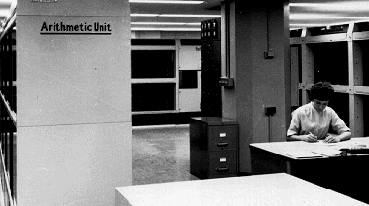
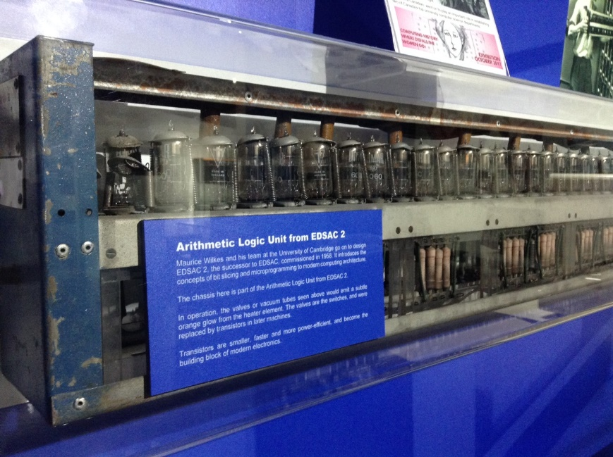
ALU in 1950s

Slide 33
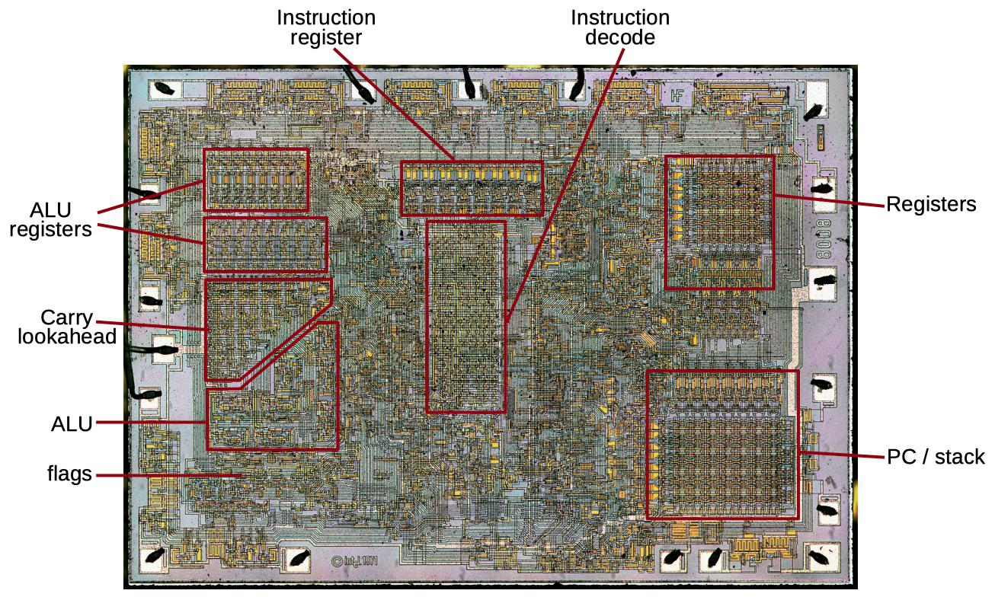
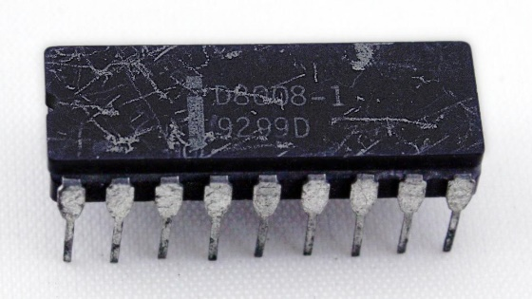
ALU in 1970s: 8008 8-bit, 10um
The Intel 8008 die with key functional blocks labeled.

Slide 34
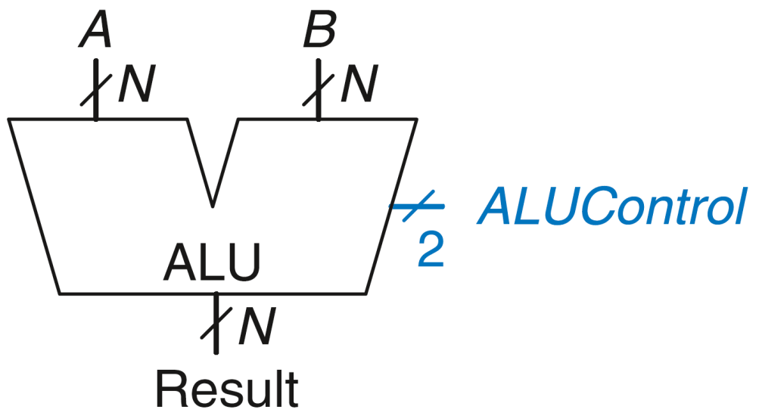
ALU: Arithmetic Logic Unit
ALUControl_{1:0} | Function
00 | Add
01 | Subtract
10 | AND
11 | OR
Example: Perform A + B
ALUControl = 00
Result = A + B

Slide 35
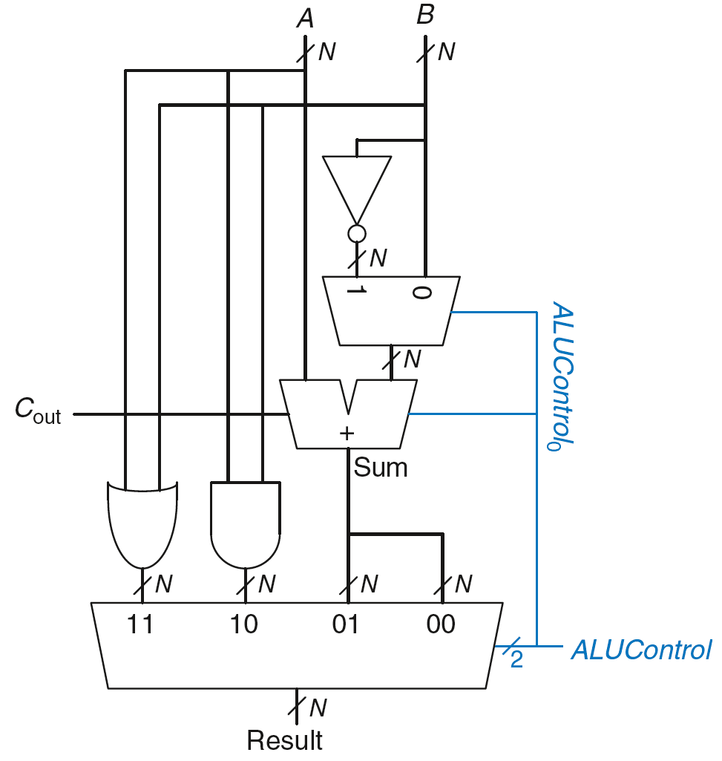
ALU: Arithmetic Logic Unit
ALUControl_{1:0} | Function
00 | Add
01 | Subtract
10 | AND
11 | OR
Example: Perform A OR B

Slide 36
ALU: Arithmetic Logic Unit
ALUControl_{1:0} | Function
00 | Add
01 | Subtract
10 | AND
11 | OR
Example: Perform A OR B
ALUControl_{1:0} = 11
Mux selects output of OR gate as Result, so
Result = A OR B

Slide 37
ALU: Arithmetic Logic Unit
ALUControl_{1:0} | Function
00 | Add
01 | Subtract
10 | AND
11 | OR
Example: Perform A + B

Slide 38
ALU: Arithmetic Logic Unit
ALUControl_{1:0} | Function
00 | Add
01 | Subtract
10 | AND
11 | OR
Example: Perform A + B
ALUControl_{1:0} = 00
ALUControl₀ = 0, so:
C_{in} to adder = 0
2nd input to adder is B
Mux selects Sum as Result, so
Result = A + B

Slide 39
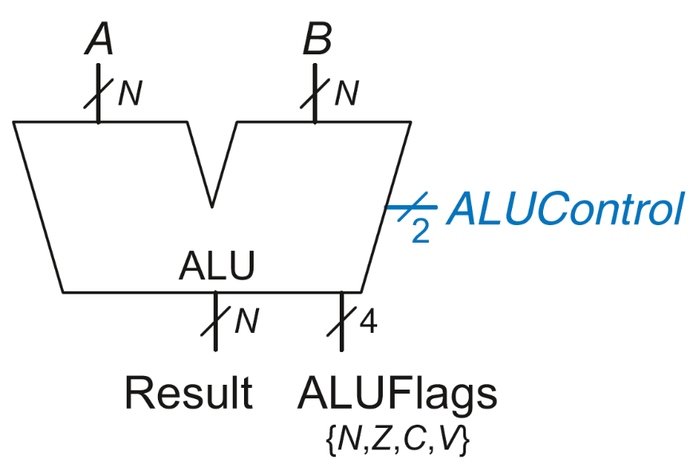
ALU with Status Flags
Flag | Description
N | Result is Negative
Z | Result is Zero
C | Adder produces Carry out
V | Adder oVerflowed

Slide 40
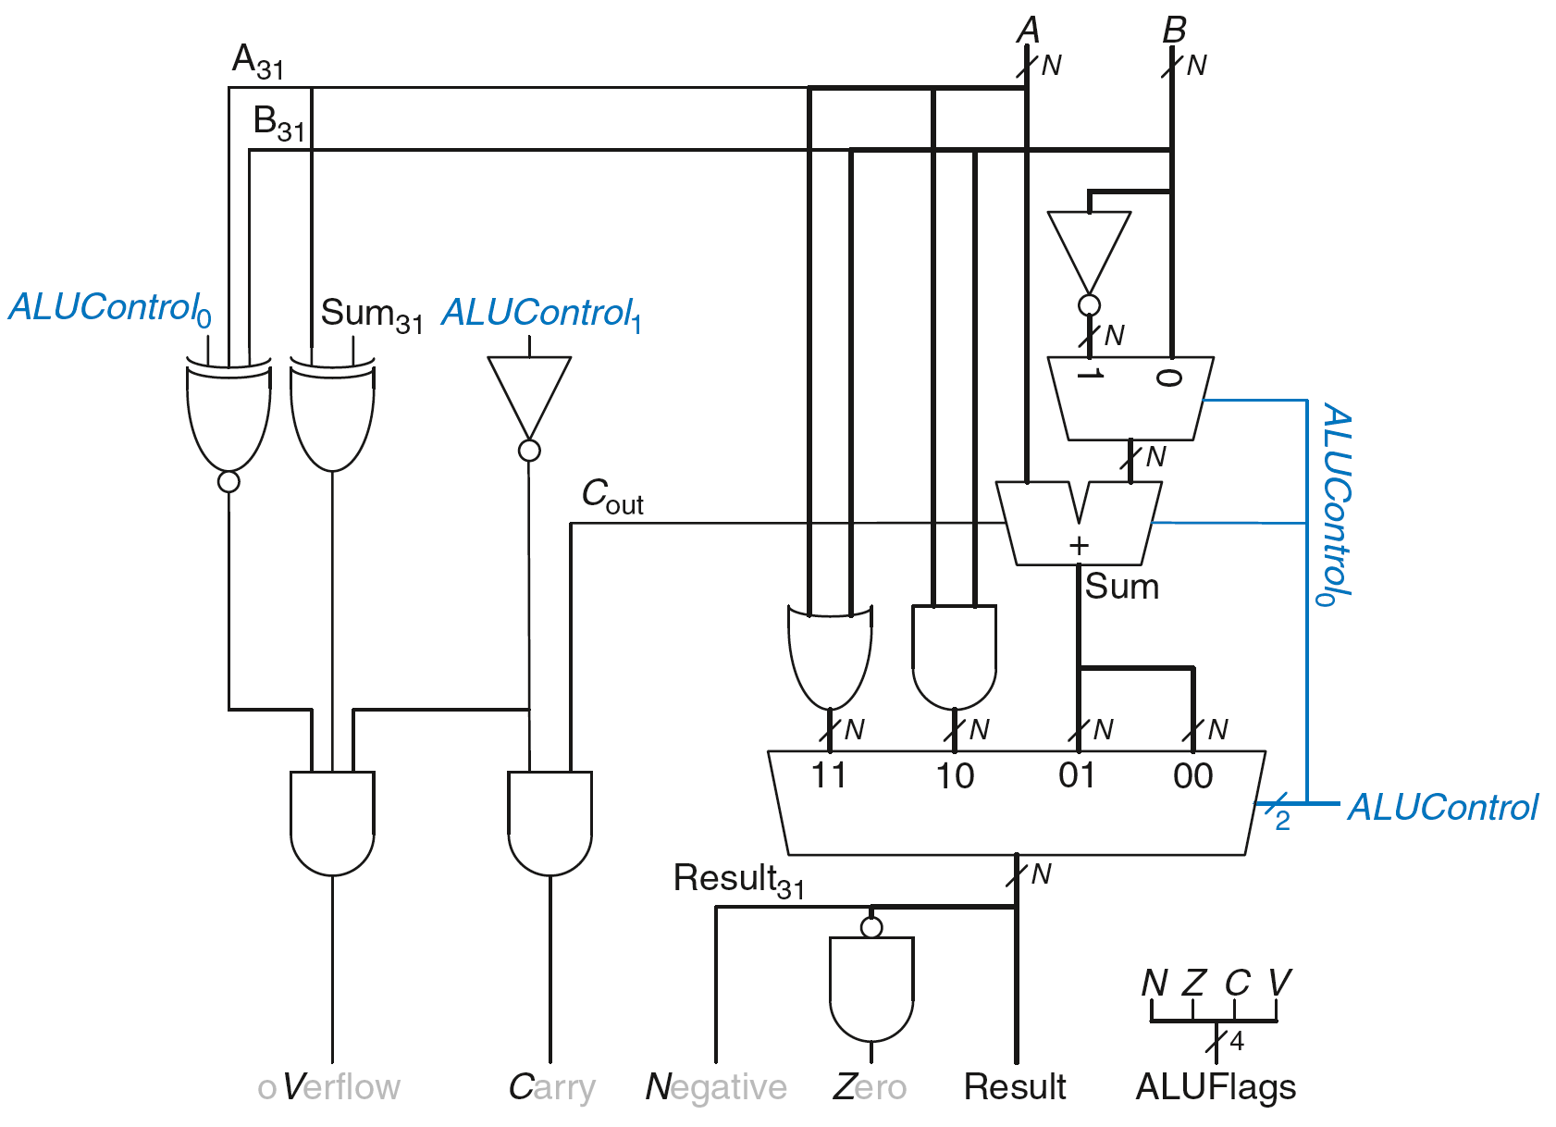
ALU with Status Flags

Slide 41
ALU with Status Flags: Negative
N = 1 if:
Result is negative
So, N is connected to most significant bit of Result

Slide 42
ALU with Status Flags: Zero
Z = 1 if:
all of the bits of Result are 0

Slide 43
ALU with Status Flags: Carry
C = 1 if:
C_{out} of Adder is 1
AND
ALU is adding or subtracting (ALUControl is 00 or 01)

Slide 44
ALU with Status Flags: oVerflow
V = 1 if:
The addition of 2 same-signed numbers produces a result with the opposite sign

Slide 45
ALU with Status Flags: oVerflow
V = 1 if:
ALU is performing addition or subtraction
(ALUControl₁ = 0)

Slide 46
ALU with Status Flags: oVerflow
V = 1 if:
ALU is performing addition or subtraction
(ALUControl₁ = 0)
AND
A and Sum have opposite signs

Slide 47
ALU with Status Flags: oVerflow
V = 1 if:
ALU is performing addition or subtraction
(ALUControl₁ = 0)
AND
A and Sum have opposite signs
AND
A and B have same signs upon addition OR
A and B have different signs upon subtraction

Slide 48
ALU with Status Flags: oVerflow
V = 1 if:
ALU is performing addition or subtraction
(ALUControl₁ = 0)
AND
A and Sum have opposite signs
AND
A and B have same signs upon addition (ALUControl₀ = 0) OR
A and B have different signs upon subtraction
(ALUControl₀ = 1)

Slide 49
Shifters
Logical shifter: shifts value to left or right and fills empty spaces with 0’s
Ex: 11001 >> 2 = 00110
Ex: 11001 << 2 = 00100
Arithmetic shifter: same as logical shifter, but on right shift, fills empty spaces with the old most significant bit (msb)
Ex: 11001 >>> 2 = 11110
Ex: 11001 <<< 2 = 00100
Rotator: rotates bits in a circle, such that bits shifted off one end are shifted into the other end
Ex: 11001 ROR 2 = 01110
Ex: 11001 ROL 2 = 00111

Slide 50
Shifter Design
Select bit
Control bit
control bit
Select bit

Slide 51
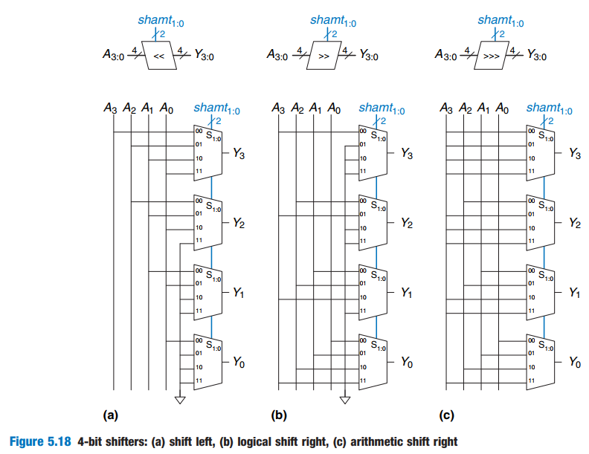

Slide 52
Shifters as Multipliers, Dividers
A << N = A × 2^{N}
Example: 00001 << 2 = 00100 (1 × 2² = 4)
Example: 11101 << 2 = 10100 (-3 × 2² = -12)
A >>> N = A ÷ 2^{N}
Example: 01000 >>> 2 = 00010 (8 ÷ 2² = 2)
Example: 10000 >>> 2 = 11100 (-16 ÷ 2² = -4)

Slide 53
Multipliers
Partial products formed by multiplying a single digit of the multiplier with multiplicand
Shifted partial products summed to form result

Slide 54
4 x 4 Multiplier
+

Slide 55
Dividers
A/B = Q + R/B
Decimal Example: 2584/15 = 172 R4

Slide 56
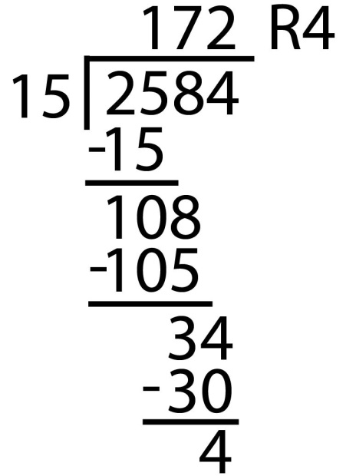
Dividers
A/B = Q + R/B
Decimal Example: 2584/15 = 172 R4
Long-Hand:

Slide 57
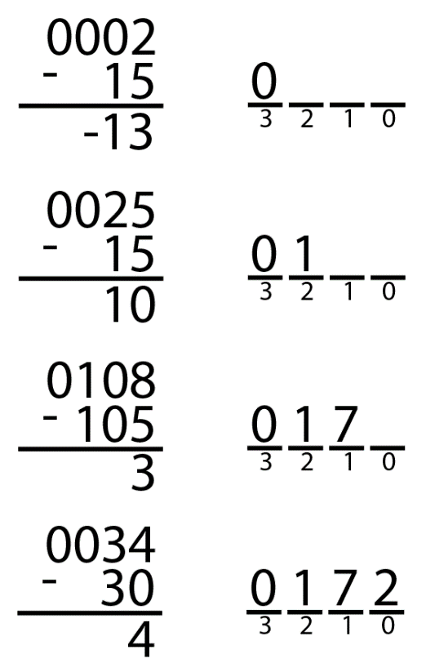
Dividers
A/B = Q + R/B
Decimal Example: 2584/15 = 172 R4
Long-Hand:
Long-Hand Revisited:

Slide 58

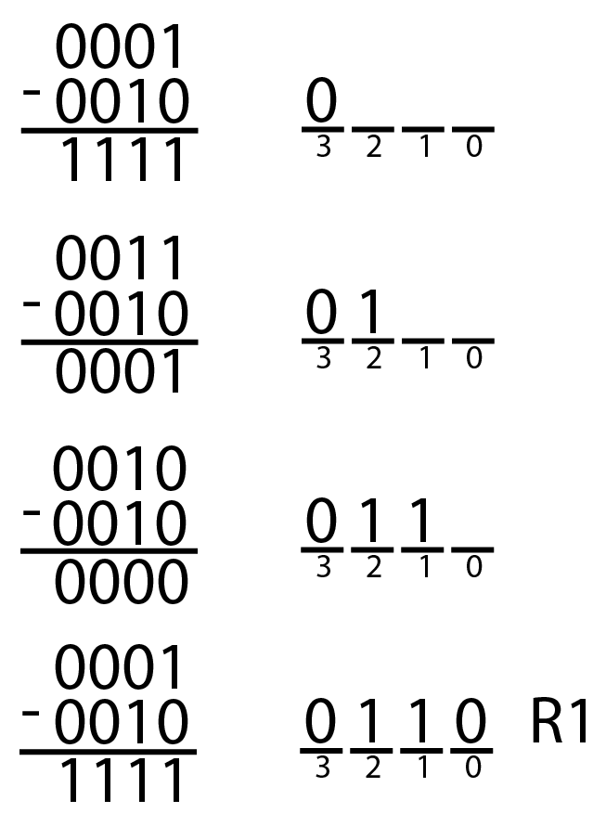
Dividers
A/B = Q + R/B
Decimal: 2584/15 = 172 R4
Binary: 1101/0010 = 0110 R1

Slide 59
Divider Algorithm
A/B = Q + R/B
R’ = 0
for i = N-1 to 0
R = {R’ << 1, A_{i}}
D = R - B
if D < 0, Q_{i}= 0; R’= R
else Q_{i}= 1; R’= D
R=R’
Binary: 1101/10 = 0110 R1

Slide 60
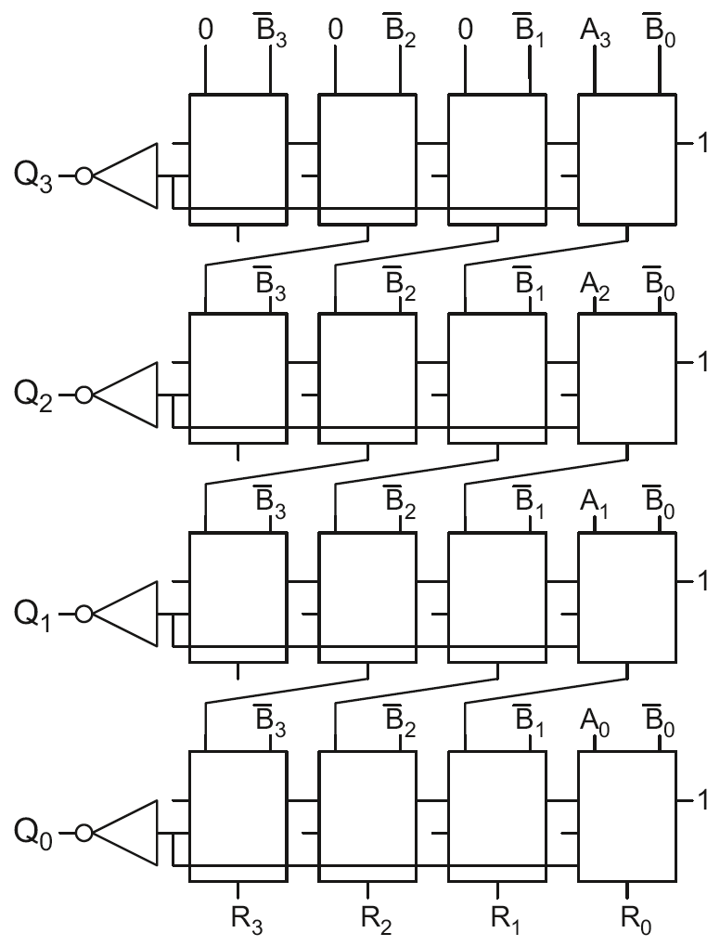
4 x 4 Divider
Division: A/B = Q + R/B
R’ = 0
for i = N-1 to 0
R = {R’ << 1, A_{i}}
D = R - B
if D < 0, Q_{i}=0, R’=R
else Q_{i}=1, R’=D
R=R’
Each row computes one iteration of the division algorithm.

Slide 61
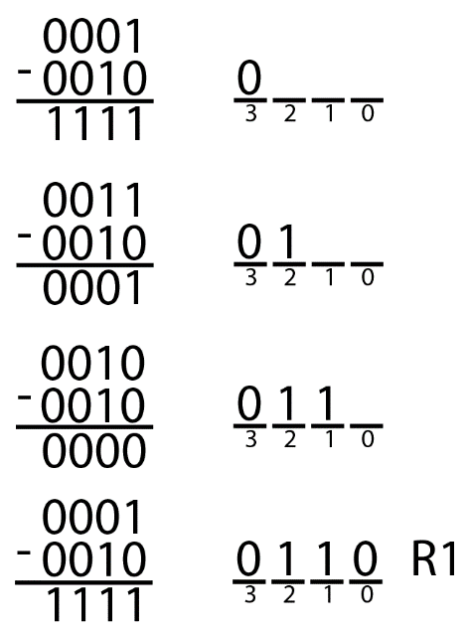
4 x 4 Divider
Each row computes one iteration of the division algorithm.

Slide 62
Number Systems
Numbers we can represent using binary representations
Positive numbers
Unsigned binary
Negative numbers
Two’s complement
Sign/magnitude numbers
What about fractions?

Slide 63
Numbers with Fractions
Two common notations:
Fixed-point: binary point fixed
Floating-point: binary point floats to the right of the most significant 1

Slide 64
Fixed-Point Numbers
6.75 using 4 integer bits and 4 fraction bits:
Binary point is implied
The number of integer and fraction bits must be agreed upon beforehand

Slide 65
Fixed-Point Number Example
Represent 7.5₁₀ using 4 integer bits and 4 fraction bits.
01111000

Slide 66
Signed Fixed-Point Numbers
Representations:
Sign/magnitude
Two’s complement
Example: Represent -7.5₁₀ using 4 integer and 4 fraction bits
Sign/magnitude:
11111000
Two’s complement:
1. +7.5: 01111000
2. Invert bits: 10000111
3. Add 1 to lsb: + 1
10001000

Slide 67
Floating-Point Numbers
Binary point floats to the right of the most significant 1
Similar to decimal scientific notation
For example, write 273₁₀ in scientific notation:
273 = 2.73 × 10²
In general, a number is written in scientific notation as:
± M × B^{E}
M = mantissa
B = base
E = exponent
In the example, M = 2.73, B = 10, and E = 2

Slide 68
Floating-Point Numbers
Example: represent the value 228₁₀ using a 32-bit floating point representation
We show three versions – final version is called the IEEE 754 floating-point standard

Slide 69
Floating-Point Representation 1
Convert decimal to binary
228₁₀ = 11100100₂
Write the number in “binary scientific notation”:
11100100₂ = 1.11001₂ × 2⁷
Fill in each field of the 32-bit floating point number:
The sign bit is positive (0)
The 8 exponent bits represent the value 7
The remaining 23 bits are the mantissa

Slide 70
Floating-Point Representation 2
First bit of the mantissa is always 1:
228₁₀ = 11100100₂ = 1.11001 × 2⁷
So, no need to store it: implicit leading 1
Store just fraction bits in 23-bit field

Slide 71
Floating-Point Representation 3
Biased exponent: bias = 127 (01111111₂)
Biased exponent = bias + exponent
Exponent of 7 is stored as:
127 + 7 = 134 = 0x10000110₂
The IEEE 754 32-bit floating-point representation of 228₁₀
in hexadecimal: 0x43640000

Slide 72
Floating-Point Example
Write -58.25₁₀ in floating point (IEEE 754)

Slide 73
Floating-Point Example
Write -58.25₁₀ in floating point (IEEE 754)
Convert decimal to binary:
58.25₁₀ = 111010.01₂
Write in binary scientific notation:
1.1101001 × 2⁵
Fill in fields:
Sign bit: 1 (negative)
8 exponent bits: (127 + 5) = 132 = 10000100₂
23 fraction bits: 110 1001 0000 0000 0000 0000
in hexadecimal: 0xC2690000

Slide 74
Floating-Point: Special Cases
Number | Sign | Exponent | Fraction
0 | X | 00000000 | 00000000000000000000000
∞ | 0 | 11111111 | 00000000000000000000000
- ∞ | 1 | 11111111 | 00000000000000000000000
NaN | X | 11111111 | non-zero

Slide 75
Floating-Point Precision
Single-Precision:
32-bit
1 sign bit, 8 exponent bits, 23 fraction bits
bias = 127
Double-Precision:
64-bit
1 sign bit, 11 exponent bits, 52 fraction bits
bias = 1023

Slide 76
Floating-Point: Rounding
Overflow: number too large to be represented
Underflow: number too small to be represented
Rounding modes:
Down
Up
Toward zero
To nearest
Example: round 1.100101 (1.578125) to only 3 fraction bits
Down: 1.100
Up: 1.101
Toward zero: 1.100
To nearest: 1.101 (1.625 is closer to 1.578125 than 1.5 is)

Slide 77
Floating-Point Addition
Extract exponent and fraction bits
Prepend leading 1 to form mantissa
Compare exponents
Shift smaller mantissa if necessary
Add mantissas
Normalize mantissa and adjust exponent if necessary
Round result
Assemble exponent and fraction back into floating-point format

Slide 78
Floating-Point Addition Example
Add the following floating-point numbers:
0x3FC00000
0x40500000

Slide 79
Floating-Point Addition Example
1. Extract exponent and fraction bits
For first number (N1): S = 0, E = 127, F = .1
For second number (N2): S = 0, E = 128, F = .101
2. Prepend leading 1 to form mantissa
N1: 1.1
N2: 1.101

Slide 80
Floating-Point Addition Example
3. Compare exponents
127 – 128 = -1, so shift N1 right by 1 bit
4. Shift smaller mantissa if necessary
shift N1’s mantissa: 1.1 >> 1 = 0.11 (× 2¹)
5. Add mantissas
0.11 × 2¹
+ 1.101 × 2¹
10.011 × 2¹

Slide 81
Floating Point Addition Example
6. Normalize mantissa and adjust exponent if necessary
10.011 × 2¹ = 1.0011 × 2²
7. Round result
No need (fits in 23 bits)
8. Assemble exponent and fraction back into floating-point format
S = 0, E = 2 + 127 = 129 = 10000001₂, F = 001100..
in hexadecimal: 0x40980000

Slide 82
Counters
Increments on each clock edge
Used to cycle through numbers. For example,
000, 001, 010, 011, 100, 101, 110, 111, 000, 001…
Example uses:
Digital clock displays
Program counter: keeps track of current instruction executing

Slide 83
Counter Verilog (FSM style)
module counter (input logic clk, reset,
output logic [N-1:0] q);
logic [N-1:0] nextq;
// register
always_ff @(posedge clk, posedge reset)
if (reset) q <= 0;
else q <= nextq;
// next state
assign nextq = q + 1;
endmodule

Slide 84
Counter Verilog (better idiom)
module counter (input logic clk, reset,
output logic [N-1:0] q);
always_ff @(posedge clk, posedge reset)
if (reset) q <= 0;
else q <= q+1;
endmodule

Slide 85
Divide-by-2^{N} Counter
Most significant bit of an N-bit counter toggles every 2^{N} cycles.
Useful for slowing a clock. Ex: blink an LED
Example: 50 MHz clock, 24-bit counter
2.98 Hz

Slide 86
Digitally Controlled Oscillator
N-bit counter
Add p on each cycle, instead of 1
Most significant bit toggles at f_{out} = f_{clk} * p / 2^{N}
Example: f_{clk} = 50 MHz clock
How to generate a f_{out} = 200 Hz signal?
p/2^{N} = 200 / 50 MHz
Try N = 24, p = 67 ➔ f_{out} = 199.676 Hz
Or N = 32, p = 17179 ➔ f_{out} = 199.990 Hz

Slide 87
Shift Registers
Shift a new bit in on each clock edge
Shift a bit out on each clock edge
Serial-to-parallel converter: converts serial input (S_{in}) to parallel output (Q_{0:N-1})
Symbol:
Implementation:

Slide 88
Shift Register with Parallel Load
When Load = 1, acts as a normal N-bit register
When Load = 0, acts as a shift register
Now can act as a serial-to-parallel converter (S_{in} to Q_{0:N-1}) or a parallel-to-serial converter (D_{0:N-1} to S_{out})

Slide 89
Shift Register Verilog Idiom
module shiftreg(input logic clk,
input logic load, sin,
input logic [N-1:0] d,
output logic [N-1:0] q,
output logic sout);
always_ff @(posedge clk)
if (load) q <= d;
else q <= {q[N-2:0], sin};
assign sout = q[N-1];
endmodule

Slide 90
Memory Arrays
Efficiently store large amounts of data
3 common types:
Dynamic random access memory (DRAM)
Static random access memory (SRAM)
Read only memory (ROM)
M-bit data value read/ written at each unique N-bit address

Slide 91
Memory Arrays
2-dimensional array of bit cells
Each bit cell stores one bit
N address bits and M data bits:
2^{N} rows and M columns
Depth: number of rows (number of words)
Width: number of columns (size of word)
Array size: depth × width = 2^{N} × M

Slide 92
Memory Array Example
2² × 3-bit array
Number of words: 4
Word size: 3-bits
For example, the 3-bit word stored at address 10 is 100

Slide 93
Memory Arrays

Slide 94
Memory Array Bit Cells

Slide 95
Memory Array Bit Cells
0
Z
1
Z

Slide 96
Memory Array
Wordline:
like an enable
single row in memory array read/written
corresponds to unique address
only one wordline HIGH at once

Slide 97
Types of Memory
Random access memory (RAM): volatile
Read only memory (ROM): nonvolatile

Slide 98
RAM: Random Access Memory
Volatile: loses its data when power off
Read and written quickly
Main memory in your computer is RAM (DRAM)
Historically called random access memory because any data word accessed as easily as any other (in contrast to sequential access memories such as a tape recorder)

Slide 99
ROM: Read Only Memory
Nonvolatile: retains data when power off
Read quickly, but writing is impossible or slow
Flash memory in cameras, thumb drives, and digital cameras are all ROMs
Historically called read only memory because ROMs were written at manufacturing time or by burning fuses. Once ROM was configured, it could not be written again. This is no longer the case for Flash memory and other types of ROMs.

Slide 100
Types of RAM
DRAM (Dynamic random access memory)
SRAM (Static random access memory)
Differ in how they store data:
DRAM uses a capacitor
SRAM uses cross-coupled inverters

Slide 101
Robert Dennard, 1932 -
Invented DRAM in 1966 at IBM
Others were skeptical that the idea would work
By the mid-1970’s DRAM in virtually all computers

Slide 102
DRAM
Data bits stored on capacitor
Dynamic because the value needs to be refreshed (rewritten) periodically and after read:
Charge leakage from the capacitor degrades the value
Reading destroys the stored value

Slide 103
DRAM

Slide 104
SRAM

Slide 105
Memory Arrays Review
DRAM bit cell:
SRAM bit cell:

Slide 106
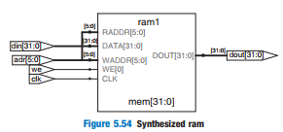
HDL Example 5.6 RAM
module ram #(parameter N = 6, M = 32)
(input logic clk,
input logic we,
input logic [N–1:0] adr,
input logic [M–1:0] din,
output logic [M–1:0] dout);
logic [M–1:0] mem [2**N–1:0];
always_ff @(posedge clk)
if (we) mem [adr] <= din;
assign dout = mem[adr];
endmodule

Slide 107
ROM: Dot Notation

Slide 108
ROM Storage

Slide 109
HDL Example 5.7 ROM
module rom(input logic [1:0] adr, output logic [2:0] dout): always_comb case(adr) 2'b00: dout = 3'b011; 2'b01: dout = 3'b110; 2'b10: dout = 3'b100; 2'b11: dout = 3'b010; endcase endmodule

Slide 110
Types of ROMs
Type | Name | Description
ROM | Read Only Memory | Chip is hardwired with presence or absence of transistors. Changing requires building a new chip.
PROM | Programmable ROM | Fuses in series with each transistor are blown to program bits. Can’t be changed after programming.
EPROM | Electrically Programmable ROM | Charge is stored on a floating gate to activate or deactivate transistor. Erasing requires exposure to UV light.
EEPROM | Electrically Erasable Programmable ROM | Like EPROM, but erasing can be done electrically.
Flash | Flash Memory | Like EEPROM, but erasing is done on large blocks to amortize cost of erase circuit. Low cost per bit, dominates nonvolatile storage today.

Slide 111

Fujio Masuoka, 1944 -
Developed memories and high speed circuits at Toshiba, 1971-1994
Invented Flash memory as an unauthorized project pursued during nights and weekends in the late 1970’s
The process of erasing the memory reminded him of the flash of a camera
Toshiba slow to commercialize the idea; Intel was first to market in 1988
Flash has grown into a $25 billion per year market

Slide 112
ROM Logic
Data₂ = A₁ ⊥ A₀
Data₁ = A₁ + A₀
Data₀ = A₁A₀

Slide 113
Example: Logic with ROMs
Implement the following logic functions using a 2² × 3-bit ROM:
X = AB
Y = A + B
Z = A B

Slide 114
Example: Logic with ROMs
Implement the following logic functions using a 2² × 3-bit ROM:
X = AB
Y = A + B
Z = A B

Slide 115
Logic with Any Memory Array
Data₂ = A₁ ⊕ A₀
Data₁ = A₁ + A₀
Data₀ = A₁A₀

Slide 116
Logic with Memory Arrays
Implement the following logic functions using a 2² × 3-bit memory array:
X = AB
Y = A + B
Z = A B

Slide 117
Logic with Memory Arrays
Implement the following logic functions using a 2² × 3-bit memory array:
X = AB
Y = A + B
Z = A B

Slide 118
Logic with Memory Arrays
Called lookup tables (LUTs): look up output at each input combination (address)

Slide 119
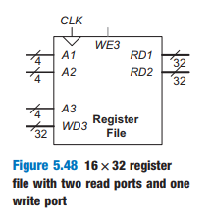
Multi-ported Memories
Port: address/data pair
3-ported memory
2 read ports (A1/RD1, A2/RD2)
1 write port (A3/WD3, WE3 enables writing)
Register file: small multi-ported memory

Slide 120
SystemVerilog Memory Arrays
// 256 x 64 memory module with one read/write port
module dmem(input logic clk, we,
input logic [7:0] a,
input logic [63:0] wd,
output logic [63:0] rd);
logic [63:0] RAM[255:0];
always @(posedge clk)
begin
rd <= RAM[a]; // synchronous read
if (we)
RAM[a] <= wd; // synchronous write
end
endmodule

Slide 121
SystemVerilog Register File
// 16 x 32 register file with two read, 1 write port
module rf(input logic clk, we3,
input logic [3:0] a1, a2, a3,
input logic [31:0] wd3,
output logic [31:0] rd1, rd2);
logic [31:0] RAM[15:0];
always @(posedge clk) // synchronous write
if (we3)
RAM[a3] <= wd3;
assign rd1 = RAM[a1]; // asynchronous read
assign rd2 = RAM[a2];
endmodule

Slide 122
Logic Arrays
PLAs (Programmable logic arrays)
AND array followed by OR array
Combinational logic only
Fixed internal connections
FPGAs (Field programmable gate arrays)
Array of Logic Elements (LEs)
Combinational and sequential logic
Programmable internal connections

Slide 123
PLAs
X = ABC + ABC
Y = AB

Slide 124
PLAs: Dot Notation

Slide 125
FPGA: Field Programmable Gate Array
Composed of:
LEs (Logic elements): perform logic
IOEs (Input/output elements): interface with outside world
Programmable interconnection: connect LEs and IOEs
Some FPGAs include other building blocks such as multipliers and RAMs

Slide 126
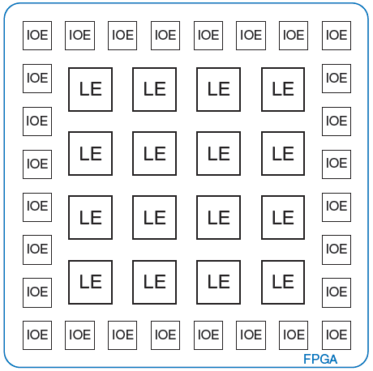
General FPGA Layout

Slide 127
LE: Logic Element
Composed of:
LUTs (lookup tables): perform combinational logic
Flip-flops: perform sequential logic
Multiplexers: connect LUTs and flip-flops

Slide 128
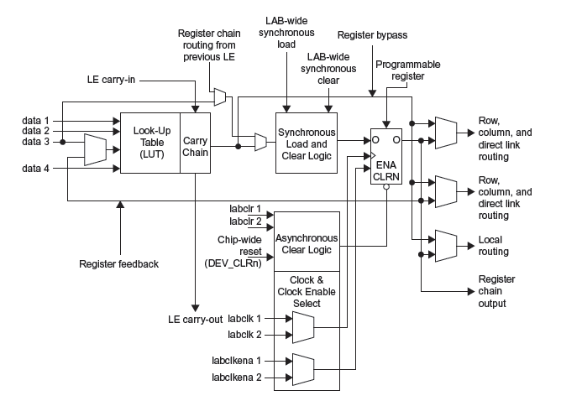
Altera Cyclone IV LE

Slide 129
Altera Cyclone IV LE
The Altera Cyclone IV LE has:
1 four-input LUT
1 registered output
1 combinational output

Slide 130
LE Configuration Example
Show how to configure a Cyclone IV LE to perform the following functions:
X = ABC + ABC
Y = AB

Slide 131
LE Configuration Example
Show how to configure a Cyclone IV LE to perform the following functions:
X = ABC + ABC
Y = AB

Slide 132
LE Example: AND5
How many LEs are required to build a 5-input AND gate?
Solution: 2. First performs AND4 (function of 4 variables). Second performs AND2 of the first result and the 5th input.

Slide 133
LE Example: 3-bit counter
How many LEs are required to build a 3-bit counter?
Solution: 3. The counter has 3 flip-flops, so it requires at least 3 LEs. The add logic for each bit is a function of less than 4 variables, so it can fit in the LUT before the flop. Hence, 3 LEs is sufficient.

Slide 134
FPGA Design Flow
Using a CAD tool (such as Altera’s Quartus II)
Enter the design with a HDL
Simulate the design
Synthesize design and map it onto FPGA
Download the configuration onto the FPGA
Test the design
This is an iterative process!

