Slide 1
Chapter 7
Digital Design and Computer Architecture: ARM® Edition
Sarah L. Harris and David Money Harris

Slide 2
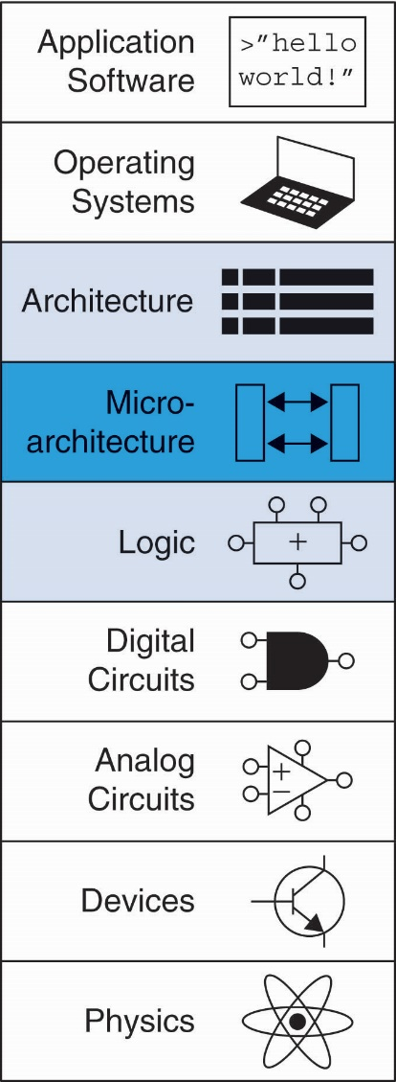
Chapter 7 :: Topics
Introduction
Performance Analysis
Single-Cycle Processor
Multicycle Processor
Pipelined Processor
Advanced Microarchitecture

Slide 3
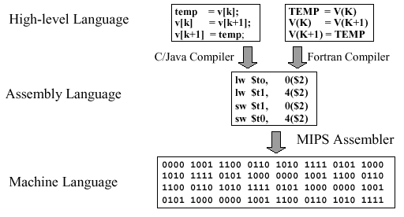
Review
if (i == j)
f = g + h;
f = f – i;
CMP R3, R4
ADDEQ R0, R1, R2
SUB R0, R0, R2
ARM Assembler
Các câu lệnh được mã hóa theo định dạng 32-bit với opcode và các toán hạng. (xem chương 6)

Slide 4
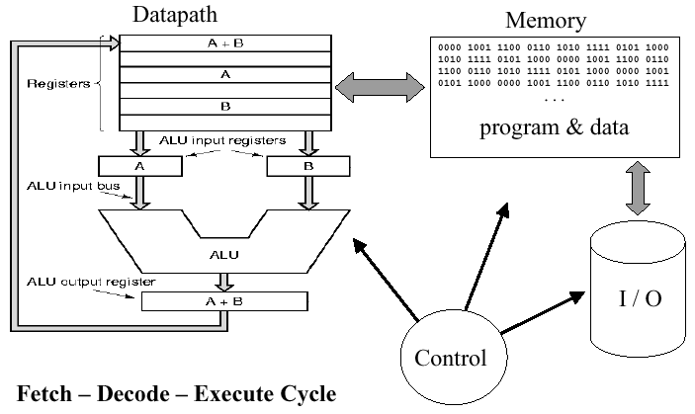
Review
Ví dụ về chu trình thực hiện lệnh – Chu kỳ lệnh
Làm sao khối ALU thực hiện được đúng câu lệnh ta mong muốn?
→ cần có bộ điều khiển, giải mã, thiết lập thông số

Slide 5
Review
Trong các chương trước, ta đã tìm hiểu:
Các linh kiện logic, khối logic
Cách thiết kế các linh kiện, khối logic
Máy trạng thái
Các câu lệnh cơ bản trong ARM Assembly
→ Vậy thì thiết kế chip như thế nào? Làm sao để chuyển được từ tập lệnh sang thành thiết kế phần cứng của chip?

Slide 6
Introduction
Microarchitecture: how to implement an architecture in hardware
the connection between logic and architecture
Arrangement of registers, ALUs, FSMs, memories, logic blocks…
Processor:
Datapath: functional blocks
Control: control signals

Slide 7
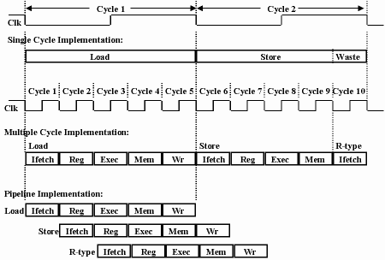
Microarchitecture
Multiple implementations for a single architecture:
Single-cycle: Each instruction executes in a single cycle
Multicycle: Each instruction is broken up into series of shorter steps
Pipelined: Each instruction broken up into series of steps & multiple instructions execute at once

Slide 8
Processor Performance
Program execution time
Execution Time = (#instructions)(cycles/instruction)(seconds/cycle)
Definitions:
CPI: Cycles/instruction
clock period: seconds/cycle
IPC: instructions/cycle = IPC
Challenge is to satisfy constraints of:
Cost
Power
Performance

Slide 9
Architectural State Elements
The CPU is like a huge FSM!
How to store the states?
Determines everything about a processor:
Architectural state:
16 registers (including PC)
Status register
Memory

Slide 10
ARM Architectural State Elements
A read of R15 returns the value from the PC + 8, and writes to R15 must be specially handled to update the PC because it is separate from the register file

Slide 11
ARM Processor
Consider subset of ARM instructions:
Data-processing instructions:
ADD, SUB, AND, ORR
with register and immediate Src2, but no shifts
Memory instructions:
LDR, STR
with positive immediate offset
Branch instructions:
B

Slide 12
Single-Cycle ARM Processor
Datapath
Control
Signals:
- Multiplexer select
- Register enable
- Memory write

Slide 13
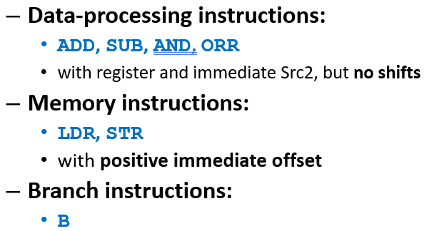
Single-Cycle ARM Processor
Datapath
Control
We begin constructing the datapath by connecting the state elements from Figure 7.1 with combinational logic that can execute the various instructions.

Slide 14
Datapath
Memory Instructions: LDR, STR

Slide 15
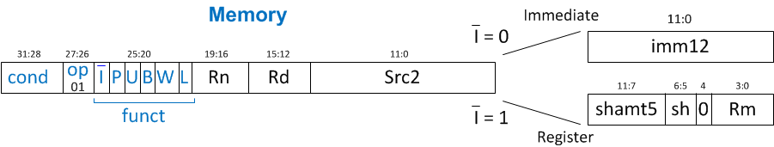
Memory Instructions: LDR
Datapath: start with LDR instruction
Example: LDR R1, [R2, #5]
LDR Rd, [Rn, imm12]

Slide 16
Single-Cycle Datapath: LDR fetch
STEP 1: Fetch instruction

Slide 17
Single-Cycle Datapath: LDR Reg Read
STEP 2: Read source operands from Register file
Rn
LDR Rd, [Rn, imm12]

Slide 18
Single-Cycle Datapath: LDR Immed.
STEP 3: Extend the immediate
ImmSrc = 01
Rn
Rd
Src2
LDR Rd, [Rn, imm12]

Slide 19
Single-Cycle Datapath: LDR Address
STEP 4: Compute the memory address
ImmSrc = 01
Rn
Rd
Cộng địa chỉ cơ sở Rn với phần mở rộng 32-bit của imm12
Src2
Mở rộng thành 32-bit
LDR Rd, [Rn, imm12]

Slide 20
Single-Cycle Datapath: LDR Mem Read
STEP 5: Read data from memory and write it back to register file
Cho phép Write dữ liệu đọc từ Data memory vào WD3
ImmSrc = 01
Truyền dữ liệu đọc từ Data memory vào WD3 (tệp thanh ghi)
LDR Rd, [Rn, imm12]

Slide 21
Single-Cycle Datapath: PC Increment
STEP 6: Determine address of next instruction
ImmSrc = 01
Tăng PC lên 01 chỉ số (+4 do kích thước 01 ô nhớ là 4 bytes)
Tuy nhiên, R15 cũng lưu giá trị PC theo nguyên tắc là:
Đọc R15 sẽ trả về PC+8
Ghi vào R15 sẽ đồng thời cập nhật PC
Nguyên tắc này là áp từ nguyên tắc của ARM. ARM có nguyên tắc này là do “lịch sử để lại.”

Slide 22
PC + 8: Nguyên nhân do “lịch sử để lại”
Chu kỳ:
1
2
3
4
Nạp lệnh
Giải mã
Thực hiện
Lệnh Branch
Ở thuở sơ khai,
Đội ngũ thiết kế ARM áp dụng pipeline có 3 stage là Nạp lệnh-Giải mã-Thực hiện lệnh
Nạp lệnh
Giải mã
Thực hiện
Lệnh tiếp theo No.1
Nạp lệnh
Giải mã
Thực hiện
Lệnh tiếp theo No.2
Lúc thực hiện lệnh Branch thì ARM coi như/lựa chọn PC đang trỏ vào Lệnh tiếp theo No.2

Slide 23
Single-Cycle Datapath: Access to PC
PC can be source/destination of instruction
ImmSrc = 01

Slide 24
Single-Cycle Datapath: Access to PC
PC can be source/destination of instruction
Source: R15 must be available in Register File
R15 is read as the current PC plus 8
Để R15 mang giá trị PC+8 thì cần thêm 4 cho PC+4.
ImmSrc = 01

Slide 25
Single-Cycle Datapath: Access to PC
PC can be source/destination of instruction
Source: R15 must be available in Register File
R15 is read as the current PC plus 8
Destination: Be able to write result to PC
Để Ghi vào R15 cập nhật PC thì kết nối ReadData với cả WD3 và PC’.
Cần thêm bộ MUX và tín hiệu PCSrc để chọn PC+4 hay lấy dữ liệu của ReadData
ImmSrc = 01

Slide 26
Single-Cycle Datapath: STR
Expand datapath to handle STR:
Write data in Rd to memory
ImmSrc = 01
Địa chỉ của memory được tạo bởi Rn và imm12
Dữ liệu của Rd được đọc ra ở RD2 và đưa vào WD
STR Rd, [Rn, imm12]

Slide 27
Data-processing Instructions
Limited subset: ADD, SUB, AND, and ORR
Immediate Addressing and Register Addressing
Quá trình thực hiện giống nhau
Đọc source register từ register file và một giá trị immediate/thanh ghi từ 4 low bits của câu lệnh
Thực hiện phép toán trên ALU
Ghi kết quả về thanh ghi đích.
They differ only in the specific ALU operation. Hence, they can all be handled with the same hardware using different ALUControl signals.
Tín hiệu điều khiển (ALUControl) như sau
ADD : 00, SUB : 01, AND : 10, ORR : 11
The ALU also produces four flags, ALUFlags3:0 (Zero, Negative, Carry, oVerflow), that are sent back to the controller

Slide 28
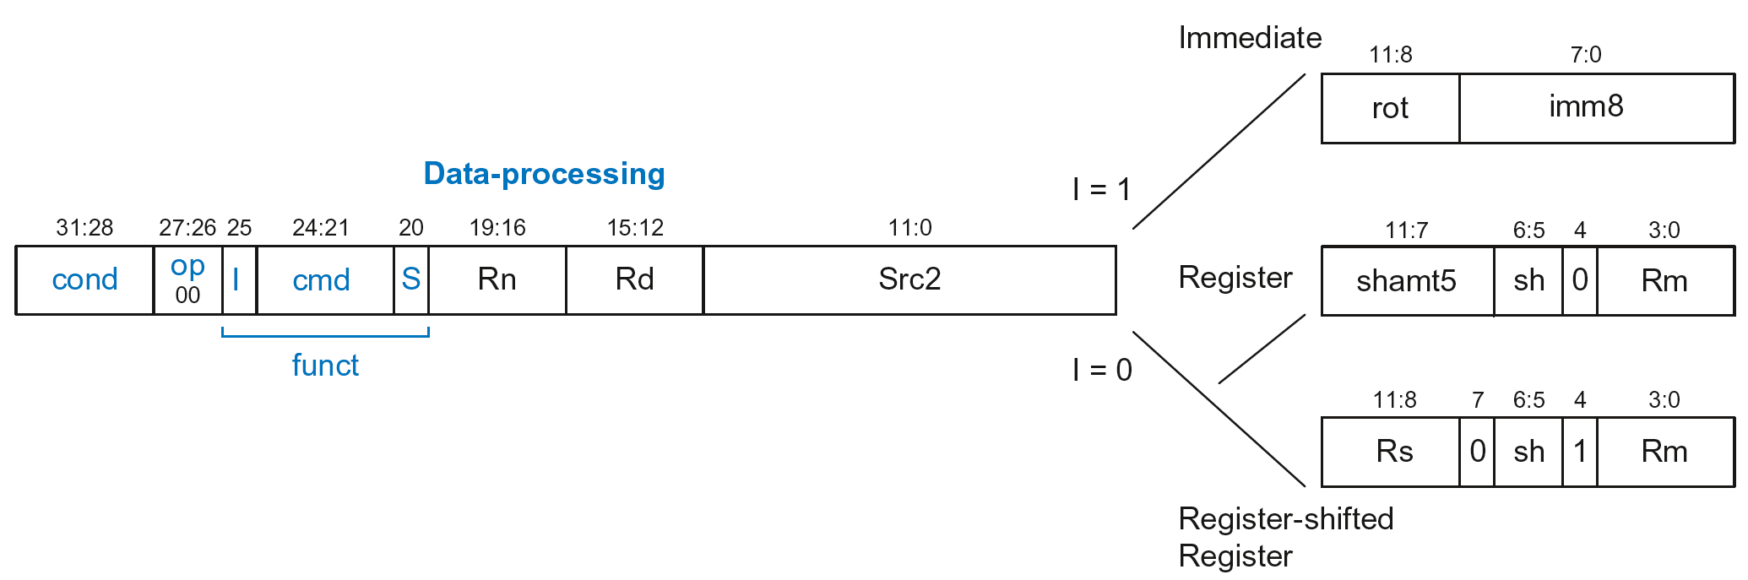
Single-Cycle Datapath: Data-processing
Lệnh ADD:
ADD Rd, Rn, imm8
With immediate Src2:
Read from Rn and Imm8 (ImmSrc chooses the zero-extended Imm8 instead of Imm12)
Write ALUResult to register file
Write to Rd
→ Cần thêm tín hiệu điều khiển ImmSrc cho bộ extension
ADD Rd, Rn, imm8

Slide 29
Single-Cycle Datapath: Data-processing
With immediate Src2:
Read from Rn and Imm8 (ImmSrc chooses the zero-extended Imm8 instead of Imm12)
Write ALUResult to register file
Write to Rd
00
ADD Rd, Rn, imm8

Slide 30
Single-Cycle Datapath: Data-processing
With register Src2:
Read from Rn and Rm (instead of Imm8)
Write ALUResult to register file
Write to Rd
ADD Rd, Rn, Rm

Slide 31
Single-Cycle Datapath: Data-processing
With register Src2:
Read from Rn and Rm (instead of Imm8)
Write ALUResult to register file
Write to Rd
ADD Rd, Rn, Rm

Slide 32
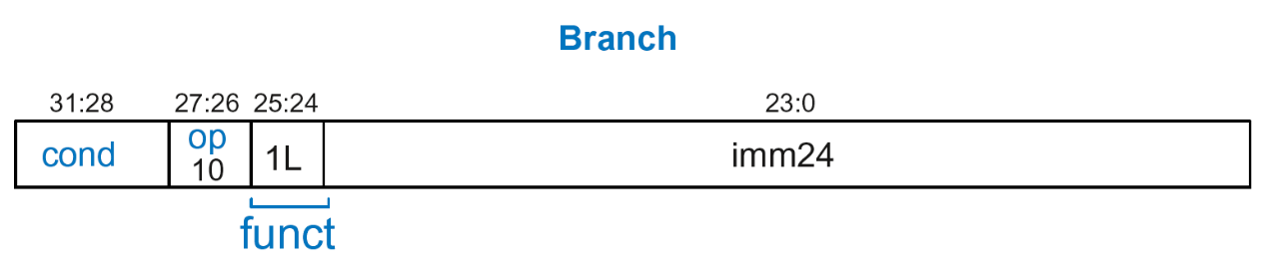
Datapath Instructions: B
Calculate branch target address:
BTA = (ExtImm) + (PC + 8)
ExtImm = Imm24 << 2 and sign-extended

Slide 33
Single-Cycle Datapath: B
Calculate branch target address:
BTA = (ExtImm) + (PC + 8)
ExtImm = Imm24 << 2 and sign-extended
B Label

Slide 34
Single-Cycle Datapath: ExtImm
ImmSrc_{1:0} | ExtImm | Description
00 | {24’b0, Instr_{7:0}} | Zero-extended imm8
01 | {20’b0, Instr_{11:0}} | Zero-extended imm12
10 | {6{Instr₂₃}, Instr_{23:0}} | Sign-extended imm24

Slide 35
Single-Cycle ARM Processor
Controller – Khối điều khiển

Slide 36
Controller for Single-Cycle ARM Processor
Output
Input

Slide 37
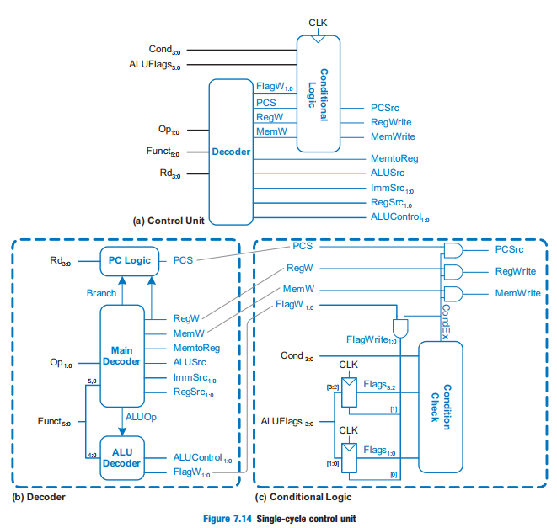

Slide 38
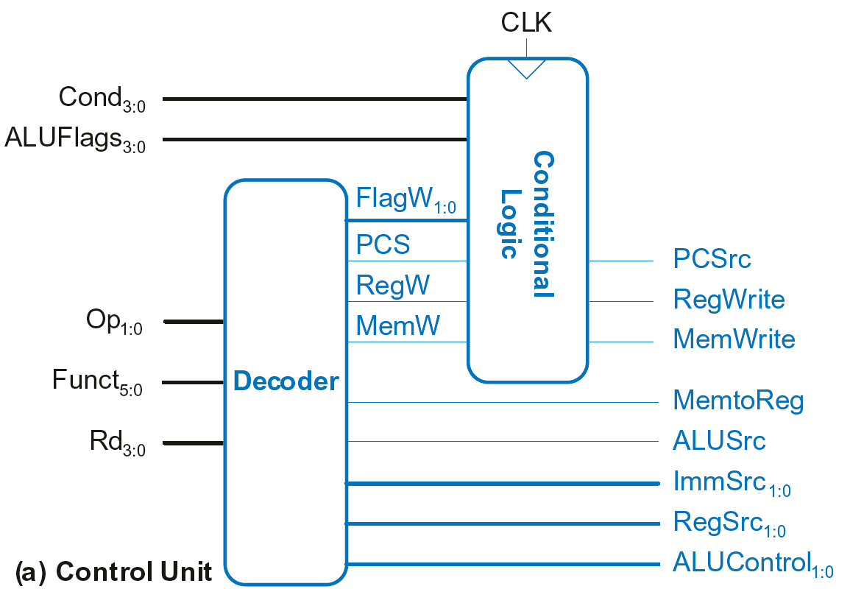
Single-Cycle Control

Slide 39
Single-Cycle Control
Sent directly
to datapath

Slide 40
Single-Cycle Control
Sent through
Conditional Logic
first, then to
datapath
Sent directly
to datapath

Slide 41
Single-Cycle Control
These signals change the state (PC, RF, Memory)
If instruction shouldn’t execute, forced to 0
Sent through
Conditional Logic
first, then to
datapath
Sent directly
to datapath

Slide 42
Single-Cycle Control
FlagW_{1:0}: Flag Write signal, asserted when ALUFlags should be saved (i.e., on instruction with S=1)

Slide 43
Single-Cycle Control
FlagW_{1:0}: Flag Write signal, asserted when ALUFlags should be saved (i.e., on instruction with S=1)
ADD, SUB update all flags (NZCV)
AND, ORR only update NZ flags

Slide 44
Single-Cycle Control
FlagW_{1:0}: Flag Write signal, asserted when ALUFlags should be saved (i.e., on instruction with S=1)
ADD, SUB update all flags (NZCV)
AND, ORR only update NZ flags
So, two bits needed:
FlagW₁ = 1: NZ saved (ALUFlags_{3:2} saved)
FlagW₀ = 1: CV saved (ALUFlags_{1:0} saved)

Slide 45
Single-Cycle Control

Slide 46
Single-Cycle Control: Decoder

Slide 47
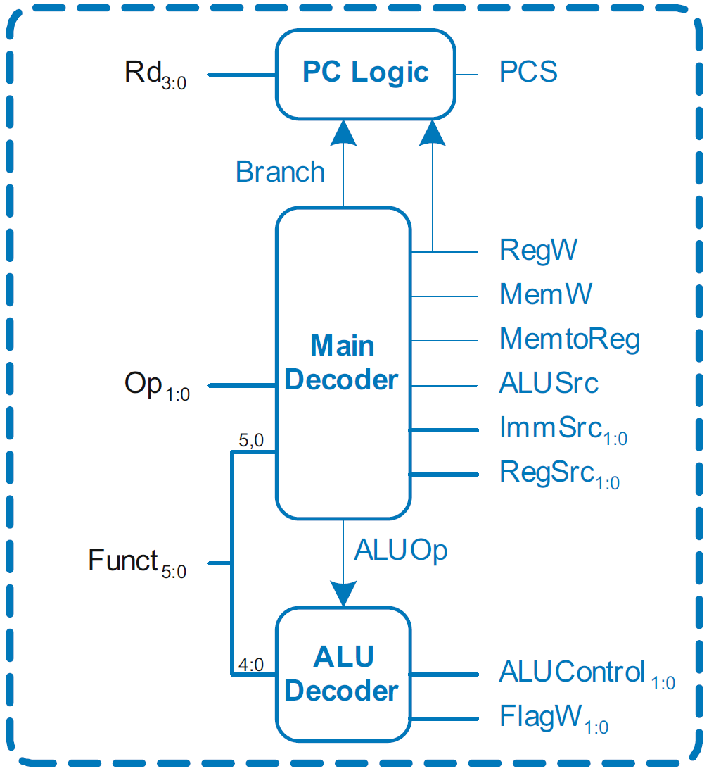
Single-Cycle Control: Decoder
Submodules:
Main Decoder
ALU Decoder
PC Logic

Slide 48
Single-Cycle Control: Decoder
Submodules:
Main Decoder
ALU Decoder
PC Logic

Slide 49
Control Unit: Main Decoder
Op | Funct₅ | Funct₀ | Type | Branch | MemtoReg | MemW | ALUSrc | ImmSrc | RegW | RegSrc | ALUOp
00 | 0 | X | DP Reg | 0 | 0 | 0 | 0 | XX | 1 | 00 | 1
00 | 1 | X | DP Imm | 0 | 0 | 0 | 1 | 00 | 1 | X0 | 1
01 | X | 0 | STR | 0 | X | 1 | 1 | 01 | 0 | 10 | 0
01 | X | 1 | LDR | 0 | 1 | 0 | 1 | 01 | 1 | X0 | 0
10 | X | X | B | 1 | 0 | 0 | 1 | 10 | 0 | X1 | 0

Slide 50
Single-Cycle Control: Decoder
Submodules:
Main Decoder
ALU Decoder
PC Logic

Slide 51
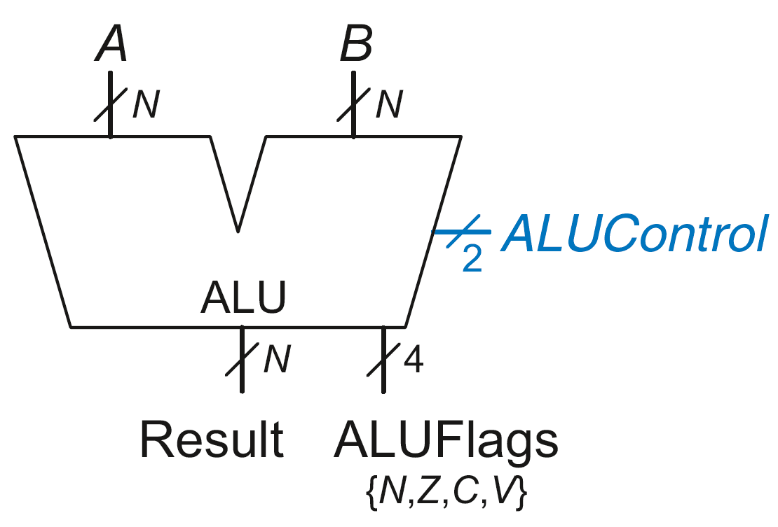
Review: ALU
ALUControl_{1:0} | Function
00 | Add
01 | Subtract
10 | AND
11 | OR

Slide 52
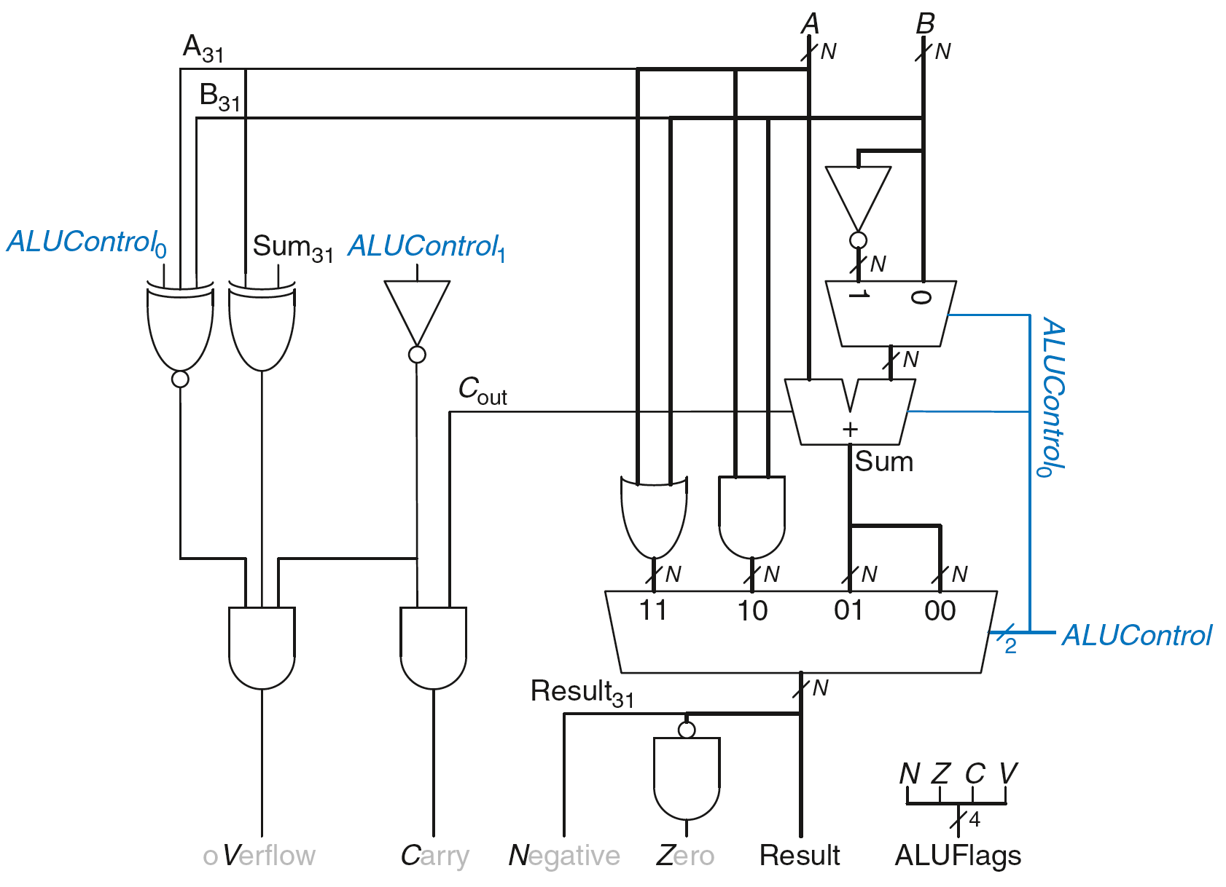
Review: ALU

Slide 53
Single-Cycle Control: Decoder
Submodules:
Main Decoder
ALU Decoder
PC Logic

Slide 54
Control Unit: ALU Decoder
ALUOp | Funct_{4:1} (cmd) | Funct₀ (S) | Type | ALUControl_{1:0} | FlagW_{1:0}
0 | X | X | Not DP | 00 | 00
1 | 0100 | 0 | ADD | 00 | 00
 |  | 1 |  |  | 11
 | 0010 | 0 | SUB | 01 | 00
 |  | 1 |  |  | 11
 | 0000 | 0 | AND | 10 | 00
 |  | 1 |  |  | 10
 | 1100 | 0 | ORR | 11 | 00
 |  | 1 |  |  | 10
FlagW₁ = 1: NZ (Flags_{3:2}) should be saved
FlagW₀ = 1: CV (Flags_{1:0}) should be saved

Slide 55
Single-Cycle Control: Decoder
Submodules:
Main Decoder
ALU Decoder
PC Logic

Slide 56
Single-Cycle Control: PC Logic
PCS = 1 if PC is written by an instruction or branch (B):
PCS = ((Rd == 15) & RegW) | Branch
If instruction is executed: PCSrc = PCS
Else PCSrc = 0 (i.e., PC = PC + 4)

Slide 57
Single-Cycle Control

Slide 58
Single-Cycle Control: Cond. Logic

Slide 59
Conditional Logic
Function:
Check if instruction should execute (if not, force PCSrc, RegWrite, and MemWrite to 0)
Possibly update Status Register (Flags_{3:0})

Slide 60
Conditional Logic
Function:
Check if instruction should execute (if not, force PCSrc, RegWrite, and MemWrite to 0)
Possibly update Status Register (Flags_{3:0})

Slide 61
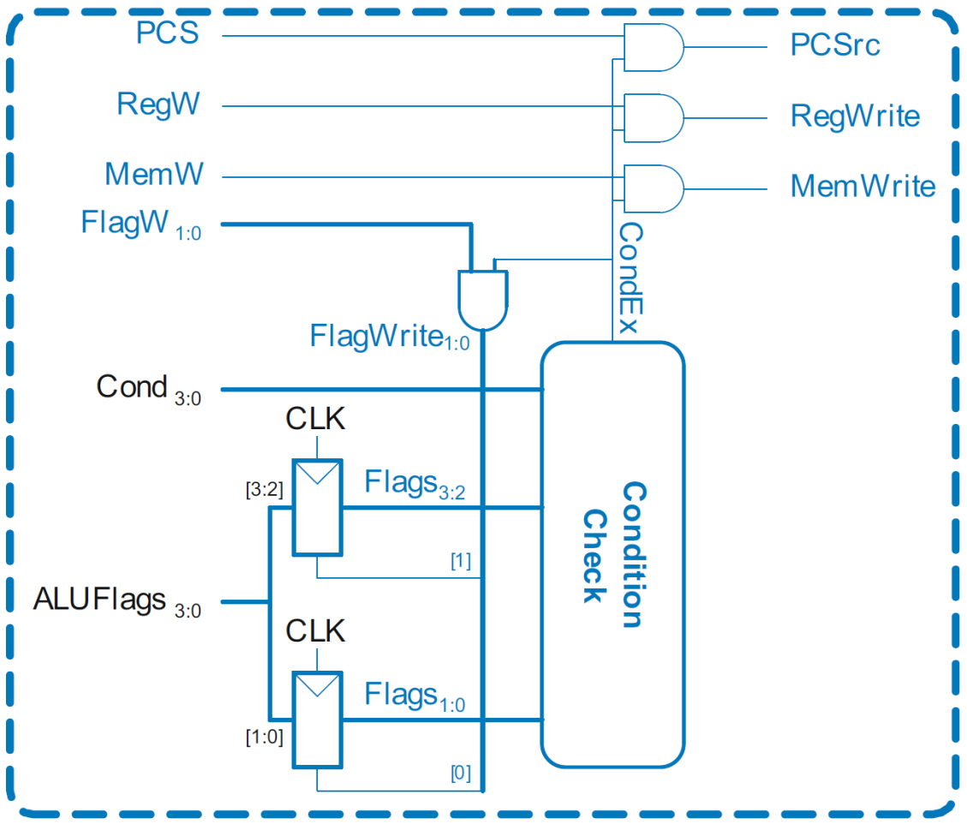
Single-Cycle Control: Conditional Logic

Slide 62
Conditional Logic: Conditional Execution
Depending on condition mnemonic (Cond_{3:0}) and condition flags (Flags_{3:0}) the instruction is executed (CondEx = 1)

Slide 63
Conditional Logic: Conditional Execution
Flags_{3:0} is the status register
Depending on condition mnemonic (Cond_{3:0}) and condition flags (Flags_{3:0}) the instruction is executed (CondEx = 1)

Slide 64
Review: Condition Mnemonics

Slide 65
Conditional Logic: Conditional Execution
Flags_{3:0} = NZCV
Example: AND R1, R2, R3
Cond_{3:0}=1110 (unconditional) => CondEx = 1

Slide 66
Conditional Logic: Conditional Execution
Flags_{3:0} = NZCV
Example: EOREQ R5, R6, R7
Cond_{3:0}=0000 (EQ): if Flags = x1xx => CondEx = 1
N Z C V

Slide 67
Conditional Logic
Function:
Check if instruction should execute (if not, force PCSrc, RegWrite, and MemWrite to 0)
Possibly update Status Register (Flags_{3:0})

Slide 68
Conditional Logic: Update (Set) Flags
Flags_{3:0} = NZCV
Flags_{3:0} updated (with ALUFlags_{3:0}) if:
FlagW is 1 (i.e., the instruction’s S-bit is 1) AND
CondEx is 1 (the instruction should be executed)

Slide 69

Conditional Logic: Update (Set) Flags
Recall:
ADD, SUB update all Flags
AND, OR update NZ only
So Flags status register has two write enables: FlagW_{1:0}

Slide 70
Review: ALU Decoder
ALUOp | Funct_{4:1} (cmd) | Funct₀ (S) | Type | ALUControl_{1:0} | FlagW_{1:0}
0 | X | X | Not DP | 00 | 00
1 | 0100 | 0 | ADD | 00 | 00
 |  | 1 |  |  | 11
 | 0010 | 0 | SUB | 01 | 00
 |  | 1 |  |  | 11
 | 0000 | 0 | AND | 10 | 00
 |  | 1 |  |  | 10
 | 1100 | 0 | ORR | 11 | 00
 |  | 1 |  |  | 10
FlagW₁ = 1: NZ (Flags_{3:2}) should be saved
FlagW₀ = 1: CV (Flags_{1:0}) should be saved

Slide 71
Conditional Logic: Update (Set) Flags
All Flags updated
Example: SUBS R5, R6, R7
FlagW_{1:0} = 11 AND CondEx = 1 (unconditional) => FlagWrite_{1:0} = 11

Slide 72
Conditional Logic: Update (Set) Flags
Flags_{3:0} = NZCV
Only Flags_{3:2} updated
i.e., only NZ Flags updated
Example: ANDS R7, R1, R3
FlagW_{1:0} = 10 AND CondEx = 1 (unconditional) => FlagWrite_{1:0} = 10

Slide 73
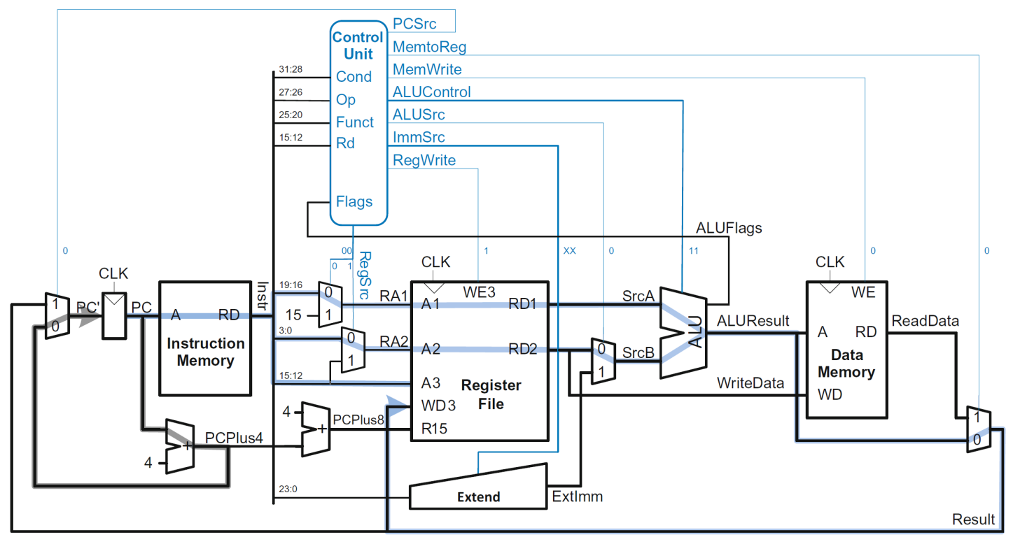
Example: ORR
Op | Funct₅ | Funct₀ | Type | Branch | MemtoReg | MemW | ALUSrc | ImmSrc | RegW | RegSrc | ALUOp
00 | 0 | X | DP Reg | 0 | 0 | 0 | 0 | XX | 1 | 00 | 1

Slide 74
Example: ORR

Slide 75
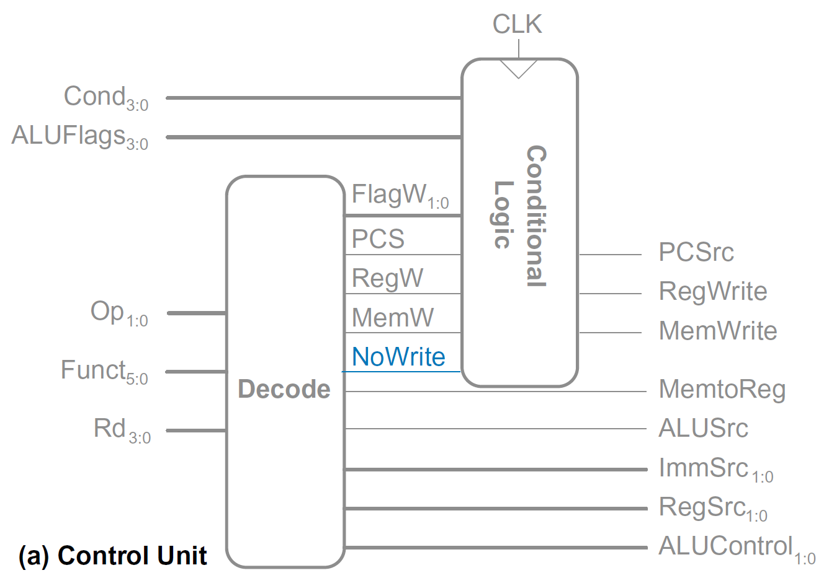
Extended Functionality: CMP

Slide 76
Extended Functionality: CMP
No change to datapath

Slide 77
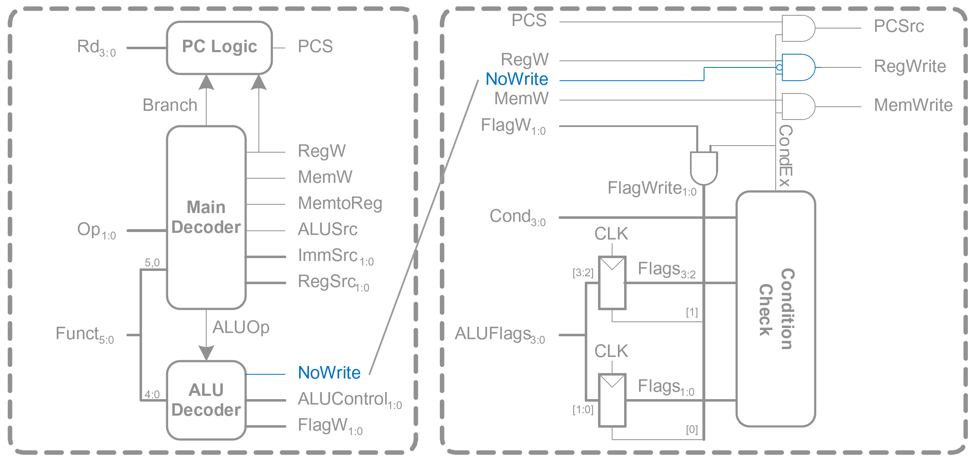
Extended Functionality: CMP

Slide 78
Extended Functionality: CMP
ALUOp | Funct_{4:1} (cmd) | Funct₀ (S) | Type | ALUControl_{1:0} | FlagW_{1:0} | NoWrite
0 | X | X | Not DP | 00 | 00 | 0
1 | 0100 | 0 | ADD | 00 | 00 | 0
 |  | 1 |  |  | 11 | 0
 | 0010 | 0 | SUB | 01 | 00 | 0
 |  | 1 |  |  | 11 | 0
 | 0000 | 0 | AND | 10 | 00 | 0
 |  | 1 |  |  | 10 | 0
 | 1100 | 0 | ORR | 11 | 00 | 0
 |  | 1 |  |  | 10 | 0
 | 1010 | 1 | CMP | 01 | 11 | 1

Slide 79
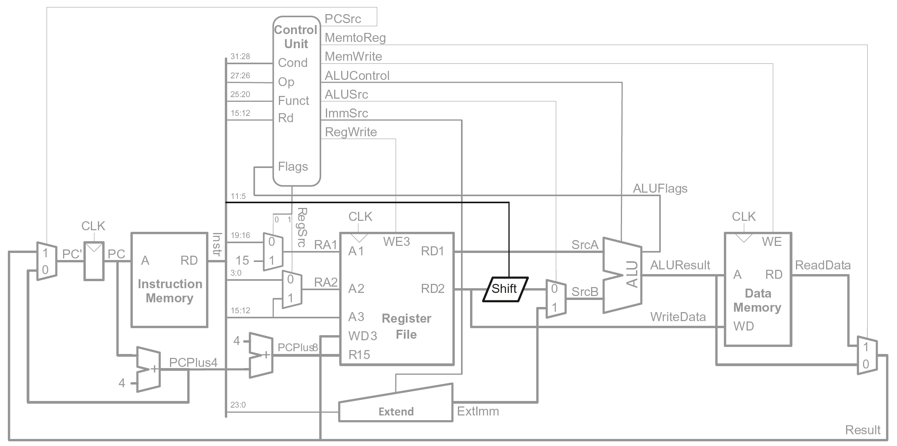
Extended Functionality: Shifted Register

Slide 80
Extended Functionality: Shifted Register
No change to controller

Slide 81
Review: Processor Performance
Program Execution Time
= (#instructions)(cycles/instruction)(seconds/cycle)
= # instructions x CPI x T_{C}

Slide 82
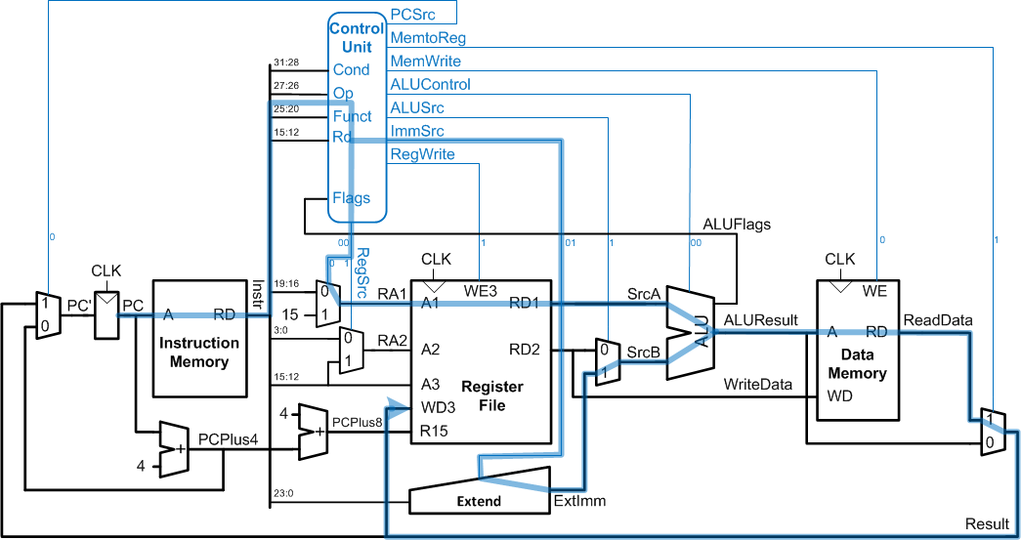
Single-Cycle Performance
T_{C} limited by critical path (LDR)

Slide 83
Single-Cycle Performance
Single-cycle critical path:
T_{c1} = t_{pcq_PC} + t_{mem} + t_{dec} +
max[t_{mux} + t_{RFread}, t_{sext} + t_{mux}] +
t_{ALU} + t_{mem} + t_{mux} + t_{RFsetup}
Typically, limiting paths are:
memory, ALU, register file
T_{c1} = t_{pcq_PC} + 2t_{mem} + t_{dec} + t_{RFread} + t_{ALU} + 2t_{mux} + t_{RFsetup}

Slide 84
Single-Cycle Performance Example
Element | Parameter | Delay (ps)
Register clock-to-Q | t_{pcq_PC} | 40
Register setup | t_{setup} | 50
Multiplexer | t_{mux} | 25
ALU | t_{ALU} | 120
Decoder | t_{dec} | 70
Memory read | t_{mem} | 200
Register file read | t_{RFread} | 100
Register file setup | t_{RFsetup} | 60
T_{c1} = ?

Slide 85
Single-Cycle Performance Example
Element | Parameter | Delay (ps)
Register clock-to-Q | t_{pcq_PC} | 40
Register setup | t_{setup} | 50
Multiplexer | t_{mux} | 25
ALU | t_{ALU} | 120
Decoder | t_{dec} | 70
Memory read | t_{mem} | 200
Register file read | t_{RFread} | 100
Register file setup | t_{RFsetup} | 60
T_{c1} = t_{pcq_PC} + 2t_{mem} + t_{dec} + t_{RFread} + t_{ALU} + 2t_{mux} + t_{RFsetup}
= [40 + 2(200) + 70 + 100 + 120 + 2(25) + 60] ps
= 840 ps

Slide 86
Single-Cycle Performance Example
Program with 100 billion instructions:
Execution Time = # instructions x CPI x T_{C}
= (100 × 10⁹)(1)(840 × 10⁻¹² s)
= 84 seconds

Slide 87
Multicycle ARM Processor
Single-cycle:
+ simple
cycle time limited by longest instruction (LDR)
separate memories for instruction and data
3 adders/ALUs
Multicycle processor addresses these issues by breaking instruction into shorter steps
shorter instructions take fewer steps
can re-use hardware
cycle time is faster

Slide 88
Multicycle ARM Processor
Single-cycle:
+ simple
cycle time limited by longest instruction (LDR)
separate memories for instruction and data
3 adders/ALUs
Multicycle:
+ higher clock speed
+ simpler instructions run faster
+ reuse expensive hardware on multiple cycles
- sequencing overhead paid many times

Slide 89
Multicycle ARM Processor
Single-cycle:
+ simple
cycle time limited by longest instruction (LDR)
separate memories for instruction and data
3 adders/ALUs
Multicycle:
+ higher clock speed
+ simpler instructions run faster
+ reuse expensive hardware on multiple cycles
- sequencing overhead paid many times
Same design steps as single-cycle:
first datapath
then control

Slide 90
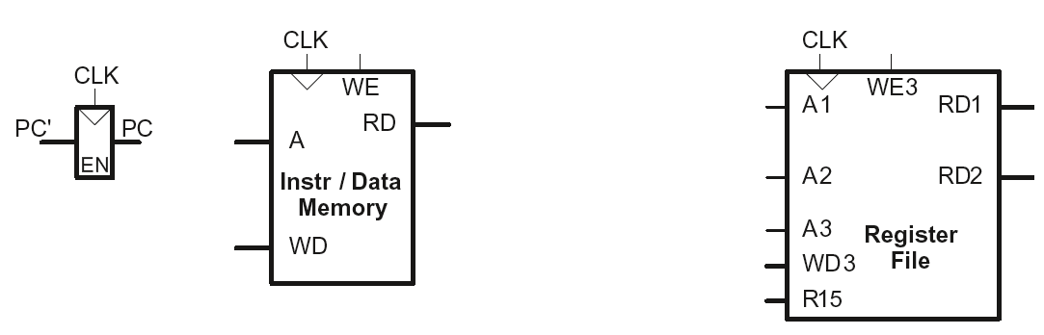
Multicycle State Elements
Replace Instruction and Data memories with a single unified memory – more realistic

Slide 91
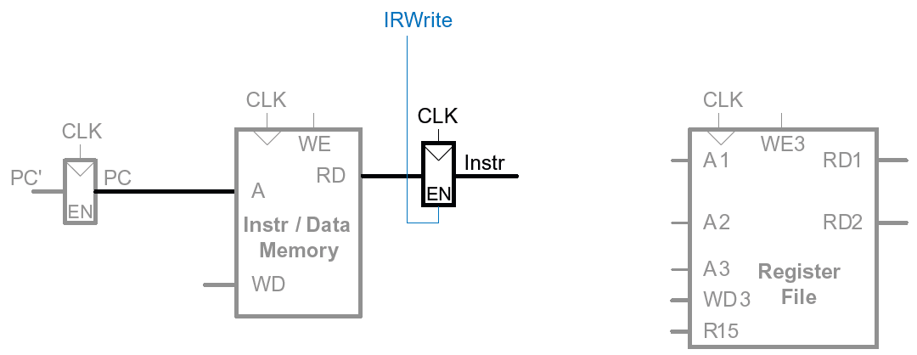
Multicycle Datapath: Instruction Fetch
STEP 1: Fetch instruction
LDR Rd, [Rn, imm12]

Slide 92
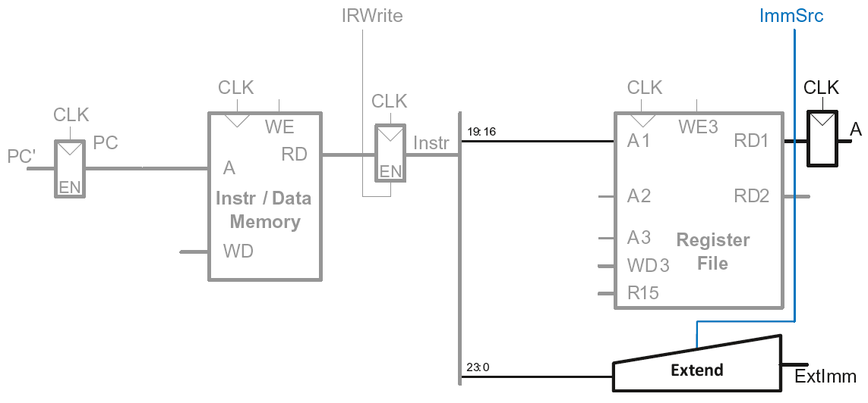
Multicycle Datapath: LDR Register Read
STEP 2: Read source operands from RF
LDR Rd, [Rn, imm12]

Slide 93
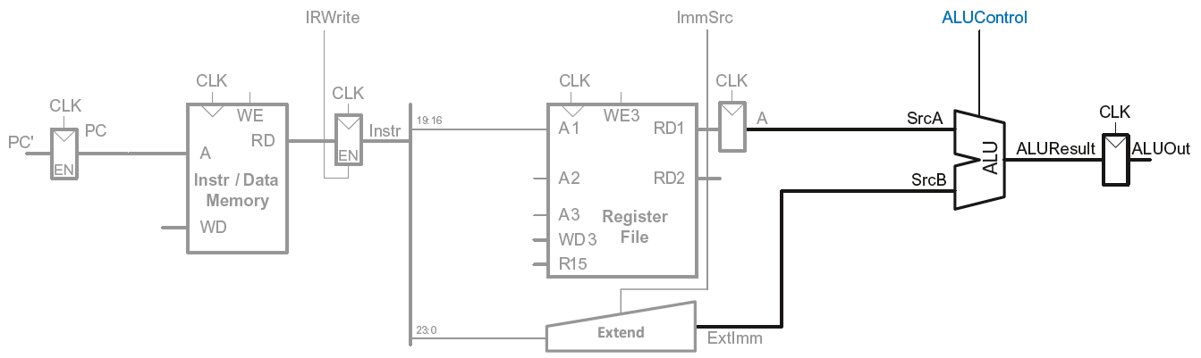
Multicycle Datapath: LDR Address
STEP 3: Compute the memory address
LDR Rd, [Rn, imm12]

Slide 94
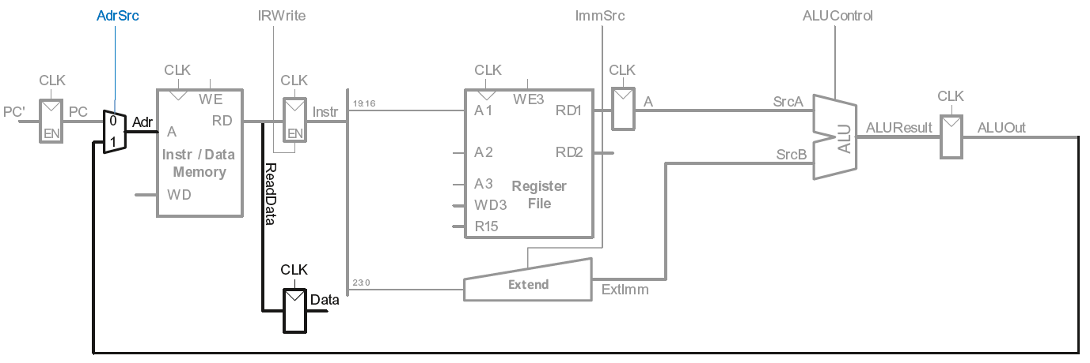
Multicycle Datapath: LDR Memory Read
STEP 4: Read data from memory
LDR Rd, [Rn, imm12]

Slide 95
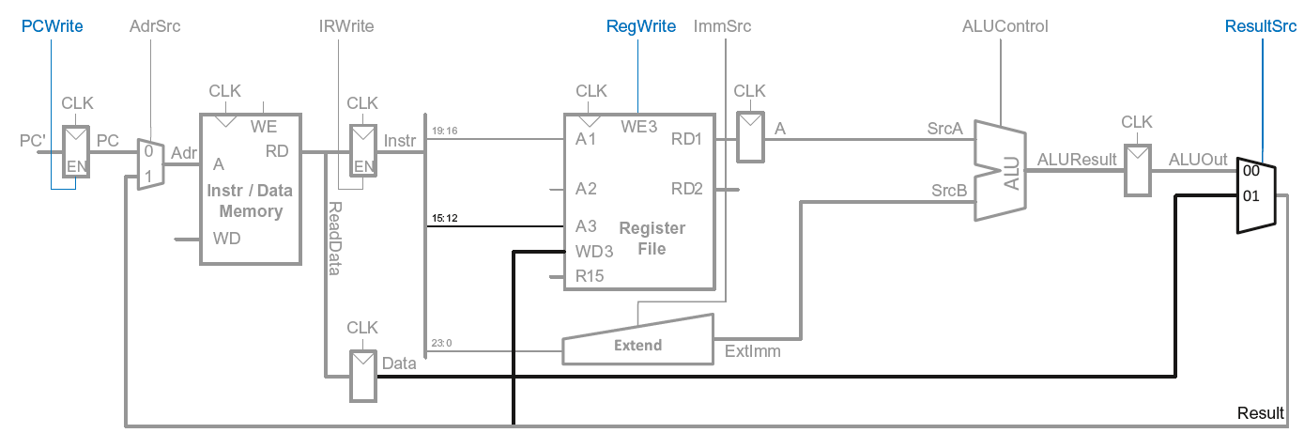
Multicycle Datapath: LDR Write Register
STEP 5: Write data back to register file
LDR Rd, [Rn, imm12]

Slide 96
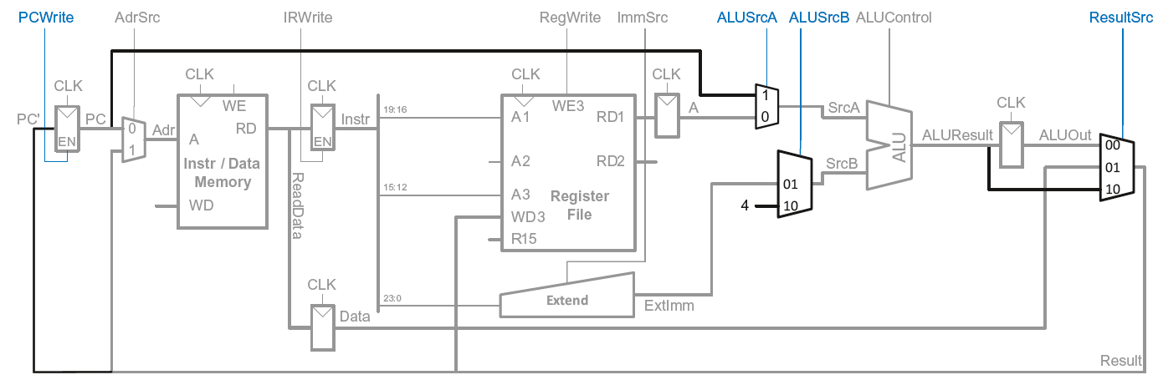
Multicycle Datapath: Increment PC
Meanwhile: Increment PC
Concurrent with fetching instruction

Slide 97
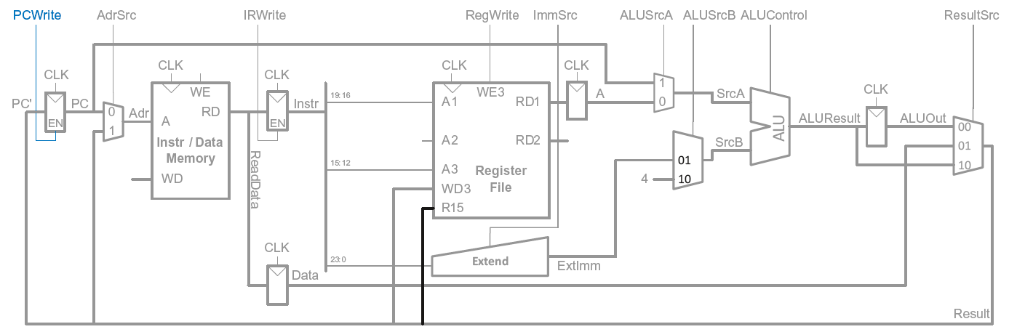
Multicycle Datapath: Access to PC
PC can be read/written by instruction

Slide 98
Multicycle Datapath: Access to PC
PC can be read/written by instruction
Read: R15 (PC+8) available in Register File

Slide 99
Multicycle Datapath: Read to PC (R15)
Example: ADD R1, R15, R2

Slide 100
Multicycle Datapath: Read to PC (R15)
Example: ADD R1, R15, R2
R15 needs to be read as PC+8 from Register File (RF) in 2nd step
PC+4 was computed in 1st step
So (also in 2nd step) ALU computes (PC+4) + 4 for R15 input

Slide 101
Multicycle Datapath: Read to PC (R15)
Example: ADD R1, R15, R2
R15 needs to be read as PC+8 from Register File (RF) in 2nd step
PC+4 was computed in 1st step
So (also in 2nd step) ALU computes (PC+4) + 4 for R15 input
SrcA = PC (which was already updated in step 1 to PC+4)
SrcB = 4
ALUResult = PC + 8
ALUResult is fed to R15 input port of RF in 2nd step (which is then routed to RD1 output of RF)

Slide 102
Multicycle Datapath: Access to PC
PC can be read/written by instruction
Read: R15 (PC+8) available in Register File
Write: Be able to write result of instruction to PC

Slide 103
Multicycle Datapath: Write to PC (R15)
Example: SUB R15, R8, R3

Slide 104
Multicycle Datapath: Write to PC (R15)
Example: SUB R15, R8, R3
Result of instruction needs to be written to the PC register
ALUResult already routed to the PC register, just assert PCWrite

Slide 105
Multicycle Datapath: Write to PC (R15)
Example: SUB R15, R8, R3
Result of instruction needs to be written to the PC register
ALUResult already routed to the PC register, just assert PCWrite

Slide 106
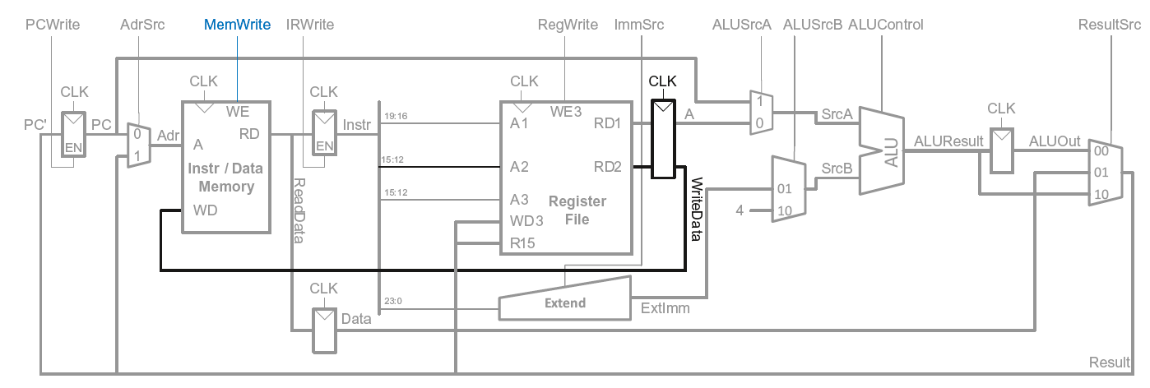
Multicycle Datapath: STR
Write data in Rn to memory

Slide 107
Multicycle Datapath: Data-processing
With immediate addressing (i.e., an immediate Src2), no additional changes needed for datapath

Slide 108
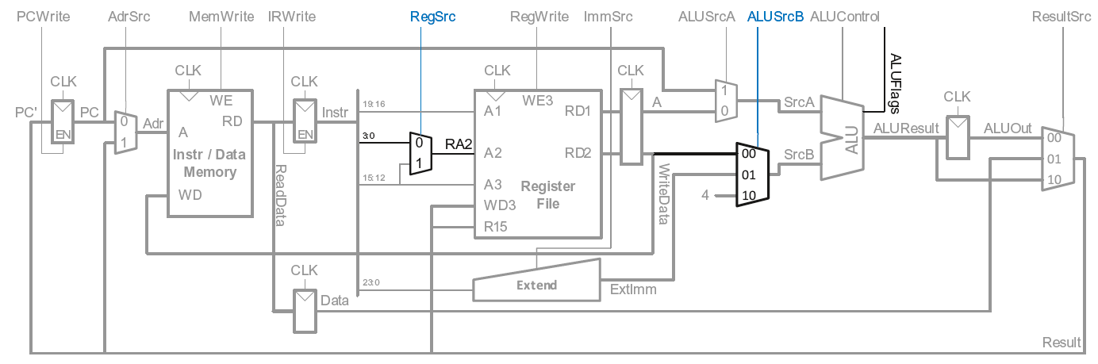
Multicycle Datapath: Data-processing
With register addressing (register Src2):
Read from Rn and Rm

Slide 109
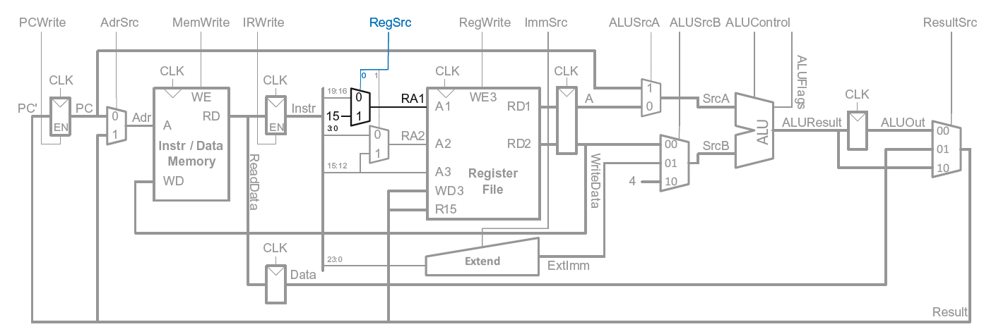
Multicycle Datapath: B
Calculate branch target address:
BTA = (ExtImm) + (PC+8)
ExtImm = Imm24 << 2 and sign-extended

Slide 110
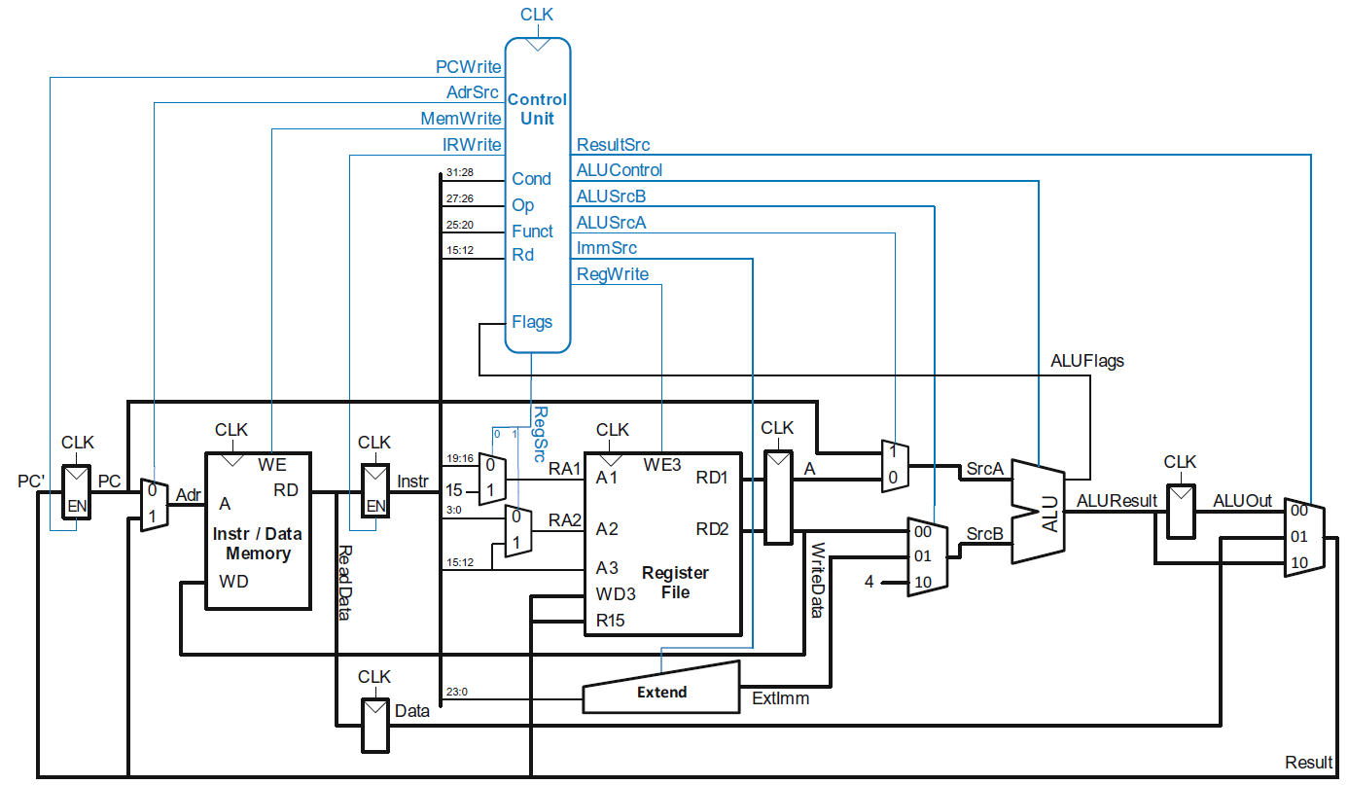
Multicycle ARM Processor

Slide 111
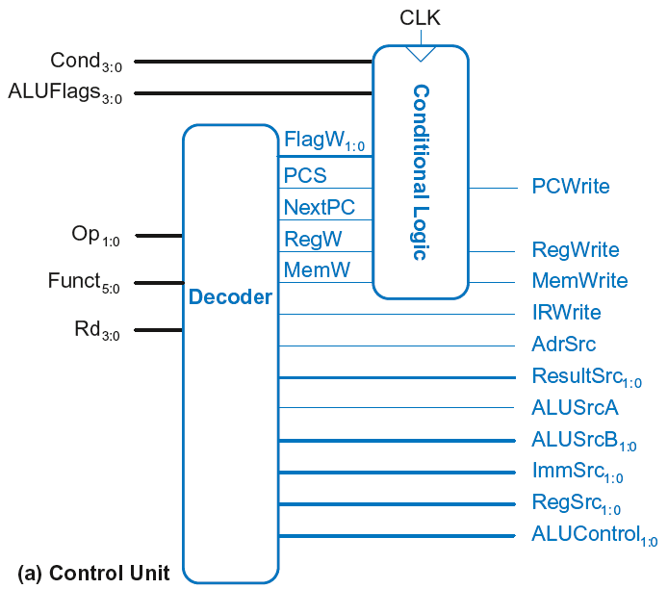
Multicycle Control
First, discuss Decoder
Then, Conditional Logic

Slide 112
Multicycle Control: Decoder

Slide 113
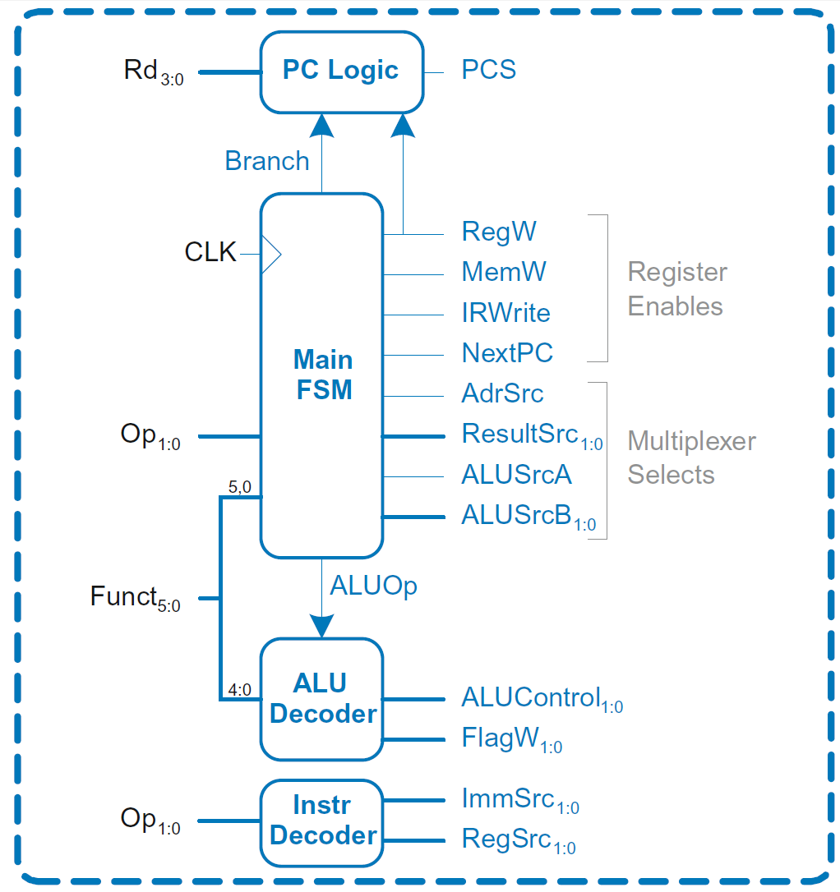
Multicycle Control: Decoder
Decoder

Slide 114
Multicycle Control: Decoder
ALU Decoder and PC Logic same as single-cycle

Slide 115
Multicycle Control: Instr Decoder
RegSrc₀ = (Op == 10₂)
RegSrc₁ = (Op == 01₂)
ImmSrc_{1:0} = Op
Instruction | Op | Funct₅ | Funct₀ | RegSrc₀ | RegSrc₁ | ImmSrc_{1:0}
LDR | 01 | X | 1 | 0 | X | 01
STR | 01 | X | 0 | 0 | 1 | 01
DP immediate | 00 | 1 | X | 0 | X | 00
DP register | 00 | 0 | X | 0 | 0 | 00
B | 10 | X | X | 1 | X | 10

Slide 116
Multicycle ARM Processor

Slide 117
Multicycle Control: Main FSM
Decoder

Slide 118
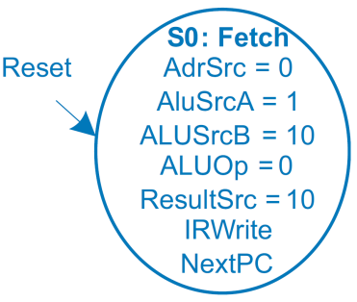

Main Controller FSM: Fetch

Slide 119
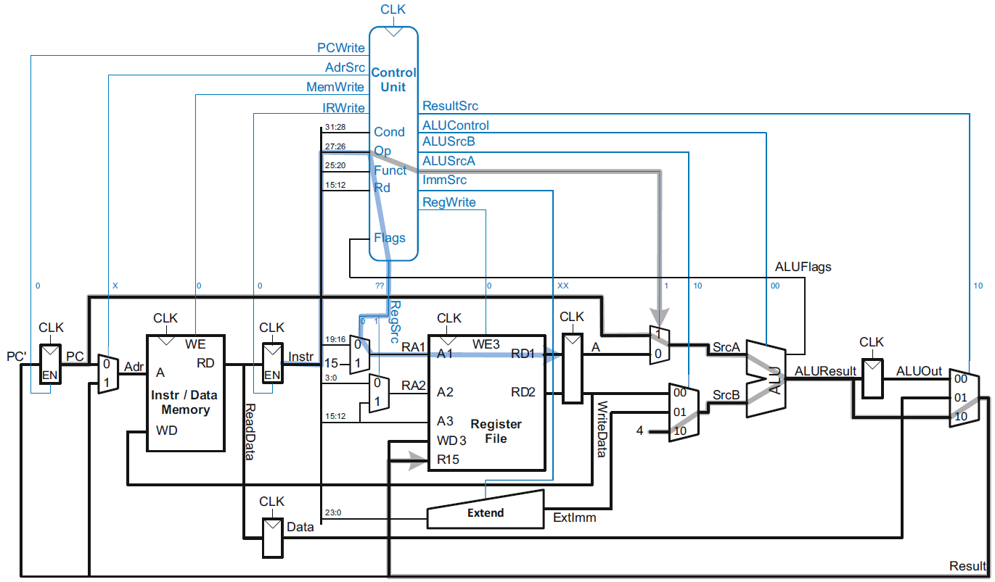
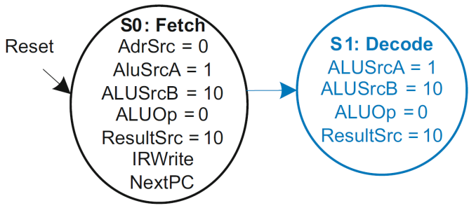
Main Controller FSM: Decode

Slide 120
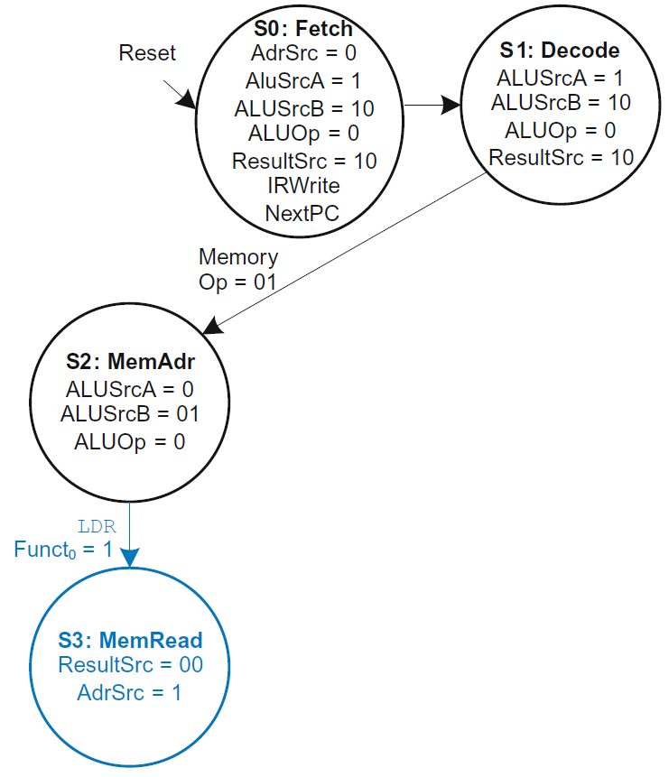
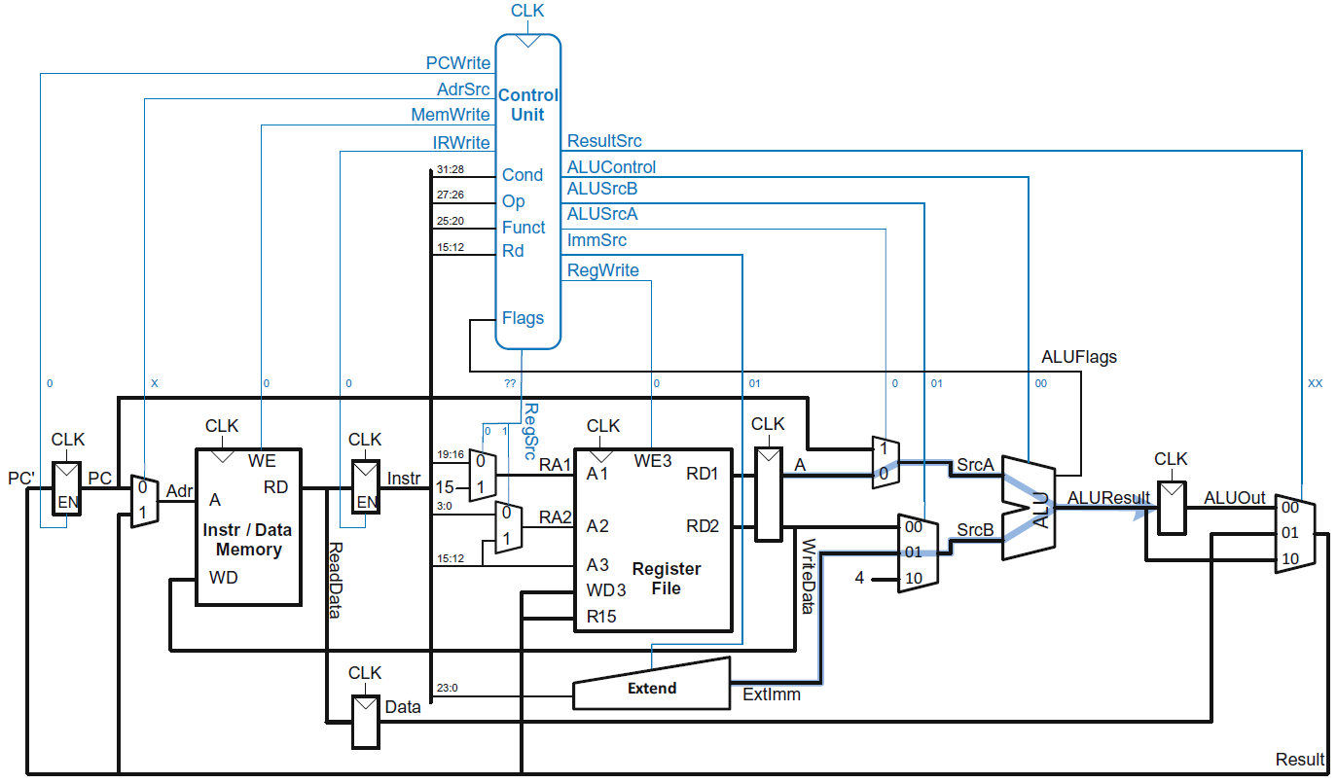
Main Controller FSM: Address

Slide 121
Main Controller FSM: Read Memory

Slide 122
Multicycle ARM Processor

Slide 123
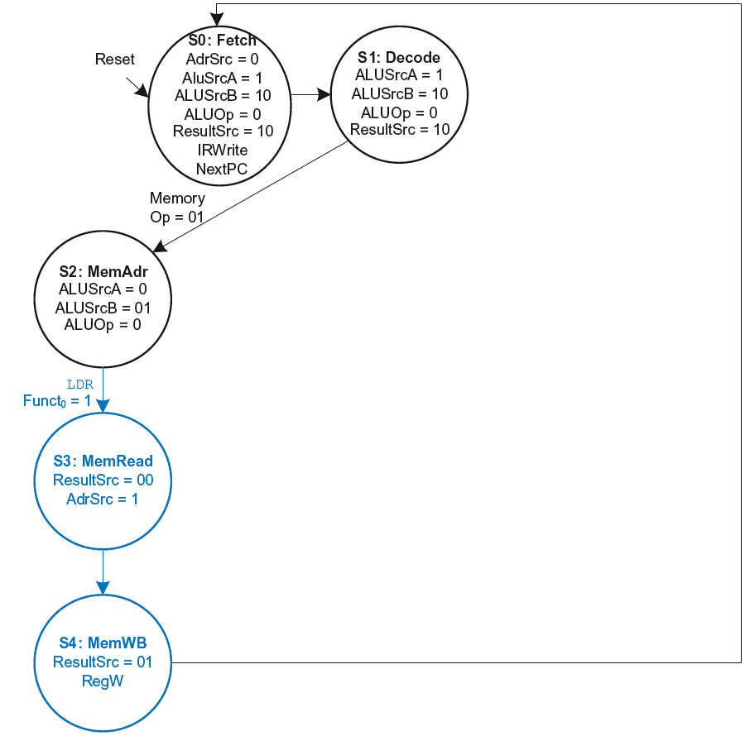
Main Controller FSM: LDR

Slide 124
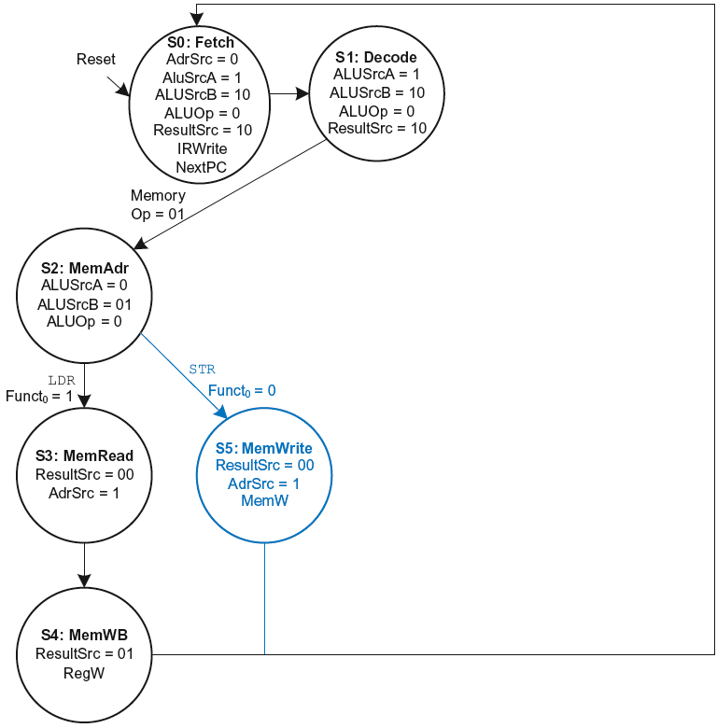
Main Controller FSM: STR

Slide 125
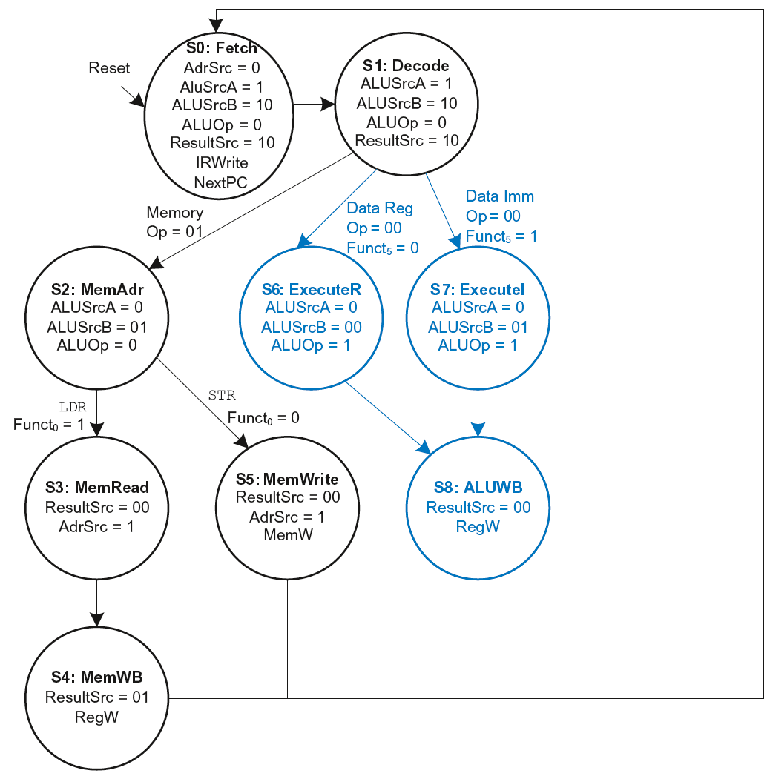
Main Controller FSM: Data-processing

Slide 126
Main Controller FSM: Data-processing

Slide 127
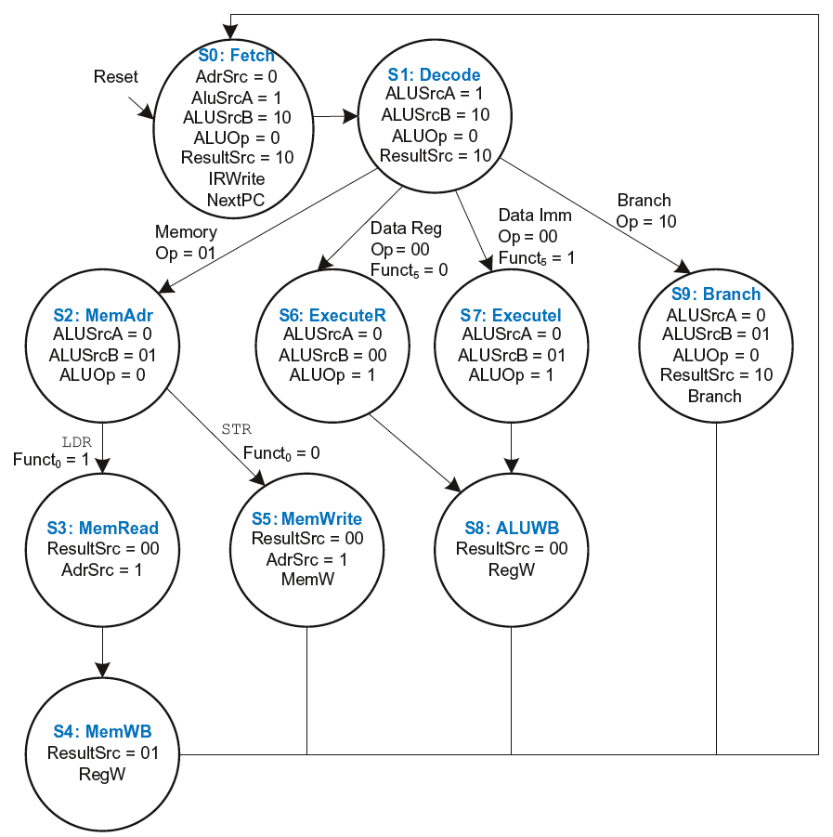
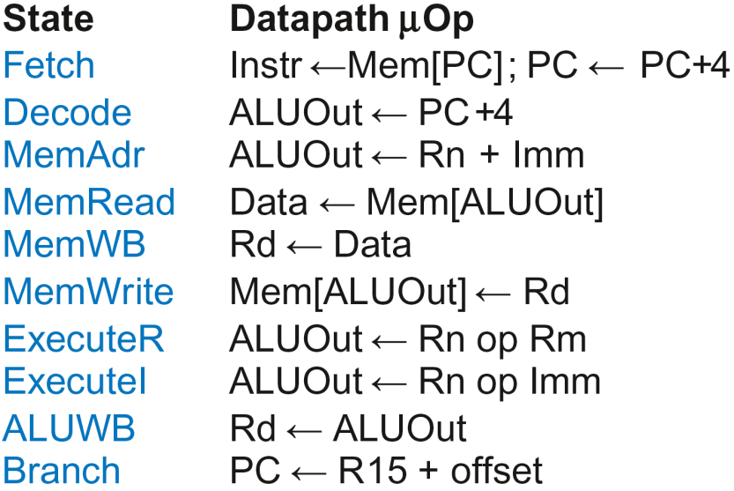
Multicycle Controller FSM

Slide 128
Multicycle Control
First, discuss Decoder
Then, Conditional Logic

Slide 129
Multicycle Control: Cond. Logic

Slide 130
Single-Cycle Conditional Logic

Slide 131
Multicycle Conditional Logic
PCWrite asserted in Fetch state
ExecuteI/ExecuteR state:
CondEx asserts
ALUFlags generated
ALUWB state:
Flags updated
CondEx changes
PCWrite, RegWrite, and
MemWrite don’t see
change till new
instruction (Fetch state)

Slide 132
Multicycle Processor Performance
Instructions take different number of cycles.

Slide 133
Multicycle Controller FSM

Slide 134
Multicycle Processor Performance
Instructions take different number of cycles:
3 cycles:
4 cycles:
5 cycles:

Slide 135
Multicycle Processor Performance
Instructions take different number of cycles:
3 cycles: B
4 cycles: DP, STR
5 cycles: LDR

Slide 136
Multicycle Processor Performance
Instructions take different number of cycles:
3 cycles: B
4 cycles: DP, STR
5 cycles: LDR
CPI is weighted average
SPECINT2000 benchmark:
25% loads
10% stores
13% branches
52% data processing

Slide 137
Multicycle Processor Performance
Instructions take different number of cycles:
3 cycles: B
4 cycles: DP, STR
5 cycles: LDR
CPI is weighted average
SPECINT2000 benchmark:
25% loads
10% stores
13% branches
52% data processing
Average CPI = (0.13)(3) + (0.52 + 0.10)(4) + (0.25)(5) = 4.12

Slide 138
Multicycle Processor Performance
Multicycle critical path:
Assumptions:
RF is faster than memory
writing memory is faster than reading memory
T_{c2} = t_{pcq} + 2t_{mux} + max(t_{ALU} + t_{mux}, t_{mem}) + t_{setup}

Slide 139
Multicycle Performance Example
Element | Parameter | Delay (ps)
Register clock-to-Q | t_{pcq_PC} | 40
Register setup | t_{setup} | 50
Multiplexer | t_{mux} | 25
ALU | t_{ALU} | 120
Decoder | t_{dec} | 70
Memory read | t_{mem} | 200
Register file read | t_{RFread} | 100
Register file setup | t_{RFsetup} | 60
T_{c2} = ?

Slide 140
Multicycle Performance Example
Element | Parameter | Delay (ps)
Register clock-to-Q | t_{pcq_PC} | 40
Register setup | t_{setup} | 50
Multiplexer | t_{mux} | 25
ALU | t_{ALU} | 120
Decoder | t_{dec} | 70
Memory read | t_{mem} | 200
Register file read | t_{RFread} | 100
Register file setup | t_{RFsetup} | 60
T_{c2} = t_{pcq} + 2t_{mux} + max[t_{ALU} + t_{mux}, t_{mem}] + t_{setup}
= [40 + 2(25) + 200 + 50] ps = 340 ps

Slide 141
Multicycle Performance Example
For a program with 100 billion instructions executing on a multicycle ARM processor
CPI = 4.12 cycles/instruction
Clock cycle time: T_{c2} = 340 ps
Execution Time = ?

Slide 142
Multicycle Performance Example
For a program with 100 billion instructions executing on a multicycle ARM processor
CPI = 4.12 cycles/instruction
Clock cycle time: T_{c2} = 340 ps
Execution Time = (# instructions) × CPI × T_{c}
= (100 × 10⁹)(4.12)(340 × 10⁻¹²)
= 140 seconds

Slide 143
Multicycle Performance Example
For a program with 100 billion instructions executing on a multicycle ARM processor
CPI = 4.12 cycles/instruction
Clock cycle time: T_{c2} = 340 ps
Execution Time = (# instructions) × CPI × T_{c}
= (100 × 10⁹)(4.12)(340 × 10⁻¹²)
= 140 seconds
This is slower than the single-cycle processor (84 sec.)

Slide 144
Review: Single-Cycle ARM Processor

Slide 145
Review: Multicycle ARM Processor

Slide 146
Pipelined ARM Processor
Aim to really improve performance
Use temporal parallelism
Divide single-cycle processor into 5 stages:
Fetch
Decode
Execute
Memory
Writeback
Add pipeline registers between stages

Slide 147
Single-Cycle vs. Pipelined

Slide 148
Pipelined Processor Abstraction

Slide 149
Single-Cycle & Pipelined Datapath

Slide 150
Corrected Pipelined Datapath
WA3 must arrive at same time as Result
Register file written on falling edge of CLK

Slide 151
Optimized Pipelined Datapath
Remove adder by using PCPlus4F after PC has been updated to PC+4

Slide 152
Pipelined Processor Control
Same control unit as single-cycle processor
Control delayed to proper pipeline stage

Slide 153
Pipeline Hazards
When an instruction depends on result from instruction that hasn’t completed
Types:
Data hazard: register value not yet written back to register file
Control hazard: next instruction not decided yet (caused by branch)

Slide 154
Data Hazard

Slide 155
Handling Data Hazards
Insert NOPs in code at compile time
Rearrange code at compile time
Forward data at run time
Stall the processor at run time

Slide 156
Compile-Time Hazard Elimination
Insert enough NOPs for result to be ready
Or move independent useful instructions forward

Slide 157
Data Forwarding

Slide 158
Data Forwarding
Check if register read in Execute stage matches register written in Memory or Writeback stage
If so, forward result

Slide 159
Data Forwarding

Slide 160
Data Forwarding
Execute stage register matches Memory stage register?
Match_1E_M = (RA1E == WA3M)
Match_2E_M = (RA2E == WA3M)
Execute stage register matches Writeback stage register?
Match_1E_W = (RA1E == WA3W)
Match_2E_W = (RA2E == WA3W)
If it matches, forward result:
if (Match_1E_M • RegWriteM) ForwardAE = 10;
else if (Match_1E_W • RegWriteW) ForwardAE = 01;
else ForwardAE = 00;

Slide 161
Data Forwarding
Execute stage register matches Memory stage register?
Match_1E_M = (RA1E == WA3M)
Match_2E_M = (RA2E == WA3M)
Execute stage register matches Writeback stage register?
Match_1E_W = (RA1E == WA3W)
Match_2E_W = (RA2E == WA3W)
If it matches, forward result:
if (Match_1E_M • RegWriteM) ForwardAE = 10;
else if (Match_1E_W • RegWriteW) ForwardAE = 01;
else ForwardAE = 00;
ForwardBE same but with Match2E

Slide 162
Stalling

Slide 163
Stalling

Slide 164
Stalling Hardware

Slide 165
Stalling Logic
Is either source register in the Decode stage the same as the one being written in the Execute stage?
Match_12D_E = (RA1D == WA3E) + (RA2D == WA3E)
Is a LDR in the Execute stage AND Match_12D_E?
ldrstall = Match_12D_E • MemtoRegE
StallF = StallD = FlushE = ldrstall

Slide 166
Control Hazards
B:
branch not determined until the Writeback stage of pipeline
Instructions after branch fetched before branch occurs
These 4 instructions must be flushed if branch happens
Writes to PC (R15) similar

Slide 167
Control Hazards
Branch misprediction penalty
number of instruction flushed when branch is taken (4)
May be reduced by determining BTA earlier

Slide 168
Early Branch Resolution
Determine BTA in Execute stage
Branch misprediction penalty = 2 cycles
Hardware changes
Add a branch multiplexer before PC register to select BTA from ALUResultE
Add BranchTakenE select signal for this multiplexer (only asserted if branch condition satisfied)
PCSrcW now only asserted for writes to PC

Slide 169
Pipelined processor with Early BTA

Slide 170
Control Hazards with Early BTA

Slide 171
Control Stalling Logic
PCWrPendingF = 1 if write to PC in Decode, Execute or Memory
PCWrPendingF = PCSrcD + PCSrcE + PCSrcM
Stall Fetch if PCWrPendingF
StallF = ldrStallD + PCWrPendingF
Flush Decode if PCWrPendingF OR PC is written in Writeback OR branch is taken
FlushD = PCWrPendingF + PCSrcW + BranchTakenE
Flush Execute if branch is taken
FlushE = ldrStallD + BranchTakenE
Stall Decode if ldrStallD (as before)
StallD = ldrStallD

Slide 172
ARM Pipelined Processor with Hazard Unit

Slide 173
Pipelined Performance Example
SPECINT2000 benchmark:
25% loads
10% stores
13% branches
52% data processing
Suppose:
40% of loads used by next instruction
50% of branches mispredicted
What is the average CPI?

Slide 174
Pipelined Performance Example
SPECINT2000 benchmark:
25% loads
10% stores
13% branches
52% data processing
Suppose:
40% of loads used by next instruction
50% of branches mispredicted
What is the average CPI?
Load CPI = 1 when not stalling, 2 when stalling
So, CPI_{lw} = 1(0.6) + 2(0.4) = 1.4
Branch CPI = 1 when not stalling, 3 when stalling
So, CPI_{beq} = 1(0.5) + 3(0.5) = 2
Average CPI = (0.25)(1.4) + (0.1)(1) + (0.13)(2) + (0.52)(1) = 1.23

Slide 175
Pipelined Performance
Pipelined processor critical path:
T_{c3} = max [
t_{pcq} + t_{mem} + t_{setup} Fetch
2(t_{RFread} + t_{setup} ) Decode
t_{pcq} + 2t_{mux} + t_{ALU} + t_{setup} Execute
t_{pcq} + t_{mem} + t_{setup} Memory
2(t_{pcq} + t_{mux} + t_{RFwrite}) ] Writeback

Slide 176
Pipelined Performance Example
Element | Parameter | Delay (ps)
Register clock-to-Q | t_{pcq_PC} | 40
Register setup | t_{setup} | 50
Multiplexer | t_{mux} | 25
ALU | t_{ALU} | 120
Memory read | t_{mem} | 200
Register file read | t_{RFread} | 100
Register file setup | t_{RFsetup} | 60
Register file write | t_{RFwrite} | 70
Cycle time: T_{c3} = ?

Slide 177
Pipelined Performance Example
Element | Parameter | Delay (ps)
Register clock-to-Q | t_{pcq_PC} | 40
Register setup | t_{setup} | 50
Multiplexer | t_{mux} | 25
ALU | t_{ALU} | 120
Memory read | t_{mem} | 200
Register file read | t_{RFread} | 100
Register file setup | t_{RFsetup} | 60
Register file write | t_{RFwrite} | 70
Cycle time: T_{c3} = 2(t_{RFread} + t_{setup} )
= 2[100 + 50] ps = 300 ps

Slide 178
Pipelined Performance Example
Program with 100 billion instructions
Execution Time = (# instructions) × CPI × T_{c}
= (100 × 10⁹)(1.23)(300 × 10⁻¹²)
= 36.9 seconds

Slide 179
Processor Performance Comparison
Processor | Execution Time (seconds) | Speedup (single-cycle as baseline)
Single-cycle | 84 | 1
Multicycle | 140 | 0.6
Pipelined | 36.9 | 2.28

Slide 180
Advanced Microarchitecture
Deep Pipelining
Micro-operations
Branch Prediction
Superscalar Processors
Out of Order Processors
Register Renaming
SIMD
Multithreading
Multiprocessors

Slide 181
Deep Pipelining
10-20 stages typical
Number of stages limited by:
Pipeline hazards
Sequencing overhead
Power
Cost

Slide 182
Micro-operations
Decompose more complex instructions into a series of simple instructions called micro-operations (micro-ops or µ-ops)
At run-time, complex instructions are decoded into one or more micro-ops
Used heavily in CISC (complex instruction set computer) architectures (e.g., x86)
Used for some ARM instructions, for example:
Complex Op Micro-op Sequence
LDR R1, [R2], #4 LDR R1, [R2]
ADD R2, R2, #4
Without u-ops, would need 2nd write port on the register file

Slide 183
Micro-operations
Allow for dense code (fewer memory accesses)
Yet preserve simplicity of RISC hardware
ARM strikes balance by choosing instructions that:
Give better code density than pure RISC instruction sets (such as MIPS)
Enable more efficient decoding than CISC instruction sets (such as x86)

Slide 184
Branch Prediction
Guess whether branch will be taken
Backward branches are usually taken (loops)
Consider history to improve guess
Good prediction reduces fraction of branches requiring a flush

Slide 185
Branch Prediction
Ideal pipelined processor: CPI = 1
Branch misprediction increases CPI
Static branch prediction:
Check direction of branch (forward or backward)
If backward, predict taken
Else, predict not taken
Dynamic branch prediction:
Keep history of last several hundred (or thousand) branches in branch target buffer, record:
Branch destination
Whether branch was taken

Slide 186
Branch Prediction Example
MOV R1, #0 ; R1 = sum
MOV R0, #0 ; R0 = i
FOR ; for (i=0; i<10; i=i+1)
CMP R0, #10
BGE DONE
ADD R1, R1, R0 ; sum = sum + i
ADD R0, R0, #1
B FOR
DONE

Slide 187
1-Bit Branch Predictor
Remembers whether branch was taken the last time and does the same thing
Mispredicts first and last branch of loop

Slide 188
2-Bit Branch Predictor
Only mispredicts last branch of loop

Slide 189
Superscalar
Multiple copies of datapath execute multiple instructions at once
Dependencies make it tricky to issue multiple instructions at once

Slide 190
Superscalar Example
Ideal IPC: 2
Actual IPC: 2

Slide 191
Superscalar with Dependencies
Ideal IPC: 2
Actual IPC: 6/5 = 1.2

Slide 192
Out of Order Processor
Looks ahead across multiple instructions
Issues as many instructions as possible at once
Issues instructions out of order (as long as no dependencies)
Dependencies:
RAW (read after write): one instruction writes, later instruction reads a register
WAR (write after read): one instruction reads, later instruction writes a register
WAW (write after write): one instruction writes, later instruction writes a register

Slide 193
Out of Order Processor
Instruction level parallelism (ILP): number of instruction that can be issued simultaneously (average < 3)
Scoreboard: table that keeps track of:
Instructions waiting to issue
Available functional units
Dependencies

Slide 194
Out of Order Processor Example
LDR R8, [R0, #40]
ADD R9, R8, R1
SUB R8, R2, R3 Ideal IPC: 2
AND R10, R4, R8 Actual IPC: 6/4 = 1.5
ORR R11, R5, R6
STR R7, [R11, #80]

Slide 195
Register Renaming
LDR R8, [R0, #40]
ADD R9, R8, R1
SUB R8, R2, R3 Ideal IPC: 2
AND R10, R4, R8 Actual IPC: 6/3 = 2
ORR R11, R5, R6
STR R7, [R11, #80]

Slide 196
SIMD
Single Instruction Multiple Data (SIMD)
Single instruction acts on multiple pieces of data at once
Common application: graphics
Perform short arithmetic operations (also called packed arithmetic)
For example, add eight 8-bit elements

Slide 197
Advanced Architecture Techniques
Multithreading
Word processor: thread for typing, spell checking, printing
Multiprocessors
Multiple processors (cores) on a single chip

Slide 198
Threading: Definitions
Process: program running on a computer
Multiple processes can run at once: e.g., surfing Web, playing music, writing a paper
Thread: part of a program
Each process has multiple threads: e.g., a word processor may have threads for typing, spell checking, printing

Slide 199
Threads in Conventional Processor
One thread runs at at at a time
When one thread stalls (for example, waiting for memory):
Architectural state of that thread stored
Architectural state of waiting thread loaded into processor and it runs
Called context switching
Appears to user like all threads running simultaneously

Slide 200
Multithreading
Multiple copies of architectural state
Multiple threads active at once:
When one thread stalls, another runs immediately
If one thread can’t keep all execution units busy, another thread can use them
Does not increase instruction-level parallelism (ILP) of single thread, but increases throughput
Intel calls this “hyperthreading”

Slide 201
Multiprocessors
Multiple processors (cores) with a method of communication between them
Types:
Homogeneous: multiple cores with shared main memory
Heterogeneous: separate cores for different tasks (for example, DSP and CPU in cell phone)
Clusters: each core has own memory system

Slide 202
Other Resources
Patterson & Hennessy’s: Computer Architecture: A Quantitative Approach
Conferences:
www.cs.wisc.edu/~arch/www/
ISCA (International Symposium on Computer Architecture)
HPCA (International Symposium on High Performance Computer Architecture)

