Slide 1


Office Supply
Your one-stop shop for post-its, markers, staplers, and more!

Slide 2
Featured Products
Post-Its
Assorted Colors
$3.49 and up
Markers
Dry Erase
$5.49
Staplers
Red Swingline
$21.49

Slide 3
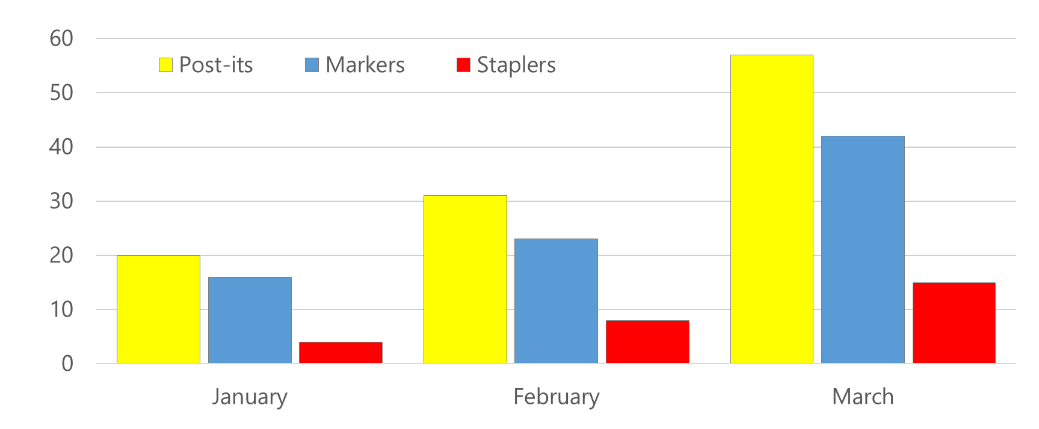
Sales Update
 | January | February | March
Post-its | 20 | 31 | 57
Markers | 16 | 23 | 42
Staplers | 4 | 8 | 15

Slide 4
Sales Data
 | January | February | March
Post-its | 20 | 31 | 57
Markers | 16 | 23 | 42
Staplers | 4 | 8 | 15

Slide 5
Order Process
Pick a Product
Set the Quantity
Click Order

