Slide 1
STRING
Bài 7

Slide 2
Declaring Strings
In PHP, strings may be declared either as simple type or complex type.
Simple strings are declared in 'single quote marks' while complex strings are declared in "double quote marks".
Ví dụ:
<?php
$name = 'Bob';
$a = 'Hello $name\n';
$b = "Hello $name\n";
echo $a; // Hello $name\n
echo $b; // Hello Bob

Slide 3
Embedding Variables
One of the chief advantages of complex strings is the fact that PHP will parse them and automatically evaluate variable names contained in them.
When using simple strings that are not evaluated, you need to terminate the string and concatenate the variable to it.
Variables names are marked by a $ in PHP. When the parser encounters one in a string, it will try to form a variable name by adding as many alphanumeric characters as it can to make a valid variable name
<?php
$catfood = "Cheeseburgers";
echo 'I can haz $catfood'; // I can haz $catfood
echo 'I can haz ' . $catfood; // I can haz Cheeseburgers?
echo "I can haz $catfood?"; // I can haz Cheeseburgers?

Slide 4
Embedding Variables
PHP allows the use of curly braces for you to explicitly tell the parser that part of a string must be evaluated. This is necessary, for example, when outputting an element from an array where it might not be immediately clear that the square brackets are intended as punctuation in the string or as syntax to reference an element in the array.
<?php
$burger = "Cheeseburger";
echo "I can haz {$burger}"; // I can haz Cheeseburger
echo "I can haz ${burger}"; // I can haz Cheeseburger
echo "I can haz $burgers"; // no variable $burgers
echo "I can haz {$burger}s"; // I can haz Cheeseburgers
echo "I can haz { $burger }"; // I can haz { Cheeseburger }

Slide 5
Embedding Variables
Note that you cannot use spaces between the braces and the variable that you want to evaluate. Because the braces explicitly denote the end of the variable in the string, it is possible to include characters immediately following them. In an earlier example, we saw that "{$burger}s" is rendered as Cheeseburgers.
<?php
$catfood = new stdClass();
$catfood->name = "Cheeseburgers";
$cat = new stdClass();
$cat->canhaz = [$catfood];
echo "$cat->canhaz[0]->name"; // array to string conversion
echo "{$cat->canhaz[0]->name}"; // Cheeseburgers

Slide 6
Control Characters
When PHP encounters a complex string, one that it declared in double quotes, it will evaluate it for variables and control characters.
Sequence | Meaning
\n | Line feed
\r | Carriage return
\t | Tab
\v | Vertical tab
\e | Escape
\f | Form feed
\\ | Backslash
\$ | Dollar symbol
[0-7]{1,3} | Sequences matching this regular expression are in octal notation
\x[0-9A-Fa-f]{1,2} | Matching sequences are in hexadecimal notation

Slide 7
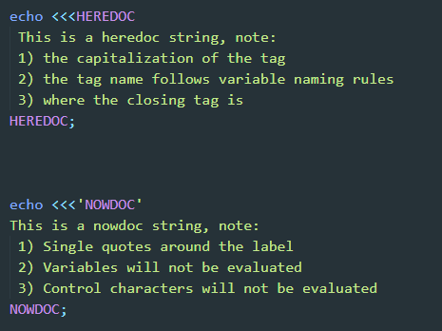
Heredoc and Nowdoc

Slide 8
Referencing Characters in Strings
You can reference a position in a string by using either square brackets or curly braces to denote the zero-based integer position you want to reference.
<?php
$hello = "world";
echo $hello[0]; // w
echo $hello{1}; // o

Slide 9
Extracting Strings
You can use the substr() function to return a portion, or slice, of a string. The PHP Manual for substr() shows the syntax for the command like this:
`string substr ( string $string , int $start [, int $length ] )`
<?php
echo substr("abcdef", 2) ; // cdef
echo substr("abcdef", -2) ; // ef
echo substr("abcdef", 0, 2) ; // ab
echo substr("abcdef", 0, -2) ; // abcd
echo substr('abcdef', 1); // bcdef
echo substr('abcdef', 1, 3); // bcd
echo substr('abcdef', 0, 4); // abcd
echo substr('abcdef', 0, 8); // abcdef
echo substr('abcdef', -1, 1); // f

Slide 10
Searching Strings
PHP search parameters have a $haystack and we are searching for a $needle. Compare the order of parameters used for strpos() and array_search()
<?php
$arr = ['a', 'b', 'c', 'd', 'e', 'f' ];
$str = 'abcdef';
echo strpos($str, 'c') . PHP_EOL;
echo array_search('c', $arr) . PHP_EOL;
For string search functions, the order is always $haystack then $needle
For array search functions, the order is always $needle then $haystack

Slide 11
Searching Strings
The next useful tip is to remember the difference between 0 and false. Although Boolean false evaluates to 0, if you cast it to integer, the number 0 is not identical to a Boolean false. Here’s an example where we seemingly don’t find the letter “a” in the string "abcdef":
<?php
$string = 'abcdef';
if (strpos($string, 'a') == false) {
echo "False negative!" . PHP_EOL;
}

Slide 12
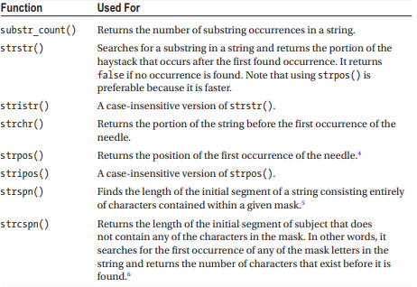
Quick Overview of Search Functions
PHP has several functions used to search strings. As a general rule, the case-insensitive functions have an “i” after the prefix. The following table lists the PHP Manual definitions for the string search functions.

Slide 13
Replacing Strings
PHP has three functions for replacing strings. str_replace() and its case-insensitive version str_ireplace() can be used for basic replacements.
<?php
echo str_replace('foo', 'bar', 'Delicious food'); // Delicious bard
Both the search and replacement parameters can be arrays. This lets you replace multiple values in one call, as in this example:
<?php
$string = "I like black hot coffee";
$search = ['black', 'coffee'];
$replace = ['green', 'tea'];
echo str_replace($search, $replace, $string); // I like green hot tea

Slide 14
Replacing Strings
strtr() is another function to replace substrings and characters.
<?php
$address = "09479 Huopainenkylä, Pöhjois-Karjala";
$address = strtr($address, "äåö", "aao");
echo $address; // 09479 Huopainenkyloa, Pohjois-Karjala

Slide 15
Formatting Strings
The printf() function is used to output a formatted string.
<?php
$minutes = 60;
$timeUnit = "an hour";
printf("There are %u minutes in %s.", $minutes, $timeUnit);

Slide 16
Formatting Numbers
The number_format() function is a simple way to format numbers.
<?php
$number = 1234.5678;
// 1,235
echo number_format($number) . PHP_EOL;
// 1,234.568
echo number_format($number, 3) . PHP_EOL;
// 1.234,57
echo number_format($number, 2, ',', '.') . PHP_EOL;

