Slide 1
Object-Oriented PHP
Bài 8

Slide 2
Declaring Classes and Instantiating Objects
Classes are declared using the class keyword.
<?php
class ExampleClass
{
// class code
}
Classes can be named using the same rules as variables. Your coding standards will determine the case convention you use.
To instantiate an object from a class, you use the new keyword:
<?php
$exampleObject = new ExampleClass();
// If you are not passing constructor parameters you can omit the brackets if you choose
$anotherObject = new ExampleClass;

Slide 3
Declaring Classes and Instantiating Objects
Summary reference table shows the syntax and limitations
for inheritance and traits.
Concept | Syntax | Limitation
Inherit from a class | class A extends A_Parent | Class may have only one parent
Interface inheritance | Interface A extends B, C | Interface can inherit multiple interfaces
Inherit from an abstract class | Interface A extends B, C | Interface can inherit multiple interfaces
Implement interface | class A implements A_ Interface | Class can implement multiple interfaces
Trait | class Foo { use A_trait; } | Class can use multiple traits

Slide 4
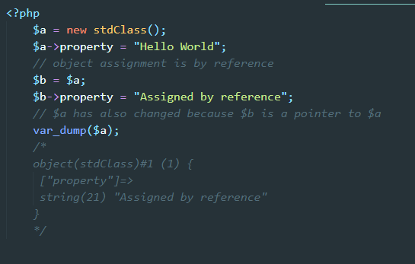
Declaring Classes and Instantiating Objects
Object assignment is always by reference
Notice in the following example how when we change the property in the copied object, the original object also changes. In fact, the two variables occupy the same space in memory because a reference is a pointer to the original data. We don’t make an entire new copy of the object

Slide 5
Visibility or Access Modifiers
The visibility of a method or property can be set by prefixing the declaration with public, protected, or private.
Public class members can be accessed from anywhere.
Protected class members can be accessed from within the class and by its children.
Private class members can only be accessed from within the class itself.
If you don’t explicitly specify a visibility then it will default to public
Interfaces can only include public methods. Any class that implements the interface must match the visibility of the method and so these methods will be public in it too.
Methods in abstract classes may have any visibility. A method in a class that extends an abstract class must have the same or less restrictive visibility

Slide 6
Instance Properties and Methods
Properties
Class properties are declared by using one of the visibility modifiers followed by the name of the property. Property names follow the same naming rules as variables.
Properties can be initialized to default values. They can be initialized with expressions, but not functions.

Slide 7
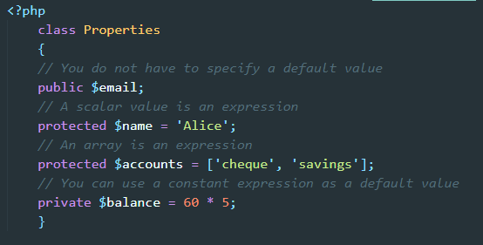
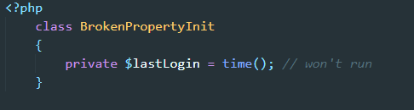
Instance Properties and Methods
Properties

Slide 8
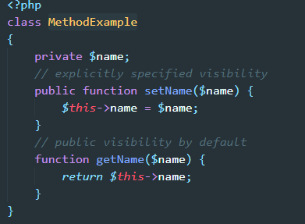
Instance Properties and Methods
Methods
Methods are functions within a scope construct. They are declared in a function by using a visibility modifier followed by the function declaration. If you omit a visibility modifier, the method will have public visibility.

Slide 9
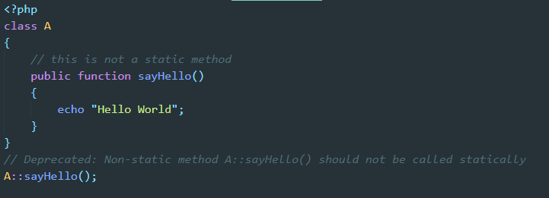
Static Methods and Properties
Declaring a method or property as static makes it available without needing a concrete implementation of the class.
Because a static method can be called without an instantiated object, the pseudovariable $this is not accessible in these methods. Static methods and properties may have any visibility modifier applied to them.
You should not call a non-static method statically. This will generate a deprecation warning:

Slide 10
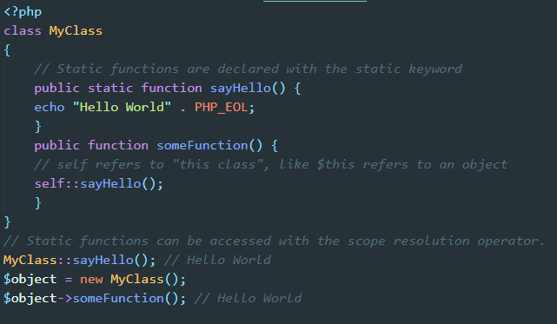
Static Methods and Properties
Referencing a static property or method is done using the scope resolution operator, which is a double-colon
When we reference a static property from within the class, we can use self, parent, or static to refer to it
When referencing the static class member from outside the class, you prefix the scope resolution operator with the name of the class. In the example, we referenced the static function with MyClass::sayHello().

Slide 11
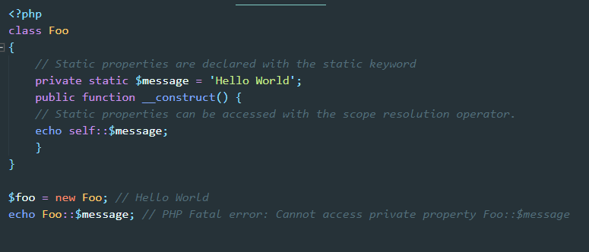
Static Methods and Properties
Static Properties
Static properties are also declared with the static keyword and can be accessed with the scope resolution operator.

Slide 12
Working with Objects
Copying Objects
If you want to create a copy of the object, you must use the clone() keyword.
<?php
// creating a shallow copy of an object
$objectCopy = clone $originalObject;
When cloning an object, PHP will try to execute the __clone() method in the object. You can override this method to include your own behavior for cloning an object. This method cannot be called directly

Slide 13
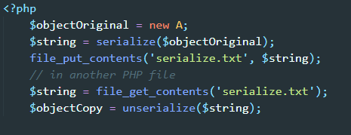
Working with Objects
Serializing Objects
Object serialization is accomplished with the serialize() and unserialize() functions. These functions support any type of PHP variable, except for resources.

Slide 14
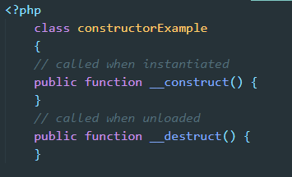
Constructors and Destructors
A constructor is a method that is run when an object is instantiated from a class. Similarly, a destructor is made when the object is being unloaded.

Slide 15
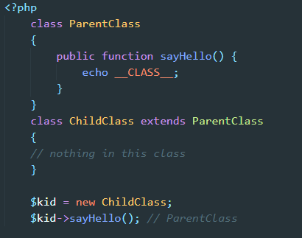
Inheritance
PHP supports inheritance in its object model. If you extend a class then the child class will inherit all of the non-private properties and methods of the parent class. In other words, the child will have the public and protected elements of the parent class. You can override them in the child class, but they will otherwise have the same functionality.
PHP does not support inheriting from more than one class at a time.
The syntax to cause a class to inherit is very simple. When declaring the class, we simply indicate the name of the class it is extending, as in this example:

Slide 16
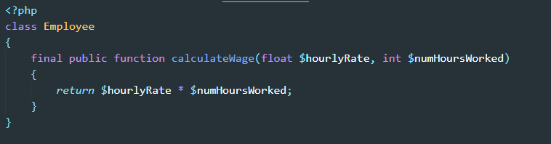
The final Keyword
PHP 5 introduced the final keyword. You can apply it either to a whole class, or to specific methods within a class. The effect of the final keyword is to prevent classes from being extended or methods from being overridden. The visibility of all final properties and methods is public.
Marking classes or functions as final helps you avoid mistakenly changing behavior when you extend a class.
PHP will issue a fatal error if you try to override a final method in a child class or if you try to declare a class that extends a class that is marked final.

Slide 17
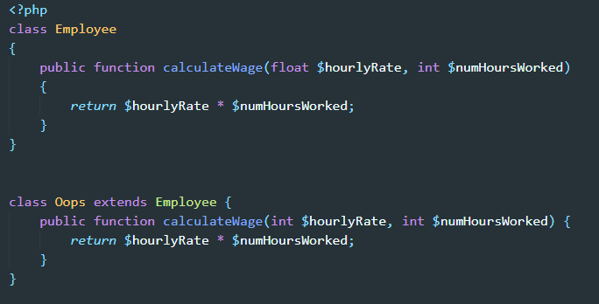
Overriding
A child class may declare a method with the same name as the parent class, providing that the method is not marked final in the parent

Slide 18
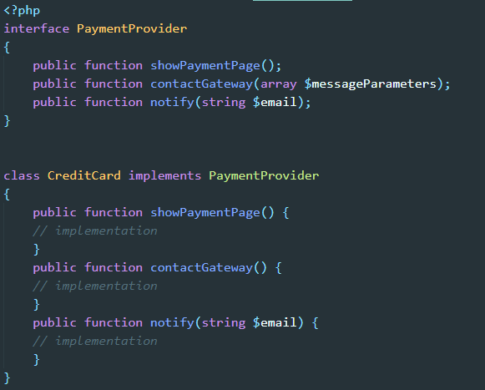
Interfaces
Interfaces allow you to specify what methods a class must implement without specifying the details of the implementation.
All methods in an interface must be declared as public and may not have any implementation themselves
Interfaces cannot have properties, but they can have constants.

Slide 19
Abstract Classes
PHP supports abstract classes, which are classes that contain one or more abstract methods. An abstract method is a method that has been declared but not implemented
Abstract classes are intended to be extended. A class that extends an abstract class must define all the methods that are marked abstract in the parent class. If the child class does not implement the methods, they must also be marked as abstract, and so the child class will also be abstract.
When a child class extends an abstract class, it must define the abstract methods with either the same or a less restrictive visibility.
The signature of the methods declared in the child class must match the abstract method’s signature. This means that the number and type of required (not optional) arguments to the method must be the same.
Private methods cannot be marked as abstract.

Slide 20
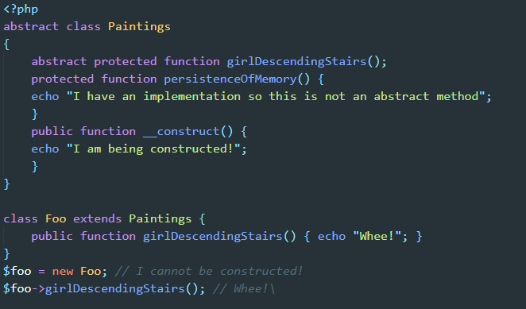
Abstract Classes

Slide 21
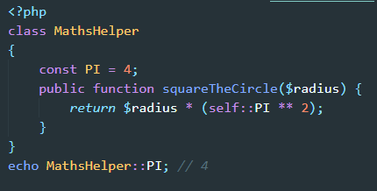
Class Constants
Class constants allow you to define such values on a per-class basis; they do not change between instances of the class. All objects created from that class have the same value for the class constant.
Class constants follow the same naming rules as variables but do not have an $ symbol prefixing them. By convention, constant names are declared in uppercase.
The value must be a constant expression, not (for example) a variable, a property, or a function call.
Class constants, like traditional constants, may only contain scalar values.

Slide 22
Magic (__*) Methods
PHP treats any method with a name prefixed by two underscores as magical. PHP calls these methods “magically” (without you needing to call them) at certain times of the object’s lifecycle. I like to think of them as being similar to hooks that are called on events. PHP calls the magic method when an associated event happens to the object
Magic methods only pertain to classes; they do not exist as stand-alone functions
There are 15 predefined magical functions and it is recommended to avoid naming other functions with the double underscore prefix.

Slide 23
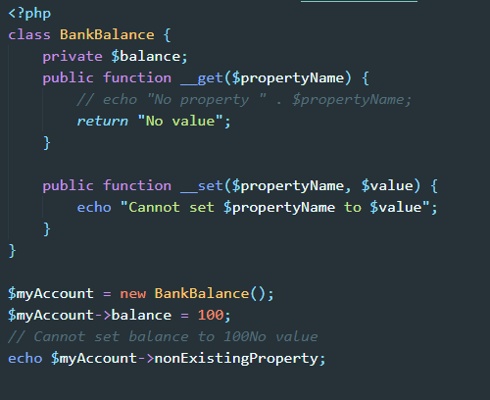
Magic (__*) Methods
__get and __set
These magic methods are called when PHP tries to read (get) or write (set) inaccessible properties.

Slide 24
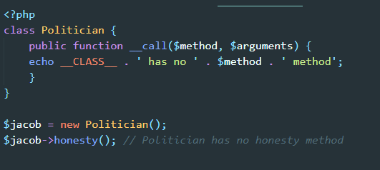
Magic (__*) Methods
__isset and __unset
The __isset() method is triggered by calling the isset() function or empty() on an inaccessible property.
The __unset() method is triggered by calling the unset() function on an inaccessible property.
__call and __callStatic
These magic methods are called if you try to call a non-existing method on an object.
The only difference is that __callStatic() responds to static calls while __call() responds to non-static calls.

Slide 25
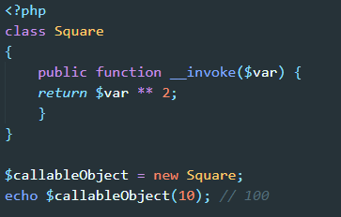
Magic (__*) Methods
__invoke
The magic method __invoke() is called when you try to execute an object as a function.

Slide 26
Magic (__*) Methods
We have dealt with the __construct() and __destruct() functions in the section on “Constructors and Destructors”.
We have dealt with __sleep() and __wake() in the section on “Serializing Objects”
We looked at __clone() when discussing “Copying Objects” and __toString() in the section named “Casting Objects to String”.

