Slide 1
Databases and SQL
Bài 9

Slide 2
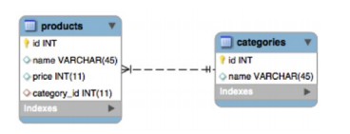
Database Basics
Keys:
Keys impose constraints, such as PRIMARY and UNIQUE.
A primary key can be defined on either a single or multiple columns.
It guarantees that each row in the database will have a unique value combination for the columns in the key
A table may have only one primary key. A foreign key can also be defined on either a single or multiple columns. It references the primary key on another table.

Slide 3
Database Basics
Indexes:
Indexes are data structures that are needed to implement the key constraint. Indexes make retrieving records faster.
The database engine will create a structure on disk or in memory that contains the data from the indexed columns.
Whenever you insert a row into a table, the indexes need to be updated. This adds an overhead to writing.
You cannot have a key without an index, but it is possible to index columns that are not keyed. You would do this in cases where you don't want to enforce uniqueness but do want to speed up SELECT statements that include these columns in their WHERE clauses.
The binding between keys and indexes is very tight and in MySQL they are considered synonymous.

Slide 4
Database Basics
Relationships:
Relationships are a core feature of relational databases. By declaring how tables are related, you can enforce referential integrity and minimize dirty data
Relationship | Description
One-to-one | One row in the parent table can reference exactly one row in the child table.
One-to-many | One row in the parent table can be referenced by many rows in the child table.
Many-to-many | Any number of rows in the parent table can be referenced by any number of rows in the child table

Slide 5
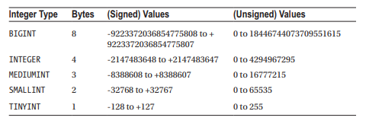
SQL Data Types
Numeric Types:
The types of integers vary in the amount of bytes that they take to store their value

Slide 6
SQL Data Types
Character Types: SQL allows for character to be stored either in fixed- or variable-length strings
A fixed-length string is always allocated the same number of bytes on disk. This can help speed up read performance in some database implementations. The trade-off is that if a string being stored in a fixed length data store is shorter than the number of characters allocated, you are storing more characters than you have to.
Variable-length strings can swell up to the limiting size given to them. The database engine allocates storage according to the length of the string. Database implementations will store the length of the string being stored. This will be at least one character to indicate the end of the string, but in some engines each variable string will incur heavier storage overhead.

Slide 7
Working with SQL
Creating a Database and Table:
The CREATE statement can be used to create databases and tables. Creating a database is simple; you just specify the name of the database:
When creating a table, you can specify a list of the columns you want to store in it. For each column, you specify the name, data type, and attributes.
CREATE DATABASE mydatabase;
CREATE TABLE IF NOT EXISTS users (
id int unsigned NOT NULL AUTO_INCREMENT,
name varchar(255) NOT NULL,
email varchar(255) NOT NULL,
password varchar(60) NOT NULL,
PRIMARY KEY (id),
UNIQUE KEY users_email_unique (email)
);

Slide 8
Working with SQL
SQLDropping Database and Tables
The inverse of CREATE is the DROP statement.
DROP TABLE category;
DROP DATABASE mydatabase;

Slide 9
Working with SQL
Retrieving Data
The SELECT statement is used to retrieve data. The syntax for SELECT can be very complicated and is one of the statements that differs the most between vendors
You can specify multiple column names separated by commas or use the wildcard * to receive all columns
SELECT name
FROM products
WHERE price > 100
ORDER BY price DESC

Slide 10
Working with SQL
Inserting New Data:
The INSERT statement is used to create new rows in the database. You will need to provide a list of the columns and the values to insert to them. Columns that are marked NOT NULL are mandatory and must have a value specified when you create the row.
INSERT INTO products
(name, price, category_id) VALUES
('cheeseburger', 100, 3)

Slide 11
Working with SQL
Updating Data:
The UPDATE statement accepts a list of values similar to the INSERT statement, as well as an optional WHERE clause similar to the SELECT statement
You must specify what values to update the existing data to, and the criteria for the rows that must be updated.
UPDATE products
SET price = price + 100
WHERE category_id = 3;

Slide 12
Working with SQL
Aggregating Data:
You can use the database to perform calculations and send you the results.
Statement | Returns
AVG | Average value of the data values
SUM | Total of all the data values found
COUNT | How many records were found
DISTINCT COUNT | How many unique records were found
MIN | The lowest value in the data set
MAX | The highest value in the data set

Slide 13
Working with SQL
Grouping Data:
You can tell SQL to group data by a column or combination of columns before returning it to you. This is often useful in conjunction with the aggregating functions
SELECT email, SUM( sales_value )
FROM `transactions`
GROUP BY email

Slide 14
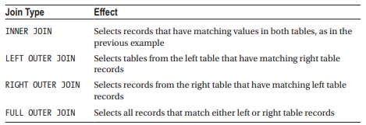
Joins
Joins are used to connect tables based on supplied criteria. This lets you retrieve information from related tables.
Join Types:

Slide 15
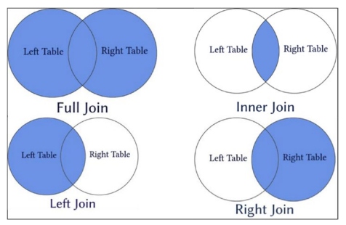
Joins
Join Types

Slide 16
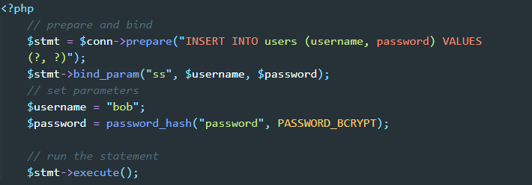
Prepared Statements
When you issue a command to a SQL engine, it must parse the command in order to execute it. After the statement has been executed, SQL will discard the compiled code with the result that repeated calls with the same SQL command will need to be parsed individually. Obviously, this results in duplicated effort.
You can save SQL from having to repeat its efforts by using prepared statements that become parsed code templates that SQL stores for multiple reuse.
Prepared statements also offer significant security advantages. Parameters are bound to the prepared statement, and are not included as part of the code string

Slide 17
Transactions
A transaction is a set of SQL statements that will either all succeed or else have no effect
In summary, a transaction is a set of SQL statements that must complete successfully in an “all or nothing” manner. After it runs the database must be in a consistent state and must be recoverable from error.

Slide 18
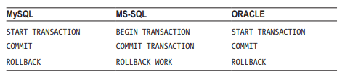
Transactions
The syntax for transactions varies between vendors, but there are three important statements:
One statement will mark the beginning of the transaction block. The SQL statements following this will be part of the transaction
There are two statements that can end a transaction. One of them will tell SQL to go ahead and make all the changes that the transaction is making.
The other end statement will tell SQL that for whatever reason you want to abandon the transaction and rather revert to the state the database was in when the transaction started.

