Slide 1
Faculty of Information Technology
DEVELOPMENT OF A MOBILE MUSIC STREAMING APPLICATION WITH INTEGRATED RECOMMENDATION AND MUSIC SHARING
Application name: TramCamXuc
Supervisor: ThS Nguyen Thi Hong Luong
Students: Do Minh Hung
Tran Huu Phuc
Ho Chi Minh, May 2026

Slide 2

Contents
1.
Project Introduction
2.
Analysis & Design
3.
Demo
4.
Conclusion & Future Development

Slide 3
1.
Project Introduction

Slide 4
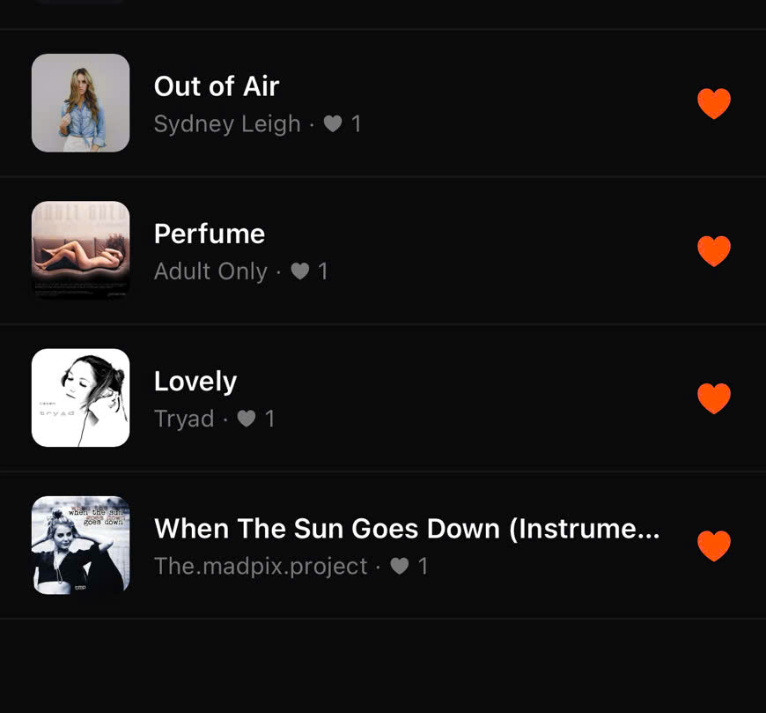
Reasons
TramCamXuc
Most popular music applications mainly rely on trending charts or manual playlists, which do not fully reflect users’ individual preferences and offer limited community interaction.
Combining an intelligent recommendation system with a social-oriented music ecosystem.
Utilizes user behavior data to provide personalized music suggestions while enabling users to connect through song sharing and artist following.
Focuses on a scalable architecture and high performance to ensure a smooth user experience, improve user satisfaction, and set a foundation for next-generation music platforms.

Slide 5








Technology
Back-end
Front-end
Database
Storage

Slide 6



Key Features
Admin
User
Artist
User Management
Sign in & Sign up
Songs Management
Music Content Management
Search & Discover
Album Management
Artist Management
Streaming Music & Get Recommendations
Create Music with AI
Music Content Management
Playlist Management
Profile Management
Subscription Management
Social Media Interaction
View Data Analysis
Get Advertising
Advertising Management
History & Statistics
Payment Subscription
Register Artist

Slide 7
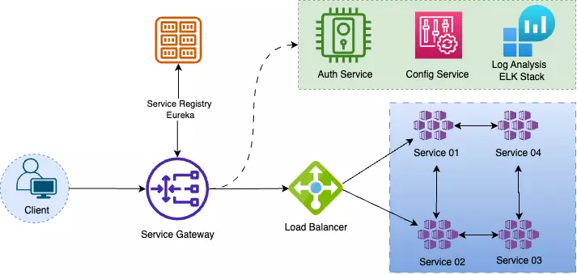
System Architecture
The system is decoupled into independent, fine-grained services rather than a single, bulky Monolithic unit.
Each service can be scaled horizontally and deployed independently based on its specific resource demands.
A failure in one module does not bring down the entire streaming platform, ensuring high system availability.
Allows using the best tool for the job.
Our Microservices architecture leverages the strengths of both Spring Boot (Backend Core) and Python(Recommendation) to optimize system performance and specialized processing.

Slide 8
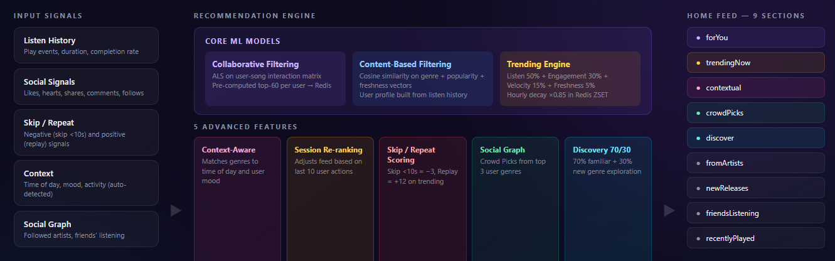
Recomendation System

Slide 9
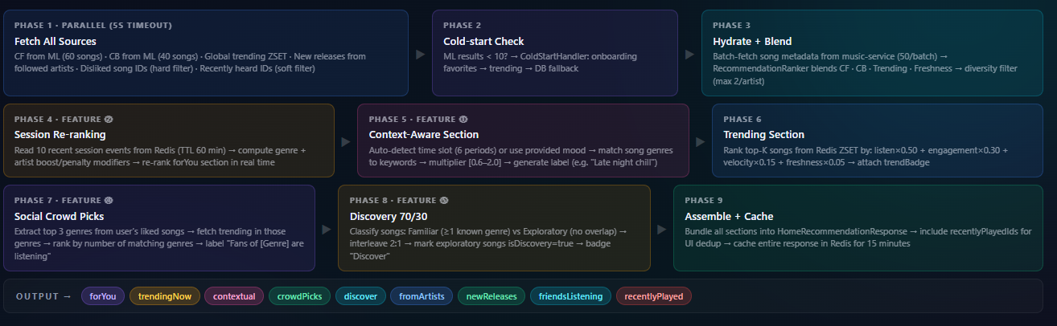
Recomendation System (cont)

Slide 10
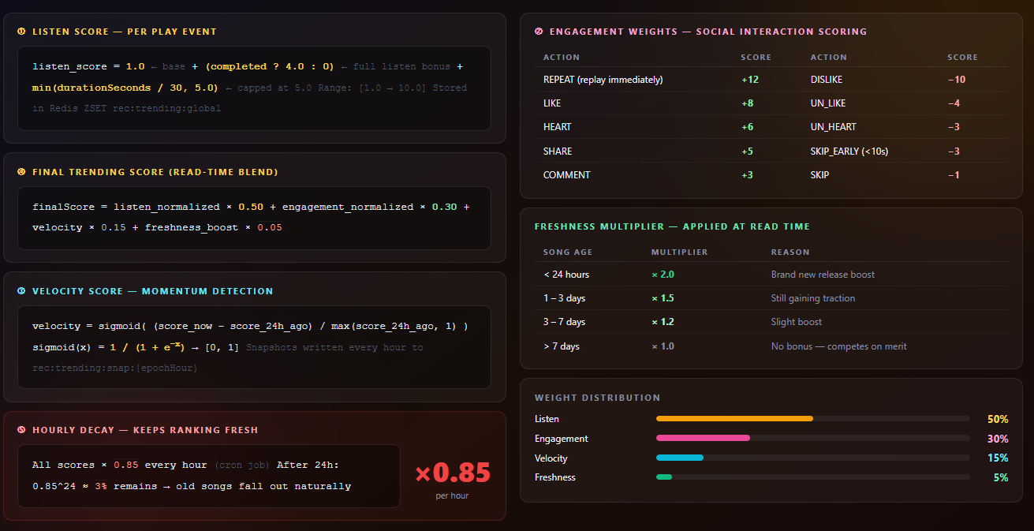
Recomendation System (cont)

Slide 11
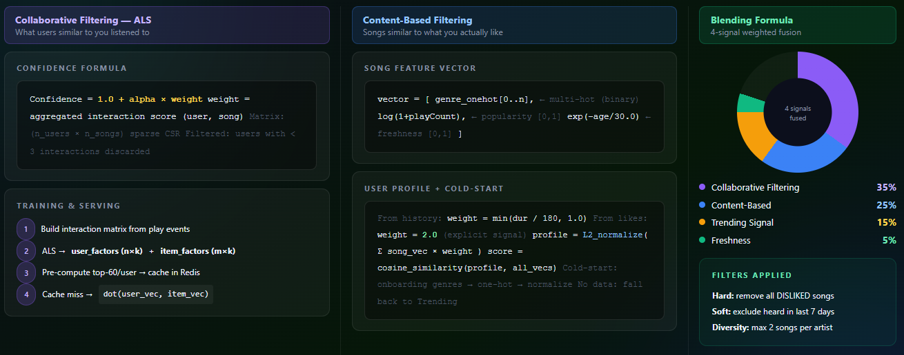
Recomendation System (cont)

Slide 12
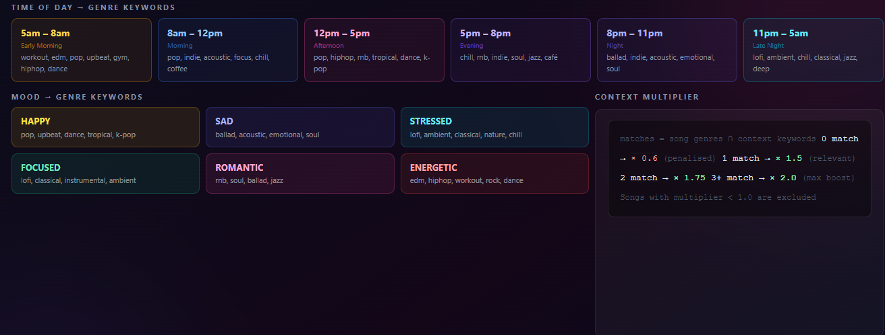
Recomendation System (cont)

Slide 13
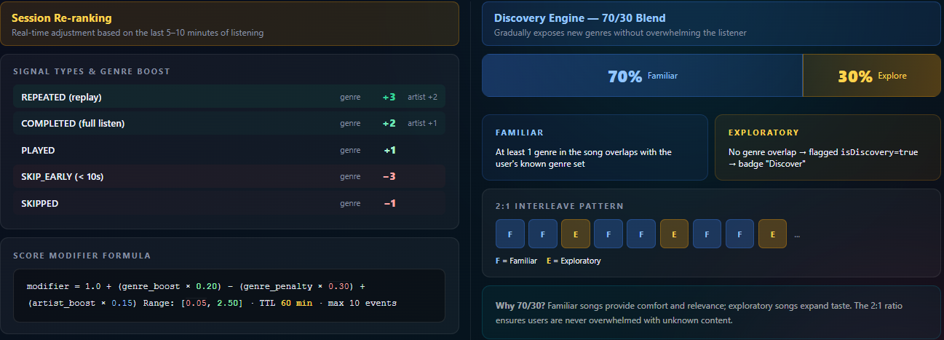
Recomendation System (cont)

Slide 14
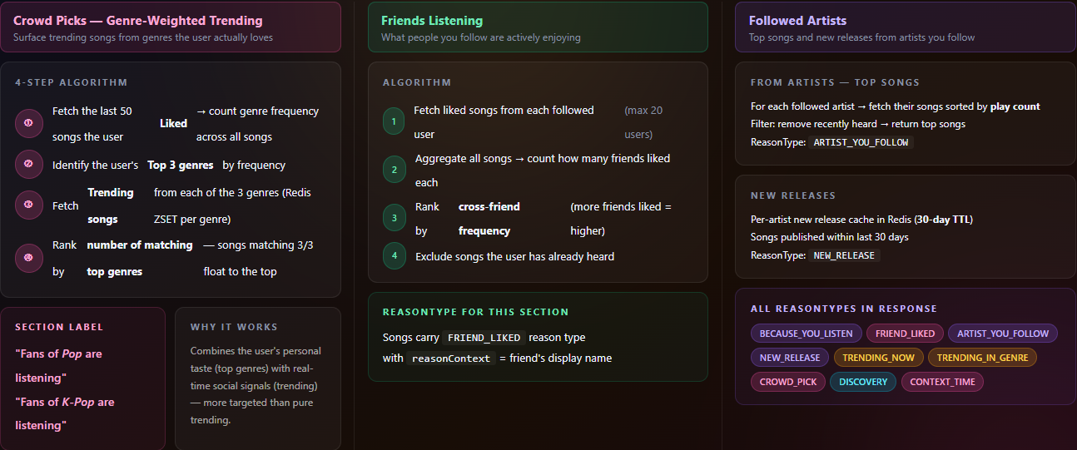
Recomendation System (cont)

Slide 15
2.
Analysis & Design

Slide 16
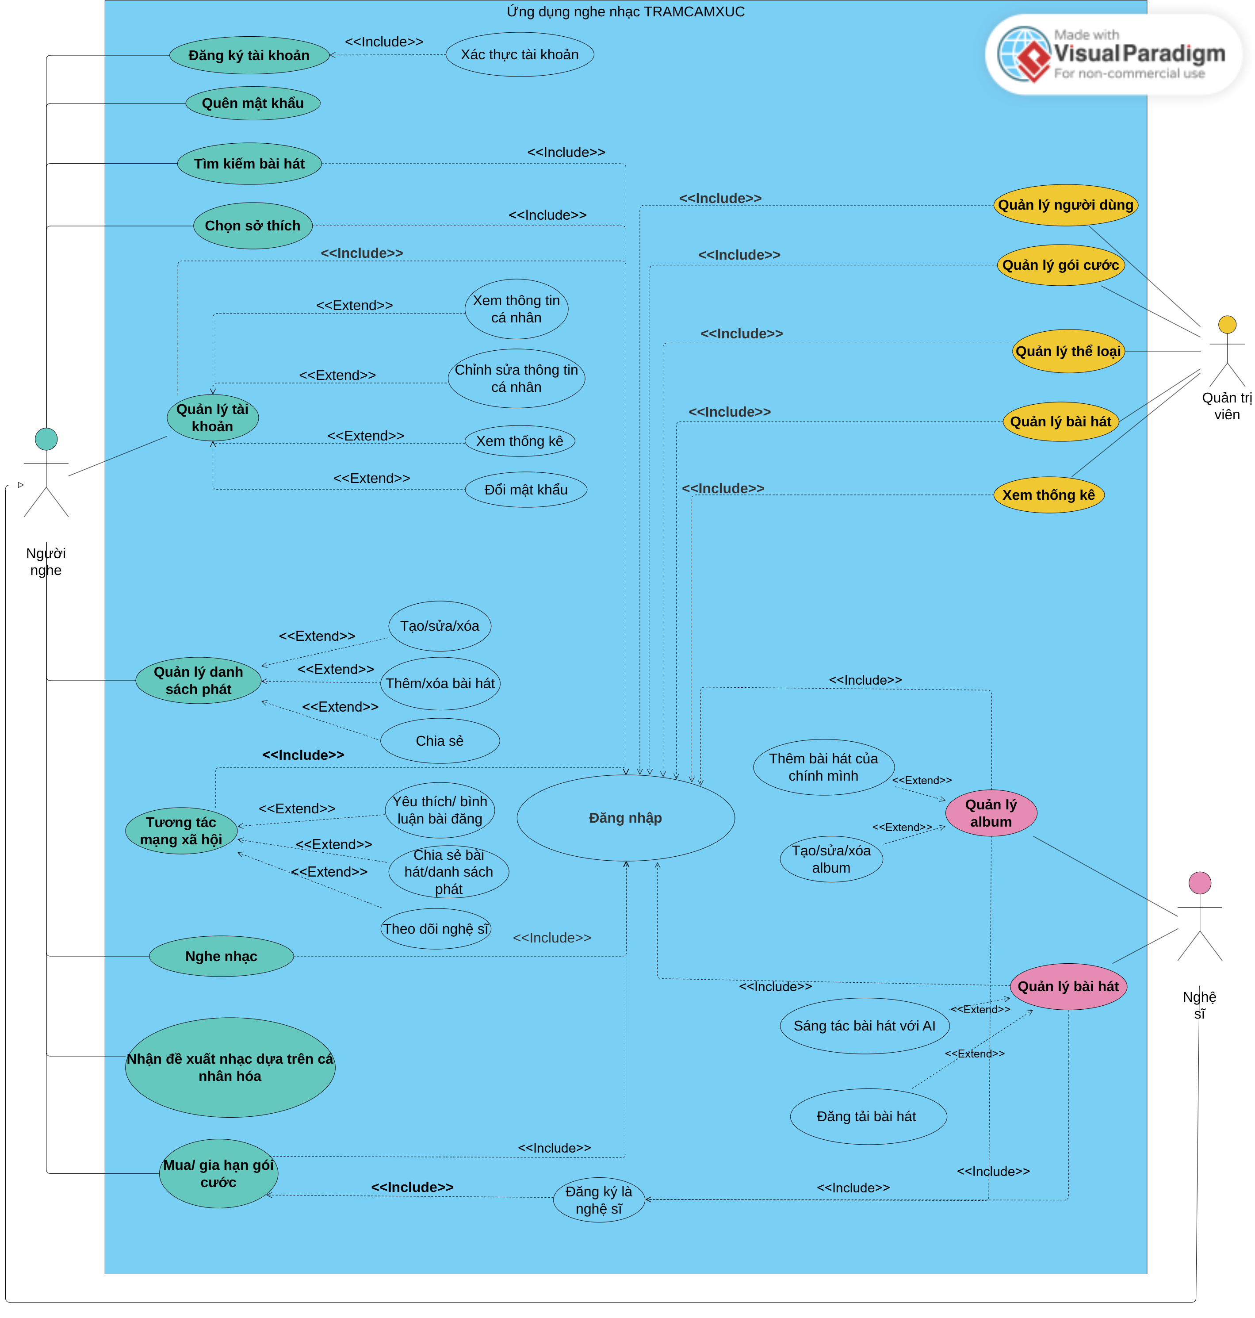
General Use Case Diagram

Slide 17
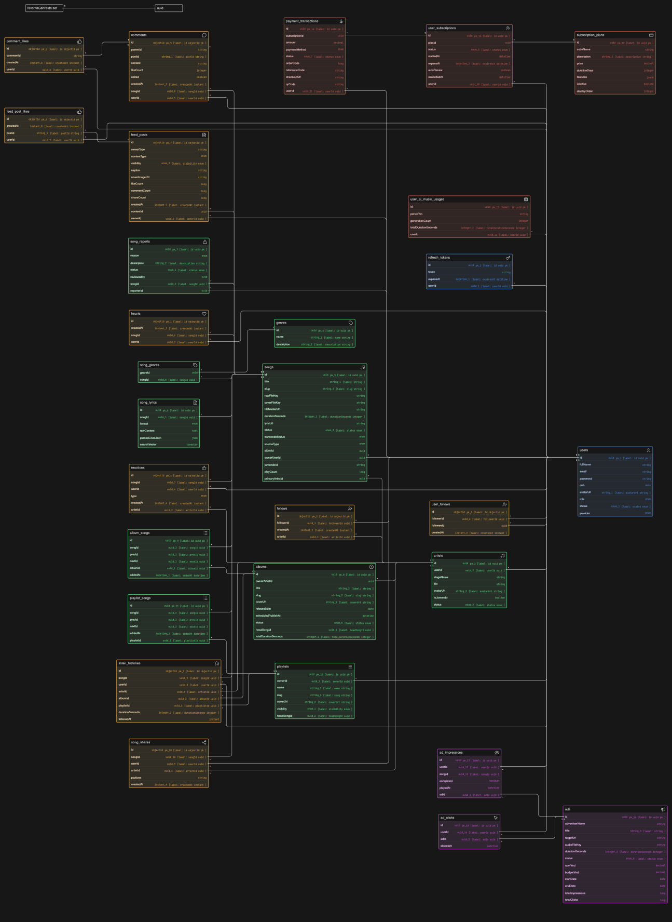
Physical Data Model

Slide 18
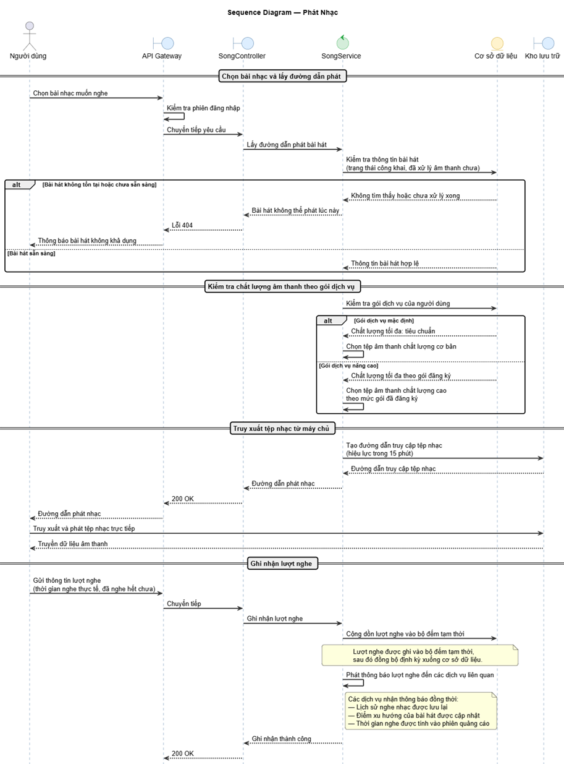
Sequence Diagram: Streamming Music

Slide 19
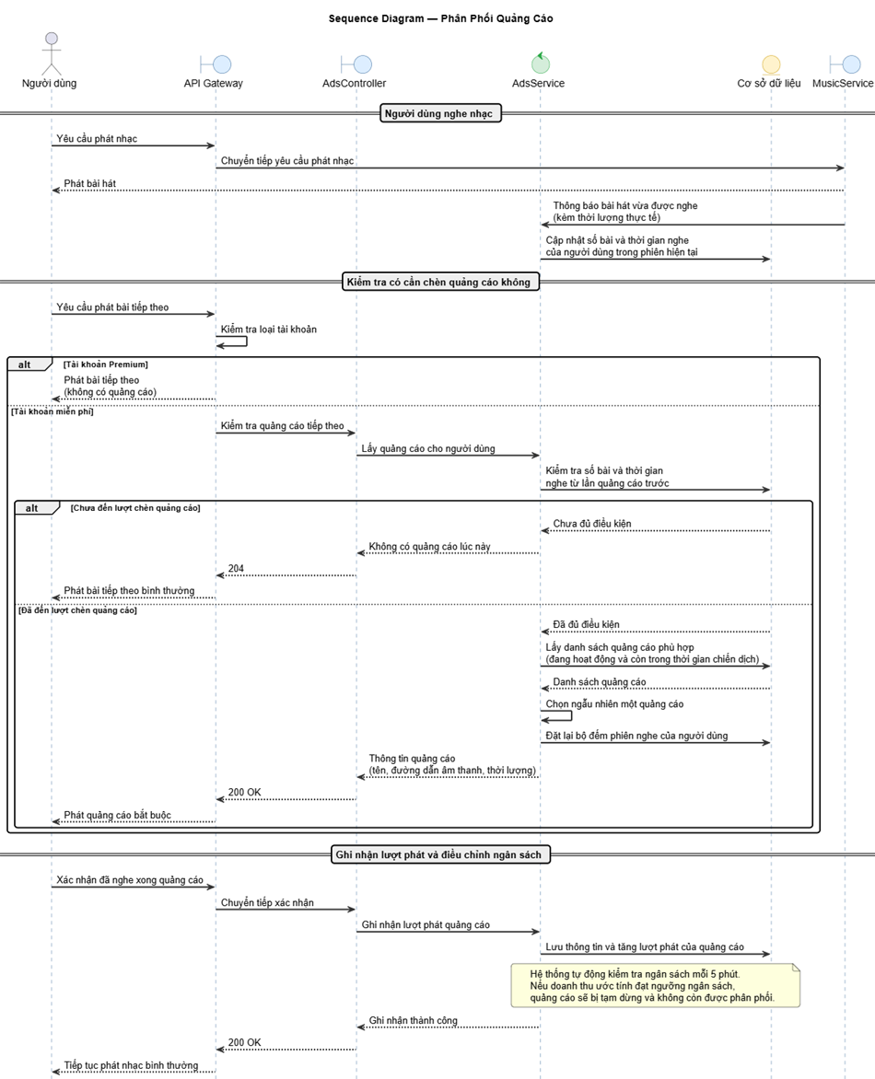
Sequence Diagram: Advertisement

Slide 20
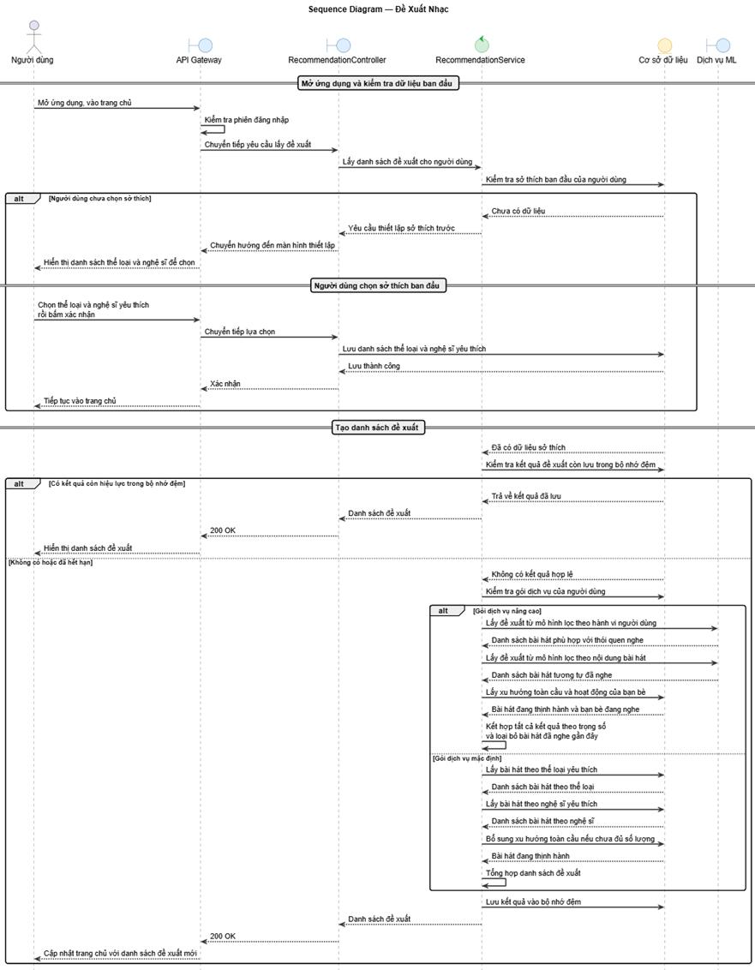
Sequence Diagram: Recommendation

Slide 21
3.
Demo

Slide 22
4.
Conclusion, Limitations & Future Development

Slide 23
Limitations
System analysis and design still face feasibility challenges, leading to issues in business workflows.
The music recommendation system requires a large amount of user data to ensure accurate and personalized suggestions.
Handling offline music playback remains a challenge.
Using a Microservices architecture increases development and deployment complexity, especially in service communication, data synchronization, request management, and error handling.
Due to copyright restrictions and API limitations from platforms like Spotify and SoundCloud, the system currently uses Jamendo APIs. However, its library mainly contains international and royalty-free music, which does not fully meet the Vietnamese market demand.

Slide 24
Future development
Integrate AI-powered music recommendations based on user behavior and listening preferences to provide more personalized playlists and song suggestions.
Strengthen security and optimize system performance to ensure stable operation and data safety as the number of users grows.
Support independent artists by allowing them to upload, manage, and promote their music on the platform.
Integrate an intelligent chatbot to help users search for songs and receive music recommendations based on mood, genre, or context.
Enhance the data analytics system to improve processing speed, optimize displayed content, and deliver a better user experience.

Slide 25
THANK YOU!

