Slide 1
MCH Campus Hackathon
3&4 February 2018, Galgotias University Greater Noida
Make for India

Slide 2
Int_elegance
Rishabh Rawat
Prakher Pratyush
Amit Chaudhary
Sargam Sharma

Slide 3
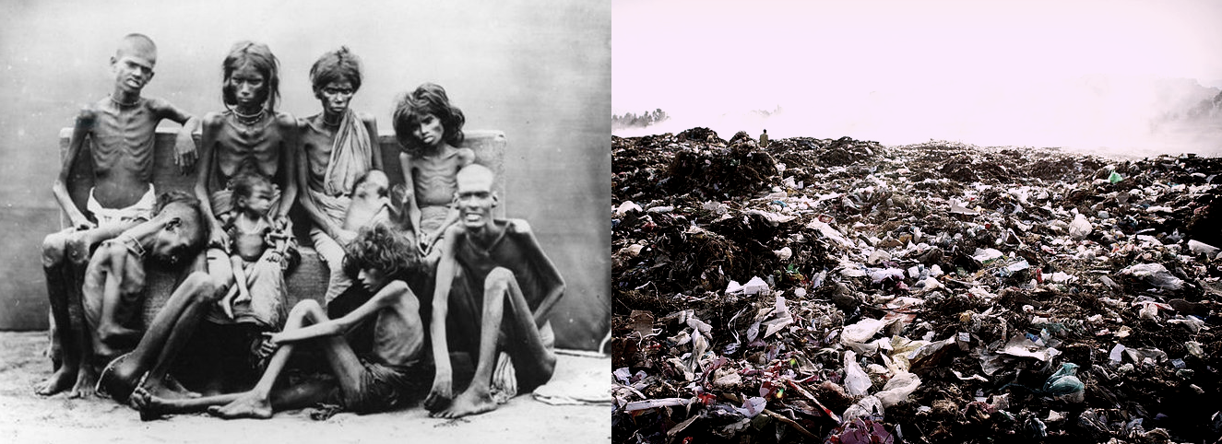
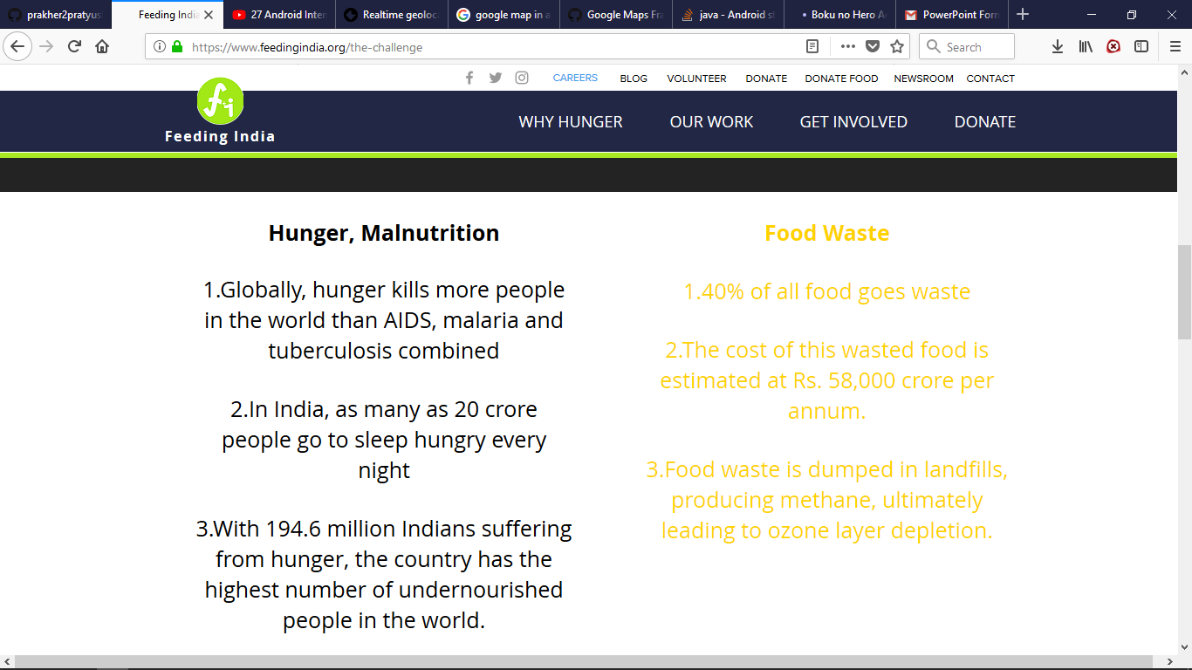
Problem Statement
Food Waste
1.40% of all food goes waste
2.The cost of this wasted food is estimated at Rs. 58,000 crore per annum.
3.Food waste is dumped in landfills, producing methane, ultimately leading to ozone layer depletion.

Slide 4
Problem Statement
In India, 10 million people die every year of chronic hunger and hunger-related diseases and 58000 crore INR worth of food go to waste per annum. We are facing hunger and food wastage at a same time. We have resources but we don’t have the correct infrastructure to channelize it.

Slide 5
Vision
Our vision is to bridge the difference between two poles of our society i.e. under-privileged people and over-privileged people. No one will go to sleep hungry and not a grain of food will go in waste, is our Goal.

Slide 6
UI Details
Information about application in form of Sliders (View Pager).
Login page is One Time Google Sign in for both Donor and NGO.
Index page has two text views having onClick function to select between Donor and NGO.
Donor Page has different values in Relative and Linear Layout to get details of Donor and Food.

Slide 7
UI Details
Donor Location page has Google map to locate Donors’ location.
NGO page has information of near by Donors.
Ones food is collected it will be removed from list.
Also after certain time Donor request will be removed.

Slide 8
Technology Used
Front End
IDE
Android Studio 3.0.1
Language
Java
XML
Back End
Firebase APIs
Real time Firebase Storage

Slide 9
Business Model
Key Clients :
Feeding India
Robin Hood Army
Mera Parivar
Roti Bank
Annakshetra
R. B. Shivakumar
Shelter Don Bosco
Santhimandiram

Slide 10
Business Model
Key Activities :
Collect information from Donor(Name, Contact Number, Time, Photograph and Description of Food).
Pass this information to nearest NGO.
There will be a time constraint. After that Donor request will be automatically terminated.
After collection of Food Donor request will be removed.

Slide 11
Business Model
Key Resources :
Hostel Mess
Restaurants
Parties
Weddings
Android Application
Firebase Real Time Database

Slide 12
Business Model
Value Proposition :
Provide information of good quality left over food to NGOs.
Provides a very user friendly channel between Donor and NGO.
Reduce wastage of food and contribute towards the problem of Hunger at the same time.
Gives satisfaction to Donors.

Slide 13
Business Model
Cost Structure :
Salaries
Play Store cost
Marketing
Revenue Stream :
Token amount from NGOs.
Donation

Slide 14
Execution Plan
Develop Android application
Make UX/UI for android application
Set up Real Time Database using Firebase.
Perform testing and debugging.

Slide 15
Execution Plan
Make a client base
Before deploying the application we must have a client base.
Here, our Target Client will be NGOs. Specially NGOs like Feeding India, Robin Hood Army etc.
We will charge these NGOs a token amount and in return allow these NGOs to use our application to get donor.
Token amount will be as minimum as possible.

Slide 16
Execution Plan
Deploy the Application on Android Play Store.
Advertise application
Television Advertisements
Social Media
Organize Fund Raising Activities. These are a great source of advertisement as well as get donations.

Slide 17
Plan and Timeline
1 Month : Research
2 Months : Development
1 Month : Testing
1 Month : Creating a basic Client Base
1 Month : Deployment of Beta version and user testing
Deploy Updated Application

Slide 18
Plan and Timeline
Advertisement
Television Advertisements
Fundraising Events
Social Media
You Tube
Facebook

