Slide 1

DoP – User group
Welcome
1 meeting: Shiny – Interactive visualisation
(Thursday the 25 of May)
2 meeting: Rmarkdown and ggplot2 – Modern science reporting
(Thursday the 30th of June)
3 meeting: …?
(Thursday the 28th of July)

Slide 2
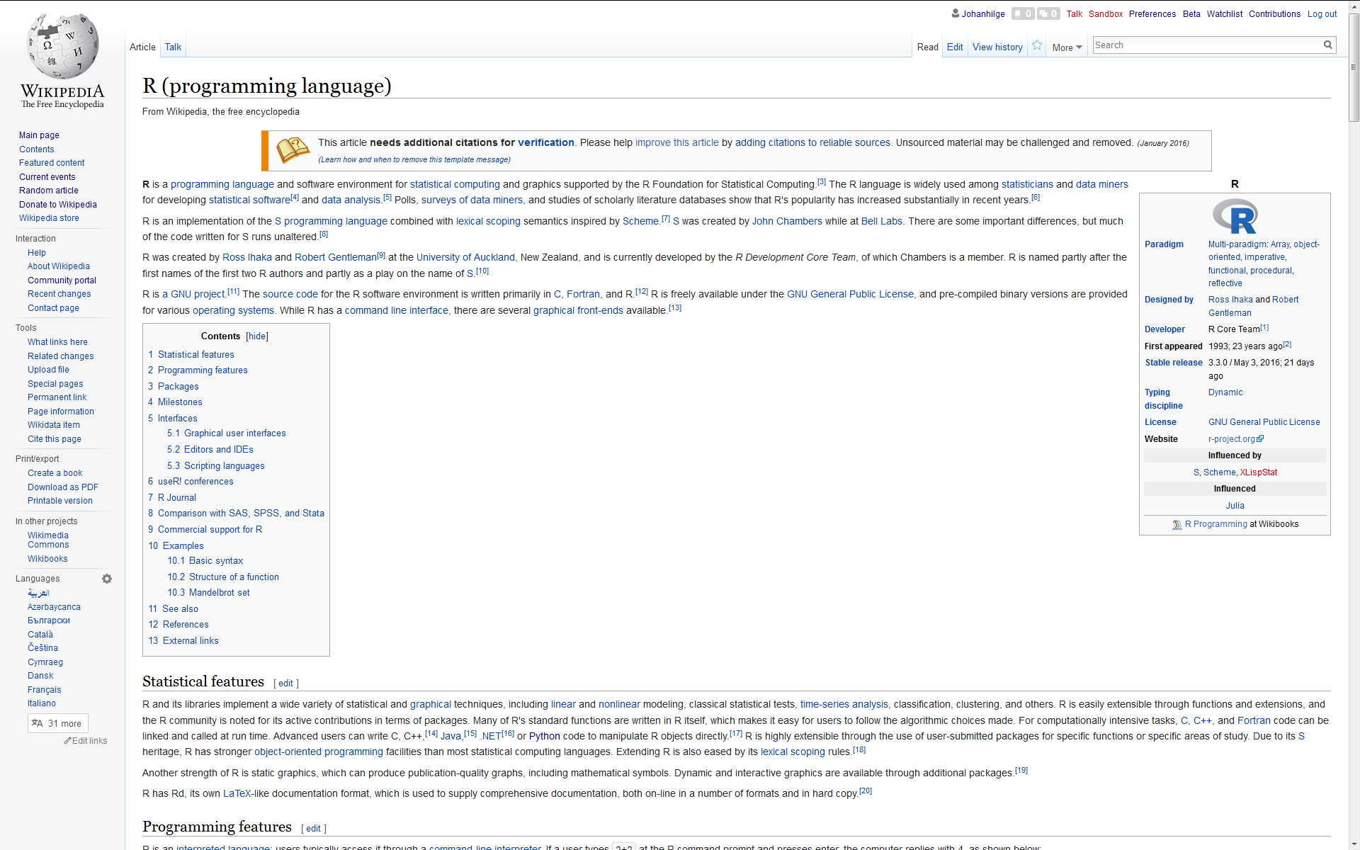
What is R?

Slide 3
Why use R?
Statistical Analysis (Regression, time-series, geo-spatial, you name it..)
It is a programing language
Data visualisation
Data mining, classification and clustering
Machine learning
Unlimited possibilities
Free and popular

Slide 4
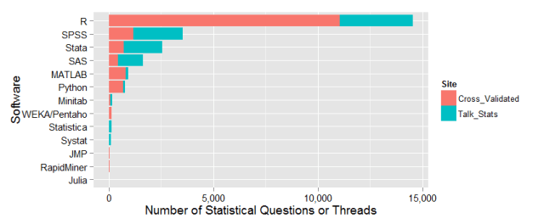
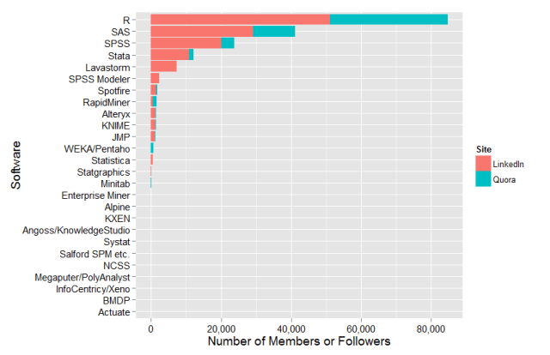
Data from 2015: http://r4stats.com/articles/popularity/

Slide 5
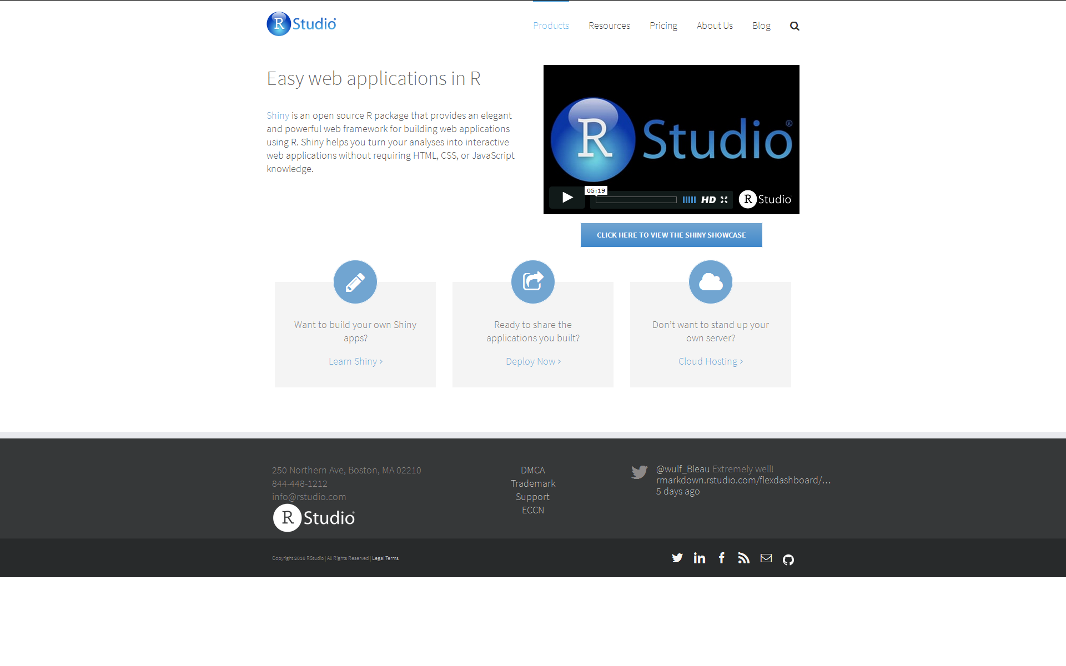

Slide 6
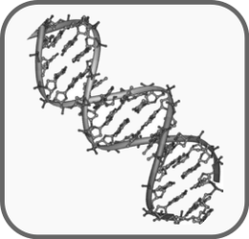


Exploring correlation and regresion
With R-shiny and psychiatric + genetics data
Schizophrenia polygenetic score

Slide 7
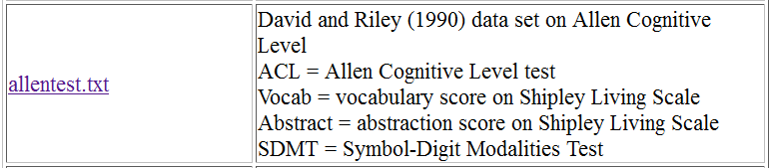
Simple example with public data
http://sites.stat.psu.edu/~xzhan/stat501/summer04/data/data.htm

Slide 9
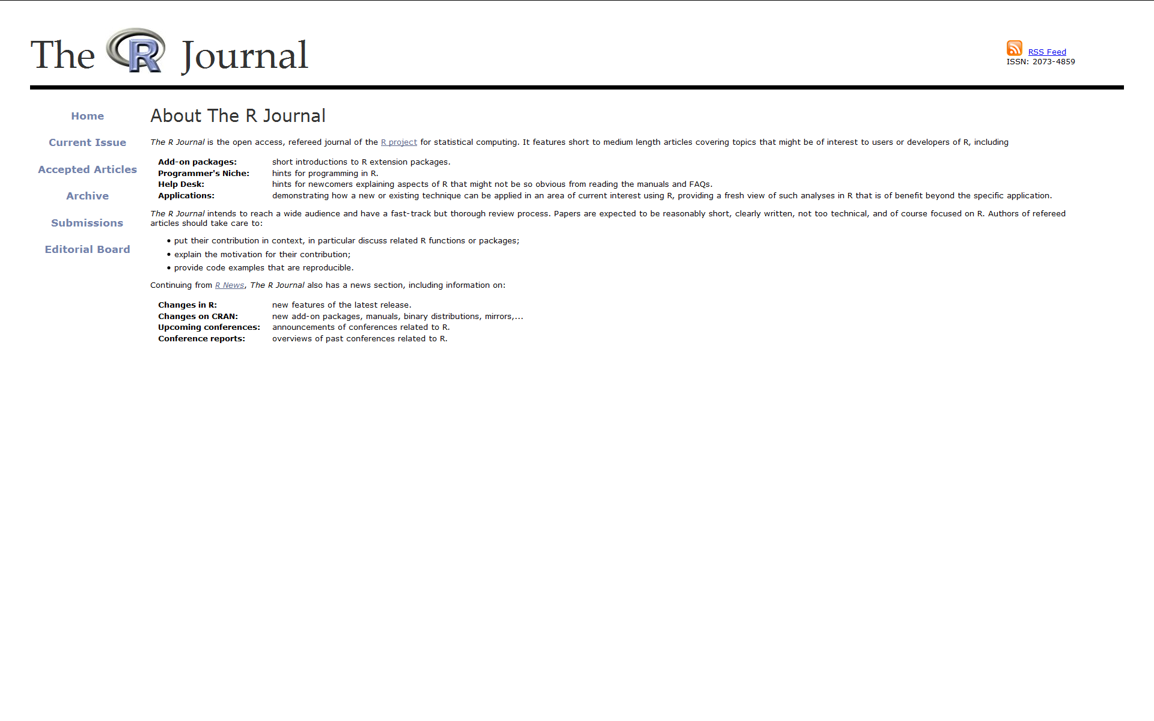
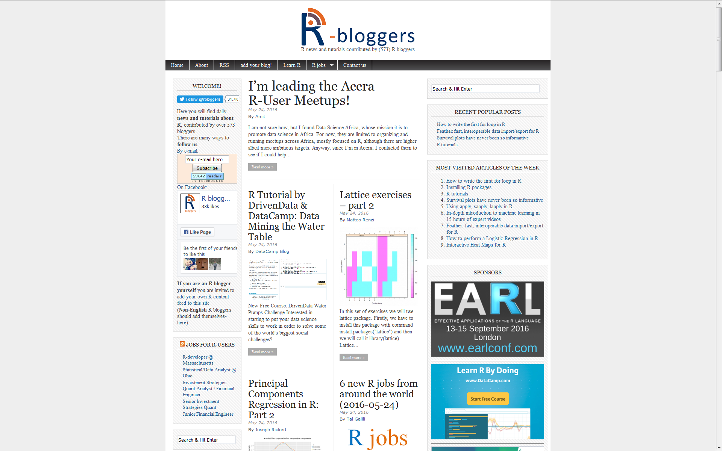
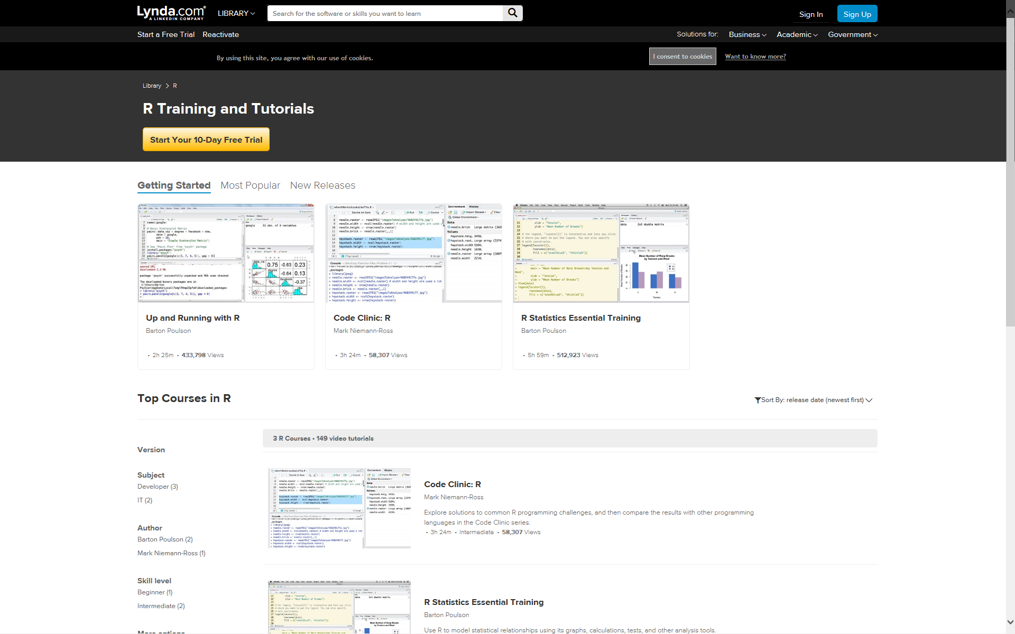
Read more about R
The R journal
https://journal.r-project.org/
R-bloggers
http://www.r-bloggers.com/
Learn more R
Lynda.com free for UCL staff
https://www.lynda.com/R-training-tutorials/1570-0.html

Slide 10
Learn more about Shiny
Get the code at our Github page
https://github.com/UCLDoPRusers
Follow the R-Studio Shiny tutorial
http://shiny.rstudio.com/tutorial/
Learn more R
Lynda.com free for UCL staff
https://www.lynda.com/R-training-tutorials/1570-0.html

Slide 11
DoP – User group
Welcome
1 meeting: R-shiney – interactive visualisation
(Thursday the 25 of May)
2 meeting: Rmarkdown and ggplot2 – Modern science reporting
(Thursday the 30th of June)
3 meeting: …?
(Thursday the 28th of July)

