Slide 1

DoP – User group
Welcome
1 meeting: Shiny – Interactive visualisation
(Thursday the 25 of May)
2 meeting: Rmarkdown and ggplot2 – Modern science reporting
(Thursday the 30th of June)
3 meeting: Curl and getting data off the web
(Thursday the 28th of July)

Slide 2
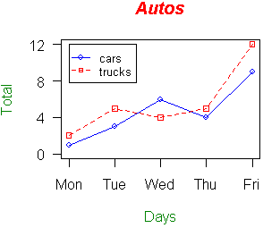
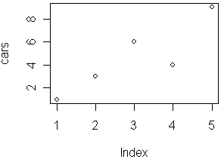
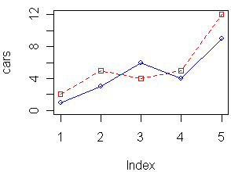
Base Plotting in R?
One of the best features of R is its plotting capability
Base plotting in R is fine and can produce brilliant graphics
Often quite time consuming requiring lots of user input
Can be fiddly

Slide 3
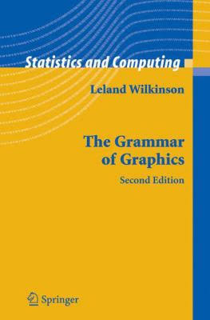
ggplot2
ggplot is based on the grammar of graphics
Plotting based on principles of grammar
Aim is to gain deep insight into data structure

Slide 4
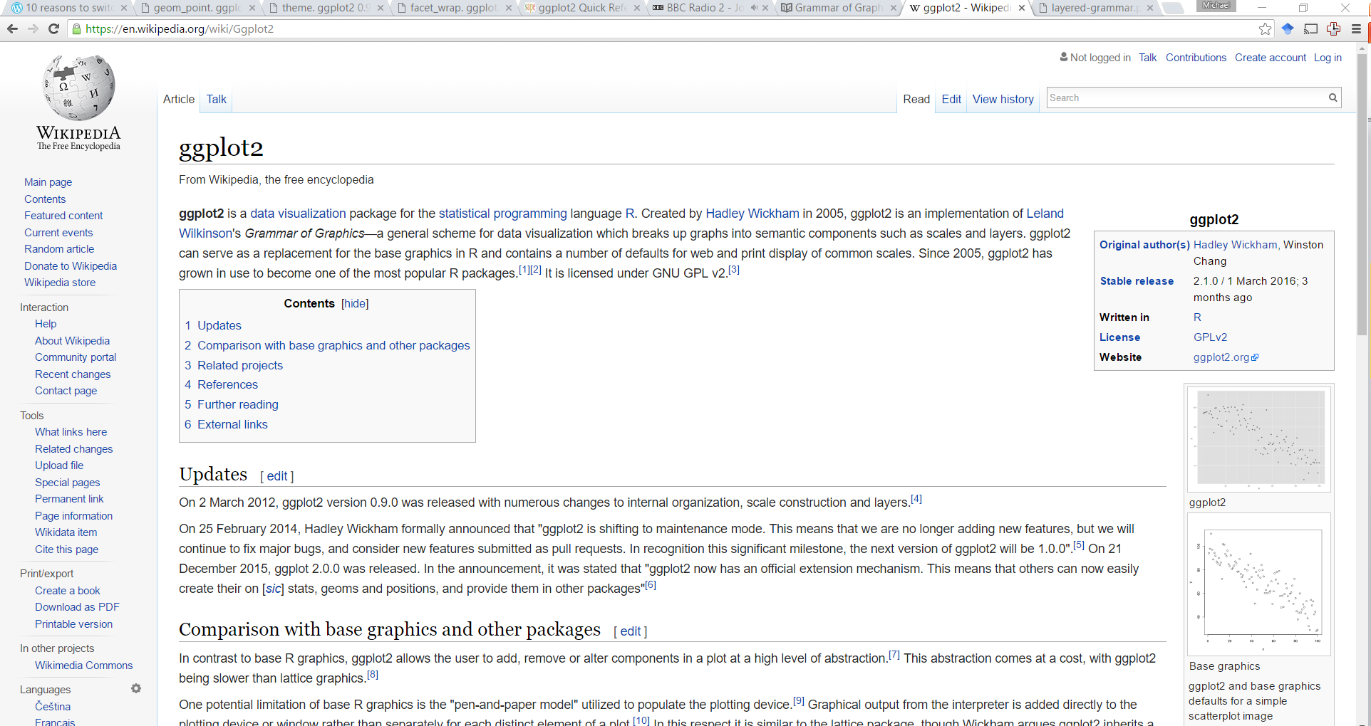
ggplot2

Slide 5
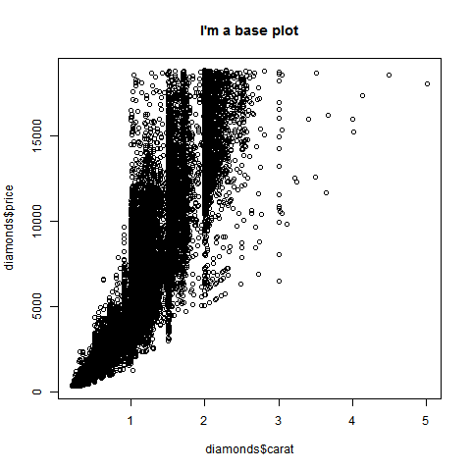
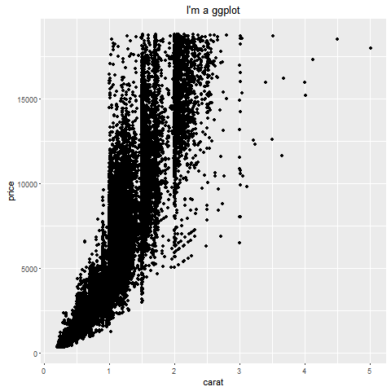
Why use ggplot?
Default plots are better looking

Slide 6
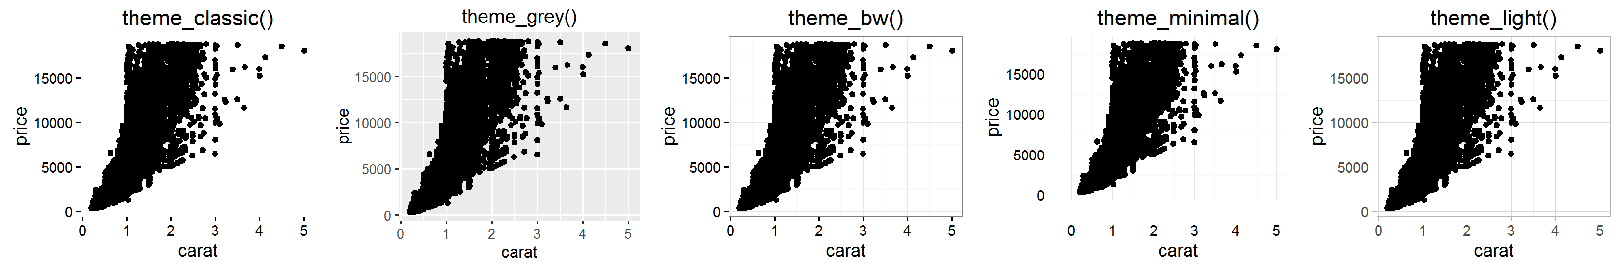
Why use ggplot?
Easy to modify plot attributes using theme elements

Slide 7
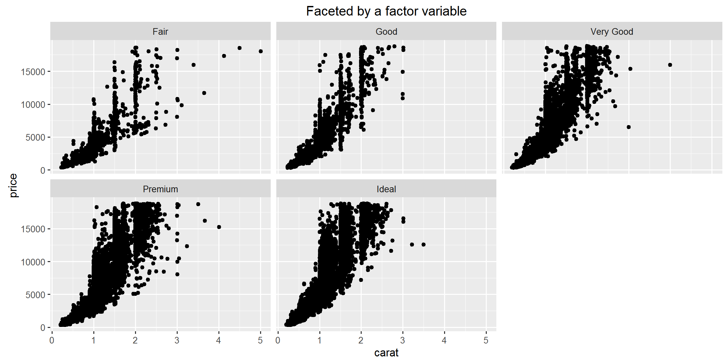
Why use ggplot?
Faceting

Slide 8
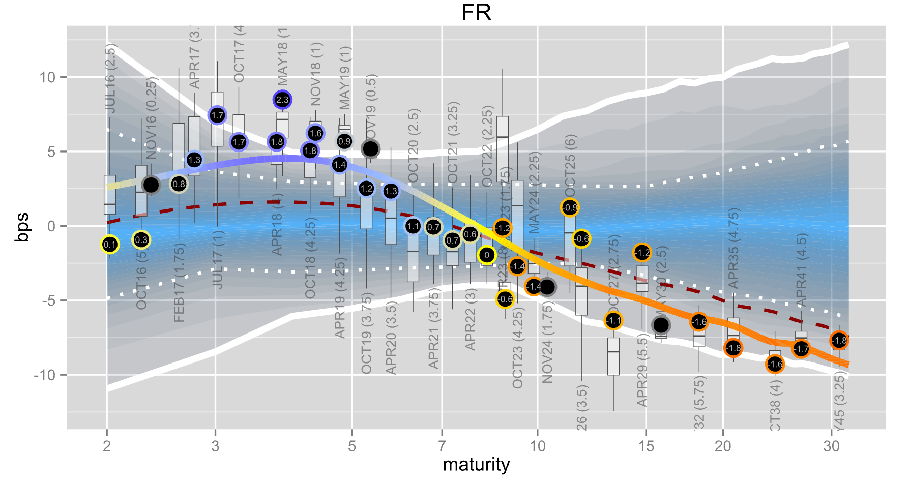
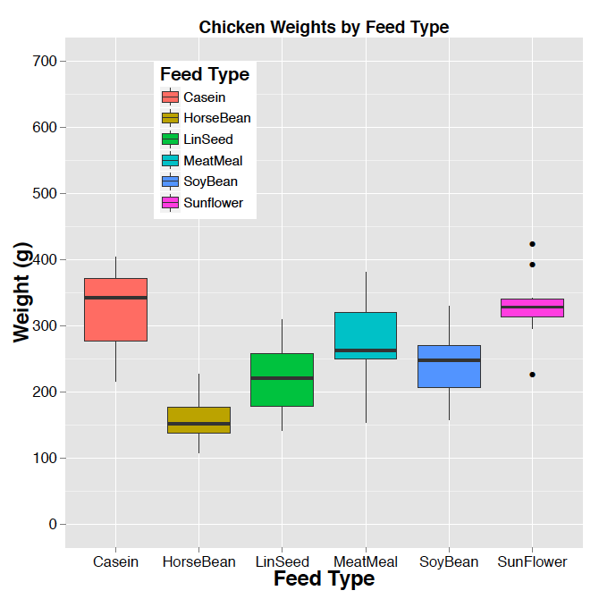
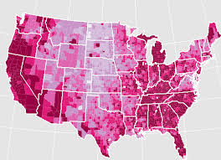
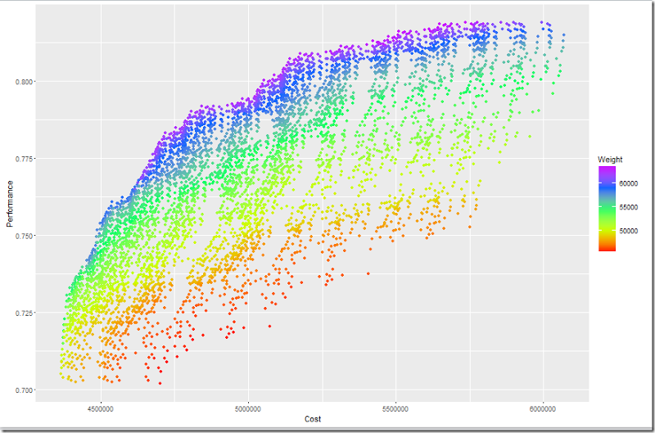
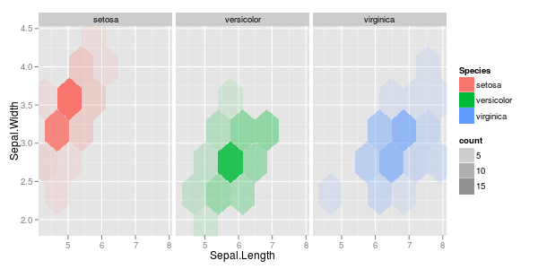
Why use ggplot?
Only limited by imagination!

Slide 9
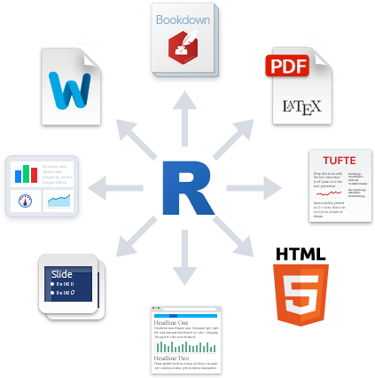
Rmarkdown
R Markdown is an authoring format that enables easy creation of dynamic documents, presentations, and reports from R.
R Markdown documents are fully reproducible
R Markdown has many available output formats including HTML, PDF, MS Word

Slide 10
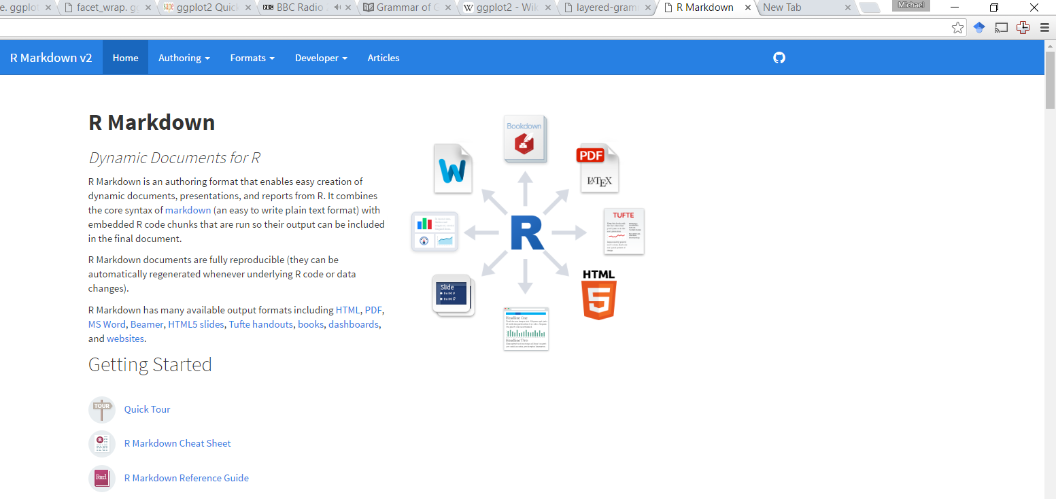
Read more about Rmarkdown
The R-studio website
http://rmarkdown.rstudio.com/

Slide 11
DoP – User group
Welcome
1 meeting: Shiny – Interactive visualisation
(Thursday the 25 of May)
2 meeting: Rmarkdown and ggplot2 – Modern science reporting
(Thursday the 30th of June)
3 meeting: Curl and getting data off the web
(Thursday the 28th of July)

