Slide 1

DoP – User group
Welcome
5 meeting: Theme undecided
(Thursday the 25 of August 15:30)

Slide 2
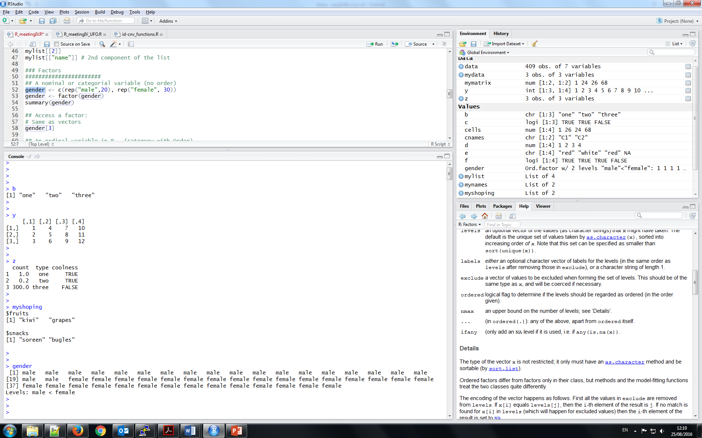
Data types
VECTOR
MATRIX
DATA.FRAME
LIST
FACTOR

Slide 3
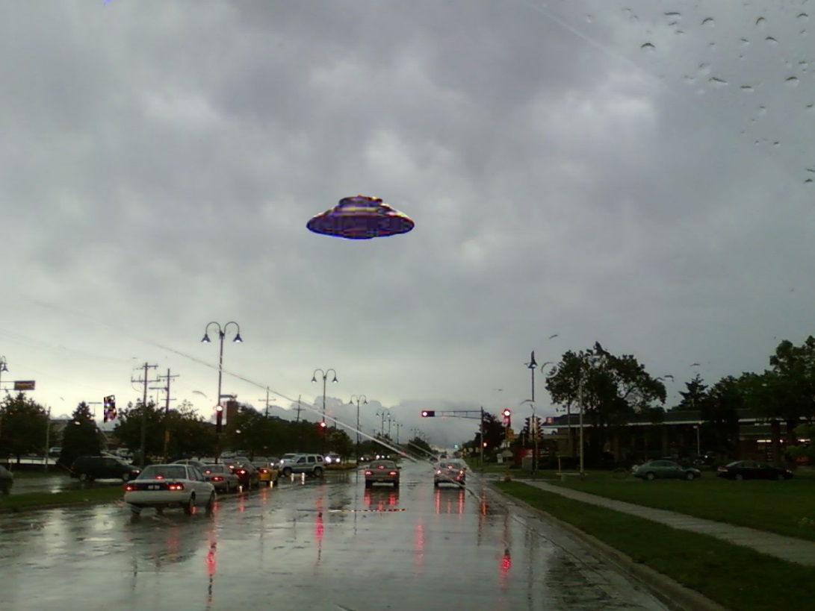
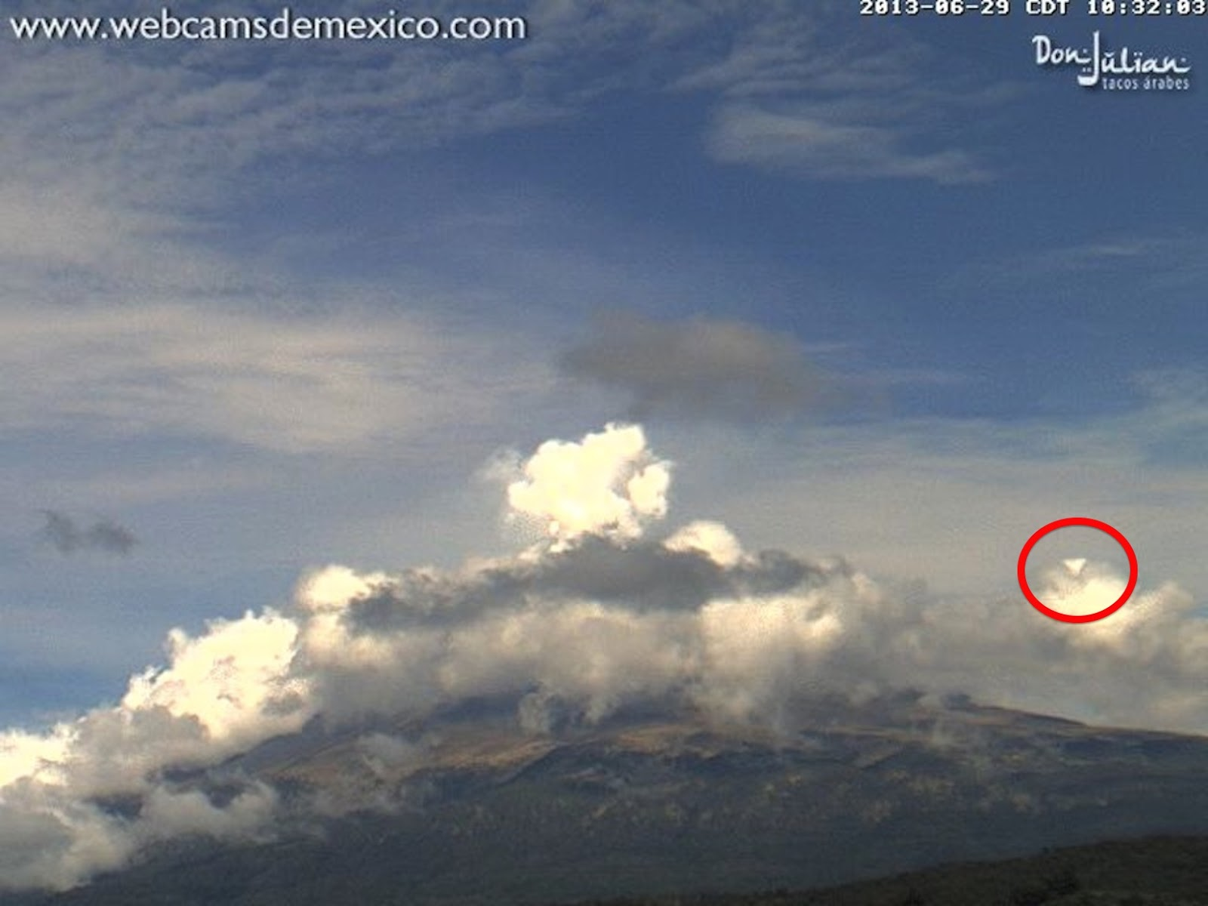
Todays dataset - UFO sightings
National UFO Reporting Center
– Reports from July 2016
bit.ly/2bhTnZB
Go to ->
http://www.nuforc.org/webreports/ndxe201607.html

