Slide 1
Project Tracker

Slide 2
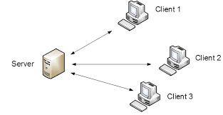
Architecture
Server-Client
Thin Client when online
Sockets & WCF
Offline time recording
possible

Slide 3
Communication
Sockets for Heartbeat and Commits (Add project/Add time)
Heartbeat
AddProject
AddTime
WCF for updating list

Slide 4
Server
Manages list of clients
Manages list of projects
Manages commits
Calculates Hash
Responds to client requests with current hashvalue of the list

Slide 5
Client
3 Threads:
Forms
Socket
WCF
Main UI
Sends commit messages
Responses contain hashvalues
Checks hashvalues an requests update if different

Slide 6
Restrictions
Clients have to connect at least once in the beginning
No projects can be added when disconnected
The files for storing messages/projects must not be changed
(could be solved by encryption)

