Slide 1
Relevance of pascal’s triangle in permutation and combination

Slide 2
Permutation
Permutation deals with the arrangement of objects in a specific order. It refers to the different ways in which a set of elements can be ordered or rearranged.
The formula for calculating the number of permutations of n objects taken r at a time is given by:
nPr = n! / (n - r)!
For example, if you have a set of 5 different elements (n = 5) and you want to arrange them in groups of 3 (r = 3), the permutation formula would be:
5P3 = 5! / (5 - 3)! = 5! / 2! = (5 × 4 × 3 × 2 × 1) / (2 × 1)
= 120 / 2
= 60

Slide 3
Combination
A combination is a way of selecting items from a larger set without regard to the order in which the items are chosen.
The formula for finding the number of combinations of n items taken r at a time is given by the binomial coefficient, denoted as C(n, r) or sometimes as "n choose r," and is calculated as follows:
C(n, r) = n! / (r! * (n - r)!)
For example, if you have a set of {A, B, C, D} and you want to find all possible combinations of 2 items, you would calculate C(4, 2) as follows:
C(4, 2) = 4! / (2! * (4 - 2)!) = 4! / (2! * 2!)
= (4 * 3 * 2 * 1) / (2 * 1 * 2 * 1)
= 6

Slide 4
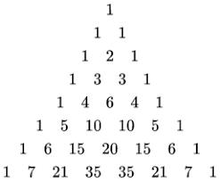
Pascal’s Triangle
Pascal’s triangle is the arrangement of the data in triangular form which is used to represent the coefficients of the binomial expansions, i.e. the second row in Pascal’s triangle represents the coefficients in (x+y)² and so on.
Each row in the triangle starts and ends with the number 1, and the interior numbers are the sum of the two numbers directly above them. For example, the number 6 in the fifth row is the sum of the numbers 3 and 3 from the row above it.

Slide 5
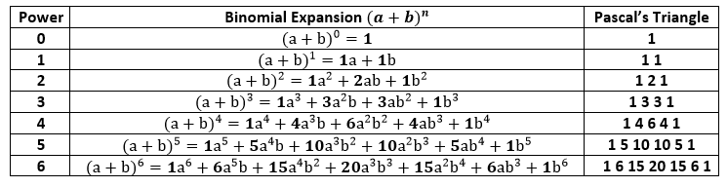
pascal’s triangle defines the binomial coefficients of terms of binomial expression (x + y)^{n}, So the expansion of (x + y)^{n} is:
(x + y)^{n} = a₀x^{n} + a₁x^{n-1} + ……a_{n-1}xy^{n-1} + a_{n}y^{n}

Slide 6
Pascal's Triangle is commonly used in permutation and combination problems due to the following reasons:
Binomial Coefficients: The numbers in Pascal's Triangle are also known as binomial coefficients. The nth row of Pascal's Triangle represents the coefficients of the binomial expansion of (a + b)^n. For example, in the fourth row, we have 1, 3, 3, 1, which corresponds to (a + b)^4 = 1a^4 + 3a^3b + 3a^2b^2 + 1b^4.
Combinations: The values in Pascal's Triangle can be used to calculate the number of combinations of choosing k elements from a set of n elements (nCk). The value at the nth row and kth column of Pascal's Triangle gives the number of ways to choose k elements from a set of n elements. For example, in the fifth row, we have 1, 4, 6, 4, 1, which means there are 6 ways to choose 2 elements from a set of 5 elements
Permutations: Pascal's Triangle also helps in calculating permutations when repetition is allowed. The value at the nth row and kth column of Pascal's Triangle gives the number of permutations of k elements from a set with n distinct elements, where repetition is allowed.

Slide 7
Use of pascal’s triangle in analysis
Binomial Distribution: In probability and statistics, the binomial distribution represents the probability of obtaining a specific number of successes in a fixed number of independent Bernoulli trials. Each trial has two possible outcomes, typically referred to as "success" and "failure."Pascal's Triangle provides the binomial coefficients, which are used to calculate the probabilities in the binomial distribution
Probability Calculations: Pascal's Triangle can be used to find probabilities in various other scenarios beyond the binomial distribution. For example, it can help calculate the probability of specific combinations in a given set of events or choices.
Combinatorial Analysis: Probability and statistical analysis often involve counting and combinatorial problems. Pascal's Triangle is a powerful tool for understanding the number of ways events can occur, which is crucial in statistical analysis.
Hypothesis Testing: In certain hypothesis testing scenarios, Pascal's Triangle can assist in calculating the probabilities of different outcomes and critical values.

