Slide 1



NajmAI
Fast. Efficient. AI-Powered.
Team Members:
Doaa Zainaddin
Raya Almohaimeed

Slide 2


Introduction

Slide 3
Mission of NajmAI
Quickly and easily resolve accidents
Reducing wait times and traffic congestion.
NajmAI

Slide 4






Research
Regulations of the Traffic Law
Development Journey
Development
RAG Architecture
(Retrieval-Augmented Generation)
Deployment
StreamLit

Slide 5

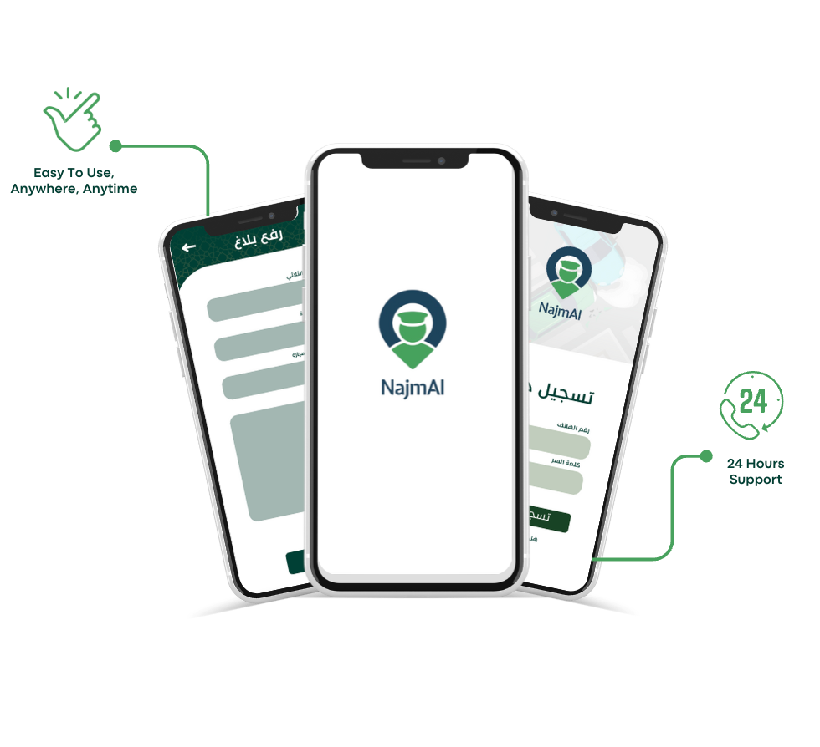
Demo

Slide 6
NajmAI
Thank you for listening

