Slide 1
Container Solution: Docker & Kubernetes
2022.04.01 - Toshiba Software Development (Vietnam) Co., Ltd

Slide 2
Contents
01
Overview Docker
02
Overview Kubernetes
03
Case study 1 – WESOpt project
04
Case study 2 – MIA project
05
Next direction
Notes:
+ Important questions:
Why use docker ?
What is docker ?

Slide 3

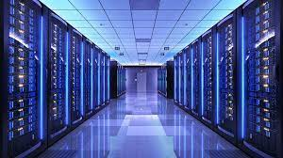


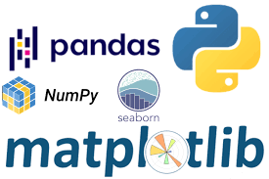
Why use docker ?
What are basic ingredients need for ML development environment ?
Compute (GPUs)
Storage (datasets)
Source control (git)
Frameworks & libraries (APIs)
Issues
Compative
Ref: https://aws.amazon.com/blogs/opensource/why-use-docker-containers-for-machine-learning-development/

Slide 4
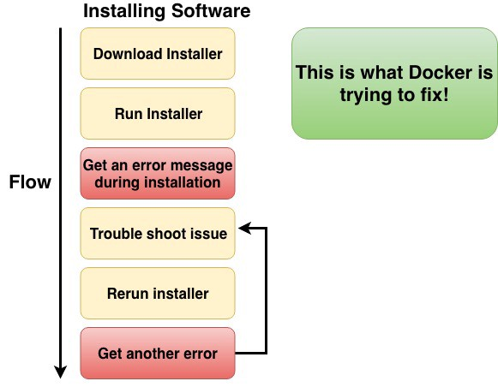
Why use containers ?
Ref: https://aws.amazon.com/blogs/opensource/why-use-docker-containers-for-machine-learning-development/
Notes:
+ container ~ virtual machine

Slide 5
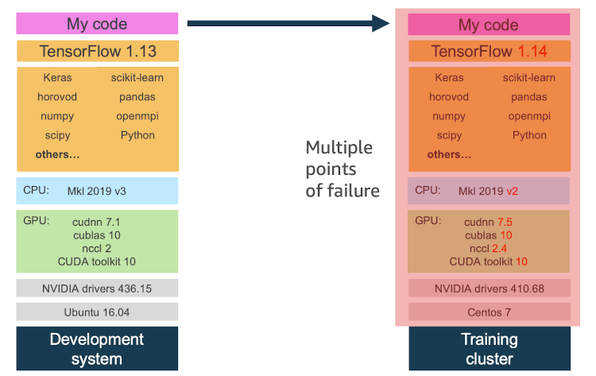
Why use containers ?
Ref: https://aws.amazon.com/blogs/opensource/why-use-docker-containers-for-machine-learning-development/
Notes:
+ container ~ virtual machine

Slide 6
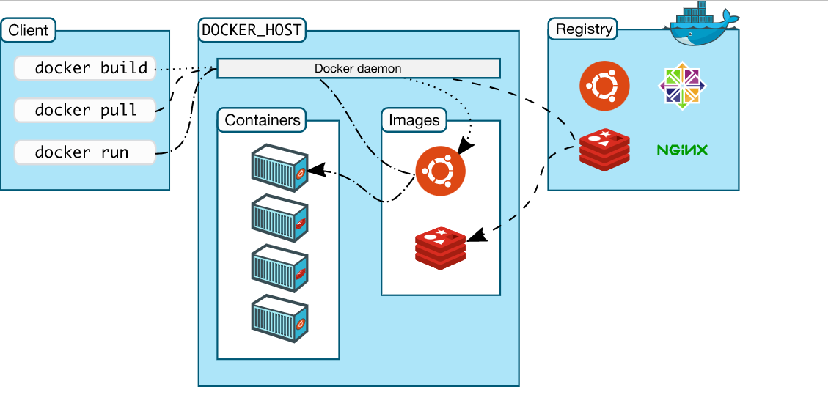
Docker architecture (1)
Ref: https://docs.docker.com/get-started/overview/
Notes:
CLI- command line interface

Slide 7
Docker architecture (2)
Docker client:
the primary way that user interact with docker host (terminal).
Send RESTfull request to docker daemon.
Ref: https://docs.docker.com/get-started/overview/

Slide 8
Docker architecture (3)
Docker daemon:
Listens & adapt docker API request from client
Managers docker objects (images, containers …)
Ref: https://docs.docker.com/get-started/overview/

Slide 9
Docker architecture (4)
Registry: Stores docker images
Ref: https://docs.docker.com/get-started/overview/

Slide 10
Docker architecture (5)
Images:
A read-only template with instructions for creating docker container.
In order to build own image, we can create Dockerfile.
Ref: https://docs.docker.com/get-started/overview/

Slide 11
Docker architecture (6)
Docker host
Registry
Docker daemon
(3)
(2)
Ubuntu:18.04
(1)
Containers
Images
Client
(4)
centos
Ubuntu:18.04
Ubuntu:18.04
$ docker run ubuntu:18.04
(5)
Ubuntu:16.04
Run :
Pull :
Ref: https://docs.docker.com/get-started/overview/
Notes:
CLI- command line interface

Slide 12
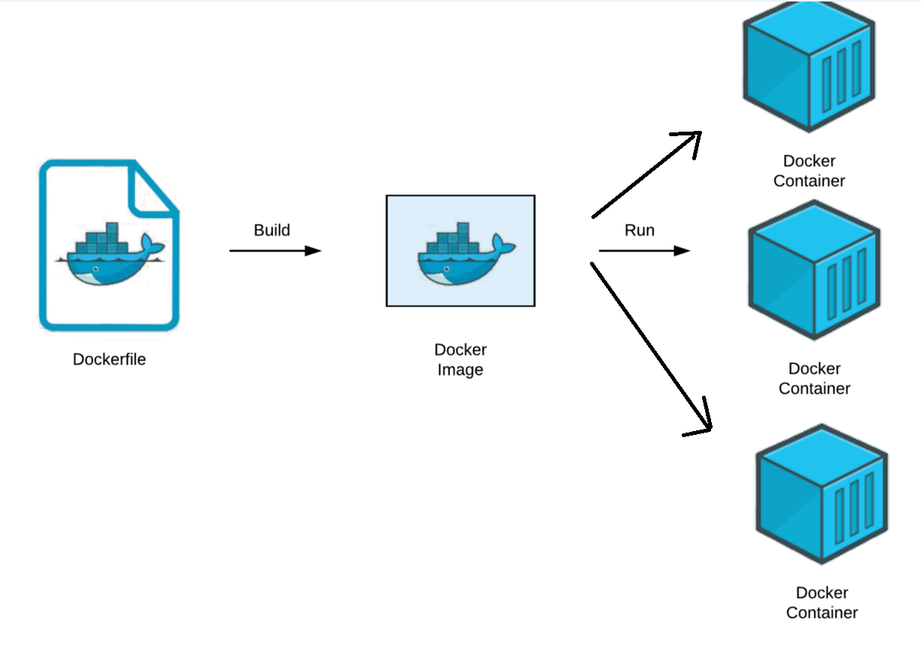
Docker images & Docker file: Overview
Docker image: a collection of files {source code, dependencies, libraries …} for deploying containers.
Docker container:
A virtualized run-time environment provides isolation capabilities for the execution of applications.
Provide a portable & lightweight environment for deploying applications.
Dockerfile:
A script of instructions can build images automatically.
Syntax:
[INSTRUCTION] [ARGUMENT]
Example:
FROM Ubuntu
RUN apt-get update && apt-get install python –y
RUN pip install flask flask-mysql
COPY . /opt/source-code
ENTRYPOINT
Layered architecture
Notes:
+ Docker image:
- 1 file dung de thuc hien code trong docker container ~ 1 tập các bước để x.dựng container.
(bản chất) docker image ~
+ portable:
+ lightweight:
Ref: https://www.whitesourcesoftware.com/free-developer-tools/blog/docker-images-vs-docker-containers/

Slide 13
Docker images & Docker file: Understanding image layers
List of instructions in the Dockerfile:
FROM: Specify base image
COPY: Copy of files/directories from host machine to container image
ENV: Add environment variables
RUN: Execute specified command
CMD: Specify the command at the time of container execution
WORKDIR: Change current directory
EXPOSE:
Reduce docker image
Change base image (-alpine)
Take advantage of layer caching helps reduce build time.
Include related RUN, ADD, COPY statements to reduce the number of new layers.
Optimized .dockerignore to remove unnecessary files during image building.
Use multi-stage build to reduce runtime image size.
Using an image template together by using ONBUILD for base image saves management effort & build time.
Ref: Docker image in production — 1GB or 100MB
Notes:
+ Docker image:
- 1 file dung de thuc hien code trong docker container ~ 1 tập các bước để x.dựng container.
(bản chất) docker image ~
+ portable:
+ lightweight:
Python3.6 (lite)
Ref: https://www.whitesourcesoftware.com/free-developer-tools/blog/docker-images-vs-docker-containers/

Slide 14
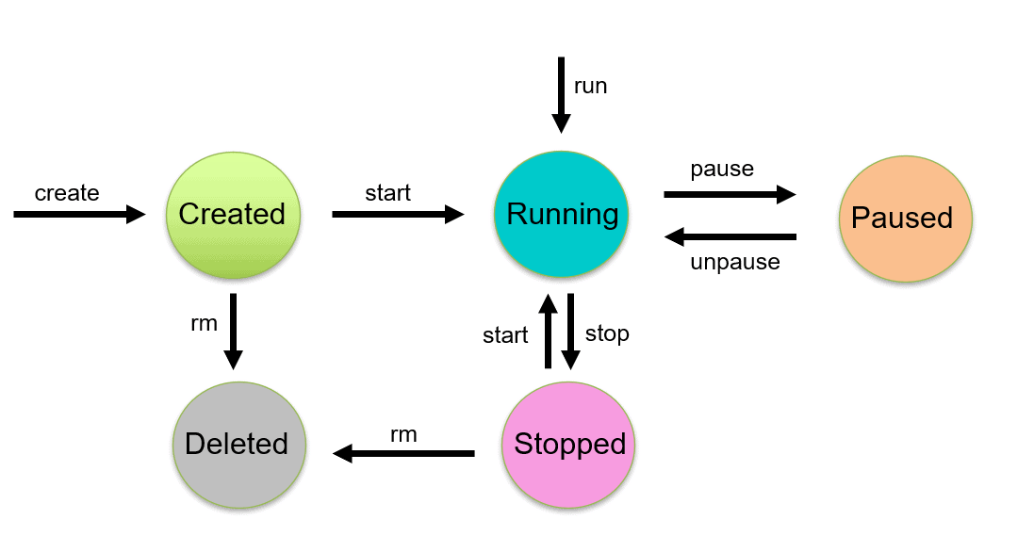
Lifecycle of Docker Container
$ docker create --name <container_name> <image_name>
Ref: https://k21academy.com/docker-kubernetes/docker-container-lifecycle-management/
Notes:
+

Slide 15
Lifecycle of Docker Container
$ docker start <container_name>
Ref: https://k21academy.com/docker-kubernetes/docker-container-lifecycle-management/
Notes:
+

Slide 16
Lifecycle of Docker Container
$ docker start <container_name>
Ref: https://k21academy.com/docker-kubernetes/docker-container-lifecycle-management/
Notes:
+

Slide 17
Lifecycle of Docker Container
$ docker run -it <container_name>
Ref: https://k21academy.com/docker-kubernetes/docker-container-lifecycle-management/
Notes:
+

Slide 18
Share Data Between the Docker Container & the Host
Share data between host to container
Share data between containers (assume container_1 mounted with Host):
Manager outside disk with docker
$ docker run -d –it –-name container_name –v path_host:path_cont image_id:TAG
$ docker run –it --volumns-from container_1 image_id:TAG
Ref: https://xuanthulab.net/chia-se-du-lieu-giua-docker-host-va-container.html
Notes:
+ Anh xa thu muc may host vao container
+ Chia se du lieu giua cac container
+ Chia se du lieuj qua volume
+ Tao volume, docker volume create
+ Gan o dia volume vao container
+ Tao o dia anh xa den thu muc host

Slide 19
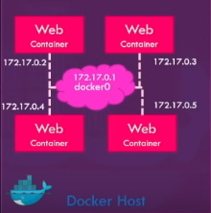
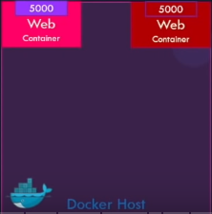
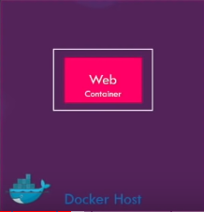
Docker networking
Docker networking: establish communication between Docker containers and the outside world via the host machine
Network drivers:
Bridge network | Host network | None network
Applications run in standalone containers Use: multiple containers communicate on the same docker host. | Remove network isolation between the container & docker host. Use the host’s networking directly. Use: Network stack should not be isolated from Docker host. | Disable all networking Used in conjunction with a customer network driver.
Notes:
+ Docker network: ket noi giua cac containers voi nhau, container voi ben ngoai hoac ket noi giua cac cum (swarm) docker containers
+ Bridge:
- Use: chay cac ung dung duoi dang cac container doc la can giao tiep voi nhau (ip address) => tranh conflict port problem
+ Host: duoc cap boi host. ~> limit: need a linux host to use it. Can not run multiple containers on the same host having same port.
+ None: ngat tat ca ket noi ~> containers k the truy cap cac mang b.ngoai or voi cac containers khac
+ Ref:
https://earthly.dev/blog/docker-networking/
https://www.youtube.com/watch?v=fqMOX6JJhGo
https://docs.docker.com/network/
https://stackoverflow.com/questions/41083328/what-is-the-use-of-docker-host-and-none-networks
https://www.bogotobogo.com/DevOps/Docker/Docker-Bridge-Driver-Networks.php
https://www.aquasec.com/cloud-native-academy/docker-container/docker-networking/

Slide 20
Bridge networks
Docker networking: establish communication between Docker containers and the outside world via the host machine
Advantages of Docker Networking:
They share a single operating system & maintain containers in an isolated environment.
Help in the fast to delivery of software
Help in application portability
Notes:
+ Docker network: ket noi giua cac containers voi nhau, container voi ben ngoai hoac ket noi giua cac cum (swarm) docker containers
+ Bridge:
- Use: chay cac ung dung duoi dang cac container doc la can giao tiep voi nhau (ip address) =>
+ Host: public network,
+ None: ngat tat ca ket noi
+ Ref:
https://www.simplilearn.com/tutorials/docker-tutorial/docker-networking?source=sl_frs_nav_playlist_video_clicked
https://earthly.dev/blog/docker-networking/
https://www.youtube.com/watch?v=fqMOX6JJhGo
https://docs.docker.com/network/
https://stackoverflow.com/questions/41083328/what-is-the-use-of-docker-host-and-none-networks
https://www.bogotobogo.com/DevOps/Docker/Docker-Bridge-Driver-Networks.php
https://www.aquasec.com/cloud-native-academy/docker-container/docker-networking/

Slide 21
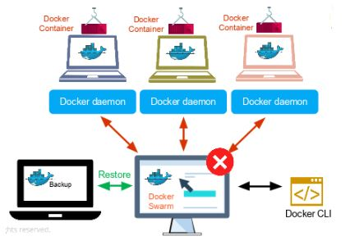
Docker Swarm (1)
Docker Swarm:
The cluster management & orchestration features in the Docker Engine.
Help end-user in creating & deploying a cluster of Docker nodes (node ~ Docker daemon)
Key concepts:
Nodes: an instance of the Docker Engine. Two types of nodes:
Manager node: (1) Receives a service definition from user then (2) dispatches units of work (tasks) to worker nodes.
Worker: Receives & executes tasks from manager node.
Services & tasks:
Service: The definition of tasks to execute on manager node or worker nodes.
Task: the commands run inside the container.
Load balancing
Expose the ports for services to an external load balancer.
Source
Ref:
https://xuanthulab.net/chia-se-du-lieu-giua-docker-host-va-container.html
https://docs.docker.com/engine/swarm/key-concepts/
https://stackoverflow.com/questions/45079988/ingress-vs-load-balancer
Notes:
+ Trong thuc te, khi trien khai 1 du an, project can chay tren nhieu host (virtual private server – may chu ao rieng) ~> kho quan ly, k the config, deploy cho tung con host => docker swarm
Cong cu: cac tinh nang dieu phoi & quan ly cum docker host (~ containers)
+ Key concepts:
Node ~ 1 instance cua Docker enginer cu the => {Docker Engine ~ a client-server application}. Một máy vật lý or máy ảo chạy docker.
Load balancing: (confirm ki)

Slide 22
Docker Swarm (2)
Feature highlights:
Cluster management integrated
Decentralized design
Declarative service model
Scaling
Desired state reconciliation
Multi-host networking
Service discovery
Load balancing
Secure by default
Rolling updates
Ref:
https://xuanthulab.net/chia-se-du-lieu-giua-docker-host-va-container.html
https://docs.docker.com/engine/swarm/key-concepts/
Notes:
+ Trong thuc te, khi trien khai 1 du an, project can chay tren nhieu host (virtual private server – may chu ao rieng) ~> kho quan ly, k the config, deploy cho tung con host => docker swarm
Cong cu: cac tinh nang dieu phoi & quan ly cum docker host)
+ Feature highlights
-

Slide 23
Deploying an app to a Swarm
Share data between host to container
Share data between containers (assume container_1 mounted with Host):
Manager outside disk with docker
$ docker run -d –it –-name container_name –v path_host:path_cont image_id:TAG
$ docker run –it --volumns-from container_1 image_id:TAG
Ref:
https://docs.docker.com/engine/swarm/swarm-tutorial/create-swarm/
https://github.com/docker/labs/blob/master/swarm-mode/beginner-tutorial/README.md
Notes:
+ Anh xa thu muc may host vao container
+ Chia se du lieu giua cac container
+ Chia se du lieuj qua volume
+ Tao volume, docker volume create
+ Gan o dia volume vao container
+ Tao o dia anh xa den thu muc host

Slide 24
Docker compose
Ref:

Slide 25
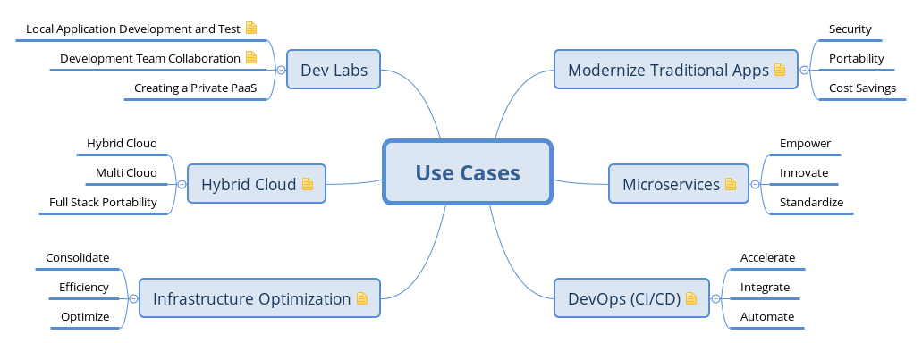
Case study
Notes:
+ container ~ virtual machine

Slide 26
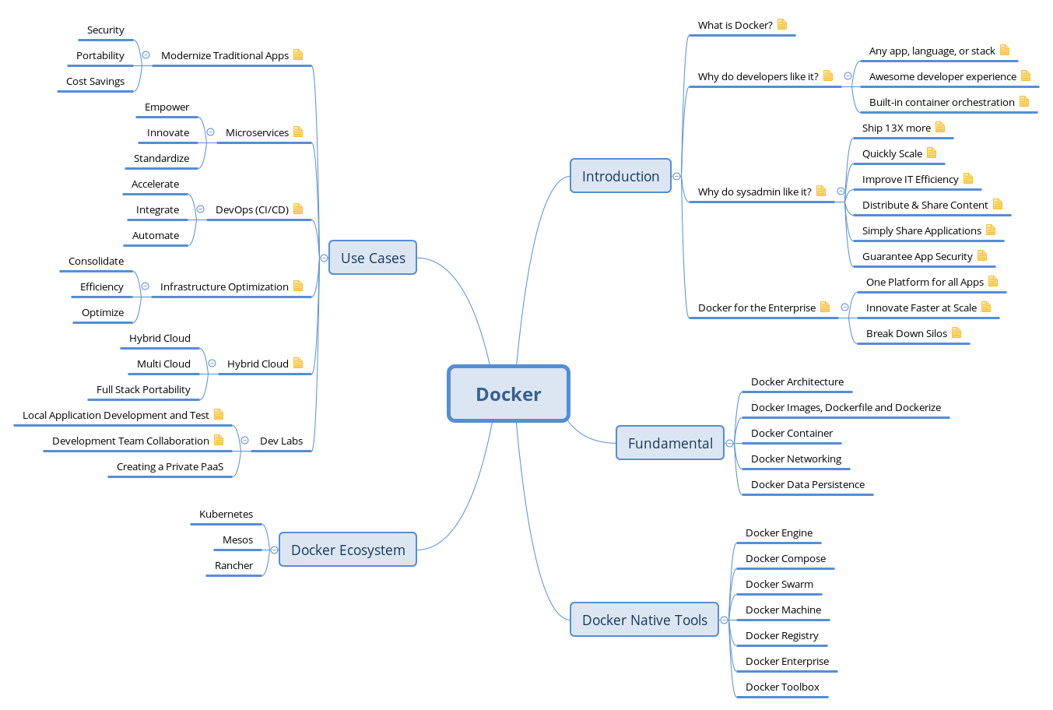
Summary
Notes:
+ container ~ virtual machine

Slide 27
Reference:
Docker & Kubernetes Complete Tutorial link
Docker 101 devopsz
Play with docker link
Notes:
1. Docker:
+ Overview
- why use docker ?
/ develop an application stack with a lot of # components (~ version)
/ compatible with the underlysing OS or just temporarily
/ the compatibility between the services & the libraries & dependencies on the OS
/ change components of project
- what is docker ?
+ Achitecture
- image & container
+ Connection details
- lifecycle of container: cmd (run, ps, ps -a, stop, rm, images, rmi, pull, attach & detach, ...)
- volumn ~> detail run command line
- inspect container & container logs
+ Docker swarm
+ Docker network
- default networks {brigde, none, host}
- user-defined networks
- inspect network
- embedded dns
+ Docker file ~> docker images
- Layered architecture (failure)
+ Docker compose
2. Kunernetes
+ K8S overview (suggest ver {microk8s, k3s }; {kind, minikube} - gioi thieu)
+ Deployment co ban
+ Expose service on K8S
+ Manage on K8S
+ Logging & monitoring
+ Storage
+ Rolling update application
+ Tich hop jenkins
3. Appendix
https://docs.docker.com/engine/swarm/how-swarm-mode-works/nodes/
https://cognitiveclass.ai/courses/docker-essentials/
https://dockerlabs.collabnix.com/

