Slide 1
Container Solution: Docker
2022.04.01 - Toshiba Software Development (Vietnam) Co., Ltd

Slide 2
Contents
01
Why use docker ? What is docker ?
02
Docker Containers & Images
03
Getting Containers Ready for Production
04
Kubernetes
05
Docker networking
06
Docker Swarm
Notes:
+ Important questions:
Why use docker ?
What is docker ?

Slide 3
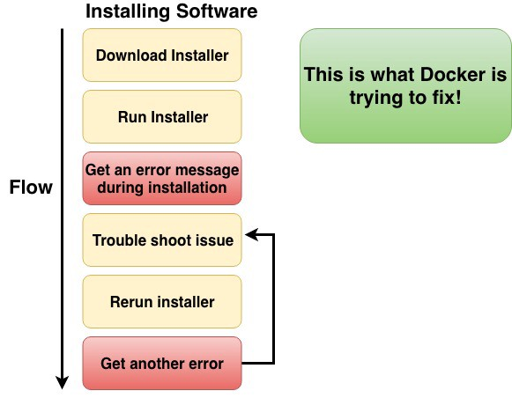
1. Why use docker ? What is docker ? (1)
Ref: https://techmaster.vn/posts/35110/docker-cho-nguoi-moi-bat-dau

Slide 4
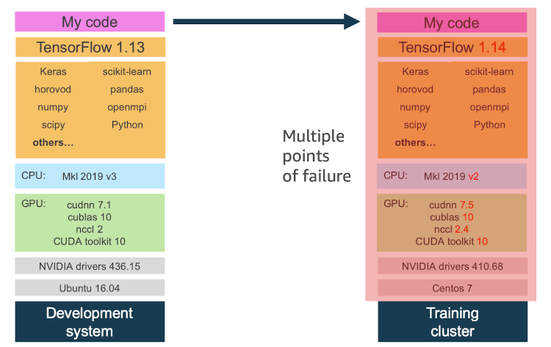
1. Why use docker ? What is docker ? (2)
Ref: https://aws.amazon.com/blogs/opensource/why-use-docker-containers-for-machine-learning-development/
Notes:
+ container ~ virtual machine

Slide 5
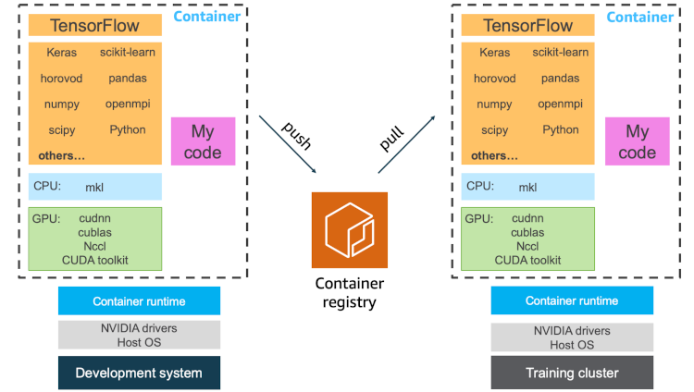
1. Why use docker ? What is docker ? (3)
Ref: https://aws.amazon.com/blogs/opensource/why-use-docker-containers-for-machine-learning-development/
Notes:
+ container ~ virtual machine

Slide 6
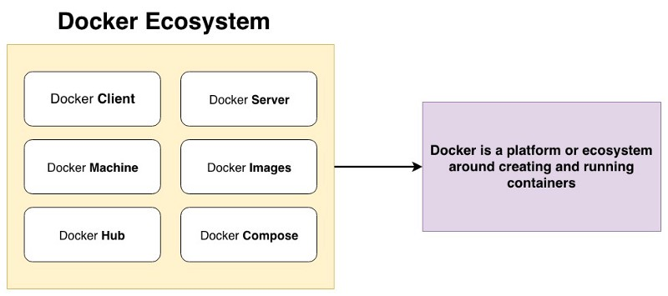
1. Why use docker ? What is docker ? (4)
Notes:
+ container ~ virtual machine

Slide 7
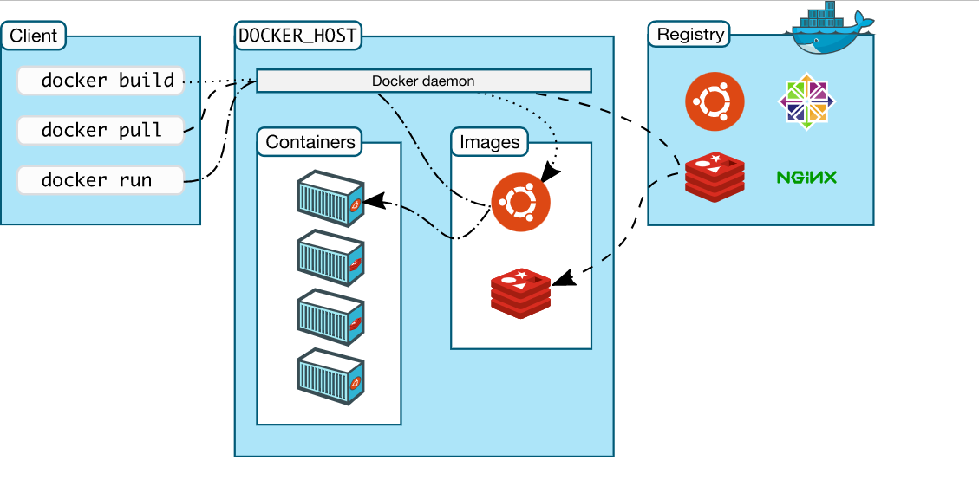
2. Docker architecture (1)
Ref: https://docs.docker.com/get-started/overview/
Notes:
+

Slide 8
2. Docker architecture (2)
Docker client:
the primary way that user interact with docker host (terminal).
Send RESTfull request to docker daemon.
Ref: https://docs.docker.com/get-started/overview/

Slide 9
2. Docker architecture (3)
Docker daemon:
Listens & adapt docker API request from client
Managers docker objects (images, containers …)
Ref: https://docs.docker.com/get-started/overview/

Slide 10
2. Docker architecture (4)
Registry: Stores docker images
Ref: https://docs.docker.com/get-started/overview/

Slide 11
2. Docker architecture (5)
Container:
A runnable instance of an image
(a run-time environment)
Like a box, it contains an application in it.
Images:
A read-only template with instructions for creating docker container.
In order to build own image, we can create Dockerfile.
Ref: https://docs.docker.com/get-started/overview/
Notes:
+ container:

Slide 12
2. Docker architecture (5)
Container:
A runnable instance of an image
(a run-time environment)
Like a box, it contains an application in it.
Images:
A read-only template with instructions for creating docker container.
In order to build own image, we can create Dockerfile.
Ref: https://docs.docker.com/get-started/overview/
Notes:
+ Phân biệt rõ hơn về Container & image:
-

Slide 13
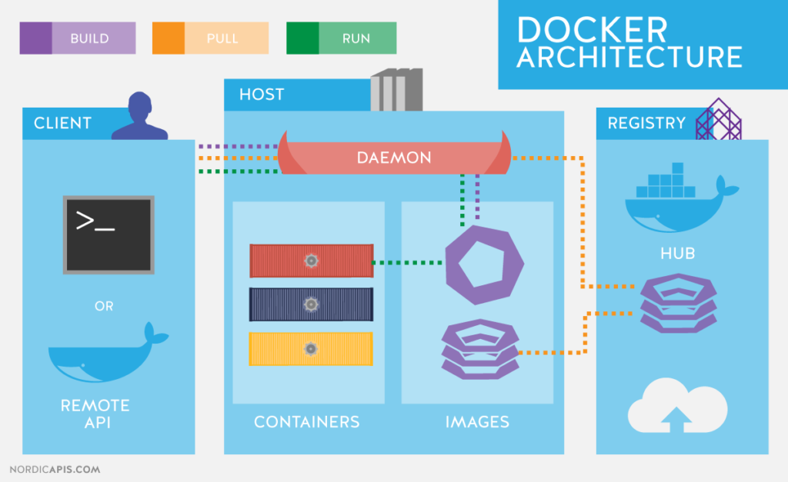
2. Docker architecture (6)
Ref: https://nordicapis.com/api-driven-devops-spotlight-on-docker/
Notes:
+ Khi user gửi nhập vào 1 cmd, the client gửi 1 yêu cầu thông qua REST API tới docker daemon {manages images, containers & other resources …}

Slide 14
2. Docker architecture (6)
Docker host
Registry
Docker daemon
(3)
(2)
Ubuntu:18.04
(1)
Containers
Images Cache
Client
(4)
centos
Ubuntu:18.04
Ubuntu:18.04
$ docker run ubuntu:18.04
(5)
Ubuntu:16.04
Run :
Pull :
Ref: https://docs.docker.com/get-started/overview/
Notes:
+ Mô tả luồng:
(1) nhập 1 cmd vào
(2) docker

Slide 15
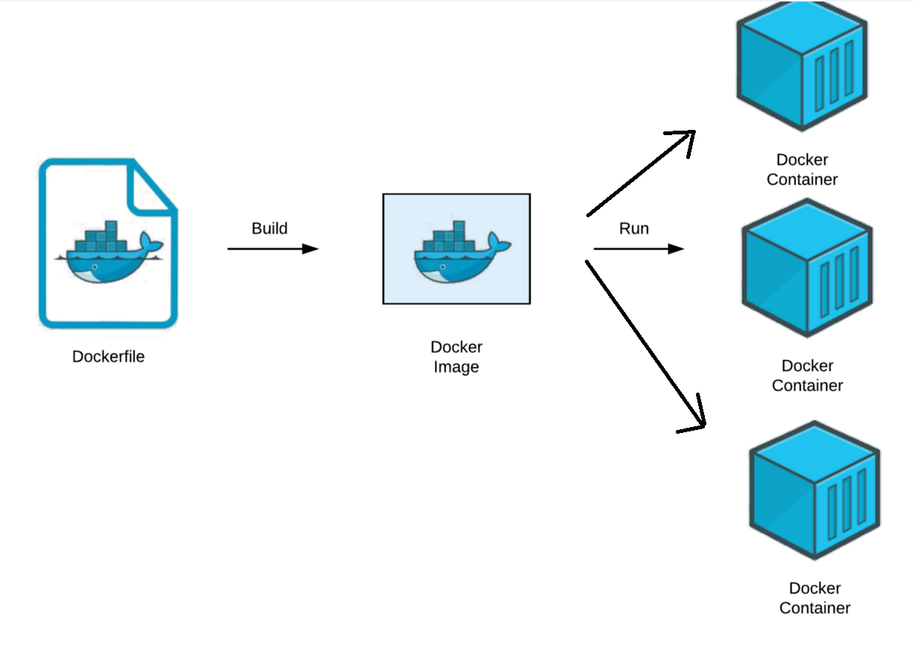
3. Docker images & Docker file: Overview
Docker image: a collection of files {source code, dependencies, libraries …} for deploying containers.
Docker container:
A virtualized run-time environment provides isolation capabilities for the execution of applications.
Provide a portable & lightweight environment for deploying applications.
Dockerfile:
A script of instructions can build images automatically.
Syntax:
[INSTRUCTION] [ARGUMENT]
Example:
FROM Ubuntu
RUN apt-get update && apt-get install python –y
RUN pip install flask flask-mysql
COPY . /opt/source-code
ENTRYPOINT [“python”, “app.py”]
Layered architecture
Notes:
Ref: https://www.whitesourcesoftware.com/free-developer-tools/blog/docker-images-vs-docker-containers/

Slide 16
3. Docker images & Docker file: Understanding image layers
List of instructions in the Dockerfile:
FROM: Specify base image
COPY: Copy of files/directories from host machine to container image
ENV: Add environment variables
RUN: Execute specified command
CMD: Specify the command at the time of container execution
WORKDIR: Change current directory
Optimize docker image:
Change base image (-alpine).
Take advantage of layer caching helps reduce build time.
Include related RUN, ADD, COPY statements to reduce the number of new layers.
Optimized .dockerignore to remove unnecessary files during image building.
Use multi-stage build to reduce runtime image size.
Using an image template together by using ONBUILD for base image saves management effort & build time.
Ref:
Docker image in production — 1GB or 100MB
Docker Layer Caching

Slide 17
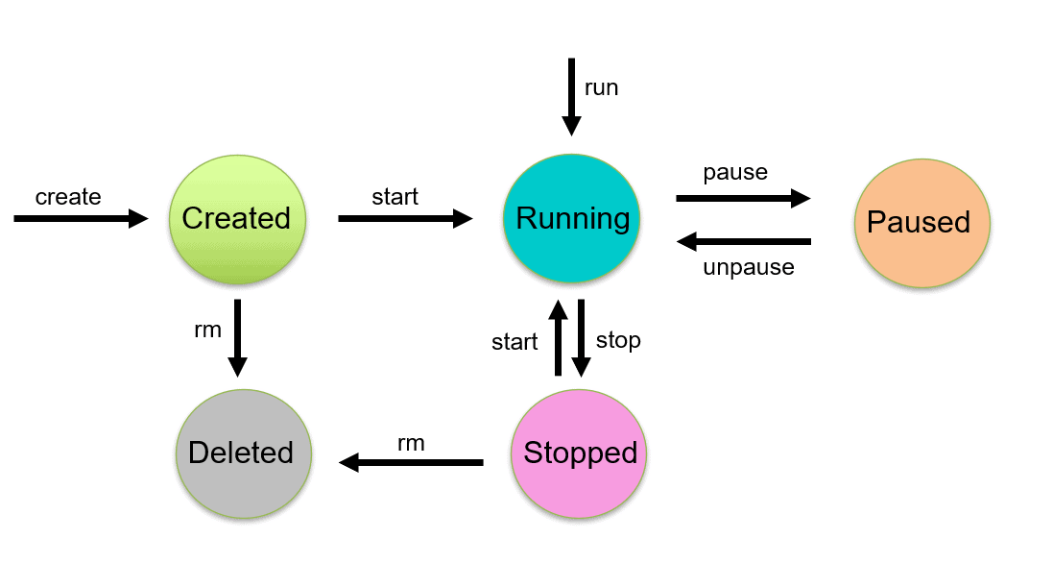
4. Lifecycle of Docker Container (1)
$ docker create --name <container_name> <image_name>
Ref: https://k21academy.com/docker-kubernetes/docker-container-lifecycle-management/
Notes:
+

Slide 18
4. Lifecycle of Docker Container (2)
$ docker start <container_name>
Ref: https://k21academy.com/docker-kubernetes/docker-container-lifecycle-management/
Notes:
+

Slide 19
4. Lifecycle of Docker Container (3)
$ docker start <container_name>
Ref: https://k21academy.com/docker-kubernetes/docker-container-lifecycle-management/
Notes:
+

Slide 20
4. Lifecycle of Docker Container (4)
$ docker run -it <container_name>
Ref: https://k21academy.com/docker-kubernetes/docker-container-lifecycle-management/
Notes:
+

Slide 21
Share Data Between the Docker Container & the Host
Share data between host to container
Share data between containers (assume container_1 mounted with Host):
$ docker run -d –it –-name container_name –v path_host:path_cont image_id:TAG
$ docker run –it --volumes-from container_1 image_id:TAG
Ref: https://xuanthulab.net/chia-se-du-lieu-giua-docker-host-va-container.html
Notes:
+ Anh xa thu muc may host vao container
+ Chia se du lieu giua cac container
+ Chia se du lieuj qua volume
+ Tao volume, docker volume create
+ Gan o dia volume vao container
+ Tao o dia anh xa den thu muc host

Slide 22
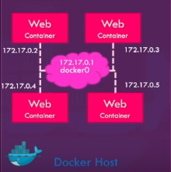
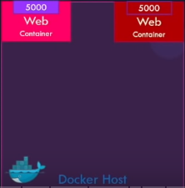
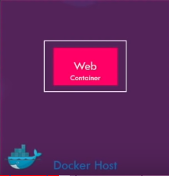
5. Docker networking
Docker networking: establish communication between Docker containers and the outside world via the host machine
Network drivers:
Bridge network | Host network | None network
Applications run in standalone containers Use: multiple containers communicate on the same docker host. | Remove network isolation between the container & docker host. Use the host’s networking directly. Use: Network stack should not be isolated from Docker host. | Disable all networking Used in conjunction with a customer network driver.
Notes:
+ Docker network: ket noi giua cac containers voi nhau, container voi ben ngoai hoac ket noi giua cac cum (swarm) docker containers
+ Bridge:
- Use: chay cac ung dung duoi dang cac container doc la can giao tiep voi nhau (ip address) => tranh conflict port problem
+ Host: duoc cap boi host. ~> limit: need a linux host to use it. Can not run multiple containers on the same host having same port.
+ None: ngat tat ca ket noi ~> containers k the truy cap cac mang b.ngoai or voi cac containers khac
+ Ref:
https://earthly.dev/blog/docker-networking/
https://www.youtube.com/watch?v=fqMOX6JJhGo
https://docs.docker.com/network/
https://stackoverflow.com/questions/41083328/what-is-the-use-of-docker-host-and-none-networks
https://www.bogotobogo.com/DevOps/Docker/Docker-Bridge-Driver-Networks.php
https://www.aquasec.com/cloud-native-academy/docker-container/docker-networking/

Slide 23
5. Bridge networks
Docker networking: establish communication between Docker containers and the outside world via the host machine
Advantages of Docker Networking:
They share a single operating system & maintain containers in an isolated environment.
Help in the fast to delivery of software
Help in application portability
Notes:
+ Docker network: ket noi giua cac containers voi nhau, container voi ben ngoai hoac ket noi giua cac cum (swarm) docker containers
+ Bridge:
- Use: chay cac ung dung duoi dang cac container doc la can giao tiep voi nhau (ip address) =>
+ Host: public network,
+ None: ngat tat ca ket noi
+ Ref:
https://www.simplilearn.com/tutorials/docker-tutorial/docker-networking?source=sl_frs_nav_playlist_video_clicked
https://earthly.dev/blog/docker-networking/
https://www.youtube.com/watch?v=fqMOX6JJhGo
https://docs.docker.com/network/
https://stackoverflow.com/questions/41083328/what-is-the-use-of-docker-host-and-none-networks
https://www.bogotobogo.com/DevOps/Docker/Docker-Bridge-Driver-Networks.php
https://www.aquasec.com/cloud-native-academy/docker-container/docker-networking/

Slide 24
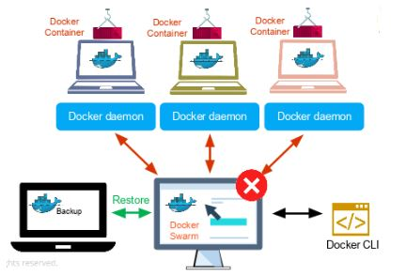
6. Docker Swarm (1)
Docker Swarm:
The cluster management & orchestration features in the Docker Engine.
Help end-user in creating & deploying a cluster of Docker nodes (node ~ Docker daemon)
Key concepts:
Nodes: an instance of the Docker Engine. Two types of nodes:
Manager node: (1) Receives a service definition from user then (2) dispatches units of work (tasks) to worker nodes.
Worker: Receives & executes tasks from manager node.
Services & tasks:
Service: The definition of tasks to execute on manager node or worker nodes.
Task: the commands run inside the container.
Load balancing
Expose the ports for services to an external load balancer.
Source
Ref:
https://docs.docker.com/engine/swarm/key-concepts/
https://stackoverflow.com/questions/45079988/ingress-vs-load-balancer
Notes:
+ Trong thuc te, khi trien khai 1 du an, project can chay tren nhieu host (virtual private server – may chu ao rieng) ~> kho quan ly, k the config, deploy cho tung con host => docker swarm
Cong cu: cac tinh nang dieu phoi & quan ly cum docker host (~ containers)
+ Key concepts:
Node ~ 1 instance cua Docker enginer cu the => {Docker Engine ~ a client-server application}. Một máy vật lý or máy ảo chạy docker.
Load balancing: (confirm ki)

Slide 25
6. Docker Swarm (2)
Feature highlights:
Cluster management integrated
Decentralized design
Declarative service model
Scaling
Desired state reconciliation
Multi-host networking
Service discovery
Load balancing
Secure by default
Rolling updates
Ref:
https://xuanthulab.net/chia-se-du-lieu-giua-docker-host-va-container.html
https://docs.docker.com/engine/swarm/key-concepts/
Notes:
+ Trong thuc te, khi trien khai 1 du an, project can chay tren nhieu host (virtual private server – may chu ao rieng) ~> kho quan ly, k the config, deploy cho tung con host => docker swarm
Cong cu: cac tinh nang dieu phoi & quan ly cum docker host)
+ Feature highlights
-

Slide 26
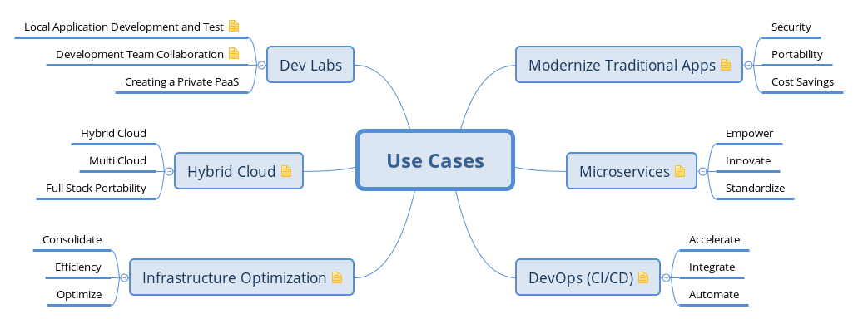
Case study
Notes:
+ container ~ virtual machine

Slide 27
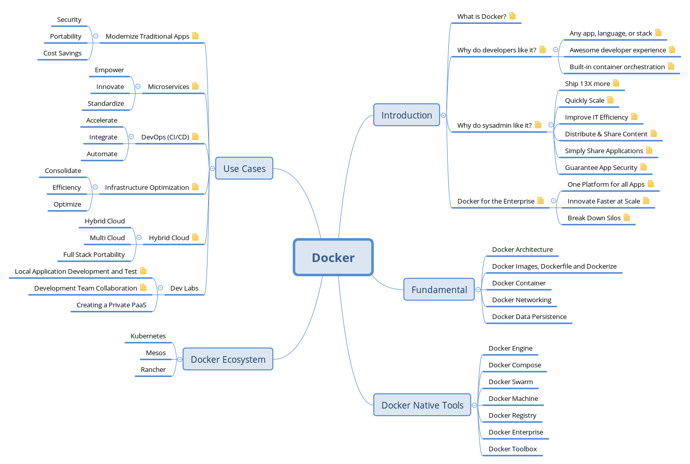
Summary
Notes:
+ container ~ virtual machine

Slide 28
Reference:
Docker & Kubernetes Complete Tutorial link
Docker 101 devopsz
Play with docker link
Notes:
1. Docker:
+ Overview
- why use docker ?
/ develop an application stack with a lot of # components (~ version)
/ compatible with the underlysing OS or just temporarily
/ the compatibility between the services & the libraries & dependencies on the OS
/ change components of project
- what is docker ?
+ Achitecture
- image & container
+ Connection details
- lifecycle of container: cmd (run, ps, ps -a, stop, rm, images, rmi, pull, attach & detach, ...)
- volumn ~> detail run command line
- inspect container & container logs
+ Docker swarm
+ Docker network
- default networks {brigde, none, host}
- user-defined networks
- inspect network
- embedded dns
+ Docker file ~> docker images
- Layered architecture (failure)
+ Docker compose
2. Kunernetes
+ K8S overview (suggest ver {microk8s, k3s }; {kind, minikube} - gioi thieu)
+ Deployment co ban
+ Expose service on K8S
+ Manage on K8S
+ Logging & monitoring
+ Storage
+ Rolling update application
+ Tich hop jenkins
3. Appendix
https://docs.docker.com/engine/swarm/how-swarm-mode-works/nodes/
https://cognitiveclass.ai/courses/docker-essentials/
https://dockerlabs.collabnix.com/

Slide 29
Contents
01
Introduction to Kubernetes (K8s)
02
Main K8s Components
03
Minikube & Kubectl – Local Setup
04
Main Kubectl Commands – K8s CLI
05
K8s YAML Configuration File
06
Advanced Concepts
Notes:
+ Advanced concepts:
K8s Namespace – Organize Component
K8s Ingress
Heml – Package Manager
Volumes – Persisting data in K8s
K8s StatefulSet – Deploying Stateful apps
K8s Services

Slide 30
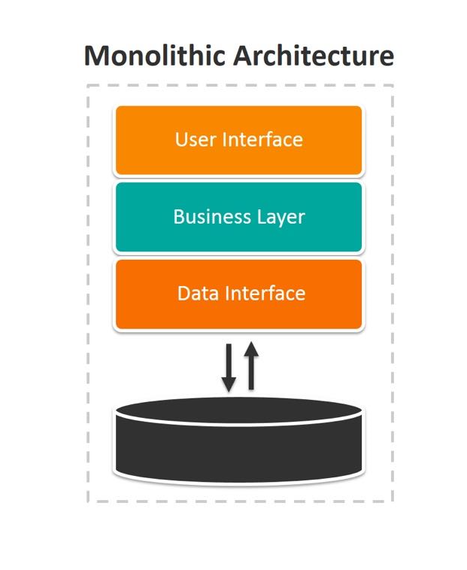
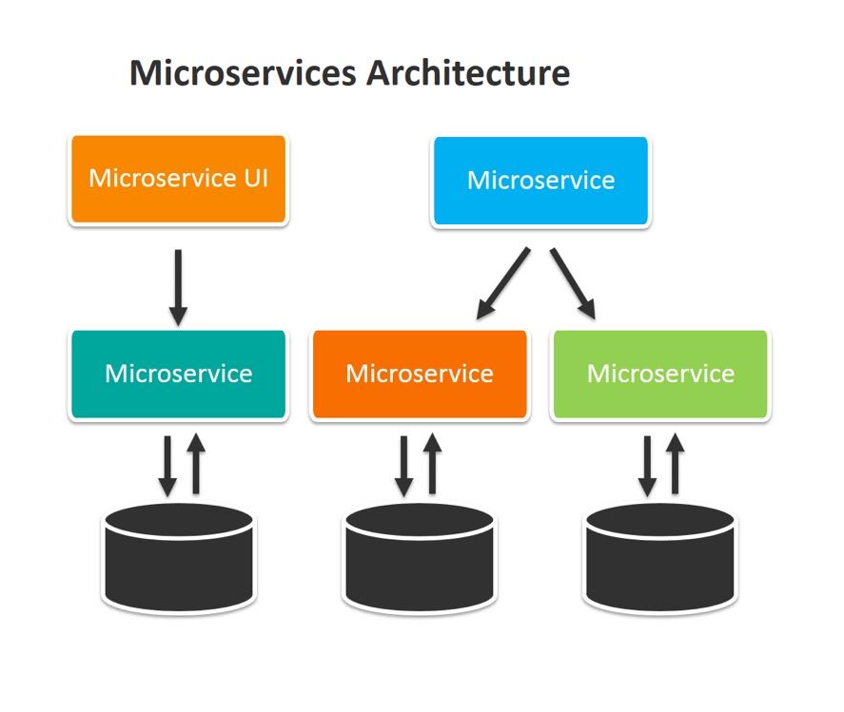
1. Introduction to Kubernetes - Motivation
Moving from monolithic apps to microservices
As one entity
Run as multiple processes deployed on different servers
Lack of agility & innovation
Scale individually (both dimensions)
Impossible to scale a part
Harder to make updates/changes
Difficult manage components
Kubernetes uses Linux container technologies to provide isolation of running applications.
Notes:
+ Developed, deployed & managed as one entity
- pros: de phat trien, test, deploy
+ Each microservice runs as an independent process
Communicate through synchronous protocols (HTTP) & expose RESTfull API or AMQP
+ Difficult :
gia su khi thay doi, can config (discuss) lai toan bo he thong de dam bao cac thanh phan lam viec voi nhau
Doi khi, cac ver cua 1 library o cac components khac nhau
- The differences in the environments (dev & deploy, env of a single production machine’ll change over time)

Slide 31
1. Introduction to Kubernetes – What is Kubernetes ?
Official definition:
Open source container orchestration (deployment & management) tool (Google).
Manage containerized applications in differenct deployment environments (physical, virtual, cloud …)
The tasks of an orchestration tool:
Trend from Monolith to Microservices
Increased usage of containers
Demand for a proper way of managing those hundreds of containers.
What features do orchestration tools offer ?
High availability or no down-time
Scalability or high performance
Disaster recovery – backup & restore
Notes:
+ Containerized applications ~
+ Container technology: (Docker, Podman, Windows Hyper-V)
+ small independent apps like microservices -> comprised of hundreds containers be managed by script
+ Features:
Always accessible by users
Load fast & high response rates from the application
Unexpected problem: lost data or damage server

Slide 32
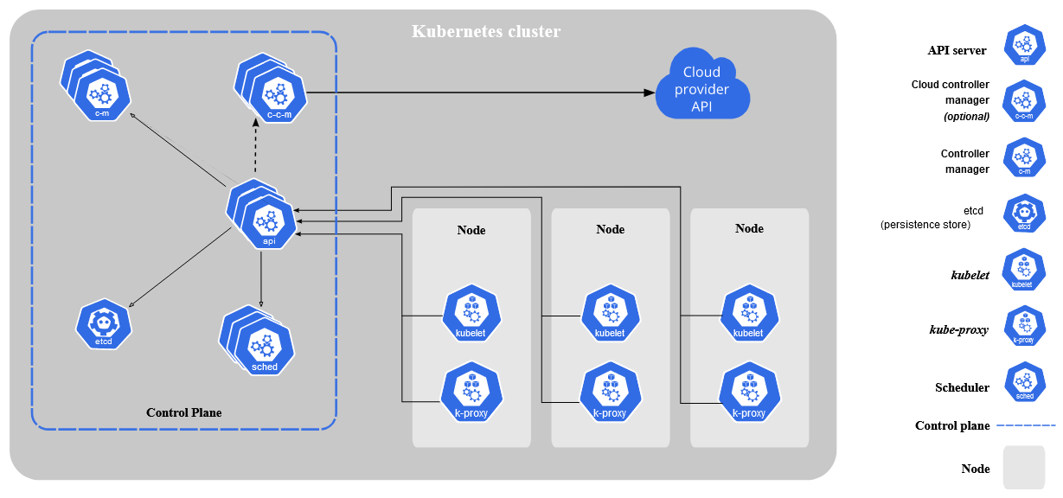
1. Introduction to Kubernetes - Kubernetes Architectures (1)
Worker nodes

Slide 33
1. Introduction to Kubernetes - Kubernetes Architectures (2)
(1)
(3)
(3)
(4)
(4)
(1)
(5)
(2)
(5)
(2)
Host the components used to manage Kubernetes cluster (state)
Worker nodes
Notes:
+ Thong tin cac components:
(1): you & the other control plane components communicates with
(2): lên kế hoạch cho apps (giao task cho node) >< thời gian
(4): thực hiện các chức năng cho từng cụm (sao chép files, giám sát trạng thái của các node, giải quyết các vấn đề phát sinh …)
(5): dạng thông tin ~ key-value cho mục đích lưu trữ toàn bộ cấu hình, trạng thái & metadata của k8s (hãy nêu ví dụ về nó)
+ CP co thể chạy như 1 node đơn hoặc được thiết lập thành nhiều nodes ~> tăng khả năng quản lý hệ thống.

Slide 34
1. Introduction to Kubernetes - Kubernetes Architectures (3)
(1)
(3)
(3)
(4)
(4)
(1)
(5)
(6)
(5)
(6)
(7)
(2)
(2)
(7)
Can be virtual machines or physical machines
A node hosts pods which run one or more containers (run the applications)
Worker nodes
Notes:
+ Kubelet: talks to the API server & manages containers on its node.
+ kube-proxy: load-balances network traffic between application components.
~> khi học 1 kiến thức: (1) nó có thể làm gì ? (2) nó làm/làm nó ntn ? (3) nó hoạt động ntn ?

Slide 35
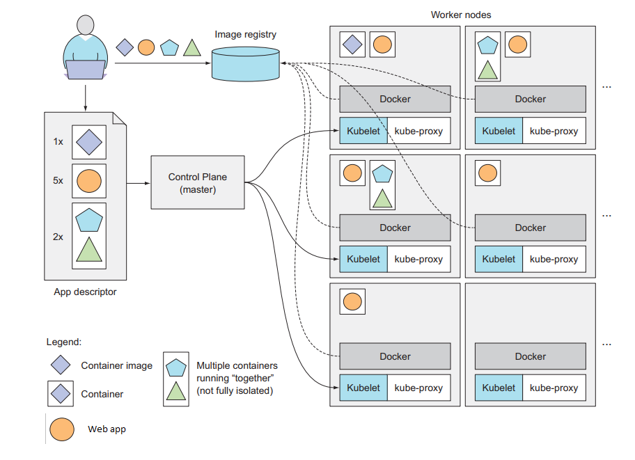
1. Introduction to Kubernetes – Running an application in Kubernetes
Ref: Kubernetes in Action (Marko Luksa)
Notes:
Xét ví dụ: Giả sử app descriptor gồm 5 containers

Slide 36
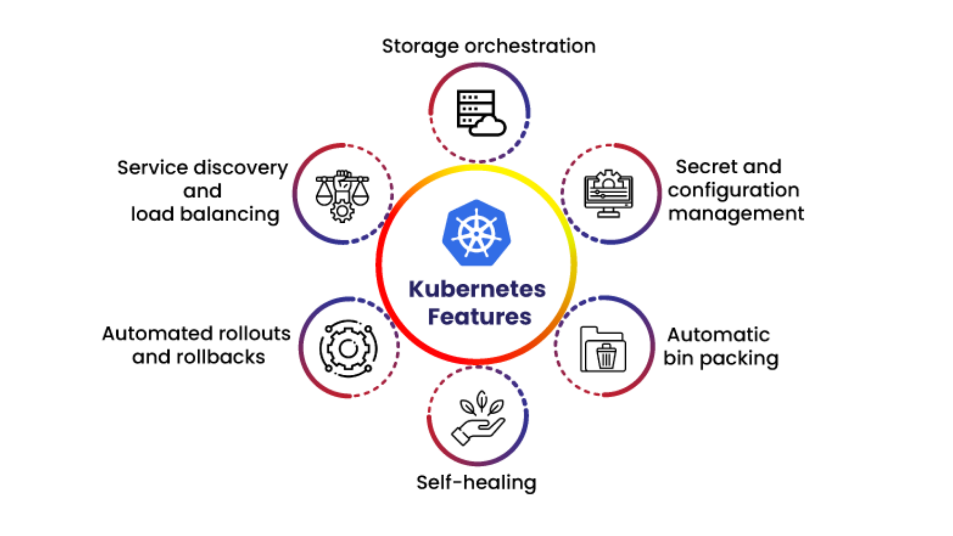
1. Introduction to Kubernetes – Why use Kubernetes ?
Business Benefits of Kubernetes
Notes:
+ Service discovery: k8s có thể expose/show 1 containers thông qua IP/DNS của nó & cân bằng tải: khi lượng traffic truy cập 1 container cao, k8s cân bằng tải & phân phối lưu lượng mạng
+ Điều phối bộ nhớ: Cho phép tự động mount 1 hệ thống lưu trữ tùy ý (local storages, public cloud providers …)
+ Tự động rollouts & rollbacks: tự động hóa việc tạo mới or xóa các container
+ Đóng gói tự động: cung cấp tt k8s như tập các nodes sử dụng để chạy 1 tác vụ đc đóng gói or nguồn tài nguyên điều phối cho các container (tối ưu resource).
+ Tự động phục hồi: k8s khởi động lại containers lỗi, thay thế or xóa containers không phản hồi lại cấu hình health check
+ Quản lý cấu hình & bảo mật: lưu trữ & bảo mật: password, Oauth token & SSH key.

Slide 37
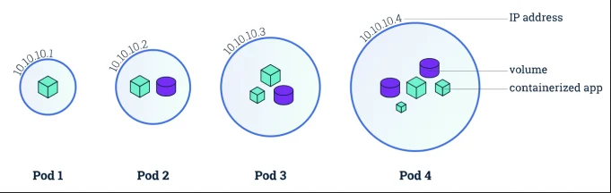
1. Main K8s Components: Pods
Definition:
The smallest deployable units of K8s.
A group of one or more containers (shared storage & network resources)
Properties:
Be created using workload resources.
Usually 1 application per Pod.
Each Pod gets its own IP address.
Non-permanent resources (*)
Main purpose: support co-located processes.
Workload resources for managing pods:
Run a single container
Run multiple containers that word together.
Source
Ref: https://kubernetes.io/docs/concepts/workloads/pods/
Notes:
+ consider a worker node (~ simple server/VM / container ): the smallest unit of Kubernetes ~ pop
+ g.su khi db bi mat -> replace new db => re-connect pop with db
Service ~ a static ip & attached each Pod. Pop & service not connect -> if pop dies, service & its ip will constant
App should be accessible through browser -> pop use external service & db use internal service
+ neu lam viec voi nhieu containers ~> moi container giu 1 vai tro (store data, updates files …)
+ “Workload resources” ~> pods (~ applications) run parallel
+ Problem: moi nhóm được gán bằng 1 địa chỉ IP nhưng Pods chỉ có tính tạm thời ~> khi một Pods chết/thay thế làm thế nào để giữ kết nối như lúc đầu ?

Slide 38
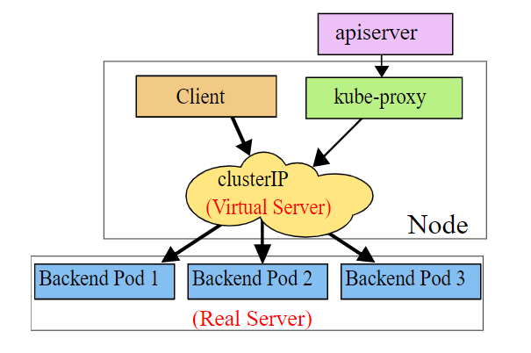
1. Kubernetes Components: Service
Motivation (*): Assume some set of Pods are created & destroyed (ex: metadata). How do other Pods find out & keep track of which IP address to connect ?
Solution: Service (stable IP address)
Definition:
An abstract way to expose an application running on a set of Pods as a network service. It defines:
A logical set of Pods.
A policy by which to access set of Pods.
K8s gives Pods their own IP addresses & a single DNS name for a set of Pods.
Lifecycle of Pod & Service NOT connected => if Pod dies, the service & its IP address don’t change.
Service types:
ClusterIP Services
Headless Services
NodePort Services
LoadBalancer Services
Source
Ref: https://kubernetes.io/docs/concepts/services-networking/service/
Notes:
+ Motivation:
- Problem: mặc dù mỗi Pods có 1 IP nhưng có thể x.ra tập Pods cùng chạy tại 1 thời điểm đến từ các tập Pods khác nhau. Khi đó, 1 tập các Pods (~ backend) thực hiện các chức năng & truyền tới 1 tập Pods khác (~ front end). Làm sao để chúng có thể tìm đc địa chỉ ip của nhau ?
Pods ~ nonpermanent resources (created & destroyed dynamically)
Load balancing: giả sử khi có nhiều ứng dụng cùng chạy

Slide 39
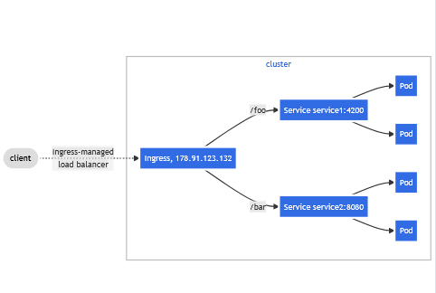
1. Kubernetes Components: Ingress
Ingress exposes HTTP & HTTPS routes from outside the cluster to services within the cluster.
Notes:
+ dung điều hướng các yêu cầu từ giao thức HTTP & HTTPS từ bên ngoài vào các dịch vụ bên trong cluster

Slide 40
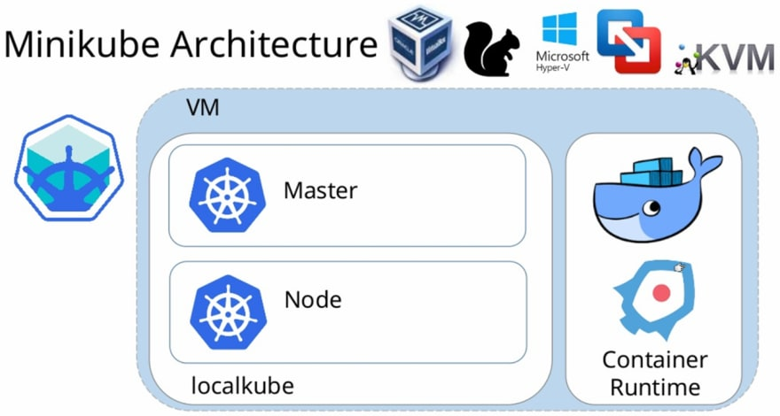
3. Minikube & Kubectl – Local Setup
Minikube: A single node cluster and the easiest way of deploying Kubernetes.
Master & node processes run on one Machine
Kubectl: Command Line Interface to access Kubernetes cluster.
Basic kubectl commands:
CRUD commands:
Create/Edit/Delete deployment:
$ kubectl create/edit/delete deployment [name]
Status of different K8s components
Notes:
+ Motivation: hãy bắt đầu bằng những điều giản đơn
Sau khi tạo đc minikube, kubectl dung để giao tiếp với node cluster đó
Để giao tiếp master processes -> API server có 3 cách: UI, api, kubectl (hiệu quả nhất)

Slide 41
1. Kubernetes Components: ConfigMap
Motivation:
External configuration of application. It contains configuration data (urls of database)
Notes:
+ Pods communicate with other each using a service

Slide 42
2. Architecture & Main Components

